Slide 1
Issues in knowledge representation

Slide 2
1. Ambiguity:
Ambiguity arises when a piece of information can be interpreted in multiple ways.
This can lead to misunderstandings or incorrect inferences by AI systems.
2. Incompleteness:
It is often impossible to represent all knowledge comprehensively in a knowledge base.
This leads to gaps in information that can result in incomplete or incorrect reasoning.
3. Inconsistency:
Inconsistencies occur when a knowledge base contains conflicting information.
This can lead to logical contradictions and unreliable conclusions.

Slide 3
4. Scalability:
As the amount of knowledge grows, the system must scale to handle increasingly large and complex data sets. This can lead to performance challenges.
5. Expressiveness vs. Computability:
There is often a trade-off between the expressiveness of a knowledge representation system (its ability to describe complex concepts) and its computability (how efficiently it can be processed).
6. Context Sensitivity: The meaning of information can change depending on the context in which it is used. Representing and reasoning about context is challenging for AI systems.

Slide 4
7. Temporal Representation: Representing time and temporal relationships is complex, especially when dealing with events that have durations, sequences, or dependencies.
8. Knowledge Acquisition Bottleneck: Acquiring and encoding knowledge into a format that machines can process is a labor-intensive and time-consuming process, often referred to as the "knowledge acquisition bottleneck.“
9. Difficulty in Representing Common Sense Knowledge: Common sense knowledge, which humans use effortlessly, is surprisingly difficult to formalize and encode in AI systems.

Slide 5
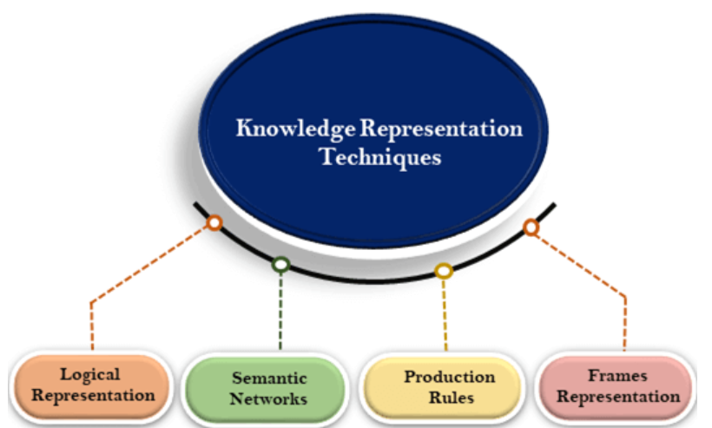
Techniques of knowledge representation
There are mainly four ways of knowledge representation which are given as follows:

Slide 6
1. Logical Representation
Logical representation is a language with some concrete rules which deals with propositions and has no ambiguity in representation. Logical representation means drawing a conclusion based on various conditions. This representation lays down some important communication rules. It consists of precisely defined syntax and semantics which supports the sound inference. Each sentence can be translated into logics using syntax and semantics.
Syntax:
Syntaxes are the rules that decide how to construct legal sentences in the logic.
It determines which symbol we can use in knowledge representation.
How to write those symbols.
Semantics:
Semantics are the rules by which we can interpret the sentence in the logic.
Semantic also involves assigning a meaning to each sentence.

Slide 7
Logical representation can be categorised into mainly two logics:
Propositional Logics
Predicate logics
Advantages of logical representation:
Logical representation enables us to do logical reasoning.
Logical representation is the basis for the programming languages.
Disadvantages of logical Representation:
Logical representations have some restrictions and are challenging to work with.
Logical representation technique may not be very natural, and inference may not be so efficient.

Slide 8
2. Semantic Network Representation
Semantic networks are alternative of predicate logic for knowledge representation. In Semantic networks, we can represent our knowledge in the form of graphical networks. This network consists of nodes representing objects and arcs which describe the relationship between those objects. Semantic networks can categorize the object in different forms and can also link those objects. Semantic networks are easy to understand and can be easily extended.
This representation consist of mainly two types of relations:
IS-A relation (Inheritance)
Kind-of-relation

Slide 9
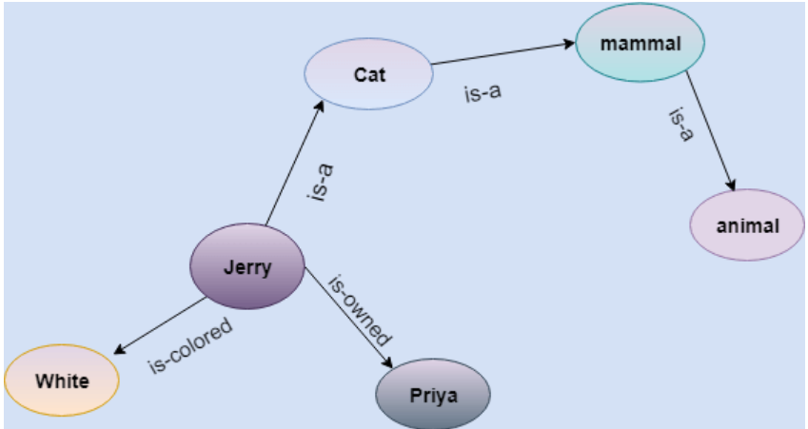
Example: Following are some statements which we need to represent in the form of nodes and arcs.
Statements:
Jerry is a cat.
Jerry is a mammal
Jerry is owned by Priya.
Jerry is brown colored.
All Mammals are animal.

Slide 10
Drawbacks in Semantic representation:
Semantic networks take more computational time at runtime as we need to traverse the complete network tree to answer some questions. In the worst-case scenario, it might be possible that after traversing the entire tree, we find that the solution does not exist in this network.
Semantic networks try to model human-like memory (Which has 1015 neurons and links) to store the information, but in practice, it is not possible to build such a vast semantic network.
These types of representations are inadequate as they do not have any equivalent quantifier, e.g., for all, for some, none, etc.
Semantic networks do not have any standard definition for the link names.
These networks are not intelligent and depend on the creator of the system.

Slide 11
Advantages of Semantic network:
Semantic networks are a natural representation of knowledge.
Semantic networks convey meaning transparently.
These networks are simple and easily understandable.

Slide 12
3. Frame Representation
A frame is a record like structure which consists of a collection of attributes and its values to describe an entity in the world. Frames are the AI data structure which divides knowledge into substructures by representing stereotypes situations. It consists of a collection of slots and slot values. These slots may be of any type and size. Slots have names and values which are called facets.
Facets: The various aspects of a slot is known as Facets. Facets are features of frames which enable us to put constraints on the frames. Example: IF-NEEDED facts are called when data of any particular slot is needed. A frame may consist of any number of slots, and a slot may include any number of facets and facets may have any number of values. A frame is also known as slot-filter knowledge representation in artificial intelligence.

Slide 13
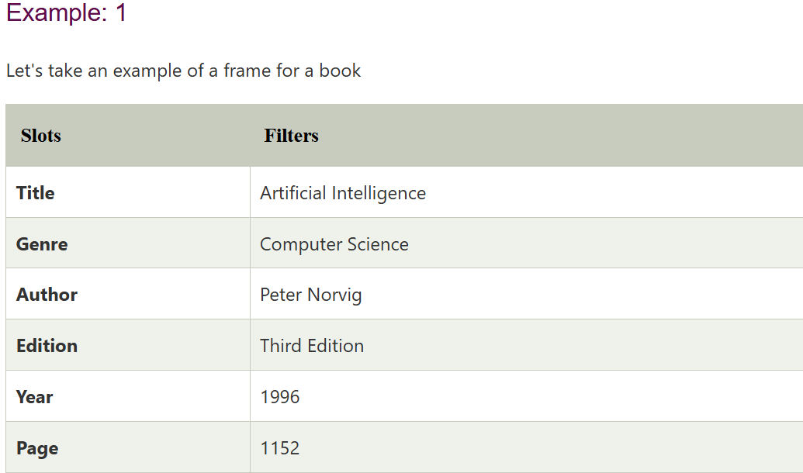
Frames are derived from semantic networks and later evolved into our modern-day classes and objects. A single frame is not much useful. Frames system consist of a collection of frames which are connected. In the frame, knowledge about an object or event can be stored together in the knowledge base. The frame is a type of technology which is widely used in various applications including Natural language processing and machine visions.

Slide 14
Advantages of frame representation:
The frame knowledge representation makes the programming easier by grouping the related data.
The frame representation is comparably flexible and used by many applications in AI.
It is very easy to add slots for new attribute and relations.
It is easy to include default data and to search for missing values.
Frame representation is easy to understand and visualize.
Disadvantages of frame representation:
In frame system inference mechanism is not easily processed.
Inference mechanism cannot be smoothly proceeded by frame representation.
Frame representation has a much more generalized approach.

Slide 15
4. Production Rules
Production rules system consist of (condition, action) pairs which mean, "If condition then action". It has mainly three parts:
The set of production rules
Working Memory
The recognize-act-cycle
In production rules agent checks for the condition and if the condition exists then production rule fires and corresponding action is carried out. The condition part of the rule determines which rule may be applied to a problem. And the action part carries out the associated problem-solving steps. This complete process is called a recognize-act cycle.
The working memory contains the description of the current state of problem-solving and the rule can write knowledge to the working memory. This knowledge matches and may fire other rules.
If there is a new situation (state) is generated, then multiple production rules will be fired together, this is called a conflict set. In this situation, the agent needs to select a rule from these sets, and it is called a conflict resolution.

Slide 16
Example:
IF (at bus stop AND bus arrives) THEN action (get into the bus)
IF (on the bus AND paid AND empty seat) THEN action (sit down).
IF (on bus AND unpaid) THEN action (pay charges).
IF (bus arrives at destination) THEN action (get down from the bus).

Slide 17
Advantages of Production rule:
The production rules are expressed in natural language.
The production rules are highly modular, so we can easily remove, add or modify an individual rule.
Disadvantages of Production rule:
Production rule system does not exhibit any learning capabilities, as it does not store the result of the problem for future uses.
During the execution of the program, many rules may be active hence rule-based production systems are inefficient.

Slide 18
Propositional logic in Artificial intelligence
Propositional logic (PL) is the simplest form of logic where all the statements are made by propositions. A proposition is a declarative statement which is either true or false. It is a technique of knowledge representation in logical and mathematical form.
Example:
a) It is Sunday.
b) The Sun rises from West (False proposition)
c) 3+3= 7(False proposition)
d) 5 is a prime number.

Slide 19
Following are some basic facts about propositional logic:
Propositional logic is also called Boolean logic as it works on 0 and 1.
In propositional logic, we use symbolic variables to represent the logic, and we can use any symbol for a representing a proposition, such A, B, C, P, Q, R, etc.
Propositions can be either true or false, but it cannot be both.
Propositional logic consists of an object, relations or function, and logical connectives.
These connectives are also called logical operators.
The propositions and connectives are the basic elements of the propositional logic.
Connectives can be said as a logical operator which connects two sentences.
A proposition formula which is always true is called tautology, and it is also called a valid sentence.

Slide 20
A proposition formula which is always false is called Contradiction.
Statements which are questions, commands, or opinions are not propositions such as "Where is Rohini", "How are you", "What is your name", are not propositions.
Syntax of propositional logic:
The syntax of propositional logic defines the allowable sentences for the knowledge representation. There are two types of Propositions:
Atomic Propositions
Compound propositions

Slide 21
1. Atomic Proposition: Atomic propositions are the simple propositions. It consists of a single proposition symbol. These are the sentences which must be either true or false.
a) 2+2 is 4, it is an atomic proposition as it is a true fact.
b) "The Sun is cold" is also a proposition as it is a false fact.
2. Compound proposition: Compound propositions are constructed by combining simpler or atomic propositions, using parenthesis and logical connectives.
Example:
a) "It is raining today, and street is wet."
b) "Ankit is a doctor, and his clinic is in Mumbai."

Slide 22
Logical Connectives:
Logical connectives are used to connect two simpler propositions or representing a sentence logically. We can create compound propositions with the help of logical connectives. There are mainly five connectives, which are given as follows:
Negation: A sentence such as ¬ P is called negation of P. A literal can be either Positive literal or negative literal.
Conjunction: A sentence which has ∧ connective such as, P ∧ Q is called a conjunction.
Example: Rohan is intelligent and hardworking. It can be written as, P=Rohan is intelligent, Q= Rohan is hardworking. → P∧ Q.
3. Disjunction: A sentence which has ∨ connective, such as P ∨ Q. is called disjunction, where P and Q are the propositions.
Example: "Ritika is a doctor or Engineer", Here P= Ritika is Doctor. Q= Ritika is Doctor, so we can write it as P ∨ Q.

Slide 23
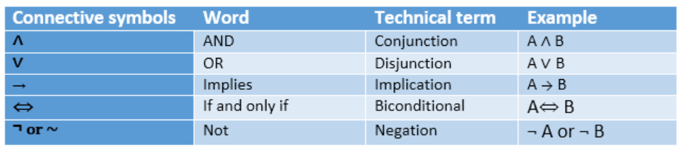
4. Implication: A sentence such as P → Q, is called an implication. Implications are also known as if-then rules. It can be represented as
If it is raining, then the street is wet. Let P= It is raining, and Q= Street is wet, so it is represented as P → Q
5. Biconditional: A sentence such as P⇔ Q is a Biconditional sentence, example If I am breathing, then I am alive
P= I am breathing, Q= I am alive, it can be represented as P ⇔ Q.
Following is the summarized table for Propositional Logic Connectives:

Slide 24
Properties of Operators:
Commutativity:
P∧ Q= Q ∧ P, or
P ∨ Q = Q ∨ P.
Associativity:
(P ∧ Q) ∧ R= P ∧ (Q ∧ R),
(P ∨ Q) ∨ R= P ∨ (Q ∨ R)
Identity element:
P ∧ True = P,
P ∨ True= True.
Distributive:
P∧ (Q ∨ R) = (P ∧ Q) ∨ (P ∧ R).
P ∨ (Q ∧ R) = (P ∨ Q) ∧ (P ∨ R).
DE Morgan's Law:
¬ (P ∧ Q) = (¬P) ∨ (¬Q)
¬ (P ∨ Q) = (¬ P) ∧ (¬Q).
Double-negation elimination:
¬ (¬P) = P.

Slide 25
Limitations of Propositional logic:
We cannot represent relations like ALL, some, or none with propositional logic. Example:
All the girls are intelligent.
Some apples are sweet.
Propositional logic has limited expressive power.
In propositional logic, we cannot describe statements in terms of their properties or logical relationships.

Slide 26
Predicate Logic/First-Order Logic in Artificial intelligence
In propositional logic, we can only represent the facts, which are either true or false. PL is not sufficient to represent the complex sentences or natural language statements. The propositional logic has very limited expressive power. Consider the following sentence, which we cannot represent using PL logic.
"Some humans are intelligent", or
"Sachin likes cricket.“
To represent the above statements, PL logic is not sufficient, so we required some more powerful logic, such as first-order logic.

Slide 27
First-Order logic:
First-order logic is another way of knowledge representation in artificial intelligence. It is an extension to propositional logic.
FOL is sufficiently expressive to represent the natural language statements in a concise way.
First-order logic is also known as Predicate logic or First-order predicate logic. First-order logic is a powerful language that develops information about the objects in a more easy way and can also express the relationship between those objects.

Slide 28
First-order logic (like natural language) does not only assume that the world contains facts like propositional logic but also assumes the following things in the world:
Objects: A, B, people, numbers, colors, wars, theories, squares, pits, wumpus, ......
Relations: It can be unary relation such as: red, round, is adjacent, or n-any relation such as: the sister of, brother of, has color, comes between
Function: Father of, best friend, third inning of, end of, ......
As a natural language, first-order logic also has two main parts:
Syntax
Semantics

Slide 29
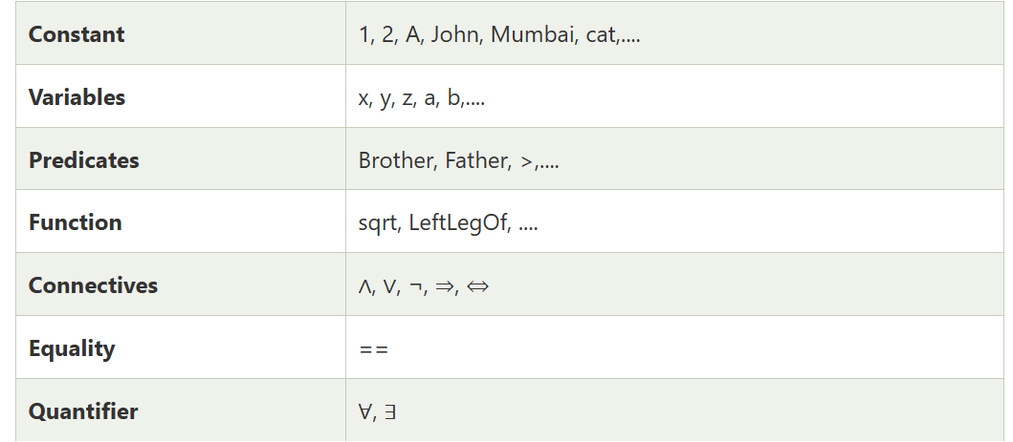
Syntax of First-Order logic:
The syntax of FOL determines which collection of symbols is a logical expression in first-order logic. The basic syntactic elements of first-order logic are symbols. We write statements in short-hand notation in FOL.
Basic Elements of First-order logic:
Following are the basic elements of FOL syntax:

Slide 30
Atomic sentences:
Atomic sentences are the most basic sentences of first-order logic. These sentences are formed from a predicate symbol followed by a parenthesis with a sequence of terms.
We can represent atomic sentences as Predicate (term1, term2, ......, term n).
Example: Ravi and Ajay are brothers: => Brothers(Ravi, Ajay). Chinky is a cat: => cat (Chinky).
Complex Sentences:
Complex sentences are made by combining atomic sentences using connectives.

Slide 31
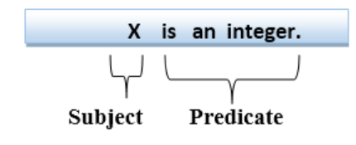
First-order logic statements can be divided into two parts:
Subject: Subject is the main part of the statement.
Predicate: A predicate can be defined as a relation, which binds two atoms together in a statement.
Consider the statement: "x is an integer.", it consists of two parts, the first part x is the subject of the statement and second part "is an integer," is known as a predicate.

Slide 32
Quantifiers in First-order logic:
A quantifier is a language element which generates quantification, and quantification specifies the quantity of specimen in the universe of discourse.
These are the symbols that permit to determine or identify the range and scope of the variable in the logical expression. There are two types of quantifier:
Universal Quantifier, (for all, everyone, everything)
Existential quantifier, (for some, at least one).

Slide 33
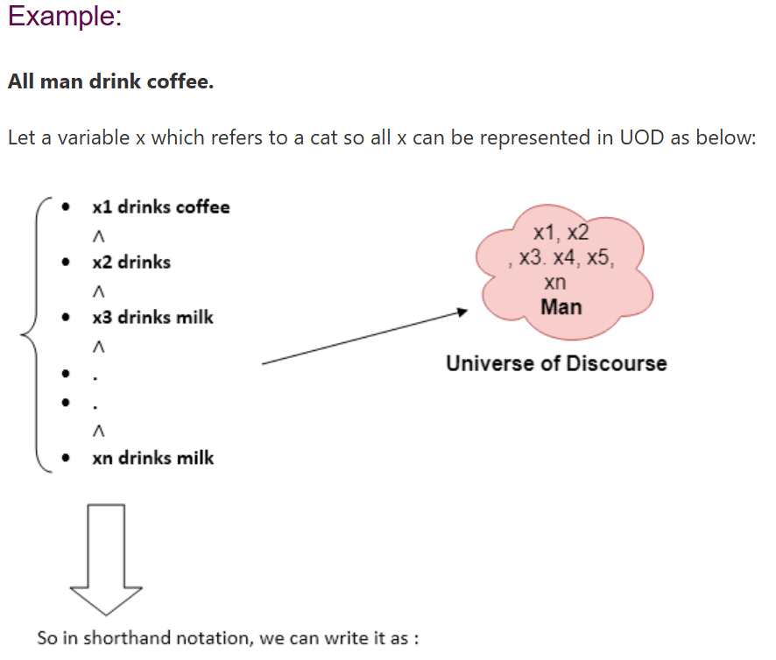

Universal Quantifier:
Universal quantifier is a symbol of logical representation, which specifies that the statement within its range is true for everything or every instance of a particular thing.
The Universal quantifier is represented by a symbol ∀, which resembles an inverted A
If x is a variable, then ∀x is read as:
For all x
For each x
For every x.
There are all x where x is a man who drinks coffee.

Slide 34
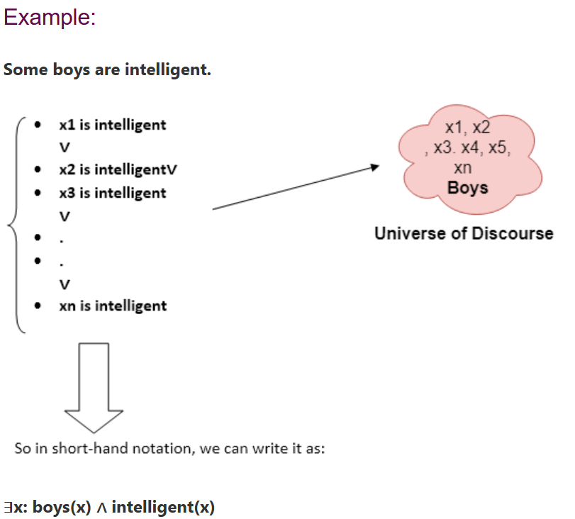
Existential Quantifier:
Existential quantifiers are the type of quantifiers, which express that the statement within its scope is true for at least one instance of something.
It is denoted by the logical operator ∃, which resembles as inverted E. When it is used with a predicate variable then it is called as an existential quantifier.
If x is a variable, then existential quantifier will be ∃x or ∃(x). And it will be read as:
There exists a 'x.'
For some 'x.'
For at least one 'x.'
There are some x where x is a boy who is intelligent.

Slide 35
Points to remember:
The main connective for universal quantifier ∀ is implication →.
The main connective for existential quantifier ∃ is and ∧.
Properties of Quantifiers:
In universal quantifier, ∀x∀y is similar to ∀y∀x.
In Existential quantifier, ∃x∃y is similar to ∃y∃x.
∃x∀y is not similar to ∀y∃x.

Slide 36
Some Examples of FOL using quantifier:
1. All birds fly. In this question the predicate is "fly(bird)."
And since there are all birds who fly so it will be represented as follows. ∀x bird(x) →fly(x).
2. Every man respects his parent. In this question, the predicate is "respect(x, y)," where x=man, and y= parent.
Since there is every man so will use ∀, and it will be represented as follows: ∀x man(x) → respects (x, parent).
3. Some boys play cricket. In this question, the predicate is "play(x, y)," where x= boys, and y= game.
Since there are some boys so we will use ∃, and it will be represented as: ∃x boys(x) → play(x, cricket).

Slide 37
4. Not all students like both Mathematics and Science. In this question, the predicate is "like(x, y)," where x= student, and y= subject.
Since there are not all students, so we will use ∀ with negation, so following representation for this: ¬∀ (x) [ student(x) → like(x, Mathematics) ∧ like(x, Science)].
5. Only one student failed in Mathematics. In this question, the predicate is "failed(x, y)," where x= student, and y= subject.
Since there is only one student who failed in Mathematics, so we will use following representation for this: ∃(x) [ student(x) → failed (x, Mathematics) ∧∀ (y) [¬(x==y) ∧ student(y) → ¬failed (x, Mathematics)].

