Slide 1
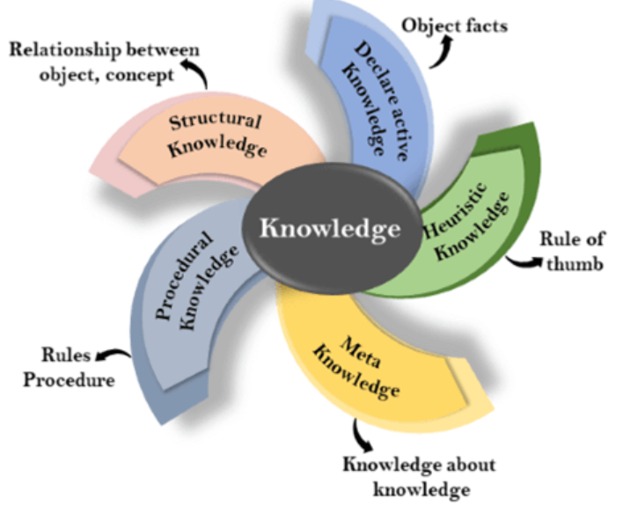
Types of knowledge
Following are the various types of knowledge:

Slide 2
Declarative Knowledge:
Declarative knowledge is to know about something.
It includes concepts, facts, and objects.
It is also called descriptive knowledge and expressed in declarative sentences.
It is simpler than procedural language.
2. Procedural Knowledge
It is also known as imperative knowledge.
Procedural knowledge is a type of knowledge which is responsible for knowing how to do something.
It can be directly applied to any task.
It includes rules, strategies, procedures, agendas, etc.
Procedural knowledge depends on the task on which it can be applied.

Slide 3
3. Meta-knowledge:
Knowledge about the other types of knowledge is called Meta-knowledge.
4. Heuristic knowledge:
Heuristic knowledge is representing knowledge of some experts in a filed or subject.
Heuristic knowledge is rules of thumb based on previous experiences, awareness of approaches, and which are good to work but not guaranteed.
5. Structural knowledge:
Structural knowledge is basic knowledge to problem-solving.
It describes relationships between various concepts such as kind of, part of, and grouping of something.
It describes the relationship that exists between concepts or objects.

Slide 4
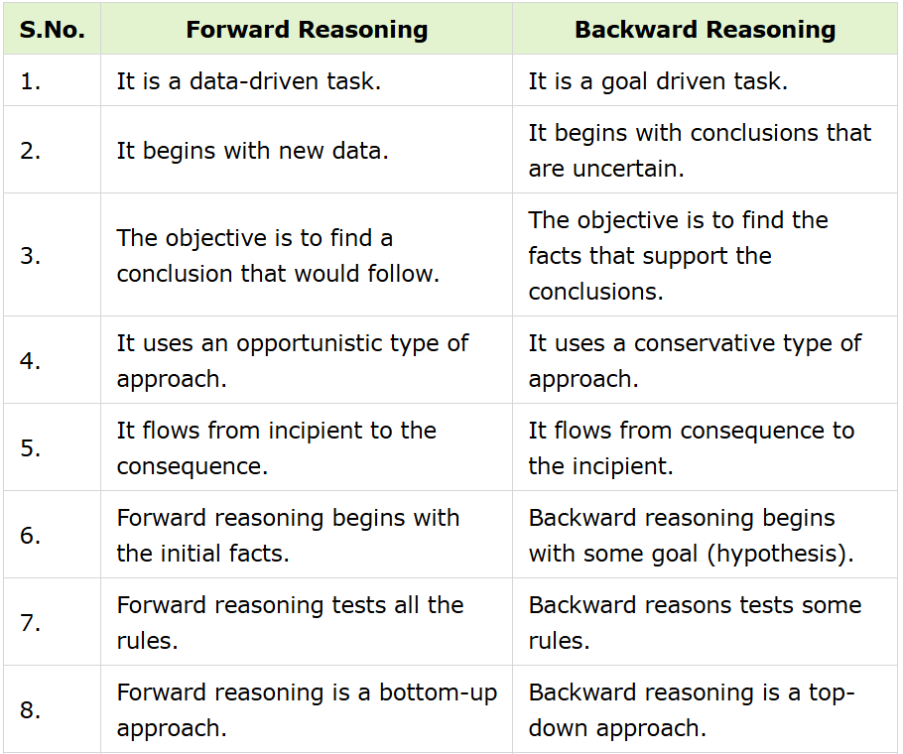
Difference between Forward and Backward Reasoning in AI

Slide 5
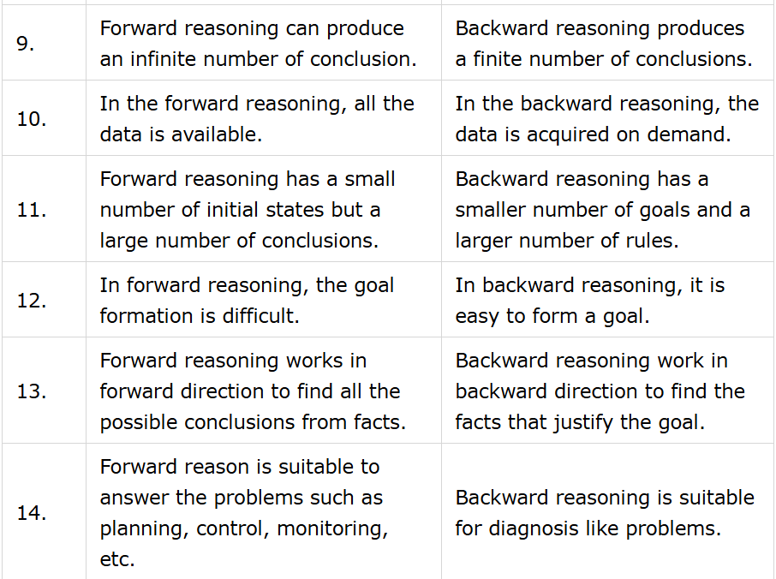

Slide 6
Statistical Reasoning

Slide 7
Probabilistic reasoning in Artificial intelligence
Uncertainty:
Till now, we have learned knowledge representation using first-order logic and propositional logic with certainty, which means we were sure about the predicates. With this knowledge representation, we might write A→B, which means if A is true then B is true, but consider a situation where we are not sure about whether A is true or not then we cannot express this statement, this situation is called uncertainty.
So to represent uncertain knowledge, where we are not sure about the predicates, we need uncertain reasoning or probabilistic reasoning.
Causes of uncertainty:
Following are some leading causes of uncertainty to occur in the real world.
Information occurred from unreliable sources.
Experimental Errors
Equipment fault
Temperature variation
Climate change.

Slide 8
Probabilistic reasoning:
Probabilistic reasoning is a way of knowledge representation where we apply the concept of probability to indicate the uncertainty in knowledge. In probabilistic reasoning, we combine probability theory with logic to handle the uncertainty.
We use probability in probabilistic reasoning because it provides a way to handle the uncertainty that is the result of someone's laziness and ignorance.
In the real world, there are lots of scenarios, where the certainty of something is not confirmed, such as "It will rain today," "behavior of someone for some situations," "A match between two teams or two players." These are probable sentences for which we can assume that it will happen but not sure about it, so here we use probabilistic reasoning.
Need for probabilistic reasoning in AI:
When there are unpredictable outcomes.
When specifications or possibilities of predicates become too large to handle.
When an unknown error occurs during an experiment.

Slide 9
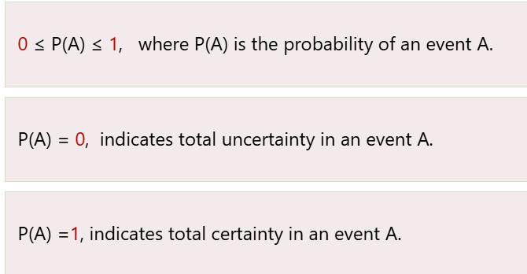
In probabilistic reasoning, there are two ways to solve problems with uncertain knowledge:
Bayes' rule
Bayesian Statistics
As probabilistic reasoning uses probability and related terms, so before understanding probabilistic reasoning, let's understand some common terms:
Probability: Probability can be defined as a chance that an uncertain event will occur. It is the numerical measure of the likelihood that an event will occur. The value of probability always remains between 0 and 1 that represent ideal uncertainties.

Slide 10
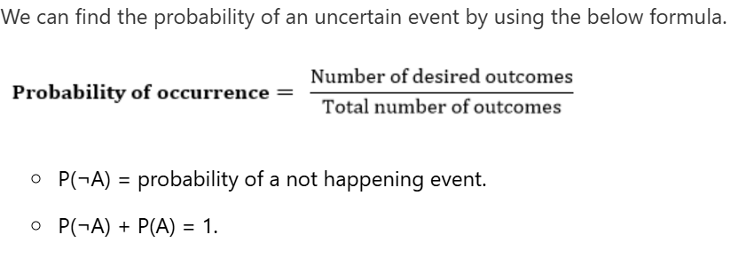
Event: Each possible outcome of a variable is called an event.
Sample space: The collection of all possible events is called sample space.
Random variables: Random variables are used to represent the events and objects in the real world.
Prior probability: The prior probability of an event is probability computed before observing new information.
Posterior Probability: The probability that is calculated after all evidence or information has taken into account. It is a combination of prior probability and new information.

Slide 11
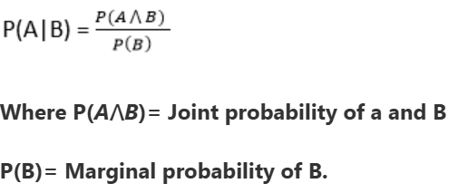
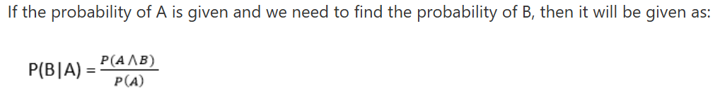
Conditional probability:
Conditional probability is a probability of occurring an event when another event has already happened.
Let's suppose, we want to calculate the event A when event B has already occurred, "the probability of A under the conditions of B", it can be written as:

Slide 12
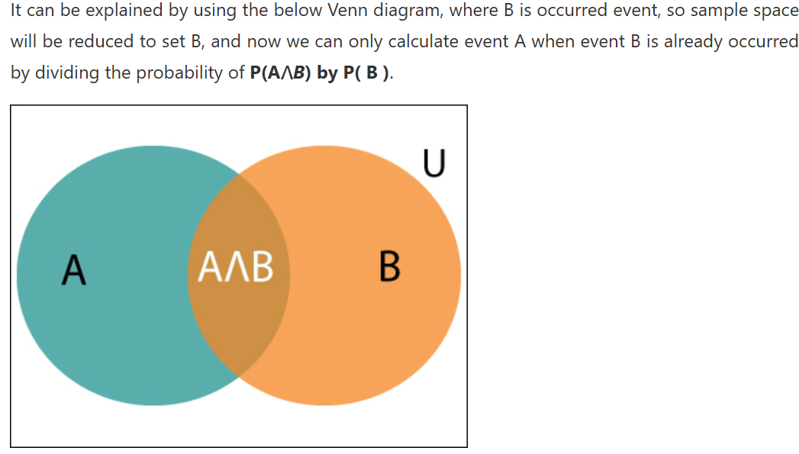

Slide 13
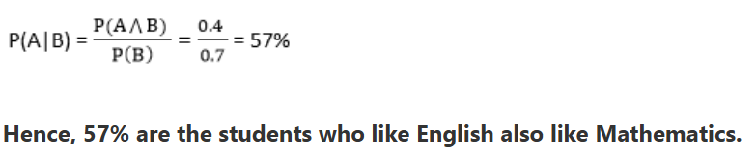
Example
In a class, there are 70% of the students who like English and 40% of the students who likes English and mathematics, and then what is the percentage of students
Solution:
Let, A is an event that a student likes Mathematics
B is an event that a student likes English.
who like English also like mathematics?

Slide 14
Bayes' theorem:
Bayes' theorem is also known as Bayes' rule, Bayes' law, or Bayesian reasoning, which determines the probability of an event with uncertain knowledge.
In probability theory, it relates the conditional probability and marginal probabilities of two random events.
Bayes' theorem was named after the British mathematician Thomas Bayes. The Bayesian inference is an application of Bayes' theorem, which is fundamental to Bayesian statistics.
It is a way to calculate the value of P(B|A) with the knowledge of P(A|B).
Bayes' theorem allows updating the probability prediction of an event by observing new information of the real world.

Slide 15
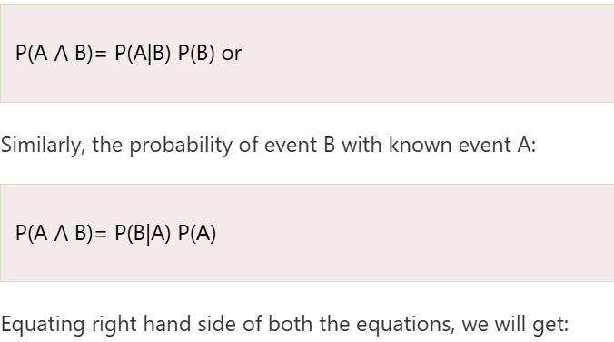
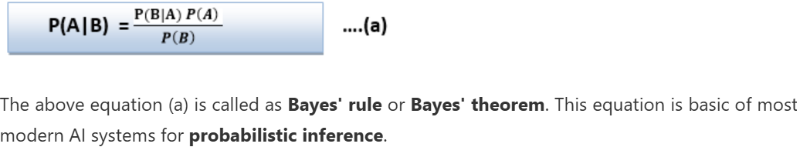
Example:
If cancer corresponds to one's age then by using Bayes' theorem, we can determine the probability of cancer more accurately with the help of age.
Bayes' theorem can be derived using product rule and conditional probability of event A with known event B:
As from product rule we can write:

Slide 16
The above equation (a) is called as Bayes' rule or Bayes' theorem. This equation is basic of most modern AI systems for probabilistic inference.
It shows the simple relationship between joint and conditional probabilities. Here,
P(A|B) is known as posterior, which we need to calculate, and it will be read as Probability of hypothesis A when we have occurred an evidence B.
P(B|A) is called the likelihood, in which we consider that hypothesis is true, then we calculate the probability of evidence.
P(A) is called the prior probability, probability of hypothesis before considering the evidence
P(B) is called marginal probability, pure probability of an evidence.

Slide 17
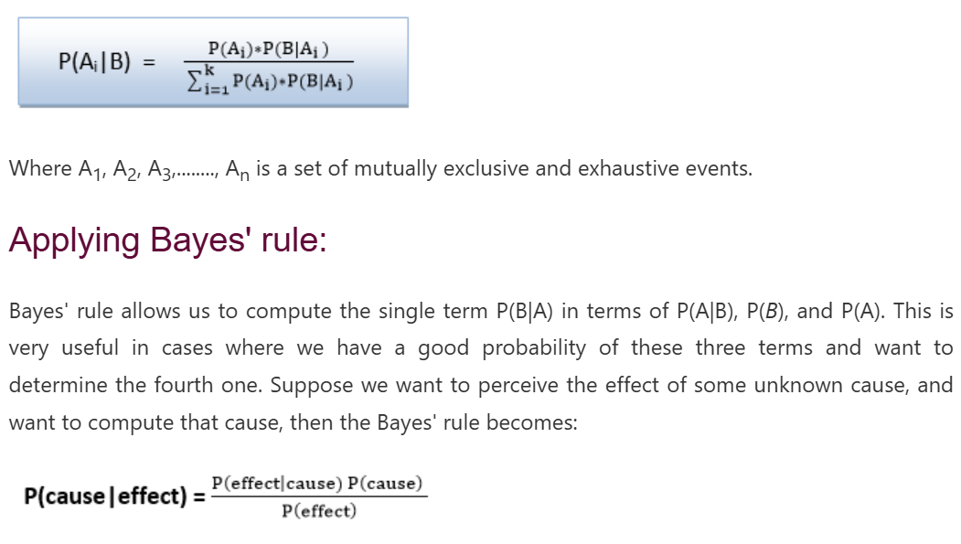
In the equation (a), in general, we can write P (B) = P(A)*P(B|Ai), hence the Bayes' rule can be written as:

Slide 18
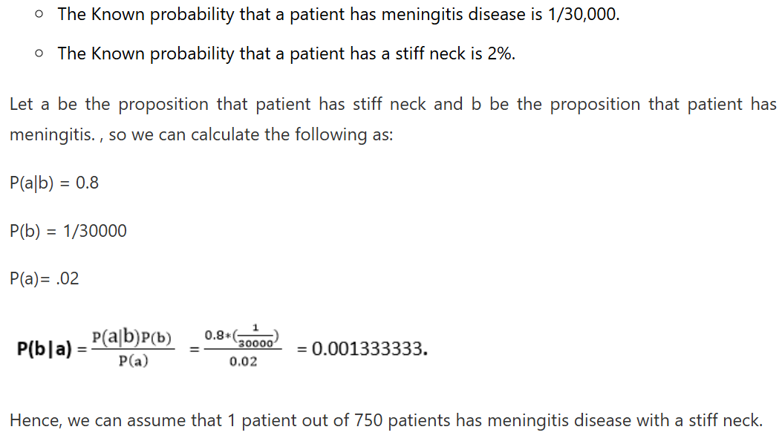
Example1:
Question: what is the probability that a patient has diseases meningitis with a stiff neck?
Given Data:
A doctor is aware that disease meningitis causes a patient to have a stiff neck, and it occurs 80% of the time. He is also aware of some more facts, which are given as follows:

Slide 19
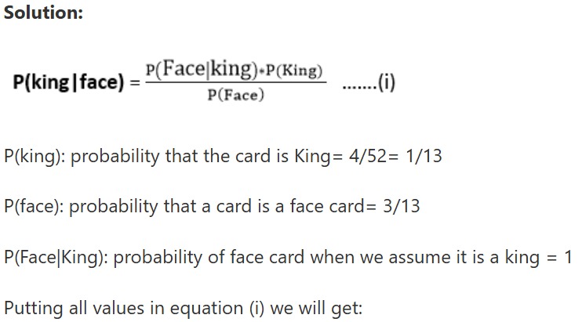
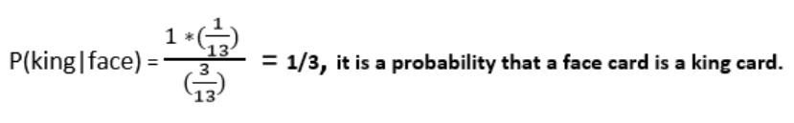
Example 2:
Question: From a standard deck of playing cards, a single card is drawn. The probability that the card is king is 4/52, then calculate posterior probability P(King|Face), which means the drawn face card is a king card.

Slide 20
Applications of Bayes’ theorem
Following are some applications of Bayes' theorem:
It is used to calculate the next step of the robot when the already executed step is given.
Bayes' theorem is helpful in weather forecasting.
It can solve the Monty Hall problem.

