Slide 1
Recommender System
UNIT-6

Slide 2
Introduction
Recommender systems are software tools and algorithms designed to suggest relevant items or content to users based on their preferences, behavior, and interactions with a platform.
A recommendation system is a subset of machine learning that uses data to help users find products and content.
Websites and streaming services use recommender systems to generate “for you” or “you might also like” pages and content.
Recommender systems are an essential feature in our digital world, as users are often overwhelmed by choice and need help finding what they're looking for.
This leads to happier customers and, of course, more sales.
Recommender systems are like salesmen who know, based on your history and preferences, what you like.

Slide 3
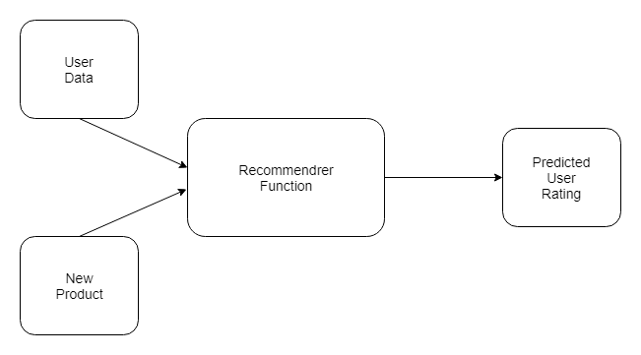
Recommender systems are so commonplace now that many of us use them without even knowing it.
Because we can't possibly look through all the products or content on a website, a recommendation system plays an important role in helping us have a better user experience, while also exposing us to more inventory we might not discover otherwise.
Some examples of recommender systems in action include product recommendations on Amazon, Netflix suggestions for movies and TV shows in your feed, recommended videos on YouTube, music on Spotify, the Facebook newsfeed and Google Ads.

Slide 4
An important component of any of these systems is the recommender function, which takes information about the user and predicts the rating that user might assign to a product, for example.
Predicting user ratings, even before the user has actually provided one, makes recommender systems a powerful tool.

Slide 5
How Do Recommender Systems Work?
UNDERSTANDING RELATIONSHIPS
Relationships provide recommender systems with tremendous insight, as well as an understanding of customers. There are three main types that occur:
User-Product Relationship
The user-product relationship occurs when some users have an affinity or preference towards specific products that they need. For example, a cricket player might have a preference for cricket-related items, thus the e-commerce website will build a user-product relation of player->cricket.
Product-Product Relationship
Product-product relationships occur when items are similar in nature, either by appearance or description. Some examples include books or music of the same genre, dishes from the same cuisine, or news articles from a particular event.
User-User Relationship
User-user relationships occur when some customers have similar taste with respect to a particular product or service. Examples include mutual friends, similar backgrounds, similar age, etc.

Slide 6
DATA & RECOMMENDER SYSTEMS
User Behavior Data
Users behavior data is useful information about the engagement of the user on the product. It can be collected from ratings, clicks and purchase history.
User Demographic Data
User demographic information is related to the user’s personal information such as age, education, income and location.
Product Attribute Data
Product attribute data is information related to the product itself such as genre in case of books, cast in case of movies, cuisine in case of food.

Slide 7
HOW DO WE PROVIDE DATA FOR RECOMMENDER SYSTEMS?
Data can be provided in a variety of ways. There are two particularly important methods, explicit and implicit rating.
Explicit Ratings
Explicit ratings are provided by the user.
They infer the user’s preference.
Examples include star ratings, reviews, feedback, likes and following.
Since users don't always rate products, explicit ratings can be hard to get.
Implicit Ratings
Implicit ratings are provided when users interact with the item.
They infer a user’s behavior and are easy to get as users are subconsciously clicking.
Examples include clicks, views and purchases. (Note: Views and purchases can be a better entity to recommend as users will have spent time and money on what is most crucial for them.)

Slide 8
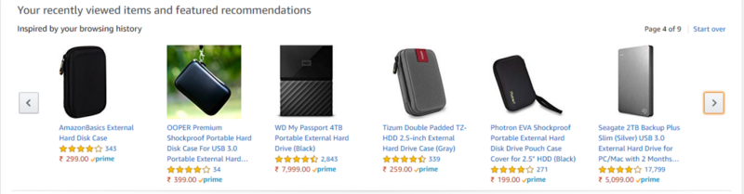
Product Similarity (Item-Item Filtering)
Product similarity is the most useful system for suggesting products based on how much the user would like the product.
If the user is browsing or searching for a particular product, they can be shown similar products.
Users often expect to find products they want quickly and move on if they have a hard time finding the relevant product.
When the user clicks on one product we can show another similar product, or if the user buys the product we can email the user advertisements or coupons based on a similar product.
Product similarity is particularly useful when we don’t know much about the user yet, but we do know what products they're viewing.

Slide 9
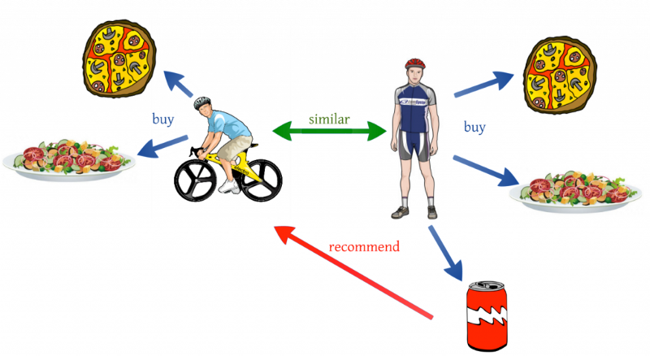
User Similarity (User-User Filtering)
User similarity is for checking the difference between the similarity of two users.
If two users have similar preferences for a product we can assume they have similar interests.
It’s like a friend recommending a product.

Slide 10
One shortcoming of user similarity, however, is that it requires all the user data to suggest products.
It’s called a cold start problem because beginning the recommendation process requires previous data from users.
A newly launched e-commerce website, for example, suffers from the cold start problem because it doesn't have a large number of users.
Product similarity doesn’t have this problem because it just requires product information and the user’s preference.
Netflix, for example, avoids this issue by asking users their likes when starting a new subscription.

Slide 11
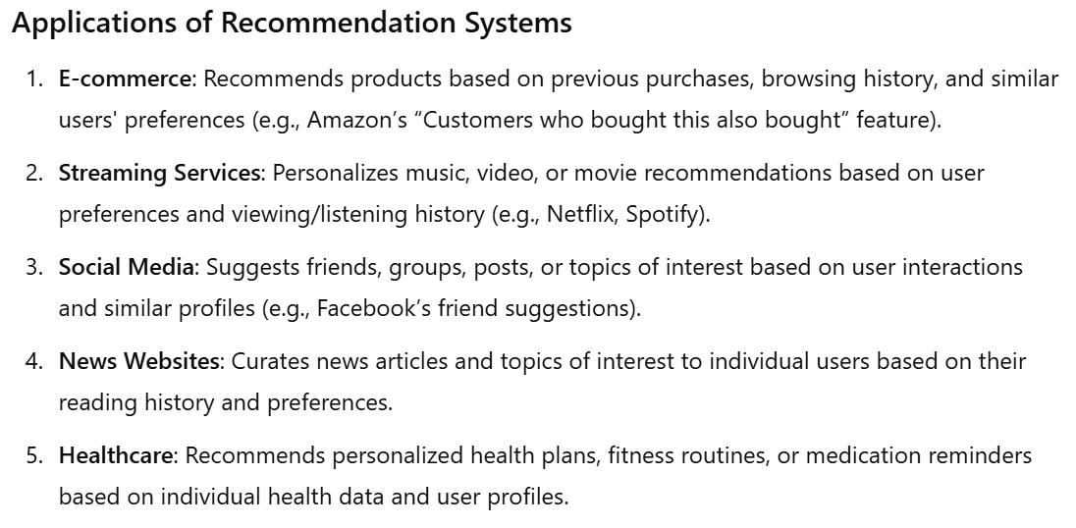

Slide 12
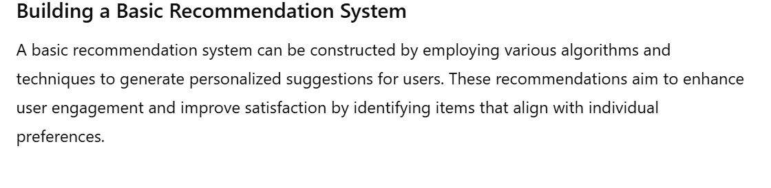
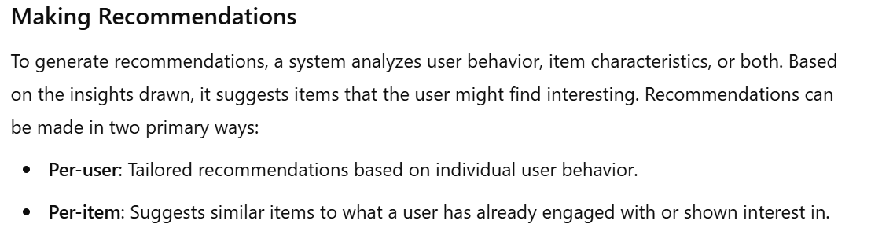

Slide 13
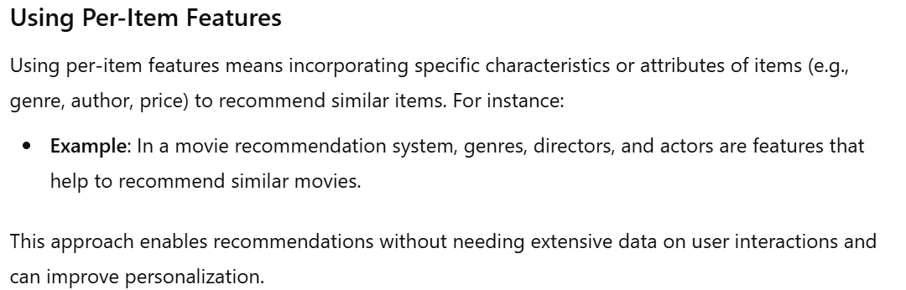

Slide 14
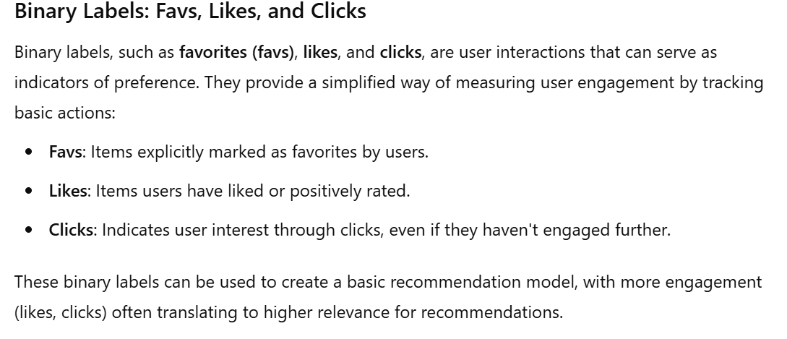

Slide 15
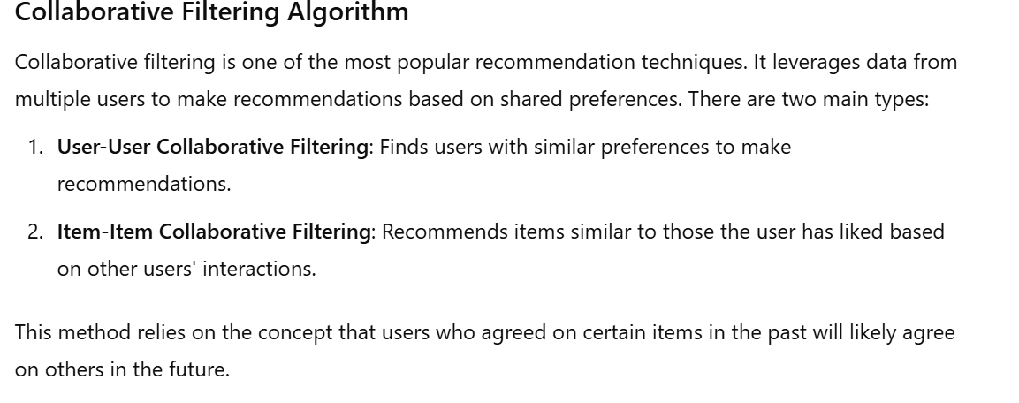

Slide 16
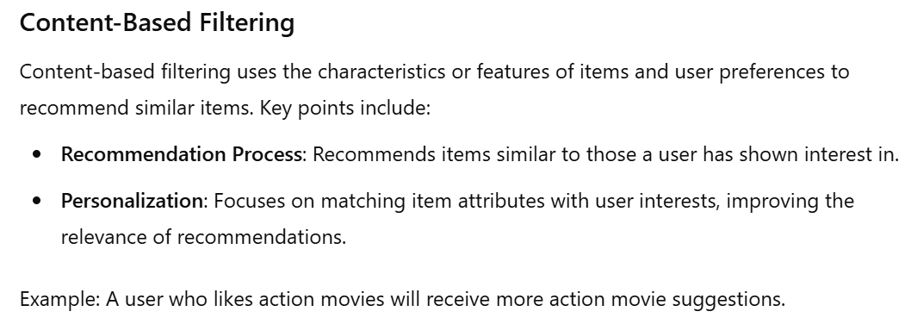

Slide 17
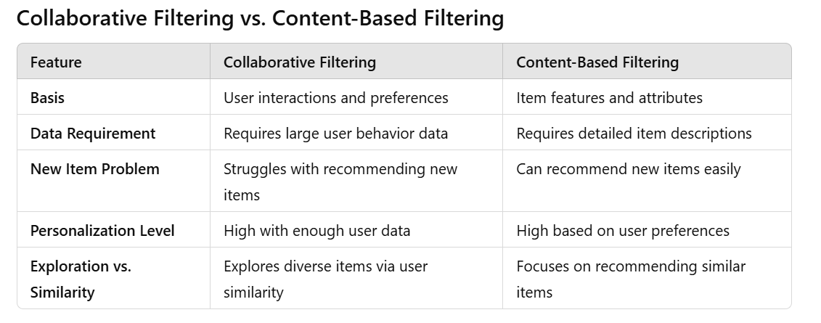

Slide 18
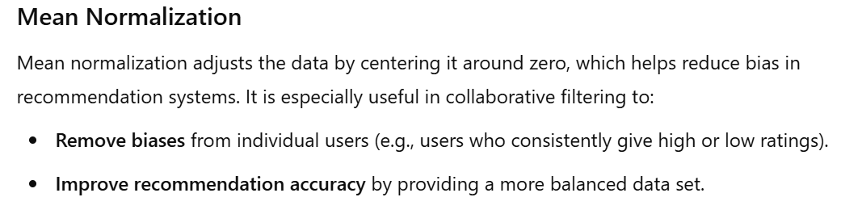

Slide 19
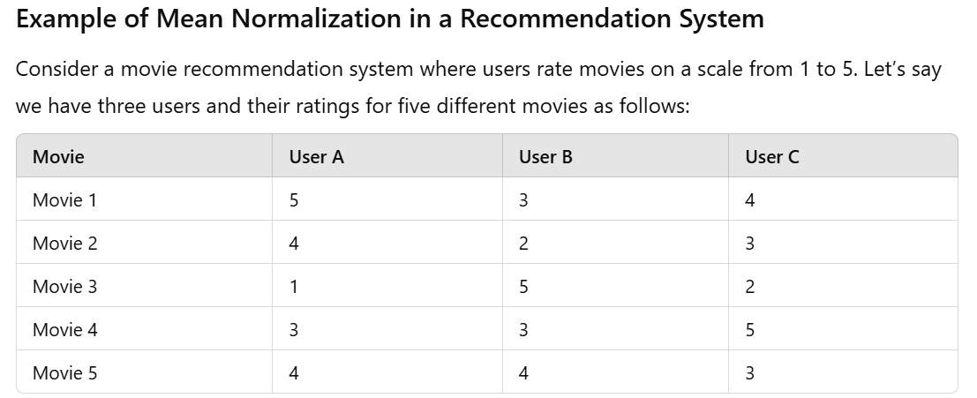

Slide 20
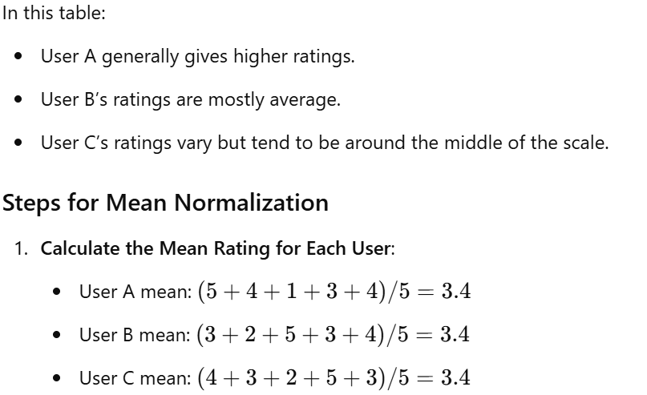

Slide 21
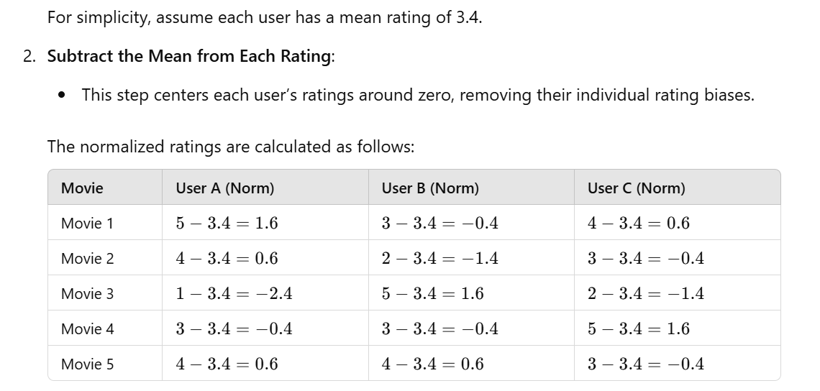

Slide 22
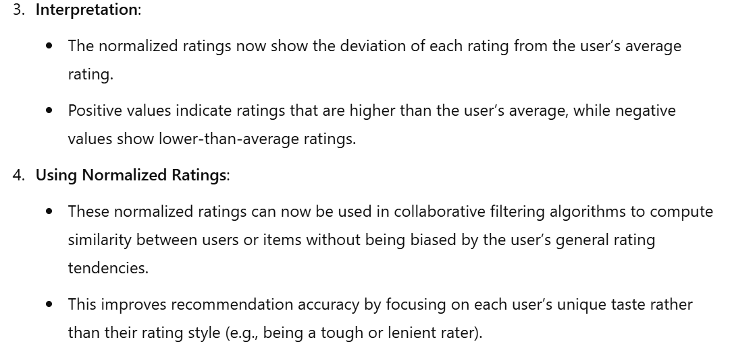

Slide 23
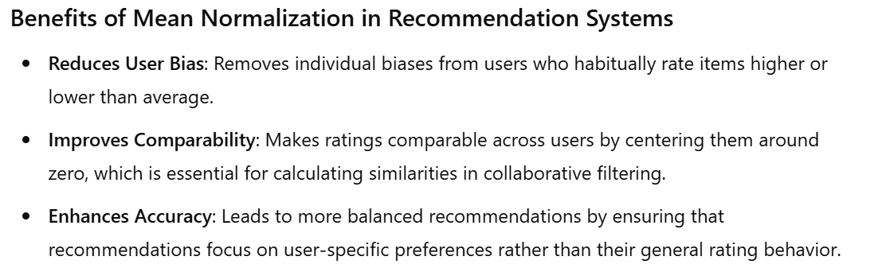

Slide 24
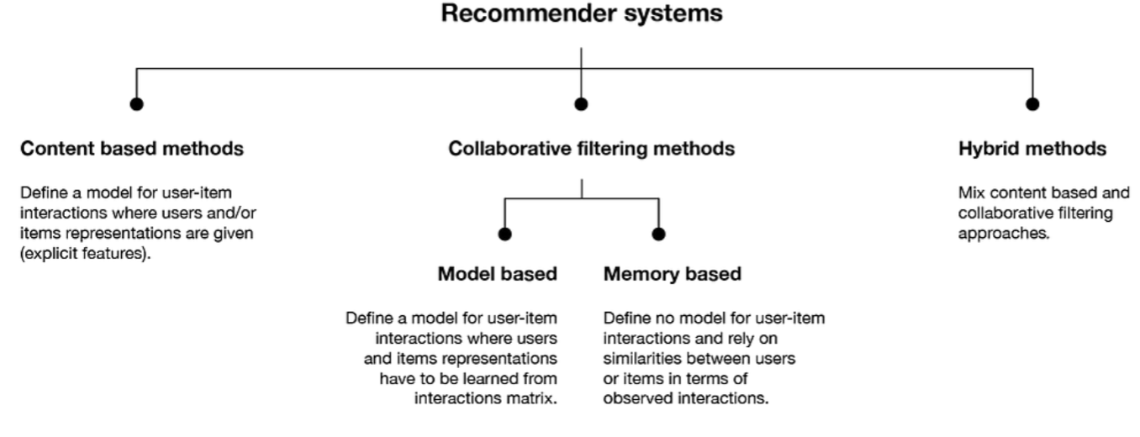
Types of Recommender Systems

Slide 25
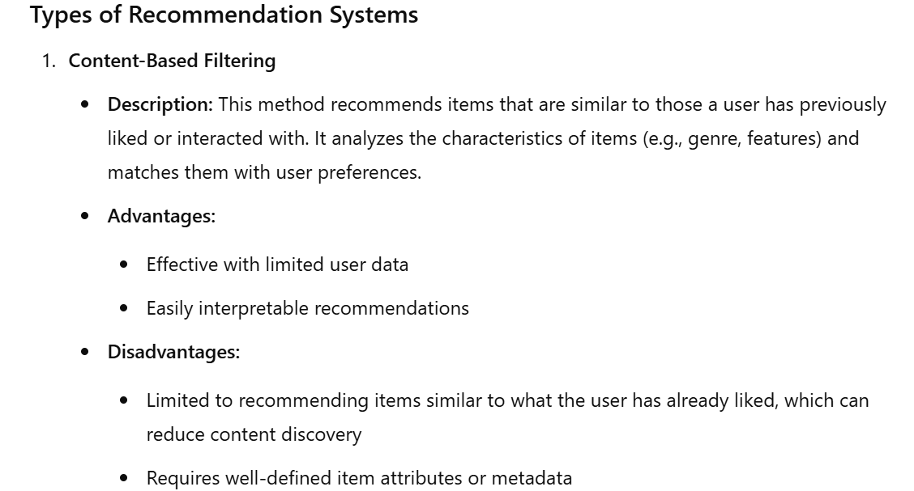
Content-Based Recommender Systems

Slide 26
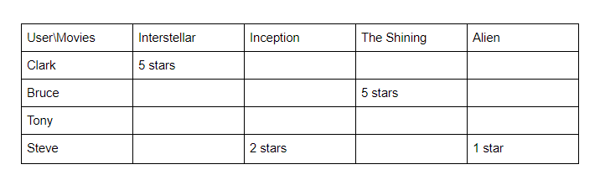
APPROACH 1: USING RATED CONTENT TO RECOMMEND
In this approach contents of the product are already rated and based on the user’s preference, then a rating is predicted for a similar product.
We'll use movie recommendations as an example.
User Ratings
In the example above, Clark and Bruce have given five-star ratings to the movies Interstellar and The Shining, clearly indicating a preference for these films.
For Tony, who has rated nothing, and Steve who has provided only low ratings, it's more difficult to discern their preferences.

Slide 27
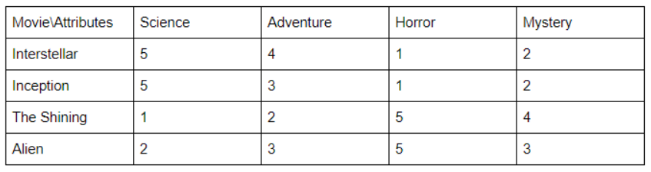
Movie Attributes
In the table above, note that Interstellar and Inception received 5s in the science category, whereas The Shining and Alien get the highest marks under the horror genre

Slide 28
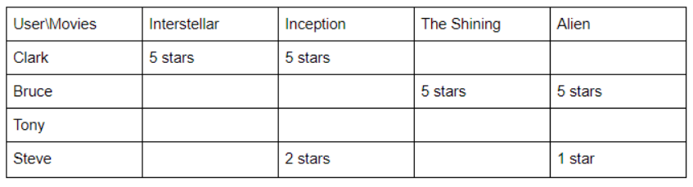
Predicted User Rating
Inception is suggested for Clark because he liked Interstellar and the movies share similar attributes.
Alien is suggested to Bruce because he liked The Shining, which is in the horror genre.
Advantages: Works even when a product has no user reviews.
Disadvantages: Requires descriptive data of all content to recommend, which is time consuming. It's also difficult to implement on large product databases as user’s have different opinions about each item.

Slide 29
APPROACH 2: RECOMMENDATION THROUGH DESCRIPTION OF THE CONTENT
This approach uses the description of the item to make recommendations.
The description goes deeper into the product details, like title, summary, tag lines, genre, etc., and it provides much more information about the item.
The format of these details are in text format(string) and it's important to convert this into numbers to easily calculate for similarity.

Slide 30

Term Frequency-Inverse Document Frequency (TF-IDF)
TF-IDF is used in information retrieval for feature extraction purposes and it is a sub-area of natural language processing (NLP).
Term Frequency: Frequency of the word in the current document to the total number of words in the document.
It signifies the occurrence of the word in a document and gives higher weight when the frequency is more, so it is divided by document length to normalize.
Inverse Document Frequency: Total number of documents to the frequency occurrence of documents containing the word.
It signifies the rarity of the word — the less the word occurs in the document, the IDF increases.
It helps in giving a higher score to rare terms in the documents.

Slide 31
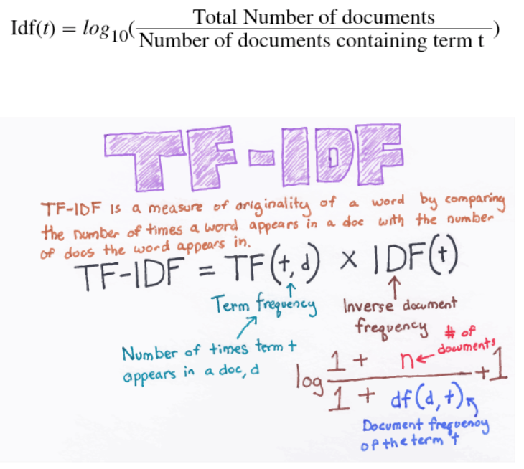

Slide 32
In the end, TF-IDF is a measure used to evaluate how important a word is to a document in a document corpus. T
he importance of the word increases proportionally to the number of times a word appears in the document but is offset by the frequency of the word in the corpus.
Example for TF-IDF: Consider a document containing 100 words wherein the word "odyssey" appears three times. The term frequency for odyssey is then (3 / 100) = 0.03. Now, assume we have 10 lakh documents and the word "odyssey" appears in 1,000 of these. The inverse document frequency is calculated as log(10,00,000 / 1,000) = 3. Thus, the TF-IDF weight for Odyssey is 0.03 * 3= 0.09.

Slide 33
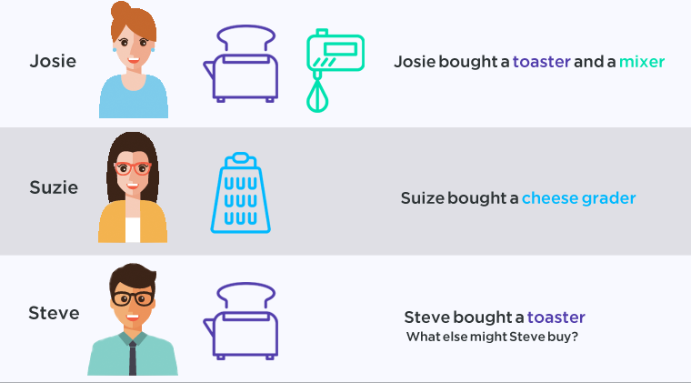
Collaborative Filtering Recommender Systems
Collaborative filtering recommenders make suggestions based on how users rated in the past and not based on the product themselves.
It only knows how other customers rated the product. “Similarity” is measured against the similarity of users.

Slide 34
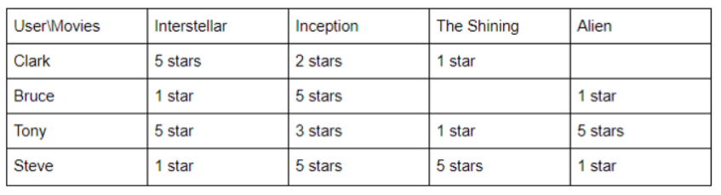
USER RATING
As we can see from above Clark and Tony have similar tastes as they rated movies similarly.

Slide 35
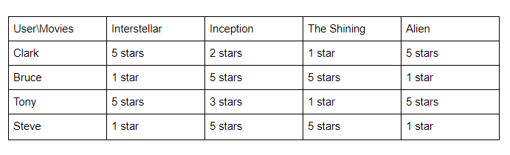
PREDICTED USER RATING
Clark is recommended "Alien" from Tony because of their similarity in rating.
Bruce was suggested "The Shining" because Steve rated it highly.
Advantages:
No requirement for product descriptions.

Slide 36
Disadvantages:
Can’t recommend items if no user reviews exist (suffers from the cold start problem).
Difficult to recommend new users and is inclined to favor popular products with lots of reviews.
Suffers from a sparsity problem as the user will review only selected items.
Faces the "gray sheep problem" (i.e., useful predictions cannot be made due to sparsity).
Difficult to recommend new releases since they have less reviews.

Slide 37
Memory Based Recommender System
Memory-based recommender systems, also known as neighborhood-based recommender systems, rely on the idea of finding similar users or items to generate recommendations.
These systems make predictions based on the preferences or interactions of users or items without employing any complex mathematical models.
There are two main types of memory-based recommender systems:
User-Based Collaborative Filtering
Item-Based Collaborative Filtering

Slide 38
User-Based Collaborative Filtering
User-Based Collaborative Filtering (UBCF) is a popular approach in recommender systems where recommendations are generated based on the behaviors and preferences of similar users.
The basic idea is to find users who are similar to the target user and recommend items liked or rated highly by those similar users.
UBCF relies on the assumption that users who have similar preferences in the past will have similar preferences in the future.

Slide 39
Here's a step-by-step explanation of how to implement a simple User-Based Collaborative Filtering recommendation system:
User-Item Interaction Matrix:
Represent the user-item interactions in a matrix where rows represent users, columns represent items, and the values represent user interactions (e.g., ratings, likes, purchase history).
Similarity Calculation:
Compute similarity between users based on their interactions using a similarity metric such as cosine similarity or Pearson correlation.
Identify Similar Users:
Identify the most similar users to the target user based on the computed similarity scores.
Generate Recommendations:
Recommend items that the target user has not interacted with, based on the interactions of similar users. Sort the recommended items by their predicted ratings or interactions.
Present Recommendations:
Present the top-N recommended items to the target user.

Slide 40
Item based collaborative filtering
Item-Based Collaborative Filtering (IBCF) is a popular technique used in recommender systems to provide recommendations based on similarities between items rather than users.
It recommends items to a user based on their interactions with similar items.
The core idea is that if a user likes or interacts with a certain item, they are likely to like other items that are similar to it.

Slide 41
Model Based Collaborative Filtering
Model-Based Collaborative Filtering is an approach used in recommender systems that involves building predictive models based on the user-item interaction data to make recommendations.
These models use machine learning or matrix factorization techniques to learn patterns, preferences, and relationships from the data to generate personalized recommendations.

Slide 42
Here's an overview of the steps to implement Model-Based Collaborative Filtering:
User-Item Interaction Matrix:
Create a matrix where rows represent users, columns represent items, and the values represent user interactions (e.g., ratings, likes, purchase history).
Model Training:
Train a machine learning model (e.g., matrix factorization, neural networks) on the interaction data to learn the underlying patterns and preferences.
Model Evaluation:
Evaluate the model's performance using appropriate evaluation metrics (e.g., mean squared error, accuracy, etc.).
Generate Recommendations:
Use the trained model to generate recommendations for each user based on their interactions and predicted preferences.
Present Recommendations:
Present the top-N recommended items to the users.

Slide 43
Matrix factorization methods like Singular Value Decomposition (SVD), Alternating Least Squares (ALS), and deep learning-based approaches like neural collaborative filtering (NCF) are commonly used in model-based collaborative filtering.

Slide 44
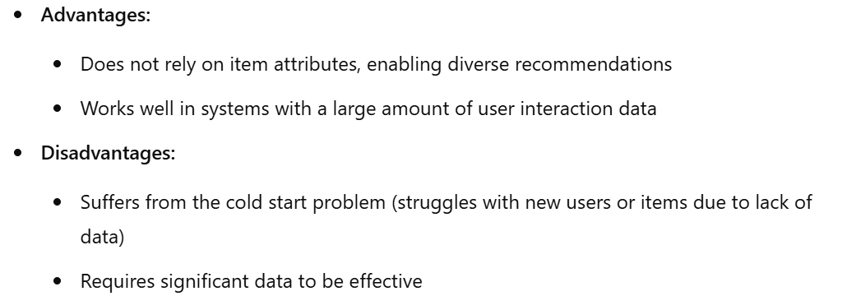

Slide 45
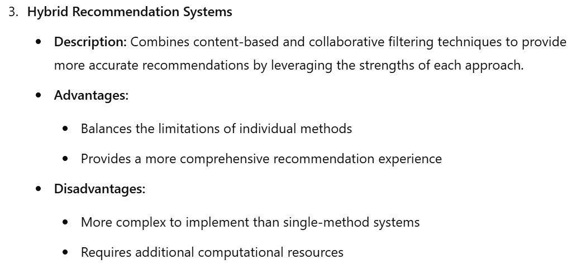

Slide 46
Ethical Use of Recommender System
The ethical use of recommender systems is of paramount importance to ensure that users are provided with fair, transparent, and helpful recommendations while respecting their privacy and well-being.
Transparency and Explanation:
Provide clear explanations of how the recommender system works, what data is used, and how recommendations are generated. Users should understand why certain recommendations are being made.
User Control and Customization:
Allow users to have control over the recommendations they receive. Offer options for customization, preferences, and the ability to filter or adjust recommendations according to their needs and preferences.
Avoid Discrimination and Bias:
Strive to eliminate biases related to race, gender, age, ethnicity, or any other characteristic. Ensure that the recommender system provides fair and unbiased recommendations to all users.
Diversity and Serendipity:
Aim to offer a diverse set of recommendations, avoiding filter bubbles where users are only exposed to content similar to their previous choices. Encourage users to explore a variety of content.

Slide 47
Informed Consent and Privacy:
Obtain informed consent from users regarding data collection, usage, and sharing. Clearly explain the privacy policy and how user data is handled, stored, and protected.
Data Collection and Storage:
Collect and store only the necessary data for providing recommendations. Implement strong security measures to protect user data from unauthorized access or misuse.
Prevent Over-Personalization:
Avoid excessive personalization that may lead to a "creepy" feeling for users. Strive for a balance between personalization and maintaining user privacy.
Avoid Manipulation and Exploitation:
Do not manipulate users or exploit their vulnerabilities to increase engagement or interactions. Prioritize the user's best interests and well-being.

Slide 48
Feedback Mechanism:
Implement a feedback mechanism where users can report issues, biases, or concerns related to recommendations. Use this feedback to improve the recommender system.
Regular Audits and Assessments:
Conduct regular audits and assessments of the recommender system to ensure compliance with ethical guidelines and standards. Address any identified issues promptly.
Stakeholder Involvement:
Involve relevant stakeholders, including users, domain experts, ethicists, and diverse communities, in the design, development, and evaluation of the recommender system to incorporate different perspectives.
Education and Awareness:
Educate users about how recommender systems function and their ethical implications. Promote digital literacy and awareness regarding online content and recommendations.

Slide 49
Thanks

