Slide 1
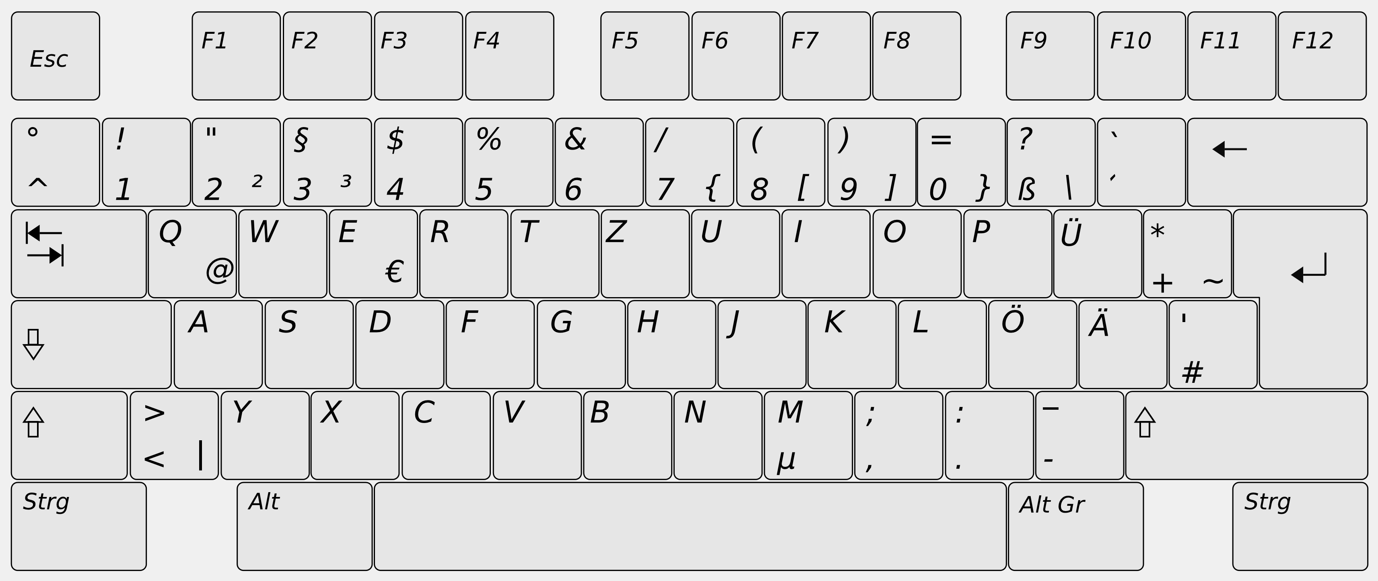
Tempomat - AXIS_CRUISE_CONTROL
Tempomat + AXIS_CRUISE_CONTROL
Handgas - mrGearboxMogliMINRPM
Handgas + mrGearboxMogliMINRPM
Gang + mrGearboxMogliSHIFTGEARUP
Gang - mrGearboxMogliSHIFTGEARDOWN
Gruppe + mrGearboxMogliSHIFTRANGEUP
Tempomat an/aus AXIS_CRUISE_CONTROL
Tempomat Geschw. 2
mrGearboxMogliSWAPSPEED
Neutral mrGearboxMogliNEUTRAL
Gruppe - mrGearboxMogliSHIFTRANGEDOWN
Vor-/Rückwärts mrGearboxMogliREVERSE
Kupplung mrGearboxMogliCLUTCH
Hud an/aus mrGearboxMogliCLUTCH

Slide 2
Tempomat Beschleunigung + mrGearboxMogliACCTOLIMIT
Tempomat Beschleunigung - mrGearboxMogliDECTOLIMIT
Gruppe 2 + mrGearboxMogliSHIFTRANG2EUP
Geschwindig-keitsbegrenzer
mrGearboxMogliSPEEDLIMIT
Tempomat Geschw. 2
mrGearboxMogliSETSPEED
Gruppe 2 - mrGearboxMogliSHIFTRANGE2DOWN
Getriebe an/aus mrGearboxMogliON_OFF
Zusammen mit Umschalt rechts
ECO Modus mrGearboxMogliREVERSE
Kupplung auto./manuell mrGearboxMogliCLUTCH
All Auto mrGearboxMogliCLUTCH

Slide 3
Gang +/- gearboxMogliSHIFTGEARTOGGLE
Gruppe 2 +/- gearboxMogliSHIFTRANGE2TOGGLE
Tempomat Geschw. 3
gearboxMogliSWAPSPEEDR
Settings HUD gearboxMogliSETTINGS
Gruppe +/- gearboxMogliSHIFTRANGETOGGLE
Automatic gearboxMogliAUTOMATIC
Handbremse gearboxMogliHANDBRAKE
Zusammen mit Strg. rechts

Slide 4
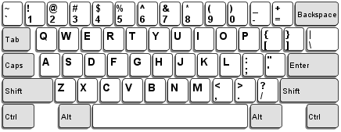
tempomat - AXIS_CRUISE_CONTROL
tempomat + AXIS_CRUISE_CONTROL
throttle - mrGearboxMogliMINRPM
throttle + mrGearboxMogliMINRPM
gear + mrGearboxMogliSHIFTGEARUP
gear - mrGearboxMogliSHIFTGEARDOWN
group + mrGearboxMogliSHIFTRANGEUP
tempomat on/off AXIS_CRUISE_CONTROL
tempomat speed 2
mrGearboxMogliSWAPSPEED
neutral mrGearboxMogliNEUTRAL
group - mrGearboxMogliSHIFTRANGEDOWN
for-/backwards mrGearboxMogliREVERSE
clutch mrGearboxMogliCLUTCH
HUD on/off mrGearboxMogliCLUTCH

Slide 5
tempomat acceleration + mrGearboxMogliACCTOLIMIT
tempomat decceleration - mrGearboxMogliDECTOLIMIT
group 2 + mrGearboxMogliSHIFTRANG2EUP
speed limiter
mrGearboxMogliSPEEDLIMIT
tempomat speed 2
mrGearboxMogliSETSPEED
group 2 - mrGearboxMogliSHIFTRANGE2DOWN
Gearbox on/off mrGearboxMogliON_OFF
RShift
ECO mode mrGearboxMogliREVERSE
clutch auto./manual mrGearboxMogliCLUTCH
All Auto mrGearboxMogliCLUTCH

Slide 6
gear +/- gearboxMogliSHIFTGEARTOGGLE
group 2 +/- gearboxMogliSHIFTRANGE2TOGGLE
tempomat speed 3
gearboxMogliSWAPSPEEDR
settings HUD gearboxMogliSETTINGS
group +/- gearboxMogliSHIFTRANGETOGGLE
automatic gearboxMogliAUTOMATIC
hand brake gearboxMogliHANDBRAKE
RStrg

Slide 7
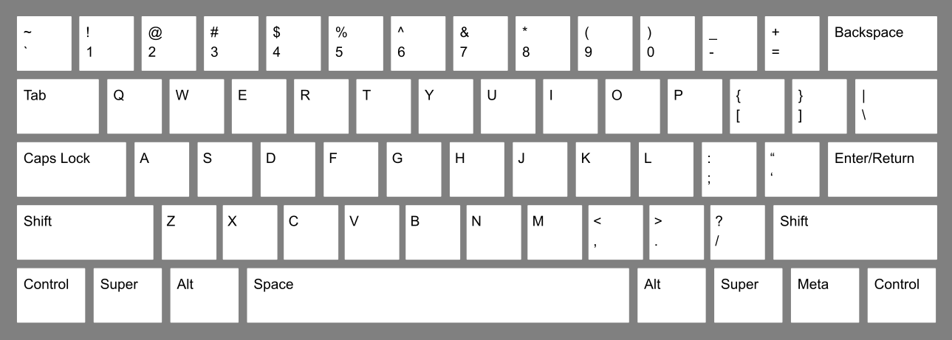
cc acc. + mrGearboxMogliSHIFTGEARUP
2nd group + mrGearboxMogliSHIFTRANGEUP
cc dec. - mrGearboxMogliSHIFTGEARDOWN
speed limiter on/off AXIS_CRUISE_CONTROL
cruise control set speed
mrGearboxMogliSWAPSPEED
gearbox on/off mrGearboxMogliNEUTRAL
2nd group - mrGearboxMogliSHIFTRANGEDOWN
clutch automatic/manual mrGearboxMogliREVERSE

Slide 8
All Auto mrGearboxMogliCLUTCH

