Slide 1
School Of Computing Science And Engineering
GALGOTIAS UNIVERSITY
Program : B.Tech
Course-Code: BCSE3016
Course-Name: Web Technology ( PBL )

Slide 2
Project Name: Website For CSE Department Team No. : Semester: 6 Batch: 11 Team Member 1: Sumit Kumar(17SCSE101641) Team Member 2: Vikash Sharma(17scse101828)

Slide 3
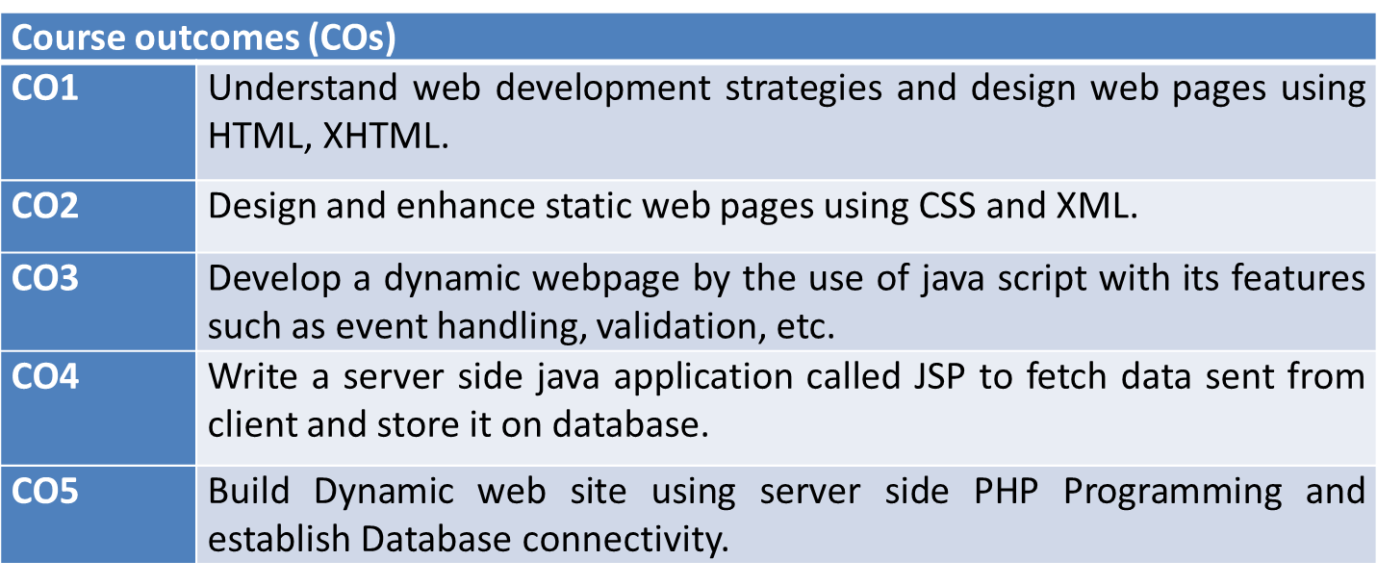
Course Outcomes:

Slide 4
Course Prerequisites
Object Oriented Programming Database Management System

Slide 5
Syllabus
Unit I: Introduction to web and HTML 8 lecture hours
Introduction to web, web development strategies, web team. HTML introduction: basic tag, elements,
attributes, formatting, comments, marquee, list, table, images, frames, forms; Links : text, image and email. XHTML: Syntax and Semantics.
Unit II: CSS and XML 8 lecture hours
CSS : color, background, fonts, images, link, table, margins, lists, border, paddings, scroll, class.
CSS3 : border Image, round corner, text shadow, layers.
XML: DTD, XML schemes, presenting and using XML.
Unit III: JavaScript 8 lecture hours
Java script: Introduction, documents, forms, statements, functions, objects; Event and event handling; Error handling; validation.
Unit IV: JSP 8 lecture hours
Java server pages (JSP), JSP application design, declaring variables and methods, debugging, sharing data between JSP pages, JSP objects, Session, development of java beans in Jsp, data base action with JSP.

Slide 6
TABLE OF CONTENTS
Introduction
Project Details
Features
System Requirements
Diagram

Slide 7
Introduction
This project is web application which will be an online portal or website for Galgotias University focusing on the CSE Department of the University. The system shall provide features to the user of the Galgotias University to gather information about placement and upcoming events for the CSE department of the university. Currently due to lack of specific website for the department the many student Don’t get all the information. Website contain the list of the faculty member along with their field of Specialization so that is become easy for the student to directly contact for their project work.

Slide 8
Project Details
This is a separate website for the CSE department of the university wherein Students of Computer Science department can access to all the resources and the information related to their academics .
Everyone can see the website’s some pages like placements, about us, contact us etc.
The Faculty and students will have to register once.
Faculty after login will be able to put event details and resources related to CSE.
CSE students will be able to get the resources and other information from the website only.

Slide 9
Features
User-Friendly:- easy to use for everyone.
CSE Oriented :- separate website only for CSE department.
Sign up/Login:- Authentication for whom to give the access.
Resource availability:- Resources such as eBooks, educational sites, online coding practice and competitions sites
links will be made available.
Notifications:- authorized students will get notified for the events related to CSE department.
Registration for Events:- Students can register themselves in the events like hackathon and other coding competitions events

Slide 10







System Requirements
FRONT-END
DATABASE
BACK-END
HTML-5
CSS-3
JAVASCRIPT
SQLITE3
PYTHON-3.7
DJANGO-2.0
JAVASCRIPT

Slide 11

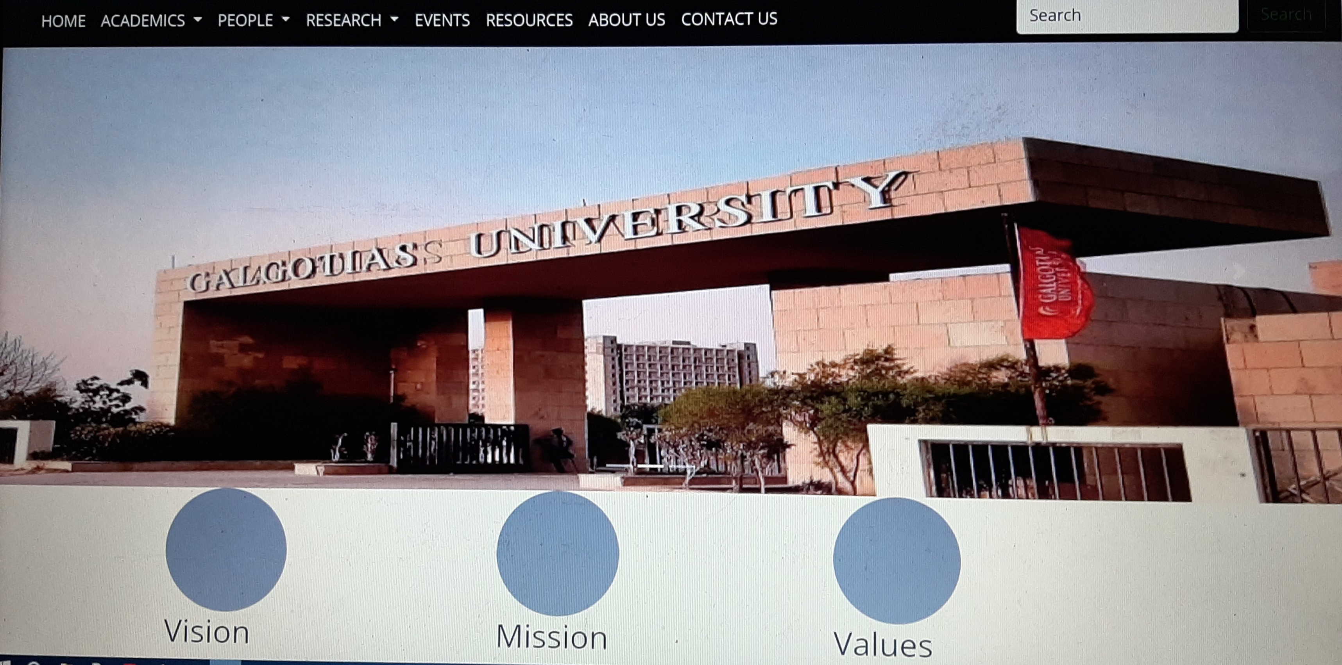


SNEAK PEEK
NAVIGATIONS
HOME
SLIDER
VISION,MISSION, VALUES

Slide 12
THANKS!

