Slide 1

Online Insurance: A cutting-edge solution designed to streamline insurance services

Slide 2

Introduction
Welcome to our presentation on the Online Insurance Platform. In today's digital age, the need for convenient and efﬁcient insurance services has never been greater. Our platform aims to revolutionize the insurance experience by providing seamless access to policy management, agent interactions, and support services, all from the comfort of your home.

Slide 3
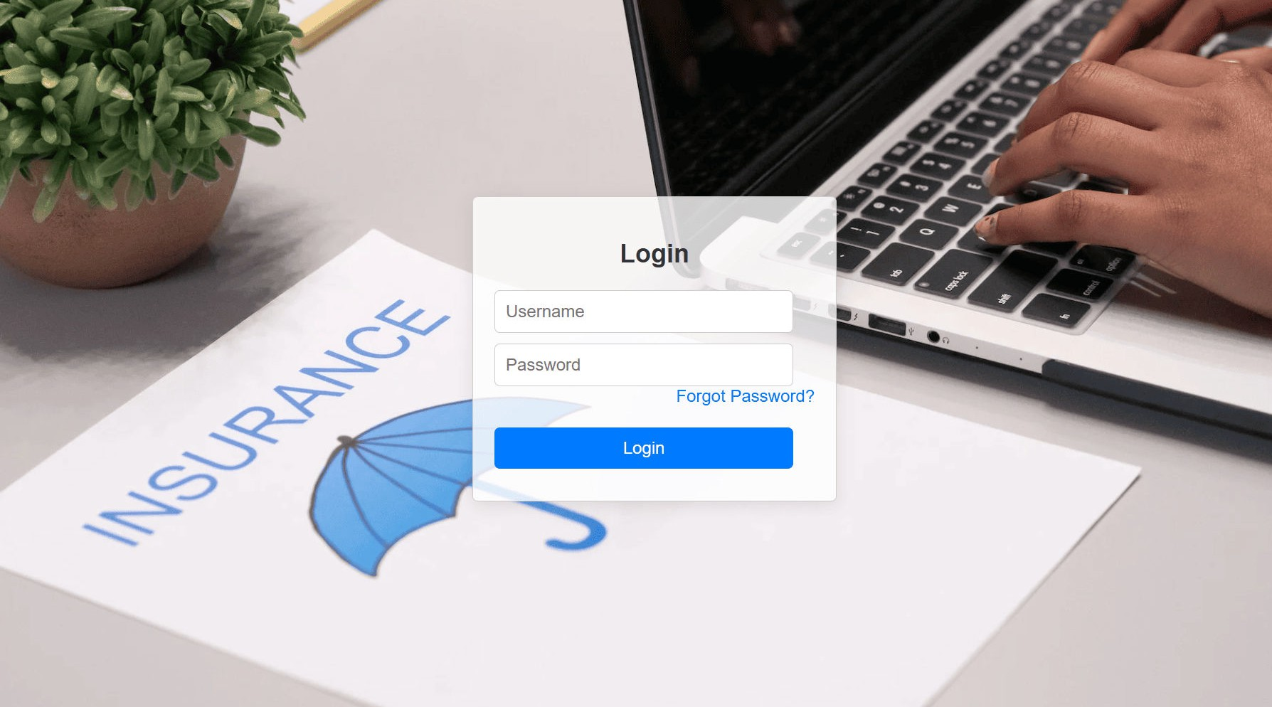
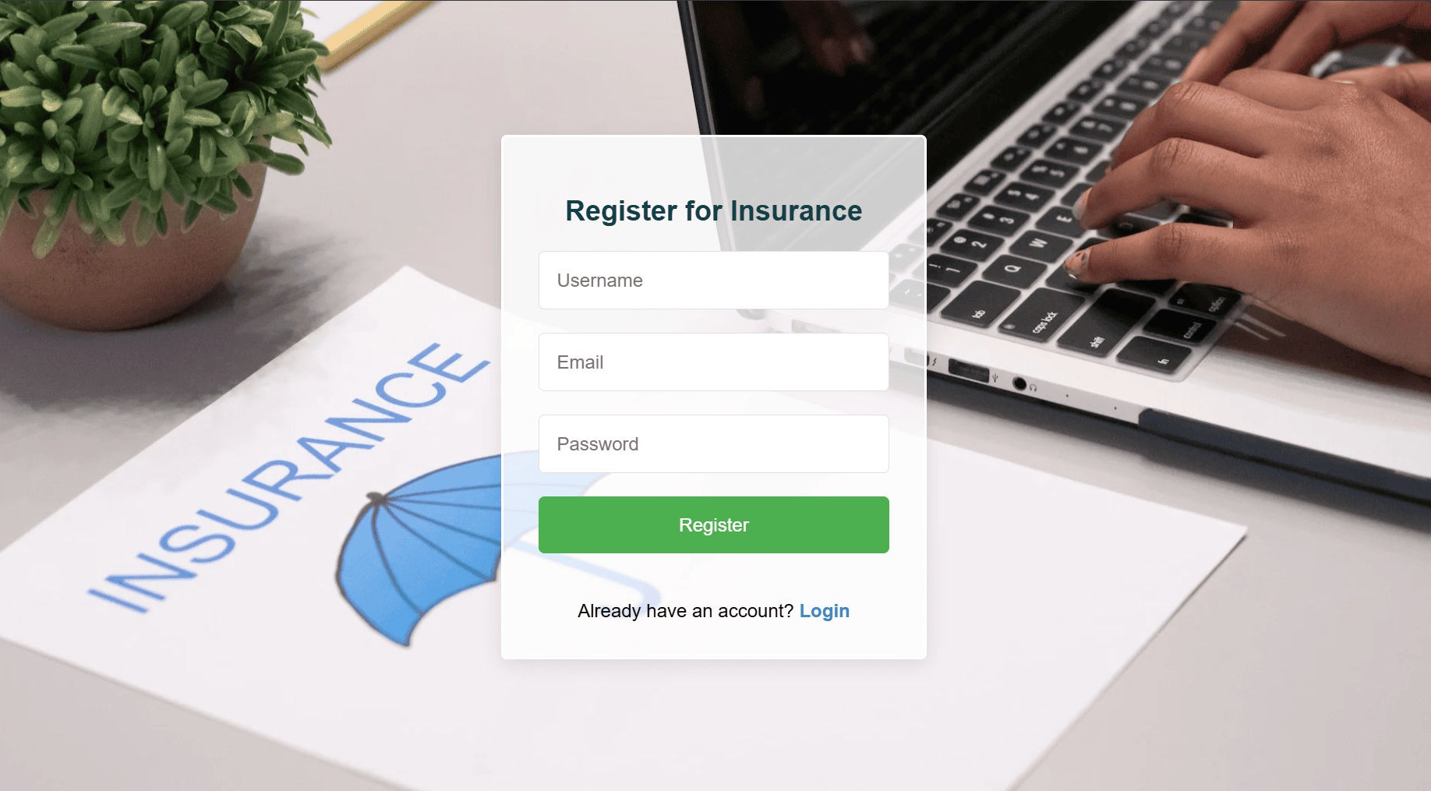

User Registration and Login
Implemented user registration functionality. Developed user login mechanism.
Integrated email veriﬁcation and password reset features.

Slide 4
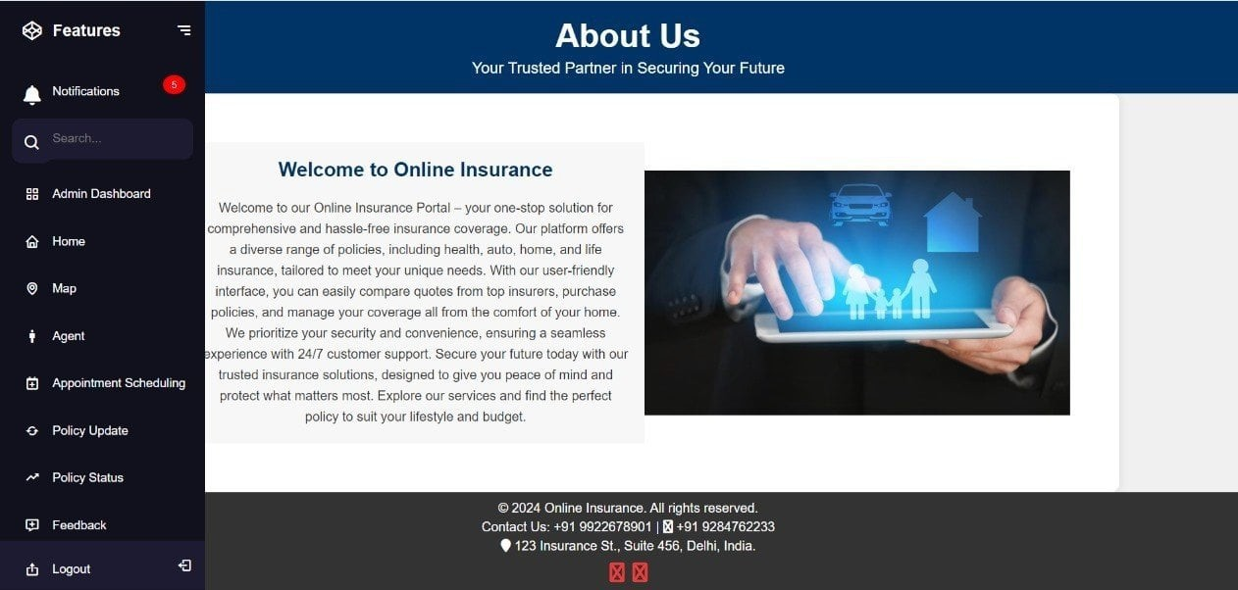
Home page
User-friendly interface Key sections:
policy options, user
dashboard, map feature, agent availabilty, appointment.
Navigation and ease of use

Slide 5
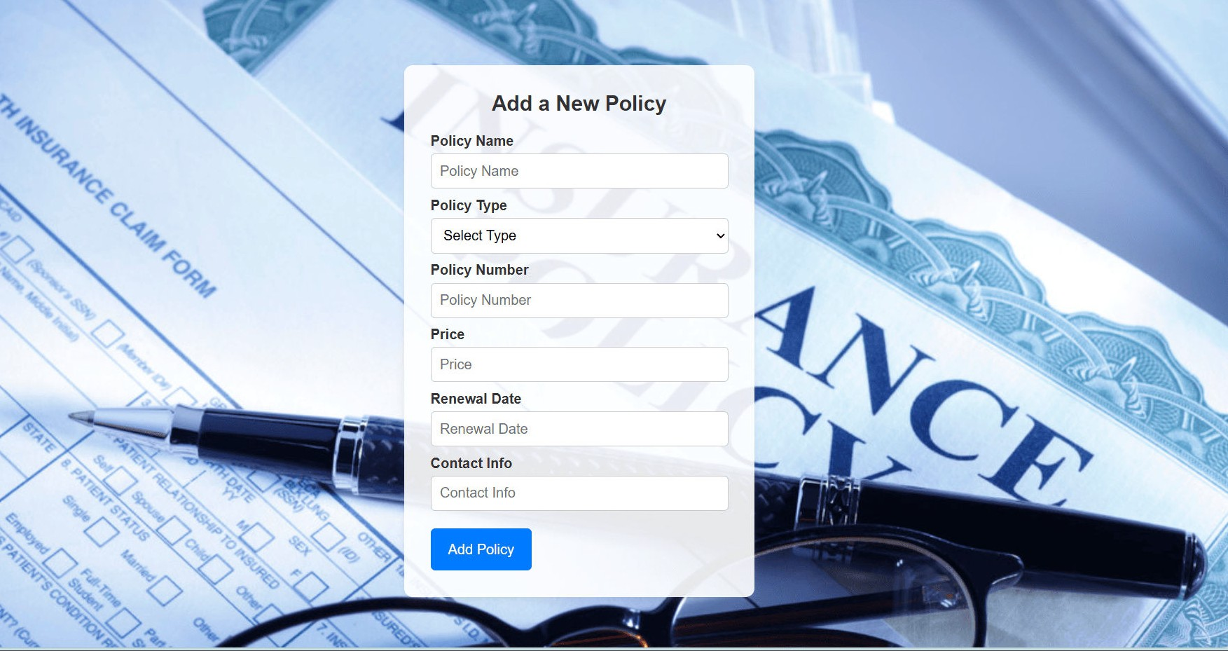
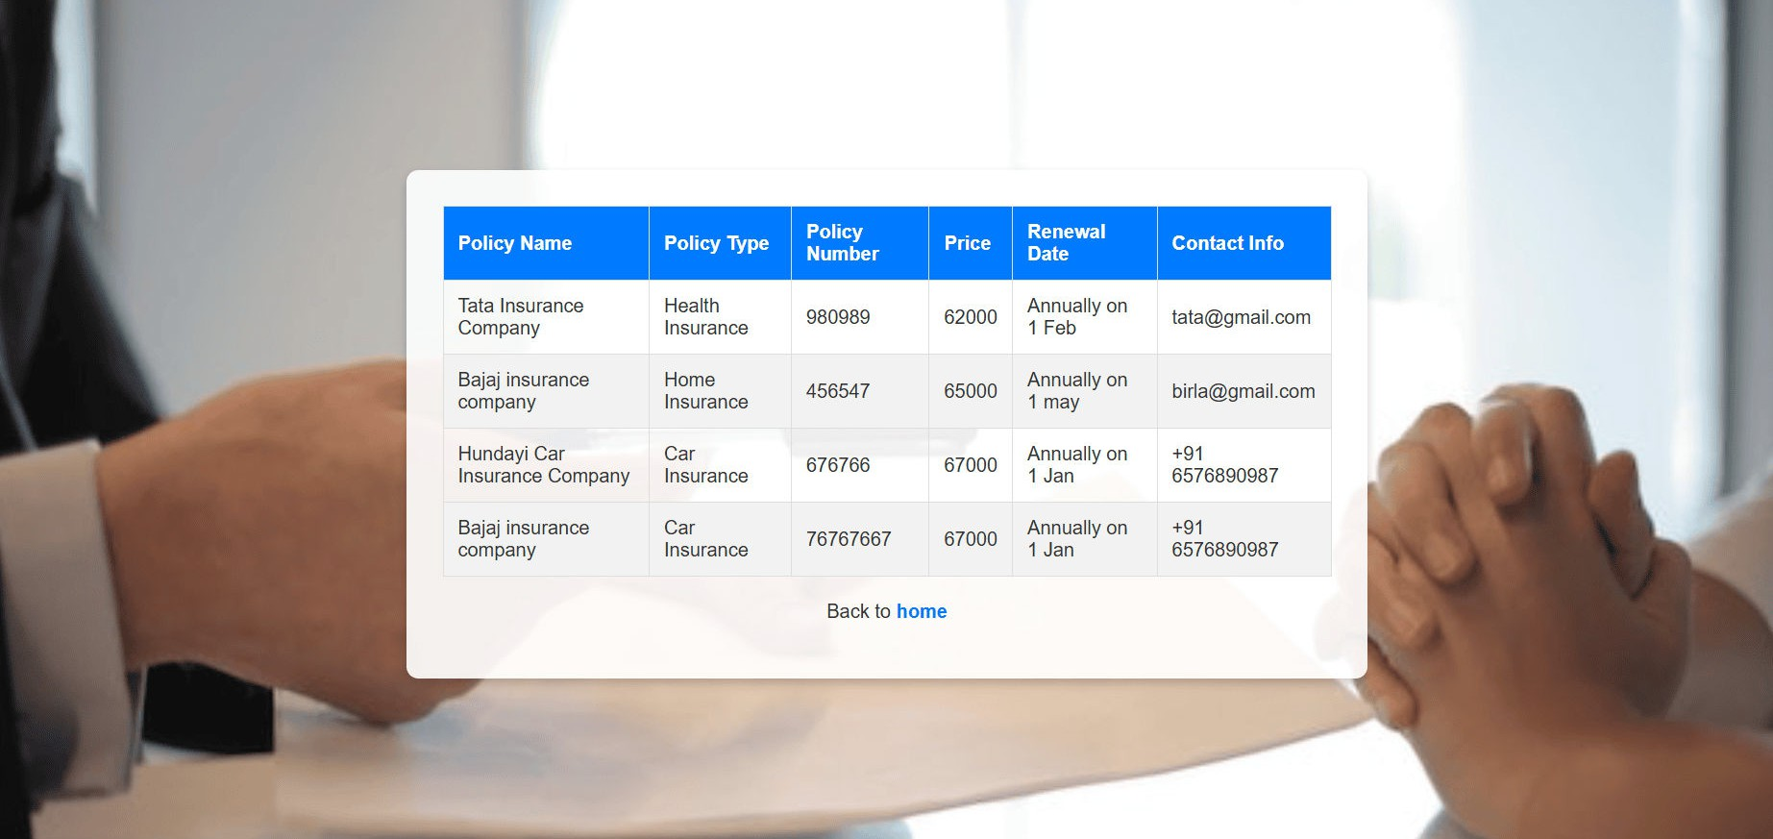

Policy Management
User-Friendly Interface: Intuitive and easy-to- navigate form for adding new policies.
Policy Details Input: Fields for policy name, type, number, price, renewal date, and contact info.
Dropdown Menu: Select the policy type from a predeﬁned list.
Responsive Design: Form adjusts seamlessly across
various devices.

Slide 6
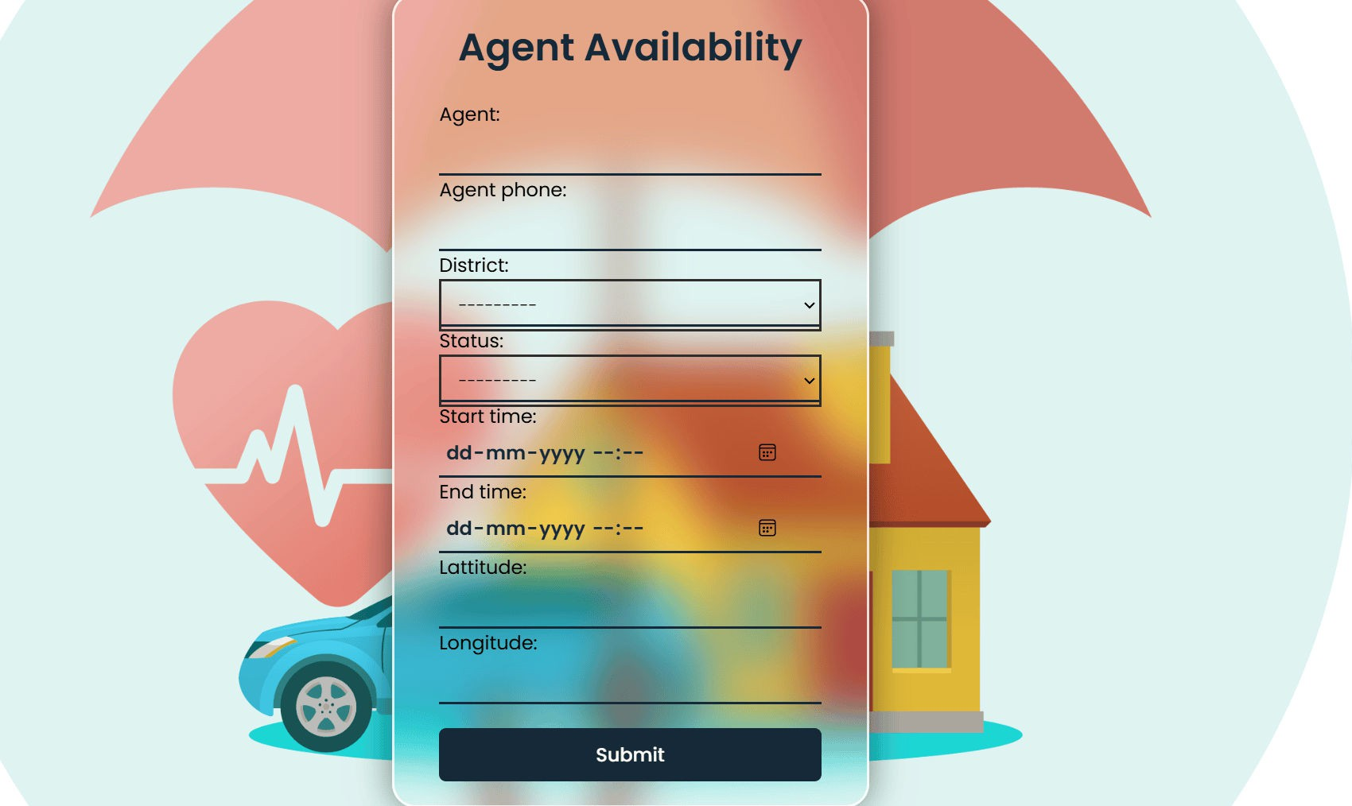
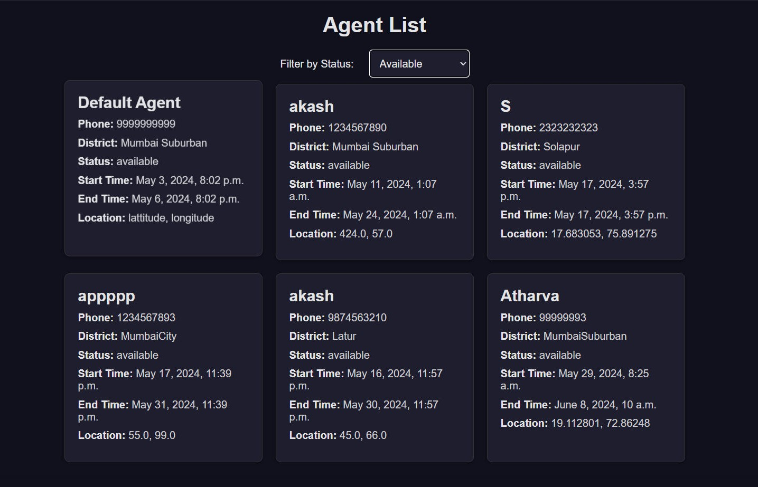
AGENT AVAILABILITY MANAGEMENT
Designed database schema for storing Agent availability information.
Developed an interface for Agents to set their availability.
Implemented backend functionality to
manage and update Agent availability.

Slide 7
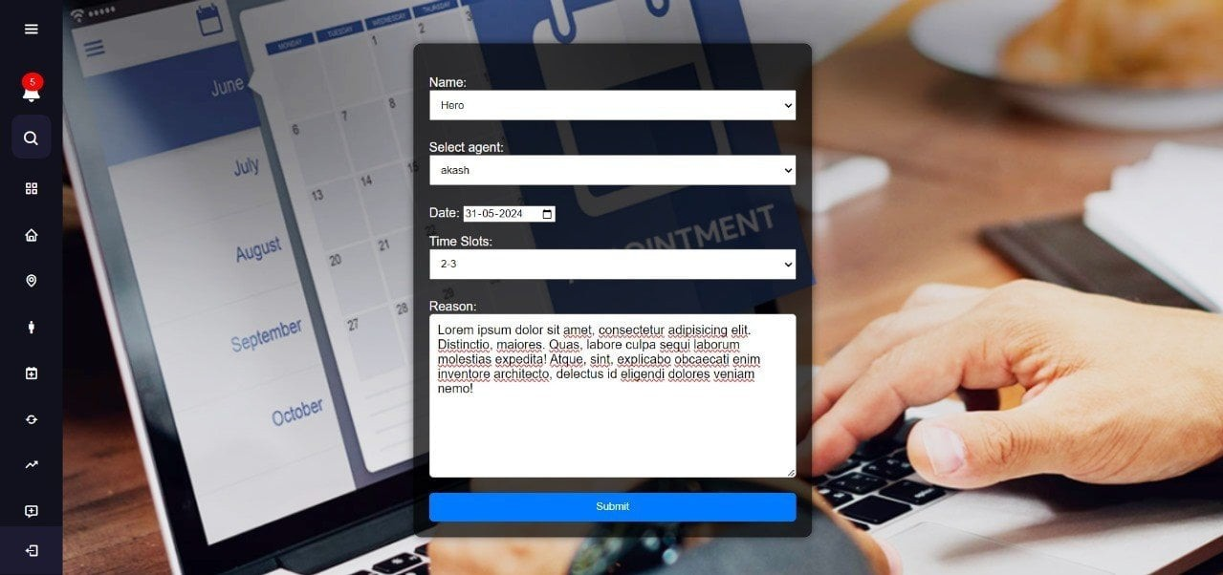

Appointment Scheduling Interface
Designed and developed the interface for appointment scheduling.
Implemented functionality for users to select Agents, preferred time slots, and reasons for the appointment.
Integrated the scheduling interface
with the backend for storing appointment details.

Slide 8
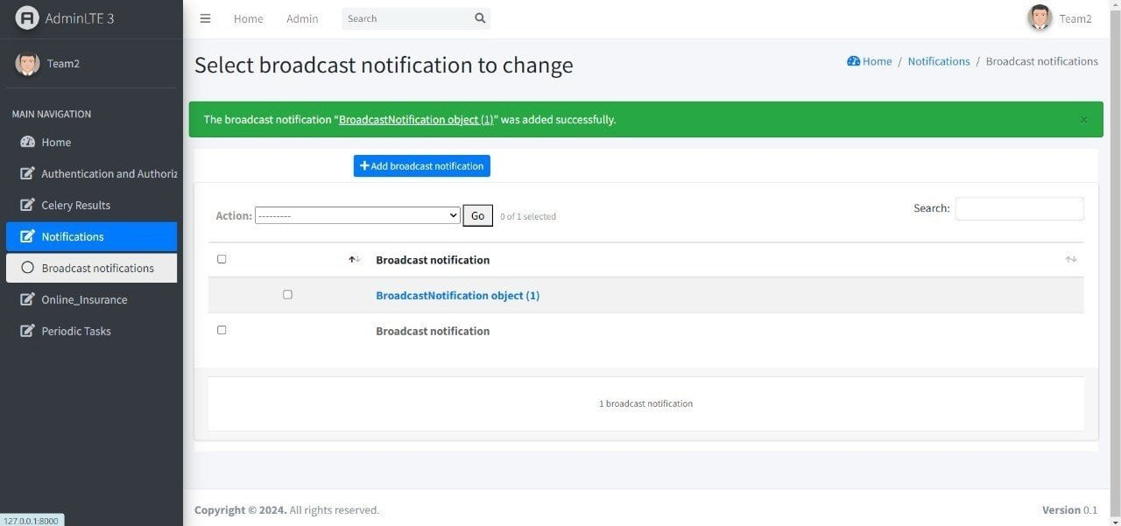
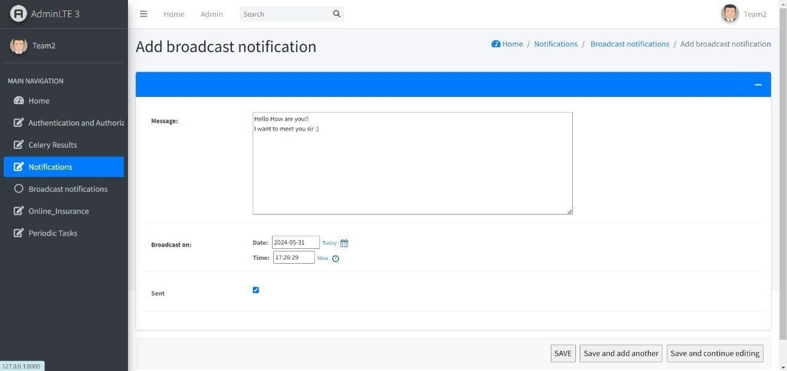
Notiﬁcation System
Integrated email and/or SMS notiﬁcation services.
Developed triggers and notiﬁcations
for appointment reminders, new bookings, and cancellations.
Implemented a system for handling and tracking notiﬁcations.

Slide 9
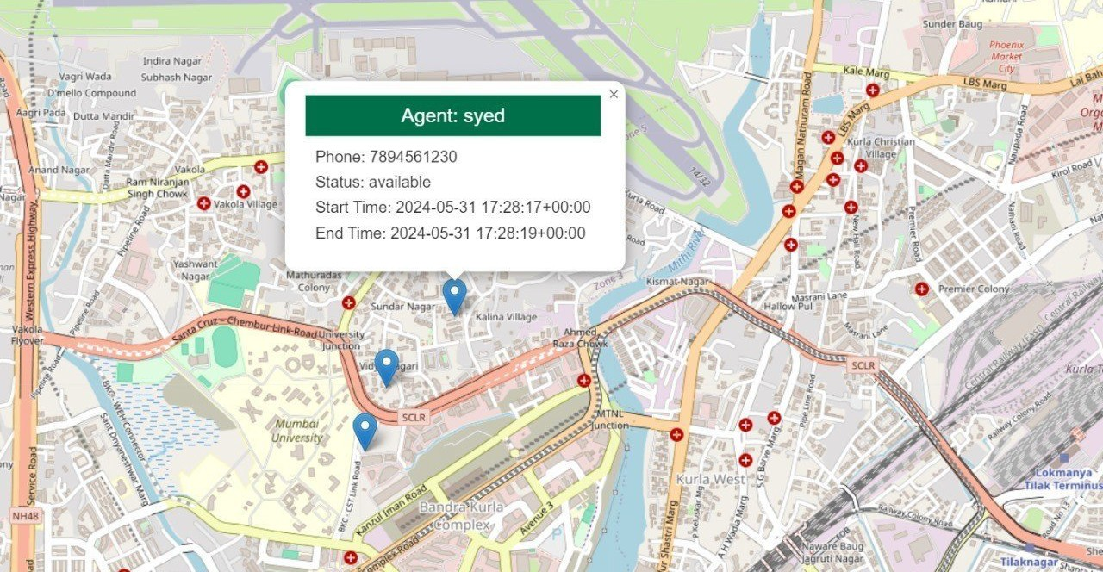
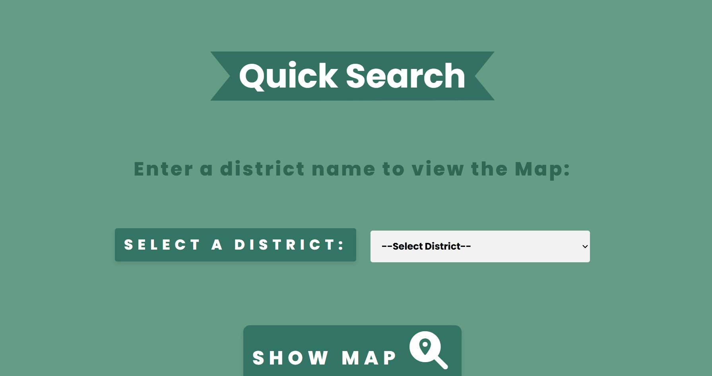
Map Feature
Agent Availability: Visual representation of agent locations and availability in real- time.
Interactive Map: Users can easily navigate, zoom in/out, and select agents based on proximity.
Enhanced User Experience: Provides a convenient way to ﬁnd and connect with nearby insurance agents.

Slide 10
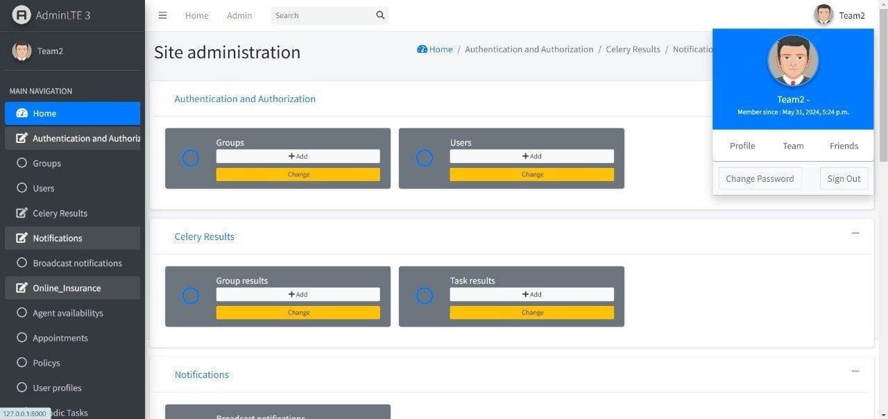
Admin Dashboard

Slide 11
CONCLUSION
Comprehensive Solution: Our online insurance platform provides a seamless, user-friendly experience for managing all insurance needs from policy creation to agent interactions.
Enhanced Accessibility: Features like policy management, agent availability maps, and a responsive design ensure accessibility and convenience for users anytime, anywhere.Future-Ready: By leveraging technology, we ensure secure, efﬁcient, and personalized insurance services, setting a new standard for the industry.
Commitment to Excellence: We are dedicated to continuous improvement and innovation, ensuring our platform evolves to meet the changing needs of our users.

Slide 12



Thanks!
Asmita Hachade Atharva Patange Sushant Jagralmudi Akash Pawar
Syed Sharukhali Sharon Chattopadhayay
Luthiya Prabhabati

