Slide 1
Data and Features, Some Simple Supervised Learners (LwP, Nearest Neighbors)
CS771: Introduction to Machine Learning

Slide 2
Announcements
Please join on Piazza
Joining link already shared in lecture 1 slides
If you don’t join by Aug 10, there will be some penalty
If you have some issue joining Piazza, let us know and we can add you
Some bonus marks will be reserved for (constructive) Piazza participation
Insightful questions and helpful answers/discussions from students
Amount of bonus at instructor’s discretion (e.g., if you are falling below the threshold of a grade, you may get a “bump up”)
Project groups should be declared by Aug 11
Will share a Google form to enter details

Slide 3





Plan today
Feature extraction from raw data
How to convert raw inputs into “features” that our ML algos can understand/use?
How to transform some given features to make them more useful?
Supervised learning methods that only require computing distances/similarities between inputs
Learning with Prototypes (LwP)
Nearest Neighbors
How to “tune” our ML models (selecting hyperparameters using cross-validation)
Images as inputs
Text docs as inputs

Slide 4

Data and Features
Features represent semantics of the inputs. Being able to extract good features is key to the success of ML algos
ML algos require a numeric feature representation of the inputs
Features can be obtained using one of the two approaches
Approach 1: Extracting/constructing features manually from raw inputs
Approach 2: Learning the features from raw inputs
Approach 1 is what we will assume/focus on primarily for now
For the first few lectures, we will assume that someone has already given us the features
Approach 2 is what is followed in Deep Learning based models and other ML models that learn a “code” (some optimal feature representation) for the inputs
Approach 1 is not as powerful as Approach 2 but still used widely

Slide 5
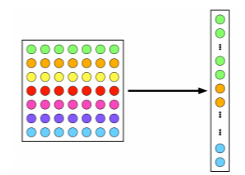

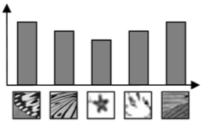
Example: Feature Extraction for Image Data
A very simple feature extraction approach for image data is flattening
Histogram of visual patterns is another popular feature extr. method for images
Many other manual feature extraction techniques developed in computer vision and image processing communities (SIFT, HoG, and others)
Flattening and histogram based methods destroy the spatial information in the image but often still work reasonably well
7x7 image
(49 pixels)
Vector of pixel
intensities
Bar heights in the histogram denote how the frequency of occurrence of each of the patterns in the given image (this vector of frequencies can be used as the extracted feature vector for this image)
These patterns can also be “discovered” by some feature learning algorithms (will see later)
Suppose these are typical patterns in the images in the dataset (some “domain expert” may have told us)
Pic credit: cat.uab.cat/Research/object-recognition

Slide 6
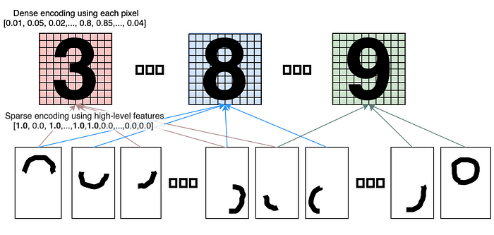
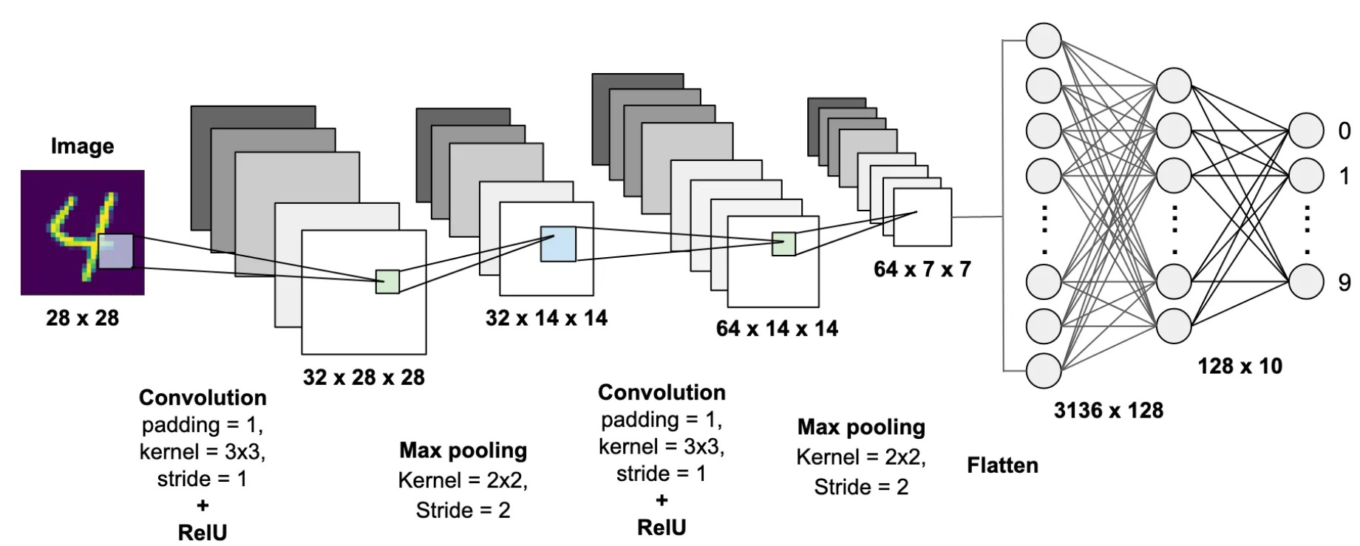
Example: Feature Extraction for Image Data
(Sparse) coding methods can also be used to learn good features
Deep Learning methods offer a very powerful way to learn good features
Each input represented using a binary feature vector denoting presence/absence of a large number of patterns (handwriting strokes)
Last layer of features (the final supervised learning model uses these features)
Several layers of feature representations learned for each input (that’s why it’s called “deep”)
https://medium.com/@apatsekin/sparse-coding-simplified-dd09b73eca14
https://towardsdatascience.com/mnist-handwritten-digits-classification-using-a-convolutional-neural-network-cnn-af5fafbc35e9

Slide 7
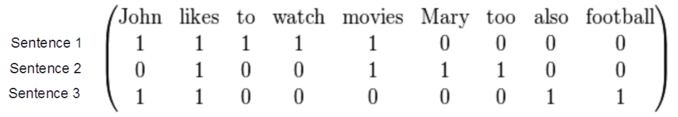
Example: Feature Extraction for Text Data
Consider some text data consisting of the following sentences:
John likes to watch movies
Mary likes movies too
John also likes football
Want to construct a feature representation for these sentences
Here is a “bag-of-words” (BoW) feature representation of these sentences
Each sentence is now represented as a binary vector (each feature is a binary value, denoting presence or absence of a word). BoW is also called “unigram” rep.
BoW is just one of the many ways of doing feature extraction for text data. Not the most optimal one, and has various flaws (can you think of some?), but often works reasonably well
Our “vocabulary” of 9 words

Slide 8
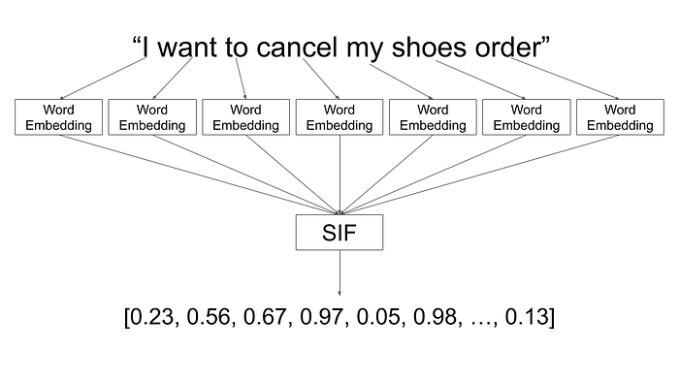
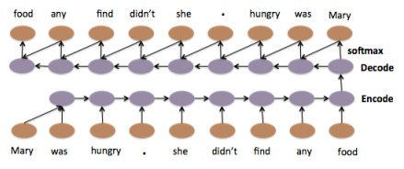
Example: Feature Extraction for Text Data
For text data (like sentences or document), we can do feature extraction using other simple methods that also use explicit semantics of words
Deep learning methods for sequence data (e.g., recurrent neural networks and transformers) are more powerful for feature extraction for text data (more on this later)
For each word, there exists an “embedding” (a vector) such that semantically similar words have similar embeddings
SIF* is a popular feature extraction method based on averaging of word embeddings
The state representation at the end of this sequence can be used as a feature for this sentence
*A Simple but Tough-to-Beat Baseline for Sentence Embeddings (Arora et al, 2017)

Slide 9
Don’t forget to apply common sense with features!
Consider a problem of predicting some air-pollutant’s (e.g., PM2.5) concentration at various locations and at various times
Here, in addition to other features, we also have features such as
Lat-long of each location
Time-stamp (e.g., hour of the day)
Using raw values of these features may not be helpful (could even hurt) since
Earth is round ☺
Hours of the day have cyclical relationships (hour 23 is closer to hour 1 than hour 18)
Thus we may need to transform such features using suitable techniques
Cyclical embeddings and other specific techniques for feature transformation can be used
Caution: Don’t leave deep learning to take care of all the features. Do apply some common sense as well

Slide 10
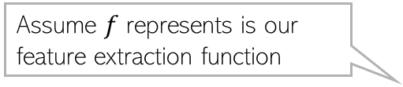
Feature Learning = Distance Function Learning?
It seems there are two ways to learn effectively from data
Extract (or rather “learn”) features from the data + use standard distance function
Use a good distance/similarity function of the “basic” features, e.g.,
Both approaches, at some level, can be seen doing the same thing, just in different ways
Any feature learning method corresponds to learning some distance/similarity function
.. and vice-versa
Assume $f$ represents is our feature extraction function
$$d\left(a,b\right)=\sqrt{{\left(f(a)−f(b)\right)}^{⊤}\left(f(a)−f(b)\right)}$$
$$d_{w}\left(a,b\right)=\sqrt{{\left(a−b\right)}^{⊤}W\left(a−b\right)}$$
$$k\left(a,b\right)= exp\left(−γ{\left\|a−b\right\|}^{2}\right)$$

Slide 11
Feature Selection
Not all the extracted features may be relevant for learning the model (some may even confuse the learner)
Feature selection (a step after feature extraction) can be used to identify the features that matter, and discard the others, for more effective learning
Many techniques exist – some based on intuition, some based on algorithmic principles (will visit feature selection later)
More common in supervised learning but can also be done for unsup. Learning
Many ML algorithms can automatically take care of feature extraction/selection
More on this later
Age
Gender
Height
Weight
Eye color
Calculating BMI from this data doesn’t require ML but this simple example is just to illustrate the idea of feature selection ☺
Body-mass index (BMI)

Slide 12
Simple Supervised Learners

Slide 13
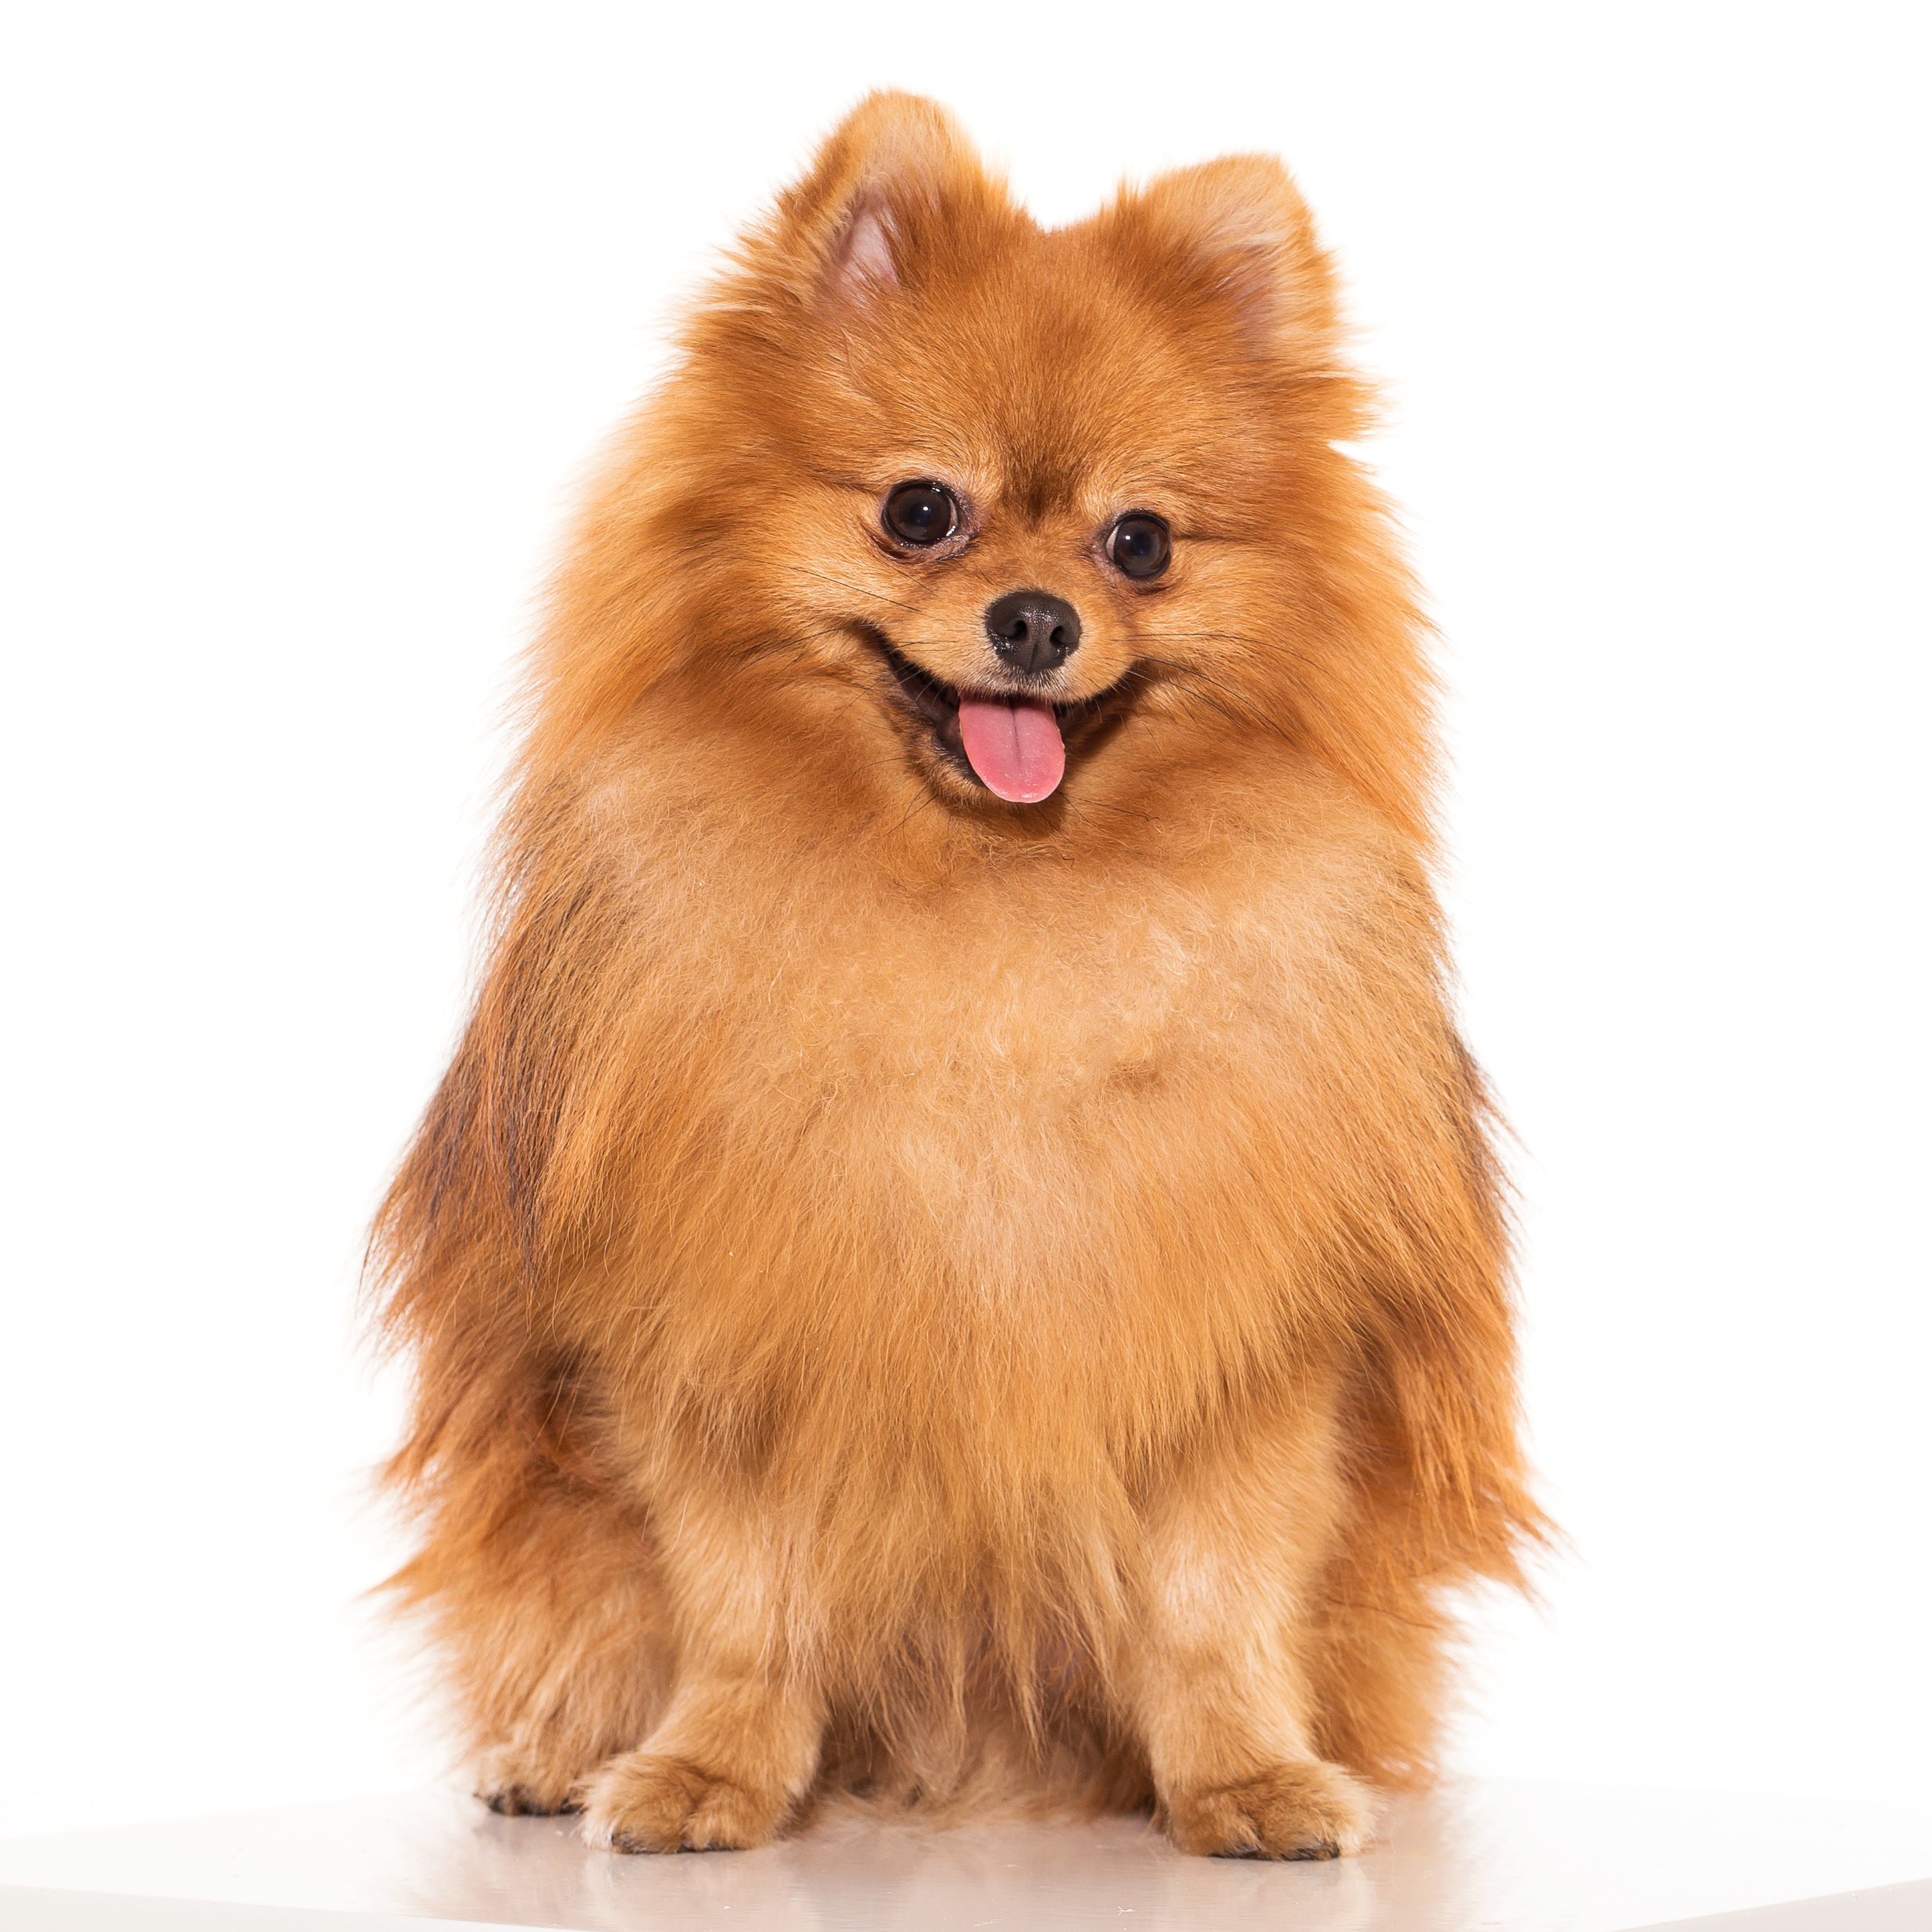



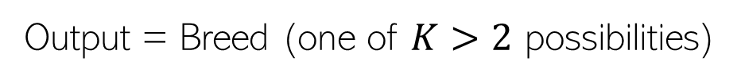
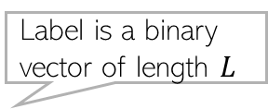
Supervised Learning: Regression and Classification
Other types of supervised learning problems also exist, such as ranking, which we will study later
Regression is when the output is real-valued, e.g.,
Classification is when the output is discrete, e.g.,
Input =
Output = Weight of the dog
Binary classification
Input =
Output = Is it a dog (1) or cat (0) ?
Label is a “one-hot” vector of length $K$
Multi-class classification
Input =
Output = Breed (one of $K>2$ possibilities)
Label is a binary vector of length $L$
$L>1$ labels, each binary
Also called “tagging”
Multi-label classification
$L=4$ in this case
Input =
Output = Dog (1/0)? Fluffy (1/0)? Sitting (1/0)? Wearing collar (1/0)?
Image by Racool_studio on Freepik

Slide 14
Learning with Prototypes

Slide 15
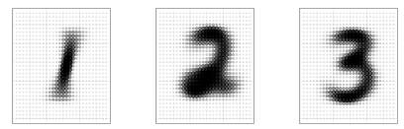
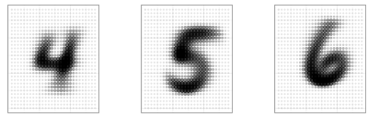
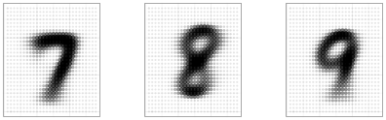
Classification via Learning with Prototypes (LwP)
Basic idea: Represent each class by a “prototype” vector
Class Prototype: The “mean” or “average” of inputs from that class
Predict label of each test input based on its distances from the class prototypes
Predicted label will be the class that is the closest to the test input
How we compute distances can have an effect on the accuracy of this model (may need to try Euclidean, weight Euclidean, or something else)
Averages (prototypes) of each of the handwritten digits 1-9
Pic from: https://www.reddit.com/r/dataisbeautiful/comments/3wgbv9/average_handwritten_digit_oc/

Slide 16





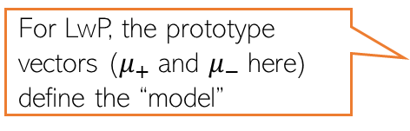
Learning with Prototypes (LwP): An Illustration
Suppose the task is binary classification (two classes assumed pos and neg)
Training data: $N$ labelled examples ${\{\left(x_{n},y_{n}\right)\}}_{n=1}^{N}$,${ x}_{n}∈ℝ^{D}$, ${ y}_{n} ∈\{−1,+1\}$
Assume $N_{+}$ example from positive class, $N_{−}$ examples from negative class
Assume green is positive and red is negative
$$μ_{−}= \frac{1}{N_{−}}\sum_{y_{n}=−1}{x_{n}}$$
$$μ_{+}= \frac{1}{N_{+}}\sum_{y_{n}=+1}{x_{n}}$$
$$μ_{−}$$
$$μ_{+}$$
LwP straightforwardly generalizes to more than 2 classes as well (multi-class classification) – K prototypes for K classes
For LwP, the prototype vectors ($μ_{+}$and $μ_{−}$here) define the “model”
Test example
Test example

Slide 17



LwP: The Prediction Rule, Mathematically
What does the prediction rule for LwP look like mathematically?
Assume we are using Euclidean distances here
$${\left|\left|μ_{−}−x\right|\right|}^{2}={\left|\left|μ_{−}\right|\right|}^{2}+{\left|\left|x\right|\right|}^{2}−2\left\langle μ_{−},x\right\rangle$$
$$μ_{−}$$
$$μ_{+}$$
$${\left|\left|μ_{+}−x\right|\right|}^{2}={\left|\left|μ_{+}\right|\right|}^{2}+{\left|\left|x\right|\right|}^{2}−2\left\langle μ_{+},x\right\rangle$$
Test example $x$
Prediction Rule: Predict label as +1 if $f\left(x\right)={\left|\left|μ_{−}−x\right|\right|}^{2}$ $−$ ${\left|\left|μ_{+}−x\right|\right|}^{2}>0$ otherwise -1

Slide 18

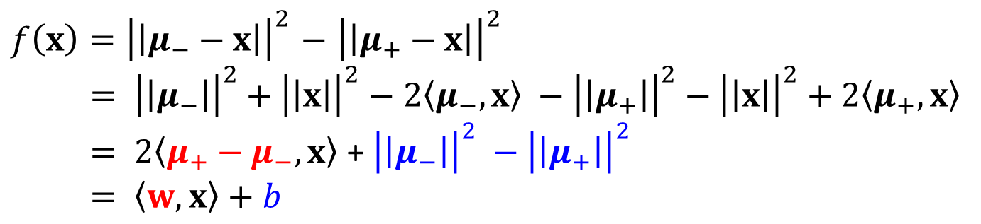
LwP: The Prediction Rule, Mathematically
Let’s expand the prediction rule expression a bit more
Thus LwP with Euclidean distance is equivalent to a linear model with
Weight vector $w=$2($μ_{+}−μ_{−})$
Bias term $b={\left|\left|μ_{−}\right|\right|}^{2} −{\left|\left|μ_{+}\right|\right|}^{2}$
Prediction rule therefore is: Predict +1 if $\left\langle w,x\right\rangle +b$ > 0, else predict -1
$f\left(x\right)={\left|\left|μ_{−}−x\right|\right|}^{2}$ $−$ ${\left|\left|μ_{+}−x\right|\right|}^{2}$
$= {\left|\left|μ_{−}\right|\right|}^{2}+{\left|\left|x\right|\right|}^{2}−2\left\langle μ_{−},x\right\rangle −{\left|\left|μ_{+}\right|\right|}^{2}−{\left|\left|x\right|\right|}^{2}+2\left\langle μ_{+},x\right\rangle$
$= 2\left\langle μ_{+}−μ_{−},x\right\rangle$ + ${\left|\left|μ_{−}\right|\right|}^{2} −{\left|\left|μ_{+}\right|\right|}^{2}$
$= \left\langle w,x\right\rangle +b$
Will look at linear models more formally and in more detail later

Slide 19



LwP: Some Failure Cases
Here is a case where LwP with Euclidean distance may not work well
In general, if classes are not equisized and spherical, LwP with Euclidean distance will usually not work well. Can you think of how to fix this issue?
Can use feature scaling or use Mahalanobis distance to handle such cases (will discuss this in the next lecture)
$$μ_{−}$$
$$μ_{+}$$
Test example $x$

Slide 20
LwP: Some Key Aspects
Very simple, interpretable, and lightweight model
Just requires computing and storing the class prototype vectors
Works with any number of classes (thus for multi-class classification as well)
Can be generalized in various ways to improve it further, e.g.,
Modeling each class by a probability distribution rather than just a prototype vector
Using distances other than the standard Euclidean distance (e.g., Mahalanobis)
With a learned distance function, can work very well even with very few examples from each class (used in some “few-shot learning” models nowadays – if interested, please refer to “Prototypical Networks for Few-shot Learning”)
How well LwP works depends crucially on the way we compute distances

Slide 21
Nearest Neighbors

Slide 22

Nearest Neighbors
Wait. Did you say distances from ALL the training points? That’s gonna be sooooo expensive! ☹
Very simple idea. Simply do the following at test time
Compute distances of the test point from all the training inputs
Sort the distances to find the “nearest” input(s) in training data
Predict the label using majority or avg label of these inputs
Note: Can work with similarities as well instead of distances
Can use Euclidean or other dist (e.g., Mahalanobis). Choice imp just like LwP
Unlike LwP which does prototype based comparison, nearest neighbors method looks at the labels of individual training inputs to make prediction
Applicable to both classifn as well as regression (LwP only works for classifn)
Yes, but let’s not worry about that at the moment. There are ways to speed up this step

Slide 23
Nearest Neighbors for Classification

Slide 24

Nearest Neighbor (or “One” Nearest Neighbor)
Decision boundary
Interesting. Even with Euclidean distances, it can learn nonlinear decision boundaries?
Indeed. And that’s possible since it is a “local” method (looks at a local neighborhood of the test point to make prediction)
Nearest neighbour approach induces a Voronoi tessellation/partition of the input space (all test points falling in a cell will get the label of the training input in that cell)
Test point
Test point

Slide 25



K Nearest Neighbors (KNN)
In many cases, it helps to look at not one but $K$ > 1 nearest neighbors
Essentially, taking more votes helps!
Also leads to smoother decision boundaries (less chances of overfitting on training data)
$K$ = 1
Test input
$K$ = 3
How to pick the “right” K value?
K is this model’s “hyperparameter”. One way to choose it is using “cross-validation” (will see shortly)
Also, K should ideally be an odd number to avoid ties

Slide 26
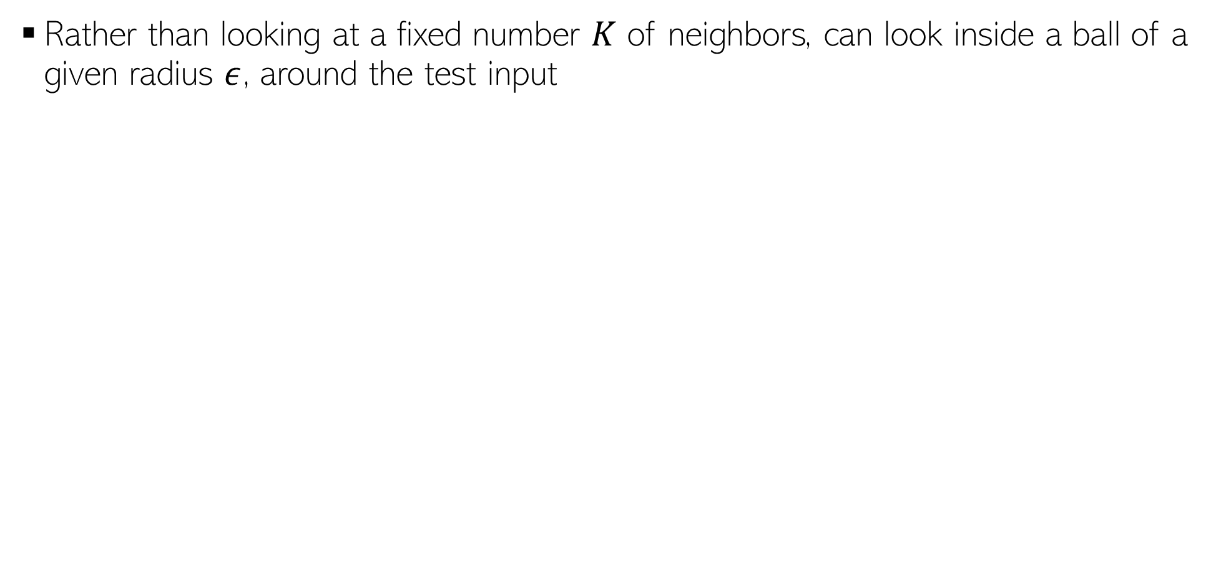
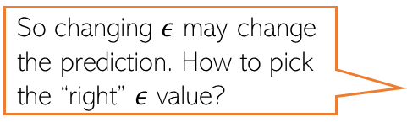
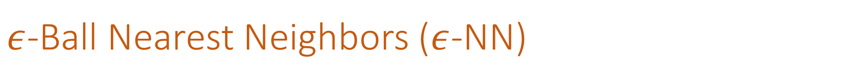
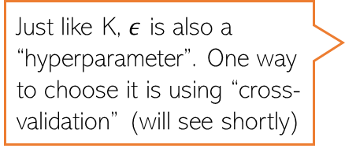
$ε$-Ball Nearest Neighbors ($ε$-NN)
Rather than looking at a fixed number $K$ of neighbors, can look inside a ball of a given radius $ε$, around the test input
So changing $ε$ may change the prediction. How to pick the “right” $ε$ value?
Test input
Just like K, $ε$ is also a “hyperparameter”. One way to choose it is using “cross-validation” (will see shortly)

Slide 27







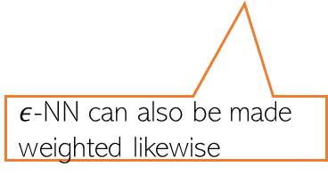
Distance-weighted KNN and $ε$-NN
The standard KNN and 𝜖-NN treat all nearest neighbors equally (all vote equally)
An improvement: When voting, give more importance to closer training inputs
$K$ = 3
Test input
$$\frac{1}{3}$$
+
$$\frac{1}{3}$$
+
$$\frac{1}{3}$$
=
In weighted approach, a single red training input is being given 3 times more importance than the other two green inputs since it is sort of “three times” closer to the test input than the other two green inputs
Unweighted KNN prediction:
$$\frac{3}{5}$$
+
$$\frac{1}{5}$$
+
$$\frac{1}{5}$$
=
Weighted KNN prediction:
$ε$-NN can also be made weighted likewise

Slide 28
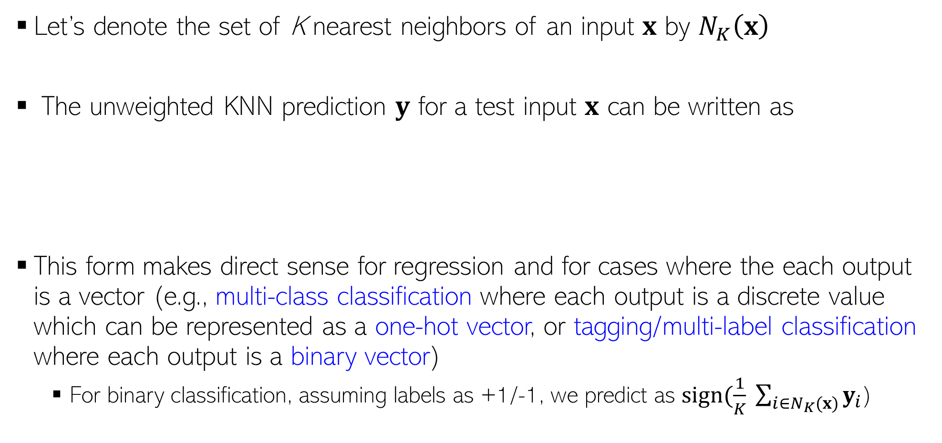

KNN Prediction Rule: The Mathematical Form
Let’s denote the set of K nearest neighbors of an input $x$ by $N_{K}\left(x\right)$
The unweighted KNN prediction $y$ for a test input $x$ can be written as
This form makes direct sense for regression and for cases where the each output is a vector (e.g., multi-class classification where each output is a discrete value which can be represented as a one-hot vector, or tagging/multi-label classification where each output is a binary vector)
For binary classification, assuming labels as +1/-1, we predict as $sign(\frac{1}{K} \sum_{i∈N_{K}(x)}{y_{i}}$)
$$y= \frac{1}{K} \sum_{i∈N_{K}(x)}{y_{i}}$$

Slide 29
Nearest Neighbors: Some Comments
An old, classic but still very widely used algorithm
Can sometimes give deep neural networks a run for their money ☺
Can work very well in practical with the right distance function
Comes with very nice theoretical guarantees
Also called a memory-based or instance-based or non-parametric method
No “model” is learned here (unlike LwP). Prediction step uses all the training data
Requires lots of storage (need to keep all the training data at test time)
Prediction step can be slow at test time
For each test point, need to compute its distance from all the training points
Clever data-structures or data-summarization techniques can provide speed-ups

Slide 30
Speeding-up Nearest Neighbors
Can use techniques to reduce the training set size
Several data summarization techniques exist that discard redundant training inputs
Now we will require fewer number of distance computations for each test input
Can use techniques to reduce the data dimensionality (no. of features)
Won’t reduce no. of distance computations but each distance computation will be faster
Compressing each input into a small binary vector (a type of dim-red)
Distance/similarity computation between bin. vecs is very fast (can even be done in H/W)
Various other techniques as well, e.g.,
Locality Sensitive Hashing (group training inputs into buckets)
Clever data structures (e.g., k-D trees) to organize training inputs
Use a divide-and-conquer type approach to narrow down the search region
We will look at Decision Trees which is also like a divide-and-conquer approach

Slide 31


Hyperparameter Selection
Every ML model has some hyperparameters that need to be tuned, e.g.,
K in KNN or $ε$ in $ε$-NN
Choice of distance to use in LwP or nearest neighbors
Would like to choose h.p. values that would give best performance on test data
Oops, sorry! What to do then?
Okay. So I can try multiple hyperparam values and choose the one that gives the best accuracy on the test data. Simple, isn’t it?
Beware. You are committing a crime. Never Ever touch your test data while building the model
Use cross-validation – use a part of your training data (we will call it “validation/held-out set”) to select best hyperparam values.
Is validation set a good proxy to test set?
Usually yes since training set (from which the val set is taken) and test sets are assumed to have similar distribution)

Slide 32
Cross-Validation
No peeking while building the model
Training Set (assuming bin. class. problem)
Test Set
Note: Not just h.p. selection; we can also use CV to pick the best ML model from a set of different ML models (e.g., say we have to pick between two models we may have trained - LwP and nearest neighbors. Can use CV to choose the better one.
Class 1
Class 2
Actual Training Set
Randomly Split
Validation Set
Randomly split the original training data into actual training set and validation set. Using the actual training set, train several times, each time using a different value of the hyperparam. Pick the hyperparam value that gives best accuracy on the validation set
What if the random split is unlucky (i.e., validation data is not like test data)?
If you fear an unlucky split, try multiple splits. Pick the hyperparam value that gives the best average CV accuracy across all such splits. If you are using N splits, this is called N–fold cross validation

