Slide 1
Nearest Neighbors (contd) and Decision Trees
CS771: Introduction to Machine Learning

Slide 2
Announcement
Quiz 1 date shifted to Aug 20
Timing will be 7:00pm – 8:00pm
Venue is likely to be L7, L18, L20
More details to be shared soon

Slide 3
Nearest Neighbors

Slide 4


Nearest Neighbors
Wait. Did you say distances from ALL the training points? That’s gonna be sooooo expensive! ☹
Very simple idea for sup. learning. Simply do the following at test time
Compute distances of the test input from all the training inputs
Sort the distances to find the “nearest” input(s) in training data
Predict the label using majority or avg label of these inputs
Note: Can work with similarities as well instead of distances
Can use Euclidean or other dist (e.g., Mahalanobis). Choice imp just like LwP
Unlike LwP which does prototype based comparison, nearest neighbors method looks at the labels of individual training inputs to make prediction
Applicable to both classifn as well as regression (LwP only works for classifn)
Yes, but let’s not worry about that at the moment. There are ways to speed up this step

Slide 5
Nearest Neighbors for Classification

Slide 6

Nearest Neighbor (or “One” Nearest Neighbor)
Decision boundary
Interesting. Even with Euclidean distances, it can learn nonlinear decision boundaries?
Indeed. And that’s possible since it is a “local” method (looks at a local neighborhood of the test point to make prediction)
Nearest neighbour approach induces a Voronoi tessellation/partition of the input space (all test points falling in a cell will get the label of the training input in that cell)
Test point
Test point

Slide 7



K Nearest Neighbors (KNN)
In many cases, it helps to look at not one but $K$ > 1 nearest neighbors
Essentially, taking more votes helps!
Also leads to smoother decision boundaries (less chances of overfitting on training data)
$K$ = 1
Test input
$K$ = 3
How to pick the “right” K value?
K is this model’s “hyperparameter”. One way to choose it is using “cross-validation” (will see shortly)
Also, K should ideally be an odd number to avoid ties

Slide 8
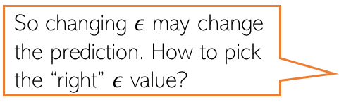
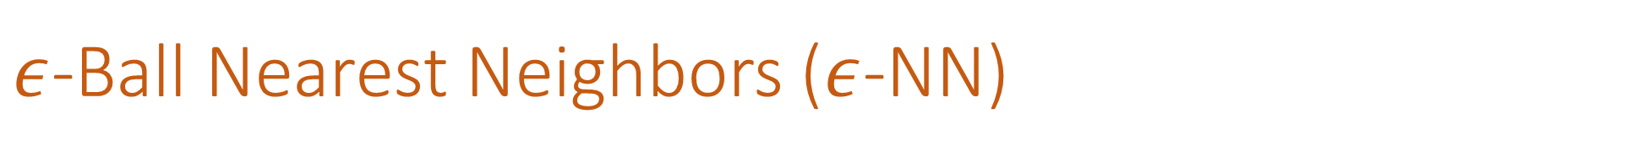

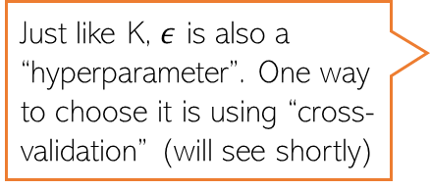
$ε$-Ball Nearest Neighbors ($ε$-NN)
Rather than looking at a fixed number $K$ of neighbors, can look inside a ball of a given radius $ε$, around the test input
So changing $ε$ may change the prediction. How to pick the “right” $ε$ value?
Test input
Just like K, $ε$ is also a “hyperparameter”. One way to choose it is using “cross-validation” (will see shortly)

Slide 9







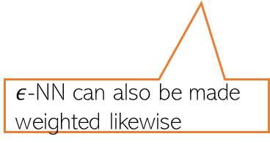
Distance-weighted KNN and $ε$-NN
The standard KNN and 𝜖-NN treat all nearest neighbors equally (all vote equally)
An improvement: When voting, give more importance to closer training inputs
$K$ = 3
Test input
$$\frac{1}{3}$$
+
$$\frac{1}{3}$$
+
$$\frac{1}{3}$$
=
In weighted approach, a single red training input is being given 3 times more importance than the other two green inputs since it is sort of “three times” closer to the test input than the other two green inputs
Unweighted KNN prediction:
$$\frac{3}{5}$$
+
$$\frac{1}{5}$$
+
$$\frac{1}{5}$$
=
Weighted KNN prediction:
$ε$-NN can also be made weighted likewise

Slide 10
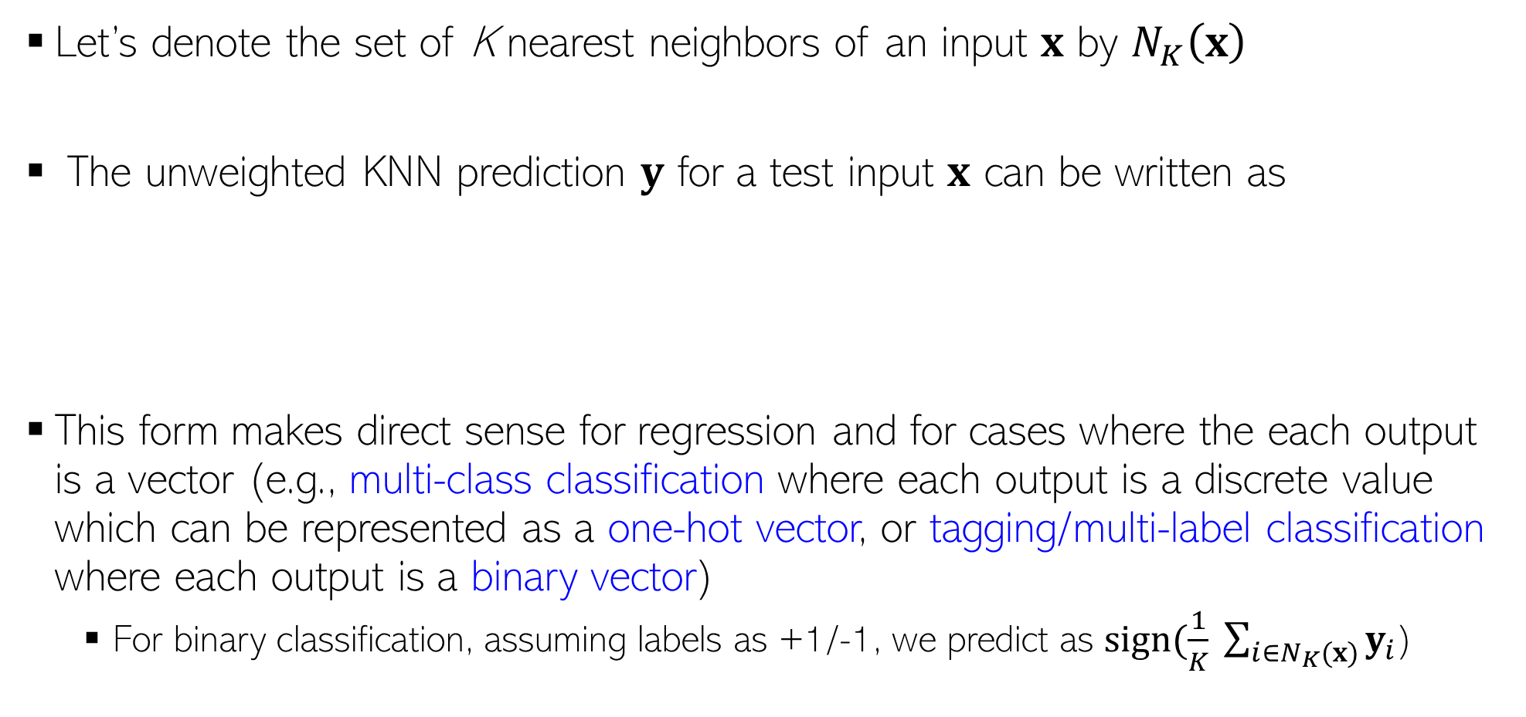

KNN Prediction Rule: The Mathematical Form
Let’s denote the set of K nearest neighbors of an input $x$ by $N_{K}\left(x\right)$
The unweighted KNN prediction $y$ for a test input $x$ can be written as
This form makes direct sense for regression and for cases where the each output is a vector (e.g., multi-class classification where each output is a discrete value which can be represented as a one-hot vector, or tagging/multi-label classification where each output is a binary vector)
For binary classification, assuming labels as +1/-1, we predict as $sign(\frac{1}{K} \sum_{i∈N_{K}(x)}{y_{i}}$)
$$y= \frac{1}{K} \sum_{i∈N_{K}(x)}{y_{i}}$$

Slide 11
Nearest Neighbors: Some Comments
An old, classic but still very widely used algorithm
Can sometimes give deep neural networks a run for their money ☺
Can work very well in practical with the right distance function
Comes with very nice theoretical guarantees
Also called a memory-based or instance-based or non-parametric method
No “model” is learned here (unlike LwP). Prediction step uses all the training data
Requires lots of storage (need to keep all the training data at test time)
Prediction step can be slow at test time
For each test point, need to compute its distance from all the training points
Clever data-structures or data-summarization techniques can provide speed-ups

Slide 12
Speeding-up Nearest Neighbors
Can use techniques to reduce the training set size
Several data summarization techniques exist that discard redundant training inputs
Now we will require fewer number of distance computations for each test input
Can use techniques to reduce the data dimensionality (no. of features)
Won’t reduce no. of distance computations but each distance computation will be faster
Compressing each input into a small binary vector (a type of dim-red)
Distance/similarity computation between bin. vecs is very fast (can even be done in H/W)
Various other techniques as well, e.g.,
Locality Sensitive Hashing (group training inputs into buckets)
Clever data structures (e.g., k-D trees) to organize training inputs
Use a divide-and-conquer type approach to narrow down the search region
We will look at Decision Trees which is also like a divide-and-conquer approach

Slide 13


Hyperparameter Selection
Every ML model has some hyperparameters that need to be tuned, e.g.,
K in KNN or $ε$ in $ε$-NN
Choice of distance to use in LwP or nearest neighbors
Would like to choose h.p. values that would give best performance on test data
Oops, sorry! What to do then?
Okay. So I can try multiple hyperparam values and choose the one that gives the best accuracy on the test data. Simple, isn’t it?
Beware. You are committing a crime. Never Ever touch your test data while building the model
Use cross-validation – use a part of your training data (we will call it “validation/held-out set”) to select best hyperparam values.
Is validation set a good proxy to test set?
Usually yes since training set (from which the val set is taken) and test sets are assumed to have similar distribution)

Slide 14
Cross-Validation
No peeking while building the model
Training Set (assuming bin. class. problem)
Test Set
Note: Not just h.p. selection; we can also use CV to pick the best ML model from a set of different ML models (e.g., say we have to pick between two models we may have trained - LwP and nearest neighbors. Can use CV to choose the better one.
Class 1
Class 2
Actual Training Set
Randomly Split
Validation Set
Randomly split the original training data into actual training set and validation set. Using the actual training set, train several times, each time using a different value of the hyperparam. Pick the hyperparam value that gives best accuracy on the validation set
What if the random split is unlucky (i.e., validation data is not like test data)?
If you fear an unlucky split, try multiple splits. Pick the hyperparam value that gives the best average CV accuracy across all such splits. If you are using N splits, this is called N–fold cross validation

Slide 15
Decision Trees

Slide 16
Decision Trees
A Decision Tree (DT) defines a hierarchy of rules to make a prediction
Root and internal nodes test rules. Leaf nodes make predictions
DT learning is about learning such a tree from labeled training data
Root Node
Body
temp.
Warm
Cold
Non-mammal
An Internal Node
A Leaf Node
Gives
birth
Yes
No
Mammal
Non-mammal

Slide 17
Decision Tree Learning: The Basic Idea
Recursively partition training data till you get (roughly) homogeneous regions
Some typical prediction rules for each region
Use a constant label (e.g., majority) if region fully/almost homogeneous
Learn another prediction model(e.g., LwP) if region not fully homogeneous
Test time: Given a test input, first locate its region. Then use the prediction rule of that region to predict its label
What do you mean by “homogeneous” regions?
Within each region, we can even use a very sophisticated model (like a deep neural network) but we usually prefer a simple rule (constant label, or maybe use a simple ML model like LwP) so that training and test phases are fast
A homogeneous region will have all (or most of) the training inputs with the same outputs/labels

Slide 18



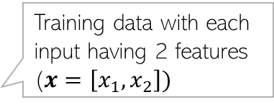


Decision Tree for Classification: An Example
Training data with each input having 2 features ($x=\left[x_{1},x_{2}\right])$
5
NO
YES
Test input
$$x_{1}>3.5 ?$$
4
NO
YES
NO
YES
3
$$x_{2}>2 ?$$
$$x_{2}>3 ?$$
Feature 2 ($x_{2})$
2
Predict Red
Predict Green
Predict Green
Predict Red
1
1
2
3
4
5
6
Feature 1 ($x_{1})$
Remember: Root node contains all training inputs. Internal/leaf nodes receive a subset of training inputs
DT is very efficient at test time: To predict the label of a test point, nearest neighbors will require computing distances from 48 training inputs. DT predicts the label by doing just 2 feature-value comparisons! Way more fast!!!

Slide 19
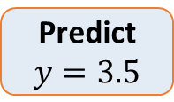


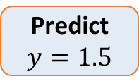

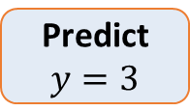

Decision Tree for Regression: An Example
Can use any regression model but would like a simple one, so let’s use a constant prediction based regression model
Another simple option can be to predict the average output of the training inputs in this region
4
3
2
1
NO
YES
$$x>4 ?$$
$$y$$
NO
YES
Predict $y=3.5$
$$x>3 ?$$
Predict $y=3$
Predict $y=1.5$
1 2 3 4 5
$$x$$
To predict the output for a test point, nearest neighbors will require computing distances from 15 training inputs. DT predicts the label by doing just at most 2 feature-value comparisons! Way more fast!!!

Slide 20


Constructing a Decision Tree
Given some training data, what’s the “optimal” DT?
5
How to decide which rules to test for and in what order?
NO
YES
$$x_{1}>3.5 ?$$
4
NO
YES
NO
YES
How to assess informativeness of a rule?
3
$$x_{2}>2 ?$$
$$x_{2}>3 ?$$
Feature 2 ($x_{2})$
2
Predict Red
Predict Green
Predict Green
Predict Red
1
In general, constructing DT is an intractable problem (NP-hard)
1
2
3
4
5
6
Feature 1 ($x_{1})$
The rules are organized in the DT such that most informative rules are tested first
Often we can use some “greedy” heuristics to construct a “good” DT
Hmm.. So DTs are like the “20 questions” game (ask the most useful questions first)
To do so, we use the training data to figure out which rules should be tested at each node
Informativeness of a rule is of related to the extent of the purity of the split arising due to that rule. More informative rules yield more pure splits
The same rules will be applied on the test inputs to route them along the tree until they reach some leaf node where the prediction is made

Slide 21
Decision Trees: Some Considerations
Usually, cross-validation can be used to decide size/shape
What should be the size/shape of the DT?
Number of internal and leaf nodes
Branching factor of internal nodes
Depth of the tree
Split criterion at root/int. nodes
Use another classifier?
Or maybe by doing a simpler test?
What to do at the leaf node? Some options:
Make a constant prediction for each test input reaching there
Use a nearest neighbor based prediction using training inputs at that leaf node
Train and predict using some other sophisticated supervised learner on that node
Root and internal nodes of DT split the training data (can think of them as a “classifier”)
Usually, constant prediction at leaf nodes used since it will be very fast

Slide 22
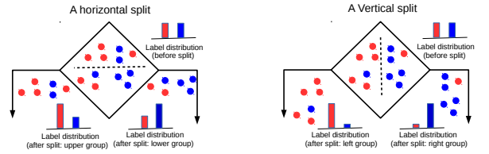
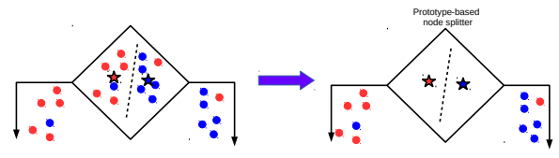
Techniques to Split at Internal Nodes?
22
This decision/split can be done using various ways, e.g.,
Testing the value of a single feature at a time (such internal node called “Decision Stump”)
Testing the value of a combination of features (maybe 2-3 features)
Learning a classifier (e.g., LwP or some more sophisticated classifier)
With this approach, all features (2 real-valued features in this example) and all possible values of each feature need to be evaluated in selecting the feature to be tested at each internal node. If features binary/discrete (only finite possible values), it is reasonably easy
DT methods based on testing a single feature at each internal node are faster and more popular (e.g., ID3, C4.5 algos)
DT methods based on learning and using a separate classifier at each internal node are less common. But this approach can be very powerful and sometimes used in some advanced DT methods

Slide 23
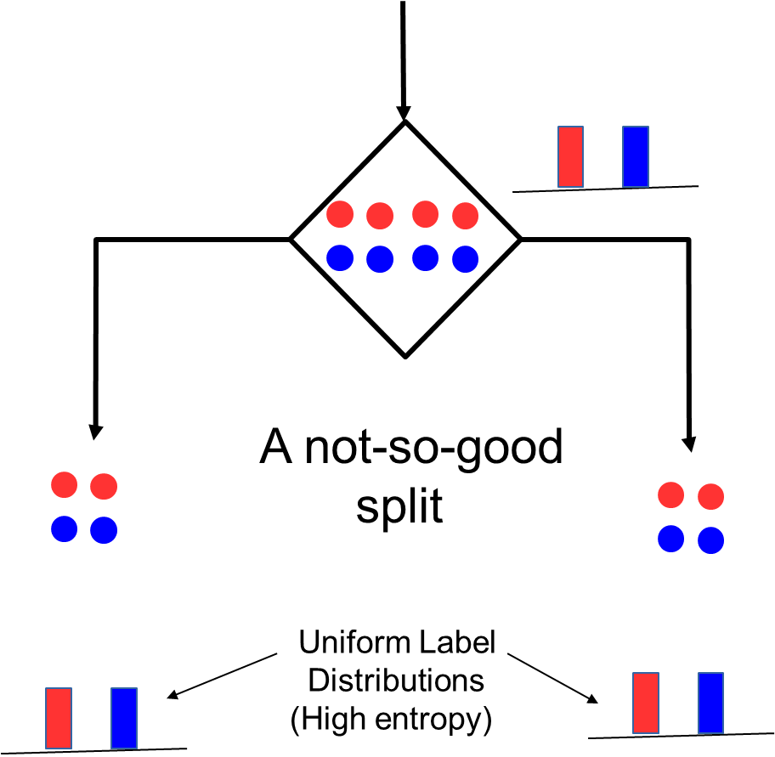
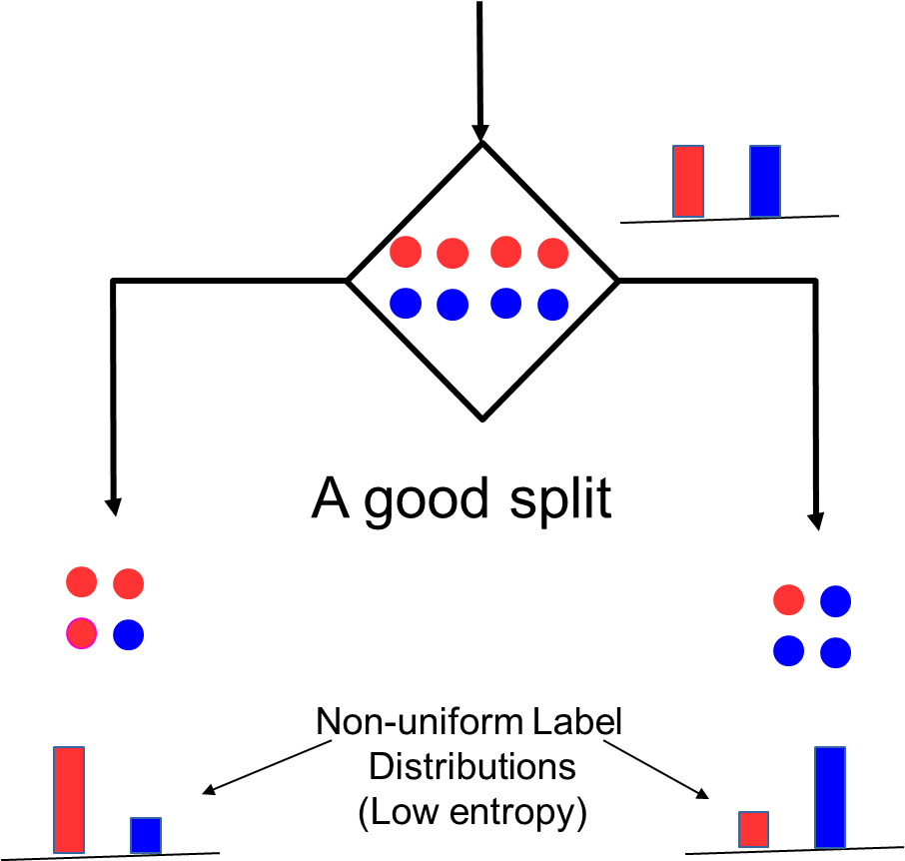
Internal Nodes: Good vs Bad Splits
23
Recall that each internal node receives a subset of all the training inputs
Regardless of the criterion, the split should result in as “pure” groups as possible
Meaning: After split, in each group, majority of the inputs have the same label/output
For classification problems (discrete outputs), entropy is a measure of purity
Low entropy ⇒ high purity (less uniform label distribution)
Splits that give the largest reduction (before split vs after split) in entropy are preferred (this reduction is also known as “information gain”)

Slide 24
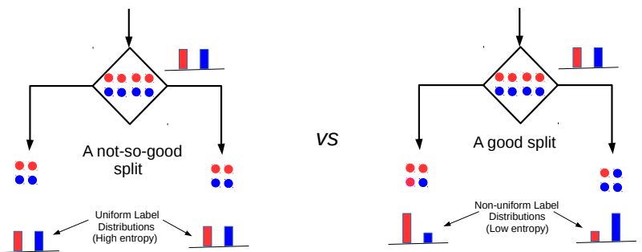


Entropy and Information Gain
24
Assume a set of labelled inputs $S$ from C classes, $p_{c}$ as fraction of class c inputs
Entropy of the set $S$ is defined as $H(S)=−\sum_{c∈C}{p_{c} log p_{c}}$
Suppose a rule splits $S$ into two smaller disjoint sets $S_{1}$ and $S_{2}$
Reduction in entropy after the split is called information gain
Uniform sets (all classes roughly equally present) have high entropy; skewed sets low
$IG=H\left(S\right)− \frac{\left|S_{1}\right|}{\left|S\right|}H\left(S_{1}\right)$ $− \frac{\left|S_{2}\right|}{\left|S\right|}H\left(S_{2}\right)$
This split has a low IG
(in fact zero IG)
This split has higher IG

Slide 25
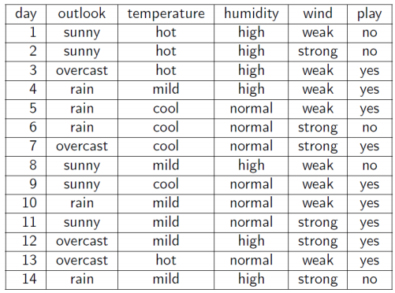
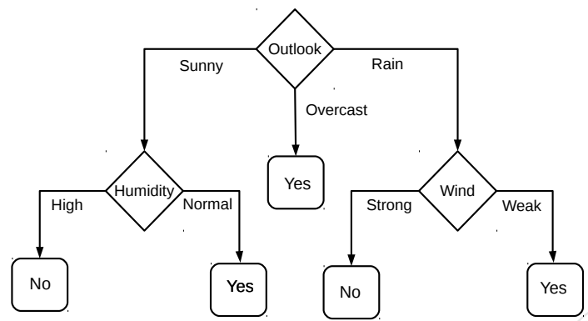
Decision Tree for Classification: Another Example
Deciding whether to play or not to play Tennis on a Saturday
Each input (Saturday) has 4 categorical features: Outlook, Temp., Humidity, Wind
A binary classification problem (play vs no-play)
Below Left: Training data, Below Right: A decision tree constructed using this data
Why did we test outlook feature’s value first?
Because outlook feature is the most informative (has highest IG) at the root node position
Example credit: Tom Mitchell

Slide 26
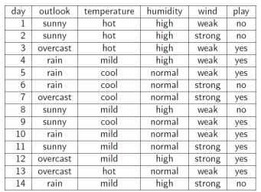
Entropy and Information Gain
26
Let’s use IG based criterion to construct a DT for the Tennis example
At root node, let’s compute IG of each of the 4 features
Consider feature “wind”. Root contains all examples S = [9+,5-]
S_{weak} = [6+, 2−] ⇒ H(S_{weak} ) = 0.811
S_{strong} = [3+, 3−] ⇒ H(S_{strong}) = 1
Likewise, at root: IG(S, outlook) = 0.246, IG(S, humidity) = 0.151, IG(S,temp) = 0.029
Thus we choose “outlook” feature to be tested at the root node
Now how to grow the DT, i.e., what to do at the next level? Which feature to test next?
Rule: Iterate - for each child node, select the feature with the highest IG
$$\text{H}\text{(}\text{S} \text{) =}\text{ −(9/14) }\text{log}\text{2}\text{(9/14) − (5/14) }\text{lo}\text{g}\text{2}\text{(5/14) = 0.94}$$
$IG(S,wind)=H\left(S\right)− \frac{\left|S_{weak}\right|}{\left|S\right|}H\left(S_{weak}\right)$ $− \frac{\left|S_{strong}\right|}{\left|S\right|}H\left(S_{strong}\right)$ = 0.94 − 8/14 ∗ 0.811 − 6/14 ∗ 1 = 0.048

Slide 27
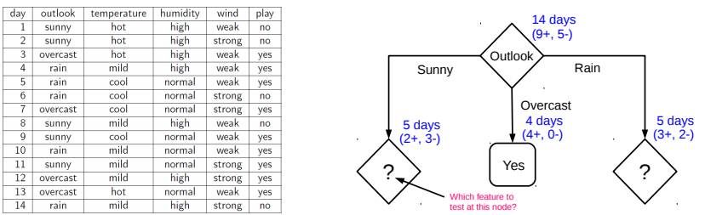
Growing the tree
27
Proceeding as before, for level 2, left node, we can verify that
IG(S,temp) = 0.570, IG(S, humidity) = 0.970, IG(S, wind) = 0.019
Thus humidity chosen as the feature to be tested at level 2, left node
No need to expand the middle node (already “pure” - all “yes” training examples ☺)
Can also verify that wind has the largest IG for the right node
Note: If a feature has already been tested along a path earlier, we don’t consider it again

Slide 28
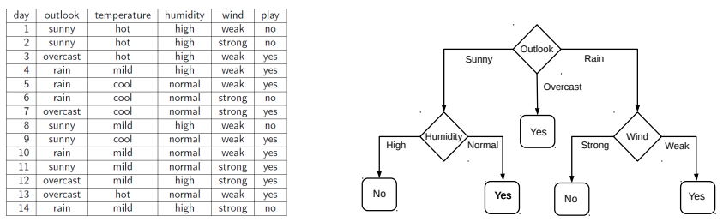
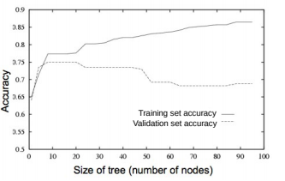
When to stop growing the tree?
28
Stop expanding a node further (i.e., make it a leaf node) when
It consist of all training examples having the same label (the node becomes “pure”)
We run out of features to test along the path to that node
The DT starts to overfit (can be checked by monitoring
the validation set accuracy)
Important: No need to obsess with too much for purity
It is okay to have a leaf node that is not fully pure, e.g., this
At test inputs that reach an impure leaf, can predict probability of belonging to each class (in above example, p(red) = 3/8, p(green) = 5/8), or simply predict the majority label
To help prevent the tree from growing too much!
OR

Slide 29
Avoiding Overfitting in DTs
29
Desired: a DT that is not too big in size, yet fits the training data reasonably
Note: An example of a very simple DT is “decision-stump”
A decision-stump only tests the value of a single feature (or a simple rule)
Not very powerful in itself but often used in large ensembles of decision stumps
Mainly two approaches to prune a complex DT
Prune while building the tree (stopping early)
Prune after building the tree (post-pruning)
Criteria for judging which nodes could potentially be pruned
Use a validation set (separate from the training set)
Prune each possible node that doesn’t hurt the accuracy on the validation set
Greedily remove the node that improves the validation accuracy the most
Stop when the validation set accuracy starts worsening
Use model complexity control, such as Minimum Description Length (will see later)
Either can be done using a validation set

Slide 30
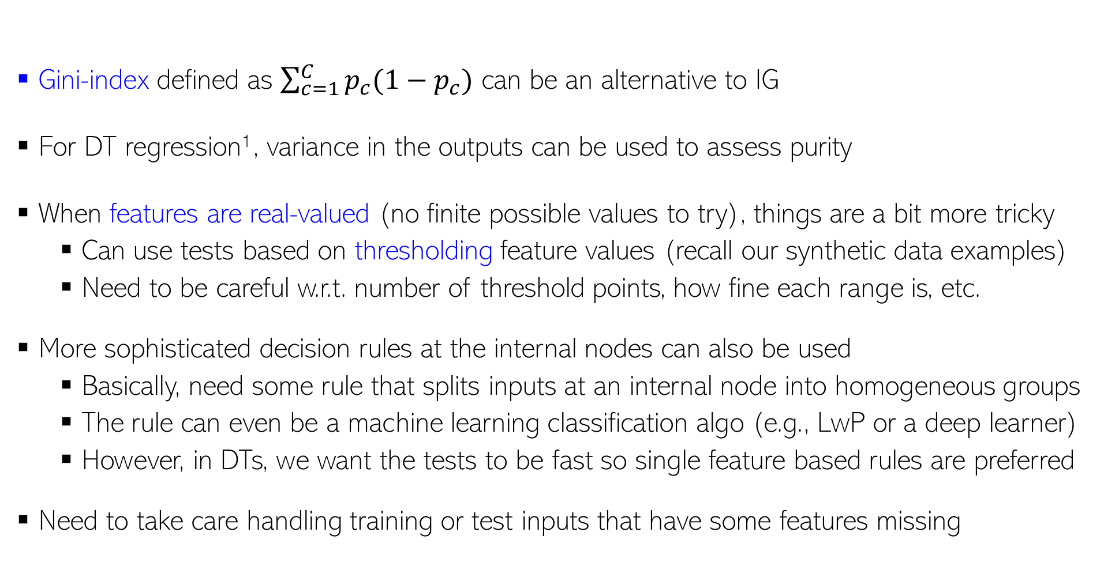
Decision Trees: Some Comments
For regression, outputs are real-valued and we don’t have a “set” of classes, so quantities like entropy/IG/gini etc. are undefined
30
Gini-index defined as $\sum_{c=1}^{C}{p_{c}(1−p_{c})}$ can be an alternative to IG
For DT regression¹, variance in the outputs can be used to assess purity
When features are real-valued (no finite possible values to try), things are a bit more tricky
Can use tests based on thresholding feature values (recall our synthetic data examples)
Need to be careful w.r.t. number of threshold points, how fine each range is, etc.
More sophisticated decision rules at the internal nodes can also be used
Basically, need some rule that splits inputs at an internal node into homogeneous groups
The rule can even be a machine learning classification algo (e.g., LwP or a deep learner)
However, in DTs, we want the tests to be fast so single feature based rules are preferred
Need to take care handling training or test inputs that have some features missing
¹Breiman, Leo; Friedman, J. H.; Olshen, R. A.; Stone, C. J. (1984). Classification and regression trees

Slide 31
Ensemble of Trees
31
All trees can be trained in parallel
Ensemble is a collection of models
Each model makes a prediction. Take their majority as the final prediction
Ensemble of trees is a collection of simple DTs
Often preferred as compared to a single massive, complicated tree
A popular example: Random Forest (RF)
XGBoost is another popular ensemble of trees
Based on the idea of “boosting” (will study boosting later) simple trees
Sequentially trains a set of trees with each correcting errors of previous ones
Each tree is trained on a subset of the training inputs/features
An RF with 3 simple trees. The majority prediction will be the final prediction

Slide 32
Decision Trees: A Summary
32
.. thus helping us learn complex rule as a combination of several simpler rules
Some key strengths:
Simple and easy to interpret
Nice example of “divide and conquer”
paradigm in machine learning
Easily handle different types of
features (real, categorical, etc.)
Very fast at test time
Multiple simple DTs can be combined
via ensemble methods: more powerful
Used in several real-world ML applications, e.g., recommender systems, gaming (Kinect)
Some key weaknesses:
Learning optimal DT is (NP-hard) intractable. Existing algos mostly greedy heuristics
Can sometimes become very complex unless some pruning is applied
5
NO
YES
$$x_{1}>3.5 ?$$
4
NO
YES
NO
YES
3
$$x_{2}>2 ?$$
$$x_{2}>3 ?$$
Feature 2 ($x_{2})$
2
Predict Red
Predict Green
Predict Green
Predict Red
1
Human-body pose estimation
1
2
3
4
5
6
Feature 1 ($x_{1})$

