Slide 1
Decision Trees (contd), and Learning as Function Approximation
CS771: Introduction to Machine Learning

Slide 2
Plan today
Wrap-up decision trees
Learning as (optimal) function approximation

Slide 3


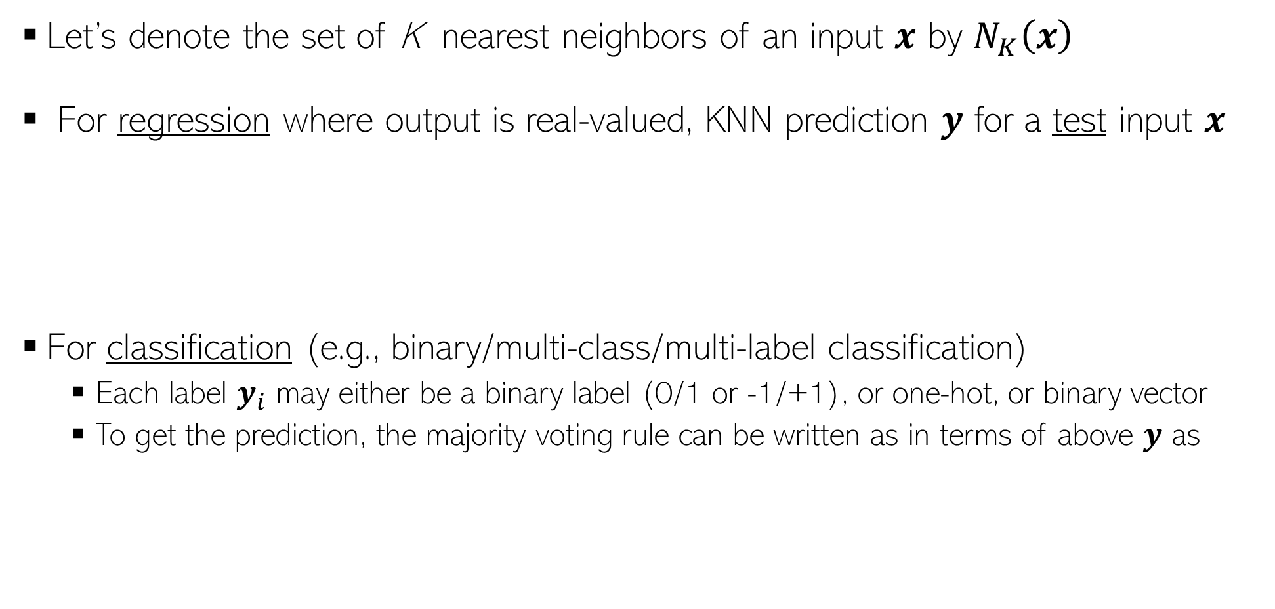




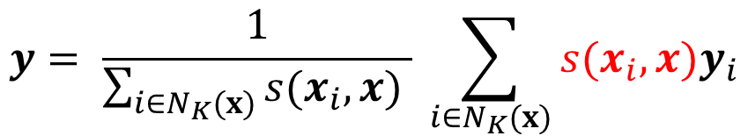



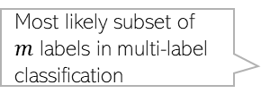
Recap: KNN Prediction Rule
Let’s denote the set of K nearest neighbors of an input $x$ by $N_{K}\left(x\right)$
For regression where output is real-valued, KNN prediction $y$ for a test input $x$
For classification (e.g., binary/multi-class/multi-label classification)
Each label $y_{i}$ may either be a binary label (0/1 or -1/+1), or one-hot, or binary vector
To get the prediction, the majority voting rule can be written as in terms of above $y$ as
More similar neighbors given more importance
Computing using some appropriate similarity function
All neighbors given equal importance in averaging of labels
$$y= \frac{1}{K} \sum_{i∈N_{K}(x)}{y_{i}}$$
$$y= \frac{1}{\sum_{i∈N_{K}(x)}{s(x_{i},x) }} \sum_{i∈N_{K}(x)}{s(x_{i},x)y_{i}}$$
If each $y_{i}$ is 0/1
Most likely class in multi-class classification
$$\hat{y}= argmax(y)$$
If each $y_{i}$ is a one-hot vector
$$\hat{y}=𝕀[y≥0.5]$$
Most likely subset of $m$ labels in multi-label classification
If each $y_{i}$ is binary vector
$$\hat{y}=sign[y]$$
If each $y_{i}$ is -1/+1
$$\hat{y}=top_m_indices (y)$$

Slide 4
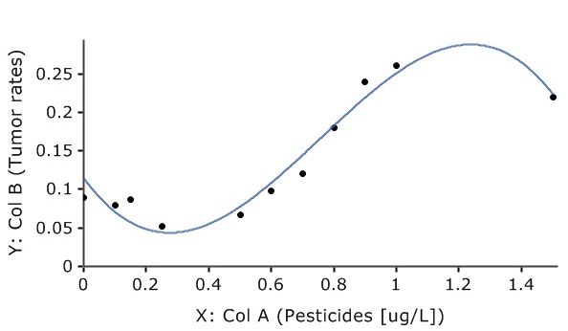
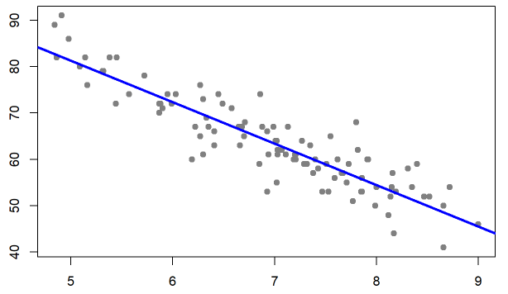
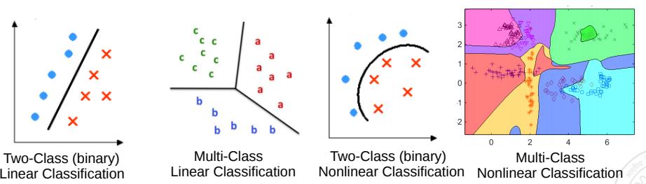
Remember: ML Problems can be viewed Geometrically
Inputs can often be represented as points or vectors in some vector space
Doing ML on such data can thus be seen from a geometric view
Regression: A supervised learning problem. Goal is to model the relationship between input (x) and real-valued output (y). This is akin to a line or curve fitting problem
y: Grumpiness (scale of 0-100)
x: sleep hours
Classification: A supervised learning problem. Goal is to learn a to predict which of the two or more classes an input belongs to. Akin to learning linear/nonlinear separator for the inputs
Pic from: https://learningstatisticswithr.com/book/regression.html, https://maxstat.de/

Slide 5
Decision Trees

Slide 6
Decision Trees
A Decision Tree (DT) defines a hierarchy of rules to make a prediction
Root and internal nodes test rules. Leaf nodes make predictions
DT learning is about learning such a tree from labeled training data
Root Node
Body
temp.
Warm
Cold
Non-mammal
An Internal Node
A Leaf Node
Gives
birth
Yes
No
Mammal
Non-mammal

Slide 7


Decision Tree Learning: The Basic Idea
Recursively partition training data till you get (roughly) homogeneous regions
Some typical prediction rules for each region
Use a constant label (e.g., majority) if region fully/almost homogeneous
Learn another prediction model(e.g., LwP) if region not fully homogeneous
We will use training data to learn a DT that defines the partitioning
What do you mean by “homogeneous” regions?
Test time: Given a test input, first locate its region using DT. Then use the prediction rule of that region to predict its label
A homogeneous region will have all (or most of) the training inputs with the same outputs/labels
Within each region, we can even use a very sophisticated model (like a deep neural network) but we usually prefer a simple rule (constant label, or maybe use a simple ML model like LwP) so that training and test phases are fast

Slide 8



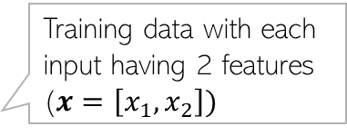


Decision Tree for Classification: An Example
Training data with each input having 2 features ($x=\left[x_{1},x_{2}\right])$
5
NO
YES
Test input
$$x_{1}>3.5 ?$$
4
NO
YES
NO
YES
3
$$x_{2}>2 ?$$
$$x_{2}>3 ?$$
Feature 2 ($x_{2})$
2
Predict Red
Predict Green
Predict Green
Predict Red
1
1
2
3
4
5
6
Feature 1 ($x_{1})$
Remember: Root node contains all training inputs. Internal/leaf nodes receive a subset of training inputs
DT is very efficient at test time: To predict the label of a test point, nearest neighbors will require computing distances from 48 training inputs. DT predicts the label by doing just 2 feature-value comparisons! Way more fast!!!

Slide 9
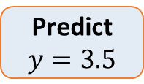


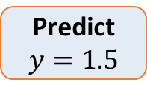

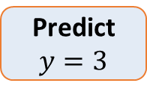

Decision Tree for Regression: An Example
Can use any regression model but would like a simple one, so let’s use a constant prediction based regression model
Another simple option can be to predict the average output of the training inputs in this region
4
3
2
1
NO
YES
$$x>4 ?$$
$$y$$
NO
YES
Predict $y=3.5$
$$x>3 ?$$
Predict $y=3$
Predict $y=1.5$
1 2 3 4 5
$$x$$
To predict the output for a test point, nearest neighbors will require computing distances from 15 training inputs. DT predicts the label by doing just at most 2 feature-value comparisons! Way more fast!!!

Slide 10



Constructing a Decision Tree
Given some training data, what’s the “optimal” DT?
5
How to decide which rules to test for and in what order?
NO
YES
$$x_{1}>3.5 ?$$
4
NO
YES
NO
YES
How to assess informativeness of a rule?
3
$$x_{2}>2 ?$$
$$x_{2}>3 ?$$
Feature 2 ($x_{2})$
2
Predict Red
Predict Green
Predict Green
Predict Red
1
In general, constructing DT is an intractable problem (NP-hard)
1
2
3
4
5
6
Feature 1 ($x_{1})$
The rules are organized in the DT such that most informative rules are tested first
Often we can use some “greedy” heuristics to construct a “good” DT
Hmm.. So DTs are like the “20 questions” game (ask the most useful questions first)
To do so, we use the training data to figure out which rules should be tested at each node
Informativeness of a rule is related to the extent of the purity of the split arising due to that rule. More informative rules yield more pure splits
The same rules will be applied on the test inputs to route them along the tree until they reach some leaf node where the prediction is made

Slide 11
Decision Trees: Some Considerations
Usually, cross-validation can be used to decide size/shape
What should be the size/shape of the DT?
Number of internal and leaf nodes
Branching factor of internal nodes
Depth of the tree
Split criterion at root/int. nodes
Use another classifier?
Or maybe by doing a simpler test?
What to do at the leaf node? Some options:
Make a constant prediction for each test input reaching there
Use a nearest neighbor based prediction using training inputs at that leaf node
Train and predict using some other sophisticated supervised learner on that node
Root and internal nodes of DT split the training data (can think of them as a “classifier”)
Usually, constant prediction at leaf nodes used since it will be very fast

Slide 12
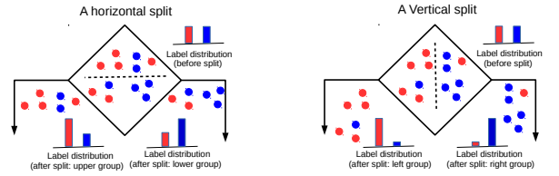
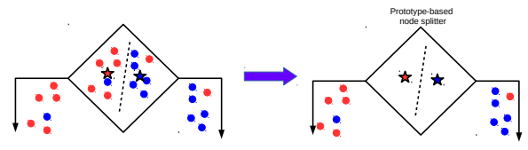
Techniques to Split at Internal Nodes?
12
This decision/split can be done using various ways, e.g.,
Testing the value of a single feature at a time (such internal node called “Decision Stump”)
Testing the value of a combination of features (maybe 2-3 features)
Learning a classifier (e.g., LwP or some more sophisticated classifier)
With this approach, all features (2 real-valued features in this example) and all possible values of each feature need to be evaluated in selecting the feature to be tested at each internal node. If features binary/discrete (only finite possible values), it is reasonably easy
DT methods based on testing a single feature at each internal node are faster and more popular (e.g., ID3, C4.5 algos)
DT methods based on learning and using a separate classifier at each internal node are less common. But this approach can be very powerful and sometimes used in some advanced DT methods

Slide 13
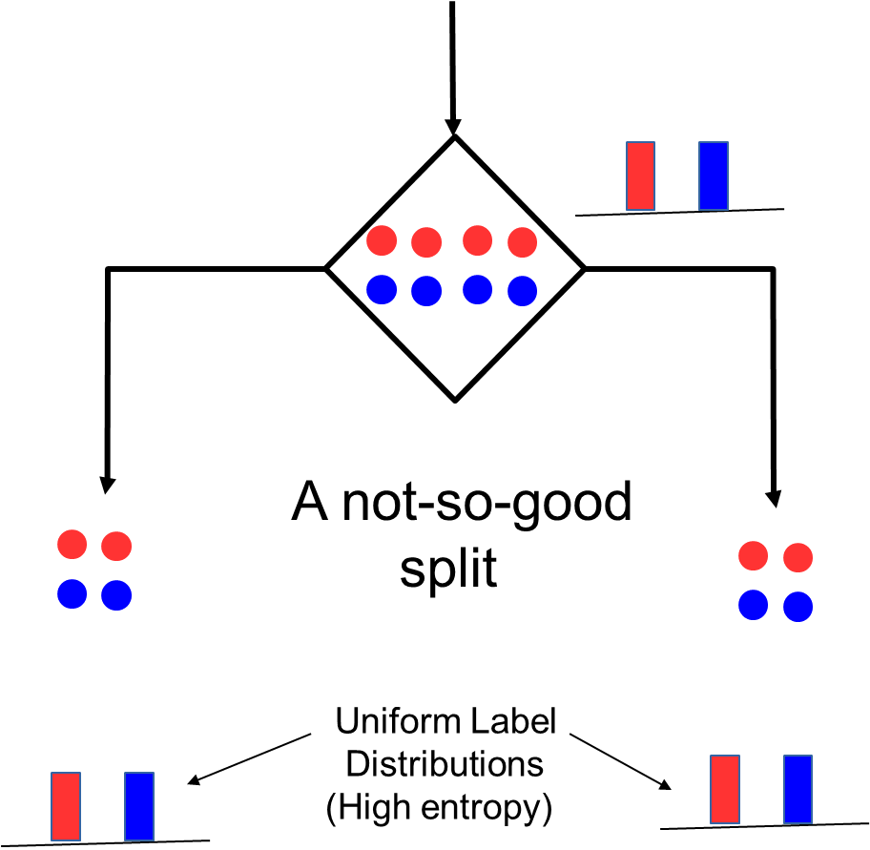
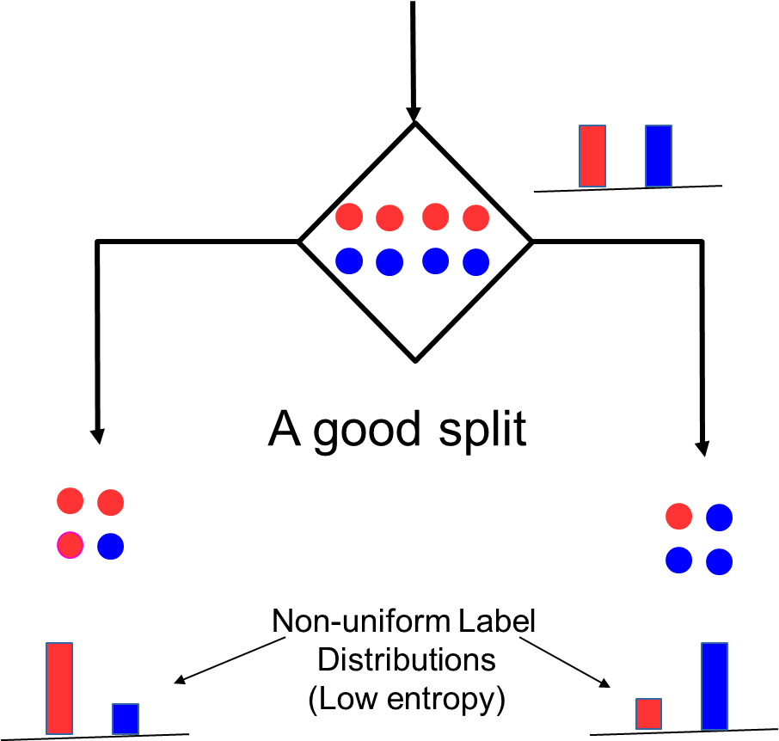
Internal Nodes: Good vs Bad Splits
13
Recall that each internal node receives a subset of all the training inputs
Regardless of the criterion, the split should result in as “pure” groups as possible
Meaning: After split, in each group, majority of the inputs have the same label/output
For classification problems (discrete outputs), entropy is a measure of purity
Low entropy ⇒ high purity (less uniform label distribution)
Splits that give the largest reduction (before split vs after split) in entropy are preferred (this reduction is also known as “information gain”)

Slide 14
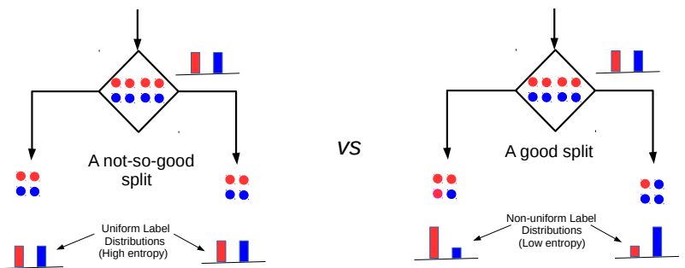


Entropy and Information Gain
14
Assume a set of labelled inputs $S$ from C classes, $p_{c}$ as fraction of class c inputs
Entropy of the set $S$ is defined as $H(S)=−\sum_{c∈C}{p_{c} log p_{c}}$
Suppose a rule splits $S$ into two smaller disjoint sets $S_{1}$ and $S_{2}$
Reduction in entropy after the split is called information gain
Uniform sets (all classes roughly equally present) have high entropy; skewed sets low
$IG=H\left(S\right)− \frac{\left|S_{1}\right|}{\left|S\right|}H\left(S_{1}\right)$ $− \frac{\left|S_{2}\right|}{\left|S\right|}H\left(S_{2}\right)$
This split has a low IG
(in fact zero IG)
This split has higher IG

Slide 15
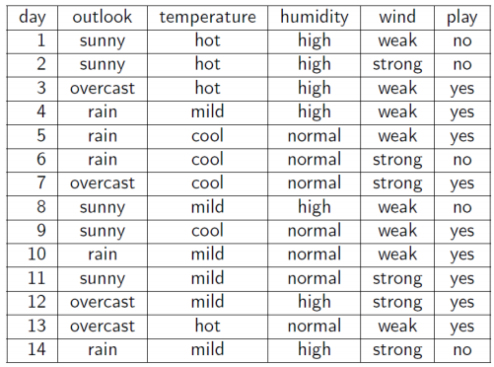
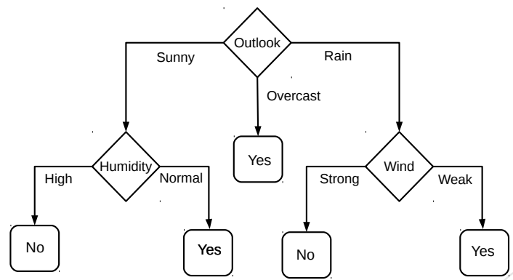
Decision Tree for Classification: Another Example
Deciding whether to play or not to play Tennis on a Saturday
Each input (Saturday) has 4 categorical features: Outlook, Temp., Humidity, Wind
A binary classification problem (play vs no-play)
Below Left: Training data, Below Right: A decision tree constructed using this data
Why did we test outlook feature’s value first?
Because outlook feature is the most informative (has highest IG) at the root node position
Example credit: Tom Mitchell

Slide 16
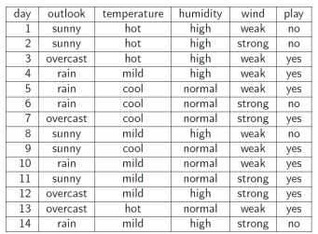
Entropy and Information Gain
16
Let’s use IG based criterion to construct a DT for the Tennis example
At root node, let’s compute IG of each of the 4 features
Consider feature “wind”. Root contains all examples S = [9+,5-]
S_{weak} = [6+, 2−] ⇒ H(S_{weak} ) = 0.811
S_{strong} = [3+, 3−] ⇒ H(S_{strong}) = 1
Likewise, at root: IG(S, outlook) = 0.246, IG(S, humidity) = 0.151, IG(S,temp) = 0.029
Thus we choose “outlook” feature to be tested at the root node
Now how to grow the DT, i.e., what to do at the next level? Which feature to test next?
Rule: Iterate - for each child node, select the feature with the highest IG
$$\text{H}\text{(}\text{S} \text{) =}\text{ −(9/14) }\text{log}\text{2}\text{(9/14) − (5/14) }\text{lo}\text{g}\text{2}\text{(5/14) = 0.94}$$
$IG(S,wind)=H\left(S\right)− \frac{\left|S_{weak}\right|}{\left|S\right|}H\left(S_{weak}\right)$ $− \frac{\left|S_{strong}\right|}{\left|S\right|}H\left(S_{strong}\right)$ = 0.94 − 8/14 ∗ 0.811 − 6/14 ∗ 1 = 0.048

Slide 17
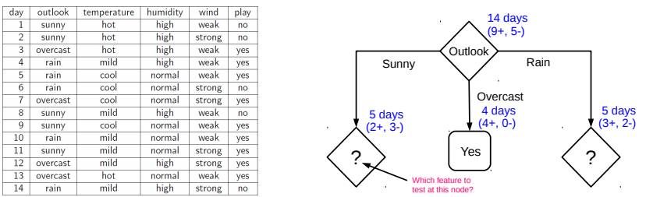
Growing the tree
17
Proceeding as before, for level 2, left node, we can verify that
IG(S,temp) = 0.570, IG(S, humidity) = 0.970, IG(S, wind) = 0.019
Thus humidity chosen as the feature to be tested at level 2, left node
No need to expand the middle node (already “pure” - all “yes” training examples ☺)
Can also verify that wind has the largest IG for the right node
Note: If a feature has already been tested along a path earlier, we don’t consider it again

Slide 18
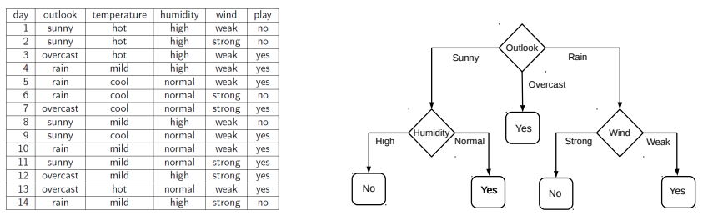
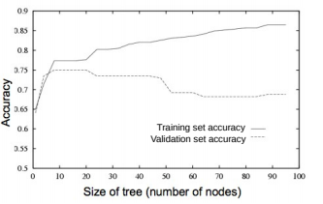
When to stop growing the tree?
18
Stop expanding a node further (i.e., make it a leaf node) when
It consist of all training examples having the same label (the node becomes “pure”)
We run out of features to test along the path to that node
The DT starts to overfit (can be checked by monitoring
the validation set accuracy)
Important: No need to obsess with too much for purity
It is okay to have a leaf node that is not fully pure, e.g., this
At test inputs that reach an impure leaf, can predict probability of belonging to each class (in above example, p(red) = 3/8, p(green) = 5/8), or simply predict the majority label
To help prevent the tree from growing too much!
OR

Slide 19
Avoiding Overfitting in DTs
19
Desired: a DT that is not too big in size, yet fits the training data reasonably
Note: An example of a very simple DT is “decision-stump”
A decision-stump only tests the value of a single feature (or a simple rule)
Not very powerful in itself but often used in large ensembles of decision stumps
Mainly two approaches to prune a complex DT
Prune while building the tree (stopping early)
Prune after building the tree (post-pruning)
Criteria for judging which nodes could potentially be pruned
Use a validation set (separate from the training set)
Prune each possible node that doesn’t hurt the accuracy on the validation set
Greedily remove the node that improves the validation accuracy the most
Stop when the validation set accuracy starts worsening
Use model complexity control, such as Minimum Description Length (will see later)
Either can be done using a validation set

Slide 20
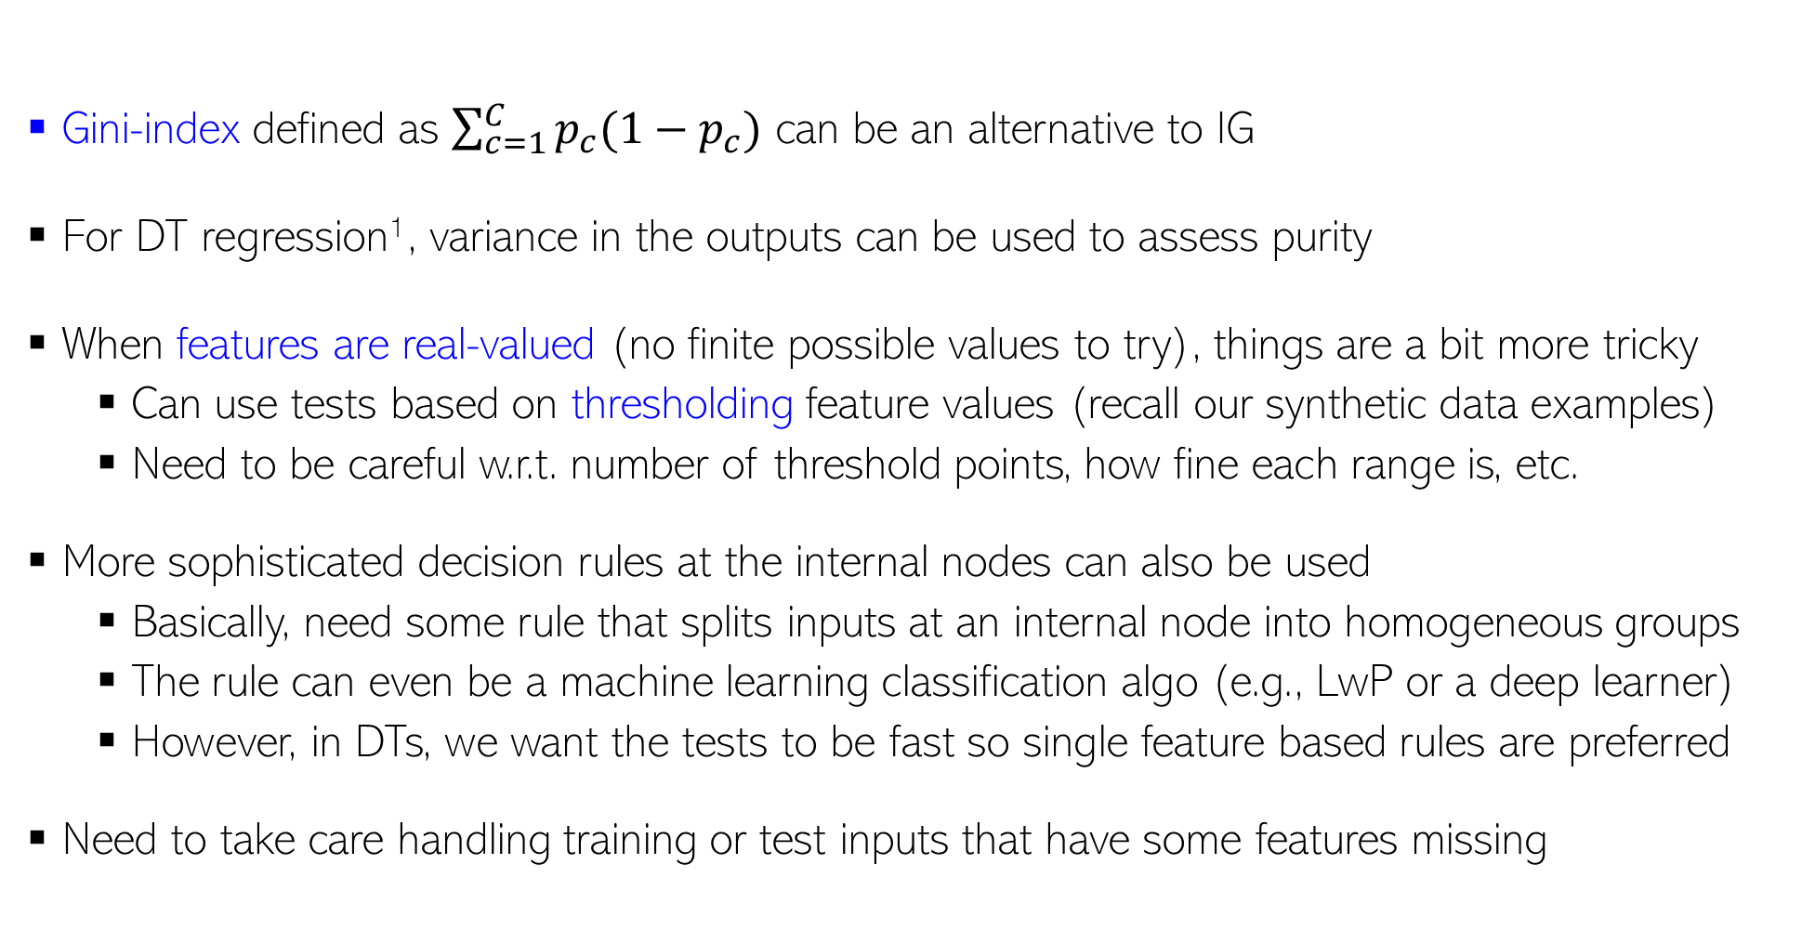
Decision Trees: Some Comments
For regression, outputs are real-valued and we don’t have a “set” of classes, so quantities like entropy/IG/gini etc. are undefined
20
Gini-index defined as $\sum_{c=1}^{C}{p_{c}(1−p_{c})}$ can be an alternative to IG
For DT regression¹, variance in the outputs can be used to assess purity
When features are real-valued (no finite possible values to try), things are a bit more tricky
Can use tests based on thresholding feature values (recall our synthetic data examples)
Need to be careful w.r.t. number of threshold points, how fine each range is, etc.
More sophisticated decision rules at the internal nodes can also be used
Basically, need some rule that splits inputs at an internal node into homogeneous groups
The rule can even be a machine learning classification algo (e.g., LwP or a deep learner)
However, in DTs, we want the tests to be fast so single feature based rules are preferred
Need to take care handling training or test inputs that have some features missing
¹Breiman, Leo; Friedman, J. H.; Olshen, R. A.; Stone, C. J. (1984). Classification and regression trees

Slide 21
Ensemble of Trees
21
All trees can be trained in parallel
Ensemble is a collection of models
Each model makes a prediction. Take their majority as the final prediction
Ensemble of trees is a collection of simple DTs
Often preferred as compared to a single massive, complicated tree
A popular example: Random Forest (RF)
XGBoost is another popular ensemble of trees
Based on the idea of “boosting” (will study boosting later) simple trees
Sequentially trains a set of trees with each correcting errors of previous ones
Each tree is trained on a subset of the training inputs/features
An RF with 3 simple trees. The majority prediction will be the final prediction

Slide 22
Decision Trees: A Summary
22
.. thus helping us learn complex rule as a combination of several simpler rules
Some key strengths:
Simple and easy to interpret
Nice example of “divide and conquer”
paradigm in machine learning
Easily handle different types of
features (real, categorical, etc.)
Very fast at test time
Multiple simple DTs can be combined
via ensemble methods: more powerful
Used in several real-world ML applications, e.g., recommender systems, gaming (Kinect)
Some key weaknesses:
Learning optimal DT is (NP-hard) intractable. Existing algos mostly greedy heuristics
Can sometimes become very complex unless some pruning is applied
5
NO
YES
$$x_{1}>3.5 ?$$
4
NO
YES
NO
YES
3
$$x_{2}>2 ?$$
$$x_{2}>3 ?$$
Feature 2 ($x_{2})$
2
Predict Red
Predict Green
Predict Green
Predict Red
1
Human-body pose estimation
1
2
3
4
5
6
Feature 1 ($x_{1})$

Slide 23
Learning via Optimization
23

Slide 24

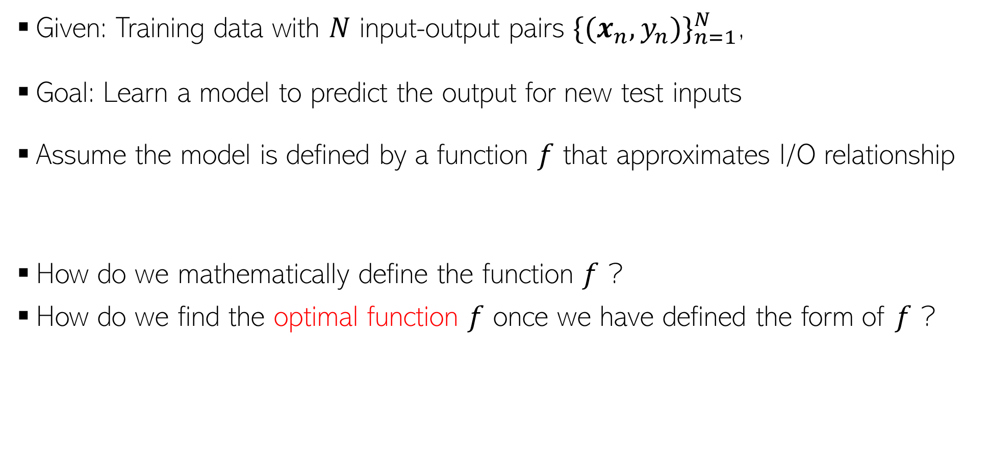
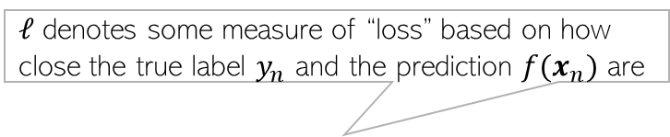
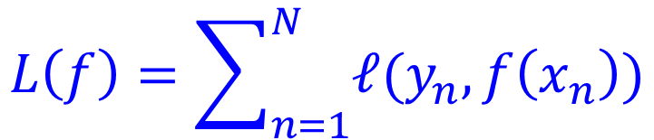

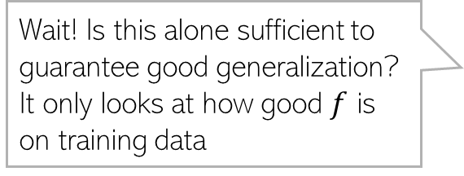

Supervised Learning as Function Approximation
24
Given: Training data with $N$ input-output pairs ${{\{(x}_{n},y_{n})\}}_{n=1}^{N}$,
Goal: Learn a model to predict the output for new test inputs
Assume the model is defined by a function $f$ that approximates I/O relationship
How do we mathematically define the function $f$ ?
How do we find the optimal function $f$ once we have defined the form of $f$ ?
And not just for the training data but also for future test data
So $f$ must generalize well
$$y_{n}≈f\left(x_{n}\right)$$
$ℓ$ denotes some measure of “loss” based on how close the true label $y_{n}$ and the prediction $f(x_{n})$ are
Optimal $f$ will be the one which minimizes this “total loss”
Wait! Is this alone sufficient to guarantee good generalization? It only looks at how good $f$ is on training data
$$L\left(f\right)=\sum_{n=1}^{N}{ℓ(y_{n}, f\left(x_{n}\right))}$$

Slide 25
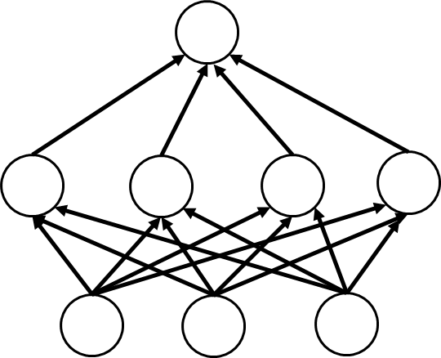
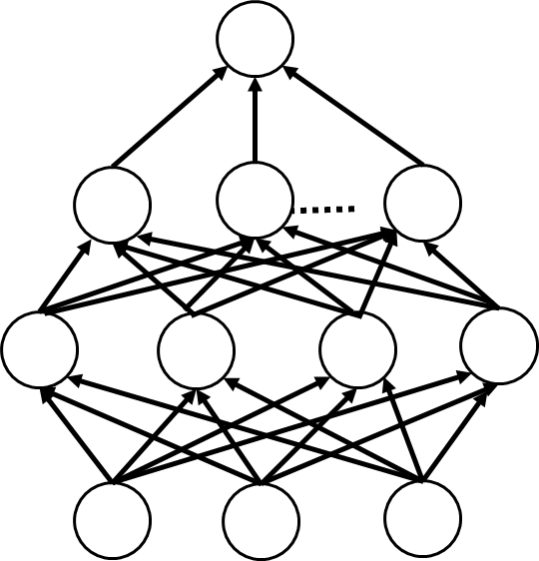


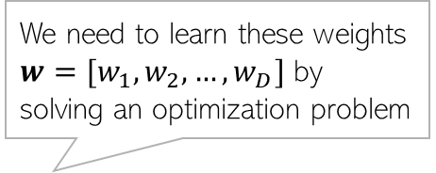





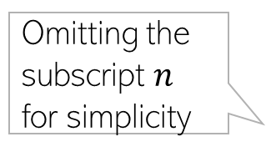

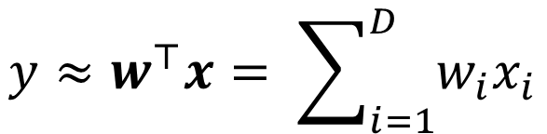



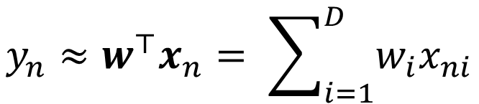



Supervised Learning as Function Approximation
25
Linear combination of features
The function $f$ can be defined in various ways, e.g.,
A linear function (or linear model). Assuming each output a scalar,
A nonlinear function which itself can be defined in various ways, e.g,
We need to learn these weights $w=[w_{1},w_{2},…, w_{D}]$ by solving an optimization problem
$$y$$
$$y_{n}≈w^{⊤}x_{n}= \sum_{i=1}^{D}{w_{i}x_{ni}}$$
$$w_{1}$$
$$w_{2}$$
$$w_{D−1}$$
$$w_{D}$$
Omitting the subscript $n$ for simplicity
$$x_{1}$$
$$x_{2}$$
$$x_{D−1}$$
$$x_{D}$$
$$y≈w^{⊤}x= \sum_{i=1}^{D}{w_{i}x_{i}}$$
Each node represents one of the features
Example of a deep neural network with two hidden layers
Linear model at the top
Linear model at the top
$$w_{3}$$
Features extracted by some learned non-linear transformation of previous layer features
Features extracted by some pre-defined non-linear transformation of input features (example: kernel methods)
$$w$$
$$w_{2}$$
Features extracted by some learned non-linear transformation of input features
$$w_{1}$$
Input features
Input features

Slide 26
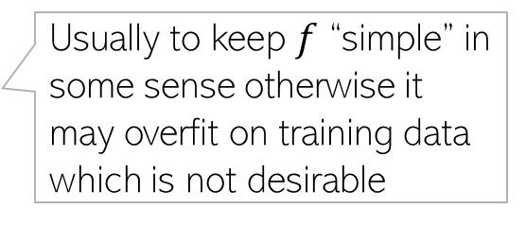
Learning as Optimization
26
The general form will be
$$\hat{f}= {argmax}_{f} L\left(f\right)={argmax}_{f}\sum_{n=1}^{N}{ℓ(y_{n}, f\left(x_{n}\right))}$$
Usually to keep $f$ “simple” in some sense otherwise it may overfit on training data which is not desirable
$$(subject to some constraints on f)$$

