Slide 1
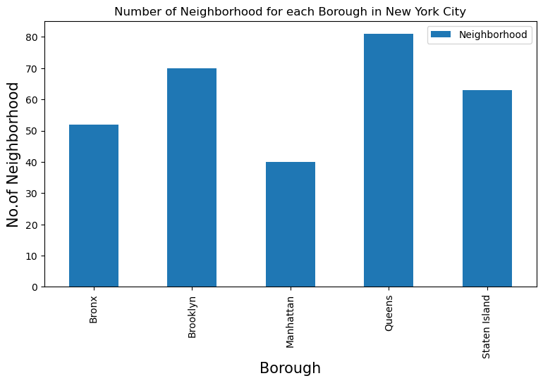
Battle of Neighborhoods in NYC
Questions
1) What is best area of New York City for pizza connoisseurs?
2) Any area that still could use pizza restaurants?
3) Which is the best place to live in NYC for pizza connoisseurs?
Analysis
1) Keeping it simple, we will use the following libraries:
pandas and numpy
2) request module for FourSquare API.
3) geopy to get co-ordinates of NYC.
4) folium to visualize results on a map
Let’s count the number of neighborhoods in each borough.

Slide 2
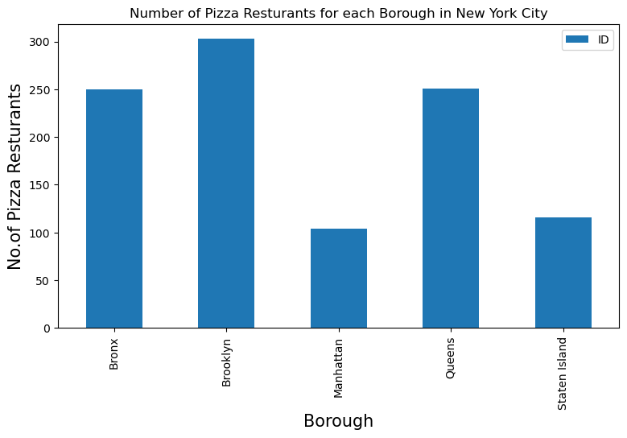
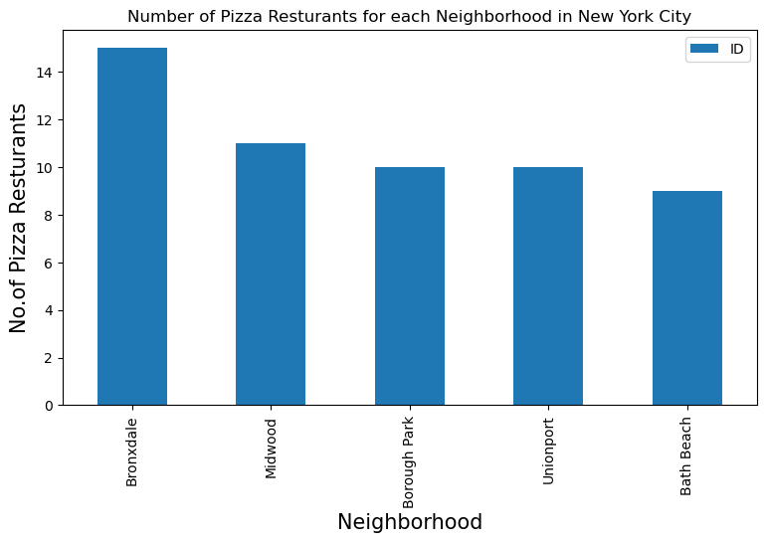
Battle of Neighborhoods in NYC
Questions
1) Which borough has the highest number of pizza restaurants?
2) 1) Which neighborhood has the highest number of pizza restaurants?
Analysis
1) Gets data with FourSquare API.
3) Geopy to get co-ordinates of NYC.
4) Count number of restaurants
Results
1) Brooklyn has most number of pizza restaurants.
2) Manhattan has the smallest number of pizza restaurants.

Slide 3
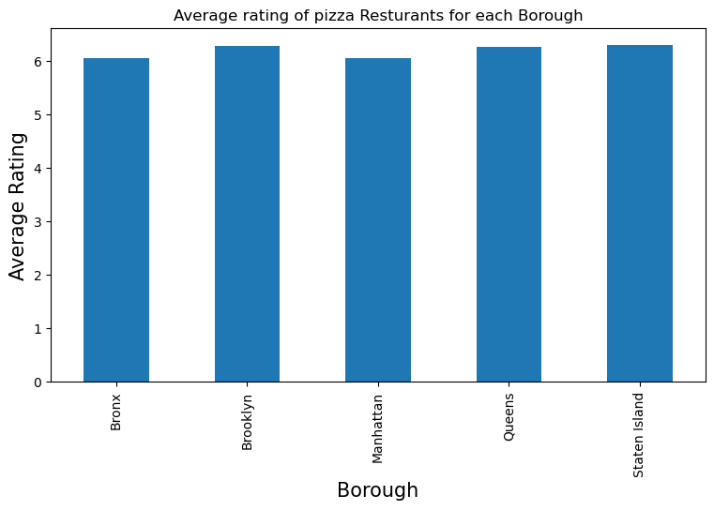
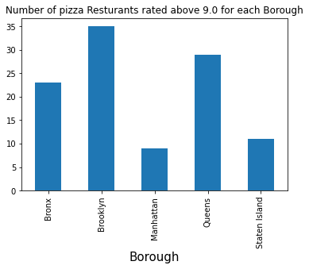
Battle of Neighborhoods in NYC
Questions
Which borough has the highest rated pizza restaurants?
Which borough has the smallest number of pizza restaurants
Results
The ratings for all five boroughs are similar.
Manhattan and Staten Island has the least number and second least number of pizza restaurants.
Staten Island is above others, barely, when it comes to average ratings of pizza places.

Slide 4
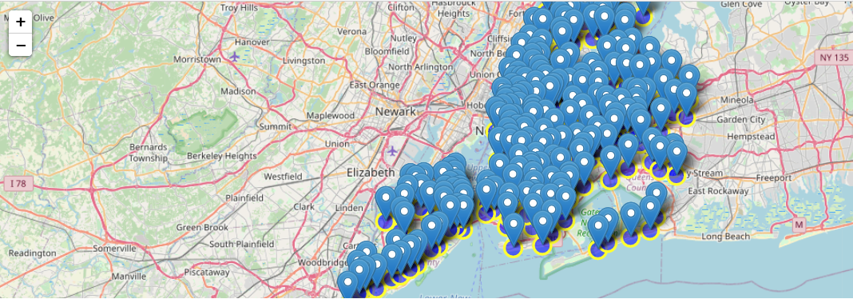
Battle of Neighborhoods in NYC
Visualizing it
They are pretty much all over the place.
No location on map that are devoid of pizza places.
Tough call to pick a location to start a new restaurant.
Best place to live Is hands down Brooklyn.

