Slide 1

Final Project
Fantasy Cricket Game
Submitted By:
Kunal Sharma (20BCS5686)

Slide 2
INTRODUCTION
GUI application to play fantasy cricket
User can play with their custom team.
Matches available to play from.
Players available to choose from just like IPL auction.
User-friendly UI.

Slide 3
Objectives
Open Source
Ad-free
Simple UI

Slide 4


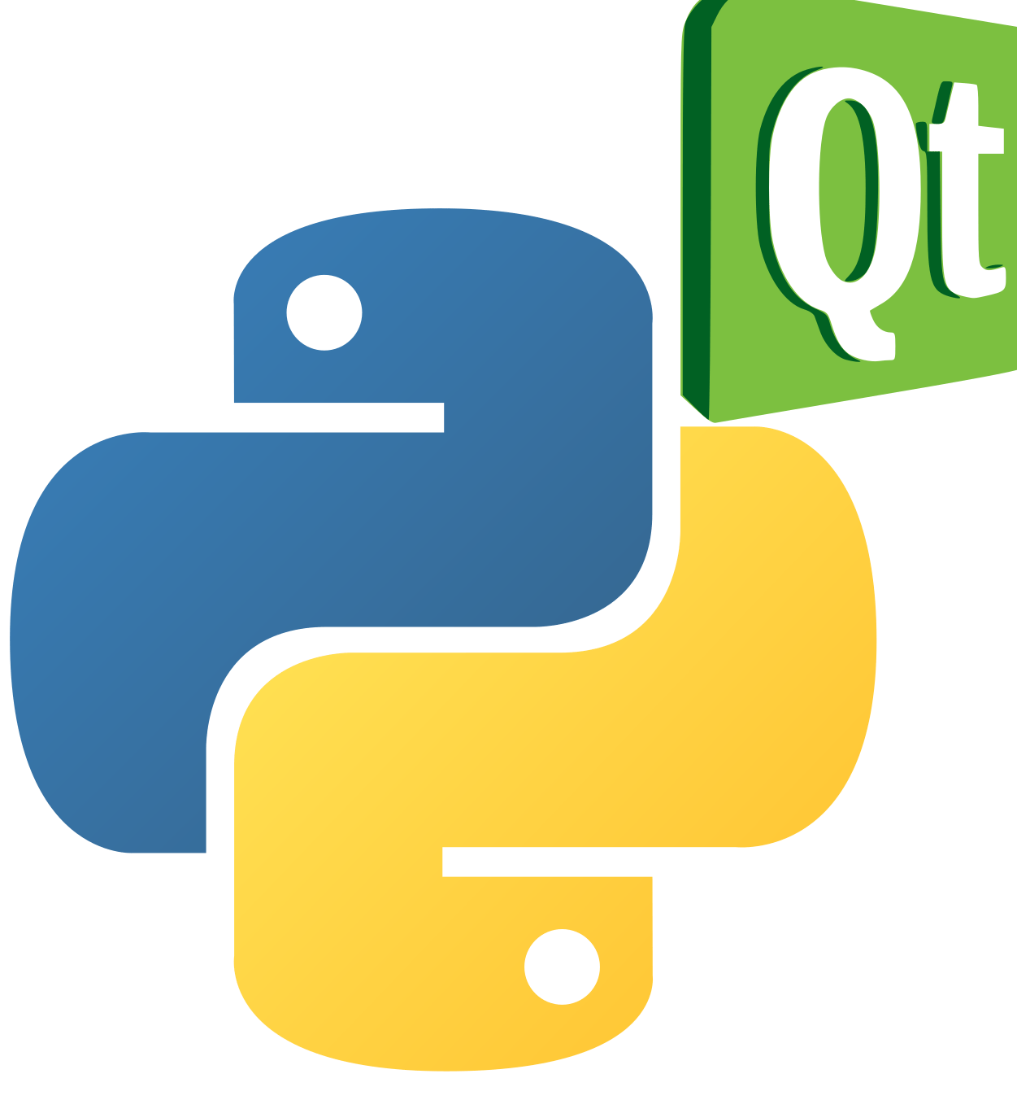
Technologies Used

Slide 5
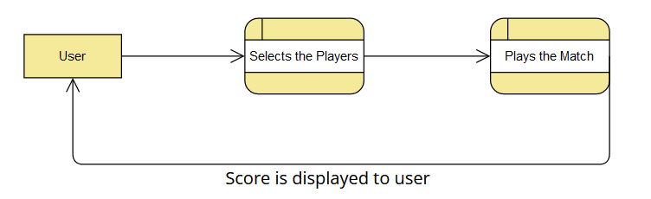
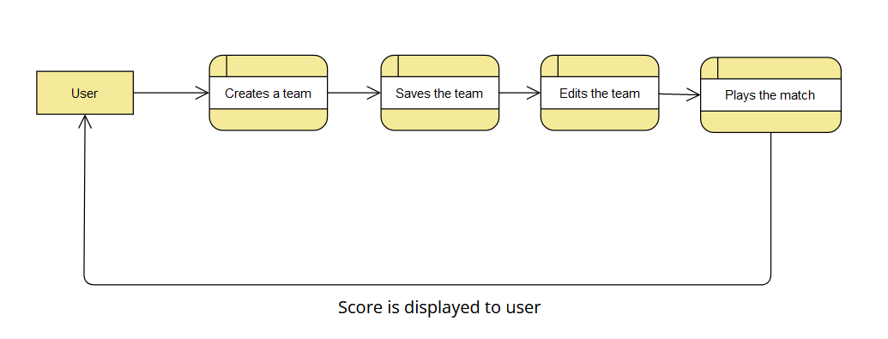
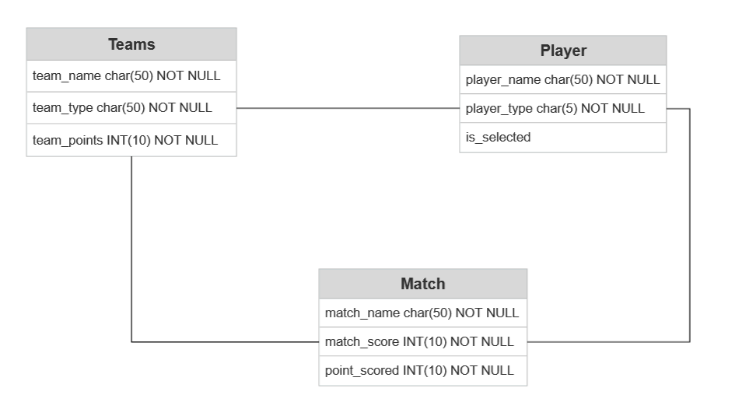
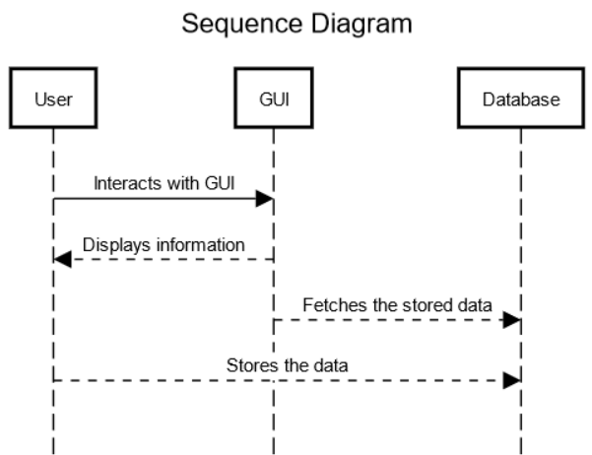
Designs
DFD (Level-0)
DFD (Level-1)
ER-Diagram
Sequence Diagram

Slide 6
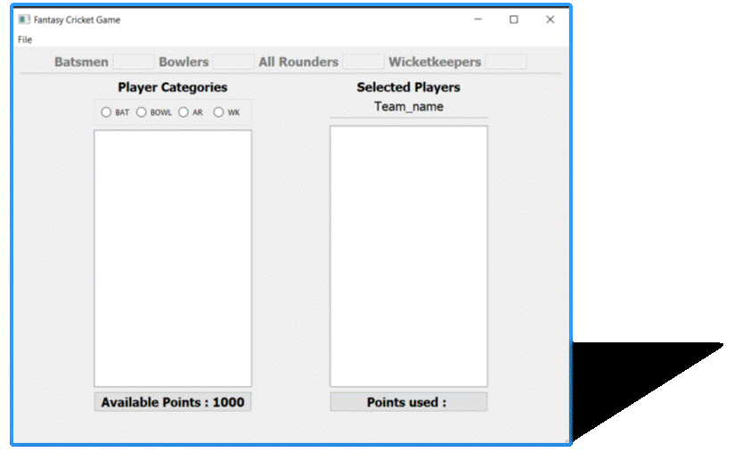
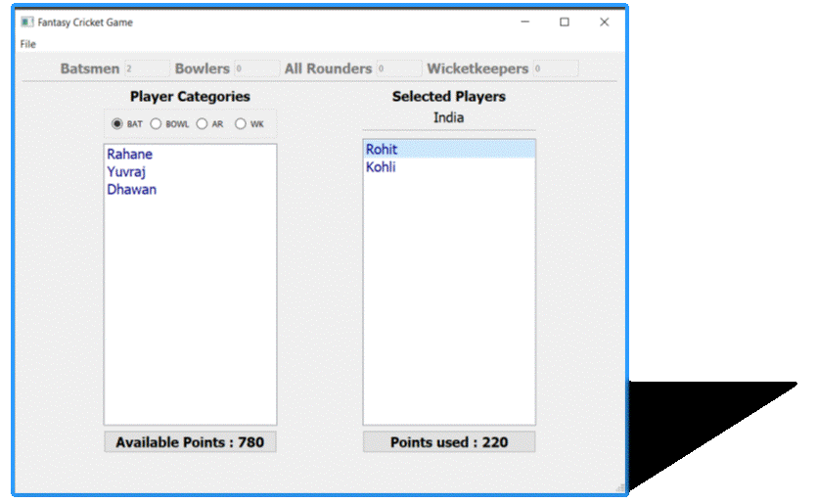
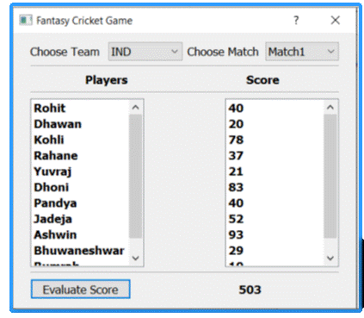
Screenshots

Slide 7
Conclusion
The app made using Python3 is free to use and open source. This app helps user to make their own team, select their own players, play their own matches and score points. This app has a lot of potential as it can be used to play with friends as a fun past-time activity. The GUI developed using PyQT framework is very user friendly and easy to use. The database used is SQLite which is a SQL database that is easy to use and integrate in Python workflow.

Slide 8
Thank you

