Slide 1

TEAM VBALL · SDC HACKATHON 2026 · FINAL ROUND · DOMAIN 2
SMErgers
Agreed on WhatsApp. Billed from memory.
Not any more.
01
02
03
Orbyte Smart SME Challenge
SDG 8.2 · 8.3
Catch it
Confirm it
Sync it

Slide 2
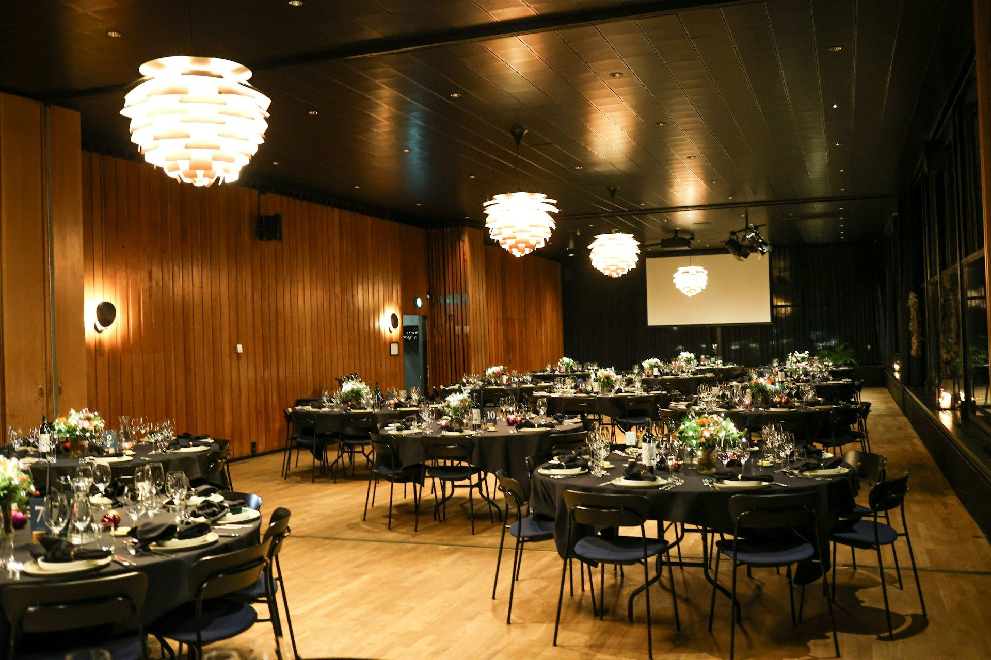
PROBLEM
Annual Dinner · WhatsApp group
Agreed on WhatsApp. Lost at billing.
Client
The LED wall abit small la. Can we upgrade?
NEXT MORNING
Team
Can! 4m x 2.5m. RM1,100 more.
1
The client asks in the chat.
2
The team says yes.
Client
Ok, go ahead.
3
The signed quote is never updated.
So the extras are billed from memory, or not at all.
Billing day: where is that RM1,100?
Illustrative example: a synthetic dinner job, written from a team member’s experience at an event company.
02

Slide 3
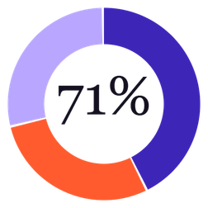
SURVEY · 7 EVENT PROFESSIONALS · 5 COMPANIES
We surveyed 7 event professionals at 5 companies.
WHERE CHANGES HAPPEN
CLIENTS ADD EXTRAS AFTER SIGNING
WhatsApp
100%
Almost every project
43%
Phone or in person
57%
Most projects
29%
Email
29%
Some projects
29%
Project software
29%
WHAT THEY ADD
QUOTE VALUE LOST ON A TYPICAL JOB
Headcount or quantity
86%
More than 15%
43%
Overtime
71%
11 to 15%
29%
Equipment upgrades
71%
6 to 10%
29%
Urgent adds, no price
57%
Nobody said under 6%.
Survey of 7 people at 5 event companies, 31 Oct 2026. Our network, self-reported estimates, small sample. Table: docs/survey.md.
03

Slide 4
PROBLEM
Where the money disappears
01
02
03
04
05
Quote signed
Changes in WhatsApp
Bill from memory
“I never agreed.”
Owner gives in
RM34,530
100%
57%
“…their boss doesn’t admit and doesn’t want to pay.”
71%
Sample dinner quote, 180 guests
of the 7 we asked run their changes in WhatsApp
scroll back through weeks of chat to find them
lose 11% or more of a typical job’s value
Owner, 100+ jobs a year
Nobody is careless. The agreement just lives in a chat, not a system.
Survey of 7 people at 5 event companies, 31 Oct 2026, self-reported. The quote in step 1 is a sample.
04

Slide 5


Competitive Analysis
Nobody turns the chat into the bill
WhatsApp + memory
Accounting apps
Event software
Contractor tools
SMErgers
CAN IT…
Bukku, AutoCount
Rentman, Event Temple
CoConstruct, Baukraft
Read agreements from WhatsApp
×
×
×
Partly
Match each change to the quote
×
×
Partly
Client confirms each change
×
×
Partly
Post the new version to the group
×
×
×
×
Link each bill line to its chat proof
×
×
×
×
Public pages and search results, 21 Oct 2026. Partly = a limited form. × = not found, not proof it does not exist.
05

Slide 6






SOLUTION
Catch it. Confirm it. Sync it.
CATCH IT
CONFIRM IT
SYNC IT
Messages arrive
Chat analysed
PM checks
Director signs off
Client confirms
Quote v2 to the group
From the job’s WhatsApp group
Reader finds item, quantity, price, source
Adds any missing price
From a link, no login
RM500 or more, and discounts
Plus bill, CSV, log
In our test, all 15 agreed changes reached the bill, with a person checking each one.
Synthetic test: 4 unseen chats, 15 agreed changes. Reproduce: python src/benefit.py
06

Slide 7
LIVE DEMO
Watch it catch a change.
A real WhatsApp group, from the owner’s chair.
Test numbers and sample business data. Backup: the recorded demo.
07

Slide 8

TECHNICAL APPROACH
The AI reads. Code and people decide.
TRIGGER
DATA
CHAT ANALYSIS
APPROVAL
OUTCOME
WhatsApp group
Quote and rate card
Reads the chat
PM, director, client
Quote v2 and bill
Rules at once. Llama AI reads the chat against the quote
A message arrives
Quote lines, prices, who’s who
Roles enforced on the server
Posted back to the group
If the AI is down, the rules keep working.
Labels are the five steps of the Domain 2 brief. AI reader: open Llama 3.1 8B on a private GPU endpoint. Accuracy results: appendix.
08

Slide 9
ORBYTE INTEGRATION
Plugs into Orbyte. Adds what it lacks.
SMErgers needs | Orbyte provides
The job and its client | Clients and projects
Who is PM, director, client | Directory, shared roles
Director and client sign-off | Approvals, eSign
A record nobody can edit | Audit trail
Sending the bill out | Accounting partners
Job data for other modules | Open APIs
WHAT WE ADD
Chat turned into approved changes
1
TODAY
Job API and the official WhatsApp webhook format
2
PILOT
Use Orbyte’s roles, approvals and eSign instead of ours
3
ADD-ON
One switch in Orbyte for SMEs that quote jobs
Orbyte modules as in the organizers’ introduction. Designed, not yet connected to a live Orbyte: docs/orbyte-integration.md.
09

Slide 10
WHO WE SELL TO
Start with events. Then any firm that quotes a job.
SECONDARY · NEXT, WITH A NEW QUOTE FILE
PRIMARY · FIRST TARGET
Renovation and fit-out
next
Small event companies
Air-con and repair
next
Quote signed, then changes in WhatsApp. This is where our survey and our demo are.
Catering
next
Printing
next
Web and creative agencies
next
Wholesale and supply orders
next
Secondary markets are planned, not yet piloted. Each is a new quote file for the same engine.
10

Slide 11
BUSINESS MODEL
We sell software by the month. The owner pays.
TRY
RUN
SCALE
Free
RM100
RM250
a month
a month
1 job at a time
10 jobs at a time
Unlimited jobs
5 of 7 event pros we asked lose 11%+ of a typical job. 6 of 7 picked a paid plan as fair.
Plans and limits are a launch proposal; the prices came from our survey of 7. How much an owner recovers is not measured yet: the pilot measures it.
11

Slide 12
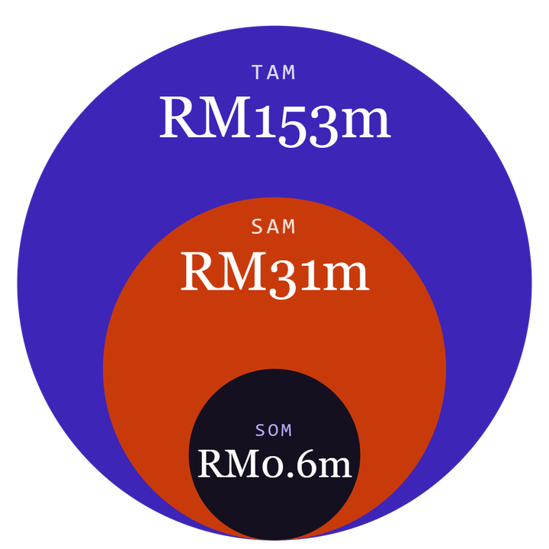
MARKET SIZE
How big? Counted bottom-up.
TAM · EVERY FIRM
About 128,000 firms
Small firms that run projects in Malaysia, at RM1,200 a year each
SAM · THE ONES WE CAN REACH
About 25,500 firms
1 in 5 run their jobs over WhatsApp
SOM · OUR 3-YEAR GOAL
About 500 firms
2% of those: the ones we aim to win
Circles not to scale. 128,000 = 102,657 construction firms (DOSM Economic Census 2023) plus about 25,000 others (our assumption). The 1 in 5 and the 2% are assumptions too.
12

Slide 13
FUTURE PLAN
Prove it. Expand it. Let it learn.
Q1 2027
2027
WITH ENOUGH DATA
Prove
Expand
Learn
First paying event company
More event firms
Train on every approved change
Official WhatsApp Business API
Renovation, catering, printing, wholesale
Suggest extras before the client asks
Measure changes caught and hours saved
Orbyte add-on
Today: counts from past jobs, e.g. 4 of 4 demo dinners ran overtime
Impact KPI: agreed changes that reach the bill, from an estimated 75% to 95% · final-bill time cut by half
SDG 8.2 · 8.3: small firms keep the revenue they have earned.
SMERGERS · TEAM VBALL
13

Slide 14
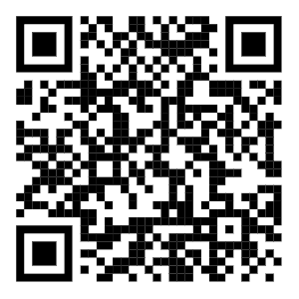
OUR ASK
Catch it.
Confirm it. Sync it.
A four-week pilot with three to five event companies. Know a firm that runs its jobs over WhatsApp? Introduce us.
TEAM VBALL
VC
Vincent Chew Wen Jie
SE
Steven Elnathan Meliala
LW
Looi Wan Wei
Orbyte Smart SME Challenge · Domain 2 · SDG 8.2 · 8.3
Scan for the code
github.com/Anonys-sky/SMErgers · Apache 2.0 · Live demo: sm-ergers-1.replit.app
14

Slide 15
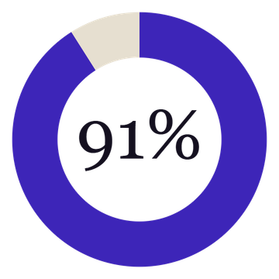
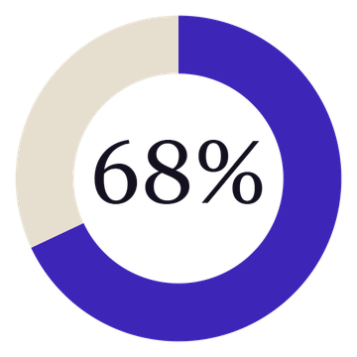
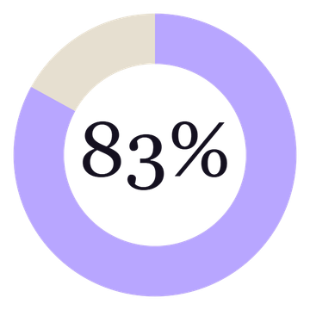
DOES THE READER WORK?
On chats it had never seen, the AI reader spotted 91% of the changes.
Spots the change
Fully right
After our fixes*
59 of 65 changes found
44 of 65: change, price and status
54 of 65, same chats
Plain rules alone: 75% spotted, 32% fully right. So the AI reads, code checks every price, and a person approves.
7 chats, 65 changes, written by outside agents who never saw our code; answer key written before scoring. *Light donut: same chats after we fixed its mistakes, so not independent. Every run: docs/results.md.
15

Slide 16
APPENDIX C
Hard questions, plain answers
“Isn’t it just an invoice maker?”
“Why not just write it down?”
No. It finds and confirms what was agreed. Invoicing stays in accounting software.
Deals happen mid-chat at 11 pm. We read the chat they already use.
“How accurate is it?”
“Is the AI reader proven?”
On 65 changes in chats written by outsiders, the AI reader spotted 91% and got 68% fully right; plain rules 75% and 32%. After our fixes, 83% fully right on those same chats (not independent). Small synthetic samples, so a pilot comes next.
Not on real chats yet. The pilot tests that.
“Is reading WhatsApp allowed?”
“What if the client never confirms?”
Through Meta’s official API, in groups the business creates, with consent.
It stays off the bill, on the director’s list. Nothing is billed silently.
“Will owners pay RM100?”
“What if a message is misread?”
The pilot tests it. Break-even is 3% of extras recovered.
Unclear items go to a person. Nothing reaches the bill without a check and the client’s yes.
Rehearse these with a teammate playing a hostile judge.
C

Slide 17
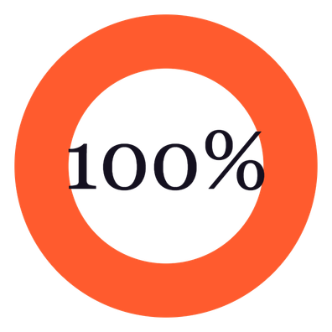
RESULT IN OUR TEST
Every agreed change reached the bill.
TIME TO BUILD THE FINAL BILL
By hand
261 min
SMErgers
53 min
80% less time
48 of 48 changes
Modelled from stated assumptions. A timed test with people is next.
across 11 chats. Starting point: about 75% (our estimate).
The reader proposes, a person finishes: 13 fixed, 2 added and 3 rejected along the way.
A person checked every change. Reproduce with python src/benefit.py; assumptions are at the top of that file. Report: docs/benefit.md.
17

Slide 18
APPENDIX D
Limits, stated plainly
NOT YET PROVEN
KNOWN WEAKNESSES
SAFEGUARD
Real chats. Everything is synthetic.
The AI reader can call an unconfirmed change ready.
A person checks every change. The client confirms. The log records both.
Real owners paying. A 7-person survey, no interviews yet.
It can price a "price later" item.
The time saved. Modelled, timed test pending.
Data is in memory and resets on restart.
Official WhatsApp groups. Needs a verified business.
Sign-in is simulated; roles are enforced.
Sources for every number: docs/results.md and docs/benefit.md in the repository.
18

Slide 19
SOLUTION
People stay in control
Who | Can | Cannot
Project manager | Check, add a missing price, reject | Approve big items or discounts
Project director | Approve RM500 or more, decide discounts | Confirm for the client
Client | Confirm, or dispute with a reason | See the team’s pages
HUMAN APPROVAL
CHECKED ON THE SERVER
ACTIVITY LOG
Nothing is billed without the PM’s check and the client’s yes.
Not just hidden buttons. A client link can’t approve its own change.
Who, role, what, when. Each entry is chained, so an edit shows.
Sign-in is simulated, as the brief allows. The RM500 limit is a setting.
19

Slide 20
APPENDIX B
Boundaries, privacy and tools
INSIDE THE BRIEF
PDPA, IN REAL USE
TOOLS DECLARED
No payments or filings
Tell people why the group is read
Replit: build and host
No legal or financial advice
Keep only messages tied to changes
GitHub: public, Apache 2.0
Bill is a draft, not an invoice
Limit access by role
Claude, Replit Agent: AI coding help
Synthetic data only
Set retention; honour requests
Llama 3.1 8B: the AI reader
Sign-in simulated; roles still enforced
Legal review before any pilot
WhatsApp Cloud API: design
RunPod: GPU that runs the AI reader (no training)
WhatsApp, honestly: Meta’s official API is built for business-to-customer chats and needs a verified business account. An unofficial client (whatsapp-web.js) was used only for team testing, never in the product.
Boundaries from the Domain 2 brief, section 6. Not legal advice.
B

Slide 21
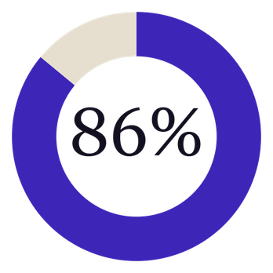
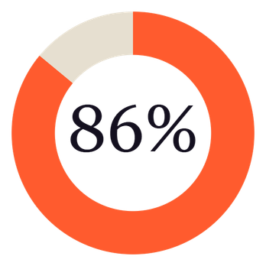
WHAT 7 EVENT PROFESSIONALS SAID
86% find it useful and pick a paid plan.
THEIR PAIN, IN SHORT
Clients add things, then deny agreeing.
OWNER, 100+ JOBS A YEAR
They do not know extra time costs money.
HOTEL EVENT OPERATIONS
Find it useful
Pick a paid plan
Last-minute adds land on finance.
6 of 7 rated it 4 or 5 out of 5. Average 4.3.
6 of 7 chose RM100 or RM250 a month as fair.
FINANCE, EVENT COMPANY
One owner has already asked to meet us. That is our first pilot conversation.
7 responses, 5 event companies, 31 Oct 2026, our network, self-reported. The question described our product. Words shortened from the free-text answers. Table: docs/survey.md.
21

Slide 22
APPENDIX A
Every number: source, confidence, caveat
Number | Source | Confidence | Caveat
102,657 construction and renovation firms (market input) | DOSM Economic Census 2023 | High | Whole sector, not only renovation
About 25,000 other project firms | Our assumption | Low | No public event-company count
20% run jobs over WhatsApp | Our assumption | Low | To measure in the pilot
35 messages, 10 changes, RM3,860 (11.2%) on one job | Synthetic dinner chat (data/chats) | Synthetic | One job; real leakage unknown
20 admin hours at RM25 | Our assumption | Low | Owners to confirm
Competitor features (grid) | Vendor pages, search results | Medium | Front pages only; not tested
Changes at “almost every event” | Team member’s experience | Medium | One person, one company
Blind chats: AI spotted 59 of 65 and got 44 fully right; rules 21 | docs/results.md, Runs 2, 5, 7 and 8 | Low | Synthetic chats by AI agents; 65 changes. 54 fully right after fixes, same chats (not independent)
A widely repeated “52% of projects see scope creep” figure could not be traced to its source, so it is not used. Checked 21 to 24 Oct 2026.
dosm.gov.my · rentman.io · helloendless.com · workflowmax.com
SMERGERS · TEAM VBALL
A

Slide 23
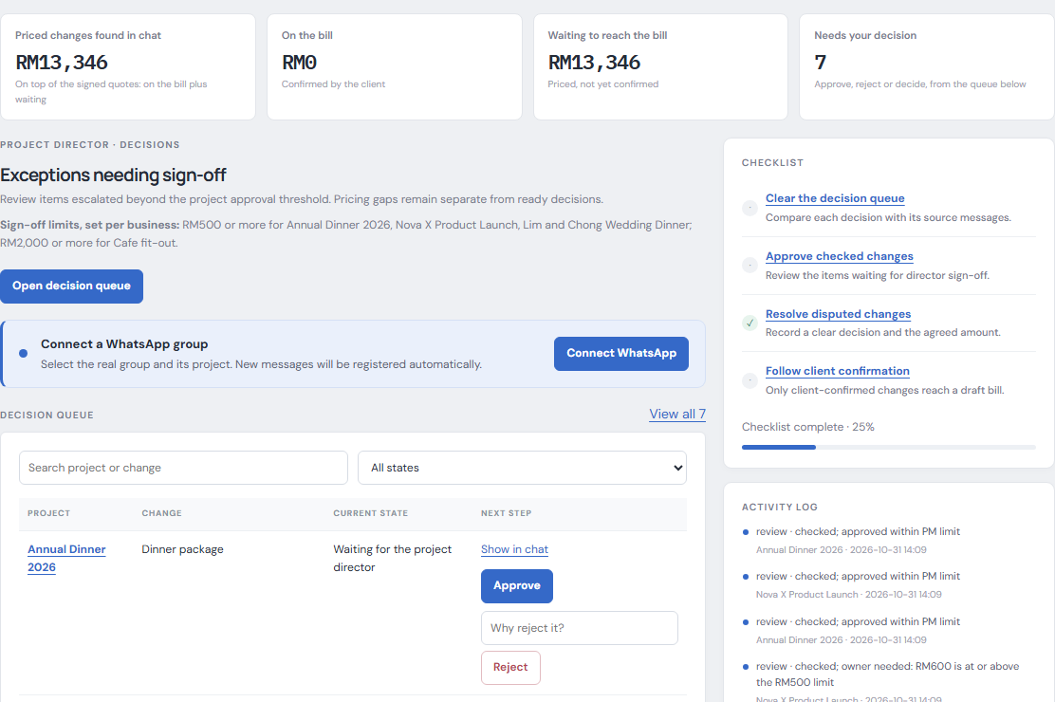
THE OWNER'S VIEW
Built for the person who signs off.
1
The money at a glance
Found in chat, on the bill, waiting to reach it.
2
Decide in one row
Evidence one click away. Approve, or reject with a reason.
3
Your limit, your rule
Each business sets the amount from which the director signs off.
Screenshot of the running app, synthetic data.
23

Slide 24
LIVE DEMO · AS THE OWNER
Monday morning: what needs me?
1
2
3
4
5
Messages arrive
I see the money
Approve or reject
Client confirms
Prove it
A real WhatsApp group on a test number is connected. New messages are read within seconds and logged.
Found in chat, on the bill, waiting. What needs my decision, with its evidence.
One row, one click. A rejection needs a reason and tells the PM.
From a link, no login. Quote v2 goes back to the group.
Activity log: who did what, when. An edit would show.
Then a second business, with its own sign-off limit.
Test numbers, sample business data. Live site: sm-ergers-1.replit.app · Backup video if the network fails.
24

Slide 25
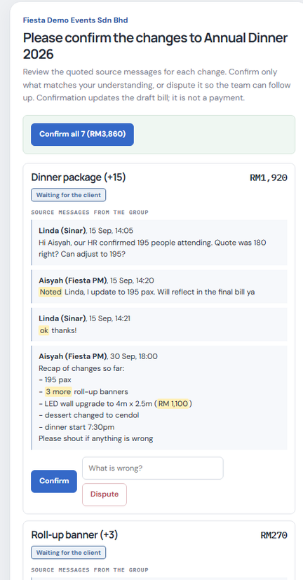

SOLUTION
The client confirms. Everyone stays in sync.
Annual Dinner · WhatsApp group
SMErgers
Confirmed by Sinar Demo Trading Sdn Bhd:
• Dinner package (+15): RM1,920
• LED wall 3m x 2m, changed to 4m x 2.5m: RM1,100
• Emcee overtime (+1): RM300
• and 4 more
Quote Q-2026-041 is now version 2, total RM38,390.
Version 1
Version 2
RM34,530
RM38,390
1 · Client taps the link
2 · The group is told. Demo: synthetic group. Production: WhatsApp Business API.
Screenshot and message are from the working prototype, synthetic data.
25

Slide 26
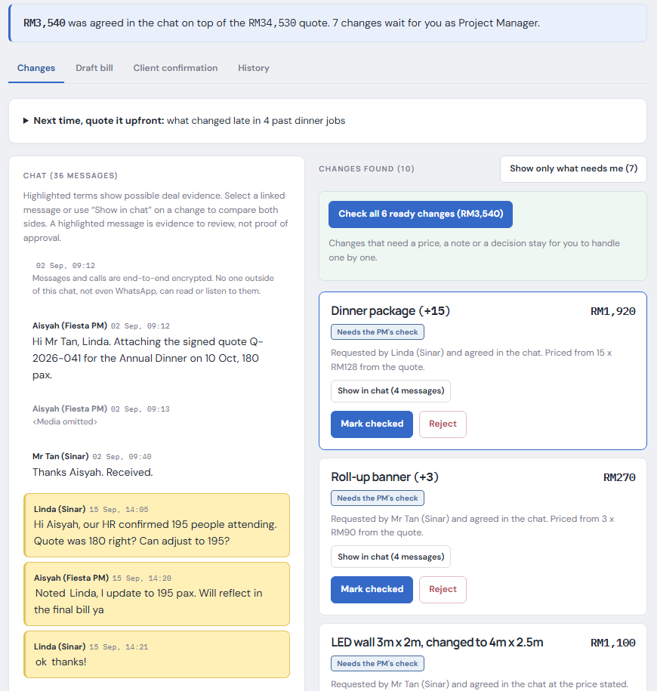
SOLUTION
The project manager’s view
Know what waits for you
1
RM3,540 agreed, 7 changes to check
Every change has proof
2
The client’s own words light up
Check six in one click
3
Unpriced items wait for a person
Screenshot of the working prototype, synthetic data.
26

Slide 27
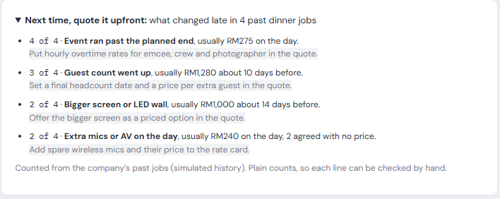
TECHNICAL APPROACH
It learns from every job
SYNTHETIC DEMO HISTORY
4 of 4
past dinners in our demo ran past the planned end. Put overtime in the quote.
NOW
NEXT
Plain counts from past jobs. Fewer last-minute decisions.
Every approval is a labelled example. After a pilot, it trains a model.
Built on 10 synthetic past jobs of one demo company. A model is trained on real approvals after a pilot.
27

Slide 28
SINCE THE PRELIMINARY ROUND
What we built and why.
A demo you step through by hand
→
A real WhatsApp group (test number) that triggers by itself
Reader only; a miss was a dead end
→
A person can add what it missed; the director signs it off
Reject was a click
→
Reject needs a reason, is logged, and tells the other side
One approval limit for everyone
→
Each business sets its own
Benefit estimated
→
Benefit counted from the engine and the log
One blind test, rules looked fine
→
A second one: the rules fall to 22%, the AI reader holds at 75%
Next: a timed bill test with real people, a pilot with 3 to 5 event companies on the official WhatsApp API, and Orbyte approvals and eSign.
352 automated tests pass. Every run is logged in docs/results.md.
28

Slide 29
WHAT YOU CAN CHECK
Ask us to prove it. It is all live.
Does it trigger by itself?
Connect a WhatsApp group: new messages are read within seconds and every arrival is logged.
Can I approve or reject?
Yes. Rejecting needs a reason, stays off the bill and tells the other side.
Who can see and act?
Switch role: PM, director, client, finance. The server refuses the wrong role.
Is there a real record?
Activity log, each entry chained to the one before. An edit shows.
Is there a second business?
Café renovation: its own quote file and its own approval limit. Add a third in one form.
Does it work on chats you wrote?
Send a message in the group yourself, or import a chat. Results are in the repository.
Everything on this slide can be opened in the live app.
29

Slide 30



BUSINESS
Market size
TAM
TAM · PROJECT-BASED SMES
RM153m
≈128,000 firms × RM1,200 a year
Renovation and contracting 102,657 firms (DOSM 2023) + about 25,000 events, agencies, print (assumption)
SAM
SAM · RUN JOBS OVER WHATSAPP
RM31m
≈25,500 firms (20% of TAM, assumption)
3 or more staff, jobs billed by project
SOM
SOM · WITHIN THREE YEARS
RM0.6m
≈510 firms (2% of SAM, assumption)
Event companies first, through Orbyte and associations
Sources and every assumption: appendix A. No event-company count exists in public data.
30

Slide 31
BUSINESS
Does it pay for itself?
1 · EXTRAS A YEAR
2 · WON BACK
3 · SUBSCRIPTION
4 · OWNER GAINS
→
−
=
RM38,600
RM9,650
RM1,200
RM8,450
RM3,860 on our dinner, times 10 dinners a year
We win back one quarter of those extras
Confirm tier: RM100 a month, for 12 months
7.0 times what they paid
WIN BACK MORE OR LESS
Won back | RM a year | Return (ROI) | With admin time (ROV)
10% | 3,860 | 2.2× | 3.6×
25% | 9,650 | 7.0× | 8.5×
50% | 19,300 | 15.1× | 16.5×
3%
is all it takes. Winning back 3% of extras pays for the whole subscription.
Return = (money won back − RM1,200) ÷ RM1,200. With admin time also counts 20 hours saved at RM25.
One simulated job, so the pilot measures the real rate. Hours and hourly rate are assumptions: appendix A.
31

Slide 32
WHO PAYS AND HOW BIG
The owner pays, because it pays back.
PER COMPANY, PER MONTH · CLIENTS NEVER PAY
MARKET, BOTTOM-UP · EVERY ASSUMPTION FLAGGED
Capture
Free
One job at a time. Find and list changes.
TAM
RM153m
About 128,000 project-based small firms
SAM
RM31m
Confirm
RM100
Approvals, client links, quote updates.
20% scope jobs over WhatsApp (assumption)
SOM
RM0.6m
Settle
RM250
All jobs, draft bills, CSV, suggestions.
2% of that in three years (assumption)
The test: win back about 3% of the extras and the subscription has paid for itself.
Illustrative; the pilot measures the real rate. Survey (7 people): 4 chose the RM250 tier, 2 chose RM100. DOSM Census 2023 for the firm count; the rest are assumptions.
32

Slide 33
BUSINESS
Business model
B2B · freemium subscription (SaaS)
SETTLE
CONFIRM
RM250
CAPTURE
RM100
per company, per month
RM0
per company, per month
All jobs. Draft bills, CSV, suggestions, log export.
always free
Approvals, client links, quote updates to the group.
One job at a time. Find and list every change.
B2B: businesses pay. Their clients never do.
Free to start. It pays for itself with the first extra it recovers.
Channel: Orbyte, then event associations. Option: usage credits.
Launch prices, validated with owners in the pilot.
33

Slide 34
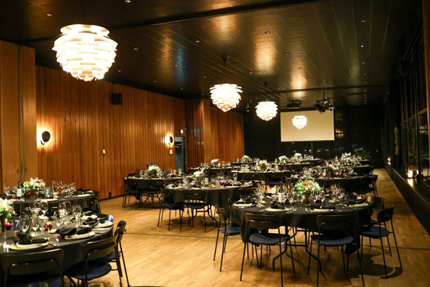
BUSINESS
Who it is for
Micro and small businesses that run on WhatsApp
NEXT
Renovation, contractors
Same flow: extras agreed on site, then argued.
START HERE
THEN
Event companies
Agencies, print, IT
Dinners, launches, weddings. Changes fly in WhatsApp.
Any team that bills by the job and scopes in chat.
BUYER
DAILY USER
TOUCHPOINT
The owner. Loses money to unbilled extras.
The project manager. Chases details across chats.
The client. Taps a link. No login.
Photo: Unsplash.
34

Slide 35
11 PM · A TUESDAY · THE EVENT TEAM'S GROUP CHAT
Client
"Ok, go ahead."
Three words. A bigger LED wall.
Nobody wrote it down.
Synthetic example, from a team member's experience at an event company.
35

