Slide 1
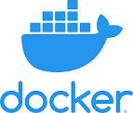
Welcome to Dockerization

Slide 2
Background
How normal applications are executed?
We find physical server
We install OS
Some additional required software & Configurations
What is container?
Why is it required?
How does it help?
Java Web application
24 GB RAM & 1 TB HD Quadcore
Installed Linux (Ubuntu)
Installing Java, tomcat, MySQL
Dotnet
Same as above
Install Windows Server 2016
Configuring server & Microsoft SQL server
For Java Web application we need 2 servers each server consumes 4 GB memory but we have servers with 24 GB which is wasting Memory
The concept that came out to use Hardware to its potential is Virtualization (Server Virtualization) where we install virtualization software and install two JVMs/OS in one server
Notes:
Virtualization – V –Sphere, VMWare EMG2
Container is better than Virtualization (VMWare)

Slide 3
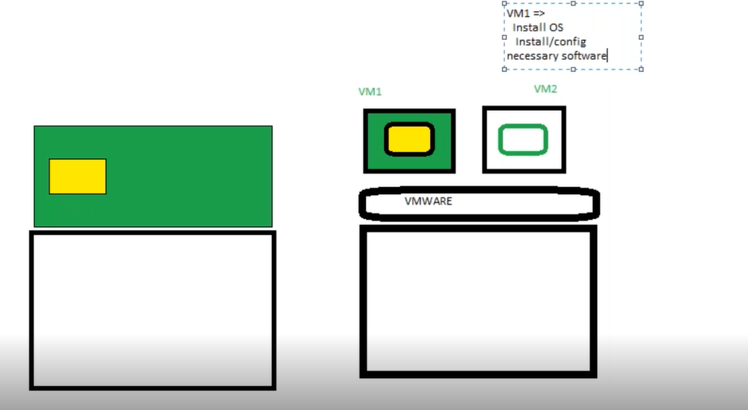
Physical Server vs VMWare
Notes:
Our Focus is on Application not on OS which is consuming more resources. This question is answered by a technology called a container
Container has become very much popular with the organization called Docker
Yellow is utilized area
Green is Free space

Slide 4
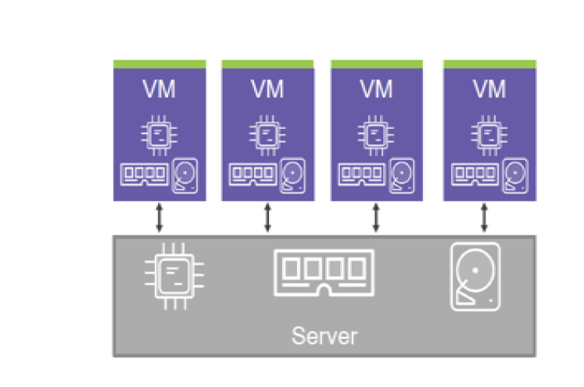
Applications run Businesses
Applications run on Servers
Procurement Lead times
Up-front capex
Ongoing opex
Hypervisors allow multiple apps per server

Slide 5
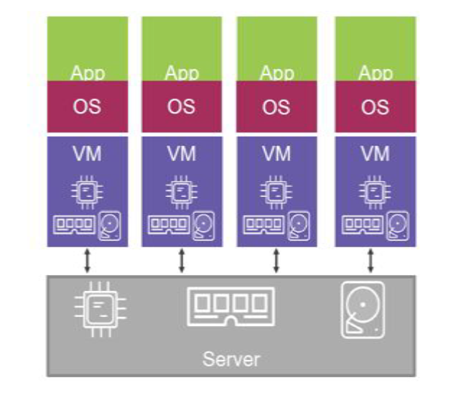
Applications run Businesses
Applications run on Servers
Procurement Lead times
Up-front capex
Ongoing opex
Hypervisors allow multiple apps per server
Uses RAM
Uses CPU
Uses Disk
May have License Cost
Requires Admin time

Slide 6
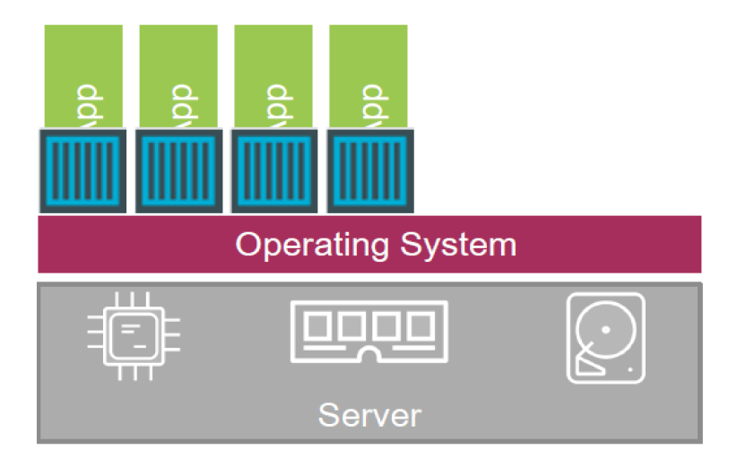
Containers
Notes:
Blue Box is the Container

Slide 7
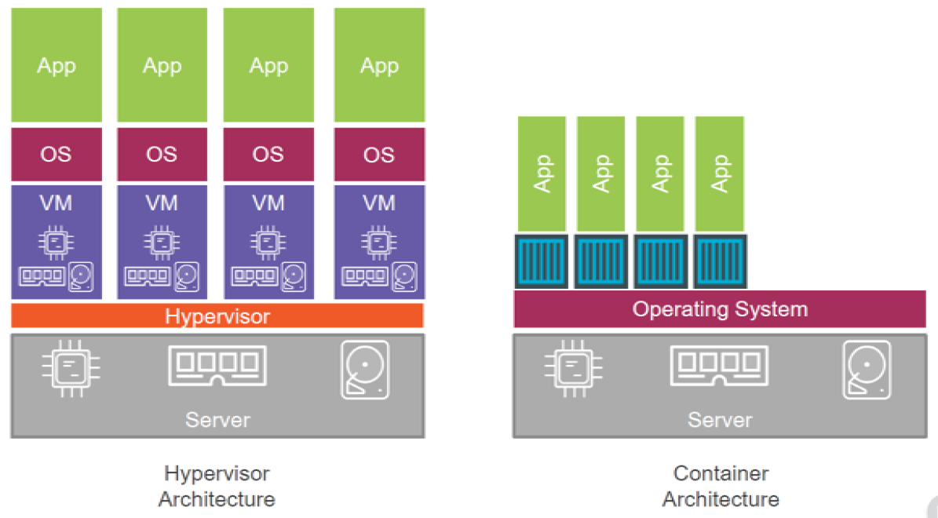
Hypervisor vs Container
Notes:
In Container Technology
For OS, container is a process
But for application, container will look as it is an OS
Application will ask container for any resource then container will ask its Parent OS
Container is an isolated area for your application execution
Container will have minimum Linux kernel (It is thin OS)
Saving cost on OS
Container not working bring up one more
We will have only what ever is required for our application in the container
It is an effective way of utilization of resources on a physical server
Reduce cost
On Same physical machine we can launch many containers
Container is not about OS, it is about your Application
Linux is Kernel, RedHat is OS

Slide 8
Virtual Machines Vs Docker Containers
Assume that each Guest OS is consuming 700 MB Disk Space
700 MB * 3 = 2.1 GB + CPU and Memory resources
App #1
App #2
App #3
BNs/LIBs
BINs/LIBs
BINs/LIBs
GUEST OS
GUEST OS
GUEST OS
App #1
App #2
App #3
BNs/LIBs
BINs/LIBs
BINs/LIBs
HYPERVISOR
DOCKER DAEMON
HOST OPERATING SYSTEM
HOST OPERATING SYSTEM
INFRASTRUCTURE
INFRASTRUCTURE
Virtual Machines
Docker Containers
Notes:
Docker Containers are not VMs
Think of Containers as isolated processes
You can think Virtual Machine as self contained computer packed into a single file but some thing able to need to run that file that’s where Hypervisor comes into play
2 Types of Hypervisors
Type 1 – Direct Link to the Infrastructure – Hyperkit (OSX) / Hyper-V (Win)
More efficient because they bypass Host OS and interact directly to the Hardware of your server
Type 2 – Runs as an app on the host OS – VirtualBox / VMWare
Very Efficient
BINs/LIBs
DB Connection Library
Ruby, Python and Node js packages

Slide 9
Virtual Machines Vs Docker Containers
Starts in Minutes
Starts in Milliseconds
Wastes Resources
Saves Resources
Isolates Systems
Isolates applications
Build Once, deploy everywhere
Virtual Machines
Docker Containers
Notes:
Docker Containers are not VMs
Think of Containers as isolated processes
You can think Virtual Machine as self contained computer packed into a single file but some thing able to need to run that file that’s where Hypervisor comes into play
2 Types of Hypervisors
Type 1 – Direct Link to the Infrastructure – Hyperkit (OSX) / Hyper-V (Win)
More efficient because they bypass Host OS and interact directly to the Hardware of your server
Type 2 – Runs as an app on the host OS – VirtualBox / VMWare
Very Efficient
BINs/LIBs
DB Connection Library
Ruby, Python and Node js packages

Slide 10
Docker’s Analogy
Virtual Machines are Houses
Houses (VMs) are fully self contained
Houses (VMs) might give you too much
Docker containers are apartments
Apts. (Docker Containers) have shared Infrastructure

Slide 11
Docker Overview
Docker is an open platform for developing, shipping, and running applications.
Docker enables you to separate your applications from your infrastructure so you can deliver software quickly.
By taking advantage of Docker’s methodologies for shipping, testing, and deploying code quickly, you can significantly reduce the delay between writing code and running it in production.
Docker provides the ability to package and run an application in a loosely isolated environment called a container.
Containers are lightweight because they don’t need the extra load of a hypervisor, but run directly within the host machine’s kernel.
Docker provides tooling and a platform to manage the lifecycle of your containers:
The container becomes the unit for distributing and testing your application.
With containers scaling and portability becomes extremely simple.
Notes:
The isolation and security allow you to run many containers simultaneously on a given host. This means you can run more containers on a given hardware combination than if you were using virtual machines. You can even run Docker containers within host machines that are actually virtual machines!
Problems Before Docker
An application works in developer’s laptop but not in testing or production. This is due to difference in computing environment between Dev, Test and Prod.
In Dev there can be a software that is upgraded and in prod the old version of software might be present.
The Company named DotCloud was working on Paas Service for which they need some isolated areas to test their services. They developed Docker technology to test their services
From the Customers no one was interested in their Paas technology instead everyone is intertester d in the Docker Technology they developed to test their Products
The Company DotCloud name changed to Docker once it got familiar

Slide 12
Microservices Deployments
Running each microservice on Container is possibly the best option to deploy microservice based applications
Advantages:
Individual Microservice can be scaled
Notes:
The isolation and security allow you to run many containers simultaneously on a given host. This means you can run more containers on a given hardware combination than if you were using virtual machines. You can even run Docker containers within host machines that are actually virtual machines!
Problems Before Docker
An application works in developer’s laptop but not in testing or production. This is due to difference in computing environment between Dev, Test and Prod.
In Dev there can be a software that is upgraded and in prod the old version of software might be present.
The Company named DotCloud was working on Paas Service for which they need some isolated areas to test their services. They developed Docker technology to test their services
From the Customers no one was interested in their Paas technology instead everyone is intertester d in the Docker Technology they developed to test their Products
The Company DotCloud name changed to Docker once it got familiar

Slide 13
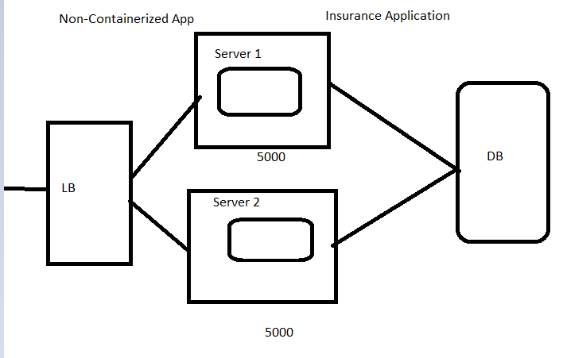
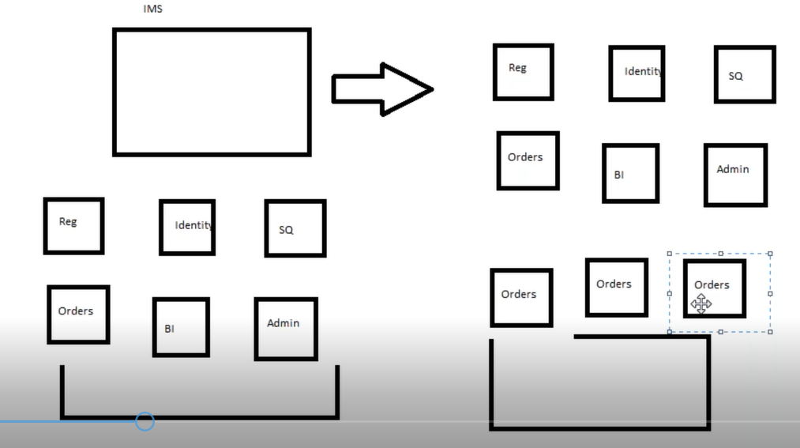
Why do we need to containerize the Application
Notes:
Containerization is subset of Virtualization
Microservices –
Breaking down your application into smaller self-executable services are called micro services
Container is the best way to Host Micro services
Web service you address large set of functionalities whereas Micro service addresses small set of functionalities
Microservice takes 512 MB to 1 Gb

Slide 14
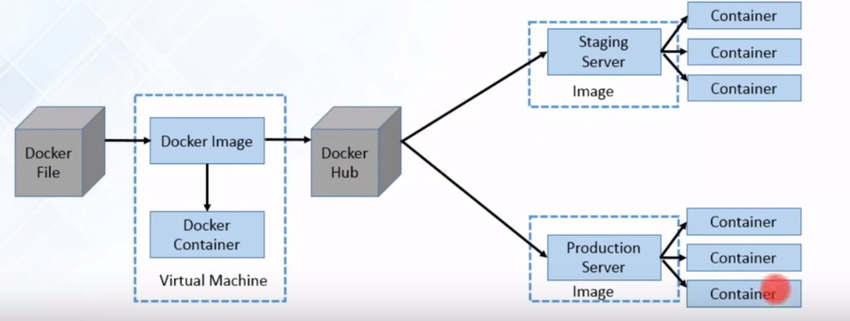
Docker Workflow
Docker file builds a Docker image and that image contains all the project’s code
You can run that image to create as many Docker containers as you want
Then this image can be uploaded on Docker hub, from Docker hub any one can pull the image and build a container
Notes:
Docker is the application which helps you to create the containers
Docker is replacement for Server or Services you cannot use Docker for MS-Word or Google Chrome
Containers are not for Front end applications
If your application is containerized or Dockerized then it is very simple to go your application into Cloud
Containerize the Application is the job of Docker Service

Slide 15
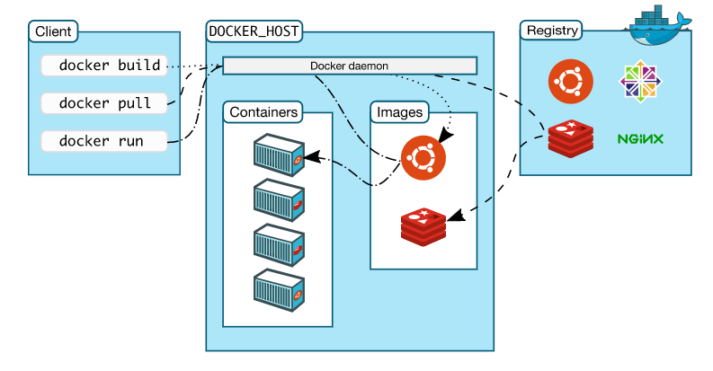
Docker Architecture
Docker uses a client-server architecture. The Docker client talks to the Docker daemon, which does the heavy lifting of building, running, and distributing your Docker containers.
Notes:
The Docker client and daemon can run on the same system, or you can connect a Docker client to a remote Docker daemon. The Docker client and daemon communicate using a REST API, over UNIX sockets or a network interface.

Slide 16
Docker Components
The Docker Daemon
The Docker daemon (dockerd) listens for Docker API requests and manages Docker objects such as images, containers, networks, and volumes. A daemon can also communicate with other daemons to manage Docker services.
The Docker Client
The Docker client (docker) is the primary way that many Docker users interact with Docker. When you use commands such as docker run, the client sends these commands to dockerd, which carries them out. The docker command uses the Docker API. The Docker client can communicate with more than one daemon

Slide 17
Docker Components
Docker Registries
A Docker registry stores Docker images. Docker Hub is a public registry that anyone can use, and Docker is configured to look for images on Docker Hub by default. You can even run your own private registry. If you use Docker Datacenter (DDC), it includes Docker Trusted Registry (DTR).
When you use the docker pull or docker run commands, the required images are pulled from your configured registry. When you use the docker push command, your image is pushed to your configured registry.

Slide 18
Docker Objects
When you use Docker, you are creating and using images, containers, networks, volumes, plugins, and other objects.
IMAGES
An image is a read-only template with instructions for creating a Docker container. Often, an image is based on another image, with some additional customization.
CONTAINERS
A container is a runnable instance of an image. You can create, start, stop, move, or delete a container using the Docker API or CLI. You can connect a container to one or more networks, attach storage to it, or even create a new image based on its current state.
SERVICES
Services allow you to scale containers across multiple Docker daemons, which all work together as a swarm with multiple managers and workers.

Slide 19
Docker Images
An image is a read-only template with instructions for creating a Docker container. Often, an image is based on another image, with some additional customization.
You might create your own images or you might only use those created by others and published in a registry.
To build your own image, you create a Dockerfile with a simple syntax for defining the steps needed to create the image and run it.
Each instruction in a Dockerfile creates a layer in the image. When you change the Dockerfile and rebuild the image, only those layers which have changed are rebuilt. This is part of what makes images so lightweight, small, and fast, when compared to other virtualization technologies.
Build by Docker users
Stored in Docker Hub or Your Local Registry
Notes:
For example, you may build an image which is based on the ubuntu image, but installs the Apache web server and your application, as well as the configuration details needed to make your application run.
docker images
docker build -t my-first:latest . (Dockerfile location)
-t – Name of the image and tag (Version)

Slide 20
Docker Container
A container is a runnable instance of an image. You can create, start, stop, move, or delete a container using the Docker API or CLI.
You can connect a container to one or more networks, attach storage to it, or even create a new image based on its current state.
By default, a container is relatively well isolated from other containers and its host machine.
You can control how isolated a container’s network, storage, or other underlying subsystems are from other containers or from the host machine.
A container is defined by its image as well as any configuration options you provide to it when you create or start it.
When a container is removed, any changes to its state that are not stored in persistent storage disappear.

Slide 21
Dockerfile
FROM -> Selecting Base/Parent Image
MAINTAINER -> WRITER/AUTHOR (LABEL “key” =“value”)
EXPOSE 8080
ENV myEnv=8.0
ADD/COPY
RUN -> These are the commands executed while building Image
CMD -> is executed when container is created (when you run docker run these statements will get executed)
Name -> Dockerfile (if the name is this then no need to specify file name otherwise -f option has to point the location of the file)
Ref: https://docs.docker.com/engine/reference/builder/

Slide 22
Dockerfile
FROM centos
RUN yum install java -y
RUN mkdir /opt/tomcat/
WORKDIR /opt/tomcat
ADD https://dlcdn.apache.org/tomcat/tomcat-9/v9.0.54/bin/apache-tomcat-9.0.54.tar.gz /opt/tomcat
RUN tar xvfz apache*.tar.gz
RUN mv apache-tomcat-9.0.54/* /opt/tomcat
EXPOSE 8080
CMD ["/opt/tomcat/bin/catalina.sh", "run"]

Slide 23
Building the Docker Image
docker build -t my-first:latest . (Dockerfile location)
-t – Name of the image and tag (Version)
docker images
docker rmi <image name>
docker images -q -> Returns image ID
docker run –d –p 8080:8080 <image name>
docker ps
docker ps –a
docker ps –a –q
docker rm <ContanerName> (-f forceful)
docker exec -it ef6a370adc96 /bin/bash – to login to the container
Notes:
For example, you may build an image which is based on the ubuntu image, but installs the Apache web server and your application, as well as the configuration details needed to make your application run.
docker images
docker build -t my-first:latest . (Dockerfile location)
-t – Name of the image and tag (Version)

Slide 24
Docker Hub
Docker Hub is a Cloud hosted service provided by Docker. Like GitHub repository for Docker images
Docker Hub is a service provided by Docker for finding and sharing container images with your team. It provides the following major features:
Repositories:
Push and pull container images. ... Builds: Automatically build container images from GitHub and Bitbucket and push them to Docker Hub.
https://hub.docker.com/
Public Images – Created By Vendors or anybody
Private images
Notes:
Better to use Official public images published by Vendors
Docker login
Docker push <imageName> -- skatta3/mywebapp
docker push localhost.localdomain:5000/ubuntu – Push image to your Own registry
)

Slide 25
Docker Commands
docker run -it ubuntu /bin/bash
When you run this command, the following happens (assuming you are using the default registry configuration):
If you do not have the ubuntu image locally, Docker pulls it from your configured registry, as though you had run docker pull ubuntu manually.
Docker creates a new container, as though you had run a docker container create command manually.
Docker allocates a read-write filesystem to the container, as its final layer. This allows a running container to create or modify files and directories in its local filesystem.
Docker creates a network interface to connect the container to the default network, since you did not specify any networking options.
This includes assigning an IP address to the container. By default, containers can connect to external networks using the host machine’s network connection.
Notes:
Docker login

Slide 26
Docker Commands
docker pull myregistry.local:5000/testing/test-image
Pulls the image from different Registry
docker push <imageName> -- skatta3/mywebapp
docker push localhost.localdomain:5000/ubuntu
Push image to your Own registry
docker rm <Container> -> to remove container which loses the history
stop the container and remove or force delete with -f option
docker rm -f <Container>
docker rm -f $(docker ps -a -q) – remove all containers
Notes:
Docker login
Docker push <imageName> -- skatta3/mywebapp
docker push localhost.localdomain:5000/ubuntu – Push image to your Own registry

Slide 27
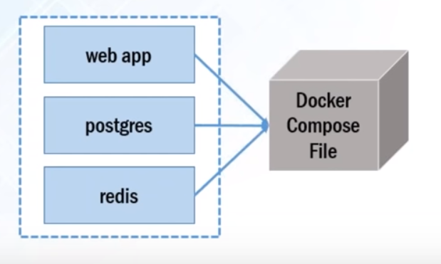
Docker Compose
Docker Compose makes it easier to configure and run applications made up of multiple containers.
With Compose, you use a YAML file to configure your application’s services. Then, with a single command, you create and start all the services from your configuration.
For example: imagine being able to define three containers – one running a web app, another running postgres, and third running redis – all in one YAML file and then running those three connected containers with a single command.

Slide 28
Docker Compose
Compose works in all environments: production, staging, development, testing, as well as CI workflows.
Using Compose is basically a three-step process:
Define your app’s environment with a Dockerfile so it can be reproduced anywhere.
Define the services that make up your app in docker-compose.yml so they can be run together in an isolated environment.
Run docker-compose up and Compose starts and runs your entire app.Use yaml file to configure application services (docker-compose.yml)
Can stop all services with a single command (docker-compose down)
Can scale up selected services when required
Notes:
sudo apt install docker-compose – To Install docker compose
docker-compose –v or docker-compose version
Check the validity of yml file with docker-compose config
Docker-compose.yml
version: "3"
services:
web:
image: nginx
database:
image: redis
docker-compose up
docker ps
docker-compose down
docker ps
docker-compose up –d –scale database=4

Slide 29
Docker Swarm
A Swarm is a group of machines that are running Docker and joined into a Cluster
The cluster management & Orchestration features are embedded inside Docker Engine.
Docker swarm consists of multiple docker hosts which run in swarm mode.
Two Roles managers and workers exist in Docker swarm
Manager is responsible for membership & delegation
Worker is responsible for running swarm services
Each Docker Host can be a manager, a worker or both.
In Docker Swarm Desired State is maintained. For instance if you are running one container in swarm on a particular node (Worker) and that node goes down, then Swarm schedules this nodes task on other node to maintain the state.
Task is a running container which is part of swarm service managed by Swarm Manager
Notes:
Docker Swarm is a tool for container orchestration
Ex: you have 100 containers
You need to do
Health check on every container
Ensure all containers are up on every system
Scaling the containers up or down depending on the load
Adding/updating changes to all the containers
Orchestration – Managing and controlling multiple docker containers as a single service

Slide 30
Docker Swarm - Nodes
It is instance of the docker engine participating in Swarm.
There are two kinds of nodes
Manager nodes:
You communicate to manager node to deploy applications in the form of Service Definitions.
Manager nodes dispatch unit of work called as tasks to the Worker nodes
Worker nodes:
They receive & execute the tasks dispatched from manager nodes.
An agent runs on the worker node & reports on the tasks assigned to it
Task
Carries a Docker container and the commands to run inside the container.
It is the atomic scheduling unit of swarm.
Once a task is assigned to node, it cannot move to another node.
It can only run on the assigned node or fail.
Notes:
Docker Swarm is a tool for container orchestration
Ex: you have 100 containers
You need to do
Health check on every container
Ensure all containers are up on every system
Scaling the containers up or down depending on the load
Adding/updating changes to all the containers
Orchestration – Managing and controlling multiple docker containers as a single service

Slide 31
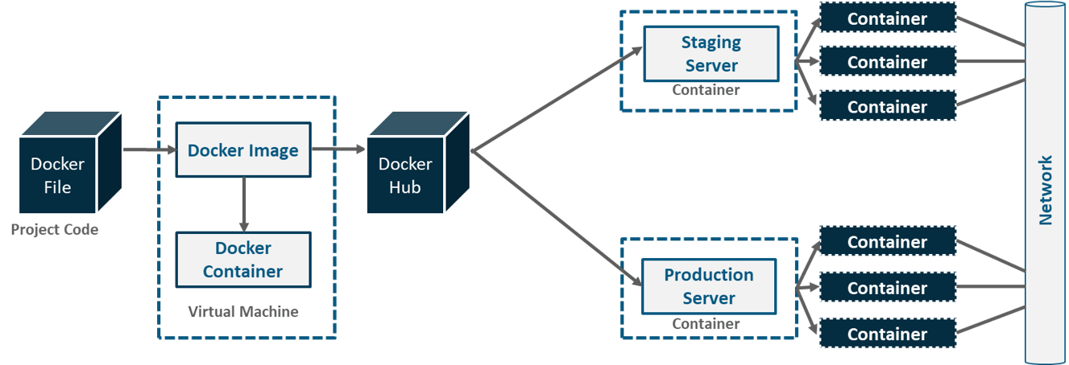
Docker Networking
These individual containers, communicate with each other through a network to perform the required actions, and this is nothing but Docker Networking.

Slide 32
Docker Networking
Docker takes care of the networking aspects so that the containers can communicate with other containers and also with the Docker Host.
If you do an ifconfig on the Docker Host, you will see the Docker Ethernet adapter. This adapter is created when Docker is installed on the Docker Host.
This is a bridge between the Docker Host and the Linux Host.
List all Docker networks
docker network ls
Inspecting a Docker network
docker network inspect networkname
Creating your own network
docker network create –-driver drivername name
drivername − This is the name used for the network driver.
name − This is the name given to the network.
Ex: sudo docker network create –-driver bridge new_nw
Notes:
IPAM – IP Address Management

Slide 33
Docker Networking
You can now attach the new network when launching the container. So let’s spin up an Ubuntu container with the following command −
docker run –it –network=new_nw ubuntu:latest /bin/bash
Notes:
IPAM – IP Address Management

Slide 34
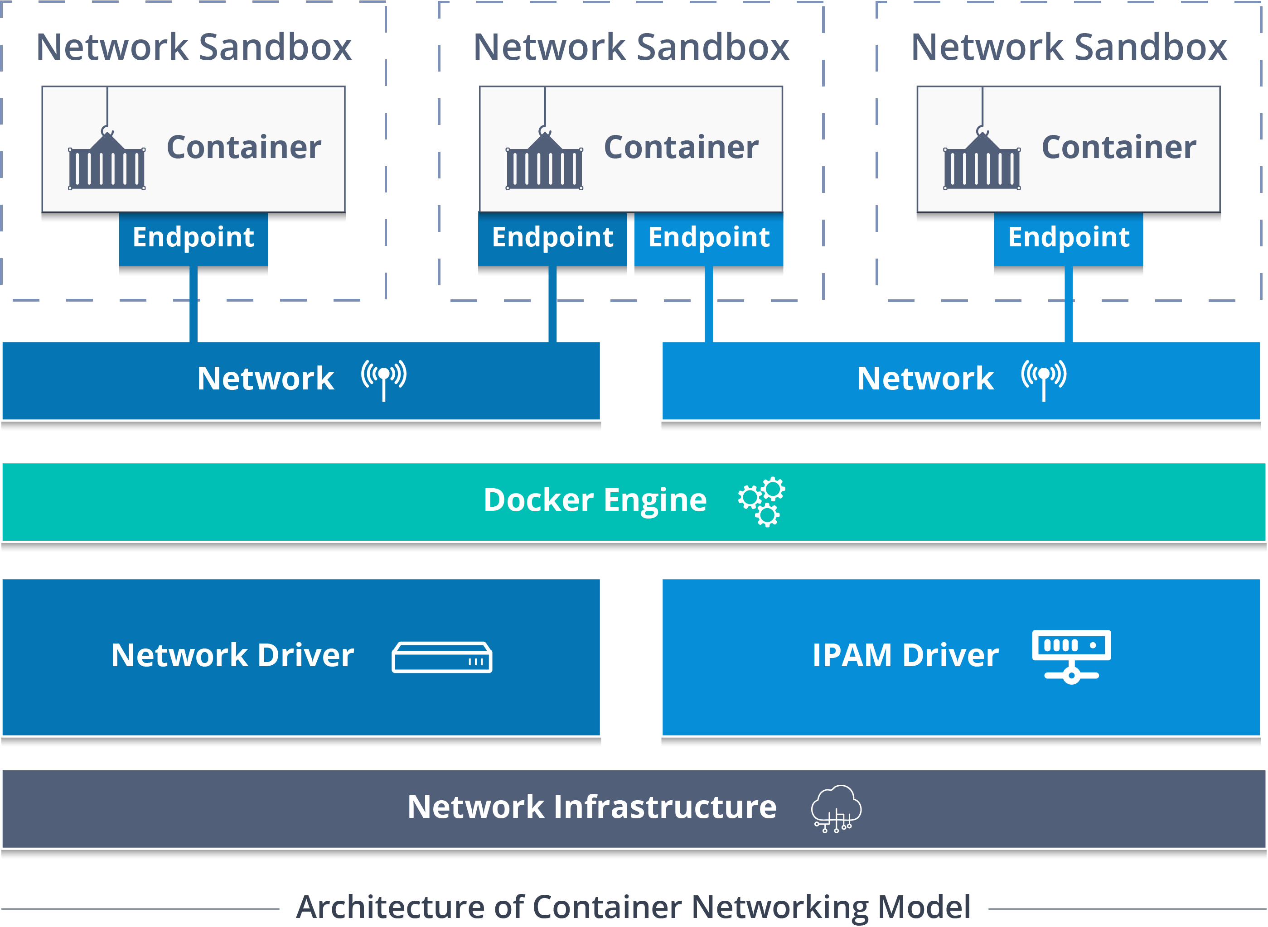
Architecture of Container Networking Model (CNM)
Notes:
Libnetwork is an open source Docker library which implements all of the key concepts that make up the CNM.
CNM formalizes the steps required to provide networking for containers, while providing an abstraction that can be used to support multiple network drivers.

Slide 35
Container Network Model
The CNM has interfaces for IPAM plugins and network plugins.
The IPAM plugin APIs are used to create/delete address pools and allocate/deallocate container IP addresses, whereas the network plugin APIs are used to create/delete networks and add/remove containers from networks.
CNM requires a distributed key-value store like console to store the network configuration.
Notes:
IPAM – IP Address Management

Slide 36
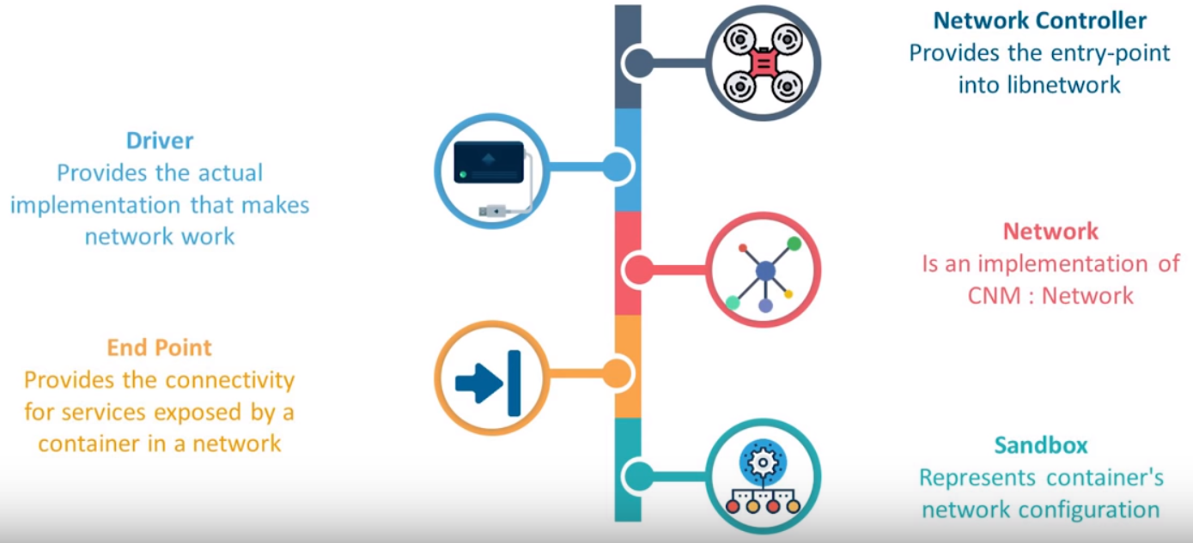
Container Networking Model (CNM) Objects

Slide 37
Container Network Model Objects
Network Controller:
Provides the entry-point into Libnetwork that exposes simple APIs for Docker Engine to allocate and manage networks.
Since Libnetwork supports multiple inbuilt and remote drivers, Network Controller enables users to attach a particular driver to a given network.
Driver:
Owns the network and is responsible for managing the network by having multiple drivers participating to satisfy various use-cases and deployment scenarios.
Network:
Provides connectivity between a group of endpoints that belong to the same network and isolate from the rest. So, whenever a network is created or updated, the corresponding Driver will be notified of the event.
Notes:
IPAM – IP Address Management

Slide 38
Container Network Model Objects
Endpoint:
Provides the connectivity for services exposed by a container in a network with other services provided by other containers in the network.
An endpoint represents a service and not necessarily a particular container, Endpoint has a global scope within a cluster as well.
Sandbox:
Created when users request to create an endpoint on a network.
A Sandbox can have multiple endpoints attached to different networks representing container’s network configuration such as IP-address, MAC-address, routes, DNS.
Notes:
IPAM – IP Address Management

Slide 39
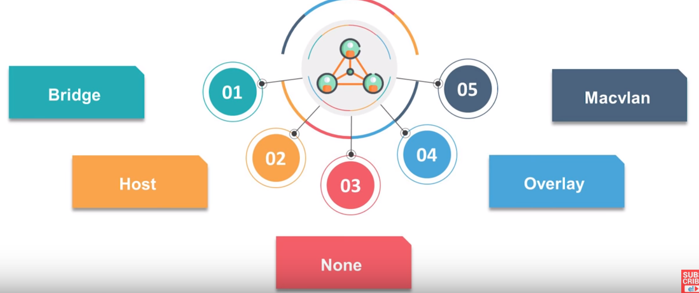
Network Drivers
Notes:
IPAM – IP Address Management

Slide 40
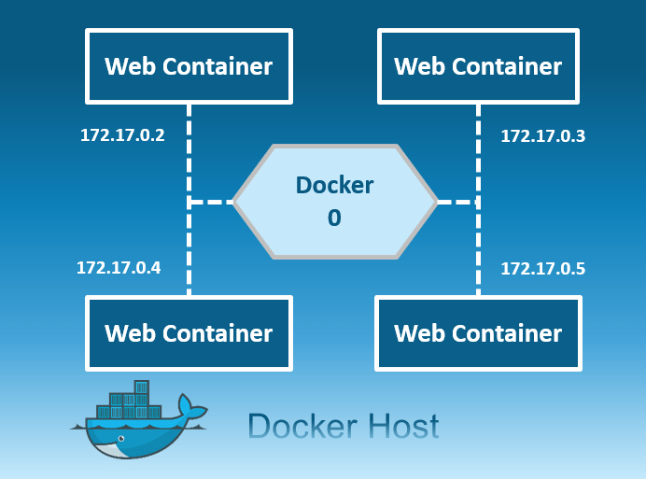
Network Drivers:Bridge
The bridge network is a private default internal network created by docker on the host.
So, all containers get an internal IP address and these containers can access each other, using this internal IP.
The Bridge networks are usually used when your applications run in standalone containers that need to communicate.

Slide 41
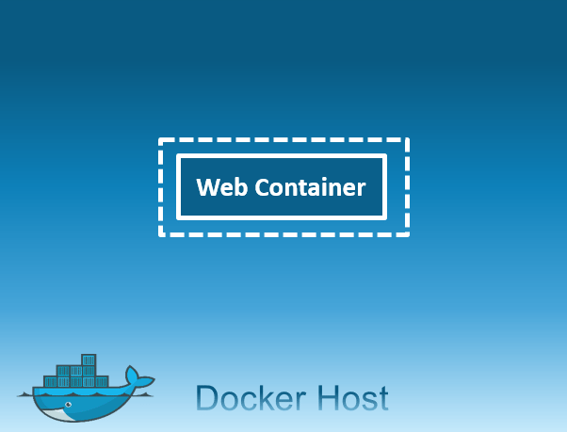
Network Drivers: None
In this kind of network, containers are not attached to any network and do not have any access to the external network or other containers.
So, this network is used when you want to completely disable the networking stack on a container and, only create a loopback device.

Slide 42
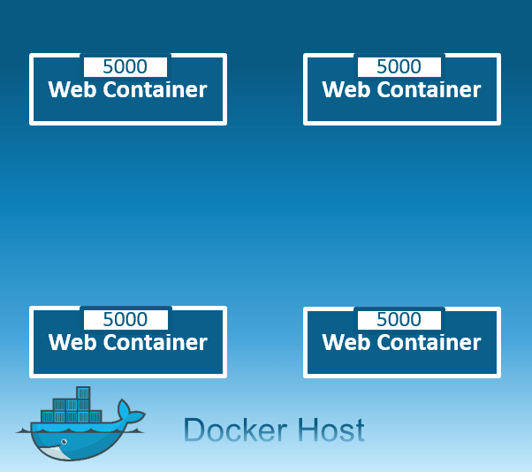
Network Drivers: Host
This driver removes the network isolation between the docker host and the docker containers to use the host’s networking directly.
So with this, you will not be able to run multiple web containers on the same host, on the same port as the port is now common to all containers in the host network.

Slide 43
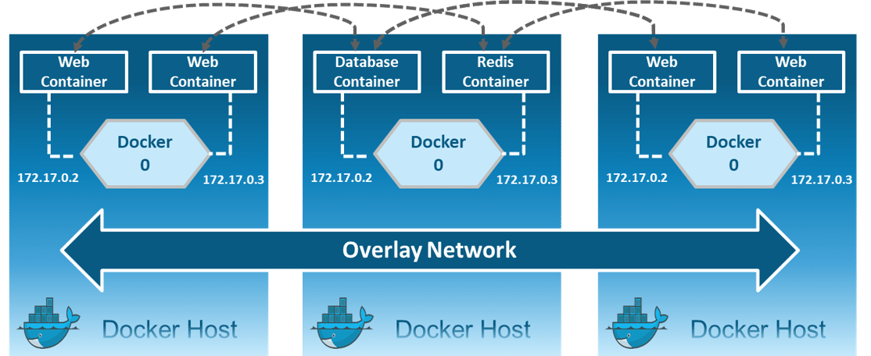
Network Drivers: Overlay
Creates an internal private network that spans across all the nodes participating in the swarm cluster.
So, Overlay networks facilitate communication between a swarm service and a standalone container, or between two standalone containers on different Docker Daemons.

Slide 44
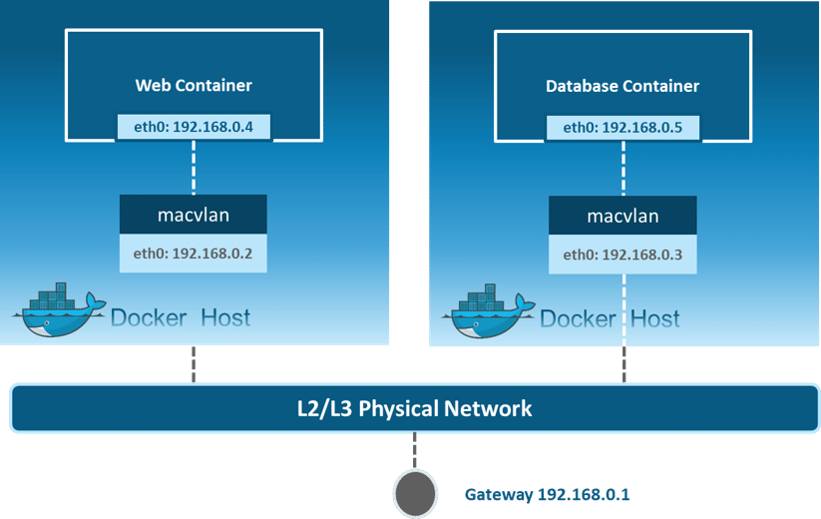
Network Drivers: Macvlan
Allows you to assign a MAC address to a container, making it appear as a physical device on your network. Then, the Docker daemon routes traffic to containers by their MAC addresses.
Macvlan driver is the best choice when you are expected to be directly connected to the physical network, rather than routed through the Docker host’s network stack.

Slide 45
Docker Networking
docker network ls
docker network inspect bridge
docker network create -d drivername name
Example: docker network create -d bridge my-bridge-network
sudo docker run –it –network=new_nw ubuntu:latest /bin/bash

Slide 46
Q & A

