Slide 1
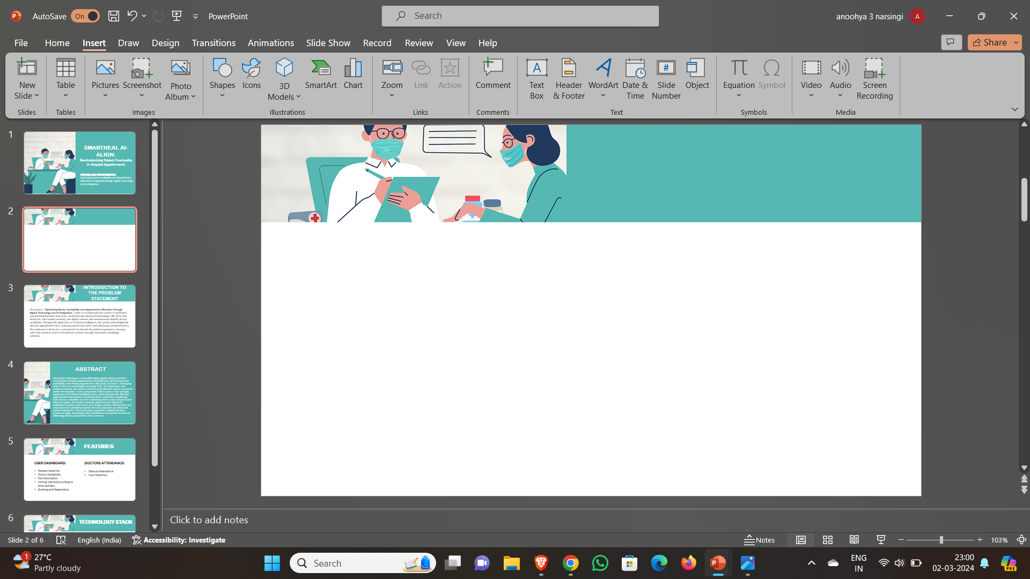

VASAVI COLLEGE OF ENGINEERING
Department of Information Technology
THEME BASED PROJECT
TITLE : SMARTHEAL
TEAM MEMBERS:
Anoohya Narsingi :1602-21-737-070
Bhavani Lavanga :1602-21-737-076 Mirza Rafiq Ahmed :1602-21-737-095

Slide 2
MOTIVATION
The motivation behind SmartHeal stems from a deep-seated desire to revolutionize the healthcare industry by addressing the pressing challenges faced by healthcare facilities worldwide. With escalating demands for efficiency, patient satisfaction, traditional healthcare management methods have become increasingly inadequate. SmartHeal seeks to bridge this gap by harnessing the power of technology to streamline administrative processes, improve communication channels, and enhance overall operational efficiency.

Slide 3
PROBLEM STATEMENT
Enhancing hospital operations and patient experience through streamlined appointment scheduling, doctor management, and efficient communication tools.

Slide 4
ABSTRACT
SmartHeal is a pioneering healthcare management platform that integrates advanced technology to streamline administrative tasks and improve patient care. With features such as doctor management, appointment scheduling, patient communication, and administrative task automation, SmartHeal revolutionizes healthcare facility operations. By prioritizing user-friendly interfaces and customizable features, SmartHeal empowers healthcare administrators to optimize workflows, save valuable time, and enhance the overall patient experience. Through its innovative approach, SmartHeal sets a new standard for healthcare management, where efficiency meets empathy.

Slide 5
EXISTING SYSTEM AND PROPOSED SOLUTION
EXISTING SYSTEM:
In the current healthcare system, patient appointments are managed manually or through scheduling software.
Patient waiting times are often long due to inefficient appointment scheduling .
Patients often have to wait unnecessarily for tests and procedures due to inefficient coordination between medical staff and resources.
Proposed Solution:
Develop a user-friendly interface for patients to book appointments based on their convenience.
Analyze patient flow and allocate resources efficiently, reducing waiting times.
Overall, the proposed solution aims to optimize doctor availability, reduce patient waiting times, and streamline the entire healthcare process through smart digital solutions.

Slide 6
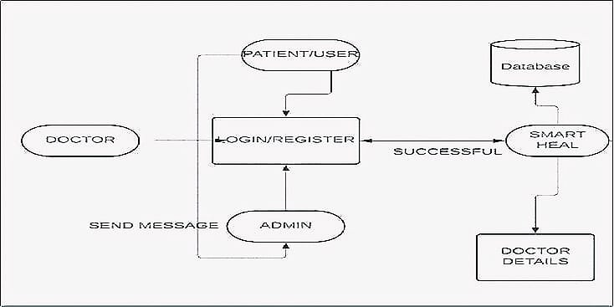
SYSTEM ARCHITECTURE

Slide 7
TECHNOLOGY STACK:
FRONTEND: Html ,React.js, CSS ,Java Script
BACKEND: Node.js, Express.js
DATABASE: MongoDB, CloudinaryAPI

Slide 8
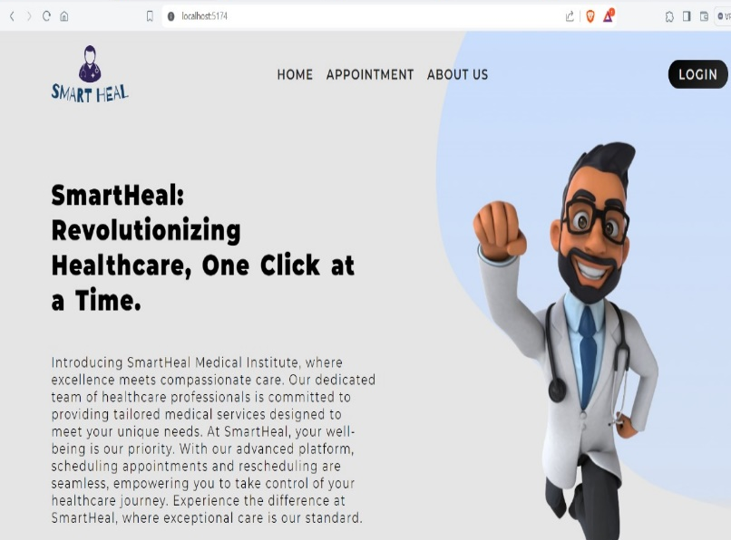
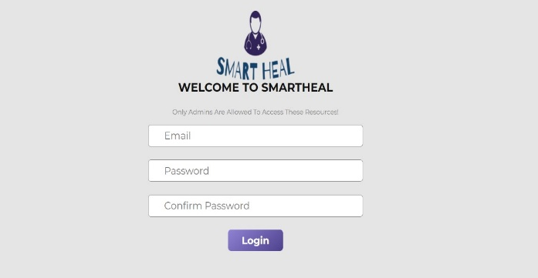
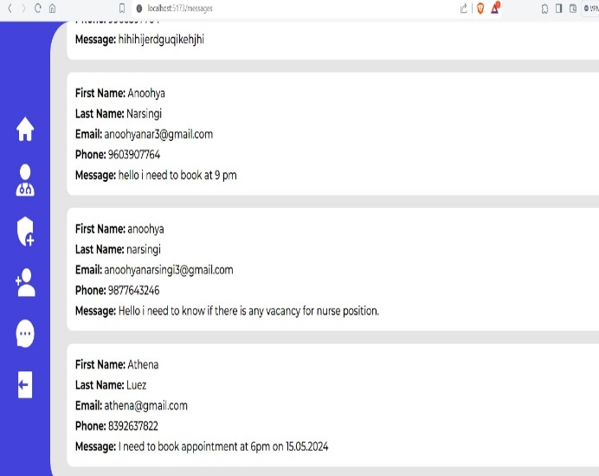
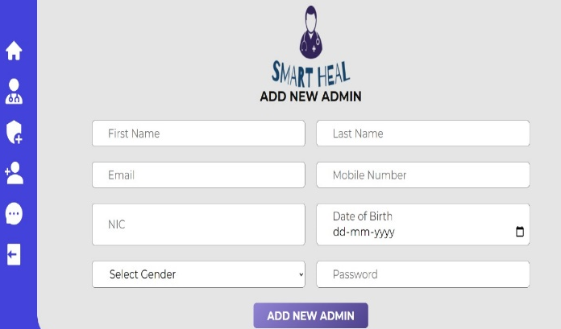
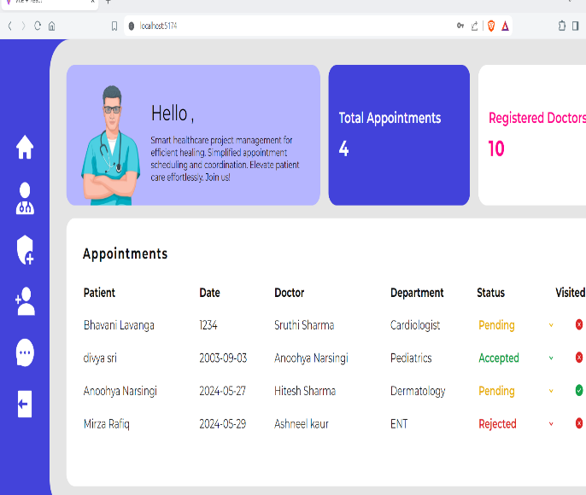
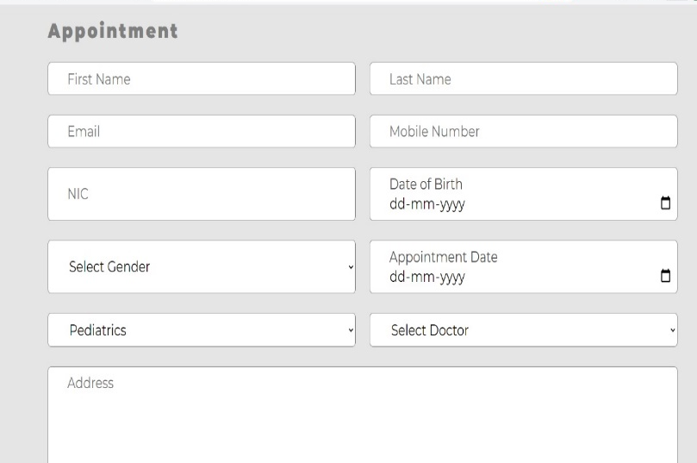
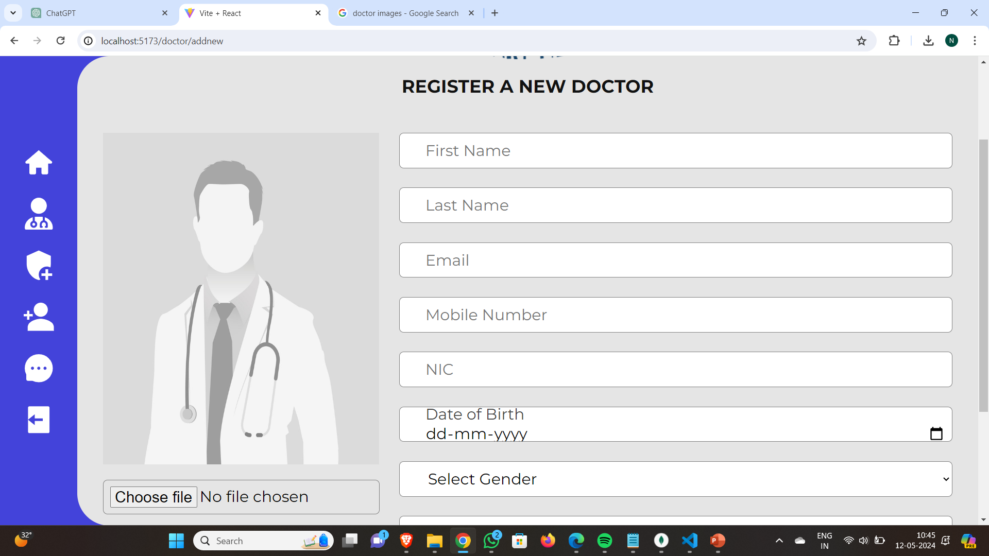
FRONT PAGE OUTPUTS
DASHBOARD OUTPUTS
BACKEND

Slide 9
FUTURE SCOPE
Expanding to Multiple Facilities: Standardizing processes and integrating with existing hospital software allows our project to scale, improving access to care and enabling effective collaboration among healthcare providers through seamless data exchange.
Integrating RFID, Mobile Proximity, and Face Detection: Using RFID tags for real-time tracking, mobile proximity for seamless communication, and face detection for security and streamlined check-ins enhances efficiency and convenience for both patients and doctors.
AI-driven Virtual Health Assistants: AI-powered virtual assistants provide personalized support, initial assessments, and valuable insights, streamlining diagnostics and reducing the load on healthcare staff.
Advanced Scheduling Algorithms and Predictive Analytics: Sophisticated algorithms and predictive analytics optimize scheduling by anticipating demand, predicting patient arrivals, and allocating resources, reducing waiting times and improving patient satisfaction.

Slide 10
CONCLUSION
SmartHeal emerges as a beacon of efficiency in healthcare administration. By integrating user-friendly interfaces with robust features, it not only optimizes operational workflows but also enhances patient satisfaction. With SmartHeal, healthcare facilities embark on a journey towards seamless coordination and improved patient outcomes.
SmartHeal – Where Efficiency Meets Empathy.

Slide 11
REFERENCES:
Benson, T. (2012). "Principles of Health Interoperability HL7 and SNOMED."
Rohleder, T. R., & Klassen, K. J. (2000). "The Use of Online Booking Systems in Healthcare."
Bove, R., et al. (2013).” Evaluation of Secure Messaging Between Patients and Healthcare Providers."
Liu, C., & Zhang J. (2016). "Customization of Healthcare Systems for Improving Efficiency."
Shortliffe, E. H., & Cimino, J. J. (2006). "Biomedical Informatics: Compute Applications in Health Care and Biomedicine."

