Slide 1


AI-Powered Intelligent Document Search & RAG Assistant
Intelligent Retrieval, Structured Summarization, and Speech-to-Text Chat Assistant
PRESENTER DETAILS
Presenter: [Insert Team Name / Members]
Track: GenAI & Automation Hackathon
CORE TECH STACK
Frontend: Angular 17
Backend: Flask (Python) & FAISS Local Vector Store
Models: GPT-4o & DeepSeek-V3 (TCS GenAI Lab API)

Slide 2
Problem Context & Impact
The Cost of Manual Search & Unstructured Information
The Challenge & Risks
• Business & technical teams lose thousands of hours manually searching through scattered requirements, specifications, and layout diagrams.
• Traditional keyword search misses critical semantic context, ignoring key synonyms and intent.
• Visual assets (flowcharts, design mockups, scanned specs) remain unsearchable and isolated.
• Leads to undetected document contradictions, missed requirements, and high dependency lags.
The GenAI RAG Solution
• Automated Ingestion: Converts PDFs, text documents, and diagrams into searchable vector indices.
• Contextual Extraction: Utilizes semantic similarity matching rather than simple keyword tags.
• Visual OCR parser: Seamlessly translates visual mockups and flows using GPT-4o Vision API.
• Structured Outputs: Delivers instant summaries of proposed changes, system impacts, and risk matrices.

Slide 3
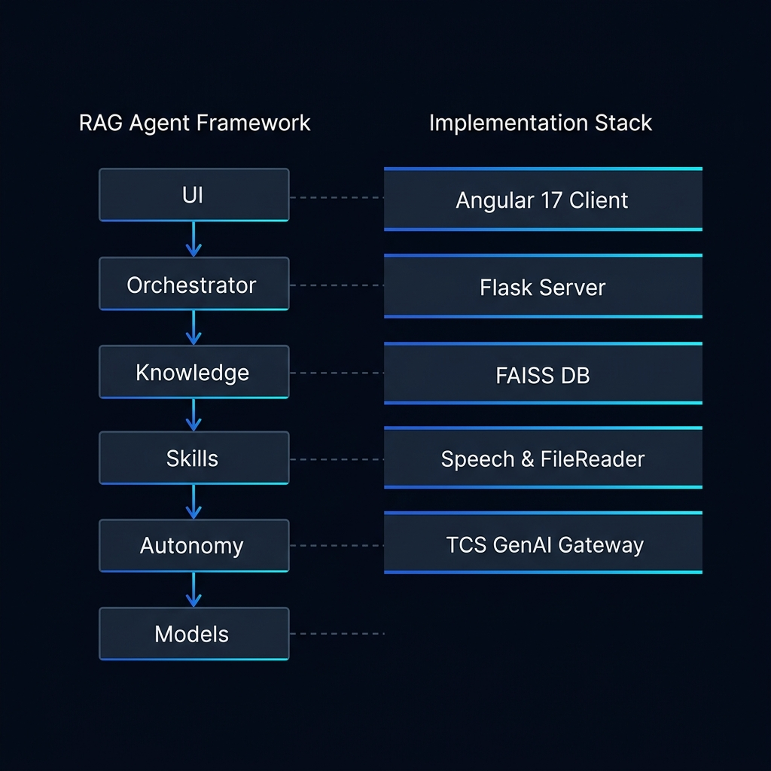
Architectural Diagram
The Cost of Manual Search & Unstructured Information

Slide 4
Technical Implementation & AI Stack
High-Performance Architecture (Local FAISS + TCS GenAI)
Angular 17 Client
• Modern Client running on Port 4202.
• Glassmorphic design built with Vanilla CSS for visual excellence.
• Integrated Web Speech SDK for hands-free analyst query input.
• Custom PDF/TXT uploader and formatted TXT/JSON exports.
Flask Python Server
• Microservice running on Port 5002.
• RAG pipeline using pdfminer to extract text without local C++ binary dependencies.
• Base64 image converter feeds diagrams directly to Vision OCR.
• Local FAISS CPU database for fast, local vector index retrieval.
TCS GenAI Lab Gateway
• Secure API boundary for embedding and reasoning models.
• Embeddings: Uses text-embedding-3-large for high-fidelity vectors.
• LLM Core: GPT-4o and DeepSeek-V3 are integrated dynamically.
• Enables advanced impact analysis and contextual chat replies.

Slide 5
Prototype Highlights & Live Walkthrough
Demonstrating Features That Accelerate Analysis
Interactive File Uploader
• Drag-and-drop file interface for quick indexing.
• Dynamic tag reference generation as files are parsed.
Structured Impact Summarizer
• Outputs four core pillars: Executive Summary, Proposed Changes, System Impact, and Stakeholder Risk/Mitigation Matrix.
Voice & Vision Chat
• Hands-free voice query parsing (Web Speech API).
• Vision attachments allow direct reasoning on flowchart images using GPT-4o Vision.
Export Capabilities
• Download structured results as standard TXT files.
• Export data to JSON formatting for external integration.

Slide 6
Future Vision & Scalability
Transitioning From Demo to Production Platform
Enterprise Security & Connectivity
• Role-Based Access Control (RBAC): Enforce document-level access permissions dynamically within vector databases.
• Enterprise API Connectors: Automate real-time ingestion pipelines with live repositories like Microsoft SharePoint, JIRA, and Confluence.
• Active Directory Integration: Single Sign-On (SSO) and group-based document access restrictions.
Advanced Processing & Offline Deployment
• Metadata Filtering: Enhance semantic similarity search with temporal filters, category rules, and author tags.
• Hybrid Indexing: Combine semantic FAISS vector search with BM25 keyword matching for optimal recall.
• Local Offline Deployment: Transition embedding and reasoning execution to secure offline LLMs (Llama-3, Phi-3) using local Ollama endpoints for 100% data leakage protection.

