Slide 1
ACTIVITY 2
NLP-Based Intelligent Writing Assistant
TEAM
SyntaxSquad
MEMBERS
Anoon M R · 25MCAR0179
Aman Kumawat · 25MCAR0023
Adithya Krishnan T N · 25MCAR0003
FACULTY
Dr. Sharal Coelho
COURSE
Natural Language Processing (25MCAAI303)
DEPARTMENT
MCA · JAIN (Deemed-to-be University)
Autocorrect, Autocomplete, and POS-Aware Suggestions
teh → the
jumpd → jumped
ovr → over
Spell correction · next-word prediction · POS tagging — built from scratch in Python

Slide 2
01 · INTRODUCTION
Introduction & Problem Statement
i
Background
!
Problem
★
Why it matters
A writing assistant built from scratch in Python — spell correction, next-word prediction and POS-aware suggestions.
Spell checkers ignore real error patterns; autocomplete ignores grammar.
Emails, messages and academic writing all suffer from context-blind corrections and ungrammatical suggestions.
Objectives — five modules
1
2
3
4
5
Tokenizer
Spell corrector
N-Gram LM
POS tagger
Live Flask UI
Regex-based word splitting
Noisy Channel, learned confusion matrix, edit distance ≤ 2
Bigram + trigram with back-off
HMM decoded with Viterbi
Debounced AJAX, updates as you type
SyntaxSquad · NLP-Based Intelligent Writing Assistant
2 / 12

Slide 3
02 · LITERATURE
Literature Survey
1964
1967
1988
1990
1999
CACM
IEEE Trans. Info. Theory
ANLP
COLING
CSL
Damerau
Viterbi
Church
Kernighan, Church & Gale
Chen & Goodman
~80% of real typos are a single edit
The decoding algorithm our POS tagger uses
HMM-style POS tagger on the Brown Corpus, 95–99% accuracy
Noisy Channel spelling correction with learned confusion matrices — basis of our corrector
Smoothing survey; explains our perplexity results
Research gap: these techniques are usually studied in isolation — we let the HMM filter the N-gram LM's suggestions in real time.
SyntaxSquad · NLP-Based Intelligent Writing Assistant
3 / 12

Slide 4
03 · METHODOLOGY
Proposed Methodology
Raw text
Tokenizer
Spell corrector
POS tagger
N-Gram LM
POS filter
Flask UI
user input
regex
Noisy Channel
HMM + Viterbi
trigram → bigram
match expected tag
live AJAX
Spell corrector
N-Gram language model
Candidates within edit distance 2, ranked by P(word) × P(typo | word). P(typo | word) learned from 12,356 real single-edit misspellings.
Trigram with back-off to bigram, Laplace smoothing; trained on Brown Corpus sentences.
HMM POS tagger
POS-aware filter
Bigram HMM over 10 Universal POS tags, decoded with the Viterbi algorithm.
Keep only next-word candidates whose tag matches the tag the HMM expects next.
SyntaxSquad · NLP-Based Intelligent Writing Assistant
4 / 12

Slide 5
04 · DATA
Dataset & Experimental Setup
54,286
24,891
54,270
38,218
cleaned sentences
vocabulary words
POS-tagged sentences
real misspelling pairs
Brown Corpus (NLTK)
frequency ≥ 2
10 Universal tags
Norvig corpus, 7,841 words
Downloaded from: Brown Corpus — NLTK data (nltk.download('brown'), nltk.org/nltk_data) Misspellings — norvig.com/ngrams/spell-errors.txt
Preprocessing (Activity 1)
Experimental setup
1
Lowercase
90% train
2
Strip punctuation
seed 42
10% test
3
Tokenize
Applied to all three datasets — every score is on unseen data.
Tools: Python 3.12 · Flask 3.1.3 · matplotlib · no GPU
4
Length filter
SyntaxSquad · NLP-Based Intelligent Writing Assistant
5 / 12

Slide 6
05 · RESULTS
Results & Evaluation
Accuracy on held-out test data
5,596
Bigram perplexity
13,641
Trigram perplexity (with back-off)
Why is trigram higher? Laplace adds V ≈ 40K to every denominator, which swamps the sparse trigram counts.
193 of 500 real misspellings are 3+ edits away — out of reach by design.
SyntaxSquad · NLP-Based Intelligent Writing Assistant
6 / 12

Slide 7
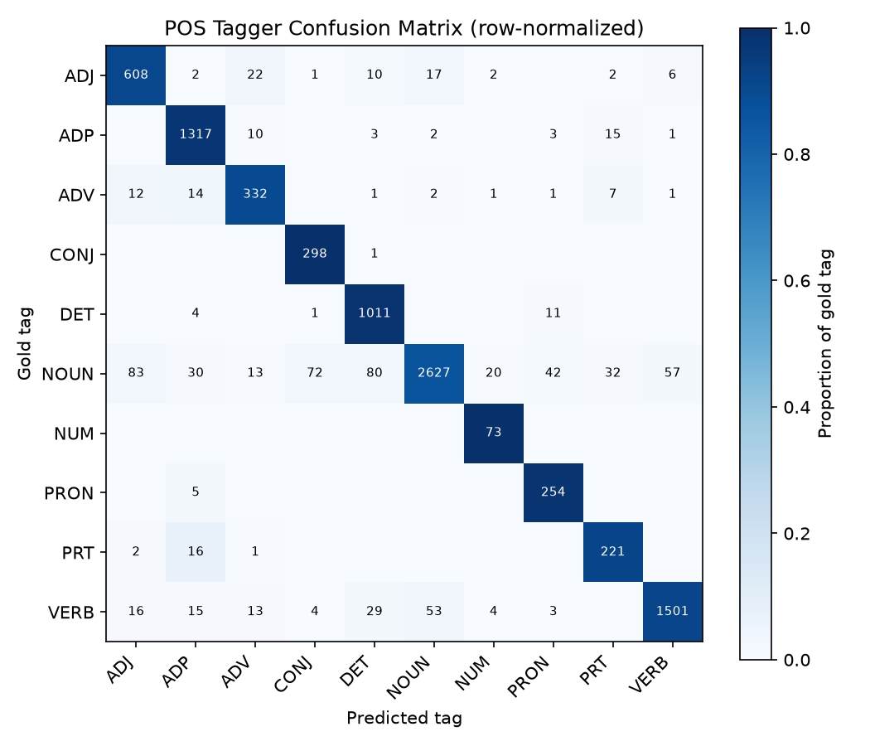
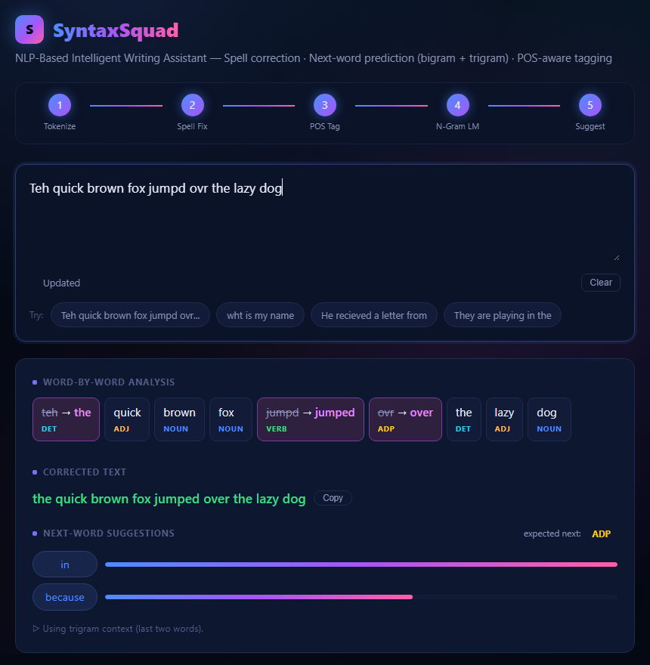
06 · OUTPUTS
Confusion Matrix & Live Output
L
POS tagger confusion matrix
Held-out set, strongly diagonal. Biggest confusions: NOUN → ADJ (83), DET (80), CONJ (72).
R
Live web app
3 typos fixed, every word tagged, next-word suggestions filtered to the expected tag.
SyntaxSquad · NLP-Based Intelligent Writing Assistant
7 / 12

Slide 8
07 · ERROR ANALYSIS
Error Analysis
Why the 48 synthetic-typo misses happened
Fixed during testing
“ovr” used to give “or” and “wht” gave “who” — both now give “over” and “what”, thanks to the learned confusion matrix. Single-letter “I” → “in” also fixed.
23 ED-2 word beat ED-1
48
11 Other ED-1 word won
misses
9 Real-word typo
POS confusions
5 Not in vocabulary
NOUN mix-ups on ambiguous words like “that” — a bigram HMM only sees one previous tag.
haed → “and”, not “head”: a very common word 2 edits away outranks the right word 1 edit away.
will → gill: a real word, so words corrected in isolation never flag it.
Next fixes
Prefer 1-edit candidates · rank spelling in context · Kneser-Ney smoothing · trigram HMM.
SyntaxSquad · NLP-Based Intelligent Writing Assistant
8 / 12

Slide 9
08 · PROJECT PROOF
Project Proof
</>
Source code on GitHub
github.com/AnoonMR/Writing-Assistant
$ pip install -r requirements.txt
$ cd src
$ python app.py
→ open http://127.0.0.1:5000
$ python evaluate.py # reproduce every metric
Not publicly hosted — runs on localhost, fully offline once the data is downloaded.
SyntaxSquad · NLP-Based Intelligent Writing Assistant
9 / 12

Slide 10
09 · CONCLUSION
Conclusion & Future Work
5 / 5
91.74%
3
modules built
POS tagging accuracy
weak spots, all diagnosed
At full proposal scope, integrated in one live web app and evaluated on held-out data.
Spelling: 76.00% on synthetic typos and 61.9% on real misspellings within reach — all from scratch.
Each has a measured cause: frequency bias at edit distance 2, out-of-range misspellings, Laplace smoothing.
Future work
Prefer 1-edit candidates
Context-aware spelling
Kneser-Ney smoothing
Trigram HMM
Optional hosting
SyntaxSquad · NLP-Based Intelligent Writing Assistant
10 / 12

Slide 11
10 · ACKNOWLEDGEMENT
AI Usage Acknowledgement
AI
This project was developed with the assistance of Claude (Anthropic), an AI tool, which was used for code implementation and debugging.
SyntaxSquad · NLP-Based Intelligent Writing Assistant
11 / 12

Slide 12
11 · REFERENCES
References
1
Damerau, F. J. (1964). A technique for computer detection and correction of spelling errors. CACM, 7(3).
6
Church, K. W. (1988). A stochastic parts program and noun phrase parser for unrestricted text. ANLP.
2
Kernighan, M. D., Church, K. W., & Gale, W. A. (1990). A spelling correction program based on a noisy channel model. COLING.
7
Viterbi, A. J. (1967). Error bounds for convolutional codes... IEEE Trans. Information Theory, 13(2).
3
Katz, S. M. (1987). Estimation of probabilities from sparse data... IEEE Trans. ASSP, 35(3).
8
Norvig, P. (2009). Natural language corpus data. In Beautiful Data, O'Reilly, 219–242.
4
Brown, P. F. et al. (1992). Class-based n-gram models of natural language. Computational Linguistics, 18(4).
9
Brants, T. (2000). TnT — A statistical part-of-speech tagger. ANLP.
5
Chen, S. F., & Goodman, J. (1999). An empirical study of smoothing techniques for language modeling. CSL, 13(4).
SyntaxSquad · NLP-Based Intelligent Writing Assistant
12 / 12

