Slide 1
ACTIVITY 2
Research Project Presentation
NLP-Based Intelligent Writing Assistant:
Autocorrect, Autocomplete, and POS-Aware Suggestions
Team Name: SyntaxSquad
Student Names and USNs: Anoon M R; [Member 2]; [Member 3]
Department of MCA | JAIN (Deemed-to-be University)
Faculty: Dr. Sharal Coelho | Date: [DD/MM/YYYY]
Activity 2 | Research Presentation 1

Slide 2
Introduction & Problem Statement
Background: a writing assistant built from scratch in Python - spell correction, next-word prediction and POS-aware suggestions
Problem: spell checkers ignore real error patterns; autocomplete ignores grammar
Why it matters: email, messages and academic writing all suffer from context-blind corrections and ungrammatical suggestions
Objectives: tokenizer, Noisy Channel spell corrector (learned confusion matrix, edit distance ≤ 2), bigram + trigram LM, HMM + Viterbi POS tagger, live Flask UI
Activity 2 | Research Presentation 2

Slide 3
Literature Survey
Damerau (1964), CACM - ~80% of real typos are a single edit
Kernighan, Church & Gale (1990), COLING - Noisy Channel spelling correction with learned confusion matrices (the basis of our spell corrector)
Church (1988), ANLP - HMM-style POS tagger on the Brown Corpus, 95-99% accuracy
Viterbi (1967), IEEE Trans. Info. Theory - the decoding algorithm our tagger uses
Chen & Goodman (1999), CSL - smoothing survey; explains our perplexity results
Gap: these are usually studied in isolation - we let the HMM filter the N-gram LM's suggestions in real time
Activity 2 | Research Presentation 3

Slide 4
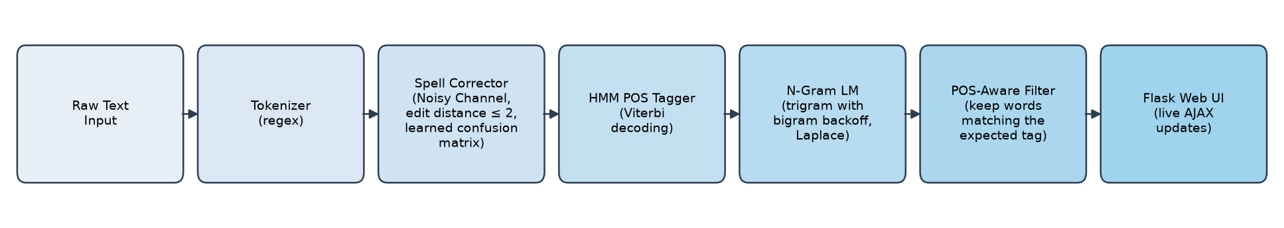
Proposed Methodology
Spell Corrector: candidates within edit distance 2, ranked by P(word) × P(typo | word); P(typo | word) learned from 12,356 real single-edit misspellings
N-Gram LM: trigram with back-off to bigram, Laplace smoothing
HMM POS Tagger: bigram HMM, Viterbi decoding, 10 Universal POS tags
POS-aware filter: keep only next-word candidates whose tag matches the tag the HMM expects next
Activity 2 | Research Presentation 4

Slide 5
Dataset & Experimental Setup
Brown Corpus (NLTK): 54,286 cleaned sentences, 24,891-word vocabulary (freq ≥ 2)
POS data: 54,270 Universal-tagset sentences, 10 tag classes
Misspelling corpus (Norvig): 7,841 words, 38,218 real (correct, misspelling) pairs
Preprocessing (Activity 1): lowercasing, punctuation stripping, tokenization, length filtering
90% / 10% train/test split (seed 42) on all three datasets - every score is on unseen data
Tools: Python 3.12, Flask 3.1.3, matplotlib - no GPU needed
Activity 2 | Research Presentation 5

Slide 6
Results & Evaluation
Metric (held-out test data) | Result
Spell Corrector top-1 accuracy - synthetic typos | 76.00% (152 / 200)
Spell Corrector top-1 accuracy - real human misspellings | 38.00% (190 / 500)
N-Gram LM bigram perplexity | 5595.97
N-Gram LM trigram perplexity (with back-off) | 13641.36
HMM POS Tagger word accuracy | 91.74% (8242 / 8984)
Real misspellings: 193 of 500 are 3+ edits away (out of reach by design); on the 307 within reach, accuracy is 61.9%
Trigram > bigram perplexity: Laplace adds V ≈ 40K to every denominator, which swamps the sparse trigram counts
Every number reproduces with: python evaluate.py (fixed seed)
Activity 2 | Research Presentation 6

Slide 7
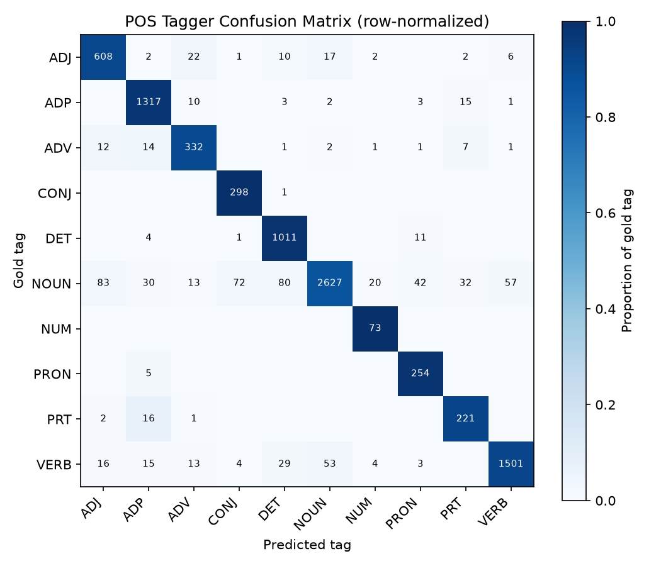
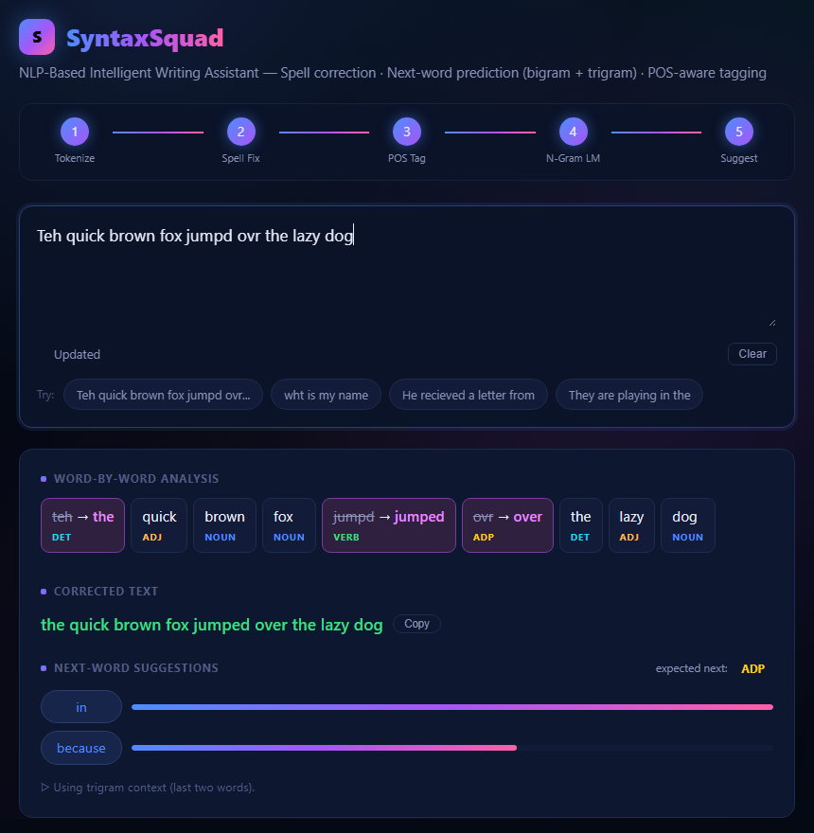
Confusion Matrix & Output
Left: POS tagger confusion matrix (held-out set) - strongly diagonal; biggest confusions are NOUN → ADJ (83), DET (80), CONJ (72)
Right: live app - 3 typos fixed, every word tagged, suggestions filtered to the expected tag
Activity 2 | Research Presentation 7

Slide 8
Error Analysis
23 of 48 synthetic misses: a very common word 2 edits away beat the right word 1 edit away (haed → 'and', not 'head') - the cost of searching edit distance 2
9 misses are real-word typos (will → gill): words are corrected in isolation, so these are never flagged
Fixed during testing: 'ovr' → 'or' and 'wht' → 'who' (both correct now, thanks to the learned confusion matrix); 'I' → 'in' (single-letter words)
POS: NOUN confusions on ambiguous words like 'that' - a bigram HMM sees only one previous tag
Next fixes: prefer 1-edit candidates, rank spelling in context, Kneser-Ney smoothing, trigram HMM
Activity 2 | Research Presentation 8

Slide 9
Project Proof
GitHub: https://github.com/AnoonMR/Writing-Assistant
Not publicly hosted: runs on localhost and fully offline once the data is downloaded
Run: pip install -r requirements.txt, then cd src and python app.py, then open http://127.0.0.1:5000
Reproduce all metrics: python evaluate.py
Activity 2 | Research Presentation 9

Slide 10
Conclusion & Future Work
All 5 modules built at full proposal scope, integrated in a live web app, and evaluated on held-out data
POS tagging 91.74%; spelling 76.00% on synthetic typos and 61.9% on real misspellings within reach - all from scratch
Every weakness has a measured cause: frequency bias at edit distance 2, out-of-range misspellings, Laplace smoothing
Future work: prefer 1-edit candidates, context-aware spelling, Kneser-Ney smoothing, trigram HMM, optional hosting
Activity 2 | Research Presentation 10

Slide 11
AI Usage Acknowledgement
This project was developed with the assistance of Claude (Anthropic), an AI tool, which was used for code implementation and debugging.
Activity 2 | Research Presentation 11

Slide 12
References
Damerau, F. J. (1964). A technique for computer detection and correction of spelling errors. CACM, 7(3).
Kernighan, M. D., Church, K. W., & Gale, W. A. (1990). A spelling correction program based on a noisy channel model. COLING.
Katz, S. M. (1987). Estimation of probabilities from sparse data... IEEE Trans. ASSP, 35(3).
Brown, P. F. et al. (1992). Class-based n-gram models of natural language. Computational Linguistics, 18(4).
Chen, S. F., & Goodman, J. (1999). An empirical study of smoothing techniques for language modeling. CSL, 13(4).
Church, K. W. (1988). A stochastic parts program and noun phrase parser for unrestricted text. ANLP.
Viterbi, A. J. (1967). Error bounds for convolutional codes... IEEE Trans. Information Theory, 13(2).
Norvig, P. (2009). Natural language corpus data. In Beautiful Data, O'Reilly, 219-242.
Brants, T. (2000). TnT - A statistical part-of-speech tagger. ANLP.
Activity 2 | Research Presentation 12

