Slide 1
PREDICTIVE ANALYTICS AND DATA VISUALIZATION · 25MCAAI302 · ACTIVITY 2
When does Montesinho burn — and what can a forest agency do about it?
Data Storytelling Through Visualization · UCI Forest Fires dataset, Portugal
513
6,613 ha
10
1
observations
burned
visualizations
interactive dashboard
Anoon M R · 25MCAR0179 · MCA AIML, Sem III · Faculty: Prof. Rahul Pawar
Notes:
Introduce the question: a forest agency has limited crews and needs to know when, why and where fire danger is highest. This deck tells that story with ten visualizations, a dashboard and a model.

Slide 2
THE DATA
513 days of park weather — when is fire danger highest?
513
52%
6,613 ha
1,091 ha
clean observations
(517 raw, 4 duplicates removed)
of observations had a fire
total area burned
largest single fire
13 attributes
Source
▸ Where: X, Y position on a 9 × 9 park grid
▸ When: month and day of week
▸ Weather: temperature, humidity, wind, rain
▸ Fire Weather Index codes: FFMC, DMC, DC, ISI
▸ Outcome: burned area in hectares
UCI Machine Learning Repository — Forest Fires
Cortez & Morais (2007), Montesinho Natural Park, north-east Portugal
Open dataset · climate / environment domain
Activity 2 · Data Storytelling Through Visualization · 25MCAAI302
2
Notes:
Explain the dataset: each row is a day and a grid cell in Montesinho Park, 2000-2003, with Fire Weather Index codes, weather and burned area.

Slide 3
DATA PREPARATION
Clean, check, and keep the extreme fires — they are the story
1
Quality checks
Fire-size classes used in every chart
0 missing values · all range checks pass · 4 exact duplicates removed
No fire
n = 244
2
Outliers kept
Rainy days, windy days and fires up to 1,091 ha are real events, not errors
Small < 1 ha
n = 27
3
Skew handled
Median fire only 6.36 ha → plot log(1 + area)
Medium 1–10 ha
n = 148
4
New features
Large > 10 ha
n = 94
season · fire-size class · fuel-dryness band · temperature band · peak period · weekday/weekend
Activity 2 · Data Storytelling Through Visualization · 25MCAAI302
3
Notes:
No missing values. 4 duplicate rows removed. Range checks passed. Outliers were kept because they are real events, not errors. Engineered season, size class, dryness and temperature bands.

Slide 4
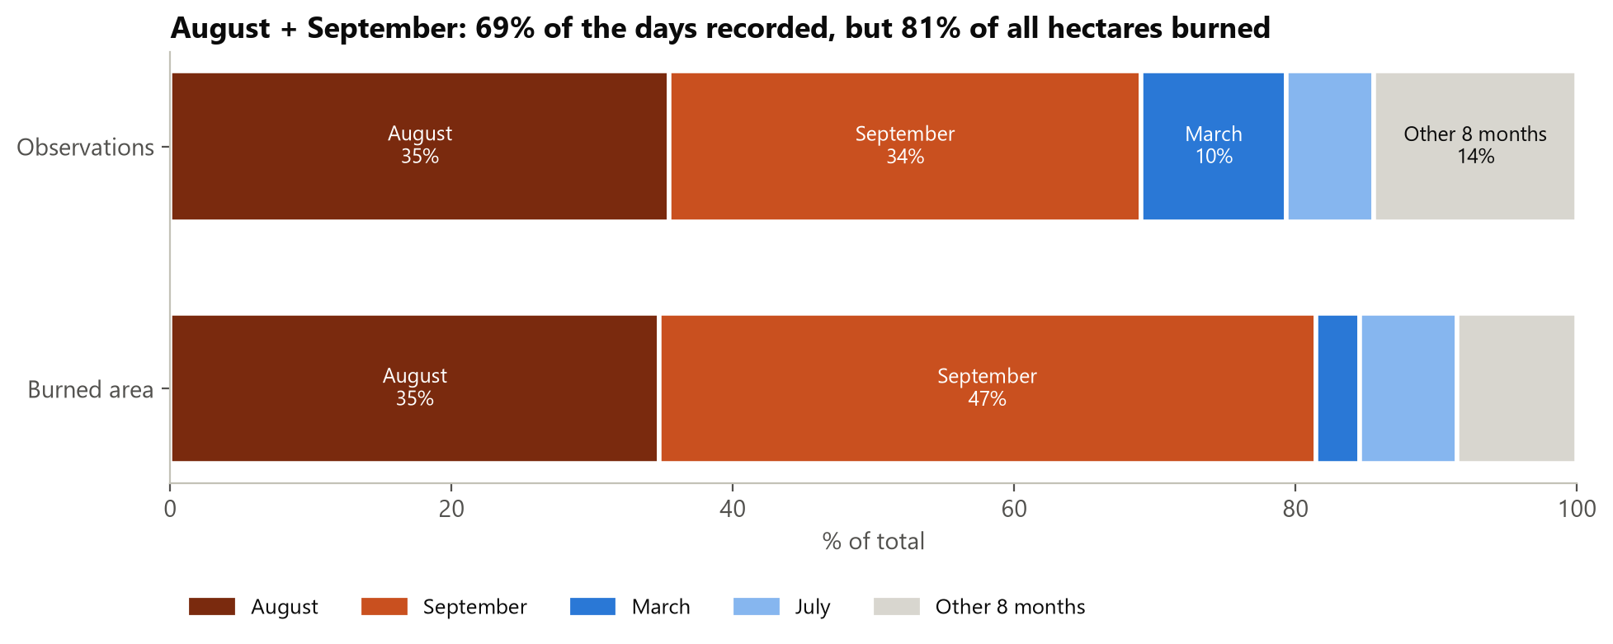
ACT 1 · WHEN — PROPORTIONS
August + September: 69% of the days, 81% of the hectares burned
81%
of burned hectares fall in Aug–Sep
What it means
▸ Two months decide the fire year
▸ September fires are larger than their share of days
▸ March: 10% of days, only 3% of damage
Activity 2 · Data Storytelling Through Visualization · 25MCAAI302
4
Notes:
Read the two bars: top is share of observations, bottom is share of burned area. September punches above its weight: 34% of days but 47% of damage.

Slide 5
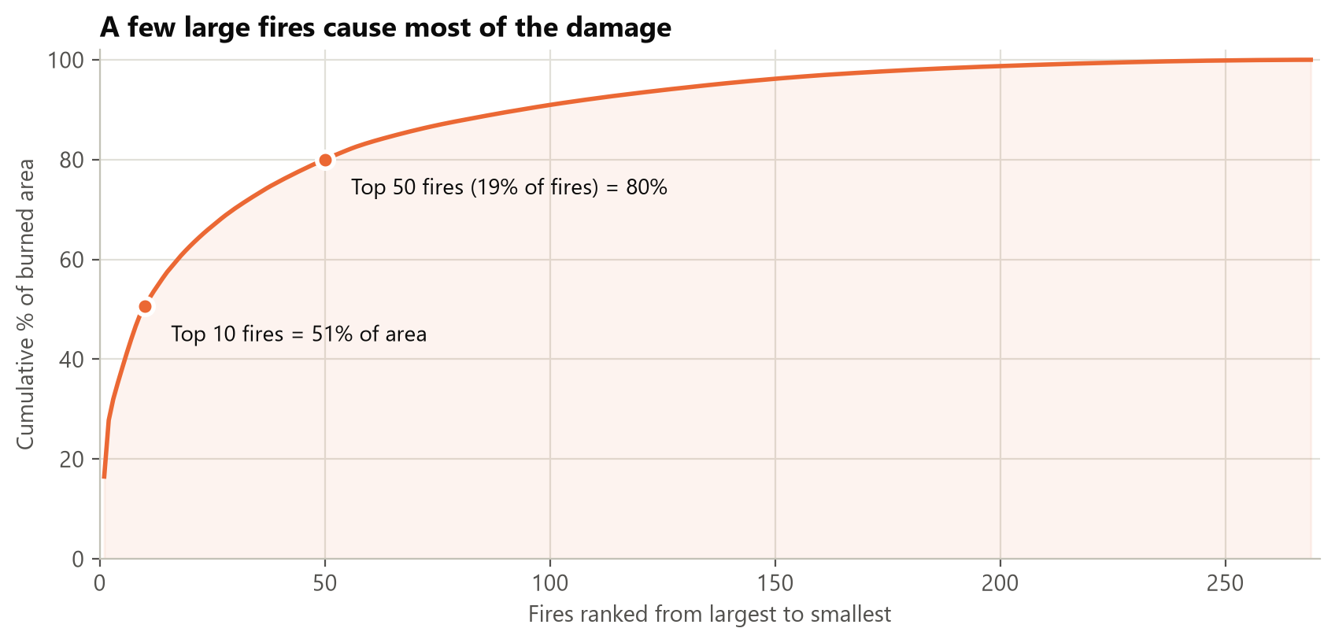
ACT 1 · WHEN — CONCENTRATION
A handful of large fires cause most of the damage
51%
of all burned area comes from the 10 largest fires
What it means
▸ Top 50 fires (19%) = 80% of area
▸ Median fire is just 6.36 ha
▸ Goal: stop the few that grow large
Activity 2 · Data Storytelling Through Visualization · 25MCAAI302
5
Notes:
Rank the fires from largest to smallest and accumulate their area. Ten fires make half the damage; 50 fires (19%) make 80%.

Slide 6
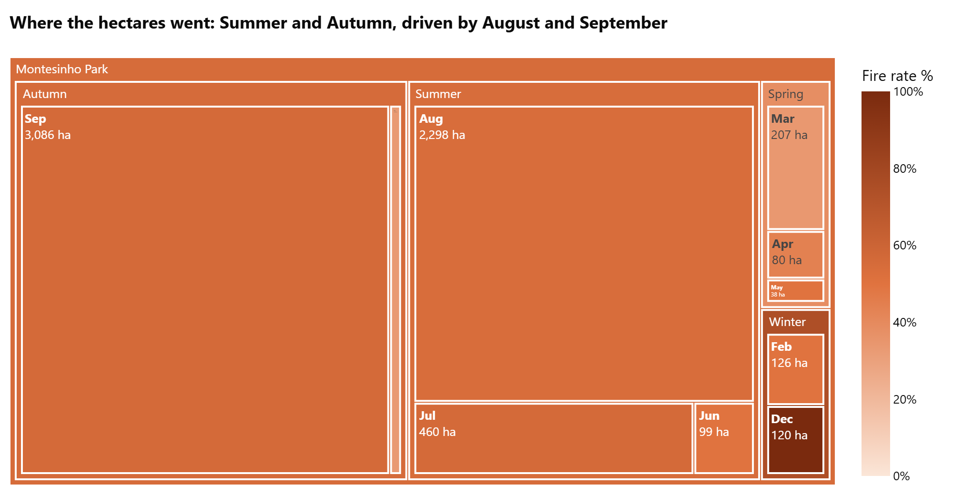
ACT 1 · WHEN — NESTED PROPORTIONS
Treemap: September and August drive almost all burned hectares
Reading the treemap
▸ Size = hectares burned
▸ Colour = share of observations with a fire
▸ Sep 3,086 ha · Aug 2,298 ha
▸ Spring & Winter are small slivers
▸ Dec is dark but n = 9 only
Activity 2 · Data Storytelling Through Visualization · 25MCAAI302
6
Notes:
Treemap: rectangle size is hectares burned, nested season then month. Colour is fire rate. December is dark but based on only 9 observations.

Slide 7
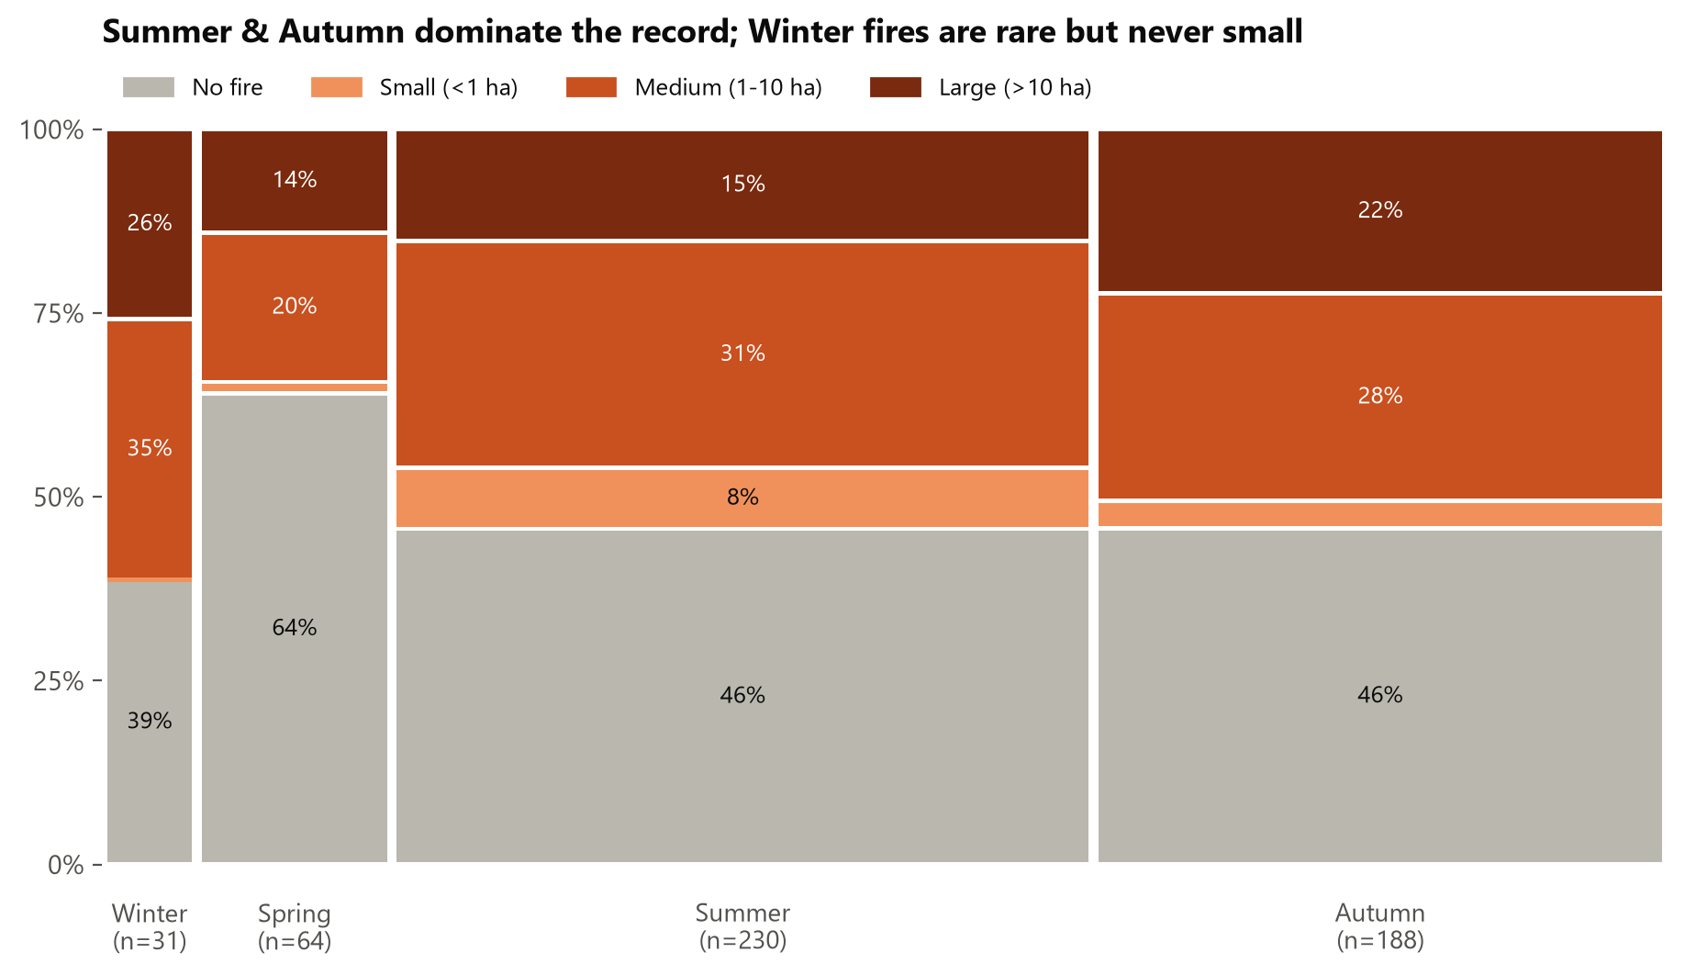
ACT 1 · WHEN — MOSAIC PLOT
Mosaic plot: Autumn has the most large fires
Reading the mosaic
▸ Width = how many observations
▸ Height = mix of fire sizes
▸ Large fires: Autumn 22% vs Summer 15%
▸ Spring: 64% no-fire days
▸ Winter (n = 31): 0% small fires
Activity 2 · Data Storytelling Through Visualization · 25MCAAI302
7
Notes:
Column width = share of observations in each season; segment height = share of each fire-size class within that season.

Slide 8
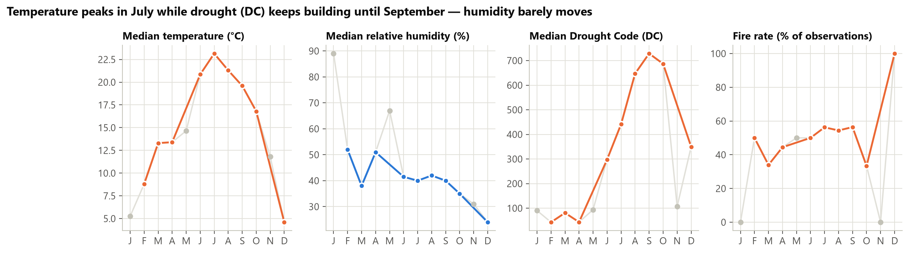
ACT 1 · WHEN — SMALL MULTIPLES
Heat peaks in July, but drought keeps building until September
Temperature
Humidity
Drought Code
Fire rate
Peaks in July at ≈ 23 °C
Barely moves — around 40% all summer
Rises to ≈ 730 in September
≈ 55% in July–September
Activity 2 · Data Storytelling Through Visualization · 25MCAAI302
8
Notes:
Four panels, each on its own scale, no dual axis. Drought Code is cumulative, so it keeps rising after temperature has peaked. Faded points have fewer than 5 observations.

Slide 9
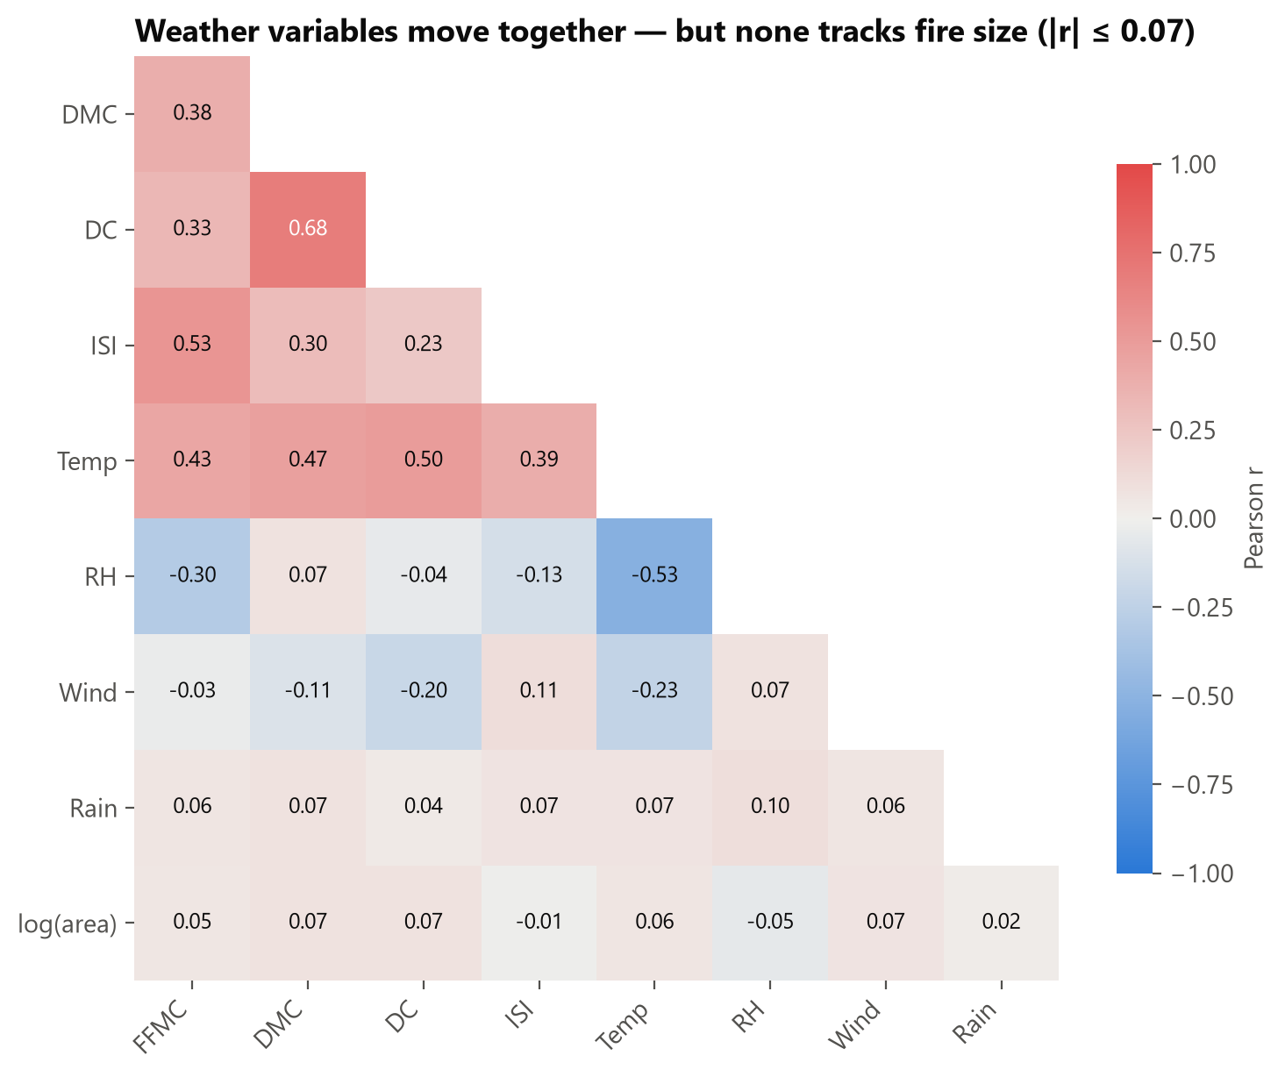
ACT 2 · WHY — CORRELOGRAM
Weather variables move together — but none tracks fire size
|r| ≤ 0.07
strongest correlation of any weather variable with fire size
What it means
▸ DMC ↔ DC r = 0.68 — both measure accumulated dryness
▸ Temp ↔ RH r = −0.53 — hot days are dry days
▸ FFMC ↔ ISI r = 0.53
▸ Weather sets the stage, but alone it does not decide how big a fire gets
Activity 2 · Data Storytelling Through Visualization · 25MCAAI302
9
Notes:
Strong pairs: DMC-DC 0.68, temperature-humidity -0.53, FFMC-ISI 0.53. But the bottom row, log(area), never exceeds |r| = 0.07.

Slide 10
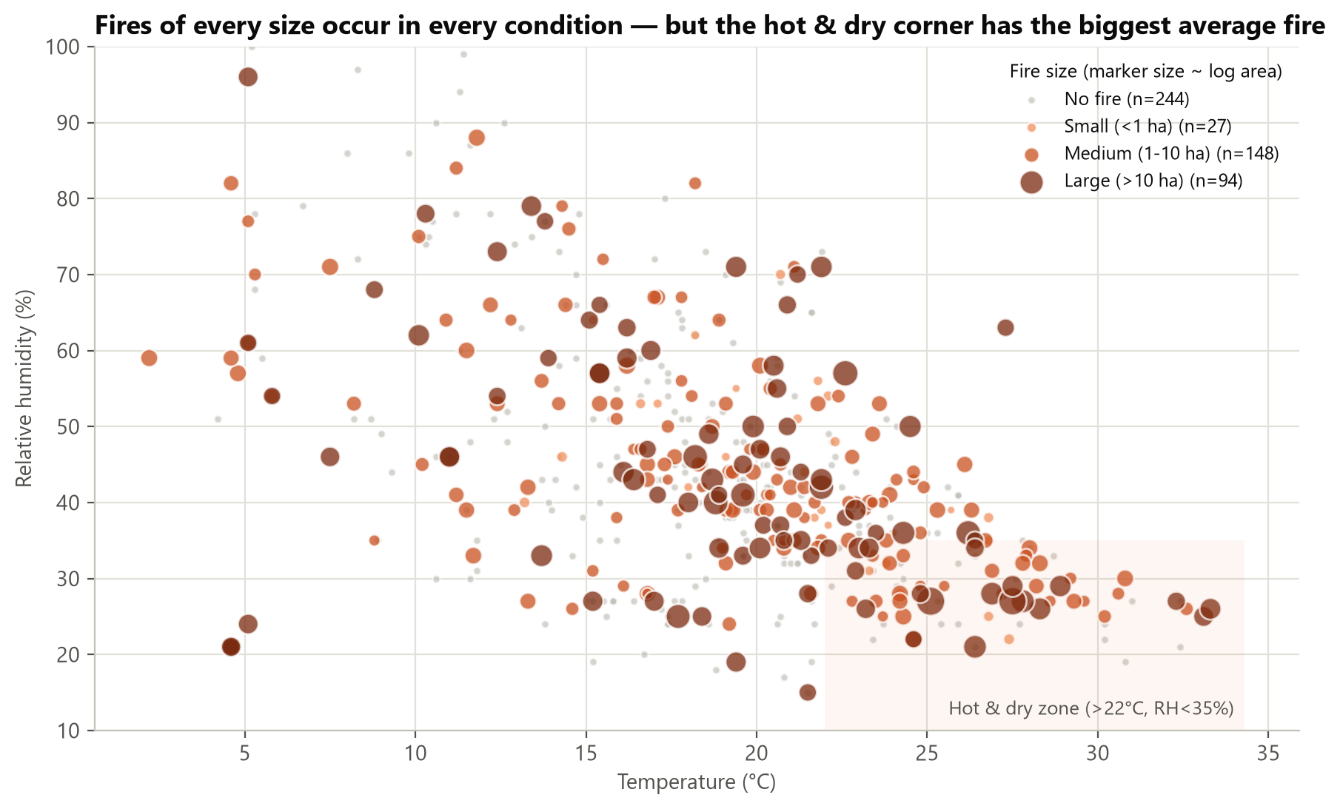
ACT 2 · WHY — SCATTER PLOT
Scatter: the hot & dry corner produces the biggest fires on average
Hot & dry vs other days
Average fire
30 ha
vs 9 ha
Fire rate
59%
vs 51%
Large-fire rate
22%
vs 18%
n = 87 hot & dry days
Activity 2 · Data Storytelling Through Visualization · 25MCAAI302
10
Notes:
Fires of every size appear everywhere, so there is no clean boundary. But in the shaded corner (above 22 C, RH below 35%) the average fire is three times larger.

Slide 11
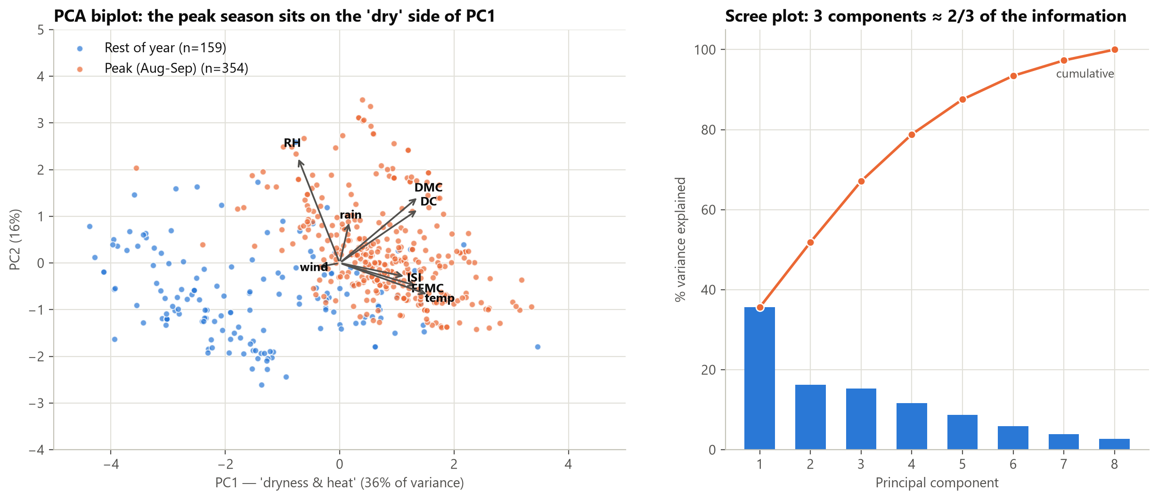
ACT 2 · WHY — DIMENSION REDUCTION
PCA: eight weather variables collapse onto one 'dryness & heat' axis
PC1 = 36% of variance · peak-season days (orange) sit on the hot/dry side · 3 components keep 67% of the information
Activity 2 · Data Storytelling Through Visualization · 25MCAAI302
11
Notes:
PCA on 8 standardized variables. PC1 (36%) loads on temperature, FFMC, ISI, DMC, DC; humidity points the other way. Peak season sits on the dry side.

Slide 12
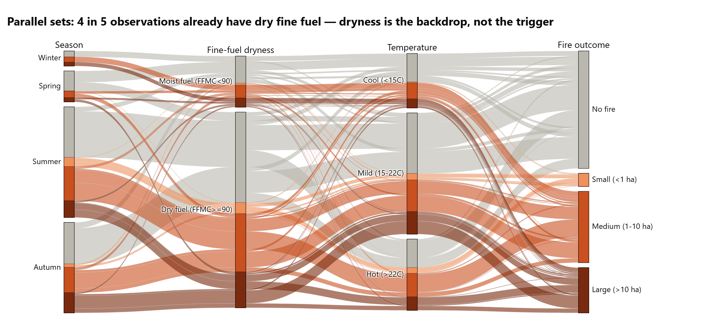
ACT 2 · WHY — PARALLEL SETS
Parallel sets: dry fuel is the backdrop of the season, not the trigger
79%
of observations already have dry fine fuel (FFMC ≥ 90)
What it means
▸ Dry-fuel ribbons reach every outcome
▸ An ignition is still needed — often human
▸ Combine weather with ignition data
Activity 2 · Data Storytelling Through Visualization · 25MCAAI302
12
Notes:
Follow the ribbons left to right: season, fine-fuel dryness, temperature band, outcome. Most observations are dry-fuel days, and they flow into every outcome including No fire.

Slide 13
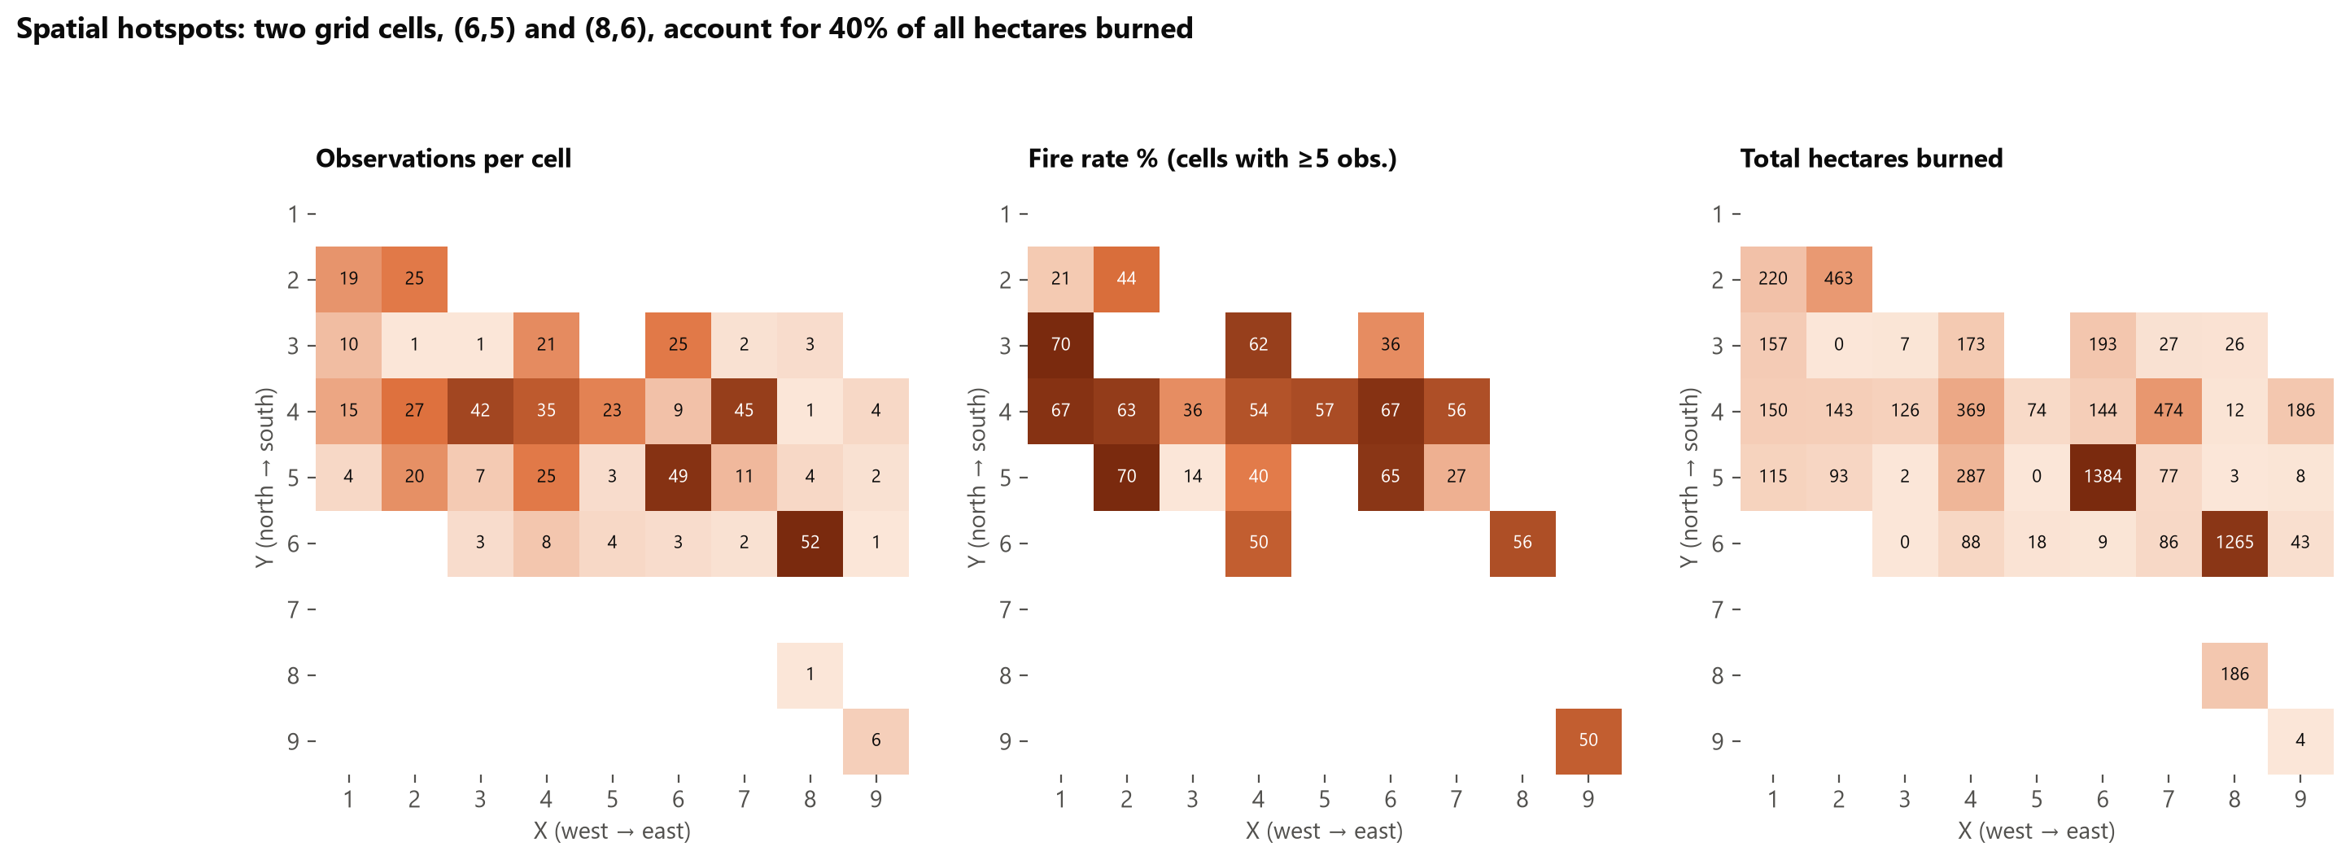
ACT 3 · WHERE — SPATIAL HOTSPOTS
Two grid cells hold 40% of all hectares burned
Cell (X=6, Y=5) 1,384 ha burned · 32 fires in 49 observations
Cell (X=8, Y=6) 1,265 ha burned · 29 fires in 52 observations
Activity 2 · Data Storytelling Through Visualization · 25MCAAI302
13
Notes:
Three heatmaps of the 9 x 9 park grid: observations, fire rate (cells with at least 5 observations) and total hectares. Cells (6,5) and (8,6) stand out.

Slide 14
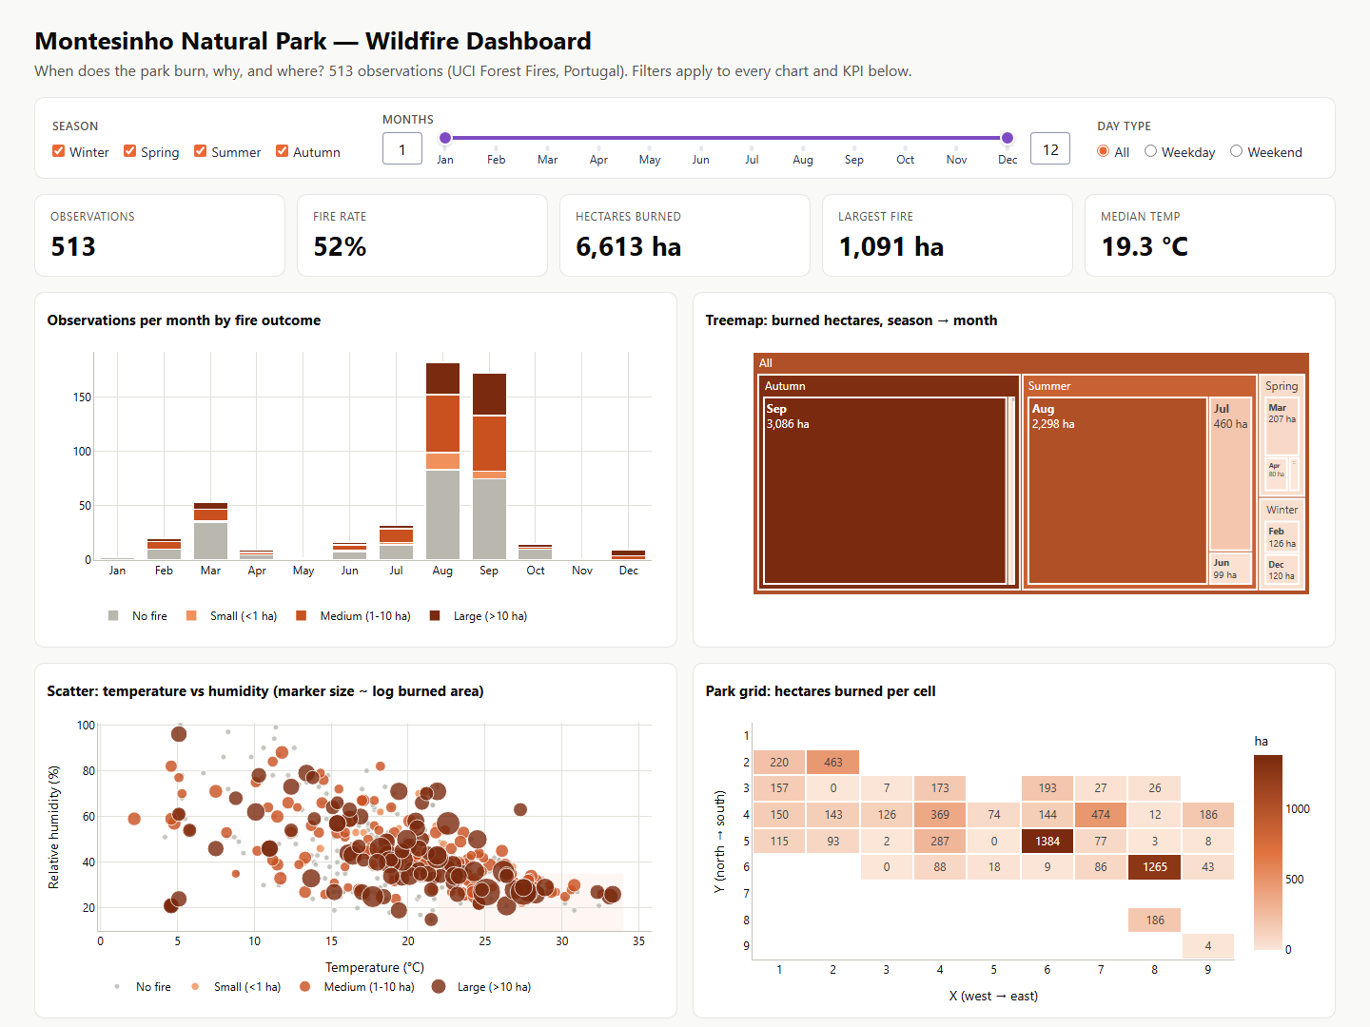
INTERACTIVE DASHBOARD · PLOTLY DASH
The dashboard: one filter row drives every chart and KPI
Built with Python
▸ Filters: season, months, weekday / weekend
▸ KPIs: observations, fire rate, hectares, largest fire, temperature
▸ 6 linked charts with hover tooltips
▸ Offline copy: Wildfire_Dashboard.html
Activity 2 · Data Storytelling Through Visualization · 25MCAAI302
14
Notes:
Demo: change the season or month range and every KPI and chart updates. Hover any mark for details. Run with: python dashboard/app.py, then open localhost:8050.

Slide 15
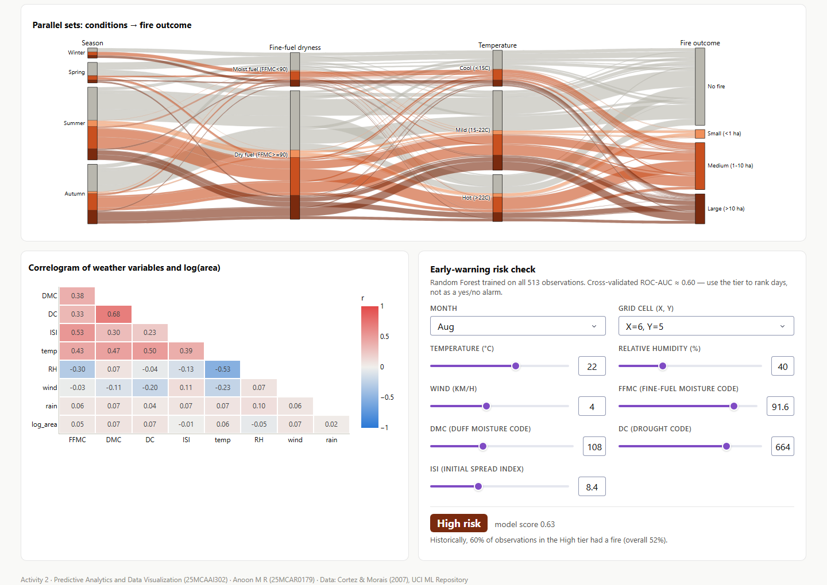
INTERACTIVE DASHBOARD · RISK PREDICTOR
Early-warning risk check: from weather inputs to a risk tier
How officers use it
▸ Choose month, grid cell and the day's weather
▸ Random Forest returns Low / Moderate / High
▸ Shows the historical fire rate of that tier
▸ Used to rank days for patrols — not as a yes/no alarm
Activity 2 · Data Storytelling Through Visualization · 25MCAAI302
15
Notes:
Demo the risk check: pick August, cell (6,5), 22 C, 40% humidity. The model returns a tier and how often days in that tier burned historically.

Slide 16
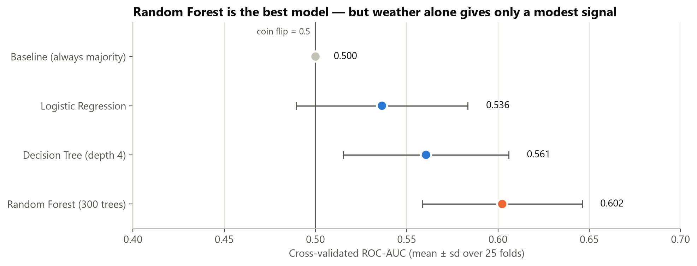
ACT 4 · WHAT NEXT — MODEL
Random Forest wins — weather gives a modest but real signal
0.60
cross-validated ROC-AUC (± 0.04)
Honest evaluation
▸ 25 cross-validation fits per model
▸ Baseline = 0.50 (coin flip)
▸ Single split said 0.68 — too optimistic
▸ Top inputs: DMC, temperature, humidity
▸ Target: fire (any area burned) · 52% positive — balanced classes
▸ Features: location, month, day, FFMC, DMC, DC, ISI, temperature, humidity, wind, rain
Activity 2 · Data Storytelling Through Visualization · 25MCAAI302
16
Notes:
Four models compared with 5x5 repeated stratified cross-validation (25 fits each). Random Forest wins at 0.60. A single hold-out split gave 0.68, which shows why cross-validation matters.

Slide 17
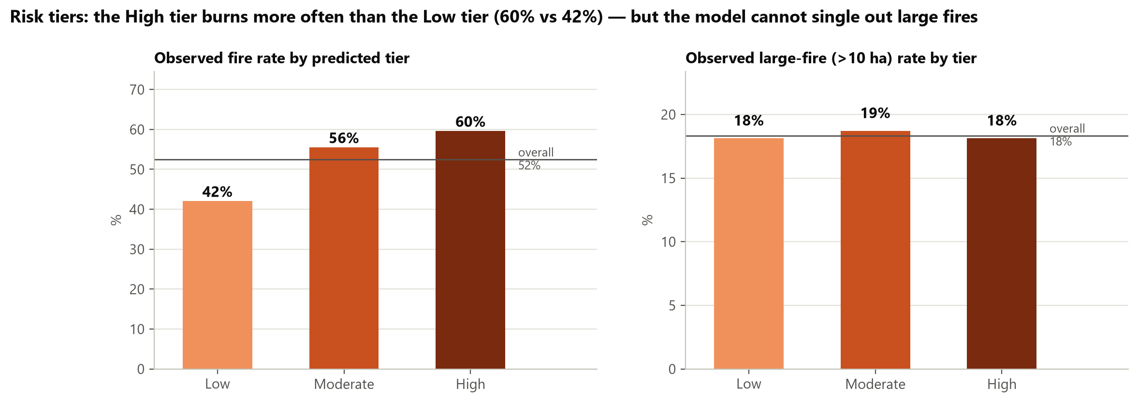
ACT 4 · WHAT NEXT — RISK TIERS
Risk tiers: High-tier days burned 60% of the time vs 42% for Low
Useful: the model ranks days by how likely a fire is. Limit: large fires are ≈ 18% in every tier — it cannot predict how big a fire will grow.
Activity 2 · Data Storytelling Through Visualization · 25MCAAI302
17
Notes:
Out-of-fold predictions split into three equal tiers. The fire rate climbs from Low to High, so the ranking works. But the large-fire rate is flat at about 18%, so the model cannot predict size.

Slide 18
ACTIONABLE INSIGHTS
Six actions for the forest agency
1
Staff up for Aug–Sep
2
Fast initial attack
3
DC as readiness trigger
81% of hectares burn in these two months — concentrate crews and aerial patrols
The 10 largest fires = 51% of damage — stop fires before they grow
Raise readiness when the Drought Code passes ≈ 600 (typical of Aug–Sep)
4
Hot & dry day protocol
5
Protect two hotspots
6
Rank days with the model
> 22 °C and RH < 35%: average fire 30 ha — pre-position tenders, restrict campfires
Cells (6,5) and (8,6) = 40% of hectares — towers, cameras, fuel breaks
Use the dashboard risk tier to prioritise patrols — not as a yes/no alarm
Activity 2 · Data Storytelling Through Visualization · 25MCAAI302
18
Notes:
Walk through each action and the evidence behind it.

Slide 19
CONCLUSION
Seasonal, concentrated, and driven by accumulated dryness
1
2
3
4
When
Why
Where
What next
Aug–Sep = 81% of hectares
Heat + drought build-up; weather sets the stage
Two cells = 40% of hectares
Risk tiers, CV ROC-AUC 0.60
Limitation: 513 observations from one park; weather explains when danger is high, not which exact plot will burn — ignition data (roads, tourism, lightning) is the next step.
Activity 2 · Data Storytelling Through Visualization · 25MCAAI302
19
Notes:
Summarise the four acts and be honest about the limitation.

Slide 20
Thank you
Questions?
Anoon M R · 25MCAR0179 · MCA AIML
Data: Cortez & Morais (2007), UCI Machine Learning Repository · Tools: Python, pandas, scikit-learn, Matplotlib, Plotly Dash
Activity 2 · Data Storytelling Through Visualization · 25MCAAI302
20

