Slide 1
The Impact of Bias in AI Technology: Ethical Challenges and Privacy Issues in Law Enforcement
A Comprehensive Study
Anoopchandra Parampalli

Slide 2
Introduction
Overview: Facial Recognition Technology (FRT) and its importance in law enforcement.
Objective: Explore ethical challenges posed by bias in AI, particularly FRT, and propose solutions.

Slide 3
Background
AI Bias in FRT: Historical and systemic biases lead to disparities in performance across demographic groups.
Key Studies: Findings on racial bias in FRT by Garvie and Frankle (2016).

Slide 4
Ethical Concerns in FRT
Racial Bias: Higher rates of misidentification for people of color.
Gender and Age Bias: Lower accuracy for female faces and older individuals.
Impact on Law Enforcement: Consequences of misidentification, including wrongful arrests and surveillance.

Slide 5
Analysis and Evaluation
Societal Impact: Erosion of public trust and reinforcement of systemic discrimination.
Technical Evaluation: Importance of diverse datasets, such as FairFace, to improve FRT accuracy.

Slide 6
Proposed Solutions
Data Diversification: Using balanced datasets like FairFace to mitigate bias.
Regular Audits and Transparency: Implementing regular checks and public reporting.
Algorithmic Fairness: Developing and enforcing regulations for fair AI algorithms.
Federated Learning: Enhancing privacy and reducing biases by decentralized training.

Slide 7
Implementation in Code
Exploratory Data Analysis (EDA): Steps in analyzing and preparing datasets to identify biases.
Model Training: Techniques to train models ensuring fair performance across demographic groups.
Federated Learning: Enhancing privacy and reducing biases.

Slide 8
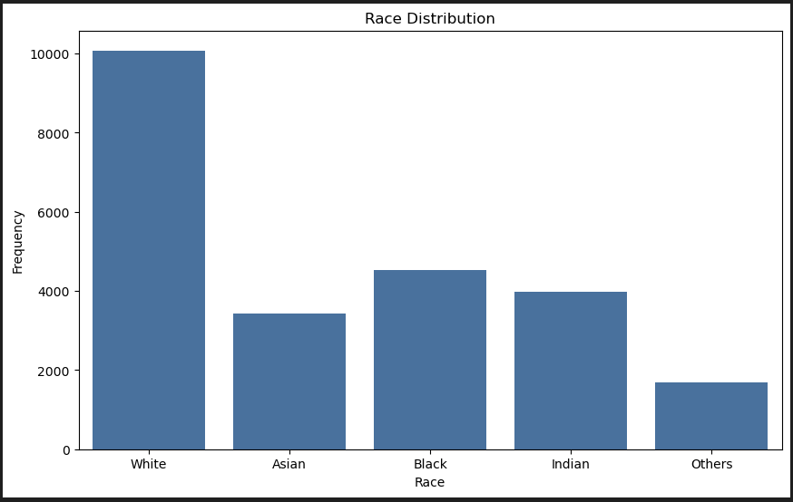
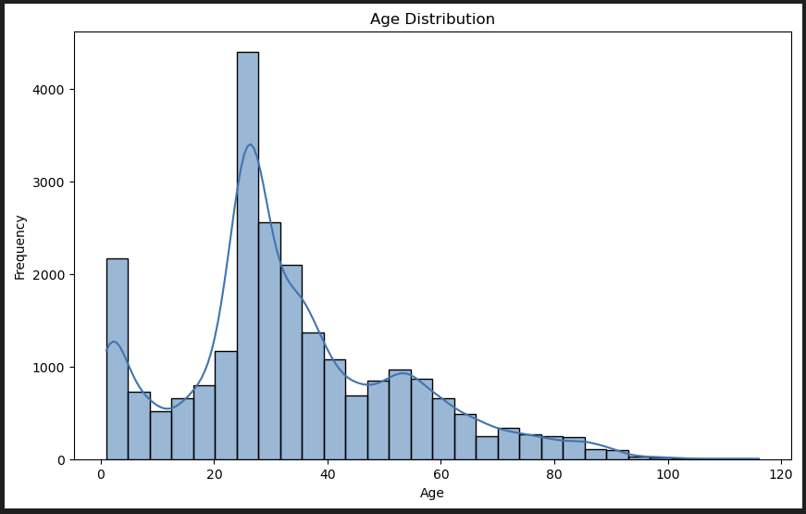
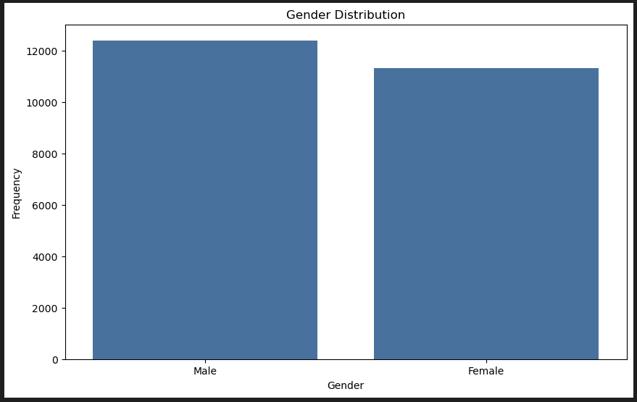

Slide 9
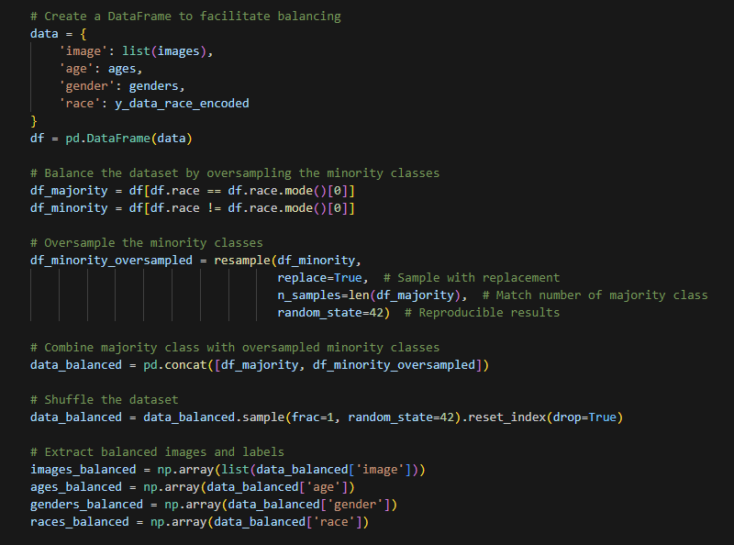
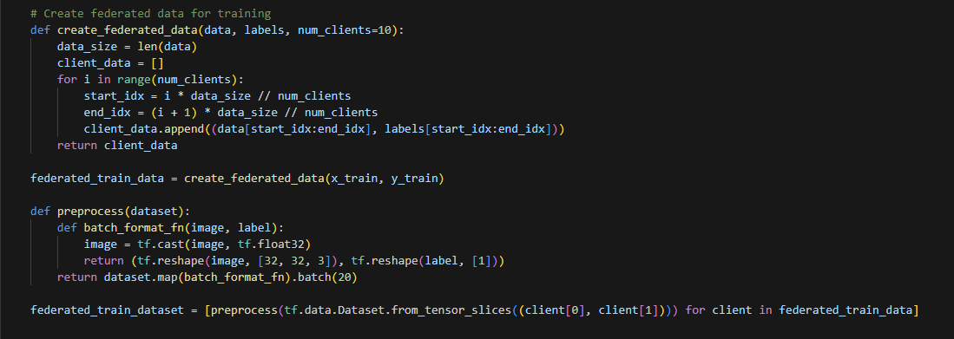

Slide 10
Results
Model Performance: Accuracy scores and bias mitigation in the trained model.

Slide 11
Conclusion
Summary: Recap of ethical challenges and proposed solutions for biased FRT.
Future Directions: Importance of ongoing research and regulation to ensure fair and ethical AI systems.

Slide 12
References
Garvie, C. & Frankle, J. (2016). Facial-Recognition Software Might Have a Racial Bias Problem.
Kärkkaïnen, K. & Joo, J. (2021). FairFace: Face Attribute Dataset for Balanced Race, Gender, and Age.

