Slide 1

Market Nest – Smart Seller Operations Platform
SOA Project Review – 1
Date & Time
 | Under the Guidance of Mrs.K.Venkateswari Department of Computer Science and Engineering, KLH CSE Bowrampet Campus
Team Members Souraja Mandal – 2420030537 Katta Anoop - 2420030503 Lakshmi Sameera - 2420030582

Slide 2
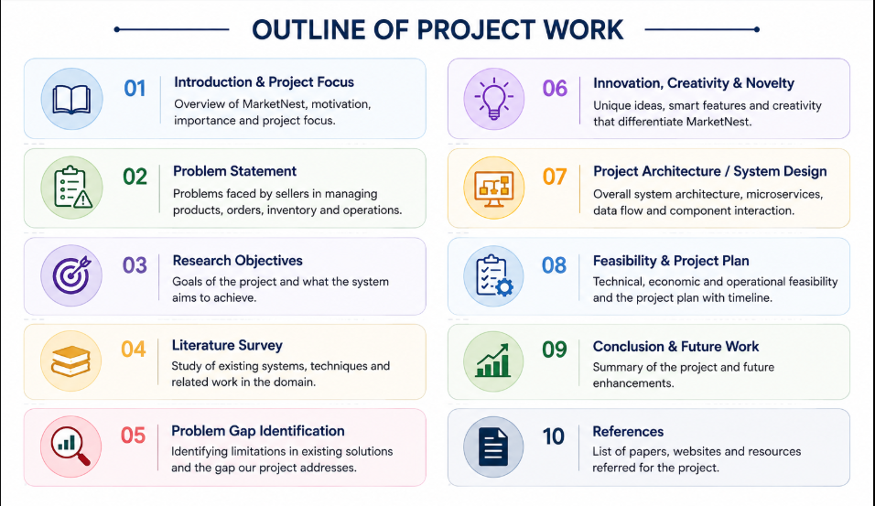
Outline of Project Work

Slide 3
Problem Statement
Current seller operations are often fragmented across separate tools for products, inventory, orders, customers and analytics.
Manual stock updates can lead to inaccurate inventory information.
Order processing and tracking become difficult when information is spread across multiple systems.
Sellers may lack a unified view of sales, product performance and business trends.
Important events such as low-stock conditions and new orders may require manual monitoring.
Existing approaches may not provide a modular and scalable architecture for expanding seller services.
Need: a centralized, modular platform that combines seller operations, automation and analytics in one system.

Slide 4
Objectives
Develop a centralized platform for managing products, inventory, orders and customers.
Implement independent microservices for major seller operations.
Provide real-time visibility into inventory, orders, sales and product performance.
Automate notifications for important operational events such as low-stock alerts and order updates.
Provide analytics dashboards and reports to support data-driven business decisions.
Use secure APIs, authentication and role-based access to protect platform operations.
Design the system for scalability, maintainability and future feature expansion.

Slide 5
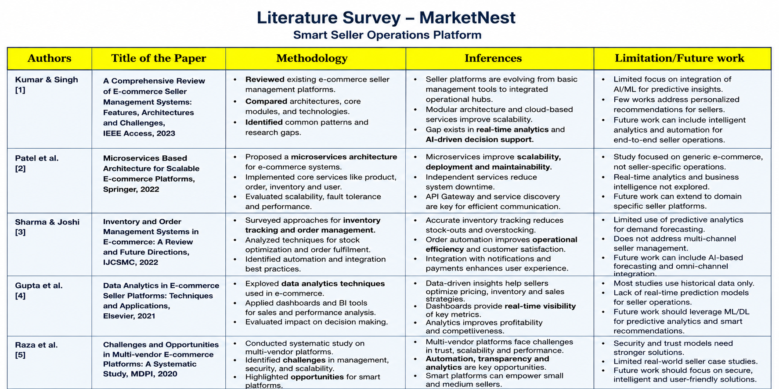

Slide 6
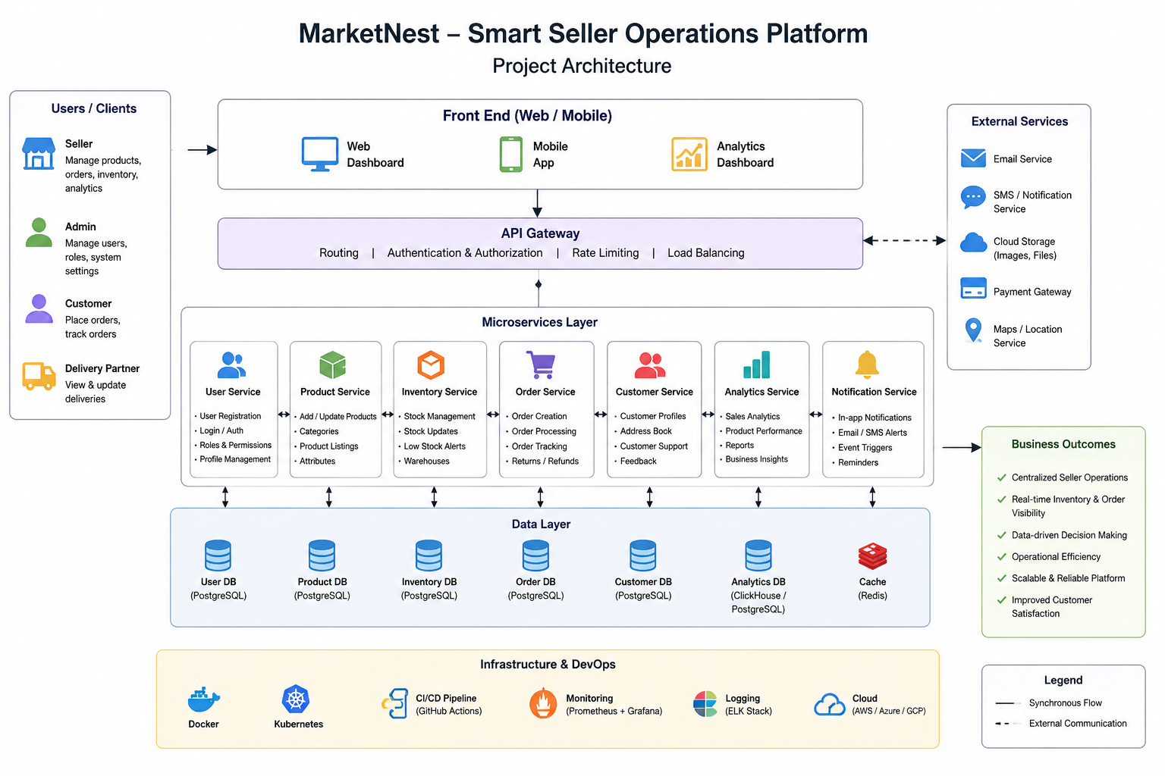
Problem Gap Identification & Proposed Architecture
Identified Gap
Disconnected seller workflows
Limited real-time operational visibility
Manual monitoring and repetitive tasks
Operational data and analytics may be separated
Difficulty scaling a monolithic workflow
Proposed Flow
Users → Front End → API Gateway → Microservices → Databases → Analytics / Notifications

Slide 7
Innovation, Creativity, and Novelty
Innovation:
Unified Seller Operations: Integrates product, inventory, order, customer, and sales management into one platform.
Smart Analytics: Converts seller data into useful business insights for better decision-making.
Automated Alerts: Provides notifications for low stock, new orders, and important operational events.
Microservices Architecture: Separates major functions into independent services for better scalability and maintenance.
Creativity:
Interactive Seller Dashboard: Presents important business information through simple visual dashboards.
Real-Time Business Monitoring: Allows sellers to quickly monitor stock, orders, revenue, and product performance.
Personalized Seller Experience: Different users can access features according to their roles and requirements.
Easy-to-Use Workflow: Reduces the complexity of managing multiple seller activities through a single interface.
Novelty:
End-to-End Seller Management: Combines daily seller operations and business analytics rather than treating them as separate systems.
Operations + Intelligence: Connects operational data with analytics to help sellers make data-driven decisions.
Scalable Microservices-Based Platform: Individual services can be independently developed, updated, and scaled. Future-Ready Design: Can be extended with demand forecasting, product recommendations, payment integration, and delivery optimization.

Slide 8
Feasibility and Project Plan
Feasibility :
Feasibility Analysis
Title: Feasibility Analysis
Technical Feasibility
ReactJS for frontend development.
Spring Boot and Microservices for backend services.
PostgreSQL/MySQL for database management.
Docker and Cloud deployment support scalability.
Economic Feasibility
Reduces manual seller operations.
Uses cost-effective open-source technologies.
Improves productivity and operational efficiency.
Operational Feasibility
Easy-to-use seller dashboard.
Centralized management of products, inventory and orders.
Real-time notifications and analytics.
Scalability Feasibility
Independent microservices can scale separately.
Supports future integrations and increasing user load.
→
→

Slide 9
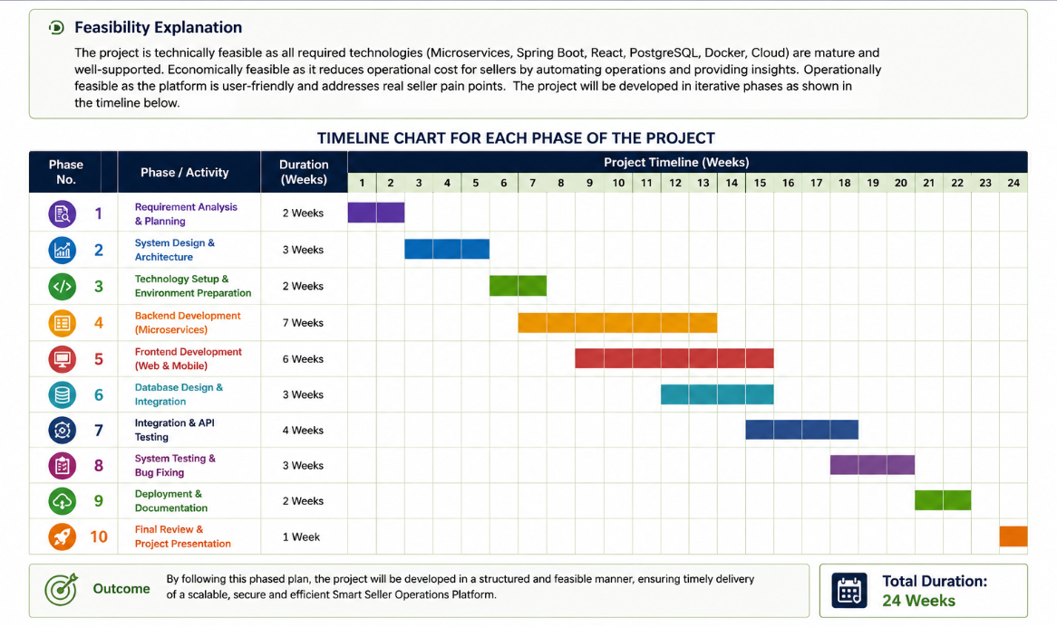
Project Plan
The MarketNest platform will be developed through multiple phases including requirement gathering, architecture design, development, testing, deployment, and final evaluation. Each phase contributes to building a scalable and efficient seller management platform.

Slide 10


