Slide 1
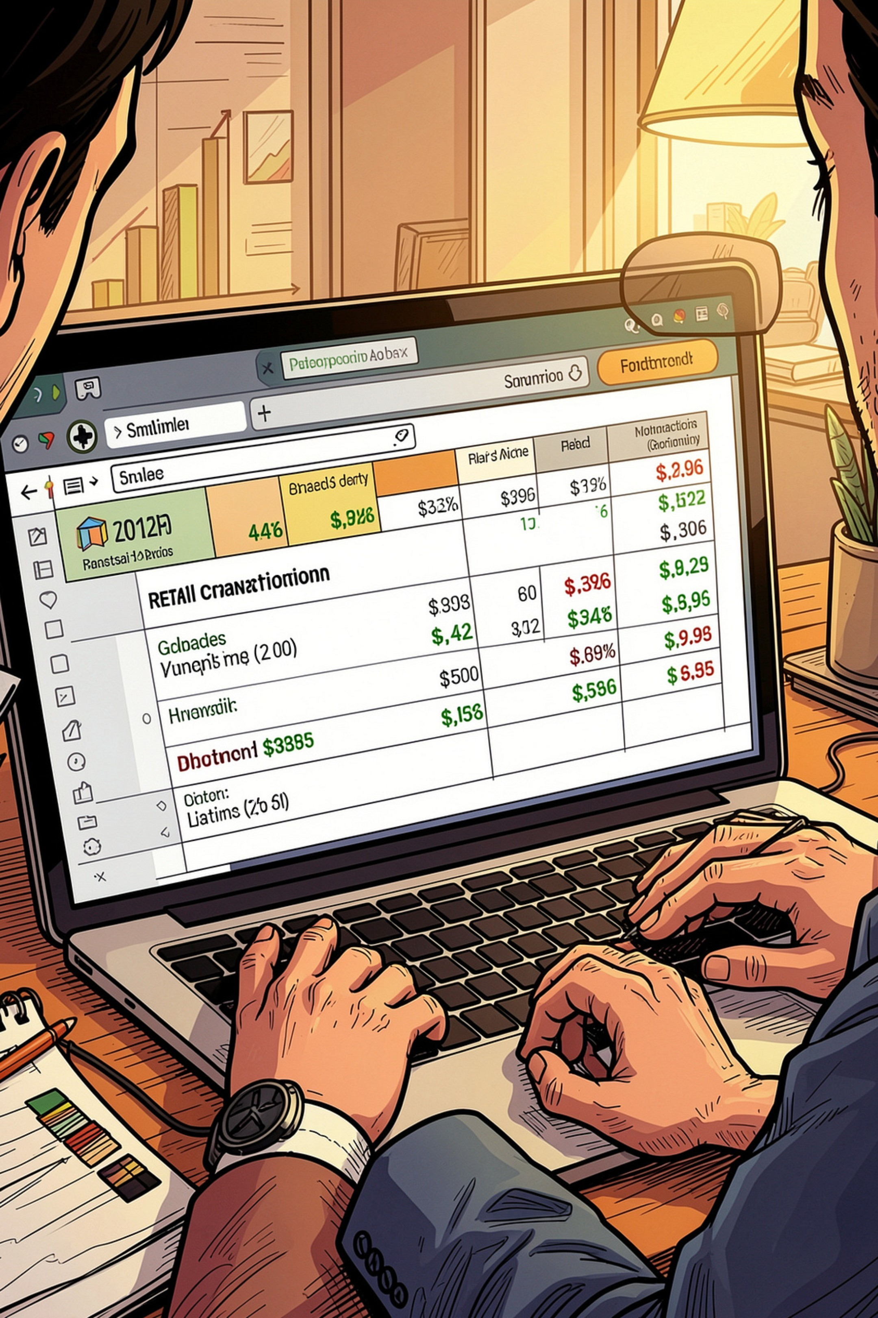
Customer Shopping Behavior Analysis
Analysis of 3,900 purchases to reveal spending patterns, segments, product preferences, and subscription behavior for strategic decisions.

Slide 2
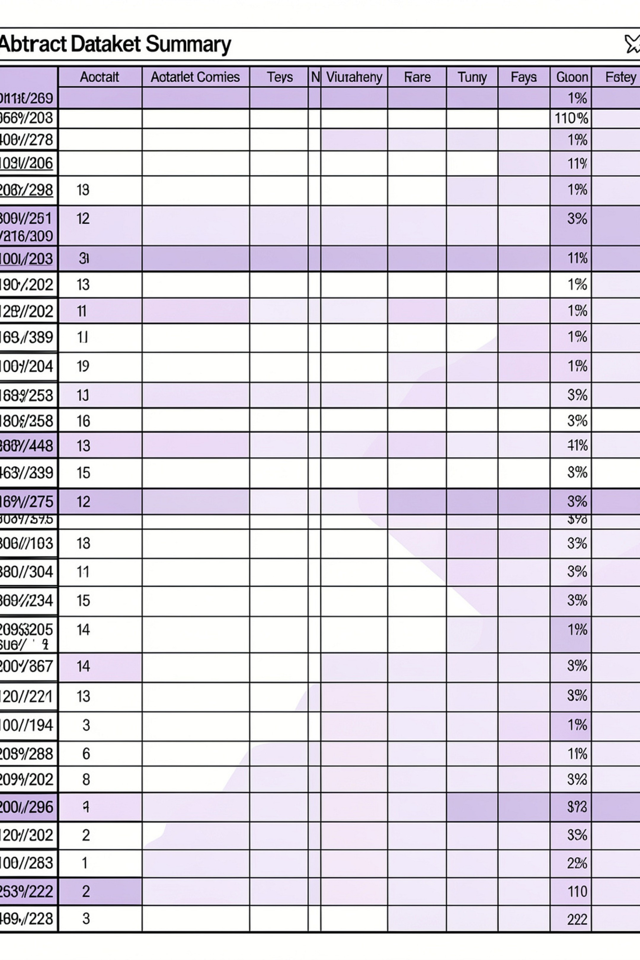
Dataset at a Glance
Rows & Columns
Key Features
3,900 rows · 18 columns
Demographics, purchase details, behavior, shipping, discounts
Missing Data
37 missing values in Review Rating

Slide 3

Data Preparation & Feature Engineering
Loaded with pandas, inspected with df.info() and .describe(). Imputed Review Rating nulls using category medians. Renamed columns to snake_case. Engineered age_group and purchase_frequency_days. Dropped redundant promo_code_used. Exported cleaned table to PostgreSQL.

Slide 4
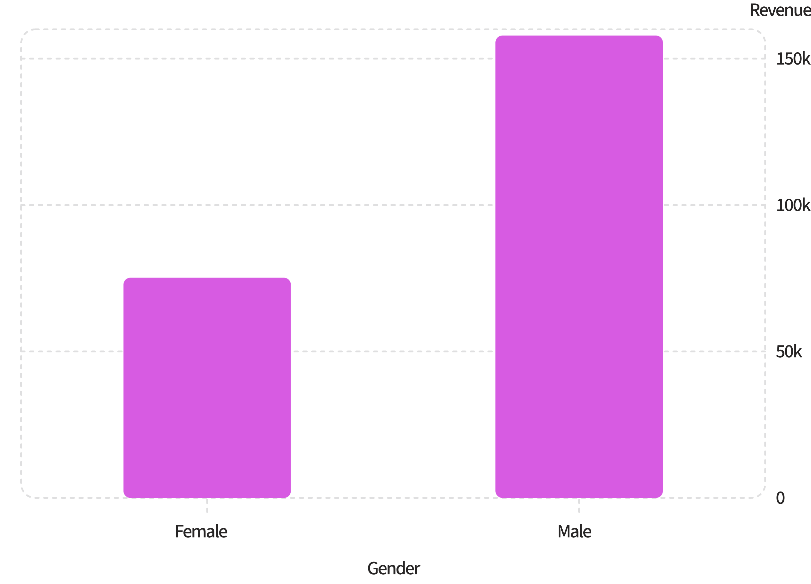

SQL: Revenue & Demographics
Male customers generated higher total revenue (157,890) than female customers (75,191).
Use gender-specific promotions cautiously—look at per-customer averages before reallocating budget.

Slide 5
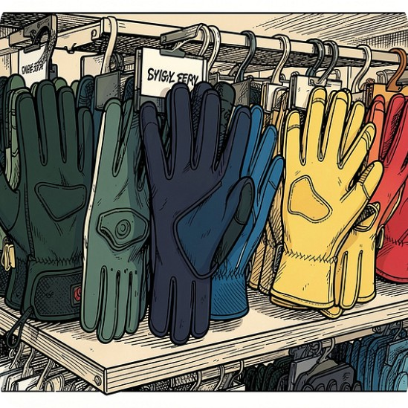

Top Products, Ratings & Discount Dependence
Top Rated
Discount-Dependent
Gloves (3.86), Sandals (3.84), Boots (3.82), Hat (3.80), Skirt (3.78)
Highest discount rates: Hat 50.00%, Sneakers 49.66%, Coat 49.07%, Sweater 48.17%, Pants 47.37%

Slide 6
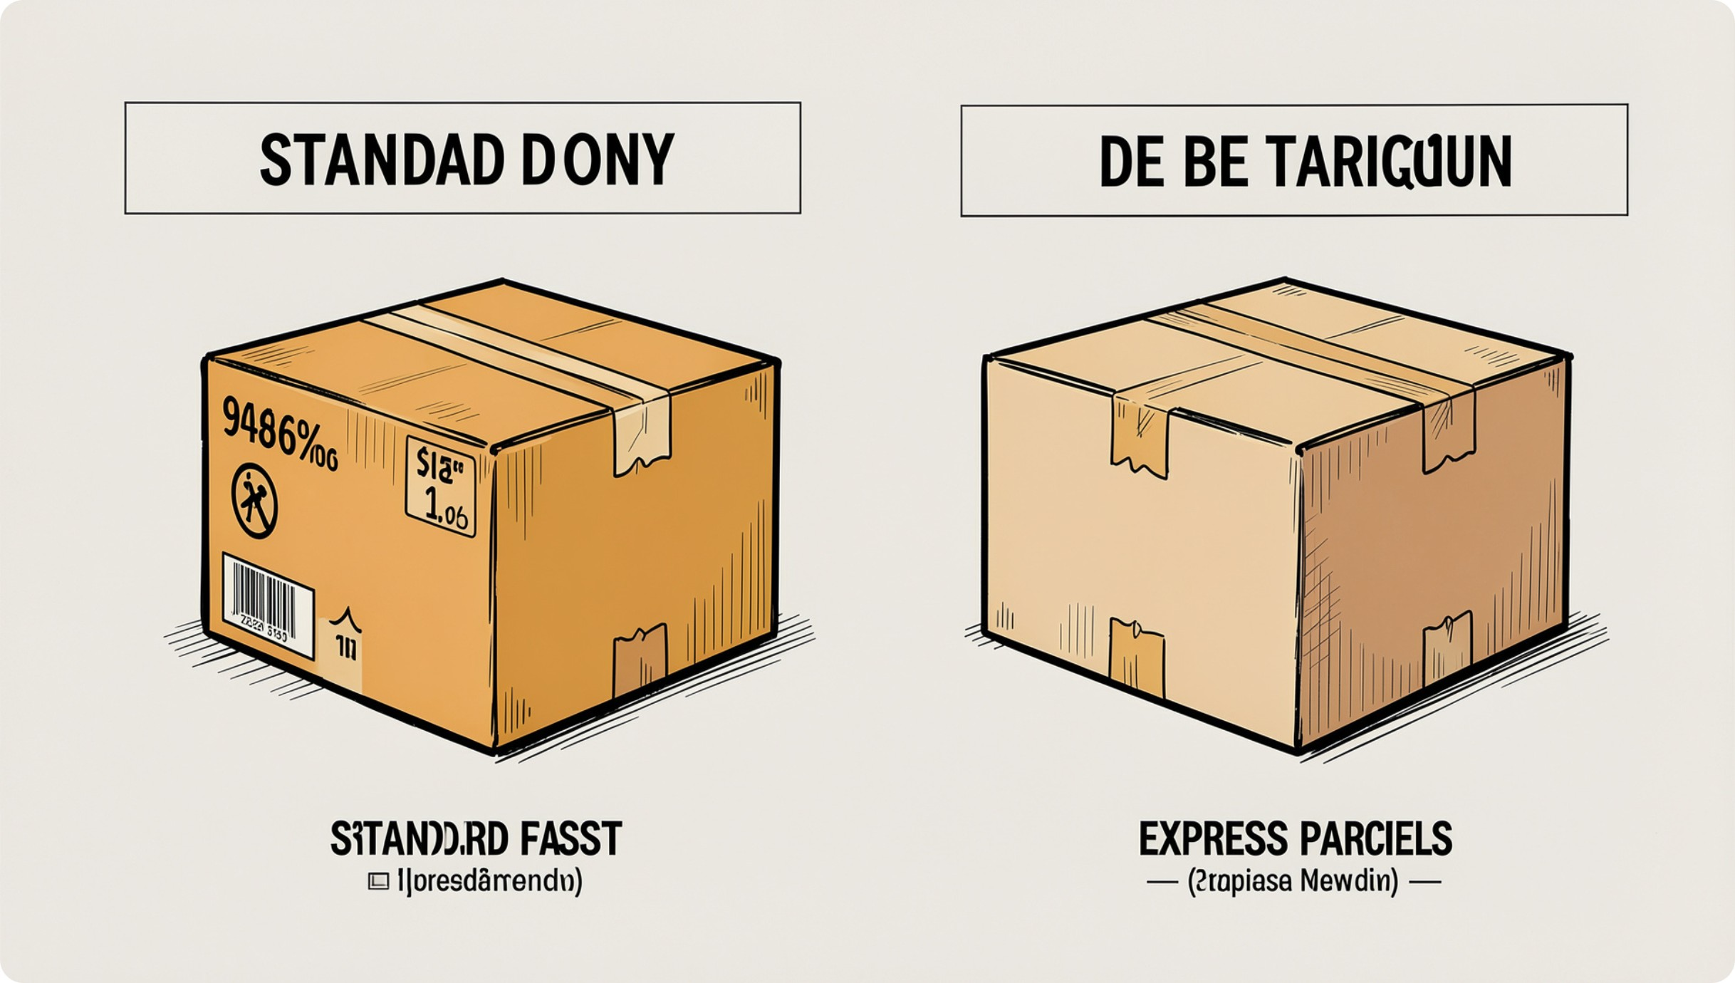
Shipping & Spend Insights
Average purchase by shipping type: Standard $58.46 · Express $60.48.
Subscribers vs Non-subscribers: 1,053 subscribers (avg spend $59.49, total revenue $62,645) vs 2,847 non-subscribers (avg spend $59.87, total revenue $170,436).
Subscription uptake is moderate—opportunity to improve ARPU through benefits.

Slide 7

Customer Segmentation & Loyalty
Segments: Loyal 3,116; Returning 701; New 83. Repeat buyers (>5 purchases): non-subscribers 2,518 vs subscribers 958.
Returning • 701
Loyal • 3,116
Prioritize moving Returning customers into Loyal via targeted rewards.
New • 83

Slide 8
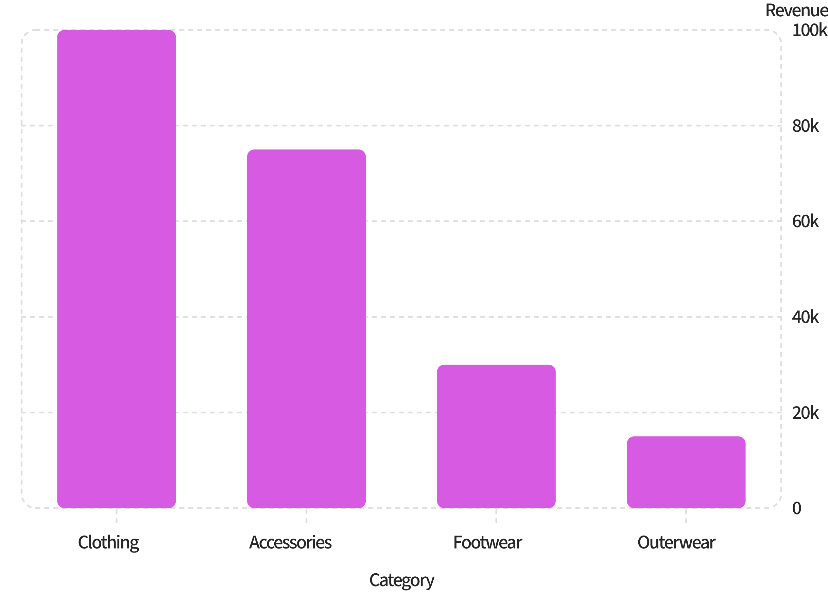
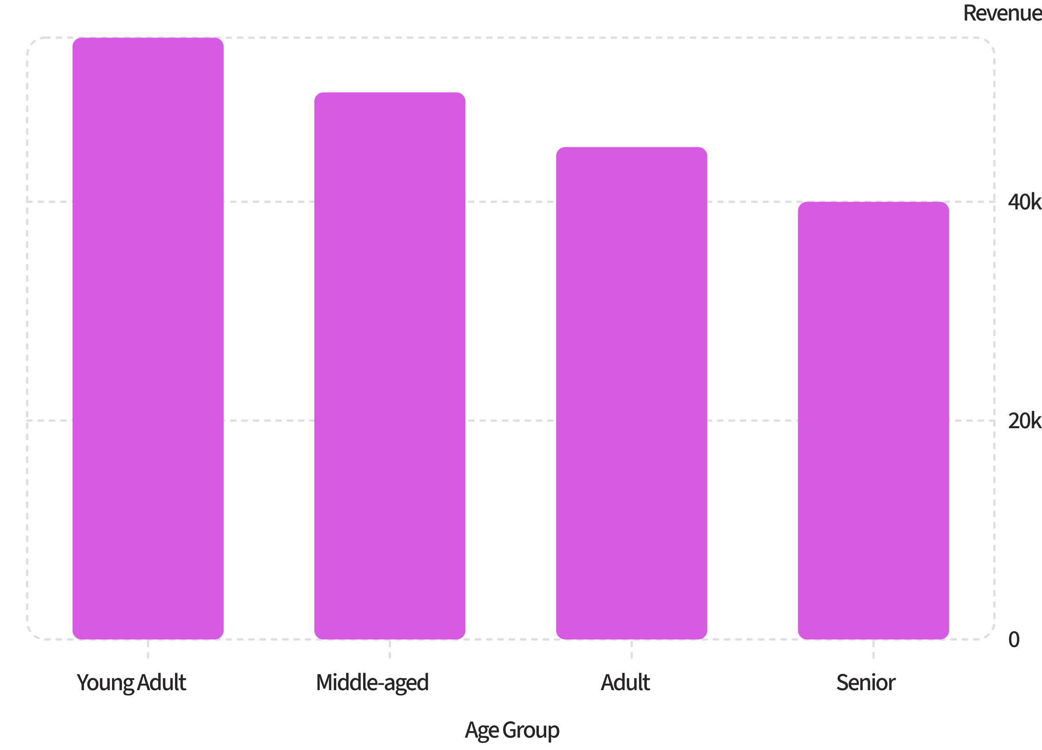
Revenue & Sales by Category & Age
Clothing drives the largest revenue. Young Adults contribute the most revenue among age groups.

Slide 9
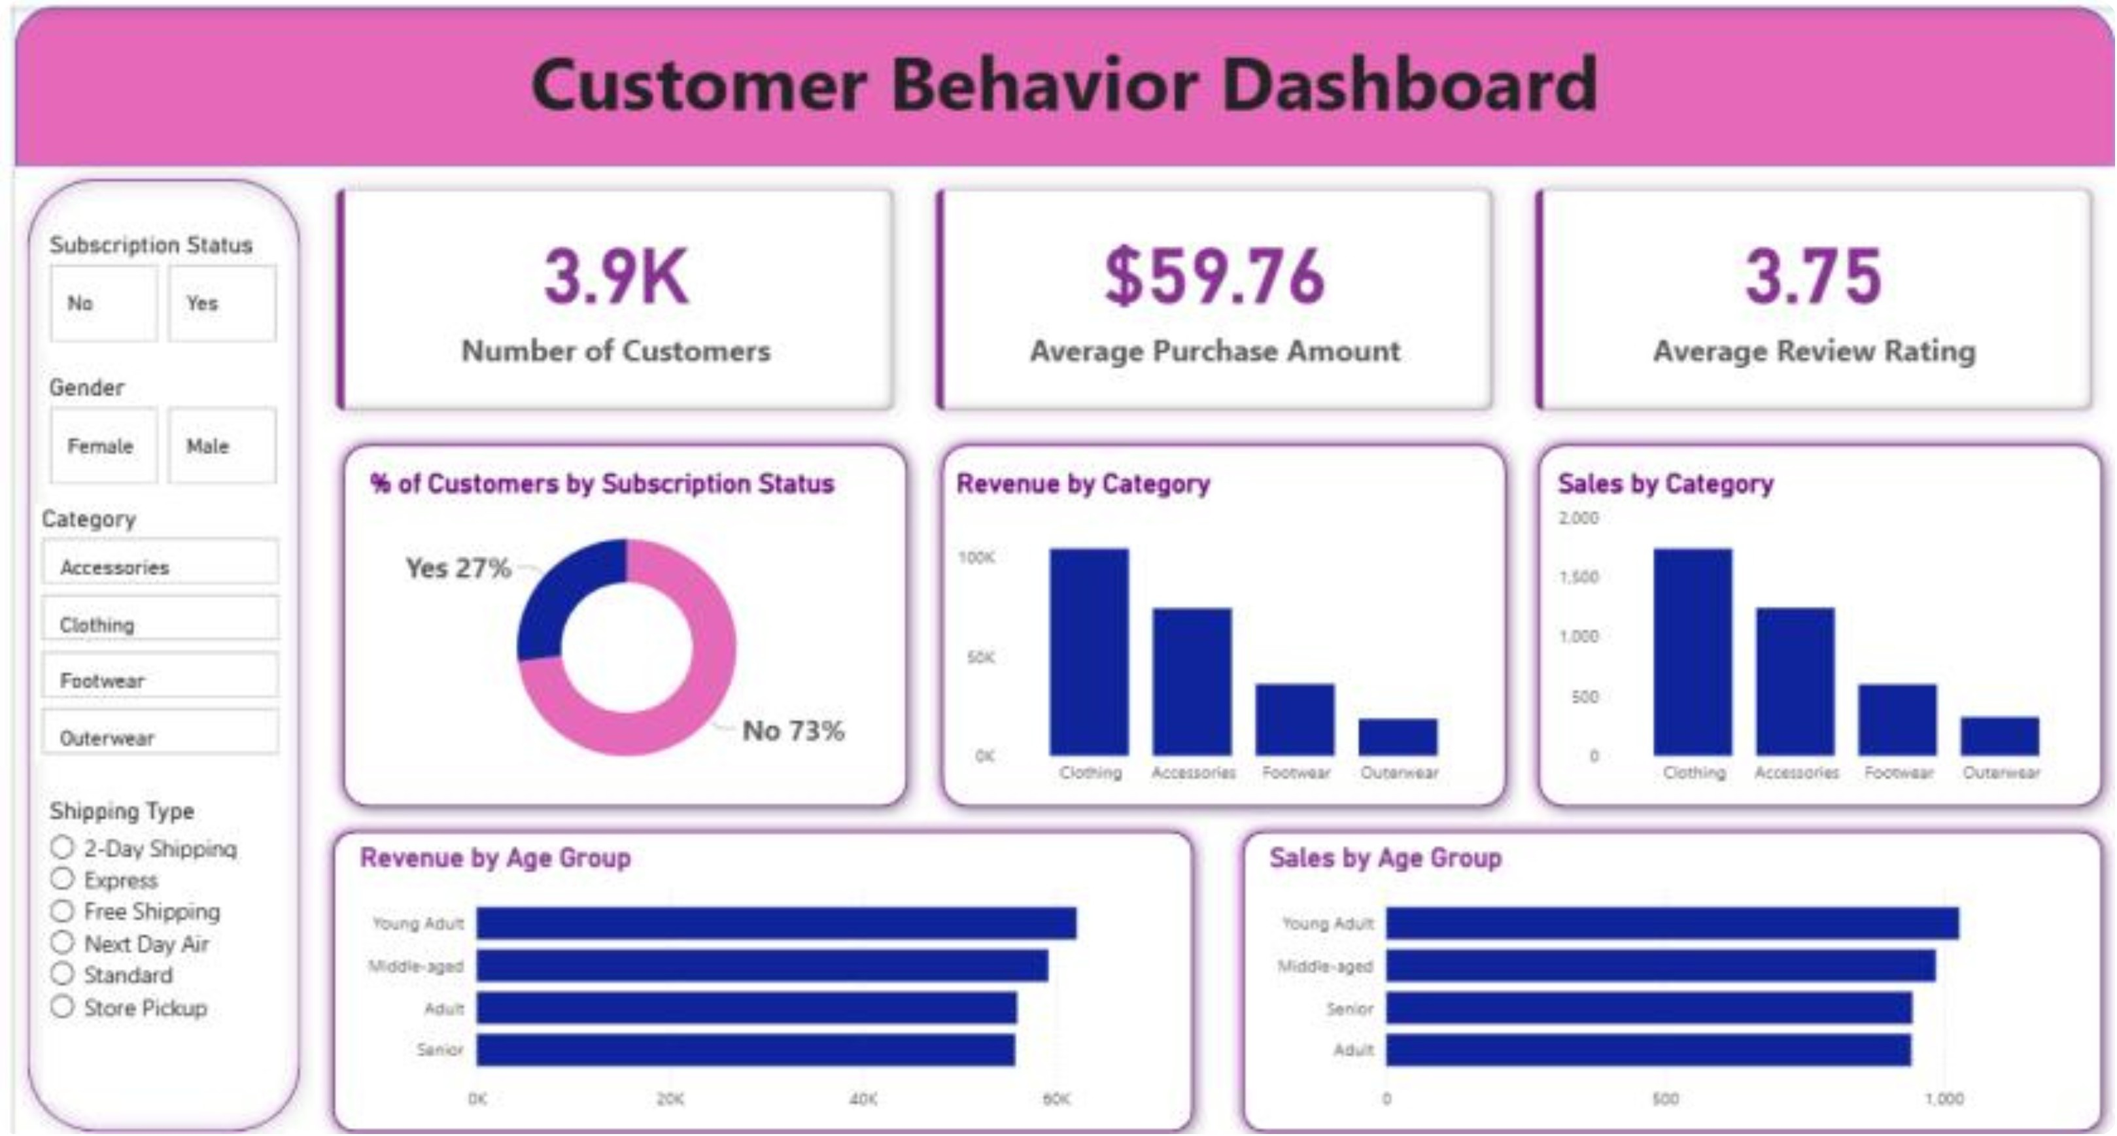
Dashboard Snapshot
Key metrics from Power BI: Number of Customers 3.9K · Avg Purchase $59.76 · Avg Rating 3.75. Subscription split: 27% Yes · 73% No.
Charts: revenue & sales by category, revenue & sales by age group, subscription donut, key KPIs.

Slide 10
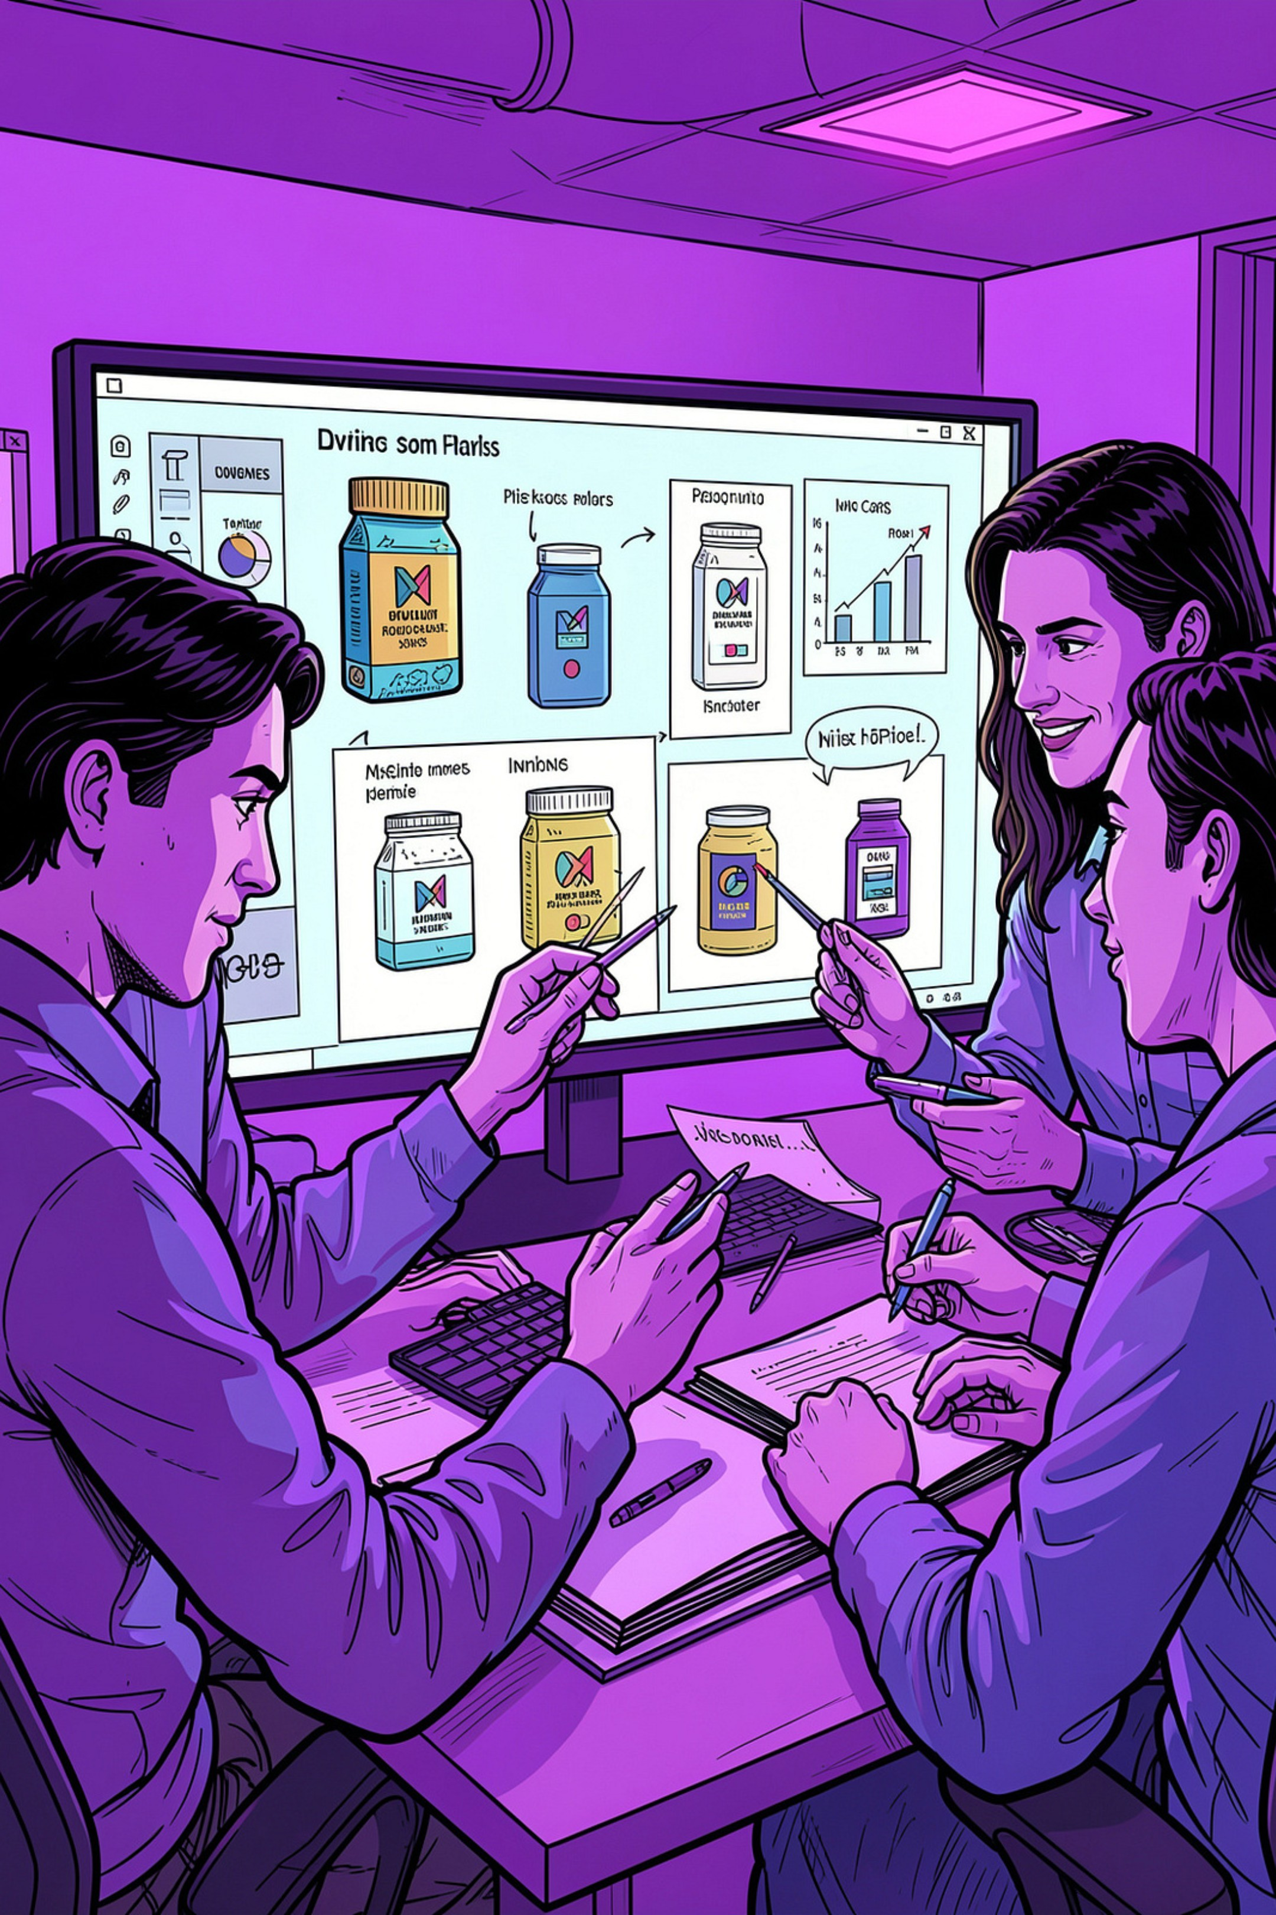


Business Recommendations
Boost Subscriptions
Loyalty Programs
Promote exclusive benefits to increase subscriber base and lifetime value.
Reward repeat buyers to drive more customers into the Loyal segment.
Review Discount Policy
Product Positioning & Targeting
Balance short-term sales from discounts with margin protection—target discount-dependent items carefully.
Highlight top-rated and best-selling items in campaigns and focus marketing on high-revenue age groups and express-shipping users.

