Slide 1
StudyFeast: Cafeteria Food Ordering Website
Submitted By:
Manjot Singh Jolly (E007)
Anoop Gupta (E004)

Slide 2
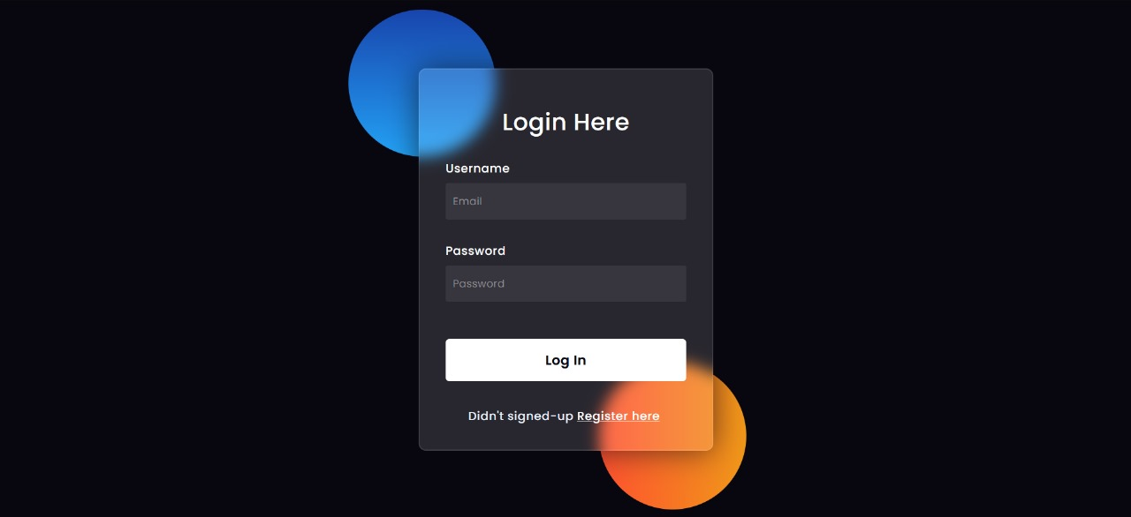
Login Page

Slide 3
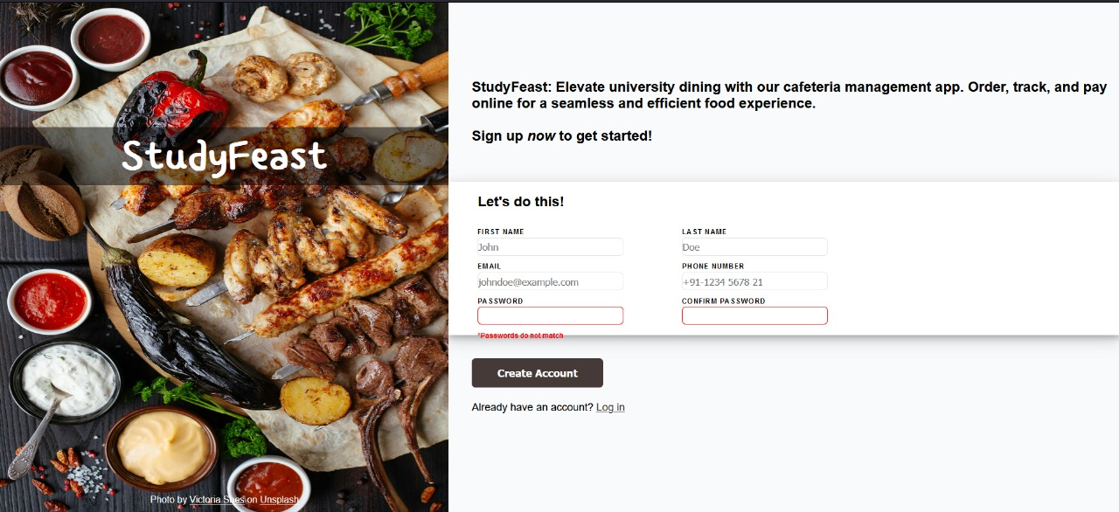
Sign-Up Form

Slide 4
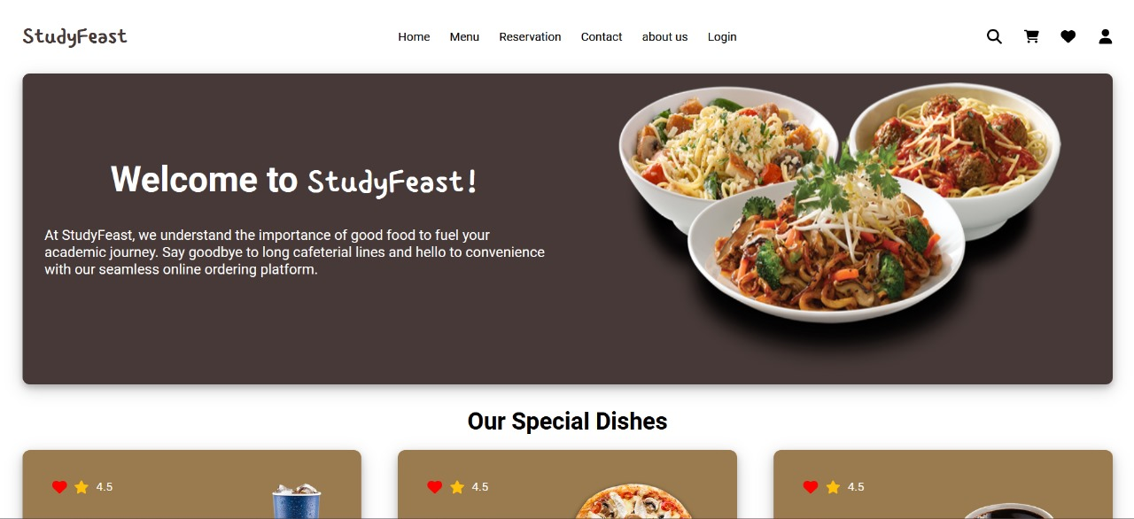
Home Page

Slide 5
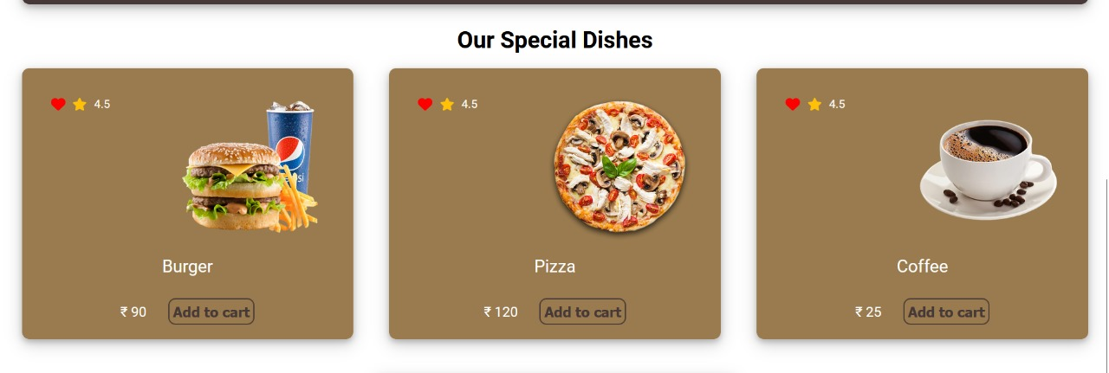
Menu

Slide 6
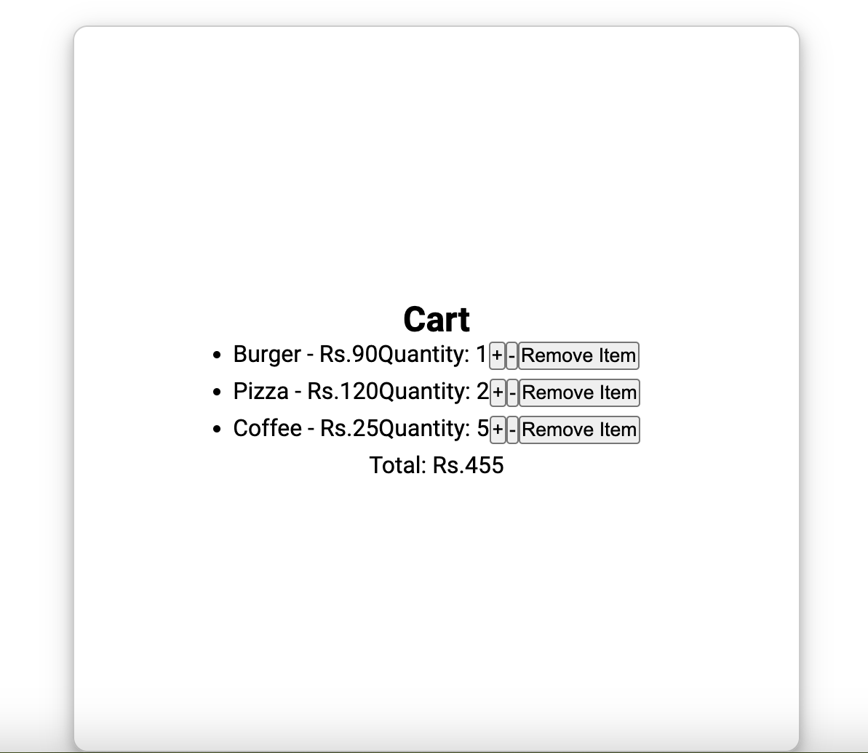
Cart

Slide 7
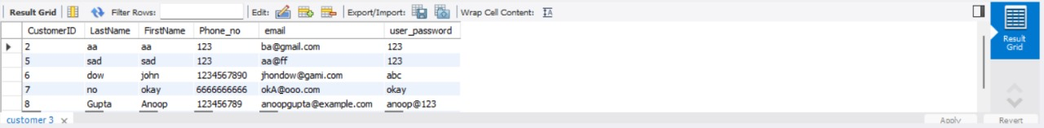
SQL Table to store user credentials

