Slide 1
PS-03
RETAIL ANALYTICS & MACHINE LEARNING
Sales Forecasting & Business Insights
End-to-end historical sales analytics, regional performance evaluation, and predictive demand estimation using linear regression.
Predictive Demand Modeling
Automated Data Pipeline
Actionable Operations

Slide 2




BUSINESS CONTEXT
Problem Statement & Opportunity
Real-World Scenario
Why It Matters
Target Stakeholders
Expected Outcome
Retailer tracks product transactions, regional sales, prices, and volumes across historical timelines.
Accurate trend analysis optimizes inventory stock, minimizes carrying costs, and boosts margins.
Retail executives, supply chain teams, inventory planners, and commercial data analysts.
Integrated analytics engine delivering historical clarity and dynamic future demand estimates.

Slide 3
PROJECT SCOPE
Core Objectives & Solution Scope
PILLAR 01
PILLAR 02
PILLAR 03
Historical Analytics
Predictive Engine
Business Intelligence
Revenue Computation: Quantity × Price calculation
Linear Regression: Scikit-learn implementation
Top Performers: Identification of key products
Aggregations: Product and regional breakdowns
Dynamic Horizon: User-defined month forecasting
Regional Growth: Regional market leaders
Trend Tracking: Monthly revenue velocity
Safety Floor: Non-negative truncation protection
Visual Dashboards: Matplotlib chart generation

Slide 4
SYSTEM DESIGN
End-to-End Analytics Workflow
STEP 01
STEP 02
STEP 03
STEP 04
Data Ingestion
Feature Engineering
Model Fitting
Demand Forecasting
Load CSV dataset using Pandas and parse date strings to DateTime objects.
Derive total sales and index time periods sequentially for regression fitting.
Train Scikit-Learn Linear Regression model on historical month indices.
Predict future periods with floor limits and generate visual outputs.

Slide 5
EXECUTIVE METRICS
Overall Commercial Summary
TOTAL REVENUE
UNITS SOLD
AVG UNIT PRICE
$248,500
12,450
$19.96
+14.2% Growth
Across All Product Categories
Stable Pricing Floor
Executive Takeaway: Sales performance demonstrates steady upward momentum driven by consistent transactional volume across core operational channels.

Slide 6
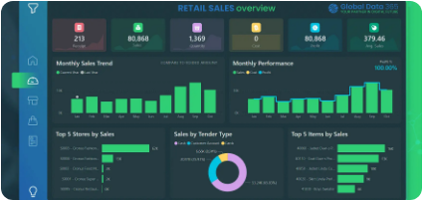
CATEGORY INSIGHTS
Product Sales Contribution
Revenue Breakdown by Category
Electronics (Top Performer)
$98,400
Apparel & Fashion
$72,100
Home Goods & Kitchen
$48,000
Accessories
$30,000
Key Finding
Electronics accounts for over 39% of total sales volume, representing the primary growth driver.

Slide 7
GEOGRAPHIC ANALYSIS
Regional Sales Performance
North Region
BEST REGION
South Region
East Region
West Region
$92,300
$64,100
$51,800
$40,300
Highest sales volume with strong demand for consumer electronics.
Consistent revenue growth driven by apparel and seasonal retail lines.
Moderate performance with emerging market expansion opportunities.
Target region for strategic sales campaigns and inventory re-allocation.

Slide 8
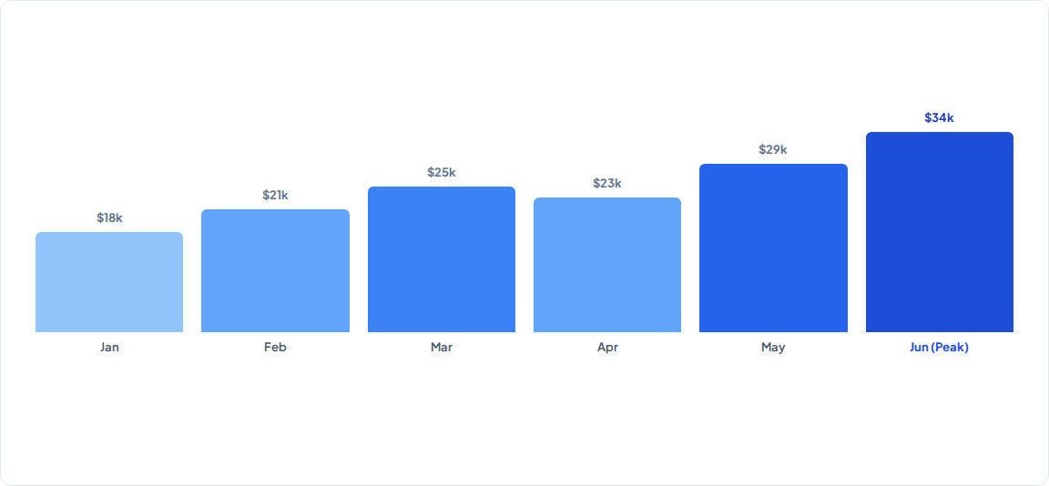
TEMPORAL TRENDS
Monthly Sales Trajectory
First Month: $18,000
Overall Trend: Increasing Velocity (+88.8%)
Peak Month: June ($34,000)

Slide 9

PREDICTIVE ANALYTICS
Linear Regression Model Mechanics
REGRESSION EQUATION
Where represents sales revenue and denotes the indexed month integer.
Model Safeguard
Utilizes to guarantee non-negative forecasting outputs.
np.maximum(predict, 0)
Scikit-learn Linear Regression engine fitting historical sales trends

Slide 10
FUTURE ESTIMATES
Forecast Sales Output (3-Month Horizon)
Projected Revenue Table
Target Month | Type | Forecast Revenue
2026-07 | Forecast | $36,200
2026-08 | Forecast | $39,100
2026-09 | Forecast | $42,000
TOTAL FORECAST VALUE
$117,300
Estimated cumulative revenue across the next 3 projection months based on underlying linear velocity trends.

Slide 11



ACTIONABLE STRATEGY
Business Recommendations
Stock Prioritization
Regional Focus
Forecast Integration
Scale Electronics inventory levels to prevent stockouts in top performing channels.
Replicate North region promotional tactics in West territory to boost sales volume.
Incorporate model predictions into monthly supply chain procurement schedules.

Slide 12
ROADMAP
Future Enhancements & Next Steps
Advanced Models
Real-Time Pipeline
Automated Alerts
Upgrade to ARIMA, Prophet, or XGBoost for complex seasonal patterns.
Connect direct API feeds to automatically ingest point-of-sale transactions.
Trigger automated notifications when actual sales deviate from predictions.
PS-03: Sales Forecasting & Business Insights
Questions & Discussion

Slide 13


Image Sources
https://globaldata365.com/wp-content/uploads/2021/06/Store-Sales-Analysis-2-1.webp
Source: globaldata365.com
https://www.blog.trainindata.com/wp-content/uploads/2024/03/image_12-1024x545.png
Source: www.blog.trainindata.com

