Slide 1


Enhanced Sentiment and Emotion Detection in Tweets Using a Hybrid Machine Learning Approach
ILLINOIS TECH
College of Computing
Nachiketh Nallamaddi
A20549679
Anoop Rao Enaganthi
A20531044
Ajay Babu Popuri
A20547319
Group - 23

Slide 2

Abstract
Recently, social media has been getting a lot of attention. Public and private opinions on various topics are constantly expressed and disseminated through many social media.
Sentiment analysis deals with identifying and classifying opinions or sentiments expressed in source text.
Analysis of Sentiment is a method of finding distinct persons thinking perspective towards anything, this can be a simple feeling, or strong opinion or something else.
Twitter is one of the most popular social media. Tweets often help generate large amounts of emotional data during analysis.
Machine Learning algorithms are used to classify the intent of the speaker without actually having to go through each tweet manually.
The Models built towards the emotion detection categorizes the textual form of tweet in to either happy or unhappy. Later it is expanded to 6 different emotions.

Slide 3

Aim and Objectives:
Aim:The aim of this project is to evaluate the performance of various machine learning models for emotion recognition by tweet classification using TF and TF-IDF.
Objectives:
Opinion mining is used to analyze public opinion on news, policies, social movements, and personalities.
Machine Learning Classifiers are applied to perform opinion mining without reading the tweets manually.
This research presents a voting classifier (LR-SVM) and aims to estimate the performance of famous ML classifiers on twitter datasets.
The stability of best classifier is further validated by testing and training it on two more datasets of different types one binary dataset and other multi-class dataset.
*
* •
th
1 8 9 0

Slide 4
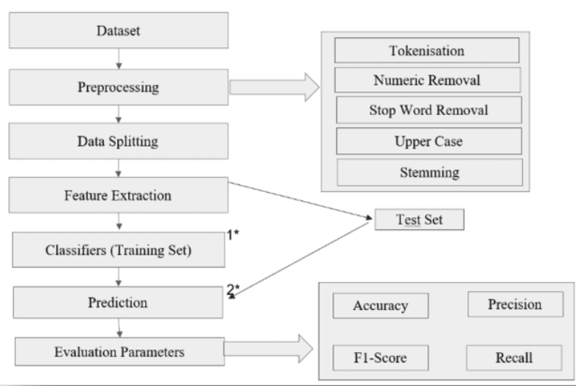
Methodology
Our approach integrates various key functions into a single, cohesive framework which aims at optimizing the outcomes of the project.
i
1 8 9 0

Slide 5
Machine Learning Classifiers are trained on Twitter Dataset for emotion recognition by tweet classification
The Twitter Dataset is extracted from Kaggle repository
Initially the Dataset is pre-processed to remove unwanted data
Then, the data was split into two sets: training set and testing set. The training set was given the percentage of 70% while the test set portion is 30%.
After that feature engineering techniques are applied on the training set. The textual features are converted into vector form using TF and TF-IDF techniques.
Multiple machine learning classifiers are trained on the training set and tested using the test set.
Accuracy, Recall, Precision, F1-Score are used as evaluation parameters in this experiment.
i
1 8 9 0

Slide 6

Data Set 1
Sentiment Analysis on Twitter data
Data Set URL: https://www.kaggle.com/code/aryantiwari123/tweets-sentiment-analysis/data
Dataset Contains 99989 training records.
Every record is labeled as happy and unhappy according to its sentimental polarity using symbol 1 and 0.
This dataset consists of 43532 negative and 56457 positive tweets.
This dataset is available at Kaggle.
It contains different features such as Item ID (Index), Sentiment Text (Tweet records), Sentiment (Happy or Unhappy).

Slide 7
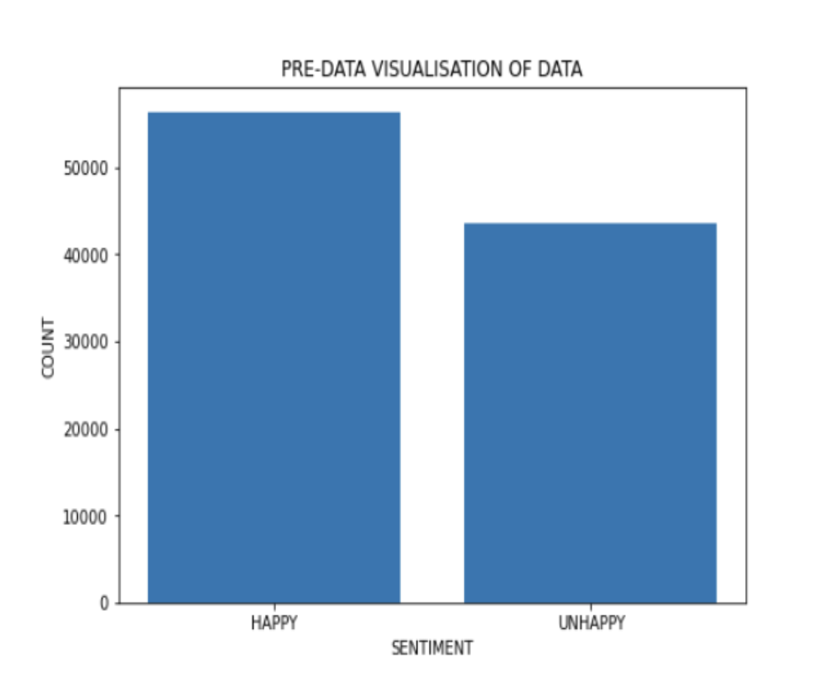

Slide 8
Data Set 2
Women's E-Commerce Clothing Reviews
Data Set URL: https://www.kaggle.com/datasets/nicapotato/womens-ecommerce-clothing-reviews
Dataset Contains 23486 training records.
Every record is labeled with rating starting from 1 to 5.
This dataset is available at Kaggle.
Its nine supportive features offer a great environment to parse out the text through its multiple dimensions. They are clothing ID, Age,Title,Review Text, Rating, Recommended ID, Positive Feedback Count,Division Count, Department Name, Class Name

Slide 9
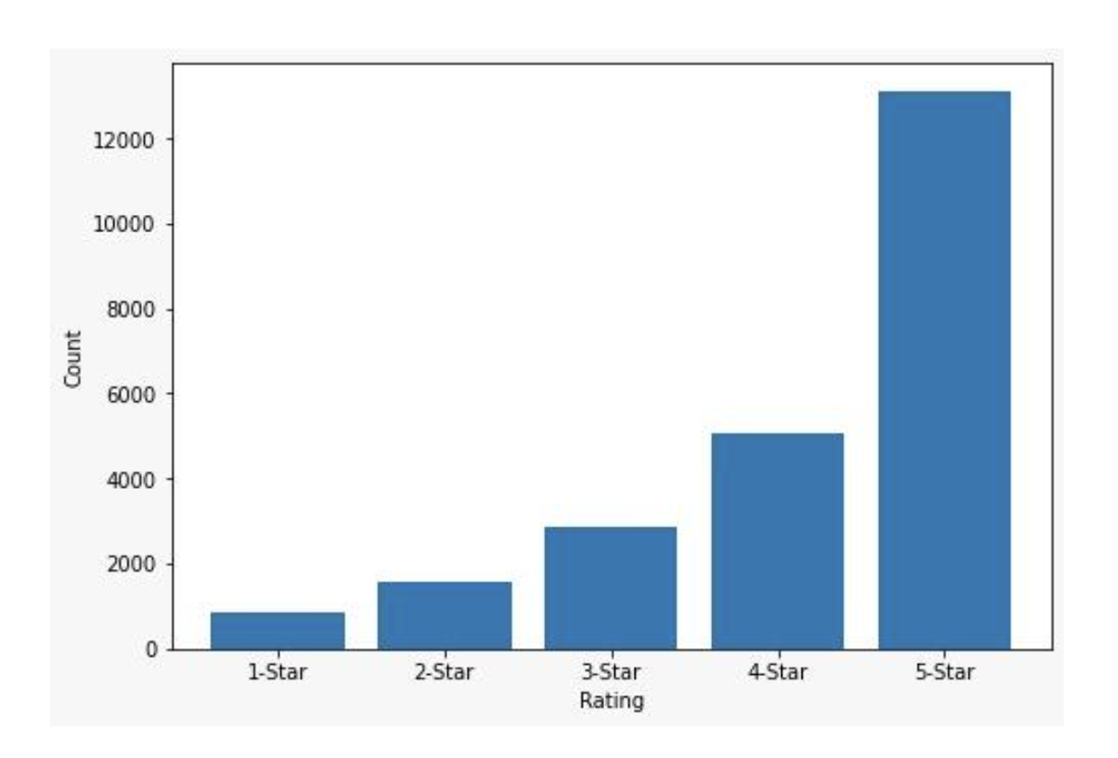

Slide 10
Data Set 3
Twitter Sentiment Analysis Hatred Speech
Data Set URL: https://www.kaggle.com/datasets/arkhoshghalb/twitter-sentiment-analysis-hatred-speech
Dataset Contains 31962 training records.
It contains 2242 hatred and 29720 non-hatred records.
Every record is labeled as Non-Hatred and Hatred according to its sentimental polarity using symbol 1 and 0.
This dataset is available at Kaggle.

Slide 11
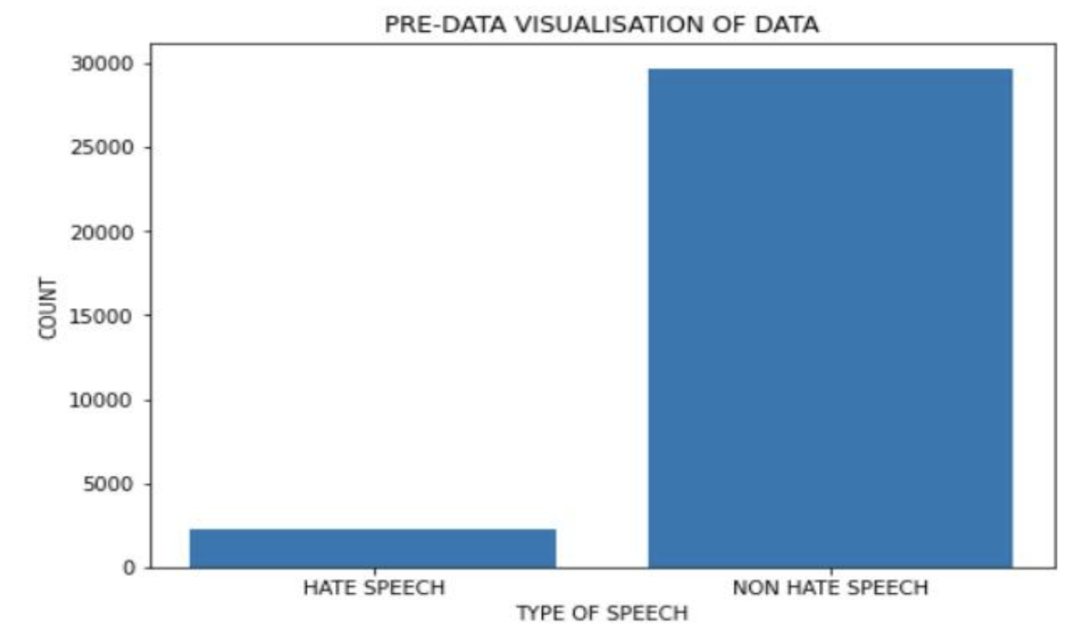
This dataset suffers from imbalance problem.We are solving the imbalance problem using oversampling technique.
Before Applying Over Sampling

Slide 12
Data Preprocessing:
Removing Unnecessary Words: Removed unnecessary characters like emojis, symbols etc.
Numeric Removal: All the numbers from the dataset samples are removed, since our major focus was on text.
Uppercase to Lowercase Conversion: Converting all the uppercase to lowercase letters, since all kind of letters convey the same emotion.
Removing Stop Words: Removing stop words such as the, is, and, for etc,. are removed as they won't carry any meaning or emotion.
Stemming: Converting all the words into their root words by eliminating suffixes and prefixes.

Slide 13

Feature Extraction:
Post-data preprocessing, the TF-IDF matrix is created to transform tweets into a two-dimensional feature matrix.
The TF-IDF technique identifies and highlights the important features, which are crucial for defining the classes in the dataset.
Feature extraction plays a critical role in reducing dimensionality and eliminating less significant features.
By focusing on the most impactful features, the models can better distinguish between different sentiments

Slide 14
Machine Learning Models:
Support Vector Machine
Random Forest
Naive Bayes
Decision Tree
Gradient Boosting Machine
Logistic Regression
Stochastic Gradient Descent
Voting Classifier

Slide 15
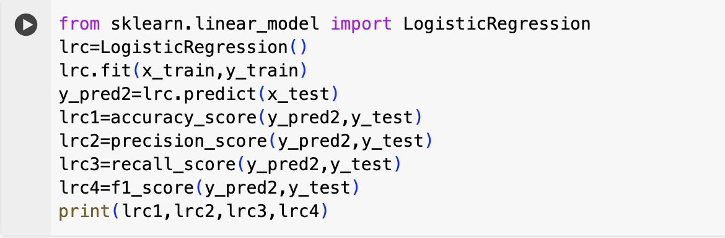
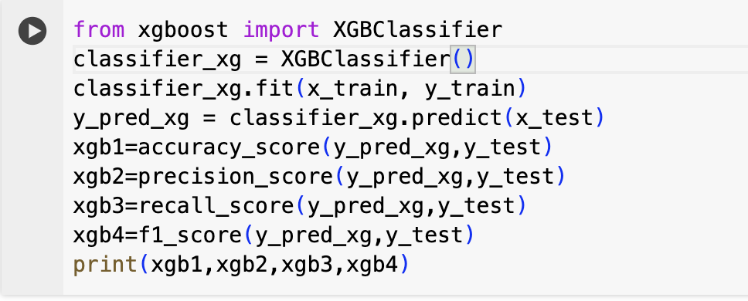
Machine Learning Models:
Logistic Regression:
Gradient Boosting Machine:

Slide 16
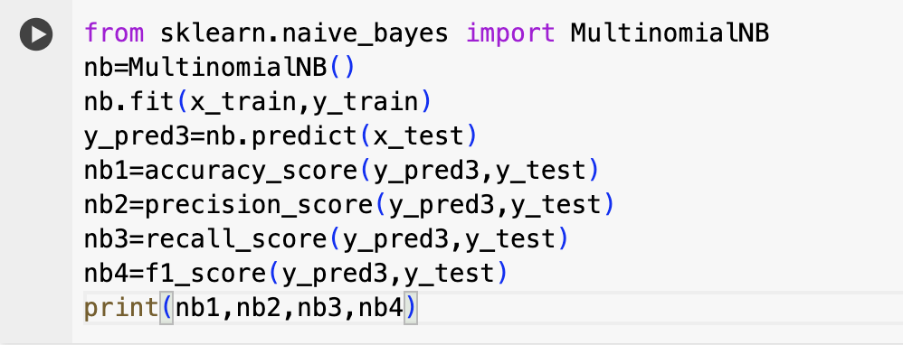
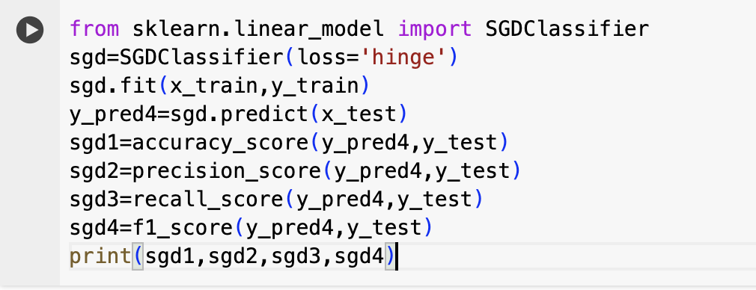
Naive Bayes:
Stochastic Gradient Descent:

Slide 17
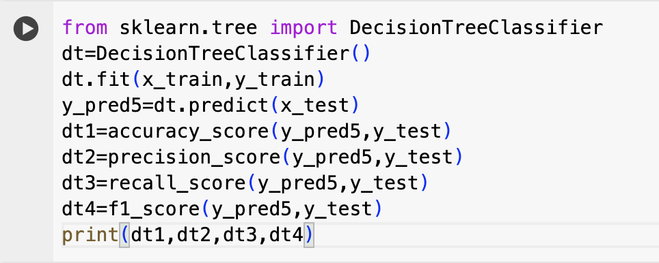
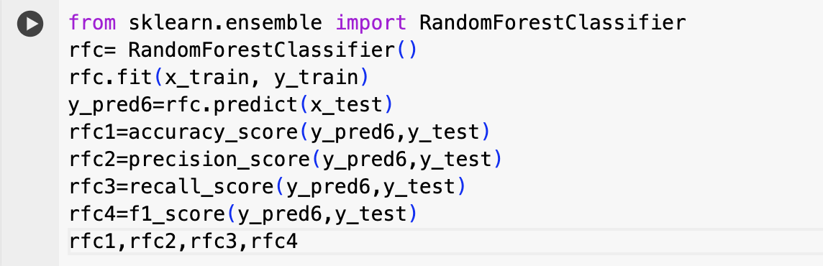
Decision Tree classifier:
Random Forest classifier:

Slide 18
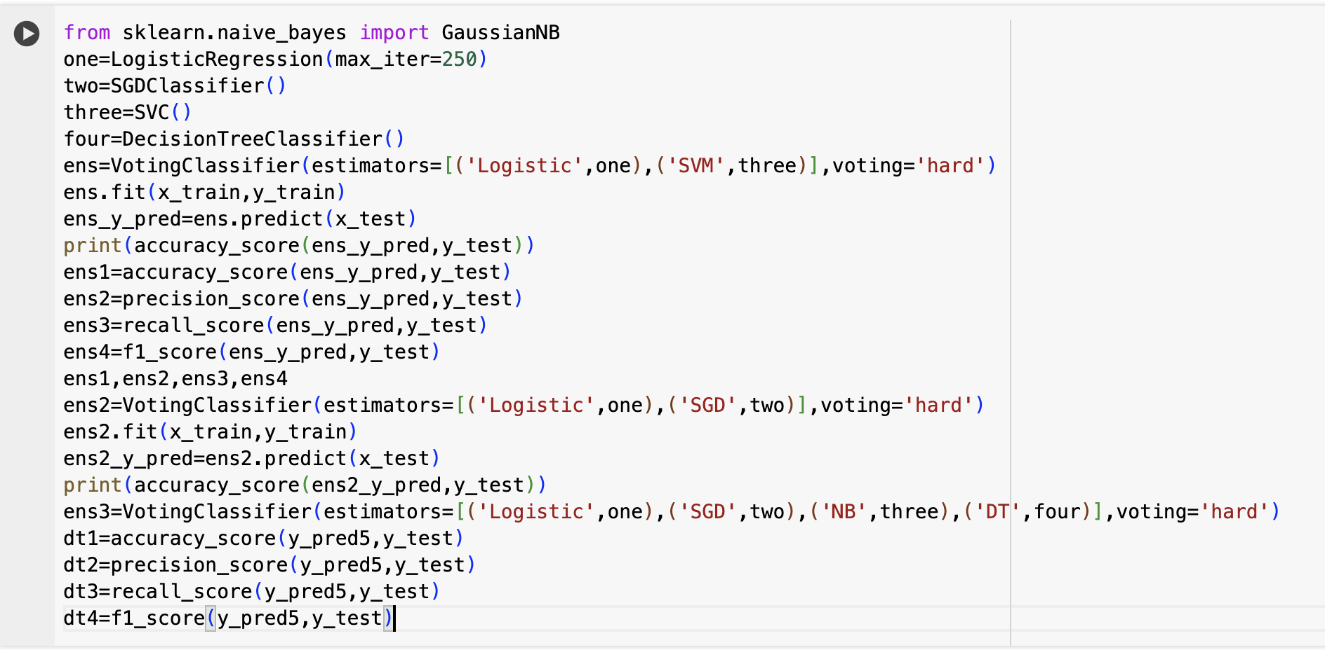
Voting Classifier:

Slide 19
Evaluation Metrics:
Accuracy:It quantifies the overall rate of correct predictions made by the model.
Precision:This metric reflects the proportion of true positive predictions in all positive predictions made
Recall:Recall measures the ratio of true positive predictions to the total actual positive cases.
F1 Score:The F1 score combines precision and recall into a single metric, balancing both for a more comprehensive performance evaluation.

Slide 20
Results For Dataset-1
Algorithms | Accuracy | Precision | Recall | F1_Score
Naive Bayes | 74.1 | 88.6 | 72.1 | 79.5
Logistic Regression | 77.4 | 84.1 | 77.8 | 80.8
Stochastic Gradient Descent | 75.1 | 83.1 | 73.2 | 77.3
Gradient Boosting Machine | 69.3 | 89.1 | 67.2 | 76.7
Decision Tree | 68.6 | 72.9 | 71.9 | 72.4
Random Forest | 75.7 | 83.7 | 75.9 | 79.6
Support Vector Machine | 78.0 | 84.6 | 78.2 | 81.3
Voting Classifier | 83.5 | 85.1 | 83.0 | 85.0

Slide 21
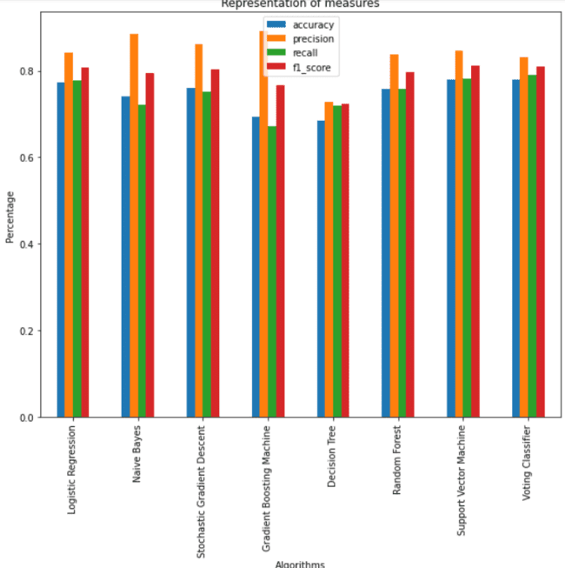
BAR GRAPH VISUALISING ALL THE ALGORITHMS WITH PERFORMANCE METRICS (DATASET 1)

Slide 22
Results For Dataset-2
Algorithms | Accuracy | Precision | Recall | F1_Score
Random Forest | 58.9 | 92.2 | 58.9 | 70.5
Support Vector Machine | 74.4 | 89.3 | 74.4 | 80.0
Naive Bayes | 56.8 | 98.7 | 56.8 | 56.8
Gradient Boosting Machine | 61.0 | 82.8 | 61.0 | 68.5
Logistic Regression | 73.4 | 88.3 | 72.4 | 81.2
Stochastic Gradient Descent | 63.4 | 79.5 | 63.4 | 69.3
Voting Classifier | 82.4 | 87.3 | 83.4 | 82.0

Slide 23
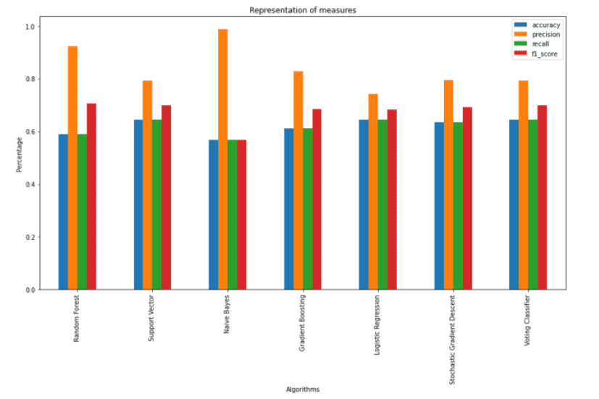
BAR GRAPH VISUALISING ALL THE ALGORITHMS WITH PERFORMANCE METRICS (DATASET 2)

Slide 24
Conclusion
Voting classifier is constructed by combining different machine learning algorithms and checked different combinations. Out of all Logistic Regression and Support Vector Machine gives better accuracy and stands out.
Out of all the ML algorithms, these two algorithms gives more accuracy, so they are combined for voting classifier.
The implementation of a Voting Classifier significantly mitigated the shortcomings of individual algorithms, showcasing a strategic approach to enhance model performance.
*
* •
th
1 8 9 0

Slide 25
Future Scope
With Machine learning algorithms, we got accuracy nearing to 80%. So to get better results, we can use deep learning algorithms.
The application of emotion recognition algorithms to multimedia content, including images and videos, for comprehensive sentiment analysis across different media types.
Incorporate real-time data analysis capabilities to process live tweets and other social media content, providing up-to-the-minute insights into public sentiment and emotional trends.
*
* •
th
1 8 9 0

Slide 26


