Slide 1

Support Vector Machines Algorithm

Slide 2

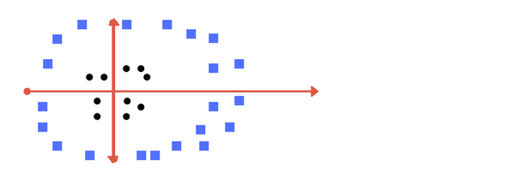
Why Support Vector Machine?
As for the real case scenario, linearly separable data for a classification is not always possible., so we need an algorithm to work well with such data.

Slide 3
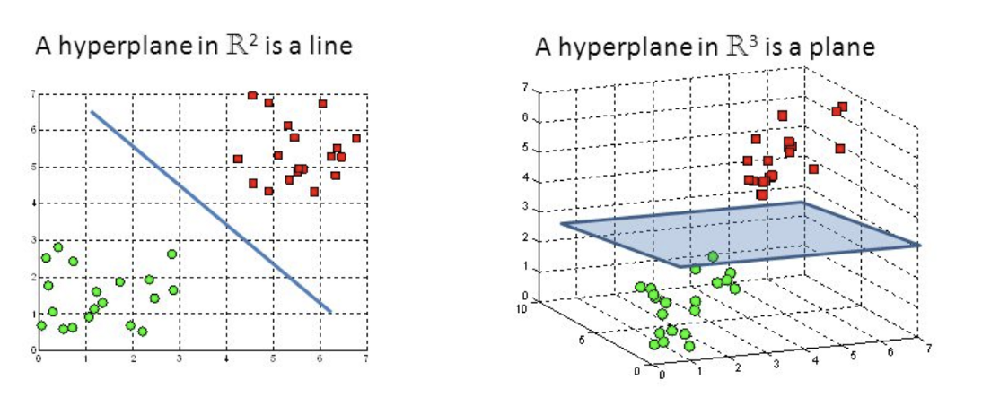
What is Support Vector Machine?
A Support Vector Machine (SVM) is a discriminative classifier formally defined by a separating hyperplane. In other words, given labeled training data (supervised learning), the algorithm outputs an optimal hyperplane which categorizes new examples.
In SVM, we take the output of the linear function and if that output is greater than 1, we identify it with one class and if the output is -1, we identify is with another class. Since the threshold values are changed to 1 and -1 in SVM.

Slide 4
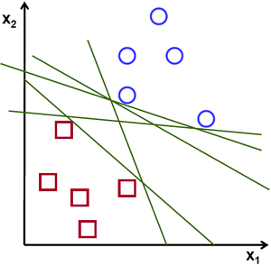
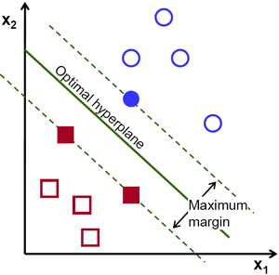
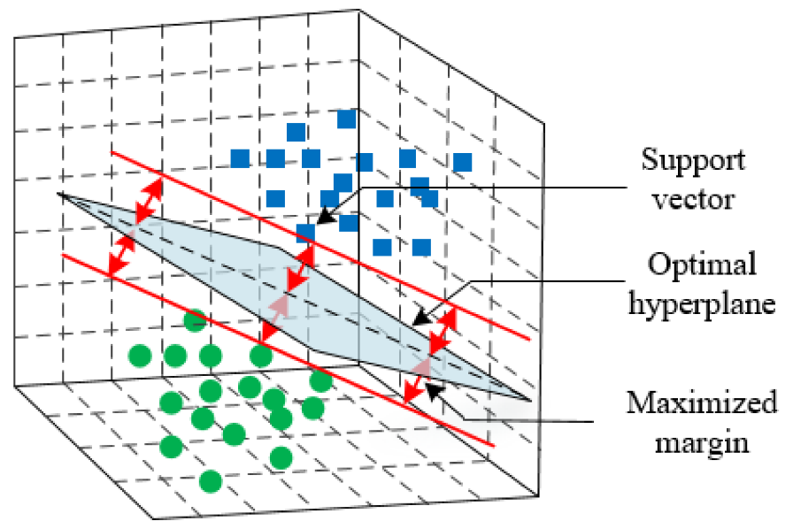
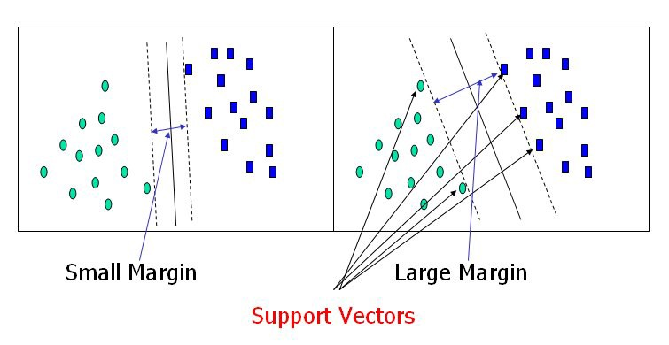
Linear Kernel Function

Slide 5
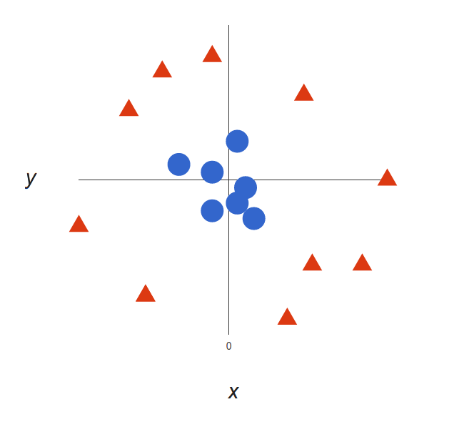
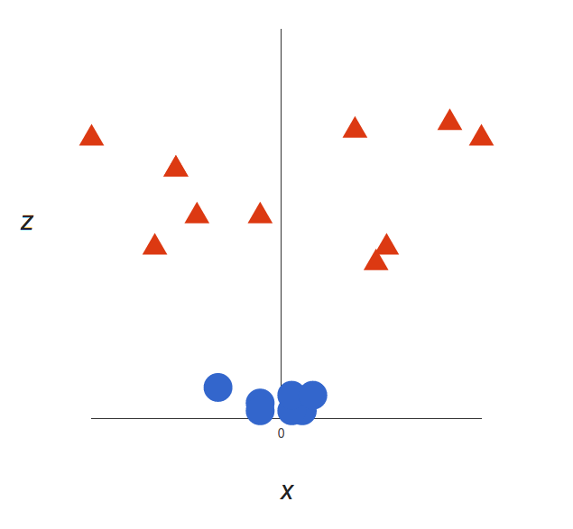
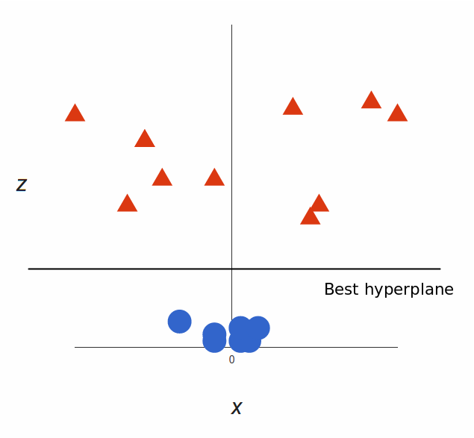
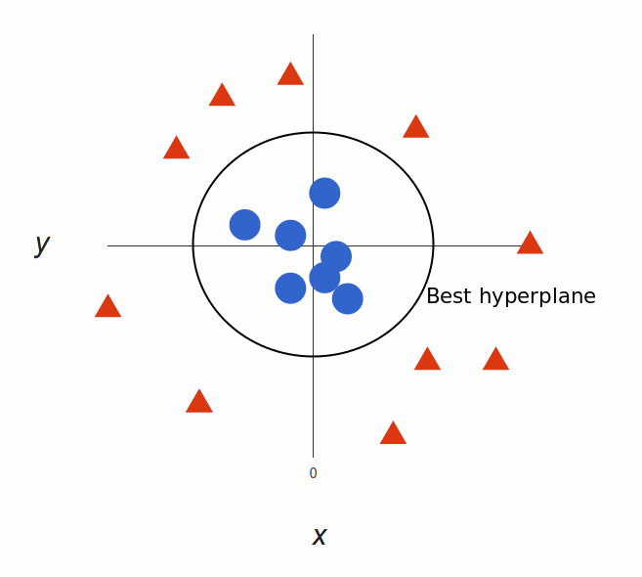
Radial Basis Function

Slide 6
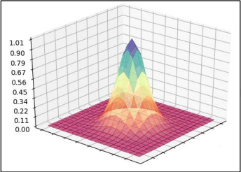
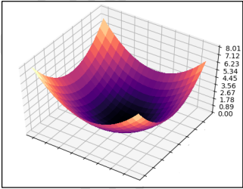
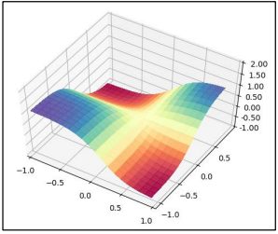
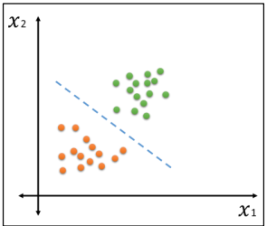
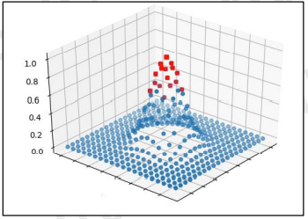
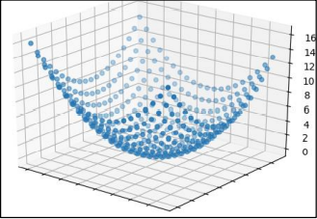
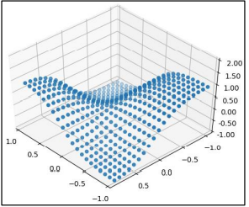
Different Kernel Functions
Sigmoid
RBF
Polynomial
Linear

Slide 7
Support Vector Machine
1
from sklearn.svm import SVC
2
clf = SVC(kernel='rbf')
3
clf.fit(X_train,Y_train)
4
Y_pred = clf.predict(X_test)

Slide 8
Support Vector Machine
Advantages
Dis-Advantages
SVM works relatively well when there is clear margin of separation between classes.
SVM is more effective in high dimensional spaces.
SVM algorithm is not suitable for large data sets.
SVM does not perform very well, when the data set has more noise and sensitive to outliers.

