Slide 1
Creating i2c device
Using ATtiny85 and TMP 36 with Raspberry pi.

Slide 2
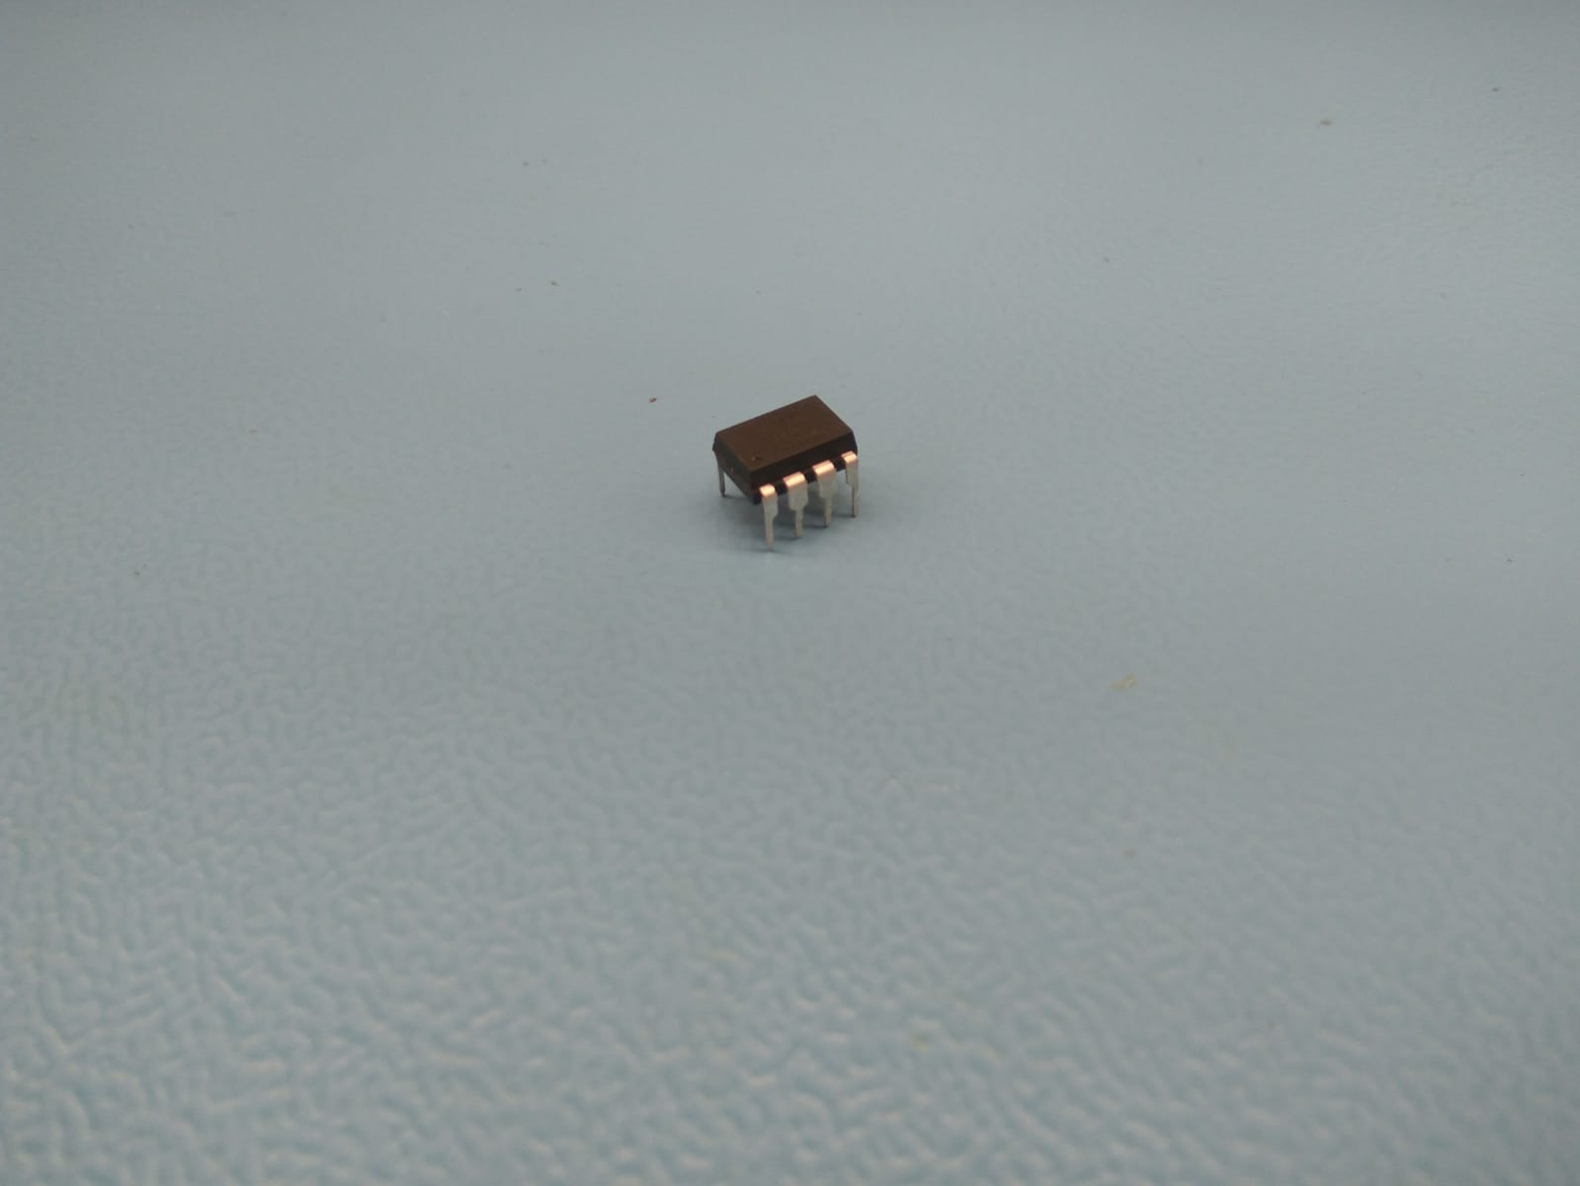
ATtiny85
It is a 8-bit microcontroller , it has many properties, but in my case it is acting as a ADC converter, which act as a slave device. It sends temperature reading when requested by raspberry pi.

Slide 3
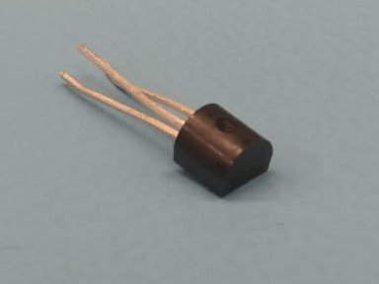
TMP36
It is a analog sensor, which records temperature, and sends reading to ATtiny85, when requested.

Slide 4
Raspberry pi + ATtiny85 + TMP36
My project includes creating a i2c device with ATtiny85. Basically, in project, Raspberry pi acts as a master device and requests data from ATtiny85, on the other hand, ATtiny85 acts as a Slave device, which records a analog value from TMP36(Temperature Sensor) and converts it into digital and sends it to Raspberry pi over i2c, when requested.

Slide 5
Budget
Raspberry pi $80
TMP36(Temperature Sensor) $2.20
ATtiny85(8-Bit microcontroller) $4.20
Jumper Wires $4.60
8 pin DIP Socket $1.00
Shipping $20
Total $112

Slide 6
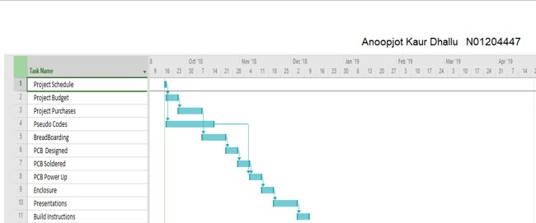
Schedule
I have a long delay in my project, after breadboarding , I cannot do PCB design and soldering unless my sensor is showing reading because I have to take my ATtiny85 again and again to program it, to test it.

Slide 7
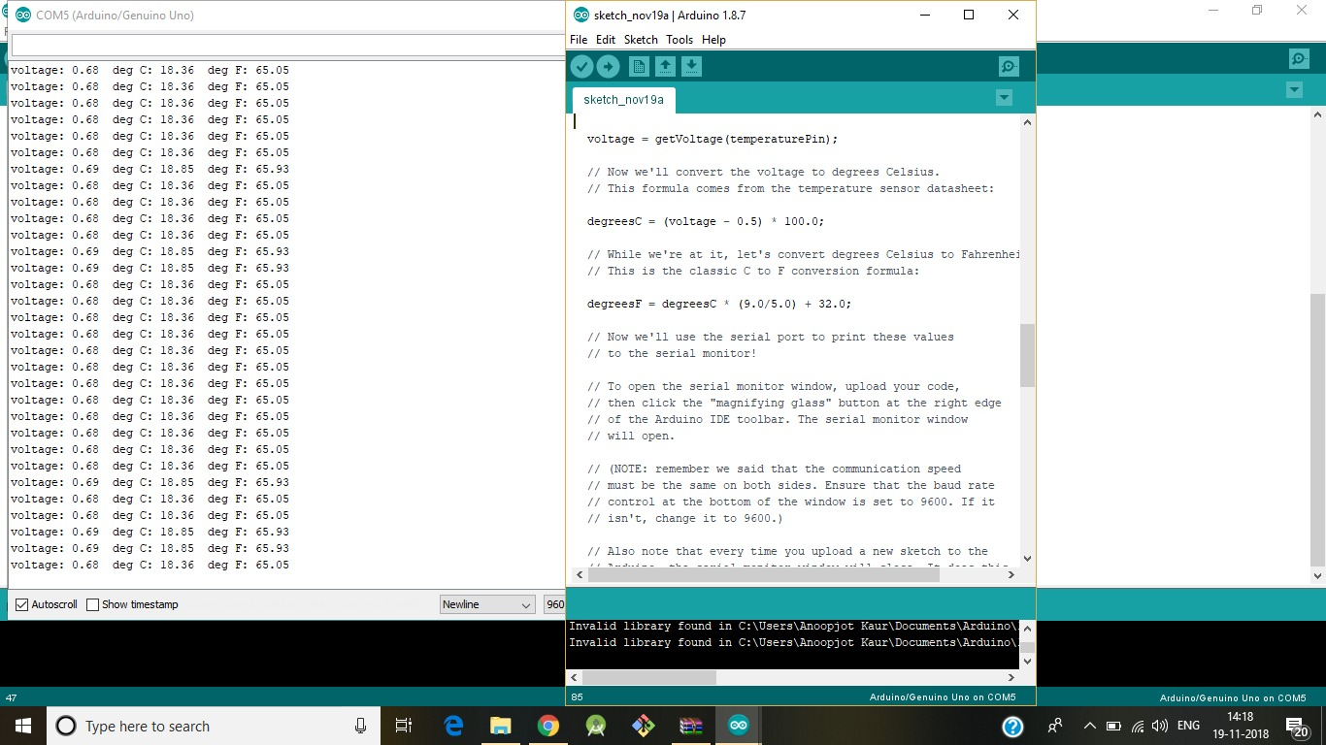
Tests
During my project I ran into various tests
-> With Arduino, it showed correct output.
But Challenge was to do it with Raspberry pi, in case of raspberry pi, it is
Showing readings but in analog, so the last issue left is with the ADC converter function.

Slide 8
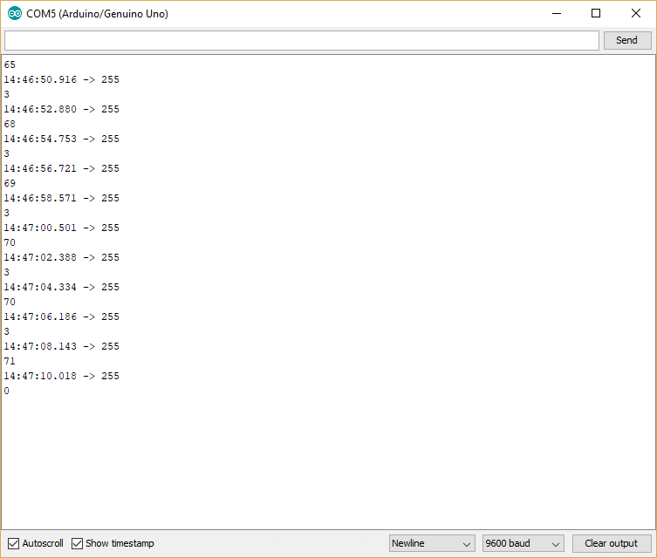
Current output

Slide 9
Course Knowledge utilized from previous courses.
Sem1- Tech101(Electric Circuits), Tech103(Digital Fundamentals)
Sem2- Tech153(Technical C),Tech150(Electronic Devices and Circuits)
Sem3- CENG215(Digital & Interface Systems), CENG216(Software Eng.)
Sem4- CENG250(PC OS Internals), CENG252(Embedded Systems)

