Slide 1

Project Title
Class Attendance Management System

Slide 2
Objective
The objective of this project Class Attendance Management System is to simplify the process of managing student’s attendance. The system allows users to view a comprehensive list of students, displaying their names and roll numbers. It enables users to mark attendance as "Present" or "Absent" for each student on a daily basis, ensuring accurate record-keeping. Additionally, the system provides a search functionality that allows users to quickly find a specific student by their roll number and view their attendance status

Slide 3

Features
Class List Display
Student Search
This functionality allows users to search for a specific student using their roll number. It displays the student’s details, including their name and attendance status.
This feature provides a complete view of all students in the class, including their names and roll numbers
Attendance Marking
Add New User
Users can record attendance for each student as "Present" or "Absent." This ensures that daily attendance records are accurately maintained and updated.
Users can add new students to the system by providing their name and roll number. This feature supports easy expansion of the class list as new students are enrolled.

Slide 4
Implementation
System has been implemented in C++

Slide 5
Display Student Function
This function has been defined to display the details of all students in the Class.
The maximum limit of the students has been fixed 100.
This function takes 2 parameters first 2D array name students to store the students data and second number of students.
The for loop which iterates through the students array and prints each student's Name, Roll No, and Attendance in a tabular format.

Slide 6
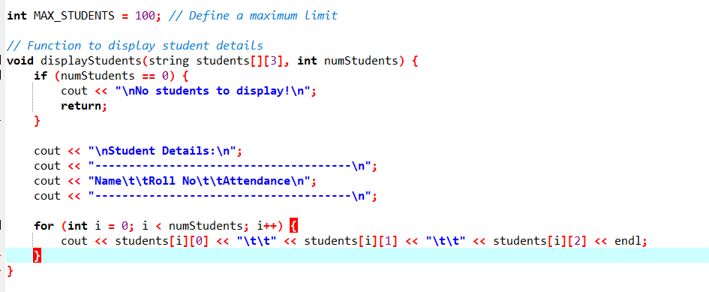

Slide 7
Add User Function
This function has been defined to add a new student (only if max limit is not reached).
This function takes 2 parameters first 2D array name students to store the students data and second number of students.
There is a IF condition that checks if the current number of students has reached the maximum limit. If it has, it prevents adding more students.
If not it will ask for the user details and add the new student.

Slide 8
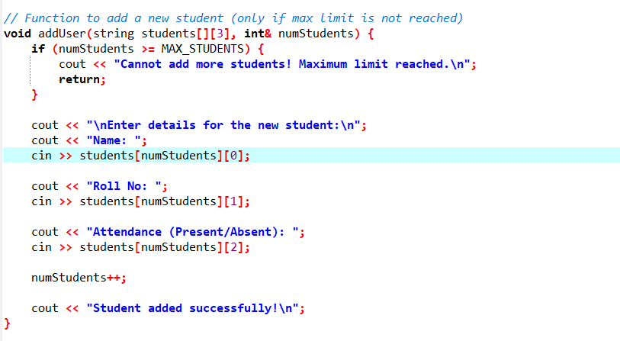

Slide 9
Search User Function
This function has been defined to search for a student by roll number.
This function takes 2 parameters first 2D array name students to store the students data and second number of students.
There is a IF condition that checks whether there are any students to search for. If numStudents is zero, it means no students are registered.
If numStudents are not zero it prompts the user to enter the roll number of the student they want to search for.
for loop that iterates through all the students in the array, from index 0 to numStudents. Inside the loop, it compares the roll number of the current student with the entered rollNo. If they match, it means the student has been found.

Slide 10
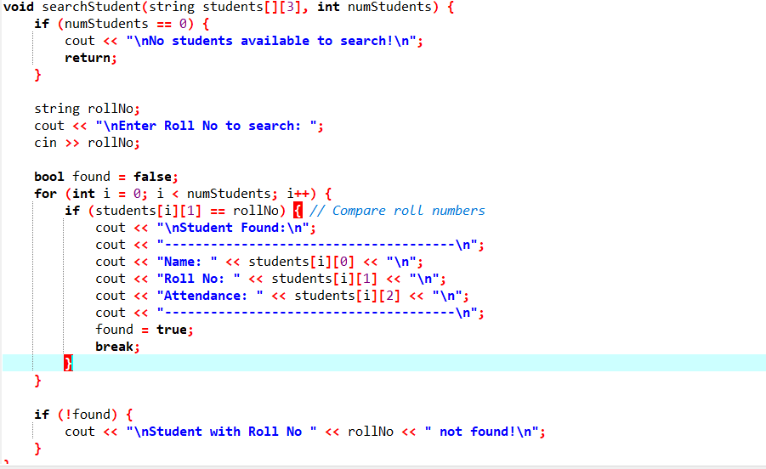

Slide 11
Mark Attendance Function
This function has been defined to mark attendance by roll number.
This function takes 2 parameters first 2D array name students to store the students data and second number of students.
There is a IF condition that checks whether there are any students to search for. If numStudents is zero, it means no students are registered.
If numStudents are not zero it prompts the user to enter the roll number of the student for they want to mark the attendance.
for loop that iterates through all the students in the array, from index 0 to numStudents. Inside the loop, it compares the roll number of the current student with the entered rollNo. If they match, they mark the attendance as Present/Absent.

Slide 12
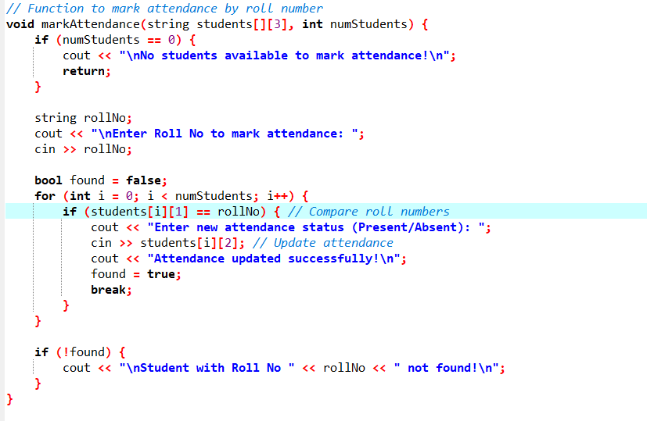

Slide 13
Main() Function
The main function serves as the entry point for the Class Attendance Management System. It prompts the user to input the number of students in the class. It provides a menu-driven interface for interacting with the system, allowing users to perform operations such as adding students, marking attendance, and searching. The menu repeats until the user chooses to exit by selecting option 5.

Slide 14
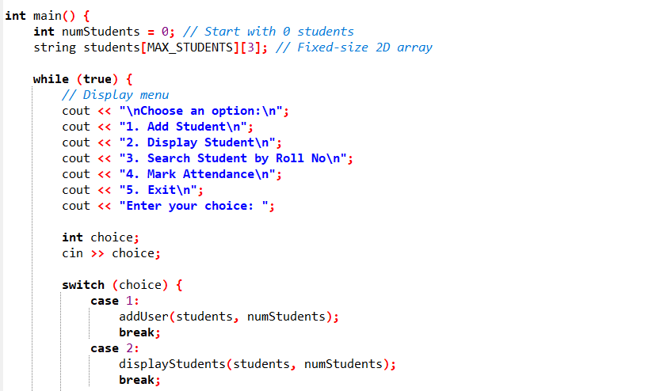

Slide 15
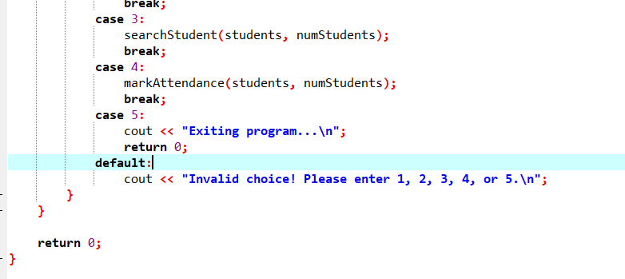

Slide 16
Thank you

