Slide 1
Applied Data Science Capstone Project
Analyzing the Neighborhoods in Mumbai to Start a new Restaurant
By:Anoosh GP,2021

Slide 2
Table of Contents
INTRODUCTION..............................................................................2
DATA COLLECTION......................................................................2
Neighborhoods Data....................................................................................3
Geographical Coordinates......................................................................3
Venue Data........................................................................................................5
METHODOLOGY.............................................................................6
Data Visualization.......................................................................................6
Feature Extraction......................................................................................7
UNSUPERVISED LEARNING........................................................9
RESULTS..........................................................................................10
DISCUSSION....................................................................................13
CONCLUSION.................................................................................15
1

Slide 3
Introduction
Mumbai is the financial capital of India and is one of the most densely populated cities in the world. It lies on the west coast of India and attracts heavy tourism from all over the globe every year. Personally, I have been brought up in Mumbai and have loved the city from the bottom of my heart. It is one of the major hubs of the world and is extremely diverse with people from various ethnicities residing here. The multi-cultural nature of the city of Mumbai has brought along with it numerous cuisines from all over the world. The people of India generally love food and I personally love to try different cuisines and experience different flavors. Thus, the aim of this project is to study the neighborhoods in Mumbai to determine possible locations for starting a restaurant. This project can be useful for business owners and entrepreneurs who are looking to invest and open a restaurant in Mumbai. The main objective of this project is to carefully analyze appropriate data and find recommendations for the stakeholders.
Data Collection
The following data is required for the project:
1) Neighborhood data of Mumbai
2) Geographical coordinates of Mumbai and all neighborhoods in Mumbai
3) Venue data for neighborhoods in Mumbai
2

Slide 4
Neighborhoods Data
The data of the neighborhoods in Mumbai was scraped from https://en.wikipedia.org/wiki/List of neighborhoods in Mumbai. The data is read into a pandas data frame using the read_htmlQ method. The main reason for doing so is that the Wikipedia page provides a comprehensive and detailed table of the data which can easily be scraped using the read_htmlQ method of pandas. The top 10 rows of the dataframe are shown in Figure 1.
 | Neighborhood | Location | Latitude | Longitude
0 | Amboli | Andheri,Western Suburbs | 19.129300 | 72.843400
1 | Chakala, Andheri | Western Suburbs | 19.111388 | 72.860833
2 | D.N. Nagar | Andheri,Western Suburbs | 19.124085 | 72.831373
3 | Four Bungalows | Andheri,Western Suburbs | 19.124714 | 72.827210
4 | Lokhandwala | Andheri,Western Suburbs | 19.130815 | 72.829270
5 | Marol | Andheri,Western Suburbs | 19.119219 | 72.882743
6 | Sahar | Andheri,Western Suburbs | 19.098889 | 72.867222
7 | Seven Bungalows | Andheri,Western Suburbs | 19.129052 | 72.817018
8 | Versova | Andheri,Western Suburbs | 19.120000 | 72.820000
9 | Mira Road | Mira-Bhayandar,Western Suburbs | 19.284167 | 72.871111
Figure 1: Top 10 rows of Mumbai neighborhoods data scraped from Wikipedia.
Geographical Coordinates
The geographical coordinates for Mumbai has been obtained from the GeoPy library in python. This data is relevant for plotting the map of Mumbai using the Folium library in python. The code for getting the geographical coordinates of Mumbai is shown in Figure 2.
3

Slide 5
address = 'Mumbai, IN'
geolocator = Nominating)
location = geolocator.geocode(address)
latitude = location.latitude
longitude = location.longitude
print('The geograpical coordinates of Mumbai are {>, {>.'.formattlatitude, longitude)) The geograpical coordinates of Mumbai are 19.0759899, 72.8773928.
Figure 2: Obtaining geographical coordinates of Mumbai.
The geocoder library in python has been used to obtain latitude and longitude data for various neighborhoods in Mumbai. The coordinates of all neighborhoods in Mumbai are used to check the accuracy of coordinates given on Wikipedia and replace them in our data frame if the absolute difference is more than 0.001. These refined coordinates are then further used for plotting neighborhoods using the Folium library in python. Figure 3 shows the coordinates of neighborhoods in Mumbai obtained from Wikipedia as ‘Latitude’ and ‘Longitude’ and those obtained from geocoder as ‘Latitudel’ and ‘Longitudel’. Furthermore, it also shows the absolute difference between the two latitude columns and the two longitude columns as ‘Latdiff and ‘Longdiff, respectively. Once again only the top 10 rows are shown.
 | Neighborhood | Location | Latitude | Longitude | Latitudel | Longitudel | Latdiff | Longdiff
0 | Amboli | Western Suburbs | 19.1293 | 72.8464 | 19.1291 | 72.8464 | 0.00024 | 0.00304
1 | Chakala, Andheri | Western Suburbs | 19.1084 | 72.8623 | 19.1084 | 72.8623 | 0.003028 | 0.001497
2 | D.N. Nagar | Western Suburbs | 19.1241 | 72.8325 | 19.1251 | 72.8325 | 0.000965 | 0.001107
3 | Four Bungalows | Western Suburbs | 19.1263 | 72.8243 | 19.1263 | 72.8243 | 0.001606 | 0.00288
4 | Lokhandwala | Western Suburbs | 19.1432 | 72.8249 | 19.1432 | 72.8249 | 0.012345 | 0.0044
5 | Marol | Western Suburbs | 19.1192 | 72.8827 | 19.1191 | 72.8828 | 0.000169 | 6.7e-05
6 | Sahar | Western Suburbs | 19.1027 | 72.8626 | 19.1027 | 72.8626 | 0.00376476 | 0.00464166
7 | Seven Bungalows | Western Suburbs | 19.1315 | 72.817 | 19.1315 | 72.8165 | 0.00240802 | 0.000558001
8 | Versova | Western Suburbs | 19.1377 | 72.8135 | 19.1377 | 72.8135 | 0.01769 | 0.00652
9 | Mira Road | Western Suburbs | 19.2657 | 72.8711 | 19.2657 | 72.8707 | 0.0184624 | 0.000418149
Figure 3: Absolute difference between latitude and longitude values obtained from Wikipedia and Geocoder.
4

Slide 6
Figure 4 shows the top 10 rows of the final Mumbai neighborhoods dataframe after replacing the latitude and longitude values as mentioned before and dropping unnecessary columns.
Neighborhood | Location | Latitude | Longitude
Amboli | Western Suburbs | 19.1293 | 72.8464
Chakala, Andheri | Western Suburbs | 19.1084 | 72.8623
D.N. Nagar | Western Suburbs | 19.1241 | 72.8325
Four Bungalows | Western Suburbs | 19.1263 | 72.8243
Lokhandwala | Western Suburbs | 19.1432 | 72.8249
Marol | Western Suburbs | 19.1192 | 72.8827
Sahar | Western Suburbs | 19.1027 | 72.8626
Seven Bungalows | Western Suburbs | 19.1315 | 72.817
Versova | Western Suburbs | 19.1377 | 72.8135
Mira Road | Western Suburbs | 19.2657 | 72.8711
0
1
2
3
4
5
6
7
8 9
Figure 4: Final Mumbai neighborhoods dataframe.
Venue Data
The venue data has been extracted using the Foursquare API. This data contains venue recommendations for all neighborhoods in Mumbai and is used to study the popular venues of different neighborhoods as well as build the unsupervised learning model to cluster neighborhoods. The venue recommendations of all neighborhoods were obtained with a limit of 200, that is, maximum of 200 venue recommendations per neighborhood and a radius of 1 km around the neighborhood’s geographical coordinates. Figure 5 shows the top 10 rows depicting the results obtained after cleaning the data from Foursquare API.
5

Slide 7



 | Neighborhood | Neighborhood Latitude | Neighborhood Longitude | Venue | Venue Latitude | Venue Longitude | Venue Category
0 | Amboli | 19.1293 | 72.84644 | Cafe Arfa | 19.128930 | 72.847140 | Indian Restaurant
1 | Amboli | 19.1293 | 72.84644 | 5 Spice, Bandra | 19.130421 | 72.847206 | Chinese Restaurant
2 | Amboli | 19.1293 | 72.84644 | Shawarma Factory | 19.124591 | 72.840398 | Falafel Restaurant
3 | Amboli | 19.1293 | 72.84644 | Jaffer Bhai's Delhi Darbar | 19.137714 | 72.845909 | Mughlai Restaurant
4 | Amboli | 19.1293 | 72.84644 | Narayan Sandwich | 19.121398 | 72.850270 | Sandwich Place
5 | Amboli | 19.1293 | 72.84644 | Persia Darbar | 19.136952 | 72.846822 | Indian Restaurant
6 | Amboli | 19.1293 | 72.84644 | Domino's Pizza | 19.131000 | 72.848000 | Pizza Place
7 | Amboli | 19.1293 | 72.84644 | Garden Court | 19.127188 | 72.837478 | Indian Restaurant
8 | Amboli | 19.1293 | 72.84644 | Subway | 19.127860 | 72.844461 | Sandwich Place
9 | Amboli | 19.1293 | 72.84644 | Sarvodaya Veg. Restaurant | 19.123760 | 72.850893 | Indian Restaurant
Figure 5: Data obtained from Foursquare API after cleaning.
Methodology
This section provides details for the methodology used in the project.
Data Visualization
In order to understand the data obtained for Mumbai neighborhoods, basic visualization was carried out. Figure 6 shows a bar plot depicting the number of neighborhoods in each location in Mumbai.
Number of Neighborhoods Grouped by Location in Mumbai
Western Suburbs South Mumbai
o
nj Mumbai
u
■
Harbour Suburbs
Eastern Suburbs
0 5 1015 2025303540
Number of Neighborhoods
Figure 6: Number of neighborhoods grouped by location.
6

Slide 8
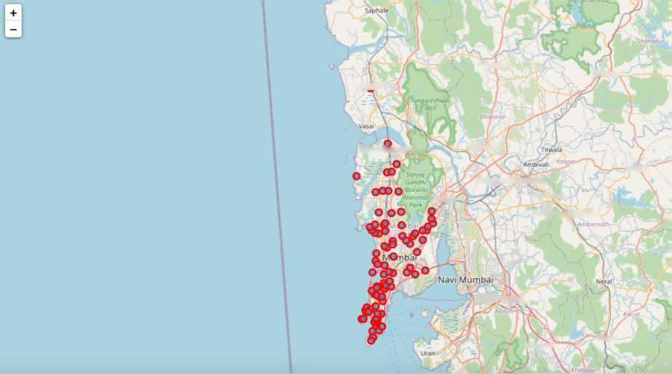
It is evident from Figure 6 that South Mumbai and Western Suburbs have the most number of neighborhoods. Notice how we see one of the locations as Mumbai itself? This is because the neighborhoods contained in this location are located at the outskirts of the city and thus have been termed as just Mumbai.
Using folium, a map was plotted to show how the different neighborhoods are spread all across Mumbai. This is shown in Figure 7.
VasA-Virar
Umber pada
Shahapur
Mira-Bnayander
Bhiwandi
Murbad
Thane
Kalyan-Dombivli
Amber nath
Kulgaon Badlapur
Panvel
Rasayam
Karjat
Figure 7: Depicting the neighborhood spread across Mumbai.
Feature Extraction
Feature extraction was carried out to obtain features from the Foursquare API data (as shown in Figure 5) which was used for building the unsupervised learning model. In order to achieve this, the “Venue Category” column had to be converted to some form of numeric value to be used for building the model. This was
7

Slide 9
achieved by the One-hot Encoding method which takes all the unique categories and creates a column for each category. Then, if a neighborhood venue belongs to that category, it would get a value of 1 for that row in that specific category column and if a neighborhood venue does not belong to the particular category, the value would be 0. This process was repeated for all venues in all neighborhoods and the result was a sparse matrix containing the neighborhood name and all unique category columns with either 1 or 0 based on whether the neighborhood venue belonged to that category or not. This dataframe was then grouped by the neighborhood name and the average value was taken for all categories. The result is shown in Figure 8 which shows only the top 10 rows.
 | Neighborhood | ATM | Accessories Store | Airport Terminal | American Restaurant | Antique Shop | Aquarium | Arcade | Art Gallery
0 | Amboli | 0.0 | 0.0 | 0.000000 | 0.0 | 0.0 | 0.0 | 0.0 | 0.0
1 | Chakala, Andheri | 0.0 | 0.0 | 0.000000 | 0.0 | 0.0 | 0.0 | 0.0 | 0.0
2 | D.N. Nagar | 0.0 | 0.0 | 0.000000 | 0.0 | 0.0 | 0.0 | 0.0 | 0.0
3 | Four Bungalows | 0.0 | 0.0 | 0,000000 | 0.0 | 0.0 | 0.0 | 0.0 | 0.0
4 | Lokhandwala | 0.0 | 0.0 | 0.000000 | 0.0 | 0.0 | 0.0 | 0.0 | 0.0
5 | Marol | 0.0 | 0.0 | 0.000000 | 0.0 | 0.0 | 0.0 | 0.0 | 0.0
6 | Sahar | 0.0 | 0.0 | 0.033333 | 0.0 | 0.0 | 0.0 | 0.0 | 0.0
7 | Seven Bungalows | 0.0 | 0.0 | 0.000000 | 0.0 | 0.0 | 0.0 | 0.0 | 0.0
8 | Versova | 0.0 | 0.0 | 0.000000 | 0.0 | 0.0 | 0.0 | 0.0 | 0.0
9 | Mira Road | 0.0 | 0.0 | 0.000000 | 0.0 | 0.0 | 0.0 | 0.0 | 0.0
Arts & Crafts Store | ... Trail | Train | Train Station | Vegetarian / Vegan Restaurant | Whisky Bar | Wine Bar | Wine Shop | Women's Store | Yoga Studio | Zoo
0.000000 | ... 0.0 | 0.0 | 0.0 | 0.000000 | 0.0 | 0.0 | 0.000 | 0.000000 | 0.0 | 0.0
0.000000 | ... 0.0 | 0.0 | 0.0 | 0.047619 | 0.0 | 0.0 | 0.000 | 0.000000 | 0.0 | 0.0
0.000000 | ... 0.0 | 0.0 | 0.0 | 0.043478 | 0.0 | 0.0 | 0.000 | 0.021739 | 0.0 | 0.0
0,000000 | ... 0.0 | 0.0 | 0.0 | 0.030303 | 0.0 | 0.0 | 0,000 | 0.015152 | 0.0 | 0.0
0.000000 | ... 0.0 | 0.0 | 0.0 | 0.010753 | 0,0 | 0.0 | 0.000 | 0.010753 | 0.0 | 0.0
0.000000 | ... 0.0 | 0.0 | 0.0 | 0.000000 | 0.0 | 0.0 | 0.000 | 0.000000 | 0.0 | 0.0
0.000000 | ... 0.0 | 0.0 | 0.0 | 0.000000 | 0.0 | 0.0 | 0.000 | 0.000000 | 0.0 | 0.0
0.014925 | ... 0.0 | 0.0 | 0.0 | 0.029851 | 0.0 | 0.0 | 0.000 | 0.000000 | 0.0 | 0.0
0.025000 | ... 0.0 | 0.0 | 0.0 | 0.000000 | 0.0 | 0.0 | 0.025 | 0.000000 | 0.0 | 0.0
0.000000 | ... 0.0 | 0.0 | 0.0 | 0.000000 | 0.0 | 0.0 | 0.000 | 0.066667 | 0.0 | 0.0
10 rows x 221 columns
Figure 8: One-hot Encoding resulting dataframe.
Notice that most of the values are 0 since there were a large number of unique categories and not all neighborhoods had venues belonging to each category. This data was used for the unsupervised learning model with the neighborhood name dropped. The unsupervised learning model is explained in the next section.
8

Slide 10
A dataframe was also created which contained the top 10 most common venues of all neighborhoods. Though this is not a part of Feature Extraction, it is important to provide a glimpse into what this dataframe looks like as it will be used later to combine the results from the unsupervised learning model. The top 10 rows of this dataframe are shown in Figure 9.
1st Most Common Venue
2nd Most Common Venue
3rd Most Common Venue
4th Most Common Venue
5th Most Common Venue
6th Most 7th Most 8th Most
Common Venue Common Venue Common Venue
9th Most Common Venue
10th Most Common Venue
Bike Rental / Bike Share
Gym Gym Coffee Shop Asian Restaurant Lounge
Falafel
Restaurant
Bistro
Sandwich Race
Bar
Chakala.
Andheri
Coffee Shop Indian Restaurant Indian Restaurant Cafe
Bakery
Cate
Pub
Indian Restaurant Cafe Diner
Indian Restaurant
Fast Food Restaurant
Pizza Place Asian Restaurant Lounge Bar Bar
Ice Cream Shop Asian Restaurant Coffee Shop
Chinese
Restaurant
Sandwich Race
Vegetarian / Vegan Restaurant
Bus Station Restaurant Snack Place
Vegetarian / Vegan Restaurant
Coffee Shop Restaurant Restaurant Asian Restaurant Bistro Basketball Court
3 ^{Four} Bungalows
4 Lokhandwala
5 Marol
6 Sahar Seven
⁷ Bungalows
Gym / Fitness Center
Vegetarian / Vegan Restaurant
Indian
Restaurant
Gym / Fitness Center
Chinese
Restaurant
Bakery Dance Studio Gym Pizza Place Coffee Shop
Fast Food Restaurant
Seafood
Restaurant
Chinese
Italian
Restaurant
Gym / Fitness Center
Indian
Restaurant
Restaurant
Chinese
Restaurant
Fast Food Restaurant
Hotel
Seafood
Restaurant
Cafe
Chinese
Restaurant
Bar Ice Cream Shop
Cafe
Indian
Pub
Restaurant
Beach
Salon/
Barbershop
Frozen Yogurt Shop
Ice Cream Shop Convenience Store
Mexican
Restaurant
Motorcycle _{MovreTSeater} Shop
Figure 9: Top 10 most common venues for neighborhoods.
Unsupervised Learning
K-means unsupervised learning technique was used to cluster the neighborhoods based on the category of venues near the neighborhoods. One important aspect of the k-means model is to determine the number of clusters to use in model development. This was determined by the Silhouette score which was calculated for a range of clusters from 2 to 15. The resulting number of clusters and their respective Silhouette scores are shown in Figure 10.
9

Slide 11
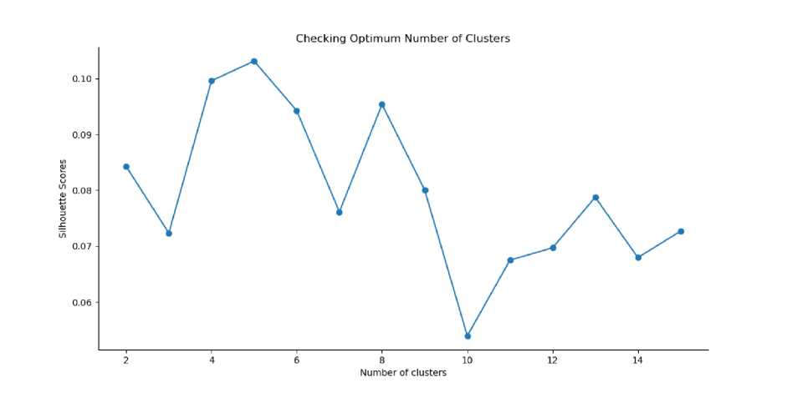
Figure 10: Silhouette scores for different number of clusters.
It is evident that the Silhouette scores are not very high even as the number of clusters increases. This means that the inter-cluster distance is not very high over the range of k-values. Despite this, the data will be clustered to the best possible extent. For this, 5 clusters will be used for the k-means clustering model since it provides the highest silhouette score as seen in Figure 10.
Results
The clustering model then clusters the neighborhoods in Mumbai and provides a label for each neighborhood which is representative of the cluster it belongs to. The cluster labels were then added to the dataframe in Figure 9 along with the
10

Slide 12
Location, Latitude, and Longitude columns to provide a complete summary of the clustering. The top 10 rows are shown in Figure 11.
Neighborhood | Location | Latitude | Longitude | Cluster Labels | 1 st Most Common Venue | 2nd Most Common Venue | 3rd Most Common Venue | 4th Most Common Venue | 5th Most Common Venue | 6th Most Common Venue | 7th Most Common Venue | 8th Most Common Venue | 9th Most Common Venue | 10th Most Common Venue
Amboli | Western Suburbs | 19.1293 | 72.8464 | 1 | Indian Restaurant | Coffee Shop | Bakery | Bar | Asian Restaurant | Pizza Place | Sandwich Place | Bowling Alley | Bus Station | Bike Rental / Bike Share
ChakaJa, Andheri | Western Suburbs | 19.1084 | 72.8623 | 1 | Hotel | Indian Restaurant | Cate | Fast Food Restaurant | Pizza Place | Asian Restaurant | Hotel Bar | Vegetarian / Vegan Restaurant | Restaurant | Gym
D.N. Nagar | Western Suburbs | 19.1241 | 72.8325 | 0 | Bar | Indian Restaurant | Pub | Gym / Fitness Center | Pizza Place | Lounge | Coffee Shop | Vegetarian / Vegan Restaurant | Snack Place | Gym
Four Bungalows | Western Suburbs | 19.1263 | 72.8243 | 0 | Pub | Catt | Indian Restaurant | Gym / Fitness Center | Chinese Restaurant | Bar | Seafood Restaurant | Lounge | Vegetarian / Vegan Restaurant | Coffee Shop
Lokhandwala | Western Suburbs | 19.1432 | 72.8249 | 0 | Indian Restaurant | Chinese Restaurant | Cafe | Pub | Bakery | Bar | Italian Restaurant | Gym / Fitness Center | Coffee Shop | Asian Restaurant
Marol | Western Suburbs | 19.1192 | 72.8827 | 1 | Indian Restaurant | Hotel | Diner | Bakery | Dance Studio | Ice Cream Shop | Chinese Restaurant | Fast Food Restaurant | Restaurant | Lounge
Sahar | Western Suburbs | 19.1027 | 72.8626 | 0 | Hotel | Cafe | Indian Restaurant | Lounge | Gym | Asian Restaurant | Pizza Place | Seafood Restaurant | Restaurant | Falafel Restaurant
Seven Bungalows | Western Suburbs | 19.1315 | 72.817 | 0 | Caf<§ | Pub | Seafood Restaurant | Chinese Restaurant | Pizza Place | Coffee Shop | Bar | Ice Cream Shop | Asian Restaurant | Bistro
Versova | Western Suburbs | 19.1377 | 72.8135 | 0 | Cafe | Ice Cream Shop | Beach | Pizza Place | Coffee Shop | Chinese Restaurant | Salon/ Barbershop | Frozen Yogurt Shop | Bistro | Sandwich Place
Mira Road | Western Suburbs | 19.2657 | 72.8711 | 1 | Indian Restaurant | Convenience Store | Coffee Shop | Mexican Restaurant | Fast Food Restaurant | Food Truck | Motorcycle Shop | Movie Theater | Basketball Court | Bar
0
1 2
3
4
5
6
7
8 9
Figure 11: Clustering neighborhoods in Mumbai.
Furthermore, neighborhoods in each individual cluster can be extracted using cluster labels and thus the details of specific clusters can be seen. This is done below for all clusters with only 10 rows for clusters that contain a high number of neighborhoods.
 | Neighborhood | Location | 1st Most Common Venue | 2nd Most 3rd Most Common Venue Common Venue |  | 4th Most Common Venue | 5th Most Common Venue | 6th Most Common Venue | 7th Most Common Venue | 8th Most Common Venue | 9th Most Common Venue | 10th Most Common Venue
1 | Chakala Andheri | Western Suburbs | Hotel | Indian Restaurant | Cafe | Hotel Bar | Asian Restaurant | Pizza Place | Vegetarian/Vegan Restaurant | Restaurant | Burger Joint | Multiplex
6 | Sahar | Western Suburbs | Hotel | Indian Restaurant | Restaurant | Gym | Asian Restaurant | Bar | Coffee Shop | Cafe | Italian Restaurant | Pub
27 | Khar Danda | Western Suburbs | Hotel | Clothing Store | Park | Coffee Shop | Dessert Shop | Bookstore | Bistro | French Restaurant | Boutique | Pool
40 | Kanjurmarg | Eastern Suburbs | Train Station | Gym | Hotel | Gift Shop | Chinese Restaurant | French Restaurant | Asian Restaurant | Multiplex | Donut Shop | Electronics Store
70 | Malabar Hill | South Mumbai | Gym | Hotel | Park | Convenience Store | Lighthouse | Coffee Shop | Dessert Shop | Indian Restaurant | Cupcake Shop | Cosmetics Shop
77 | Walkeshwar | South Mumbai | Gym | Park | Hotel | Convenience Store | Food & Drink Shop | Food Truck | Lighthouse | Restaurant | Dessert Shop | Coffee Shop
Figure 12: Cluster 1.
11

Slide 13
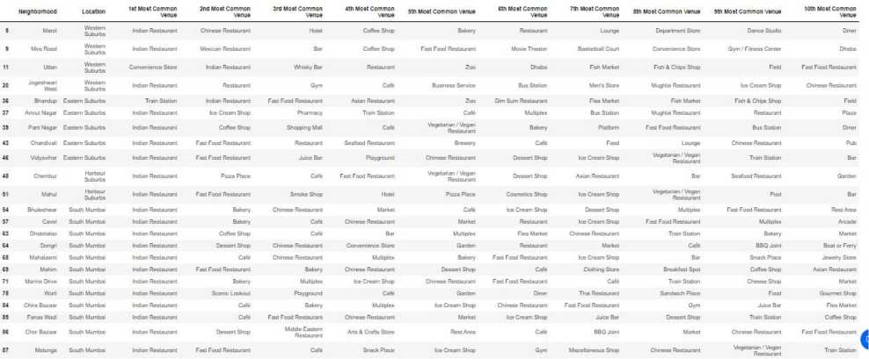
 | Neighborhood | Location | 1st Most Common Venue | 2nd Most Common Venue | 3rd Most Common Venue | 4th Most Common Venue | 5th Most Common Venue | 6th Most Common Venue | 7th Most Common Venue | 8th Most Common Venue | 9th Most Common Venue | 10th Most Common Venue
0 | Amboli | Western Suburbs | Indian Restaurant | Peza Place | Sandwich Place | Bar | Bakery | Athletics & Sports | Metro Station | Burger Joint | Bike Rental / Bike Share | Mughlai Restaurant
2 | D.N. Nagar | 'Vr3:a- Suburbs | Pub | Bar | Indian Restaurant | Pizza Place | Gym / Fitness Center | Women s Store | Vegetarian Vegan Restaurant | Juice 3a^{r} | Snack Place | Hotel Bar
3 | Four Bungalows | Wfestem Suburbs | Pub | Lounge | Chmese Restaurant | Indian Restaurant | Seafood Restaurant | Vegetarian; Vegan Restaurant | Pizza Place | Cafe | Coffee Shop | Ice Cream Shop
4 | Lokhandwala | Western Suburbs | Indian Restaurant | Cafe | Coffee Shop | Chinese Restaurant | Bar | Pub | Italian Restaurant | ⁼ast Food Restaurant | Asian Restaurant | Seafood Restaurant
7 | Seven Bungalows | Western Suburbs | Cafe | Pub | Bar | Chinese Restaurant | Indian Restaurant | Seafood Restaurant | Pizza Place | Ice Cream Shop | Vfegetarian: Vegan Restaurant | Coffee Shop
83 | Ballard Estate | South Mumbai | Indian Restaurant | Cafe | Coffee Shop | Seafccd Restaurart | Bar | Parsi Restaurant | Lounge | Train Station | Irani Cafe | Dessert Shop
88 | Parel | South Mumbai | Coffee Shop | Playground | Indian Restaurant | Chinese Restaurart | Plaza | Restaurant | Rest Area | Maharashtrian Restaurant | Bar | \fegetarian ,^{l} Vegan Restaurant
89 | Gowalia Tank | South Mumbai | Indian Restaurant | Fast Food Restaurant | Coffee Shop | Bakery | Electronics Store | Cafe | Sandwich Place | Vegeta'an ■ Vegan Restaurant | Snack Place | Ice Cream Shop
90 | Dava Bazaar | South Mumbai | Train Station | Indian Restaurant | Fish Market | Hotel | French Restaurant | Fast Food Restaurant | Cafe | Coffee Shop | Clothing Store | Asian Restaurant
91 | Dharavi | Mumbai | Indian Restaurant | Paper 1 Office Supplies Store | Cafe | Fast Food Restaurant | Shoe Store | Seafood Restaurant | Sandwich Place | Luggage Sto'e | Diner | Bus Station
Figure 13: Cluster 2.
Figure 14: Cluster 3.
Figure 15: Cluster 4.
Figure 16: Cluster 5.
Based on the clusters shown above, the neighborhoods can once again be plotted on a map of Mumbai, however, this time with different color markers to distinguish between different clusters.
12

Slide 14
Discussion
By analyzing the five clusters obtained we can see that some of the clusters are more suited for restaurants and hotels, whereas, other clusters are less suited. Neighborhoods in clusters 3, 4, and 5 contain a small percentage of restaurants, hotels, cafe and pubs in their top 10 common venues. These clusters contain a higher degree of other venues like train station, bus station, fish market, gym, performing arts venue and smoke shop, to name a few. Thus, they are not well suited for opening a new restaurant. On the other hand, neighborhoods in clusters 1 and 2 contain a much higher degree of restaurants, hotels, multiplex, cafes, bars and other food joints. Thus, the neighborhoods in these clusters would be well suited for opening a new restaurant.
Comparing clusters 1 and 2, neighborhoods in cluster 1 seem to be more suited for starting a restaurant since they contains a larger percentage of food joints in the top 10 most common venues than cluster 2. The neighborhoods in cluster 1 contain a variety of food joints like restaurants, tea rooms, bakery, cafe, steakhouse and pubs and also contain very diverse cuisines like Japanese, Indian, Chinese, Italian and seafood restaurants. Most neighborhoods in cluster 2 seem to have Indian Restaurant as their top most common venue; however, on careful analysis we can see that neighborhoods in cluster 2 also contain other venues like soccer field, flea market, smoke shop, gym, train station, dance studio, music
13

Slide 15
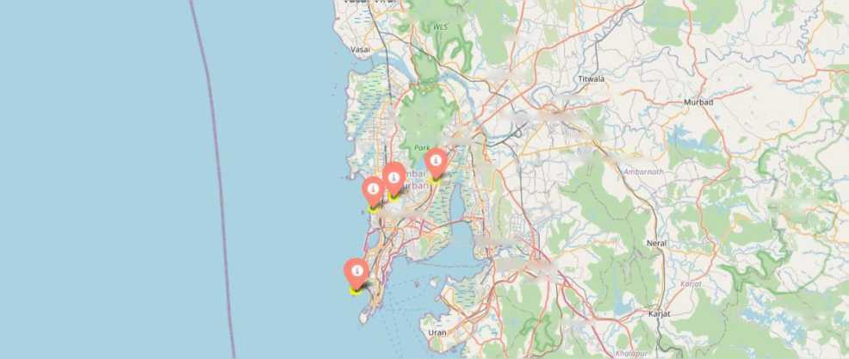
store, cosmetics shop and so on. Thus, it is recommended that the new restaurant can be opened in the neighborhoods belonging to cluster 1. This neighborhood can be further plotted on a map as shown below in Figure 18.
jjtunga/eshwp'r
Bhiwandi
Bhiwandi
Ambrvali 'n?"
tfurbod'
11 f San/ay / 1
jtc Gandhi})/ ^ j (Bormlli)^' A--.
i ^{Not}'^{on}’^{JI}Jharye-
Kalyan-Dorribivli
Ambernath
iThane y
Kulgaon Badlapur
Mumbai
Bhimashankar' V WLS
Navi Mumbai
, Panyel
Panvfi^r\
Rasayani
Bhamchandra
Mountain
Figure 17: Neighborhoods most suited for starting a new restaurant.
14

Slide 16
Conclusion
In this project, the neighborhoods in Mumbai, India have been successfully analyzed for determining which would be the best neighborhoods for opening a new restaurant. Based on the analysis carried out, neighborhoods in cluster 1 are recommended as locations for the new restaurant. This has also been plotted in the map in Figure 18. The stakeholders and investors can further tune this by considering various other factors like transport, legal requirements, and costs associated. These were out of the scope for this project and thus were not considered
15

