Slide 1



Slide 2
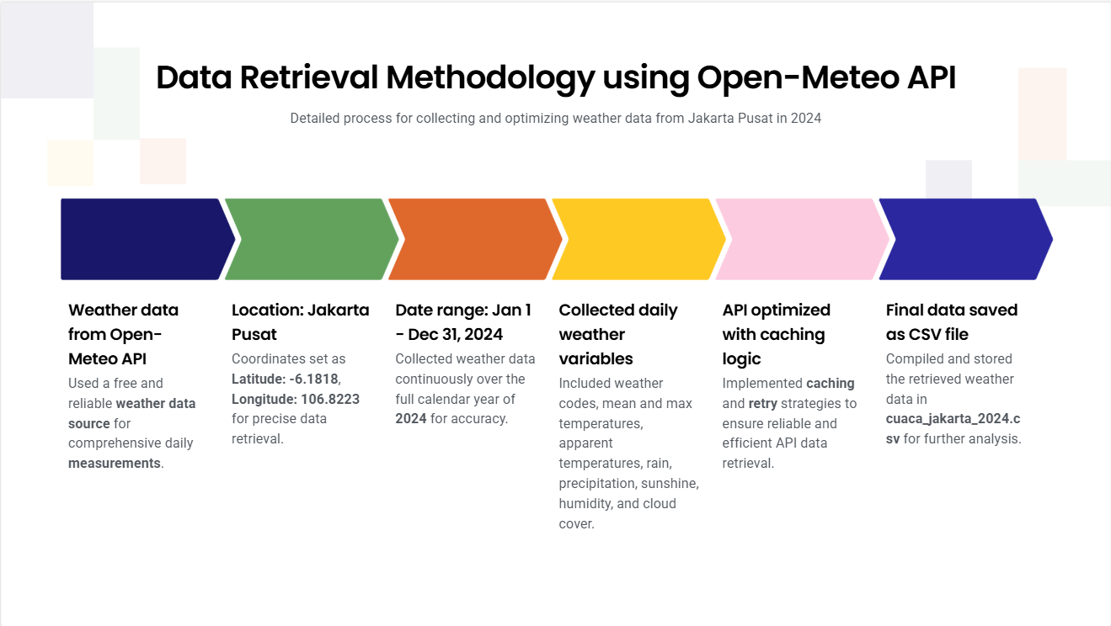

Slide 3
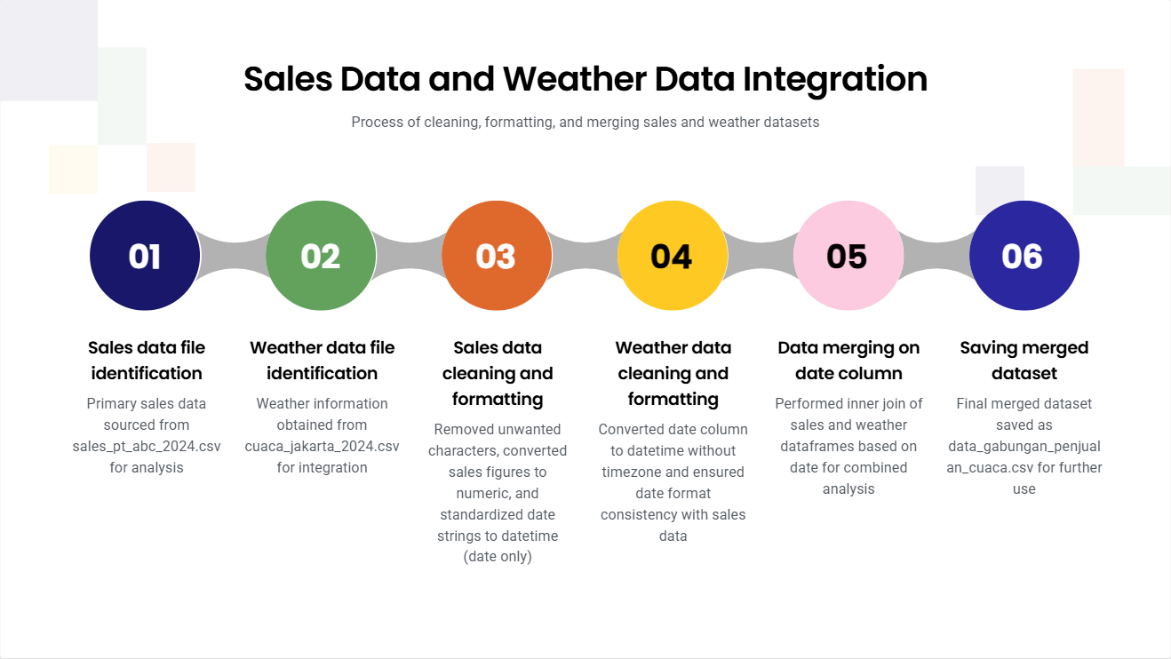

Slide 4
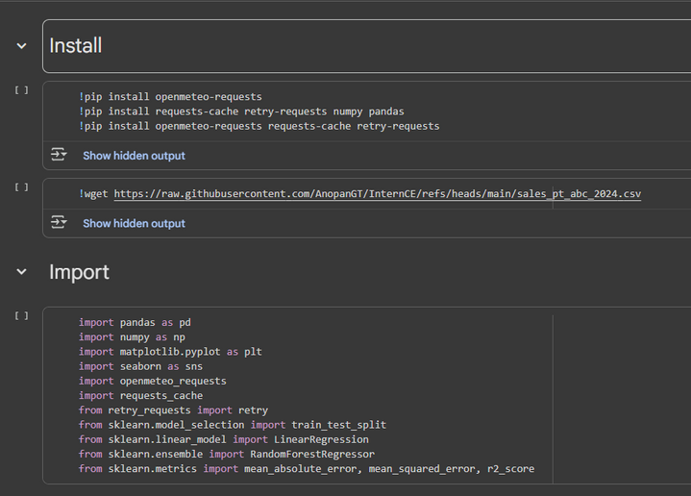
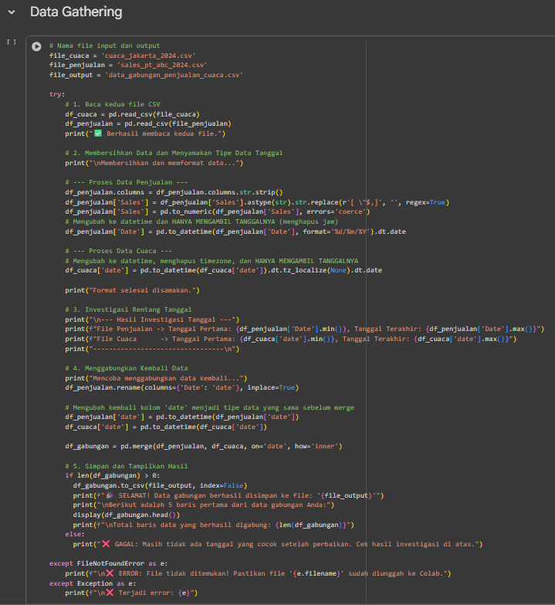
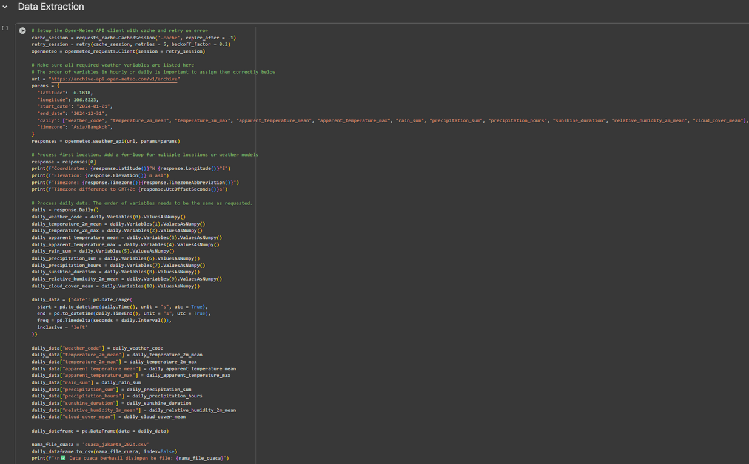
Code
link:
https://colab.research.google.com/drive/1TJK0ilUyQM4vKakqWqoXGgP_9yPFAbo0?usp=sharing

Slide 5

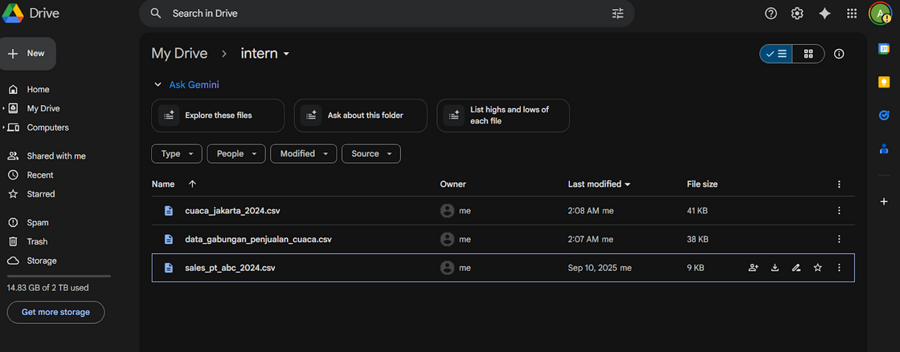
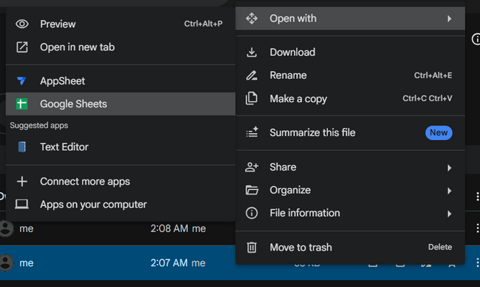

Slide 6
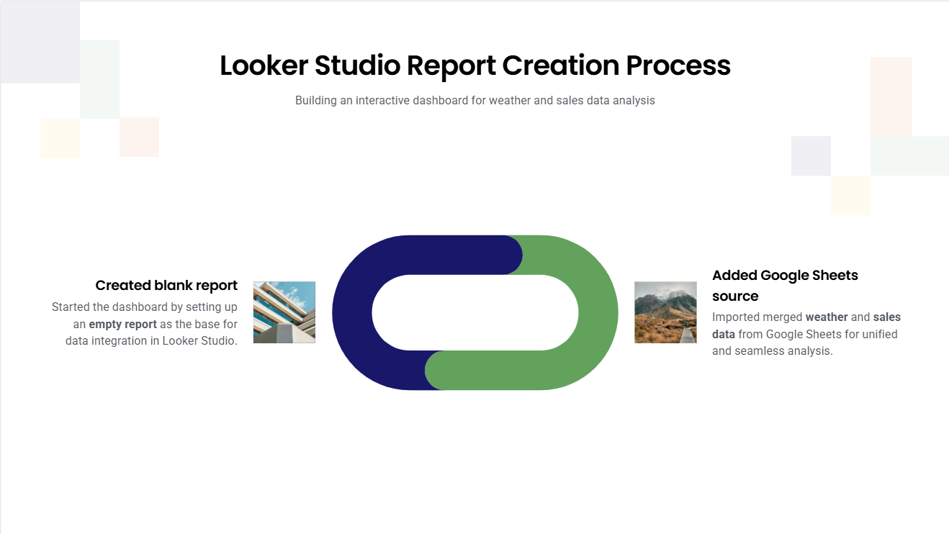

Slide 7
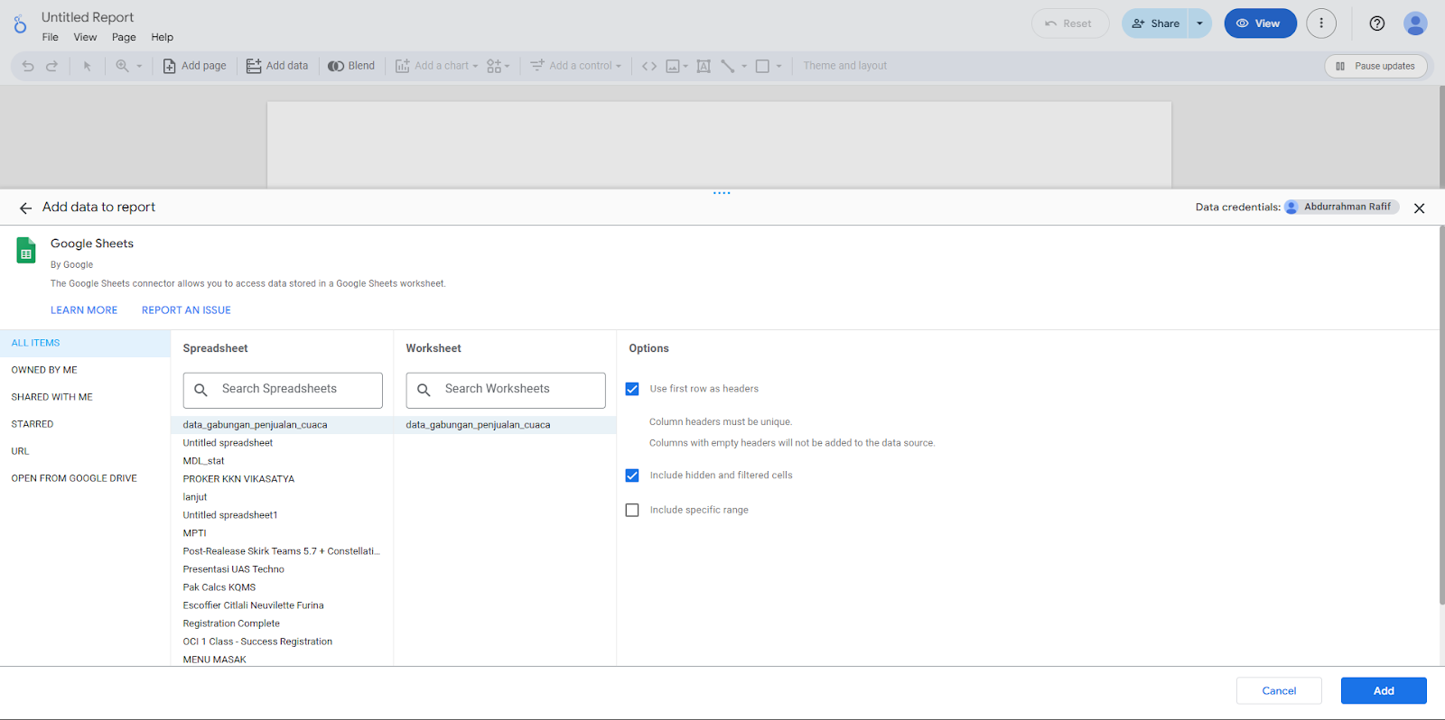

Slide 8
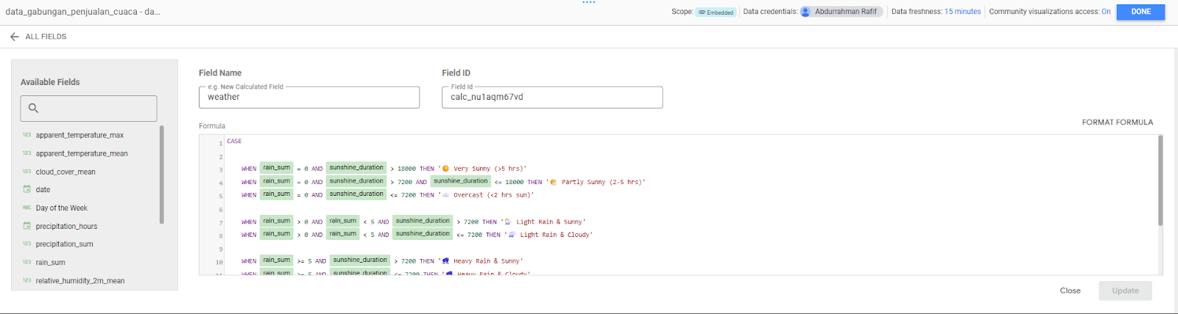
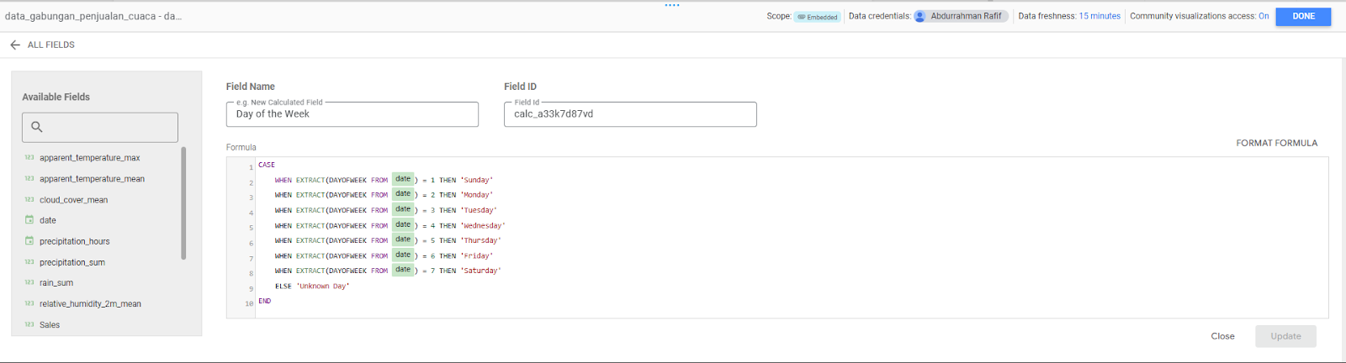
Weather Field for Weather Classification:
Day of the Week Field:

Slide 9
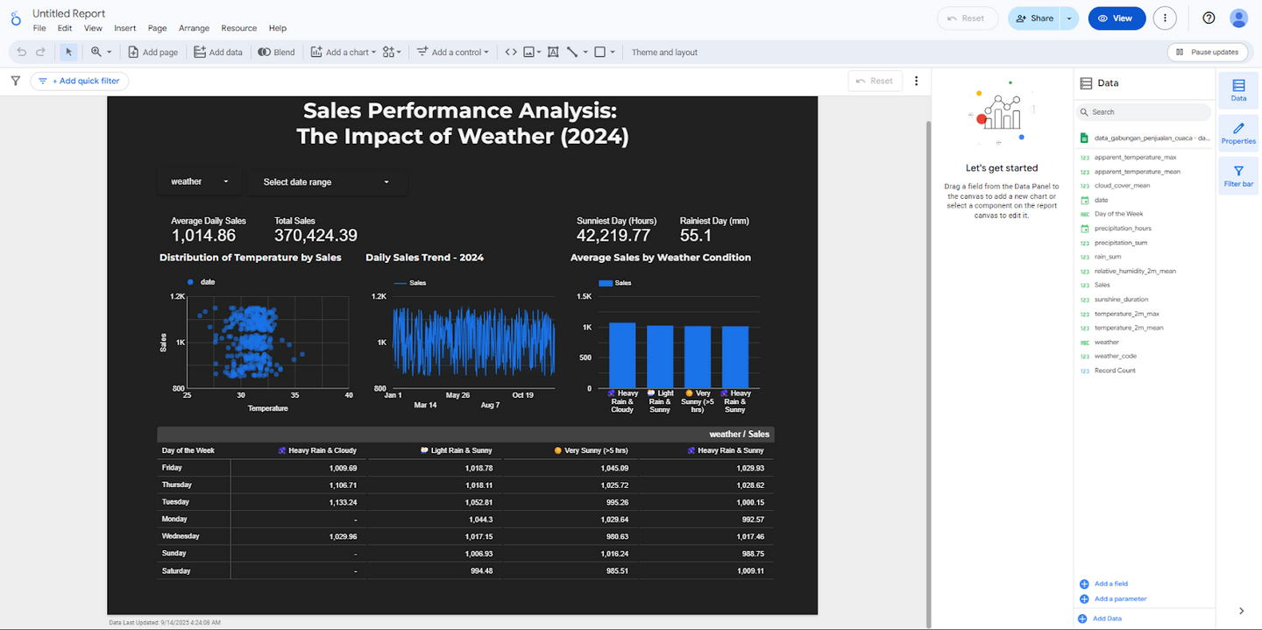
Final Looker Dashboard Result:
link:
https://lookerstudio.google.com/reporting/53e3179c-6042-4b26-8861-30a16ad60972

Slide 10
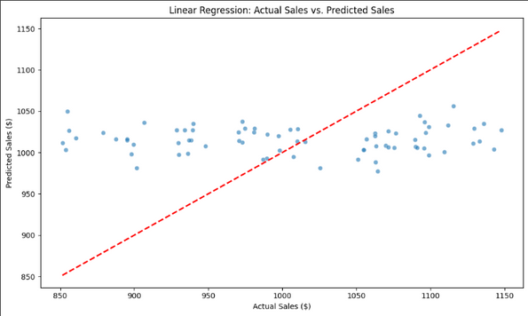
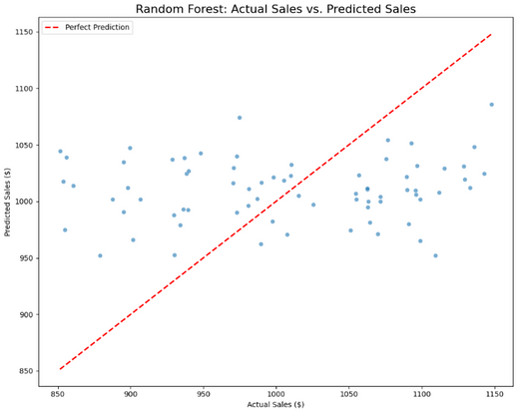
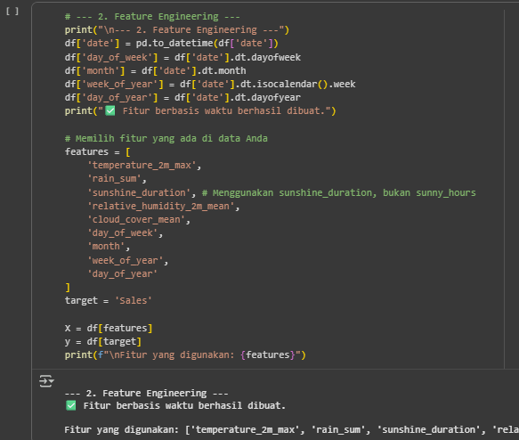
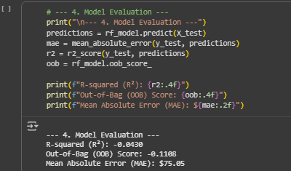
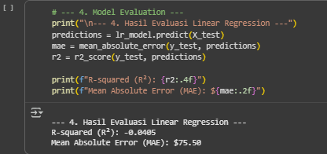
AI Modeling to Predict Sales Based on Weather
I'm using a linear regression and random forest model to predict future sales based on weather conditions. Full Code :
https://colab.research.google.com/drive/1TJK0ilUyQM4vKakqWqoXGgP_9yPFAbo0?usp=sharing
Some Screenshot Code (Feature Engineering & Evaluation):
Random Forest
Linear Regression

Slide 11
Conlusion AI Modelling
The AI modeling phase definitively concludes that daily weather conditions have no statistically significant predictive power over daily sales for this dataset. The primary drivers of sales are strong, consistent time-based patterns, such as weekly business cycles and seasonal trends throughout the year.
This is further supported by the low variance in the daily sales data itself, which suggests a stable baseline demand that is not easily influenced by external factors like weather. Therefore, any business strategy aiming to forecast sales should focus on temporal patterns rather than daily weather forecasts.

Slide 12
Thank you

