Slide 1


Building FAIR Data Competence Framework for Higher Education as a way to professionalise Data Stewardship (FAIRsFAIR T7.3 work)
Draft – Document for discussion
Changes will apply without notice
Yuri Demchenko
University of Amsterdam
FAIRsFAIR WP7 Workshop
8-9 October 2020

Slide 2
Outline
Goals and tasks for this workshop
Landscape overview: Data Management, Data Stewardship, FAIR management
Project, initiatives, Frameworks
Training, Education, Policies
Approach for FAIR4HE/DS@HE
Evidence based and community driven: Job Market and Landscape
Understand landscape and build consensus for Data Stewardship professionalisation
Mapping between existing Data Stewardship and FAIR competences definition
Proposed FAIR4HE structure
Building on the EDSF and Data Steward professional profile

Slide 3
Goals and Tasks – Discussion items
Review landscape in Data Stewardship and FAIR education and training
Identify all actors, components of the FAIR data ecosystem
Propose workable approach to implement FAIR and Data Stewardship in university curricula
Interconnect and link existing frameworks
Propose consistent vision for universities
Skills vs Competences vs Professional Profiles vs Knowledge vs Curriculum elements

Slide 4
Suggested Approach (May 2020)
Review and integrate existing frameworks
Apply proven methodologies
EDISON EDSF
EOSCpilot, ELIXIR, DeIC
Match/comply to GO FAIR initiative
FAIR principles and Maturity Framework
Verify with main use cases (e.g. as defined in GO FAIR, ELIXIR, or DeIC)
Investigate job market demand for competences and skills (e.g. LinkedIn Jobs, IEEE Jobs, Indeed.com, Monsterboard, Glassdoor)
Link to industrial Data Management and Quality Assurance Frameworks
Data as part of business processes and industry digitalisation
Match to main academic curricula:
Main courses vs professional issues
Computer Science vs Interdisciplinary
Train teachers (use NL BKO as a pilot, find other champion countries)

Slide 5
FAIR4HE Design principles – Leverage EDSF
P1. Higher Education scope: Bachelor and Master programs, Learning Outcomes, mastery levels
Empower graduates high freedom in career selection and development
P2. Linked to educational methodology
Master/Bachelor
Professional and PhD training
Continuous education and VET
P3. Address Job market demand in Data Steward and FAIR data management
Job market analysis as evidence and advice
P4. Data Stewards, Data Managers, Data Scientists and others are part of the Data Science professional Family (as defined in EDSF)
P5. Verified with the standards (in particular DMBOK and ESCO)
P6. Consensus with the existing frameworks
Trust them and take best of them

Slide 6
FAIR adoption and Ecosystem Sustainability Elements
FAIR must be accepted by all roles in organisational data management and governance process
FAIR must be endorsed by top management C-level
Roles and responsibilities to be defined and staffed
Inter-role functions as factor for modern agile organisations
FAIR must be adopted for the whole Research/industrial Data lifecycle
FAIR must be practiced by all participants along data lifecycle and specifically started from the data producers i.e. researchers or facility operators or sale agents
FAIR must be supported by infrastructure and tools
FAIR must be embedded into applications development
Organisational capability and capacity management
Education and training – To enable them all
Basic academic and professional education + continuous education

Slide 7
FAIR from the technical point of view
Findable
Metadata and PDI – infrastructure and tools
Registries and handles resolution, API
Policies and SLA
Accessible
Repositories and data storage: infrastructure and management
Policy and access control: infrastructure and API management
Data access protocols
Usage Policy and Sovereignty
Data protection, compliance, privacy and GDPR
Interoperable
Standard data formats
Metadata and API
FAIR maturity level and certification
Reusable
Data provenance and lineage
Preservation
Metadata, PID and API – linked or embedded into datasets
This motivates Data Stewards interaction with both Data Analytics and Applications developers roles and Data Infrastructure roles
Consequently related competences from Data Stewards are needed

Slide 8
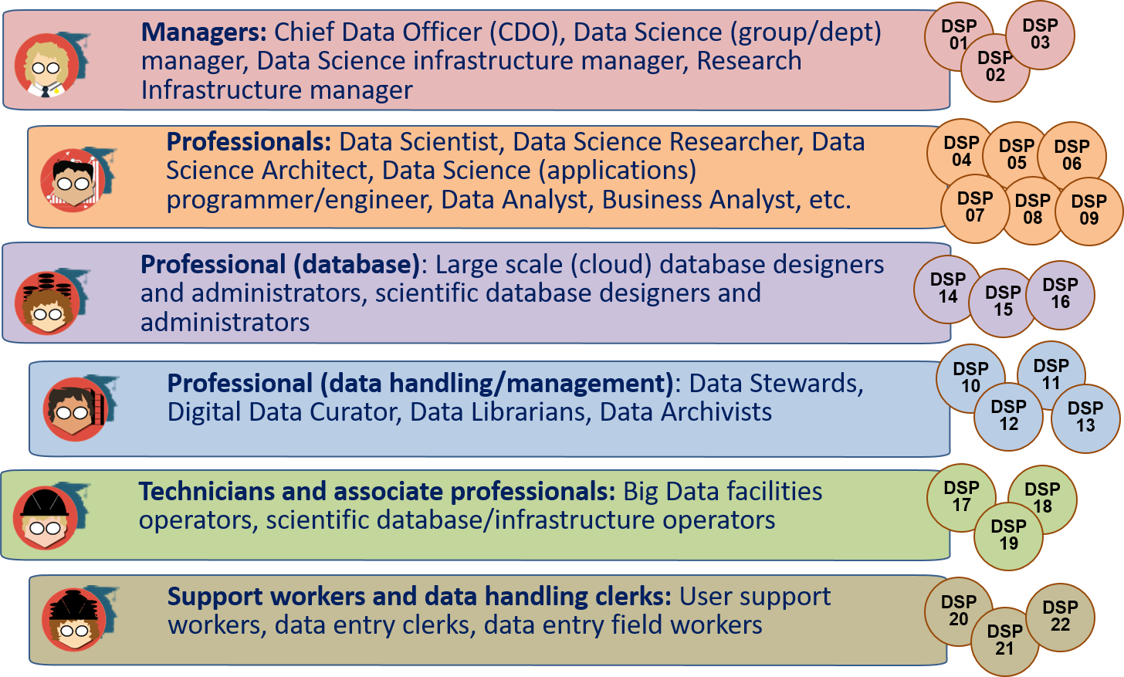
Why we need to view the whole Data Science Professional Family?
Career path
Team composition
Agile Team working
Education programs alignment
HR capacity building and management
Employability/ mobility for job seekers
Easy to market
EDISON Data Science Professional Profiles family EDSF, Part 4

Slide 9
FAIR Data Management and Organisational Roles
FAIR data principles to be adopted cross organisation for the whole data lifecycle
Data Governance and Data management
Data Stewards and CDO
Data policy and data delivery agreements
Data Infrastructure and tools for data storage and handling
Storage, database engineers/managers
Metadata and PID services, Master data and Reference data
Data Analysis
Data Scientists, Data Architects, Application developers
Data collection
Researchers, Data Engineers, data entry workers
Data preservation and curation
Data curators, Data Custodians/Archivists
Data publication, sharing access
Data Stewards, Data Curators

Slide 10
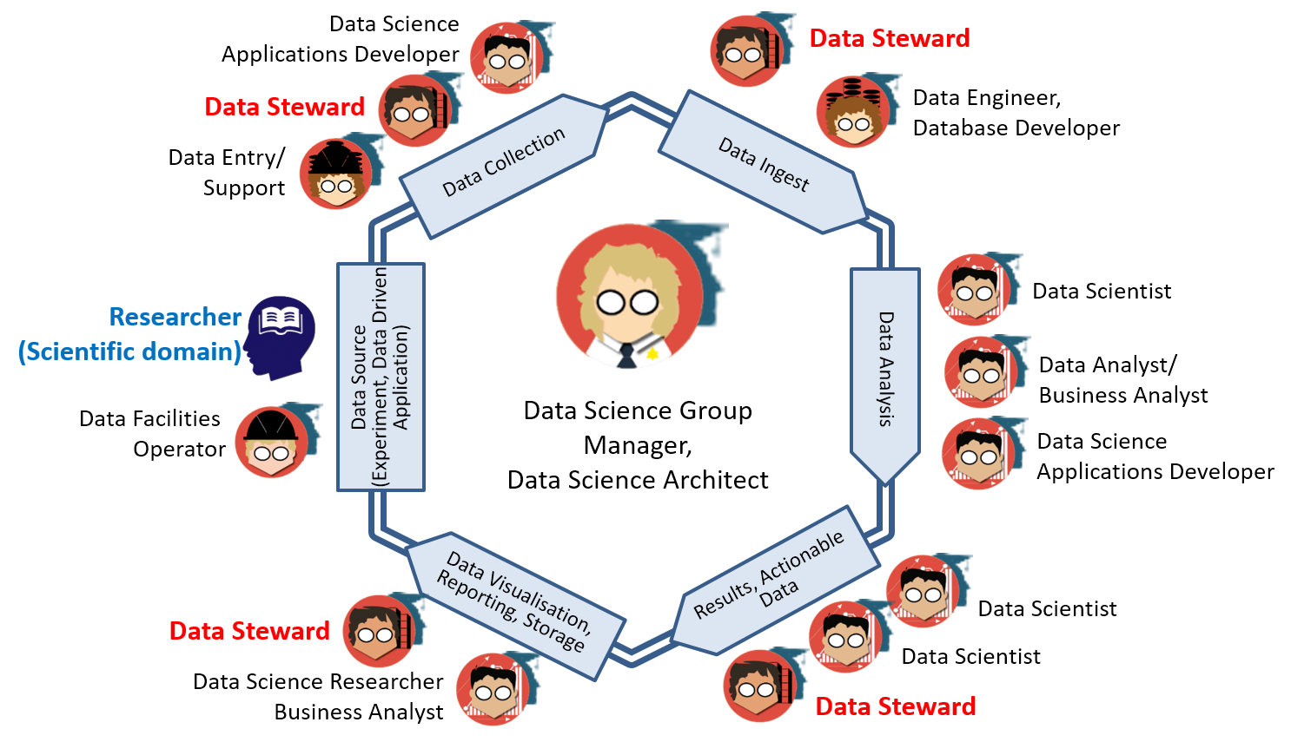
Building Data Science Team – Variety of Roles (Example)

Slide 11
FAIRsFAIR: FAIR Data Competence Framework –Pillars and Cooperation
EOSCpilot FAIR4S Data Stewardship Competence Framework
ELIXIR Data Stewardship Competence Framework
DeIC and DM Forum: Report on National Coordination of Data Steward Education in Denmark
GO FAIR Data Principles and Maturity Framework
Belmont Forum Curriculum recommendations
DAMA BoK (2007) – DAMAI Data Management Body of Knowledge
EDISON Data Science Framework (EDSF) and EDISON Community Initiative

Slide 12
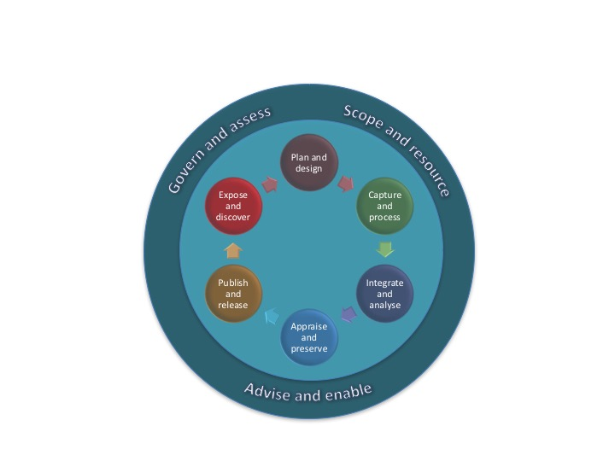
EOSCpilot FAIR4DS Data Steward Competences
Organisational capabilities for sustaining FAIR data across projects
Stewardship skills to deliver FAIR data from projects
Data Stewardship Roles and Shared responsibility:
Data Stewards and researchers
59 competences grouped in
3 general groups
Govern and assess
Scope and resource
Advise and enable
6 Data (curation) lifecycle process stages
Plan and design
Capture and process
Integrate and analyse
Apprise and preserve
Publish and release
Expose and discover
[ref] EOSCpilot D7.5 Strategy for sustainable development of skills and capabilities

Slide 13
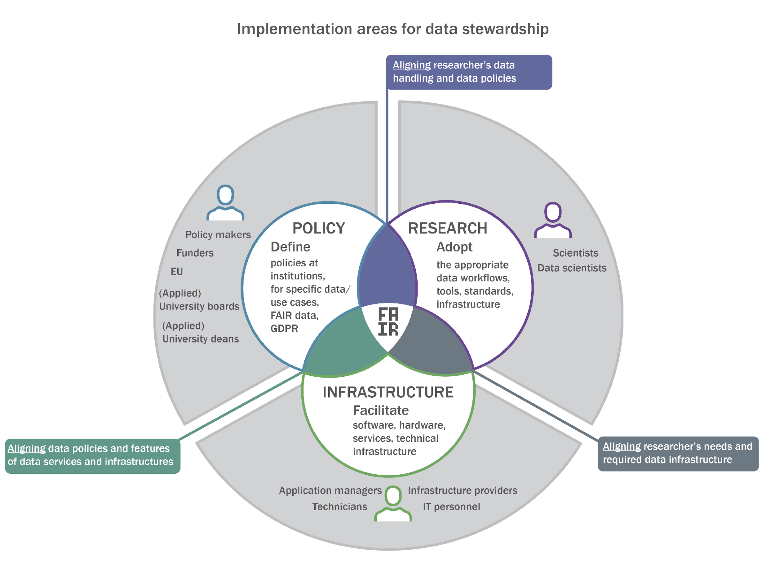


ELIXIR - Data Stewardship Competency framework (courtesy ELIXIR Project)
Data Steward Roles and Competence Profiles
Policy: institute and policy focused
Research: project and research focused
Infrastructure: data handling and e-infrastructure focused
Activities – Knowledge – Learning Objectives
The most complete framework for Data
Stewardship training curriculum development
Competence groups
1) Policy/Strategy
2) Compliance
3) Alignment with FAIR data principles
4) Services
5) Infrastructure
6) Knowledge Management
7) Network
8) Data sharing
ZonMw & ELIXIR-NL funded project “Towards FAIR Data Steward as profession for the Life Sciences”
All project output: https://zenodo.org/communities/nl-ds-pd-ls/
Final report (Oct 3, 2019): https://doi.org/10.5281/zenodo.3471707

Slide 14
DeIC 2020 and DM Forum: Report “National Coordination of Data Steward Education in Denmark”
Report focuses on the future education of Data Stewards https://www.deic.dk/sites/default/files/Data%20Steward%20Education%20in%20Denmark_0.pdf
Analysis based on
LinedIn profiles analysis – 74 profiles – March 2019
Job vacancies database in Denmark – 119 vacancies of Data Scientist – March-April 2019
Questionnaire September 2019 – 86 complete responses (42 partial)

Slide 15
DeiC Data Stewardship Curriculum principles
Four roles for Data Stewards
Administrator
Analyst
Developer
Agent of change
Three modes for Data Stewards education (using personas modle)
Student with Bachelor degree
Student with PhD and equivalent
Continuing and professional education
Competences defined
6 competence groups, 22 competences
Education/Training Format
Master – 1-2 yrs
PhD/Practitioner
Professional training
Continuous education
Competence Centers
MOOC/Self education

Slide 16
Belmont Forum
Study: Skills Gap Analysis e-Infrastructures and Data Management in Global Change Research by The Belmont Forum e-Infrastructure and Data Management (e-IDM) group
Recommendations for Multi-, inter- and trans-disciplinary curriculum design
Main subject groups (A = first year PhD; B = final year PhD; C = postdoc, D = mid-career, Principal Investigators )
i. Programming for data intensive research (for those who already code) (A)
ii. Environmental data: expectations and limitations (A)
iii. Introduction to visualising environmental data (A and B)
iv. Data management (A and B)
v. Interdisciplinary data exchange (B, C and D, mixed classes engineers, social and environmental scientists)
OPTIONAL
vi. Software development ideas for scientific coding (C and D)
vii. Object orientated programming (C and D) viii. Introductory data science topics (C and D)
ix. Data organisation (A to D)
Notes:
1. Programming for data intensive research (for those who already code) (A) – 4 DAYS
●Unix/Linux, shells, syntax and using the command line
●Coding standards and style guides e.g. PEP 8
●Version control using GIT, individual and team
●Commenting and documenting code
●Modularising code
●Domain specific data formats and libraries
●Debugging and basic error handling
●Introduction to testing and design
●Open source licensing and code
●Importance of metadata
●Optional mention of parallelising code
●Programming language agnostic, but most likely taught in Python
●Introduction to Notebooks, e.g. Jupyter, for sharing code and documents
ii.Environmental data: expectations and limitations (A) – 3 DAYS
●Uncertainties in environmental measurements
●Instrumentation examples, calibration, precision
●Spatial data - issues for gridded data and projections
●Cleaning data and dealing effectively with missing or corrupt data
●Combining datasets from multiple sources e.g. points in time and space vs averagesin time and space
●Using representative data – assessing suitability of other sources of data e.g. from adifferent location or using modelled instead of measured data
●Using numerical model outputs e.g. climate simulations
●Getting data into a usable format; documenting data workflows
●Using historical data e.g. transcribed hand written records and scanned documents
●ISO 8000 on data quality and mention of other relevant standards
●Metadata, provenance and documentation
iii.Introduction to visualising environmental data (A and B) – 2 DAYS
●Data presentation and labelling - tables and plots
●Plotting data for analysis
●Data visualisation for papers and presentations
●Scripts for reproducible figures
iv.Data management (A and B) – 2 DAYS
●Research data, collected by you and collected by others, formats
●Data management plans
●Journal and funder data policies
●Reproducibility and organising data: file names, README, structures and versions
●Metadata for describing, finding and making data reusable
●Citing and publishing data
11
● Data security including documentation, backing up, checksum and wider issues
● Best practice for data including ethics, transparency and data protection
● Persistent identifiers and introduction to research objects
● Data sharing, preservation, licensing and trusted repositories
● Data licensing using machine-readable standards (e.g. Creative Commons licenses)
● The European INSPIRE directive and similar initiatives
v. Interdisciplinary data exchange (B, C and D, mixed classes engineers, social and environmental scientists) – 2 DAYS
● Sharing and open data – data standards and metadata, interoperability standards
● Introduction to semantic vocabularies across domains and ontologies e.g. Envo
● Syntactic ways to encode data
● Discussion of uncertainties e.g. surveys, model output
● The use of expert judgment in environmental science e.g. emission pathways
● Practical collaborative project work e.g. hackathon or bring your own data
● Thinking of end-users in project design and throughout the project lifecycle
● Data and software citation and publication
● Reusability and reproducibility across domains
OPTIONAL
vi. Software development ideas for scientific coding (C and D) 3 DAYS
● Design methodologies, diagramming and data structures
● Unit and integration testing
● Requirements capture
● Error handling and debugging
vii. Object orientated programming (C and D) 3 DAYS
● Object orientated programming: analysis design and implementation
● Design patterns and advanced design methodologies
● Exception handling and exception classes
● Testing strategies, testing classes
● Debugging with classes
viii. Introductory data science topics (C and D) 1 DAY each
● Relational and non-relational databases
● Advanced visualisation
● Machine learning
● Data mining, including text mining
● Research computational infrastructure - cloud, HPC etc. (some country dependence)
ix. Data organisation (A to D) 1 DAY

Slide 17
Data Science Curriculum Structure by German Gesellschaft für Informatik (GFI)
14 fields of competences, including
basic and advanced mathematics
informatics
cryptography and security
data ethics and data privacy
data governance
data integration
data visualisation
data mining
machine learning
Business intelligence
domain-specific applications and communicating with experts
implementing data science within an organisation
Mastery levels applied to curriculum courses for Master MSc programs:
Understanding
Using
analysing

Slide 18
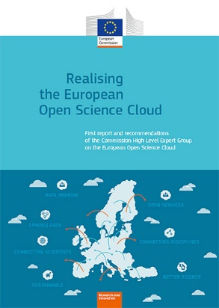
Data Stewardship in Research and FAIR Principles – GO FAIR and GO TRAIN
FAIR Initiative by Dutch Techcentre for Life Science (DTLS) – Prof. Barend Mons
Supported by Germany, France, Spain, UK, USA
Part of Horizon 2020 Programme
FAIR Principles for research data: Findable – Accessible – Interoperable - Reusable
Data Stewards as a key bridging role between Data Scientists as (hard)core data experts and scientific domain researchers (HLEG EOSC report)
Current definition of the Data Steward (part of Data Science Professional profiles)
Data Steward is a data handling and management professional whose responsibilities include planning, implementing and managing (research) data input, storage, search, and presentation.
Data Steward creates data model for domain specific data, support and advice domain scientists/ researchers during the whole research cycle and data management lifecycle.
HLEG report on European Open Science Cloud
(October 2016)

Slide 19
GO FAIR and GO TRAIN
GO TRAIN https://www.go-fair.org/go-fair-initiative/go-train/
The Objectives, Scope and Activities of a Possible GO TRAIN Implementation Network – 7 Feb 2018
Skills needed + Training materials certification/endorsement + Coordination
GO TRAIN workshop, 25 November 2019, ZBW Hamburg: Report from World Cafe Sessions at the
Incentives
FAIR training materials
Data Management and Stewardship as organisational role

Slide 20
Existing courses to use and recommend – Estimate potential curriculum fitness
RDA
Research Data Management – Catalog to be created
Old catalogs from 2016-2018 (still useful)
Domain specific courses by EOSC and ESFRI projects - many
ELIXIR
ENVRI
DARIAH
PARTHENOS
Others
Universities
See Deliverable D7.2
Projects and Associations
MATES – Digital and Data literacy courses
Belmount Forum?
Learning Units (LU) and Learning Outcomes (LO)
Match Body of Knowledge and Model Curriculum
Data Steward Professional Profile -> Competences -> Learning Outcomes -> Learning Units -> BoK Knowledge Units

Slide 21
Data Stewards – Job market review
Date 30 August – 1 September 2020
Indeed.com – NL, UK, DE, USA
Days open: >50% more than 30 days
Data Steward and related vacancies
NL – 51, UK – 30+, DE ~20, US – 300+
Key skills snapshot
Sample vacancies detailed analysis
NL, UK – 12, US - 6

Slide 22
Vacancies profile – By Data Science Competence Groups
DSA – Data Science and Analytics
DSE – Data Science Engineering
DM – Data Management and Governance
RMP – Research Methods and Project Management
DK Biz – Domain Knowledge, particular Business domain

Slide 23
Important Knowledge Items extracted from Job vacancies (indeed.com – NL, DE, UK, US, Sept 2020)
Data Management techniques
FAIR data principles
Data Management and Data Governance principles
Data integrity
Metadata, PID and linked data
Ontology and Semantics
FAIR metrics and Maturity framework, FAIR certification
Research methods
Project management
Data compliance regulations and standards
Data privacy law
GDPR
Business process management
Marketing
Banking financial services and data management
Multilevel Bill of Materials
Ethics
Data Warehouses
Version control system
Master Data Management (MDM) and Reference Data
Visual Basic for Applications (VBA) and interface design
WebAPI use for data access, collection and publishing
DevOps, Agile, Scrum methods and technologies
Data formats, stanfards
Data analysis and visualisation tools
Data lifecycle, lineage, provenance
Data modeling (SQL and EDBMS, NoSQL)
Modern data infrastructure: Data registries, Data Factories, Semantic storage, SQL/NoSQL

Slide 24
FAIR Curriculum Design: Notes on important topics from practitioners – Extracted from forums and discussions (May 2020)
Linked data, provenance
Research data and scientific publications
Ontology and semantic data interoperability
Ontology engineering
Multi-disciplinary data semantics and Interoperability
How to make semantics FAIR
Open Knowledge Graph?
FAIR for different types of data: Observational data, experimental, social, life science
FAIR metrics and Maturity Framework
PID for data
Use of standards
LERU Roadmap and LEARN project: RDM at universities

Slide 25
Methodology: EDISON Data Science Framework (EDSF) - Overview
EDISON Data Science Framework (EDSF) and community based maintenance
Data Science Programmes at UvA
Data Management and Governance curriculum design
EDSF Data Management Body of Knowledge (DSDM-BoK)
DAMA Body of Knowledge (DAMA BoK)
Data Stewardship – Existing Frameworks
Research Data Management (RDM) best practices
Methodology: Evidence based and Community driven
Job market analysis
Existing initiatives and frameworks

Slide 26
EDISON Project (2015-2017) and Follow on
EDISON project website - http://edison-project.net/ (old domain edison-project.eu expired)
EDISON Data Science Framework (EDSF) – main outcome of the project
Currently maintained by EDISON Community Initiative, coordinated by UvA
EDSF Release 3 published in 2018
EDSF Release 4 Design Workshop – 20 Nov 2019, UvA
EDSF Release 4 (EDSF2020) to be published by the end of 2020 (initially planned January 2020)

Slide 27
EDISON Data Science Framework (EDSF) – Core components and community maintained services
CF-DS
MC-DS
Data Science
Educational Environ
Community Portal (CP)
EDSF specification
Community support
Tools and code repository
DS-BoK
Taxonomy and Vocabulary
Directory Edu &Train Materials
Data Science Framework
DS Prof Profiles
Virtual Data Labs
Foundation & Concepts
Apps & Services
EDISON Framework core components and documents
CF-DS – Data Science Competence Framework (Part 1)
DS-BoK – Data Science Body of Knowledge (Part 2)
MC-DS – Data Science Model Curriculum (Part 3)
DSPP – Data Science Professional profiles (Part 4)
Data Science Taxonomies and Scientific Disciplines Classification
Applications and Services
Virtual Data Science Labs
Data Science Educational Environment
Directory of edu & train resources
Community Portal – currently github

Slide 28
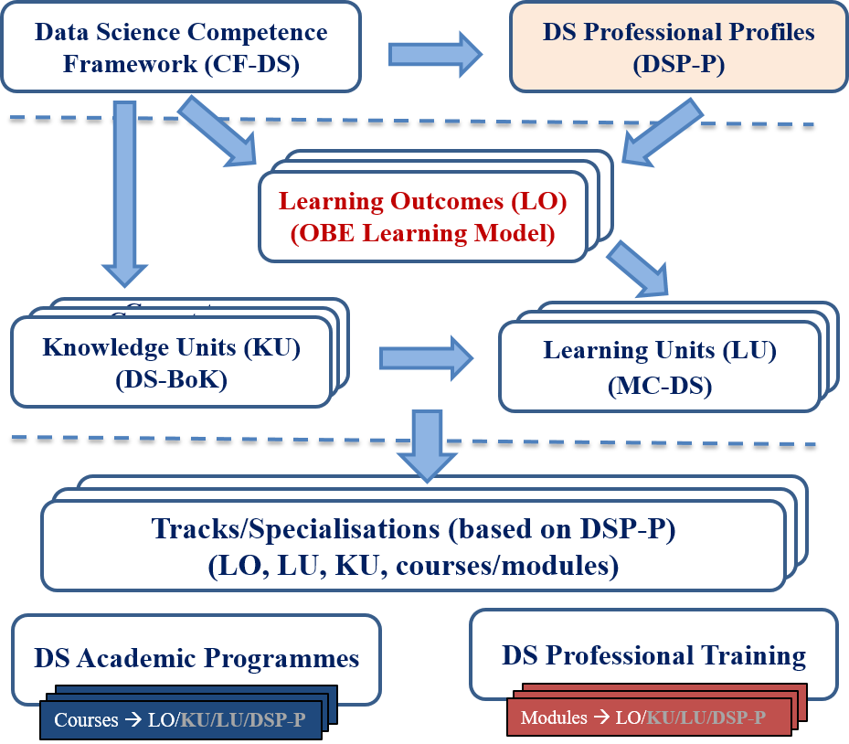
Outcome Based Educations and Training Model: Addressing target competences for the profession
Target Competences
From Competences and DSP Profiles
to Learning Outcomes (LO) and
to Knowledge Unites (KU) and Learning Units (LU)
EDSF methodology allows for customized educational courses and training modules design

Slide 29
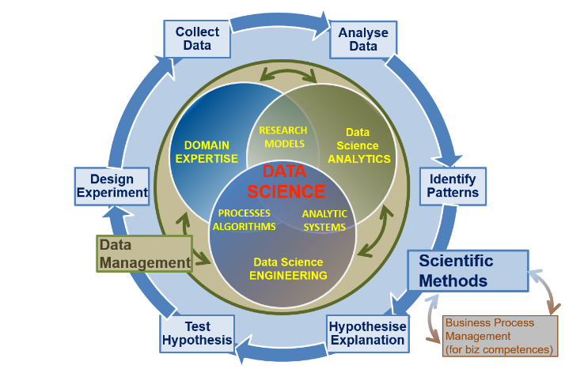
Data Science Body of Knowledge (DS-BoK)
DS-BoK Knowledge Area Groups (KAG)
KAG1-DSA: Data Analytics group including Machine Learning, statistical methods, and Business Analytics
KAG2-DSE: Data Science Engineering group including Software and infrastructure engineering
KAG3-DSDM: Data Management group including data curation, preservation and data infrastructure
KAG4-DSRM: Research Methods and Project Management group
KAG5-DSBA: Business Analytics and Business Intelligence
KAG* - DSDK: Data Science domain knowledge to be defined by related expert groups

Slide 30
KAG3-DSDM: Data Management group: data curation, preservation and data infrastructure
DM-BoK version 2 “Guide for performing data management” – 11 Knowledge Areas
(1) Data Governance
(2) Data Architecture
(3) Data Modelling and Design
(4) Data Storage and Operations
(5) Data Security
(5a) Data compliance, Data Privacy, GDPR
(6) Data Integration and Interoperability
(7) Documents and Content
(8) Reference and Master Data
(9) Data Warehousing and Business Intelligence
(10) Metadata
(11) Data Quality
Other Knowledge Areas motivated by RDA, European Open Data initiatives, European Open Data Cloud
(12) PID, linked data, data registries
(13) Data Management Plan
(14) Open Science, Open Data, Open Access, ORCID
(15) Responsible data use, Ethics
(16)* Data Sovereignty (and Indigenous data protection)
Highlighted in red: Considered (Research) Data Management literacy (minimum required knowledge)

Slide 31
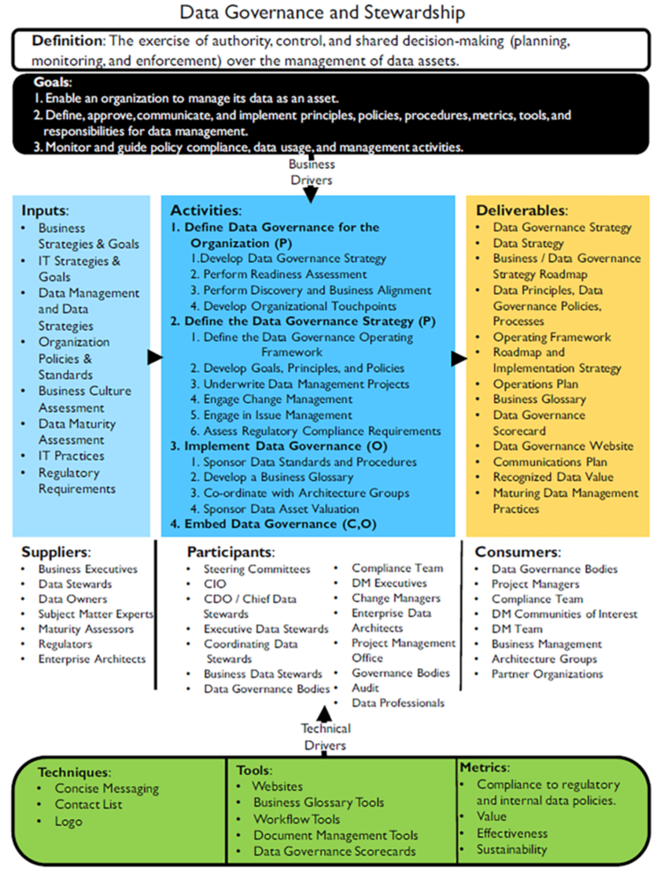
DMBOK: Data Governance and Stewardship
Scope of a Data Governance Programme
Strategy
Policy
Standards and quality
Oversight
Compliance
Issue management
Data management projects
Data asset valuation

Slide 32
DMBOK: Data Management Principles
Data is an asset with unique properties
The value of data can and should be expressed in economic terms
Managing data means managing the quality of data
It takes Metadata to manage data
It takes planning to manage data
Data management requirements must drive Information Technology decisions
Data management is cross-functional; it requires a range of skills and expertise
Data management requires an enterprise perspective
Data management must account for a range of perspectives
Data management is lifecycle management
Different types of data have different lifecycle characteristics
Managing data includes managing the risks associated with data
Effective data management requires leadership commitment

Slide 33
Data Stewardship (according to DM-BOK)
Creating and managing core Metadata: Definition and management of business terminology, valid data values, and other critical Metadata.
Documenting rules and standards: Definition/documentation of business rules, data standards, and data quality rules.
High quality data are often formulated in terms of rules rooted in the business processes that create or consume data.
Stewards help surface these rules and ensure their consistent use.
Managing data quality issues: Stewards are often involved with the identification and resolution of data related issues or in facilitating the process of resolution.
Executing operational data governance activities: Stewards are responsible for ensuring that, day-today and project-by-project, data governance policies and initiatives are adhered to. They should influence decisions to ensure that data is managed in ways that support the overall goals of the organization.
“Best Data Steward is not made but found” DMBOK1 (2009)

Slide 34
Case Study: Data Science related Master Programmes at UvA
Big Data Engineering (joint UvA and VU) - since 2016
Data Science at AI department (stopped 2018)
Data Science at the Institute of Interdisciplinary Studies – since 2017
https://www.uva.nl/en/programmes/masters/information-studies-data-science/data-science.html
Data Science in Business Administration (MBA) at Business School Amsterdam – part time, evening, since 2017
Data Science in Business Analytics (MBA) at Business School Amsterdam, full time starting 2020

Slide 35
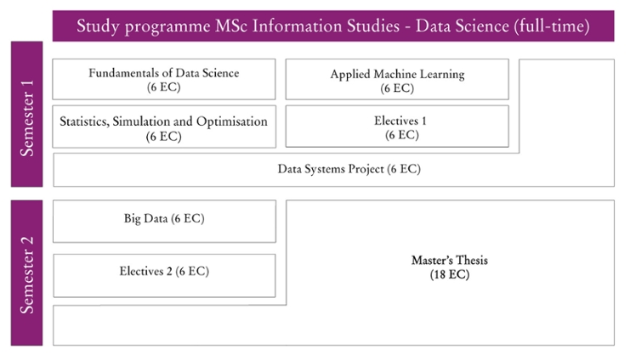
Study Programme MSc IS – Data Science (1yr)

Slide 36
Case study: BKO program for university teachers in Netherlands
Rich program of basic and advanced instructional and didactic methodologies
Still lacks of Research Data Management (RDM) courses
Currently in contact with the BKO program coordinator at UvA

Slide 37
Discussion - TBD

Slide 38
Additional information
FAIRsFAIR WP7 Task T7.3
Outcome and recommendations from FAIRsFAIR seminar 8 May 2020

Slide 39
Task 7.3: FAIR data competence framework
Objectives:
Develop a FAIR data competence framework complementary to or as extension to existing and adopted data science and other competence frameworks (e.g. the ESCO-compliant EDISON Data Science Framework).
The activities will focus on data science but also address other disciplines, where identified as relevant, to enhance the impact and sustainability of the project in fostering a FAIR data culture throughout different scientific disciplines, research communities and professions.
The FAIR data competence framework will include
FAIR data competences which can be acquired through higher education, e.g. in data science programmes in other data-intensive and data driven disciplines
FAIR data competences for graduates continuing to work as professionals in FAIR data management (e.g. data stewards, research infrastructure managers).
Reporting
D7.3 FAIR Competence Framework for Higher Education [M24; UvA]
M7.5 First Draft of competence framework [M20] [first draft finalised]

Slide 40
T7.3 Actions plan and status
CF-DS
DS-BoK
MC-DS
Data Science
Educational Environ
Community Portal (CP)
EDSF specification
Community support
Tools and code repository
Taxonomy and Vocabulary
Directory Edu &Train Materials
Data Science Framework
DS Prof Profiles
Virtual Data Labs
Foundation & Concepts
Apps & Services
1. Analyse existing FAIR data, Data Management and Data Stewardship framework
1.1. Inventory of identified and proposed competences and practices, academic programmes
1.2. Analyse available training and academic programme on Data Management, Stewardship, FAIR
1.3. Revisit EUA Survey on DM/FAIR at universities (D7.1) – PP02
Timeframe: January - June 2020
2. FAIR data competence framework development
2.1. Use EDISON methodology to create FAIR competence framework (including competences, skills and knowledge topics definitions
2.2. Community discussion: forum, feedback form, survey
PP01: Liaise with T7.2/D7.2 (August 2020)
AW/PP: EOSC Training Group by Natalia Manola
May - October 2020
3. Design Workshop to discuss the proposed Competence Framework
3.1. Workshop preparation meeting during FAIRsFAIR project meeting in April 2020
3.2. Design workshop
Goal: to discuss the proposed Competence Framework, review and validate
October 2020 in Amsterdam
3.3. Community workshops and/or tutorials
PP03: Stakeholder Workshop
October - November 2020

Slide 41
Overview existing Projects and Initiatives
Open Science Skills and Digital Literacy in Danish Research Libraries https://zenodo.org/communities/os-skills-dk
“This project was funded by Denmark’s Electronic Research Library (DEFF) with the aim to investigate, model, and deploy Open Science skills for Danish Research Librarians.
The project provides an overview of Danish digital collections, with a focus on openness and applicability.
1) access and harvest data
2) identify and guide in tools to build data corpus and
3) analyze data, were considered.

Slide 42
Courses related to RDM: MANTRA
MANTRA is a free online course for those who manage digital data as part of their research project (Univ of Edinburgh) https://mantra.edina.ac.uk/
Research data in context
Data management plans
Organising data
File formats & transformation
Documentation, metadata, citation
Storage & security
Data protection, rights & access
Sharing, preservation & licensing
Data handling tutorials
Also offered via EDSA - https://courses.edsa-project.eu/mod/checklist/view.php?id=505

Slide 43
Used materials and teaching models
The tutorial used a number of materials produced by EU and national funded projects which are released as Open Access and/or under Creative Common Attribution 4.0 International License
Data Management guidelines and template are provided by Mariëtte van Selm from University of Amsterdam Library
The following materials used (April-May 2016)
Directory of efforts and resource related to research data management education by RDA/UA and Amy Nurnberger https://docs.google.com/spreadsheets/d/10RTW-nZk0x_mpQw2VAlttcc656MV9EeCaDe2lM4umb4/edit#gid=0
FOSTER Project: Open Science training materials https://www.fosteropenscience.eu/resources
UK Data Service training materials https://www.ukdataservice.ac.uk/use-data/advice
Digital Curation Center, UK: Training materials: Support DM, DC 101, http://www.dcc.ac.uk/training/training-and-reference-materials
RDMRose Learning Materials http://rdmrose.group.shef.ac.uk/?page_id=10
TraD project supportDM course https://www.uel.ac.uk/trad/outputs/resources/
Data Management Short Course for Scientists by ESIP Federation http://commons.esipfed.org/datamanagementshortcourse

Slide 44
EDSF and EDISON Community Initiative
EDSF github project - https://github.com/EDISONcommunity/EDSF
Component documents CF-DS, DS-BoK, MC-DS, DSPP
EDISON Community work area and discussions - https://github.com/EDISONcommunity/EDSF/wiki/EDSFhome
Mailing list - edison-net@list.uva.nl
EDISON project website - http://edison-project.net/ (old domain edison-project.eu expired)

Slide 45
Course: Data Management and Governance (DMG) in Enterprise
Introduction. Big Data Infrastructure and Data Management and Governance.
Data Management concepts. Data management frameworks: DAMA Data Management framework, the Amsterdam Information Model. Extensions for Big Data and Data Science.
Enterprise Data Architecture. Data Lifecycle Management and Service Delivery Model. Data management and data governance activities and roles.
Data Science Professional profiles and organisational roles, Skills management and capacity building.
Data Architecture, Data Modelling and Design. Data types and data models. Data modeling. Metadata. SQL and NoSQL databases overview. Distributed systems: CAP theorem, ACID and BASE properties.
Enterprise Big Data infrastructure and integration with enterprise IT infrastructure. Data Warehouses. Distributed file systems and data storage.
Big Data storage and platforms. Cloud based data storage services: data object storage, data blob storage, Data Lakes (services by AWS, Azure, GCP).
Trusted storage, blockchain enabled data provenance.
FAIR data principles and Data Stewardship, Data Quality assessment and maturity model. Data repositories, Open Data services, public services.
Big Data Security and Compliance. Data Privacy and GDPR. Data security and data protection. Security of outsourced data storage. Cloud security and compliance standards and cloud provider services assessment.

Slide 46
Course: Research Data Management and Stewardship (RDMS) (1)
A. Use cases for data management and stewardship
Preserving the Scientific Record
Data Lifecycle and Provenance
B. Data Management elements (organisational and individual)
Goals and motivation for managing your data
Data formats, Metadata, related standards
Creating documentation and metadata, metadata for discovery
Using data portals and metadata registries
Tracking Data Usage, data provenance, linked data
Handling sensitive data
Backing up data, backup tools and services
Data Management Plan (DMP)
C. Responsible Data Use (Citation, Copyright, Data Restrictions)
Data privacy and GDPR compliance
Ethical issues

Slide 47
Course: Research Data Management and Stewardship (RDMS) (2)
D. FAIR principles in Research Data Management, supporting tools, maturity model and compliance
E. Data Stewardship and organisational data management
Responsibilities and competences
DMP management and data quality assurance
F. Open Science and Open Data (Definition, Standards, Open Data use and reuse, open government data)
Research data and open access
Repository and self- archiving services
RDA products and recommendations: PID, data types, data type registries, others
ORCID identifier for data and authors
Stakeholders and roles: engineer, librarian, researcher
Open Data services: ORCID.org, Altmetric Doughnut, Zenodo
G. Hands on practice topics: DMP, Metadata, Data Formats, Data publishing, etc

