Slide 1
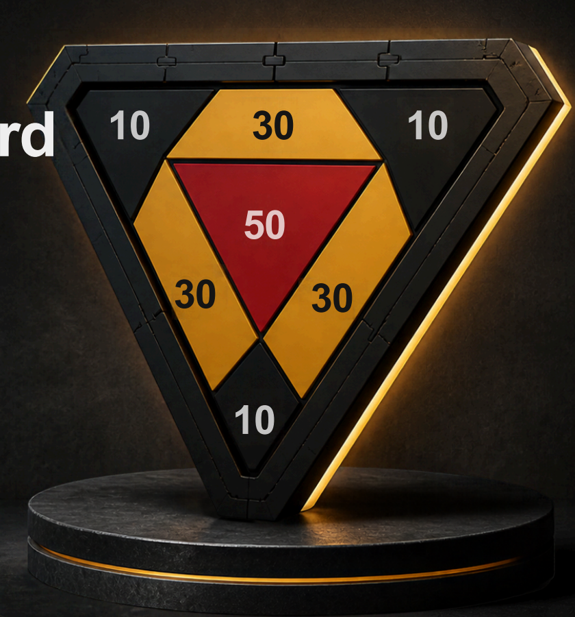
CIRCUIT SIMULATION
Smart Triangular
Dartboard
智能三角飛鏢靶 · 電路模擬報告
Tinkercad Arduino Uno · 4× FSR dividers · LCD · piezo
Issac · Adrian
2026-10-26

Slide 2
What we simulated
模擬目標
Hardware
Software
Uno R3, 4 Tinkercad Force Sensors, 10 kΩ dividers, 16×2 LCD, piezo, 9 V + switch on VIN
0.1–10 N bands, crosstalk margin 80 ADC, one score per press, LCD Score line
Link to product
Design URL
Each FSR maps to one 3D-printed face tile (T1–T4) from the project brief
tinkercad.com/things/fSkU8ixGOXg

Slide 3
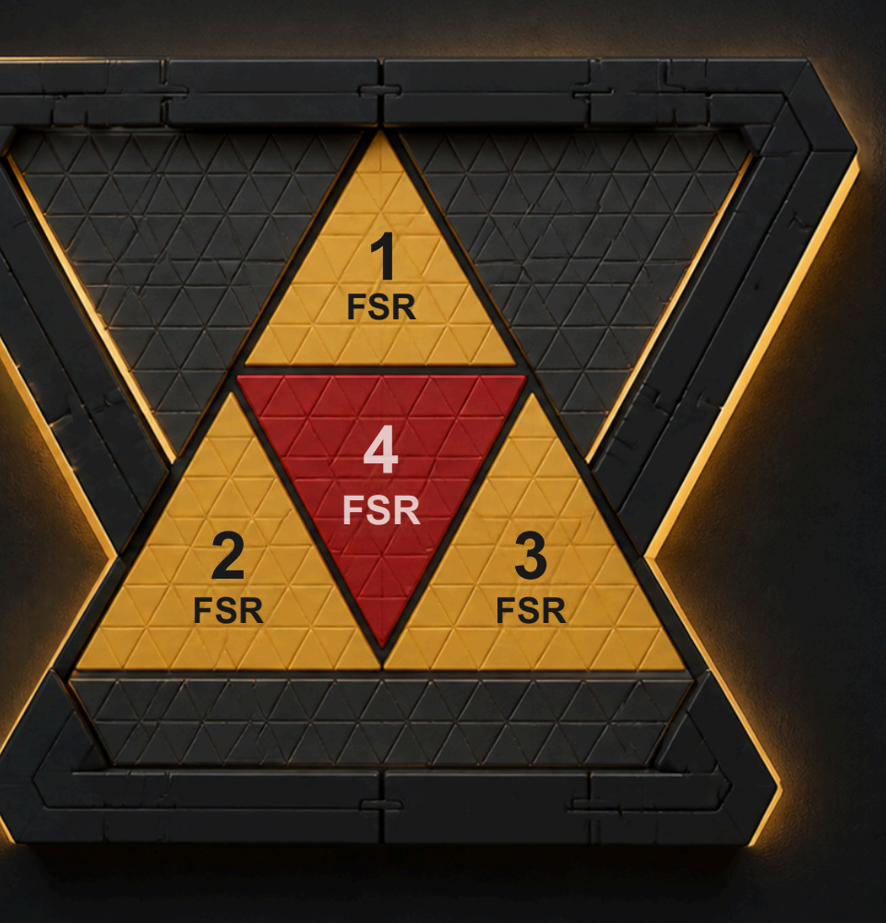
Tile ↔ FSR mapping
飛鏢面磚對應力度感應器
FSR1 → Tile 1 TOP
A0 · gold outer · med +20 / hard +30
FSR2 → Tile 3 LEFT
A1 · gold outer · med +20 / hard +30
FSR3 → Tile 4 RIGHT
A2 · gold outer · med +20 / hard +30
FSR4 → Tile 2 CENTER
A3 · red center · med +50 / hard +70
Sim scores (not face labels 10/30/50)

Slide 4
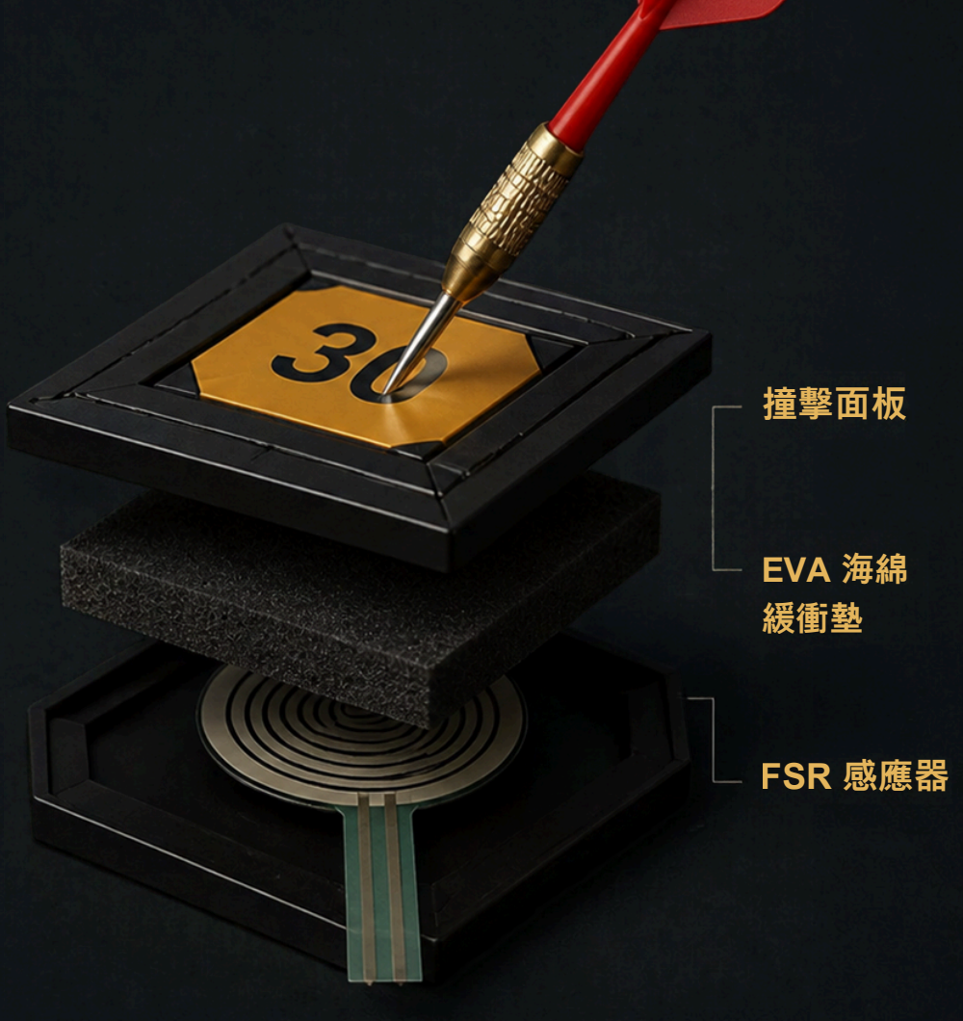
Force path through the stack
力度傳導路徑
01
Face tile
3D-printed scoring surface (T1–T4)
02
EVA foam
Cushions impact, spreads load onto FSR
03
FSR
Resistance drops → ADC rises on A0–A3
04
Firmware
Threshold → zone name + score + beep

Slide 5
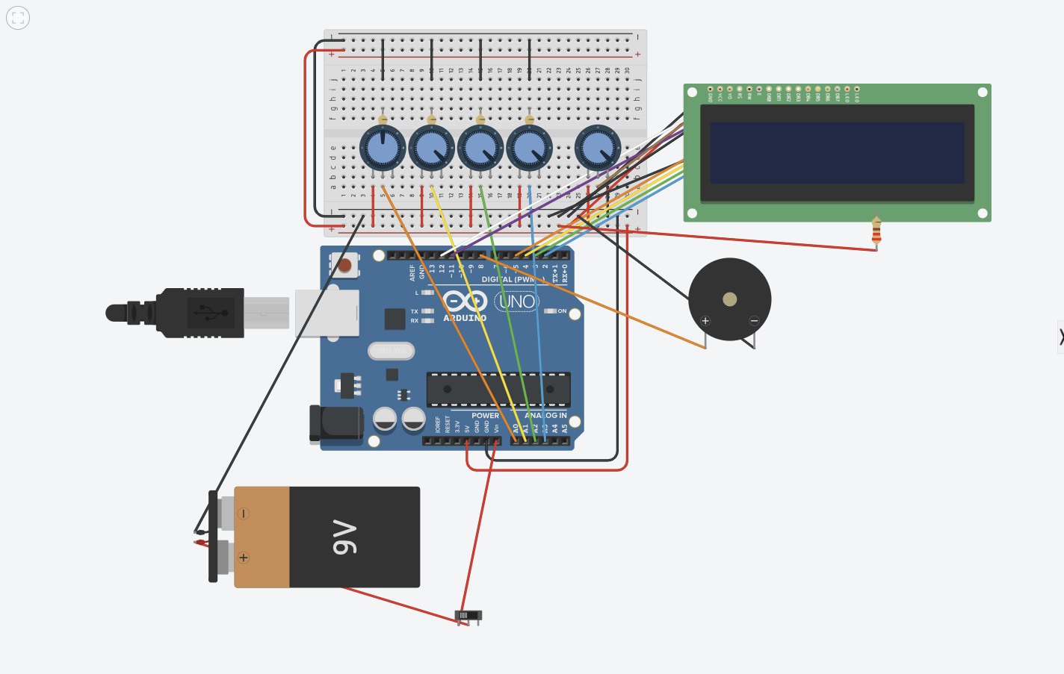
Tinkercad circuit
模擬電路全景
Pot stand-ins
Idle ≈ Position 1
(high R → low ADC)
Hard hit ≈ Position 0
(low R → ADC≈1023)
Named:
FSR1-T1top …
FSR4-T2center

Slide 6
Pin map & power
接腳與供電
Signal
Pin
Notes
FSR1 / T1 TOP
A0
Divider mid → ADC
FSR2 / T3 LEFT
A1
Divider mid → ADC
FSR3 / T4 RIGHT
A2
Divider mid → ADC
FSR4 / T2 CENTER
A3
Divider mid → ADC
LCD RS / E / D4–D7
D12 / D11 / D5–D2
4-bit parallel
Piezo
D8
Hit beep
9 V battery
VIN via switch
Not tied to 5 V rail

Slide 7
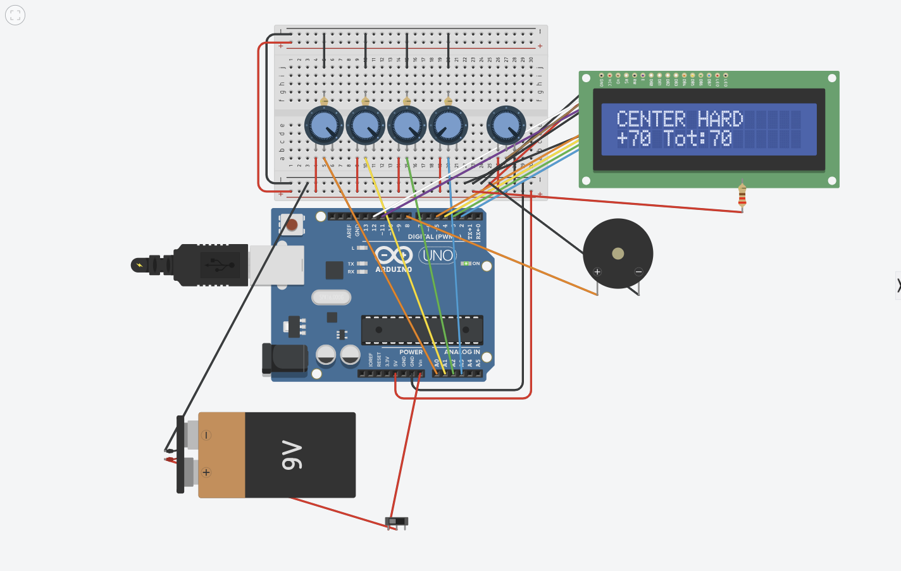
Simulation results
模擬結果
PASS
T2 CENTER hard
raw=1023 +70 once (held)
PASS
Outer med / hard
+20 / +30 on A0–A2
PASS
Dual-knob press
rejected (crosstalk)
PASS
Below threshold
no score until clear hit

Slide 8
Scoring firmware (sketch)
計分韌體邏輯
01
02
03
Read
Arm
Hit
analogRead A0–A3 each loop
armed only after all channels below threshold
any channel ≥ threshold while armed
04
05
06
Pick
Feedback
Hold
argmax raw → zoneNames[] + points
LCD print + tone(piezo) + Serial
stay disarmed until RELEASE

Slide 9
Limits & next steps
限制與下一步
Out of Tinkercad scope
Hardware build path
Real FSR hysteresis / creep
ESP32 / Wi-Fi scoring UI
Waveshare display stack
Mechanical crosstalk of EVA stack
Print T1–T4 faces; bond EVA + FSR
Calibrate HIT_THRESHOLD on real ADC
Port zoneNames / points to product MCU
Keep divider topology from this sim

Slide 10
Proof of concept
實機模擬已跑通
01
Four real Force Sensors
02
Detection floor
Slider on each tile, 0 N to 10 N. Not a potentiometer stand-in.
Under 0.1 N the part is open. The sketch ignores it.
03
Force becomes a score
04
Seen on the display
Light, medium, and hard map to different points on the LCD.
Idle screen: Dartboard ready / Score: 0.

Slide 11
Our idea
三角靶：落點同力度一齊計
A triangular board, four independent faces, and a score that depends on where the dart lands and how hard it hits.
Geometry
One large triangle, split into a red center and three gold outer faces. About 262 mm on a side.
Sense force
Face, then EVA foam, then one FSR. The foam catches the dart and passes the load into the sensor.
Score
Center starts at 50, each outer face at 20. A harder hit adds the bonus. A miss under the floor scores 0.
Standalone
9 V battery and a rocker switch. LCD shows the total. The piezo marks a light, medium, or hard hit.

Slide 12
Further plans
Canva 規劃板上的下一步
Print the board
Calibrate real FSRs
Fusion 360 faces, snap-fits, keyhole wall mount, and a bay for the Uno, switch, and 9 V cell. PLA or PETG, EVA on the face.
Move the same divider off the breadboard. Set the 0.1 N floor and the 3 N / 7 N bands from live throws, not from the slider.
Second brain
Log the game
Waveshare ESP32-C6 touch LCD on its own USB cable. UART through a resistor divider and a shared ground. Do not tie the 5 V and 3.3 V rails together.
Python on the laptop reads the serial line, so each hit keeps its zone, newtons, and score.

