Slide 1
LLAMDEX PLAN-1++
Privacy-Bounded Multimodal Injection
Corrected baselines, architecture status, and the next publishable claim
85.2%
82.0%
98.4%
DINOv2 probe
CLIP probe
Yes/no task
corrected DTD baseline
corrected DTD baseline
router-parallel runs
Advisor / research group update April 28, 2026
STATUS

Slide 2
One-slide status message
Architecture direction is intact: private client evidence is injected into a frozen server model through small trainable adapters.
Evaluation is stricter now: DTD and Oxford labels use real dataset ontologies, and CODE=label parsing is fixed.
The baseline story changed: adapted representation baselines are strong and are the correct comparator.
Publishable framing should be privacy-bounded adaptation and grounded behavior, not image-classification SOTA yet.
Claim boundary
Can say: auditable benchmark pipeline and working injection policies.
Cannot say yet: SOTA DTD classification.
Need next: retrain connector under corrected labels.
MESSAGE

Slide 3
Research question
Can we adapt a frozen multimodal LLM without sending private raw data to the server?
Client
Boundary
Server
private image local expert evidence bundle
compact evidence only manifested contract no raw image upload
frozen backbone connector/router constrained output
Evaluation target: compare injection policies against strong local representation and API baselines.
PROBLEM

Slide 4
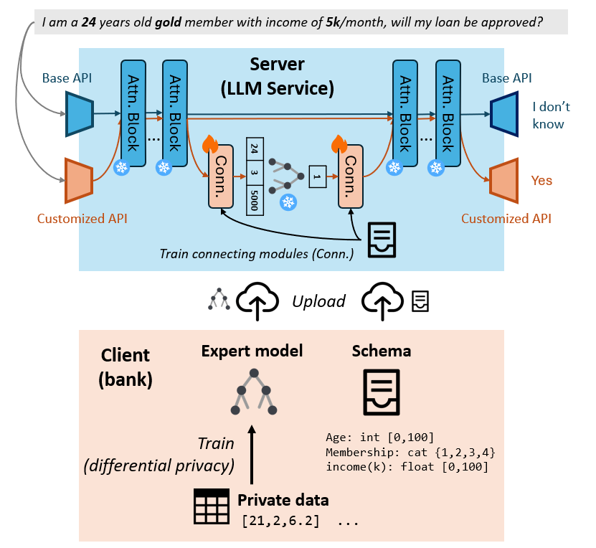
System overview
ARCHITECTURE

Slide 5
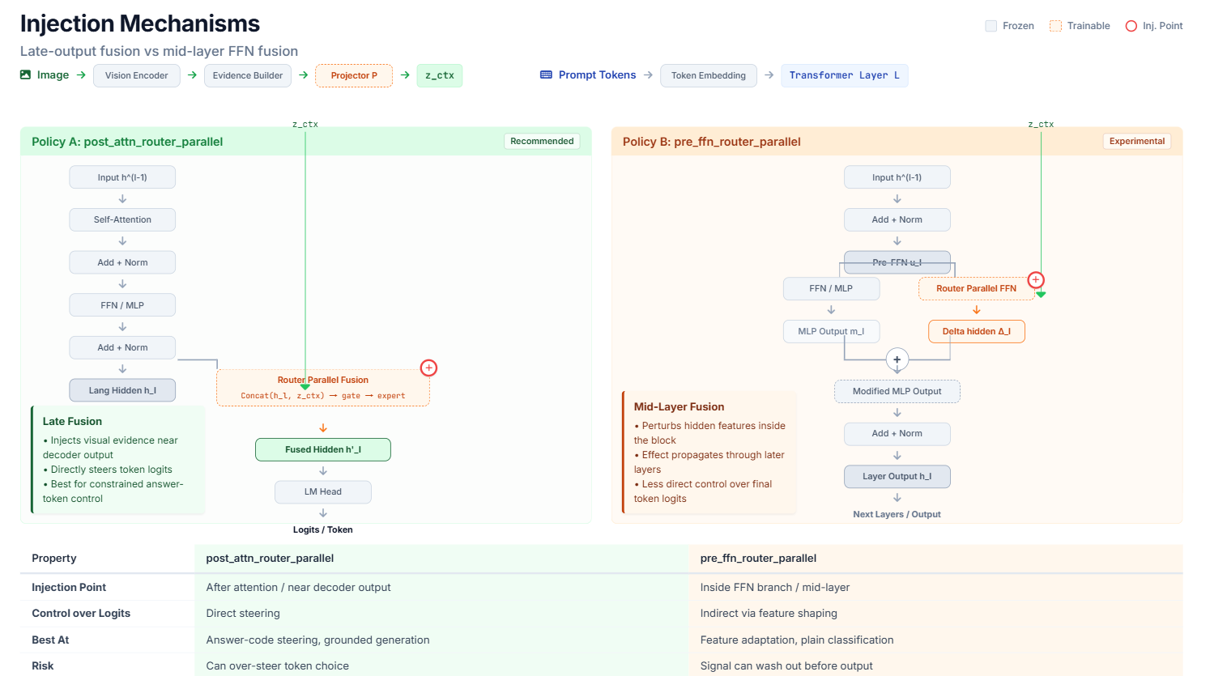
Injection mechanisms
ARCHITECTURE

Slide 6
Policy variants under test
Pre-FFN router
Post-attn-layers
Injects evidence before the feed-forward block.
Can improve task routing and answer selection.
Current runs: slightly higher fine-grained and grounded-generation accuracy.
Injects after attention across layers.
Better for nonempty and faithful rationales.
Current runs: much stronger rationale behavior.
Decision point: answer accuracy and rationale faithfulness are currently optimized by different injection sites.
POLICIES

Slide 7
Evaluation protocol now has guardrails
Axis | Current protocol
Fine-grained classification | DTD texture labels; Oxford-IIIT Pet labels
Strict yes/no | Binary visual assertions with constrained decoding
Population estimation | Numeric/relative estimation with MAE
Grounded generation | Answer plus rationale/evidence consistency
New guardrails
Real class-name ontologies.
Robust CODE=label parser.
Raw prediction audit JSONL.
DINOv2 and CLIP probes.
This is the difference between a demo benchmark and a defensible research artifact.
EVALUATION

Slide 8
Baseline audit: why the old result was too low
DTD class names were placeholders, so old zero-shot prompts did not encode the real texture label space.
Some CODE=label responses were parsed by the label text rather than the option code.
Earlier slides mixed current rows with stale artifacts and historical API numbers.
Fresh API rerun is blocked by quota, so API numbers must be labeled historical until rerun.
Publishable correction
Corrected labels.
Parser regression tests.
Auditable raw predictions.
Representation baselines included.
BASELINE

Slide 9
Corrected DTD baseline snapshot
One-shot semantic-v2 protocol, 128 eval images
Method | Acc. | Macro-F1 | Reading
DINOv2 linear probe | 85.2% | 79.2% | strong local baseline
CLIP linear probe | 82.0% | 77.1% | strong local baseline
Current injection checkpoint | 9.4% | n/a | stale/mismatched row
Caption + LLM | 7.0% | 2.0% | weak for texture taxonomy
LLM only | 3.1% | 0.2% | near random over 47 classes
Frozen VLM prompts | 2-3% | 0-1% | prompting is insufficient
Main reading: the meaningful baseline is adapted visual representation performance, not zero-shot chat prompting.
BASELINES

Slide 10
Task-matrix connector status
Metric | Pre-FFN | Post-attn | Reading
Fine-grained acc. | 53.9% | 51.2% | pre-FFN slightly higher
Strict yes/no acc. | 98.4% | 98.4% | both strong
Population MAE | 0.0228 | 0.0228 | no separation
Grounded-gen acc. | 55.5% | 53.9% | similar
Rationale nonempty | 6.8% | 72.4% | post-attn much better
Rationale faithful | 5.7% | 29.2% | post-attn much better
Takeaway: injection is useful across the task matrix, but the same site does not optimize classification and rationales.
TASK MATRIX

Slide 11
Current claim boundary
Can say now
Should not say yet
Privacy-bounded client/server evidence-injection contract is implemented.
Benchmark pipeline now has auditable labels, parsing, and raw predictions.
Pre-FFN and post-attn injection show distinct strengths across task types.
Not SOTA on DTD classification.
Not apples-to-apples against current API models until quota issue is resolved.
Not final connector result until retrained under corrected semantic labels.
CLAIMS

Slide 12
Publishable path
Step | Output needed | Why it matters
Retrain connector | new injection rows | fair comparison to DINOv2/CLIP
Rerun API baseline | current external comparator | avoid stale overclaiming
Add audit appendix | raw predictions + confusion slices | defensible failure analysis
Compare policies | pre-FFN vs post-attn same protocol | supports architecture claim
Freeze manifest | configs, commits, run paths | reproducible report
Target claim: privacy-bounded connector adaptation with grounded output, not universal image-classification SOTA.
PLAN

Slide 13
Tomorrow's discussion
Is the publishable claim better framed as privacy-bounded adaptation rather than classification SOTA?
Which comparator should be mandatory: DINOv2/CLIP probes, API VLMs, or both?
Should the next connector training optimize classification first, rationale faithfulness first, or a multi-objective mix?
What privacy threat-model detail is needed before writing the paper section?
Artifact anchors
Corrected DTD baseline Task-matrix pre-FFN Task-matrix post-attn API rerun: quota-blocked
DISCUSSION

