Slide 1
ELEVATOR CONDITION MONITORING
TEAM:
Anosh Damania (20BAI1152)
Nipun Rautela (20BAI1135)
Meghna Sinha (20BAI1133)
P V Abhiram (20BAI1132)
Sanjay (20BCE1854)

Slide 2
TABLE OF CONTENTS
PROBLEM
01
Current issues with lift
OBJECTIVE
02
Our solution
SURVEY
03
How others doing

Slide 3
TABLE OF CONTENTS
TECHNOLOGY
04
Sensors we used
DELIVERABLE
05
Outcome
REFERENCE
06

Slide 4
PROBLEM STATEMENT
In urban environments, vertical transportation is a critical component of modern infrastructure, with lifts (elevators) playing a pivotal role in facilitating efficient movement within multi-story buildings. Lift failures can result in inconvenience, operational downtime, and potential safety hazards for occupants. To address these challenges, there is a need for an advanced Lift Condition Monitoring System that can predict and detect potential lift failures in real-time, enabling proactive maintenance and minimizing service disruptions.

Slide 5
OBJECTIVE
To address these issues the concept of elevator condition monitoring has emerged as a groundbreaking solution, our system will integrate sensor data, machine learning algorithms, and predictive analytics to assess the health of lift components, anticipate potential failures, and provide timely alerts to maintenance personnel. The goal is to enhance lift reliability, reduce downtime, and improve overall user safety and satisfaction.

Slide 6
EXISTING SYSTEM(SURVEY)
Limited Sensor Integration: The existing system lacks comprehensive sensor integration, limiting its ability to capture real-time data on various lift components. This can result in an incomplete understanding of the lift's health.
Manual Inspection Dependency: The system heavily depends on manual inspections, making it prone to human error and potentially overlooking early signs of component degradation or malfunction.

Slide 7
CONTINUES…
Lack of Predictive Analytics: The lack of advanced analytics and machine learning algorithms hinders the system's ability to predict potential failures. A proactive approach to maintenance is essential for preventing unexpected downtimes.
Inefficient Fault Detection: The current system lack efficient fault detection mechanisms, making it challenging to promptly identify and isolate specific issues. This contributes to prolonged service interruptions.

Slide 8
HOW WE DIFFER
What sets our Elevator Condition Monitoring Apparatus apart is its comprehensive and integrated nature. The combination of ultrasonic sensors, load cells, cameras, accelerometers, and deep learning algorithms creates a holistic solution that covers various aspects of elevator health. The apparatus's ability to monitor structural integrity, wire conditions, and operational vibrations in real-time distinguishes it from traditional systems. Its adaptability for both new installations and retrofitting further emphasizes its versatility, making it a unique and valuable addition to the field of elevator condition monitoring.

Slide 9
CONTINUES..
The Elevator Condition Monitoring Apparatus introduces a paradigm shift by incorporating predictive maintenance strategies. Utilizing deep learning algorithms, the system analyzes data from various sensors to predict potential faults and wear patterns. This proactive approach allows for timely interventions, minimizing downtime and optimizing elevator performance. Predictive maintenance not only extends the lifespan of elevator components but also ensures that maintenance activities are conducted precisely when needed, preventing unnecessary disruptions and enhancing the overall efficiency of vertical transportation systems.

Slide 10
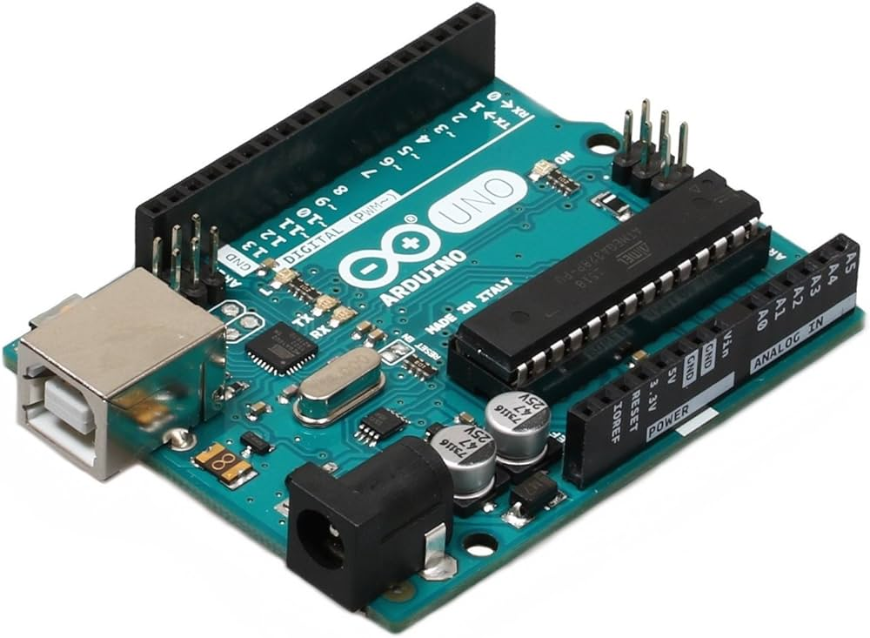
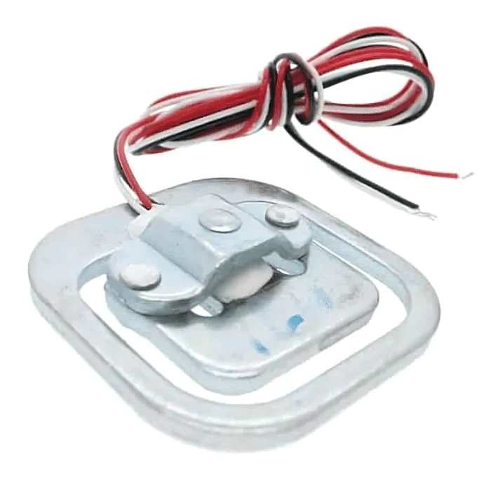
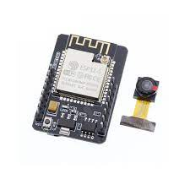
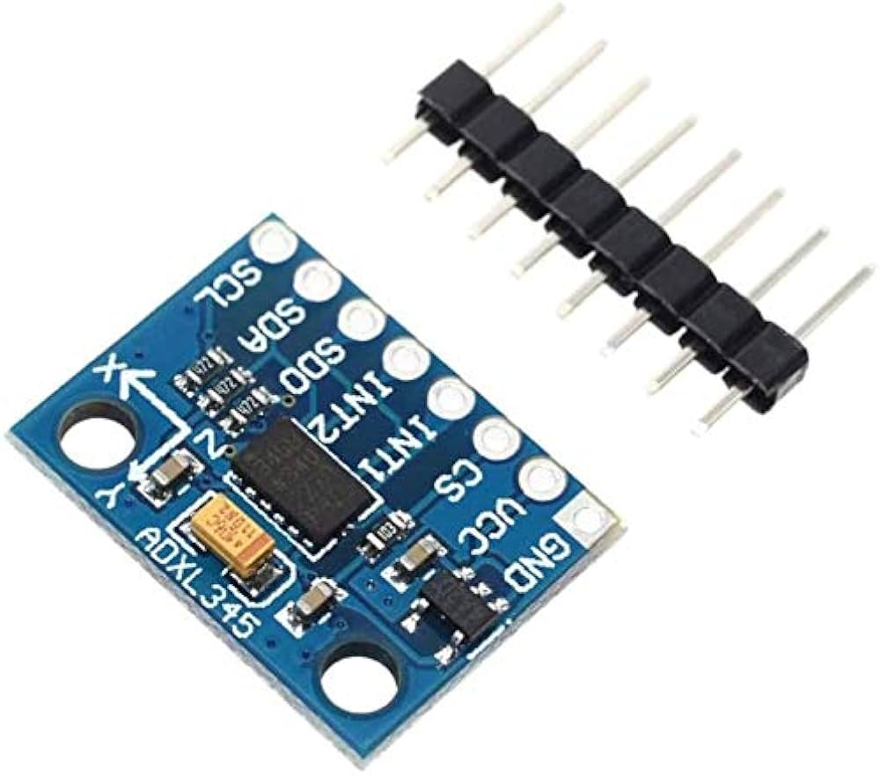
TECHNOLOGY
ARDUINO
LOAD CELL
CAMERA
ACCELEROMETER

Slide 11
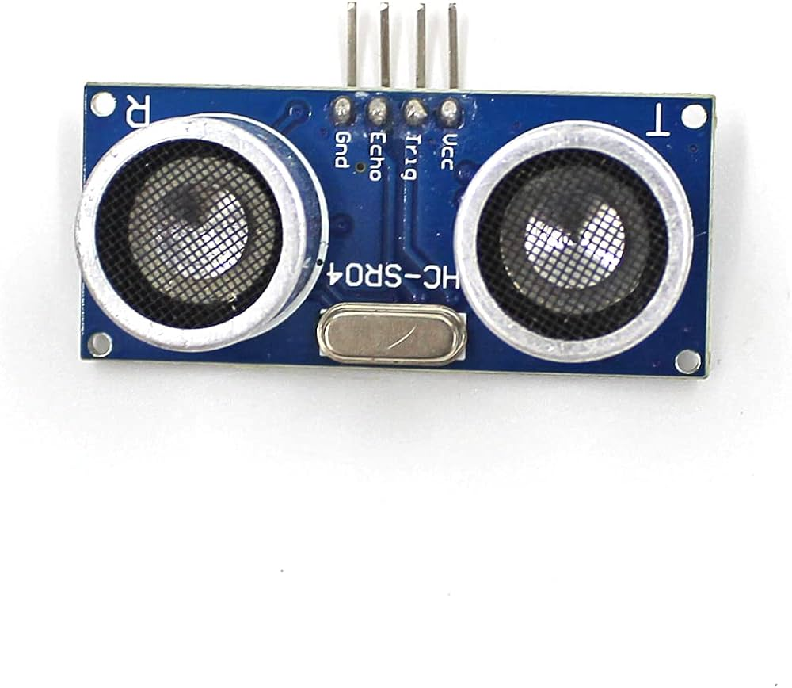
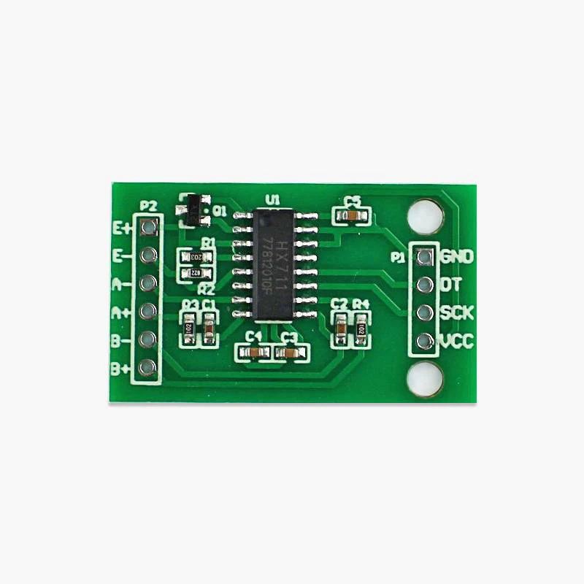
CONTINUES…
ULTRASONIC SENSORS
AMPLIFIER

Slide 12
PARAMETERS ANALYSED
WEAR AND TEAR
Ultrasonic sensors can play a pivotal role in monitoring the condition of elevator shafts by detecting wear and tear as well as the onset of rust. By strategically placing these sensors along the elevator shaft, we can continuously measure the thickness and integrity of the shaft’s surface. As the elevator moves, the ultrasonic sensor emits high-frequency sound waves, which bounce back off the shaft’s surface. Any inconsistencies in the reflected signal, such as a decrease in material thickness or the presence of rust, can be indicative of deterioration.

Slide 13
FRAYING
Detecting fraying on elevator wires is a crucial element in maintaining elevator safety and preventing catastrophic failures. To achieve this, we can implement a state-of-the-art solution that harnesses the power of high-resolution cameras. By strategically positioning cameras within elevator shafts and cabins, we can continuously capture images of the elevator wires. These images are then subjected to advanced image processing techniques and computer vision algorithms designed to identify irregularities and signs of wear.
The image processing algorithms can detect subtle changes in wire texture, color, or alignment that may signify the presence of fraying or other forms of damage. For instance, they can recognize the fine details of wire strands and highlight any deviations from the expected pattern. Additionally, color and contrast analysis can reveal discolorations or variations along the length of the wire, which may indicate corrosion or degradation.

Slide 14
LOAD
Load is measured to determine at how much capacity an elevator is running at peak times and on average throughout the day. The amount of load an elevator is under greatly impacts the chances of total mechanical failures in the future. Load limits are set for elevators and most elevators do not run if the load exceeds their limit. But these limits are set keeping load limit of all components in mind. In the long run, wires stretch, motors get unbalanced, and in general things wear down. This of course changes the load limit of the system, sometimes drastically. We must hence determine the maximum load that a system can handle at regular intervals, weekly or daily evaluation may suffice. Load limits must also be reevaluated if we find some defects/wear and tear in any of the actively working mechanisms. Needless to say, the load will also be reevaluated after a maintenance fix. To prevent catastrophic failure of the whole apparats, this might be the single most important step.

Slide 15
ACCELERATION
Monitoring acceleration is a crucial aspect of condition monitoring for elevators, providing valuable insights into the operational health and performance of the system. Here’s a detailed explanation of how monitoring acceleration aids in elevator condition monitoring:
Vibration Analysis
Accelerometers, which are sensors designed to measure acceleration, can be strategically placed on key components of the elevator system, such as the cabin, counterweight, and machinery. By continuously monitoring acceleration data, engineers can conduct vibration analysis. Unusual or excessive vibrations can indicate issues such as misalignment, imbalances, or wear in the mechanical components. Early detection through vibration analysis enables pre-emptive maintenance, preventing potential breakdowns and ensuring smooth and safe operation.

Slide 16
Data-Driven Predictive Maintenance
Leveraging acceleration data in combination with data analytics and machine learning enables the development of predictive maintenance models. These models can forecast potential failures based on historical acceleration patterns, usage trends, and the condition of components. Predictive maintenance ensures that maintenance activities are conducted precisely when needed, maximizing equipment reliability while minimizing unnecessary downtime and costs.

Slide 17
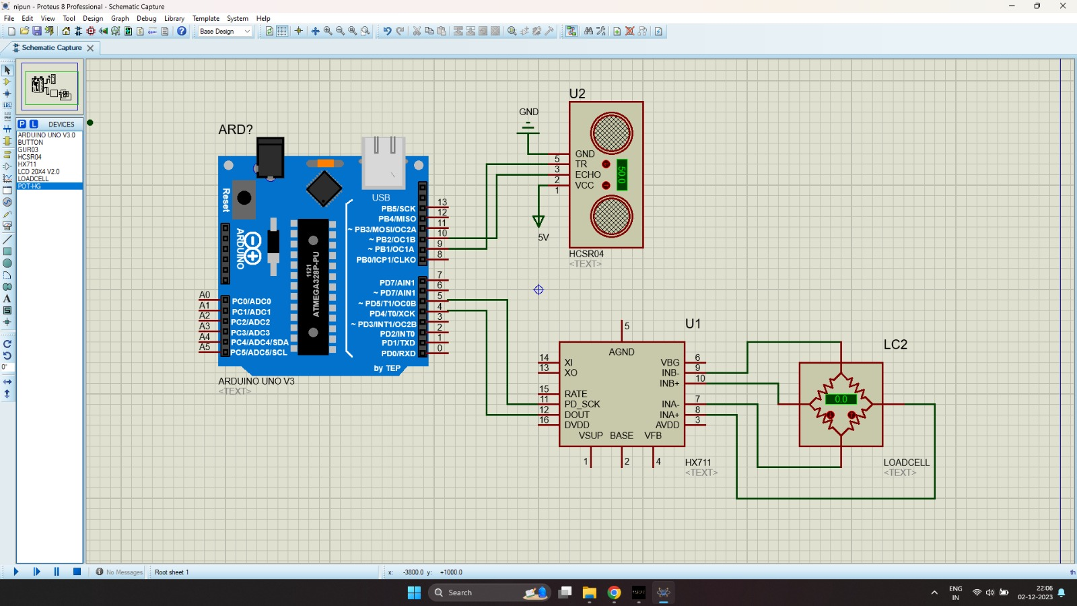
ARCHITECTURE

Slide 18

RESULT
Output of load cell

Slide 19
OUTCOME
Enhanced Safety
Predictive Maintenance Efficiency
Substantial Cost Savings
Data-Driven Solutions
Versatility and Adaptability
Preservation of Building Assets
Legal Liability Mitigation

Slide 20
END USER BENEFIT
Building Owners and Property Managers:
Benefit from increased property value through reliable elevator performance.
Reduce operational costs and enhance tenant satisfaction.
Facility Maintenance Teams:
Streamline maintenance activities through targeted interventions.
Improve efficiency by focusing efforts on critical components.
Elevator Service Providers:
Enhance customer satisfaction by offering proactive maintenance services.
Reduce emergency service calls through preventive measures.
Regulatory Authorities:
Ensure compliance with safety regulations.
Access comprehensive data for regulatory reporting and audits.

Slide 21
Occupants and Visitors:
Experience increased confidence in elevator safety.
Enjoy a smoother and more reliable elevator service.
Insurance Providers:
Mitigate risk through proactive maintenance, potentially lowering insurance premiums.
Access data for risk assessment and policy pricing.

Slide 22
CONCLUSION
In conclusion, it is evident that we have not only identified areas for improvement but have also laid the groundwork for a transformative shift in the way we manage vertical transportation systems.
The existing lift monitoring system, with its reactive maintenance approach and limited capabilities, presented challenges that impacted efficiency, reliability, and user satisfaction. Through our collective efforts, we have unearthed these challenges, recognizing the need for a more proactive and intelligent system.
The opportunities for improvement that we have identified – from implementing predictive analytics to enhancing sensor integration and embracing remote monitoring – provide a roadmap for a future where lift failures are anticipated, maintenance is streamlined, and downtime is minimized.

Slide 23
REFERENCE
Q. Peng et al., "Analysis of Vibration Monitoring Data of Flexible Suspension Lifting Structure Based on Time-Varying Theory," Sensors, vol. 20, no. 22, p. 6586, Nov. 2020.
R. E. Melchers, "The effect of corrosion on the structural reliability of steel offshore structures," Corrosion Science, vol. 47, no. 10, pp. 2391-2410, 2005.
E. P. Carden and P. Fanning, "Vibration Based Condition Monitoring: A Review," Structural Health Monitoring, vol. 3, no. 4, 2004. Available:
Y. Avenas, L. Dupont, N. Baker, H. Zara and F. Barruel, "Condition Monitoring: A Decade of Proposed Techniques," in IEEE Industrial Electronics Magazine, vol. 9, no. 4, pp. 22-36, Dec. 2015, doi: 10.1109/MIE.2015.2481564.
I. Skog, I. Karagiannis, A. B. Bergsten, J. Härdén, L. Gustafsson and P. Händel, "A Smart Sensor Node for the Internet-of-Elevators—Non-Invasive Condition and Fault Monitoring," in IEEE Sensors Journal, vol. 17, no. 16, pp. 5198-5208, 15 Aug.15, 2017, doi: 10.1109/JSEN.2017.2719630.

