Slide 1
Unit Testing: Removing Dependencies Using Mock Objects
Simon Elms
Senior Developer
Datacom South Island
simon.dev.nz@gmail.com

Slide 2
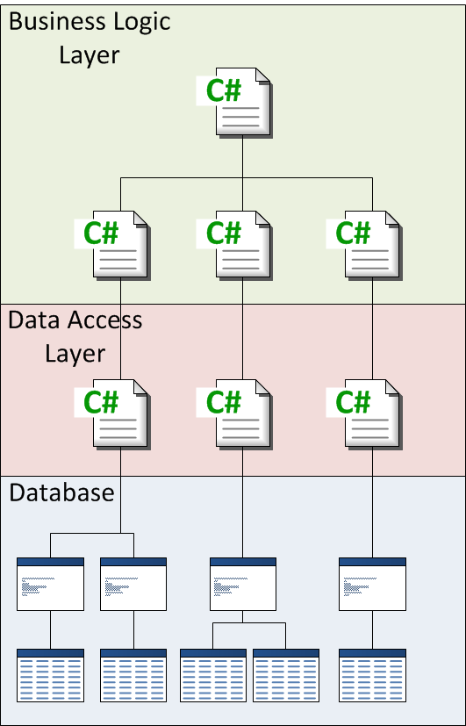
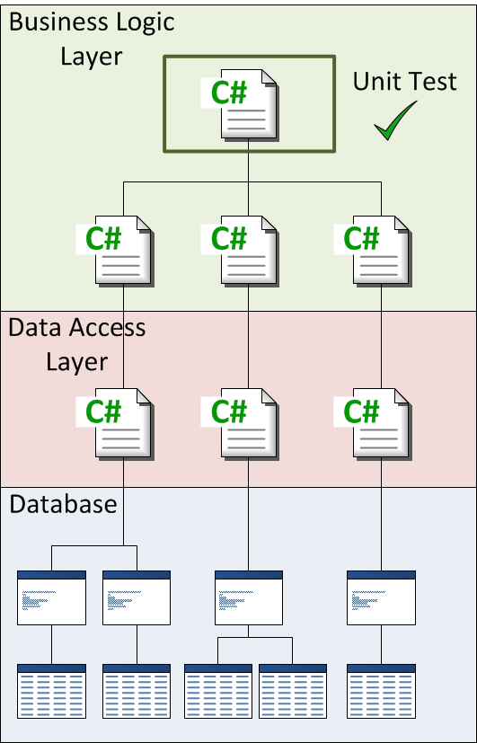
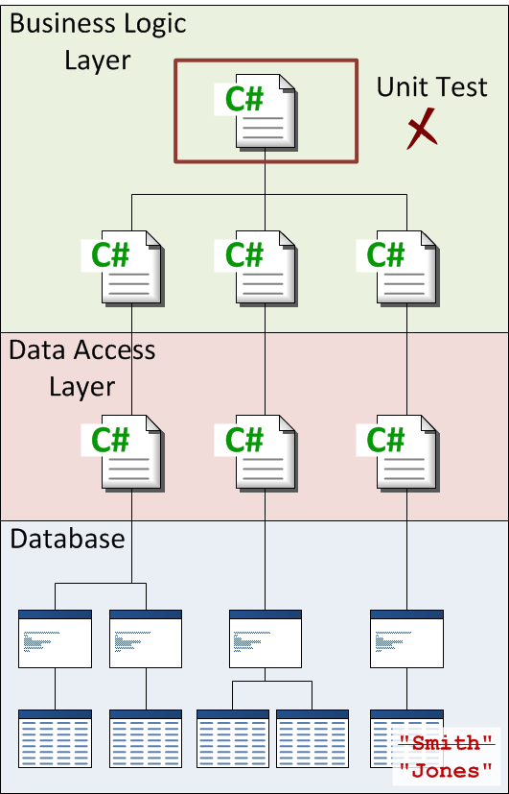
The Problem with Dependencies

Slide 3
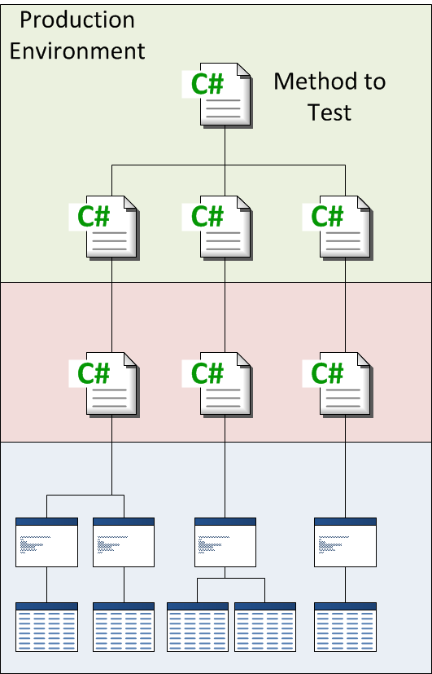
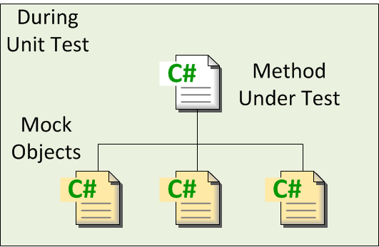
Eliminating Dependencies During Test

Slide 4
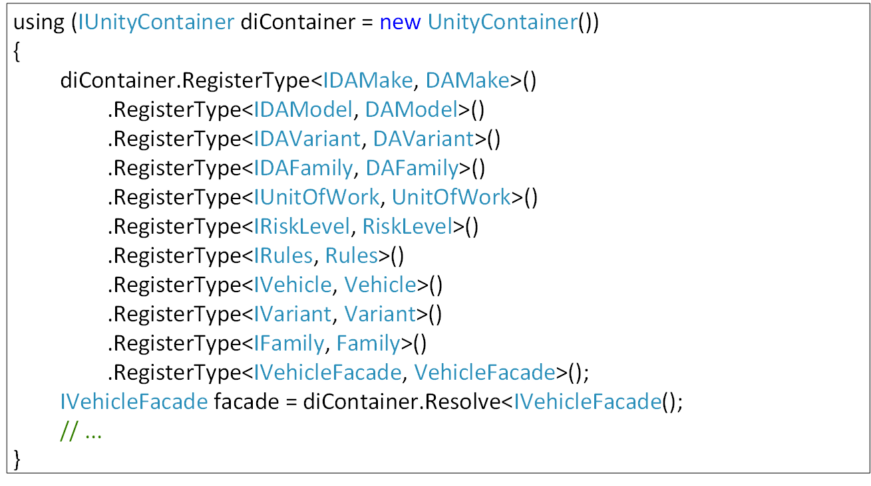
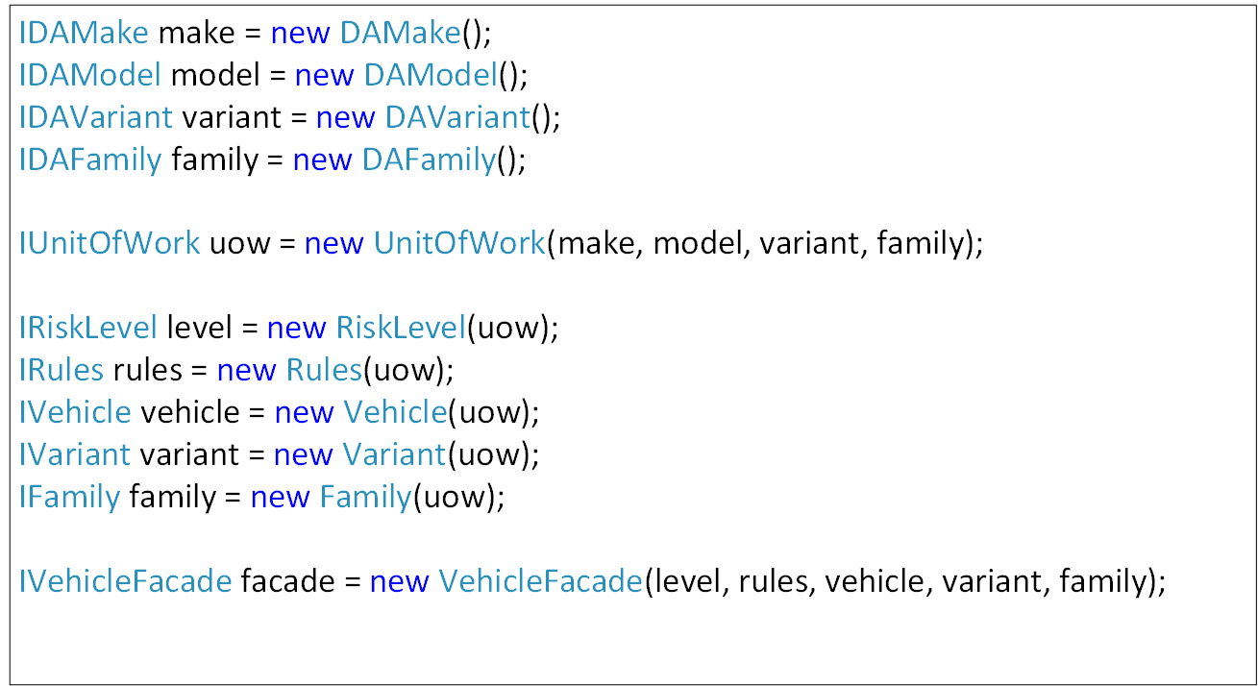
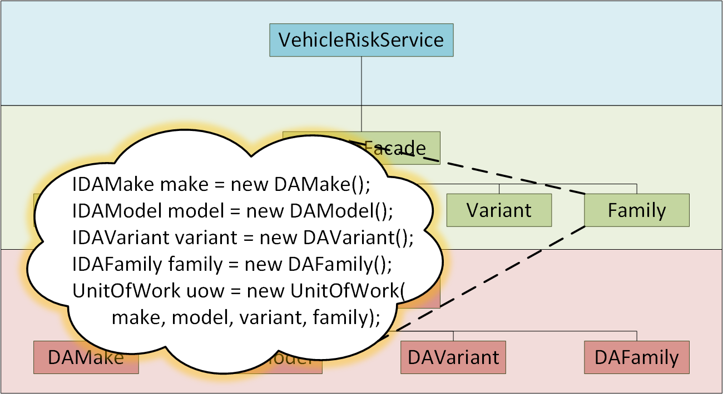
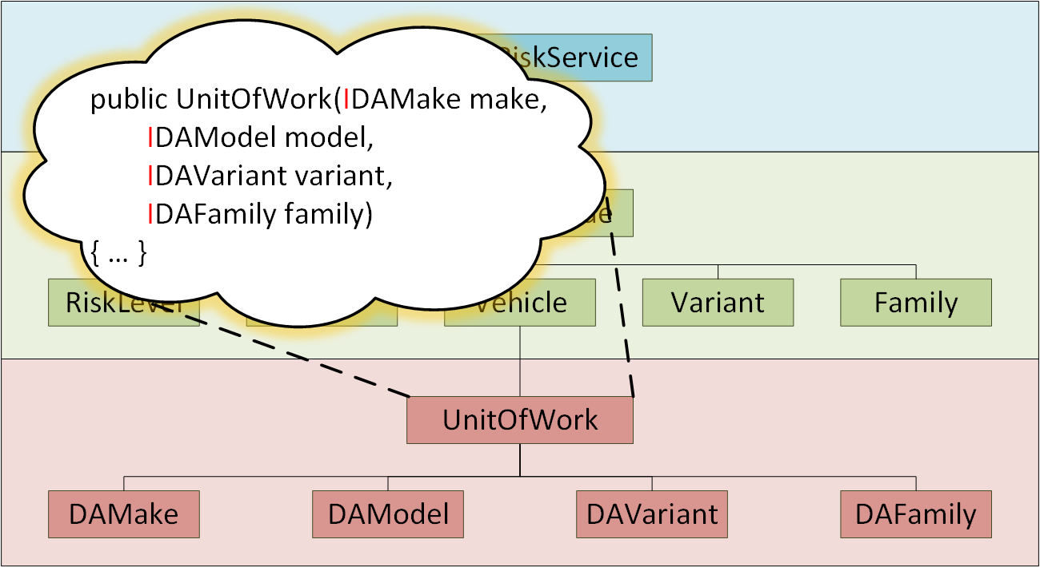

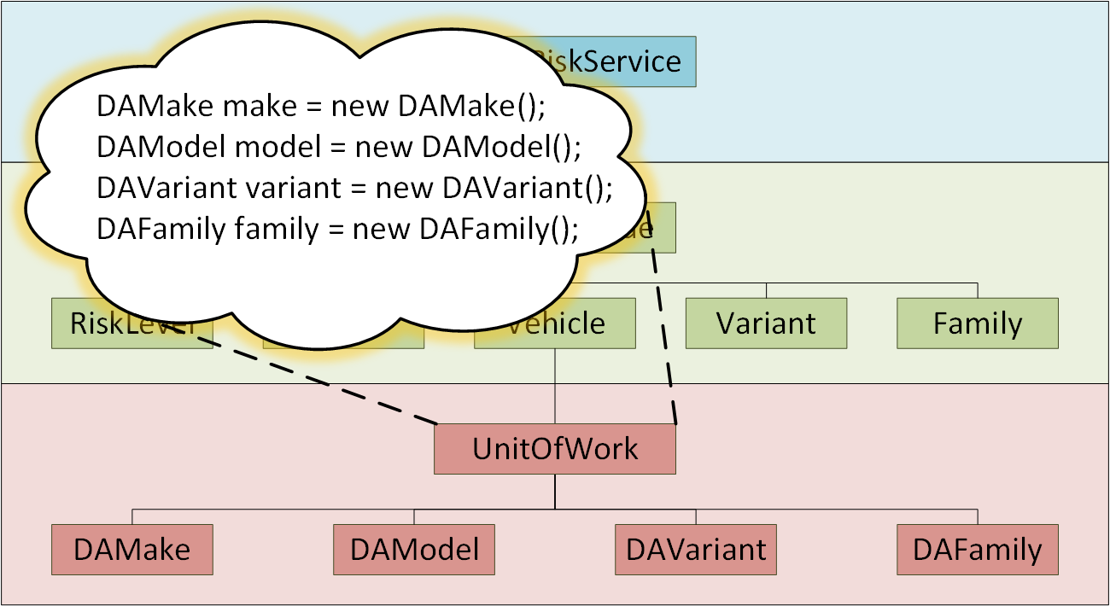
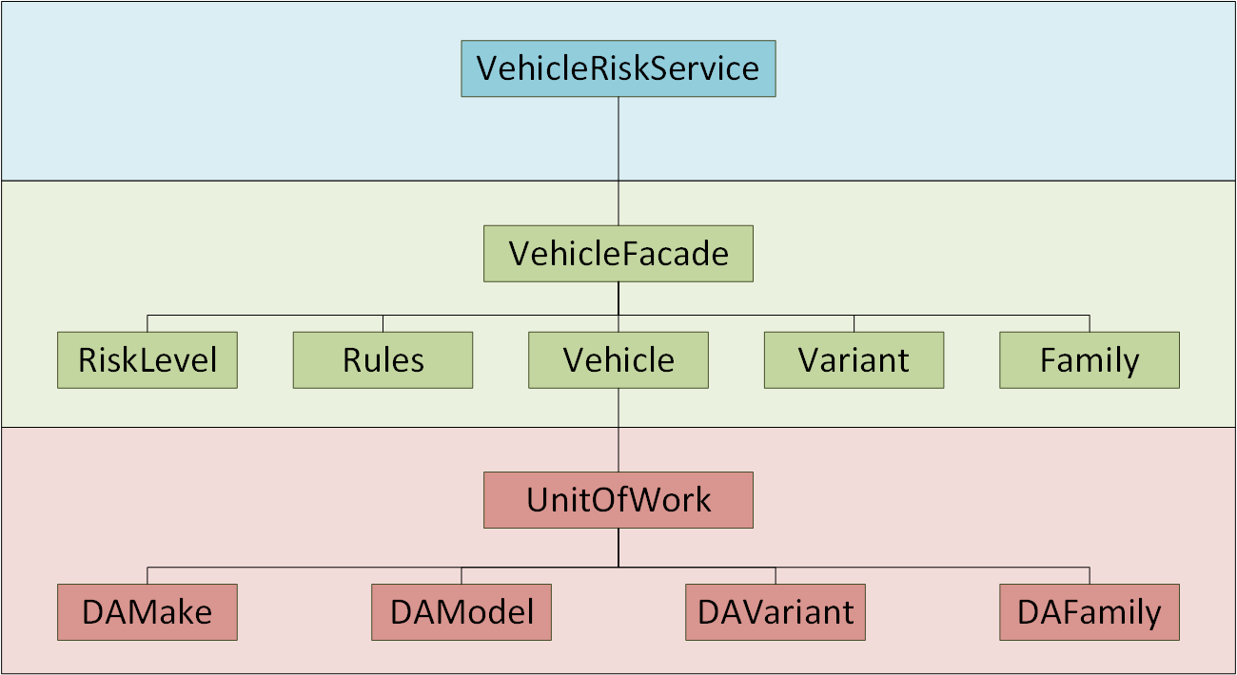
Dependency Injection Example

Slide 5

Eliminating Dependencies During Test: How?
Dependency Injection Unity Dependency Injection Container
Mock Object Moq Mocking Library

Slide 6
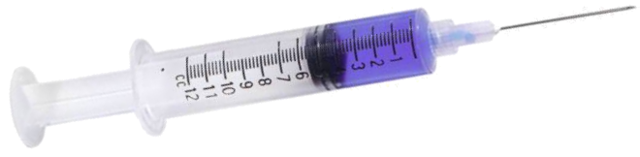
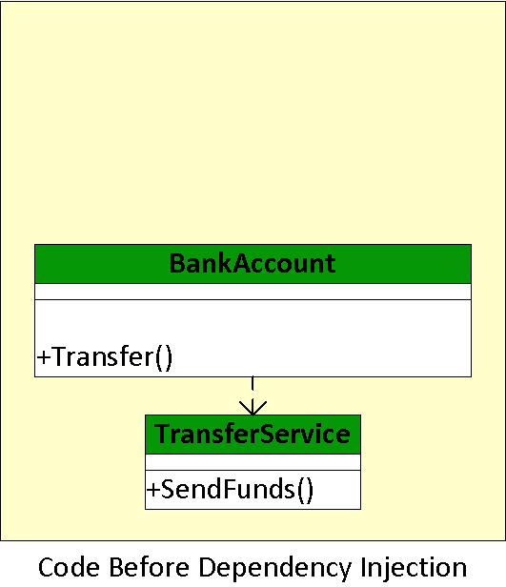
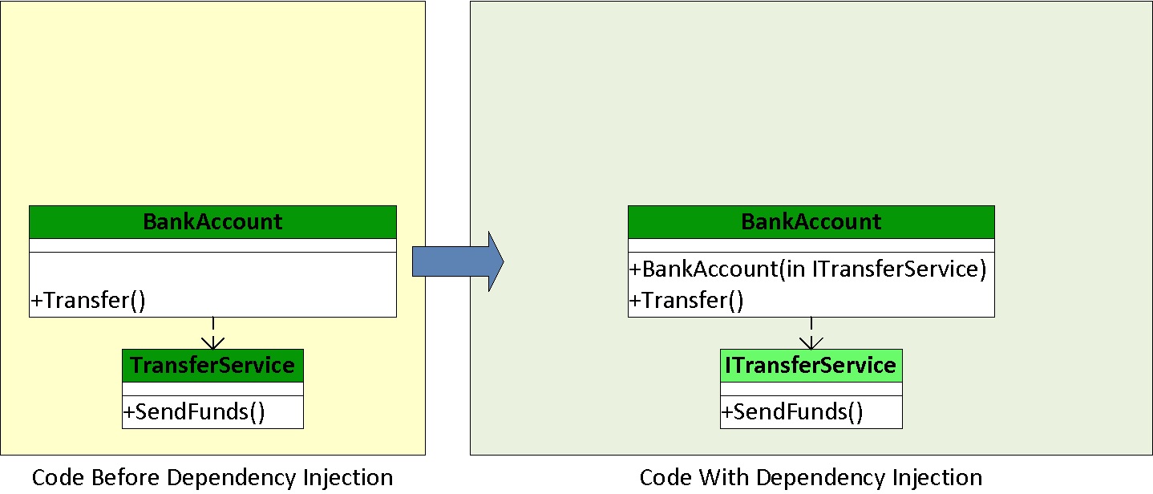
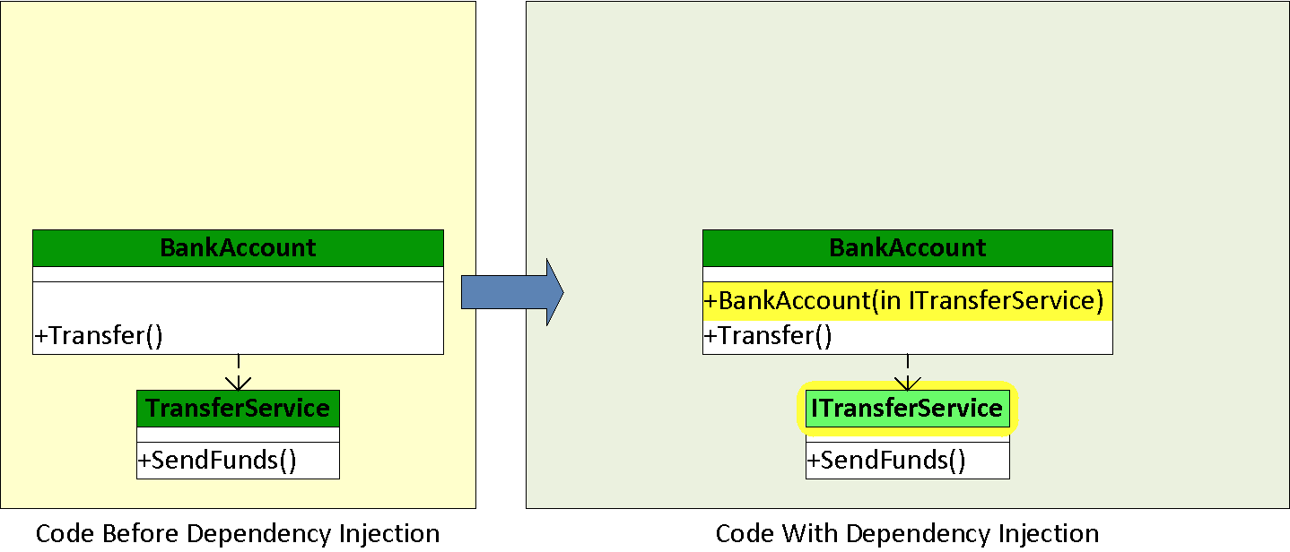
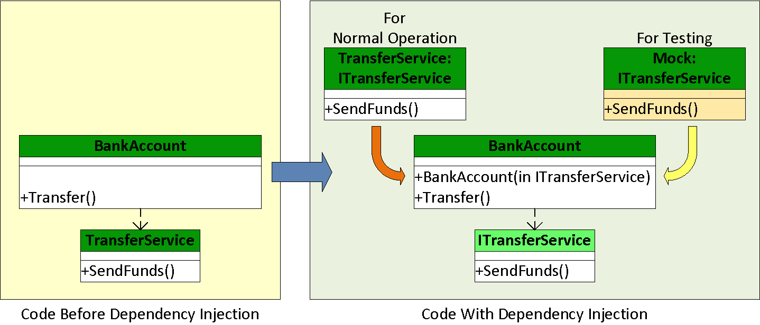
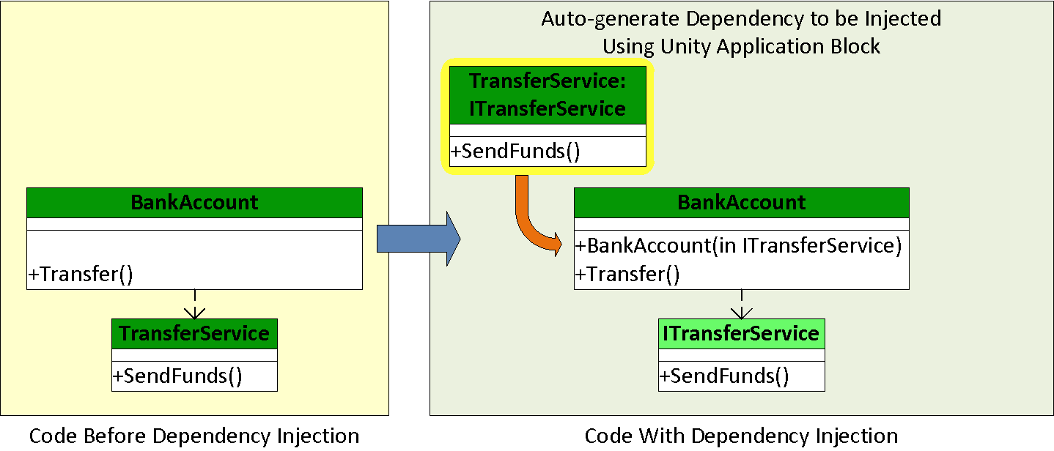
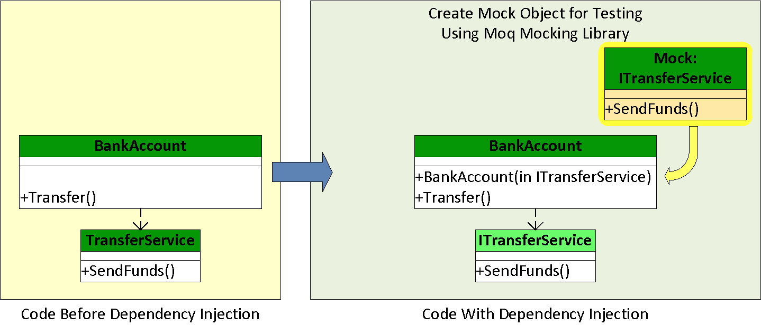
Dependency Injection Worked Example

Slide 7

Useful References
Unity Application Block: Developer's Guide to Dependency Injection Using Unity: http://msdn.microsoft.com/en-us/library/dn223671.aspx
Moq Mocking Library: Quick Start Guide: https://github.com/Moq/moq4/wiki/Quickstart
Sample solution: https://github.com/AnotherSadGit/UnitTestDemo
How to Install Unity 2.1 in Visual Studio 2010: http://www.nuget.org/packages/Unity/2.1.505.2

