Slide 1

Why ?

Slide 2

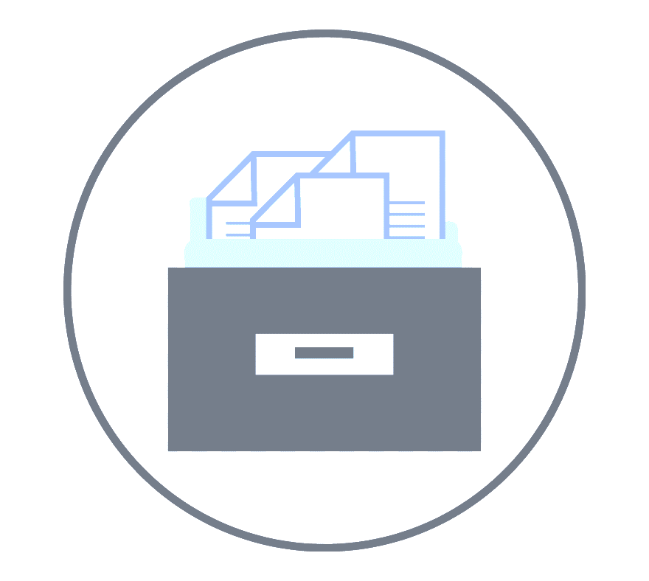

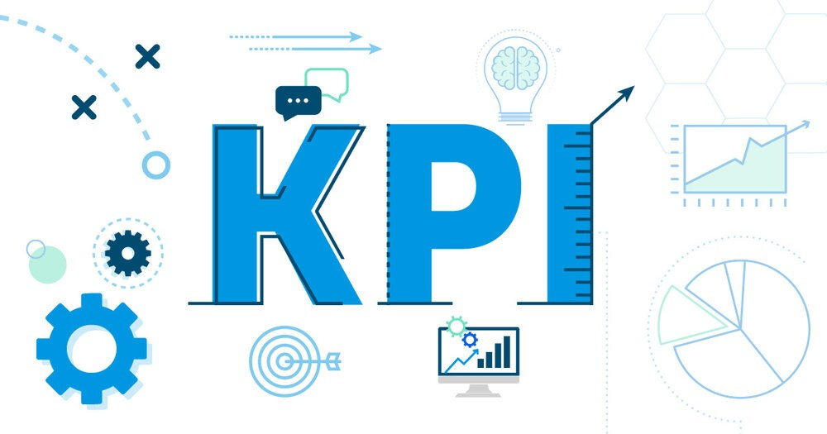
Data Engineering needs
Centralize Data
Historical Data
Transform data
Build KPIs

Slide 3
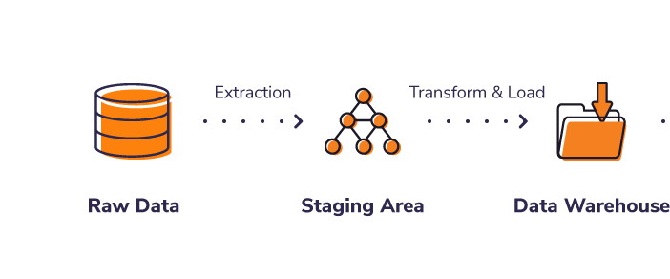
The ETL Process

Slide 4
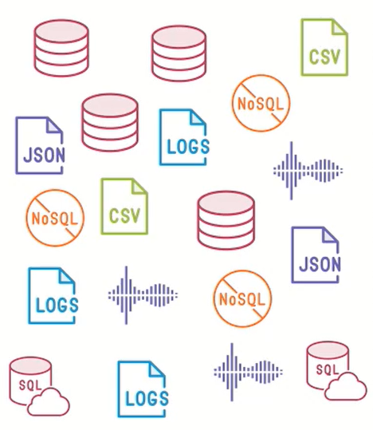


Challenges with Traditional ETL
Exponential Data Growth
Infrastructure Scalability
Envolve business Needs

Slide 5


Consumers of Data
Business User
Data Scientist

Slide 6


Slide 7

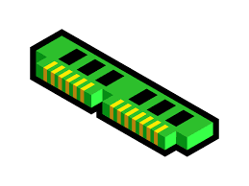


Apache Spark
Fast
In-memory
Highly scalable
Use cases

Slide 8
Difficult to use ?
Infrastructure Managment
Upgrade Challenges
Lack of User Interface
Manual Configuration
Tooling
Difficult to Collaborate

Slide 9


Slide 10
We need an intuitive and collaborative environnement, without worrying about
Infrastructure and upgrades

Slide 12




Databricks
Managed
Tools
Workspace
Setup infra.

Slide 13
