Slide 1
Presentation on The impact of data integration on the costs and benefits of information systems (Goodhue-data_integration_misq_1992)

Slide 2
WHAT IS DATA INTEGRATION?
Standardization of Data definitions and structures.
It ensures data has same meaning and use across time and across users.
Data and different systems are consistent and logically compatible.
Data Integration can be increased in one or two dimensions
Number of fields with common definitions and codes.
Number of systems or databases that adhere to these standards

Slide 3
WILL data integration always result in net benefit of an organization?
MODEL OF IMPACT DEVELOPED
ORGANISATION WIDE COORDINATION / DECISION MAKING
BENEFITS OF DATA INTEGRATION MUST BE GREATER THAN THE COST OF UNDERLYING SITUATIONS

Slide 4
Assumptions and problems
Assumption – A Common language for Data Integration exists.
Evidence – It doesn't exist in big organizations.
PROBLEMS
Organizations do not start with a clean slate.
Existing systems are not integrated.
Organizations failed or faced difficulties in changing their engineering models from non-integrated to integrated forms.

Slide 5
IF DESIRABLE, WHY IS IT DIFFICULT TO IMPLEMENT DATA INTEGRATION?
3 POSSIBLE EXPLAINATIONS
DIFFICULT IN OBTAINING TOP MANAGEMENT SUPPORT
SHORTCOMINGS IN THE METHODOLOGIES USED
IN CERTAIN ORGANIZATIONAL CONTEXT, DO NOT PROVIDE SUFFICIENT BENEFITS TO OFFSET THEIR COSTS.

Slide 6
NET RESULT OF DATA INTEGRATION DEPENDS ON
INTERDEPENDENCY OF SUBUNITS.
NEED FOR LOCALLY UNIQUE OR FLEXIBLE ACTIONS BY SUBUNITS.
DIFFICULTY OF DESIGNING AND IMPLEMENTING SYSTEMS WITH INTEGRATED SYSTEMS
It is not necessary that net result of Data Integration will always be positive.

Slide 7

TYPE OF DATA INTEGRATIONS
IN CASE OF BANKS-
COMPLETE INTEGRATION
PARTIAL INTEGRATION
Ex- Van Buren Bank
How many and what data elements to be standardized is CRITICAL.

Slide 8
The model for impact of data integration

Slide 9
What is a data integration model
Data integration model is basically an art that takes into account the types of models needed based on the types of architectural requirements for data integration and the types of models needed based on the system development life cycle.
The model to be developed here depends upon a very rational view of organizations and organizational design.
It summed the benefits and costs at the organizational level and that everyone in the organization should have an overall goal of maximizing benefits

Slide 10
Costs and benefits of IS
The IS here can be seen having cost in which cost refers to the setting up and designing of the system.
Marschak conceptualized the differences in information system designs as different ways of selecting and partitioning the available data from the environment.
Organizations face an array of possible information systems, each with certain implementation costs and different expected
To look at data integration in this light, a clear conceptualization is needed of how integration affects both the benefits and the costs to users and implementers.

Slide 11
Organizational information processing
Organizational information theory is basically the communication theory in which different organizations and their members, exchange and process information amongst themselves.
It focuses on the organizations design structure that it must create to tackle different types of organizational uncertainties.
Uncertainty is something which requires proper data handling and information processing.

Slide 12
Organizational uncertainty
Organizational uncertainty is basically the lack of knowledge, data information of a company, beliefs etc… of an organization.
As the name suggest, uncertainty is about not know for sure, be it the lack of information or data of a company.
For example: - there is a student who wants to go to a foreign country to study, He made up his mind of going abroad for higher studies but is uncertain of the country / university to choose. This is what is called organizational uncertainty.
Decision making is really important for an organization in order to avoid this uncertainty.

Slide 13
Galbraith’s proposal for low uncertainty
Galbraith proposes three different mechanisms to recover from this low uncertainty: -
1) Rules and procedure
2) Hierarchies
3) Goals
Hence an organization should increase their capacity of processing data and information through computerized information systems.

Slide 14
This paper focuses primarily on the computerized information systems.
Data Integrations is basically highly organized data and formalized language for describing the events occurring in a domain of a company / Organization.
That computerized integrated data’s scope is the extent to which that formal language is accessed across multiple functions or subunits of an organization.
Hence the Integrated data of a computerized information system is a keen factor and the most important factor in dealing with organizational uncertainty

Slide 15
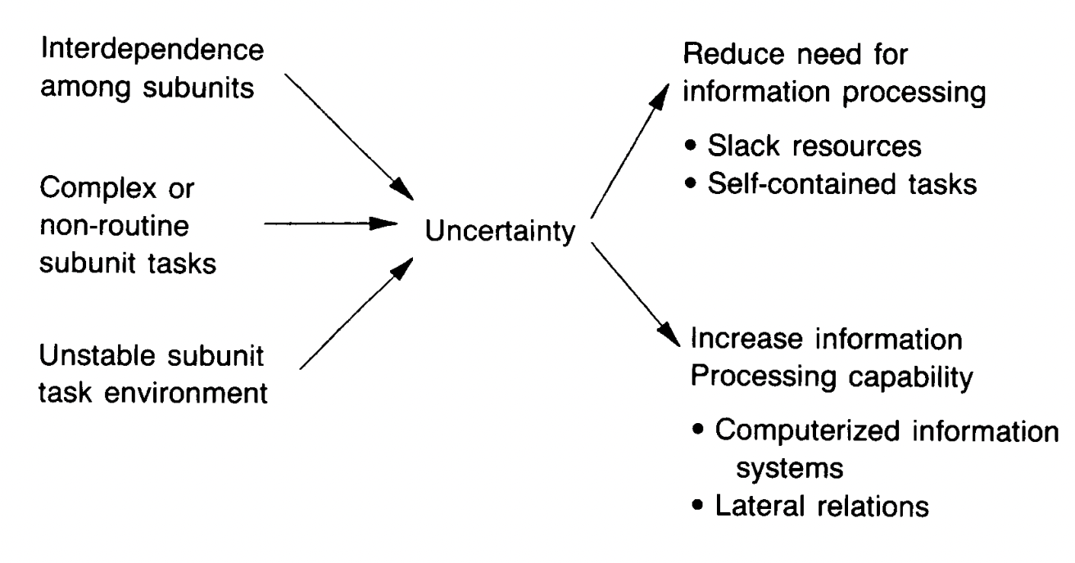
A model of organizational information processing
~Goodhue’s Impact of data
Integration on the cost and benefits of IS
Combining Galbraith, 1973 and Tushman and Nadler, 1978

Slide 16
Factors affecting the costs and benefits of an information system
Factor1:Benefits of Integrated and Shareable data
Factor 2:Flexibility to meet unique subunit requirement
Factor 3:IS design and Implementation Costs

Slide 17
Factor 1 :Benefits From Integrated and shareable Data
One of the major benefits of a single comprehensive information system come from the ability to share and aggregate information across multiple divisions ,functions , units in an organization.
Thus it is mentioned in the paper that the need for integrated information systems is the greatest where there is interdependence amongst various departments in an organization.

Slide 18
Factor 1 :Benefits From Integrated and shareable Data
The two major impacts data Integration has on an organization is as follows
Improved managerial information for organization wide communication.
Improved Operational Coordination between interdependent parts of the organization.
To explain both these impacts key takeaways from different case studies are explained in the paper.

Slide 19
Improved managerial information for organization wide communication.
Delvin Electronics Case Study:
Problem that Delvin Faced: On-time delivery of Products reduced to 70%
What did they do: An Interdisciplinary team developed organization wide integrated scheduling data to track how production schedules were made changed and adjusted by multiple departments.
Patterns Discovered due to Integration:
Plants were not properly updating their inventory levels and equipment conditions
Marketing department was overriding the Schedule without considering plant Capabilities.
Plants were thus overriding their systems without paying attention to critical order requirements.
Thus an organization wide data integration helped Delvin Electronics understand their problems better and take required corrective action which improved on-time delivery percentage to 98%.

Slide 20
Improved Operational Coordination between interdependent parts of the organization.
Burton Trucking Case Study:
In order to improve their operation Burton Trucking implemented a single Data model for the entire organization.
This helped them to link across geographies and functions
By using common sharable data they found that their dispatch systems can be expanded to give them a much better shipment tracking system.
Thus Data integration help them uncover previously unrecognized interdependencies between shipping tracking and dispatching thus improving operational coordination between two different parts of the organisation.

Slide 21
Factor 1 :Benefits From Integrated and shareable Data
Thus, to conclude upon this factor it is proposed in the paper that
As interdependence between Subunits increases, benefits of data integration will also increase and the amount of data integration in rational organizations will also increase.

Slide 22
Factor 2:Flexibility to meet unique subunit requirement
One of the downsides of data integration is that the local subunits loose their autonomy.
As every department has its own way of functioning having commonly sharable data might hamper its functioning.
The solution to this is given by the concept of requisite variety of systems theory which states that in order to successfully respond the environment a system must be a good model of that environment.
To explain this concept another Case study of Burton Trucking is considered

Slide 23
Factor 2:Flexibility to meet unique subunit requirement
As discussed before Burton Trucking implemented a single data model for the entire organization.
The new system contained integrated data about all the customers, equipment and Shipping.
The sales staff proposed that for the data to be valuable to them they need more fields but they were not able to come to common grounds as to which fields should be there.
Thus the IS department decided to model the data further specifically for the sales staff giving them additional 10 fields to store their data.

Slide 24
Factor 2:Flexibility to meet unique subunit requirement
Considering this example it is proposed in the paper that:
All other things being equal as the differentiation of subunits increases data integration will impose more and more compromise costs on local units; thus the amount of data integration in rational firms should decrease.
Another important factor related to the flexibility to meet subunit requirement is mentioned in the paper which is the reduction in local flexibility due to bureaucratic delays.
To explain as Example of Superior manufacturing is given.

Slide 25
Factor 2:Flexibility to meet unique subunit requirement
At superior manufacturing if there are any changes that have to be proposed to the Information system 1st go to the Data resource Management office.
This office decides the subject areas affected. Further data stewards analyze and review the whole recommendation. Then this is further analyzed by the database administrators and user groups affected and so on and so forth.
Thus as seen in this example multiple players perform multiple review requests and this results in the bureaucratic delay.

Slide 26
Factor 3: Information system design and implementation costs
If additional cost is too large:
Rational firms will make do without integrated data.
Even if potential weights outweigh the losses:
Organizations still need to consider the cost of designing and implementation.
So, what is the impact on costs?
(Typical argument in literature) The higher costs of more expensive initial design and implementation are compensated by lower costs for subsequent modifications of the systems, with a net increase in productivity.

Slide 27
Up-front costs
GREATER COMPLEXITY OF THE DESIGN:
Subunits
The scale of system Increase the costs
Compromise solution

Slide 28
Long-term costs
Homogenous subunits meet
same environments and
same challenges
Just need to redesign a single subunit, and make data integration more attractive
Different subunits,
Many degrees of freedom, Different types of new challenges
All subunits need to change, Have many short-term high costs, less long-term benefit, less data integration

Slide 29
Why The “Rational”model Is The Only Part Of The Picture
Organization should choose a design that maximizes the benefits and minus the costs

Slide 30
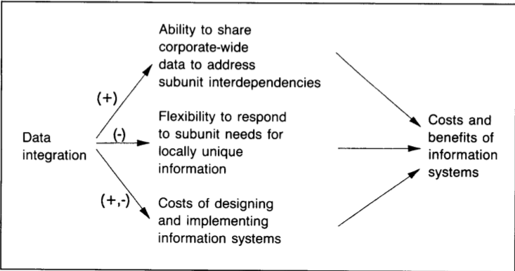
The impact of data integration on the cost & benefits of is
Interdependence with Strategy and Structure
In an Organisation, the technology employed, the structure, the strategy, individual roles & management processes are the tightly interdependent

Slide 31
Power & politics
Large net benefits to the organization as a whole, data integration may distribute those benefits and cost in an uneven way
The disparity between “who pays the costs” & “who gets the benefits “ can lead to less than optimum soln. for everyone involved

Slide 32
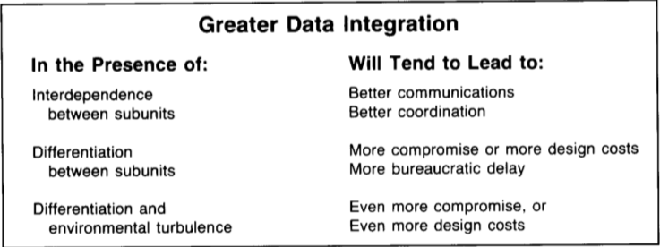
ConCulsion
The Impact of data integration in uncertain environment
The major implication of this analysis is that in general.
It will not be cost-effective to integrate all of an organizations data.

Slide 33
The Impact of data integration in uncertain environment
Organization will need help in their efforts to ”partially integrate” to achieve the most important benefits and avoid the most burdensome costs.

Slide 34
References
We have read and studied the paper “The Impact of data integration on the costs and benefits of information systems” By Goodhue and all the references are taken from that.
Other references : https://searchdatamanagement.techtarget.com/tutorial/Structuring-data-integration-models-and-data-integration-architecture

Slide 35
Thank you

