Slide 1
Audio amplifier
ELECTRONIC WORKSHOP II
Saumya Shah 20171193
Anoushka Vyas 20171057

Slide 2
Block diagram
MIC
PRE (G1) AMPLIFIER
GAIN STAGE (G2)
VOLUME CONTROL UNIT
FILTER
POWER AMPLIFIER
LOAD

Slide 3
Specifications
Supply: 5V
Gain : G1 x G2 >= 500
Power: P >= 1.4 W
Input is sine wave : 10-20 mV peak to peak
Filter should not attenuate the gain
Frequency : Audible range(20 Hz - 20KHz)
Load: 10 Ohms

Slide 4
Function of pre amplifier
Microphone records signal at mic-level i.e. output signal of mic is very weak.
We need to boost this mic-level (weak) signal to line-level (Normal sound level at which all incoming signals are) for further amplification without significantly degrading the signal-to-noise ratio(SNR).
Pre amplifier stage boosts this weak signal and makes it noise tolerant and strong enough for further processing.
This stage is also important to remove noise and distortion.
Once it is at the same level as all the other signals, it can be processed along with them by an amplifier.
The noise performance of a preamplifier is critical.When the gain of the preamplifier is high, the SNR of the final signal is determined by the SNR of the input signal and the noise figure of the preamplifier.

Slide 5
Pre amplifier:basic design
Basic Design: Differential Amplifier
An ideal preamp will be linear (have a constant gain through its operating range), have high input impedance (requiring only a minimal amount of current to sense the input signal) and a low output impedance(when current is drawn from the output there is minimal change in the output voltage).
Why Differential Amplifier?
Differential amplifier provides high gain so it can be used to boost mic level signal.
Differential amplifier amplifies difference between two inputs.So noise signal which is common to both input will get cancelled and SNR will be improved.
It has high input impedance and low output impedance.

Slide 6
Gain stage
Basic Design: Common Source Amplifier
It is used to further amplify the voltage signal.We also place an important component here - the dominant pole capacitor CC which is there between the preamp and the gain stage. It determines the main pole (low-pass filter) of the amplifier.It keeps the amplifier from oscillating, helps present a low impedance to the next stage and linearizes this stage (reduces distortion) with its local feedback.

Slide 7
Filter
Basic Design : Active Band Pass filter
Why Band Pass filter?
Audible Range is 20 Hz to 20 KHz.
So frequencies less than 20 Hz and greater than 20 KHz should be removed.
Band Pass filter is appropriate for above problem.
Band Pass filter can be built by cascading Low Pass filter with critical frequency 20 KHz and High Pass filter with critical frequency 20 Hz.

Slide 8
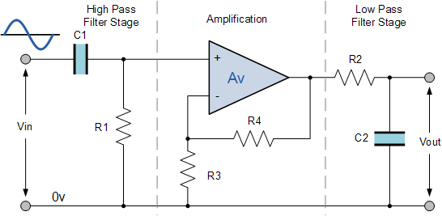
Filter : circuit

Slide 9
Power amplifier
Function:The main purpose of this amplifier is to raise power level of the input signal to get the large power at the output.
It provides sufficient power to an output load to drive speaker.
Basic Design: Class AB Power Amplifier
Why Class AB Amplifier
Although amplification of Class A amplifier is too high, it’s efficiency is less than 50%.
In class A amplifier transistor is always ON. So power dissipation is too high.
Efficiency of Class B amplifier is high but there is signal distortion in class B amplifier.
Class AB amplifier is the combination of class A and Class B amplifiers. It has higher efficiency than class A and low distortion.

Slide 10
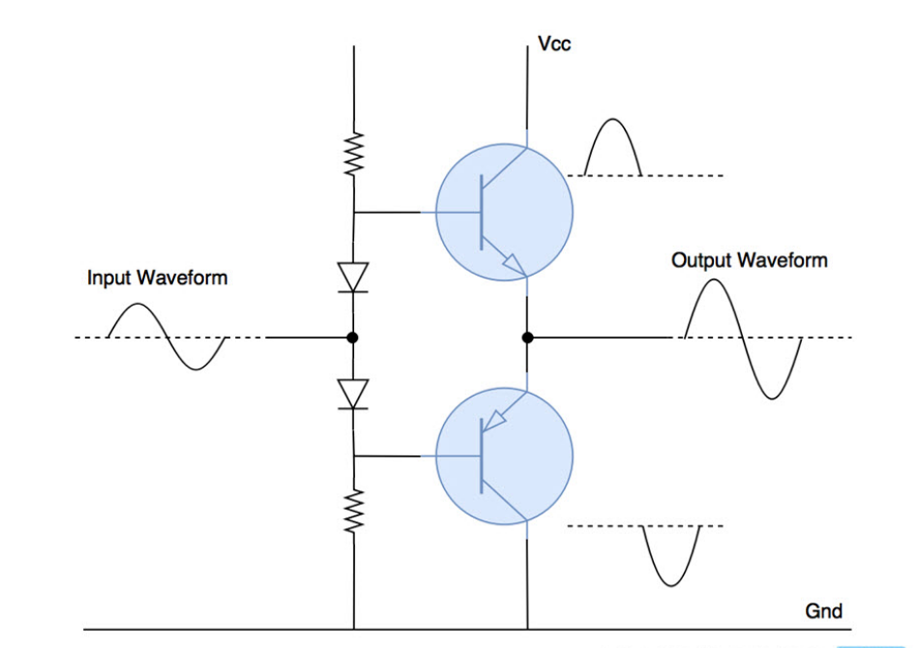
Power Amplifier:circuit

Slide 11
Buffer Amplifier
Basic Design: Common Drain Amplifier
The Buffer Stage has a gain of 1. It let’s you drive relatively low-impedance loads without affecting the gain. The buffer transfers the output voltage to the load while delivering as much current as needed. It isolates, as much as possible, the load from the gain stage.
This stage can be added in the design depending on the need.It can be added between the gain stage and the filter and between the power amplifier and the load.

Slide 12
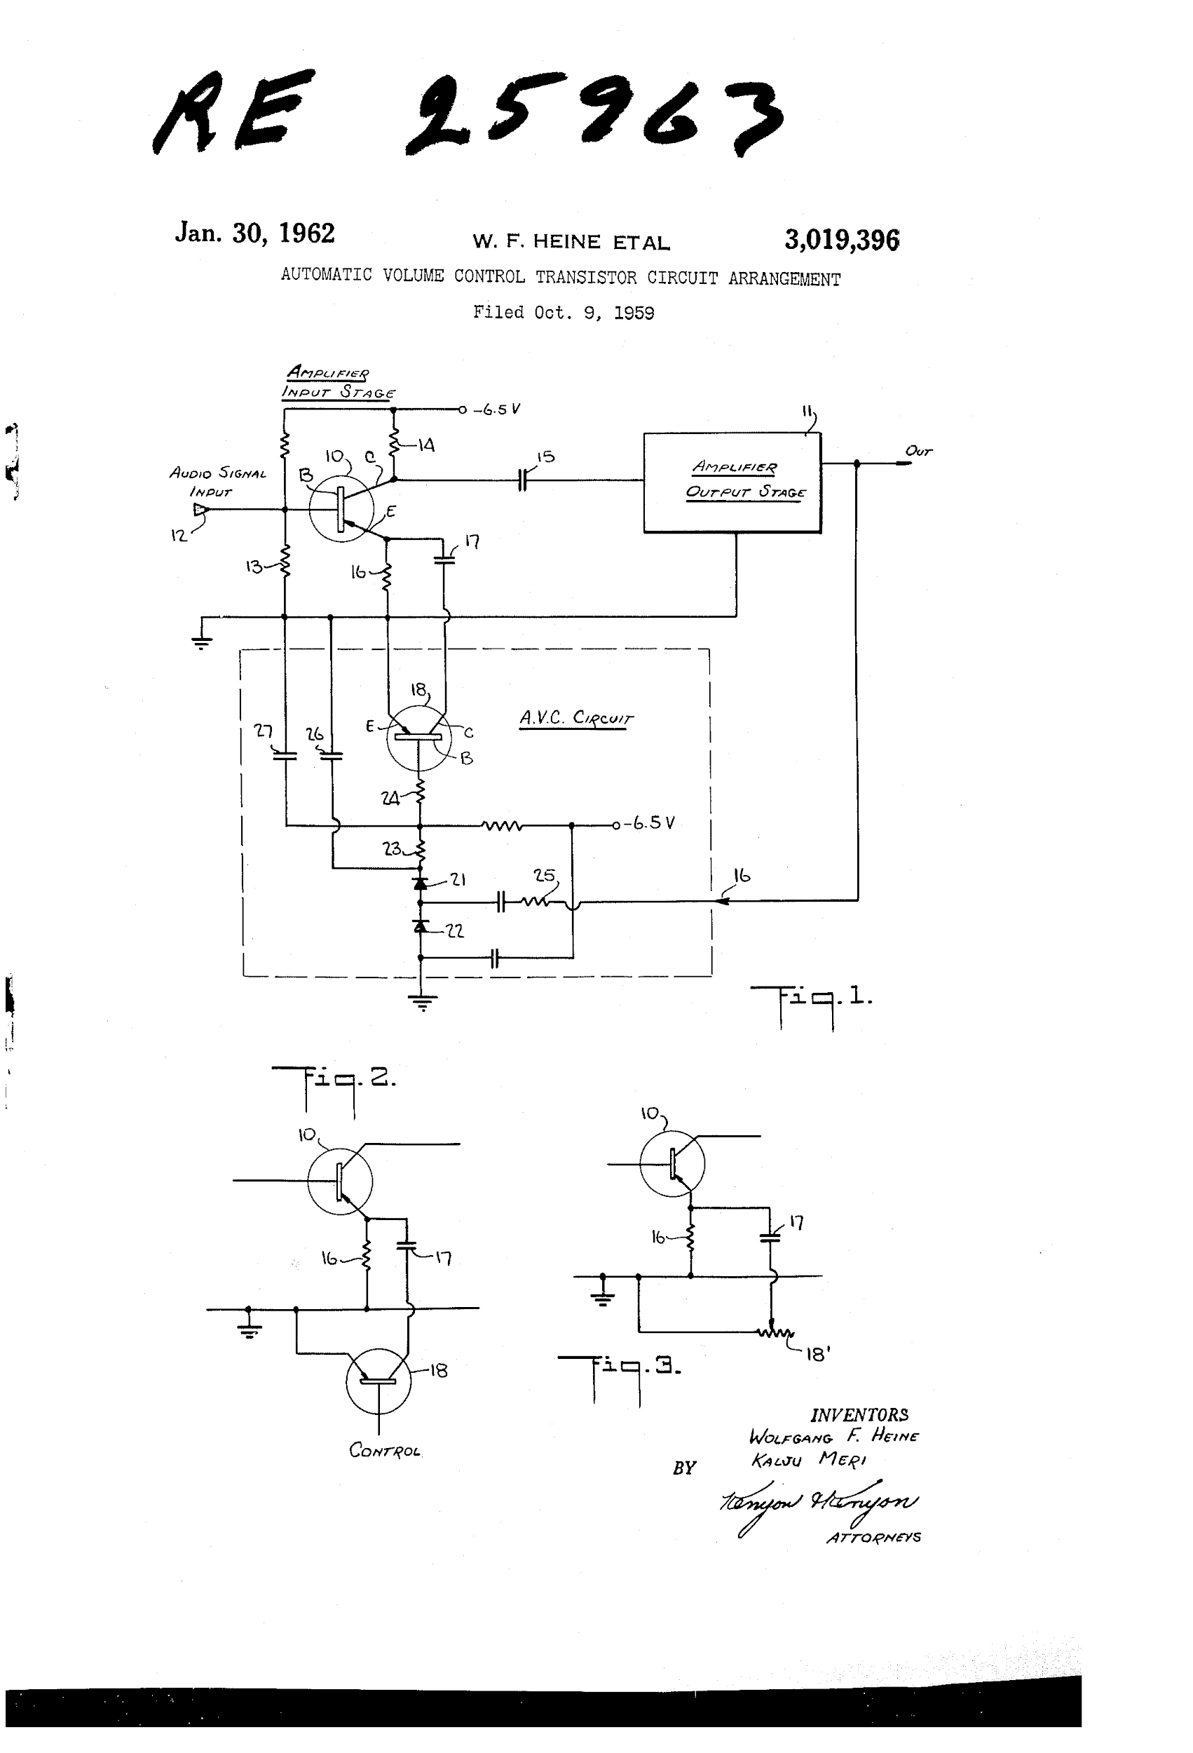
Volume controller

