Slide 1
STOCK MARKET PREDICTION AND ANALYSIS
SIN Project

Slide 2
REVIEW 2
Review 1
ide,language,packages,libraries,
algorithms:- Support Vector Machine,Logistic Regression,Random Forest
datasets(testing and training data)
data homogenization

Slide 3
data preprocessing:-DATA DISCRETITION,DATA TRANSFORMATION,DATA CLEANING,DATA INTEGRATION
Feature scaling of data
creating timestamp

Slide 4
FEATURE EXTRACTION & training MODEL
In this layer , only the features which are to be fed to neural networks are chosen.
we will choose
date
high
low
volume

Slide 5
Keras framework
it is the first move for building RNN
keras is a framework that comes under tensorflow
first for setting up the environment we need to install anaconda
it is tensorflow's high level API for building and training deep learning models

Slide 6
ANACONDA
Anaconda is a free and open-source distribution of the Python and R programming languages for scientific computing (data science, machine learning applications, large-scale data processing, predictive analytics, etc.), that aims to simplify package management and deployment.

Slide 7

create a virtual environment and activate it

Slide 8

download tensorflow,keras

Slide 9
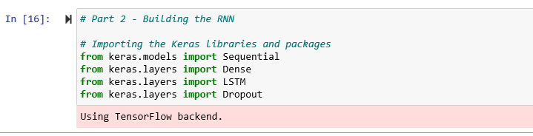
building RNN

Slide 10
BUILDING THE RNN
sequential API:- it is linear stack of layer to which you can create a sequential model by passing the list through it
DENSE :- it is a regular deeply connected neural network layer ,it is the most commonly and frequently used layer
and it is used to change the dimension of our output .
the dense layer basically represents a matrix vector

Slide 11
multipication so the value in the matrices , which are trainable parameter get updated during backpropagation.
so if you get a M dimesional vector as an output a dense layer is used to change the dimension of your vector.
LSTM :- Long Short-Term Memory layer
Dropout:- The Dropout layer randomly sets input units to 0 with a frequency of rate at each step during training time, which helps prevent overfitting.

Slide 12

TRAINING NEURAL NETWORK

Slide 13
Intialising RNN
For a time series problem like this
we are basically going to be using a regression model
So For our regression deep learning model the first step is to read in the data,
which is a sequential data
And we are going to assign it to the model here named as regressor
So basically, regressor represents our model;

Slide 14
Adding the LSTM layer and some Dropout regularisation
We are going to assign random biases and weights to our model
Now this LSTM model is composed of a sequential input layer followed by three LSTM layers and dense layer with activation and then finally a dense output layer with linear activation function

Slide 15
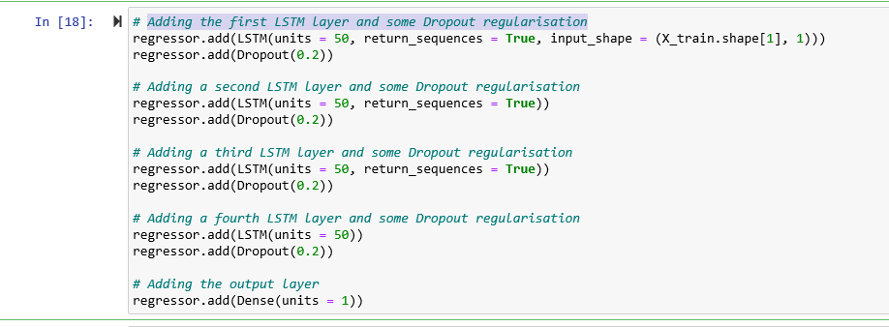

Slide 16
Dropouts
Dropouts basically a regularisation technique for
Reducing overfitting in neural networks so it drops out units in a neural network when required.
Dropouts are used in making the neurons more robust and hence allowing them to predict the trend without focussing on any one neuron

Slide 17

COMPILING RNN
For compiling RNN we are goint to use optimizer,
Optimizer is one of the two arguments that are required for compiling Keras model
the type of optimizer used can greatly affect how fast the algorithm converges to the minimum value.
here we have chosen “adam” optimizer. this optimizer combine the perks of two other optimizers i:e;
ADAgrad and RMSprop

Slide 18
ADAM
Adaptive movement Estimation
it is a method that computes the adaptive learning rates for each parameter based on its past gradients
so the final optimizer which we are using is
Q(t+1)=Q(t) - ( n/ (sqrt(v( t )))+E) * M( t );

Slide 19
Regularisation
another aspect of training the model is making sure the weights do not get too large ,hence overfit.
for this purpose we have chosen t use Tikhonov regularization

Slide 20
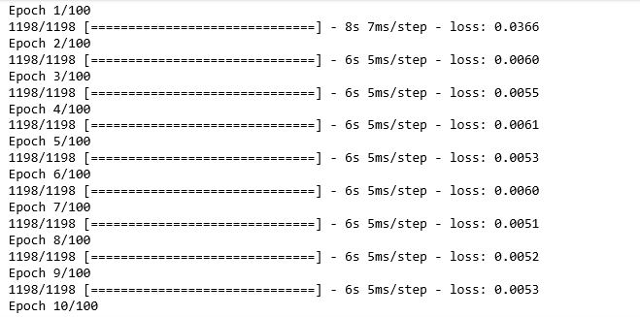
Fitting Data

Slide 21


