Slide 1
IEEE Activities in
Pre University Education
Moshe Kam
IEEE Educational Activities
June 2006

Slide 2
A Few Words about IEEE
IEEE is the largest professional engineering association in the world
  367,000 members in 150 countries
  A 501(c)3 organization in incorporated in New York
Originally concentrating on power engineering and communications IEEE at present spans technical interests across the spectrum of technology
  From nanotechnology to oceanic engineering
In many respects IEEE has become “the steward of Engineering”

Slide 3
What is IEEE?
A membership organization
A major creator and guardian of technical IP
A mechanism to bring people of common technical interests together
  both geographically and disciplinarily
A guardian of the future of Engineering
An implementer of technology-related public Imperatives

Slide 4
What is IEEE?
A membership organization
A major creator and guardian of technical IP
A mechanism to bring people of common technical interests together
  both geographically and disciplinarily
A guardian of the future of Engineering
An implementer of technology-related public Imperatives

Slide 5
Why is IEEE interested in pre-university engineering education
Because it is in our stated and un-stated mission
Because in many IEEE Sections there is marked decline in the interest of young people in Engineering
  This is bad for the future of these communities and would have a negative impact on their standard of living
Because we do not believe the problem is going to be tackled effectively without us
  Industry does not appear to be able to address the problem directly
  Governments do not appear sufficiently concerned (yet)
  Other engineering associations look up to us

Slide 6
What is the Problem?
Flat or declining engineering enrollments in most developed nations
  Coupled with disappointing performance of youth in Mathematics
  E.g., “free fall” in Scandinavia
Insufficient number of engineers and engineering educational programs in most developing countries
  Asia is far behind Europe and the US in number of engineers per capita
Women & minority students conspicuously under-represented
Public perception of engineers/ engineering/ technology is largely misinformed
  Resulting in early decisions that block the path of children to Engineering

Slide 7
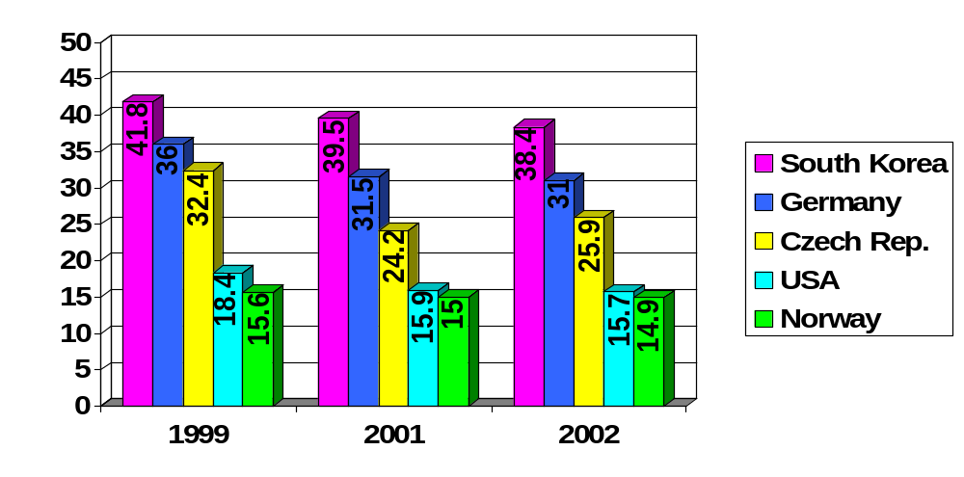
Percentage of Science Degrees Awarded
Science degrees include life sciences, physical sciences, mathematics, statistics, computer sciences, engineering, manufacturing, and building
Source: Organization of Economic Cooperation and Development

Slide 8
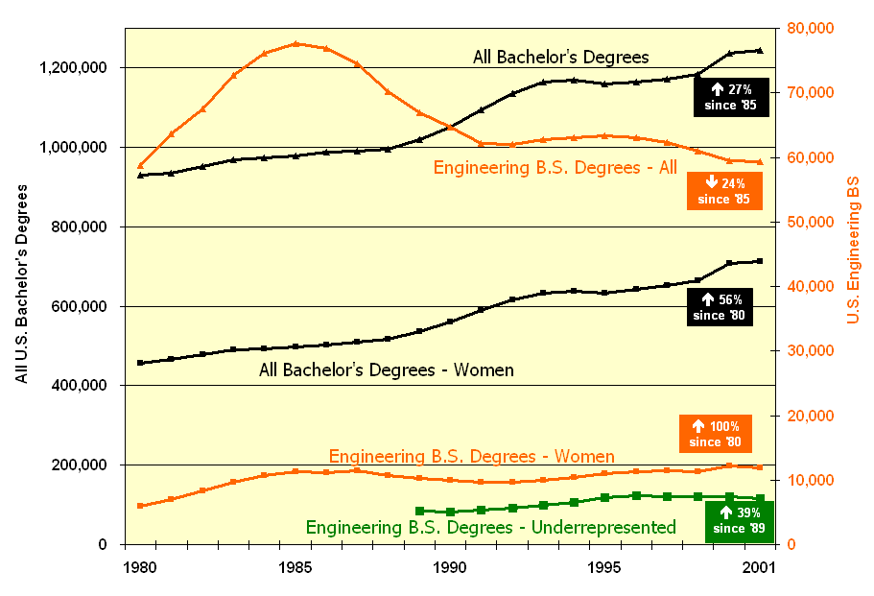
BS Degrees Awarded (US)
Source: U.S. Department of Education, National Center for Education Statistics
Notes:
Retirements of engineers will increase dramatically over the next 20 years, impacting our national competitiveness and our national capacity to perform. This alone creates a national imperative.

Slide 9
Who inside IEEE is active in this area?
The IEEE Educational Activities Board (EAB)
The IEEE Regional Activities Board (RAB)
IEEE-USA

Slide 10
IEEE’s Pre-University Initiative
2005-2006 New Initiative
  “Launching Our Children’s Path to Engineering”
Objectives
  Increase the propensity of young people worldwide to select Engineering as a career path
  Build a sustained public awareness program, led by IEEE, with broad support of corporations and professional associations

Slide 11
Objective 1: Engineering in the classroom
Institutionalization of IEEE Teacher In Service Program
  IEEE Section engineers develop and present technology-oriented projects to local pre-university educators
  Emphasis on volunteer-teacher interaction as opposed to volunteer-student interaction
  Ideally: a sustained program involving several thousand schools every year

Slide 12
Objective 2:
Engineering Associations, Unite!
Center for Pre-University Engineering Education
  A multi-association organization
    With partners such as ASCE, ASME, IEE, SEE
    It is about ENGINEERING, not Electrical Engineering
  Ideally: the resource of choice for pre-university cooperation with Engineering Associations

Slide 13
Objective 2:
Engineering Associations, Unite!
Center for Pre-University Engineering Education
  A multi-association organization
    With partners such as ASCE, ASME, IEE, SEE
    It is about ENGINEERING, not Electrical Engineering
  Ideally: the resource of choice for pre-university cooperation with Engineering Associations
  If we cannot achieve unity we should document the failure and conclude that we are alone to lead the field.

Slide 14
Objective 3: Strong On-line presence
New on-line portals for students, teachers, school counselors, and parents
  Educational and entertaining
    Focused on the audience
  From lesson plans for teachers to games for students
  Ideally: the premier on-line resource on engineering for pre-university students

Slide 15
The Teacher In Service Program
IEEE Section engineers develop and present technology-oriented projects to local pre-university educators
Started at the Florida West Coast Section in 2001
Lesson plans in English and Spanish for teachers and engineers
Lesson plans matched to educational standards

Slide 16
The Teacher In Service Program
IEEE Section engineers develop and present technology-oriented projects to local pre-university educators
Started at the Florida West Coast Section in 2001
Lesson plans in English and Spanish for teachers and engineers
Lesson plans matched to educational standards

Slide 17

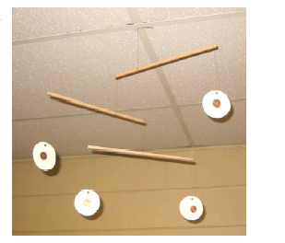
Rotational Equilibrium:
A Question of Balance
Demonstrate the concept of rotational equilibrium, by building and testing a Mobile

Slide 18
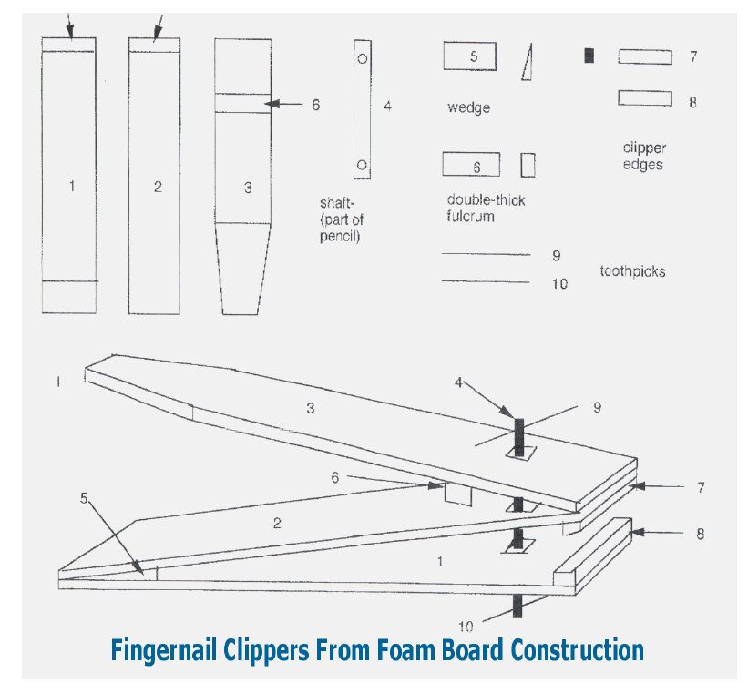
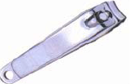
Build working models with household items

Slide 19
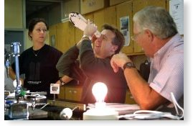
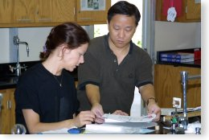
What have we done in 2005?
Pilot training workshop in Region 3
  65 participants, from 23 Sections, in Atlanta, GA
  Whole day workshop on lessons, association with educational standards and working with schools
    Plus half a day of a simulated TISP session
  Feedback: multiple groups organizing training sessions in Southeastern US and Jamaica

Slide 20
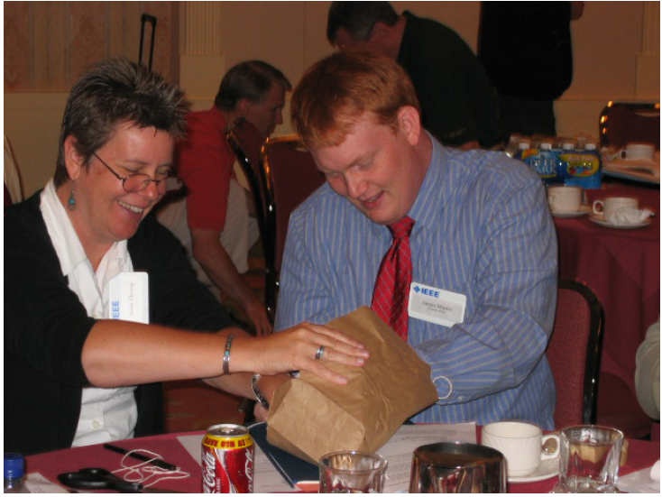
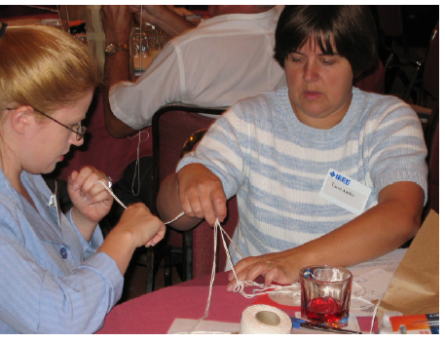
Atlanta, 22 July 2005

Slide 21
What has happened since?

Slide 22
Central North Carolina Section
Performed a TISP presentation to eight (8) Science Teacher Chairs in November 2005
Gave a TISP presentation to high school Science Club students on 8 February 2006
Made another TISP presentation on 15 February to 12 High and Middle school teachers
Have a meeting scheduled to speak with Middle School Teacher Chairs in March 2006
Have 12 local engineers/volunteers committed to TISP
Founded a TISP steering committee for the Section

Slide 23
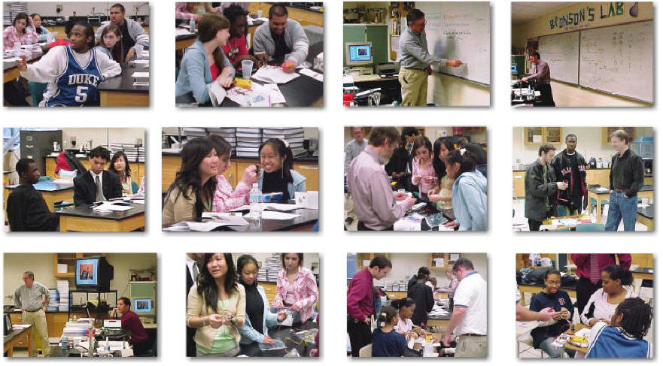
Central North Carolina Section
TISP event

Slide 24
Atlanta Section
Held a TISP workshop on 7 November 2005 at Marietta Center for Advanced Academics
Presented an overview of TISP at a teacher workshop on 11 February 2006
Currently working with a high school teacher to develop hands-on activities for Algebra 1 to show examples of how Algebra is applied in engineering
Working with a local parent to develop new TISP lesson plans
Presenting a TISP workshop to Marietta Center for Advanced Academics (a magnet school for grades 3-5) on 20 February
Presenting TISP modules at the Morningside Elementary Family Science Night on 23 February

Slide 25
Additional impact in Region 3
Florida West Coast Section
  Held a high school TISP presentation on 19 April
    motor controllers
  Held a TISP presentation at the University of Central Florida on April 28
Mississippi Section
Plans a TISP presentation for summer 2006 at a teacher workshop conducted at Mississippi State University
  "Introduction to Engineering for Teachers and Counselors"

Slide 26
What are we doing in 2006?
A Region 3 refresher
Expand to
  Region 1 (Boston, MA)
  Region 4 (Indianapolis, IN)
  Region 8 (South Africa)
  Region 10 (Malaysia)

Slide 27
Sponsors of our activities
  Region 1 (Boston, MA)
  Region 4 (Indianapolis, IN)
  Region 8 (South Africa) RAB
  Region 10 (Malaysia) RAB
IEEE-USA
IEEE-USA

Slide 28
What are we doing in 2006?
Expanding to Industry
  Lockheed Martin is the first participant
Ask IEEE Technical Activities Board (TAB) to develop new lesson plans
  We are also exploring with TAB the idea of parallel conferences to young people next to major established conferences

Slide 29
What will we do in 2007?
Expand to
  Region 2 (Baltimore)
  Region 5 (Denver)
  Region 9 (Argentina)
  Region 10 (Hong Kong)

Slide 30
On Line Portal
Tryengineering.org

Slide 31
The Web provides us with high potential for reachability
A successful portal can become a major resource for students, parents, school counselors, and teachers
  But success is difficult in an ever-crowded medium
Effort needs to be coupled with more modern tools
  Instant messaging, podcasts

Slide 32
What information is needed on line?
We met with school counselors and Engineering Associations
  Need on line tools for identifying formal and informal engineering education opportunities
  Engineering associations that participated in our discussions
    ACM, AIChE, AIAA, ASME, ASCE, IEE, JETS, SAE, SEE, Sloan Career Cornerstone Center

Slide 33
What information is available on line?
We conducted a comprehensive review of engineering education resources
  By EAB and consultants
Conclusions:
  Many “Engineering Resources” are actually focusing on Science and Mathematics
  Resources for teachers are largely inadequate
  Wrong message is sent about the nature of engineering and the life of engineers

Slide 34
From Collegeboard.com: Law
It helps to be… | Are you ready to…
fascinated by the relationship between law and society | engage in intense discussion of thorny legal problems ?

Slide 35
From Collegeboard.com:
Broadcast Journalism
It helps to be… | Are you ready to…
sharp of mind and quick of tongue | learn how to find and interview sources?

Slide 36
From Collegeboard.com:
Civil Engineering
It helps to be… | Are you ready to…
A problem-solver who’s creative, curious, logical, and a fan of math. | Spend hours and hours working on problem sets and design projects?

Slide 37
From Collegeboard.com:
Mechanical Engineering
It helps to be… | Are you ready to…
A fan of science and math, a creative problem solver, and someone who likes to take things apart to find out how they work. | Rely on your math skills? Master difficult scientific concepts? Take on a heavy course load? Spend five years as an undergrad…

Slide 38
From Collegeboard.com:
Electrical Engineering
It helps to be… | Are you ready to…
A fan of science and math who’s curious about the way things work | Spend hours building detailed, complicated systems Try, try, and try again when at first a project doesn’t succeed

Slide 39
Good existing model
Tryscience.org
  “Your gateway to experience the excitement of contemporary science and technology through on and offline interactivity with science and technology centers worldwide.”
  Science is exciting, and it's for everyone!
Partnership between
  IBM
  the New York Hall of Science
  the Association of Science-Technology Centers
  Science centers worldwide

Slide 40
Next step – tryengineering.org
Companion site to tryscience.org
Comprehensive
Ultimate Audience: young people ages 9-18
Designed to convey excitement about engineering and design
  Can-do attitude
  Hands-on experience
  Positive image of the engineering process and engineering
“Discover the creative engineer in you”

Slide 41
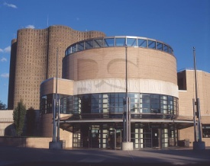

Tryengineering.org
A portal for students, parents, school counselors and teachers
School search By location, program, environment | Day in the life of an engineer
Hands-on and virtual projects | Lesson plans for teaching engineering design
Ask an engineer Brought to you by SAE | Ask a student Brought to you by JETS
Games | Summer camps, internship opportunities

Slide 42
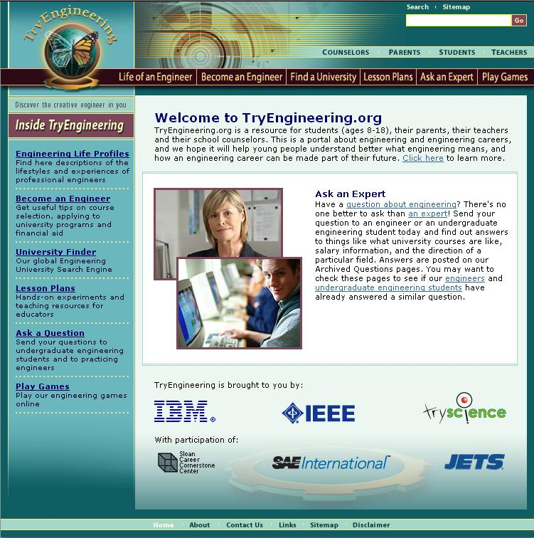

Exploring TryEngineering
Life of an Engineer Find profiles of engineering disciplines
Becoming an Engineer Learn about preparation tips, Degree Fields
University Finder– Search a database of accredited programs
Lesson Plans Download activities that are aligned to Standards with Engineering Content
Ask an Expert Pose questions to Engineers or Undergraduate Students
Play Games
Find links to online game
Notes:
The portal has several features of interest to school counselors, educators, parents and students.
Of interest to the school counselor: The university finder allows the visitor to search for accredited programs in US and Canada.Life of an Engineer has a snapshot in time of an engineers work, while becoming an engineer has the preparation tips.
To the Educator – The lesson plan section in particular provides activities for the classroom
To the Parent and Student – The university finder, life of an engineer, become and enginer, ask an expert, and play games section.
Ask an Expert allows the visitor to pose questions to the engineering professional and/or undergraduate students.

Slide 43
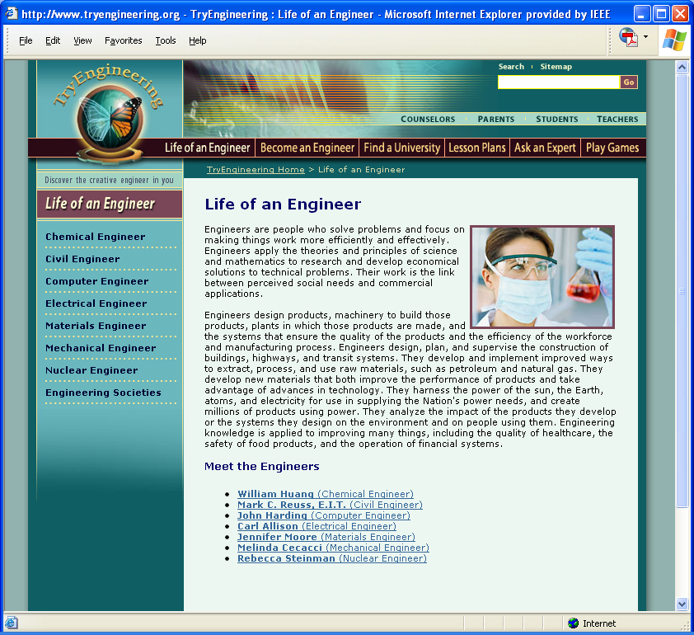

Slide 44
Unique features
School search
Ask an Engineer
  To be managed by SAE
Ask a Student
  To be managed by JETS

Slide 45
Current status
TryEngineering.org is on line
  Please visit and provide us with feedback
We will have a “quiet launch” between now and late August
  We already had several thousand visitors in the first week
Advertising campaign in late August – early September

Slide 46






Our partners
The IEEE Foundation
United Engineering Foundation
ASME
ASCE
National Association for College Admission Counseling (NACAC)
American School Counselor Association (ASCA)
IBM and the New York Hall of Science
National Academy of Engineering

Slide 47
Design and Build a
Better Candy Bag
Region 4
Indianapolis, Indiana
Brad Snodgrass, Central Indiana Section
Douglas Gorham, Educational Activities

Slide 48
Principles & Standards for School Mathematics
Geometry:
  Use visualization, spatial reasoning, and geometric modeling to solve problems
  Analyze characteristics and properties of two- and three-dimensional geometric shapes and develop mathematical arguments about geometric relationships
Problem Solving:
  Recognize and apply geometric ideas in areas outside of the mathematics classroom
  Apply and adapt a variety of appropriate strategies
Communication:
  Communicate mathematical thinking coherently and clearly to peers, teachers, and others

Slide 49
National Science
Education Standards
Standard E: Science and Technology
Abilities to distinguish between natural objects and objects made by humans
Abilities of technological design
Understandings about science and technology
Communicate the process of technological design
Notes:
HO #6 – Standards Comparison

Slide 50
Standards for
Technological Literacy
Students will develop an understanding of…
Standard 8. the attributes of design.
Standard 10. the role of troubleshooting, research and development, invention and innovation, and experimentation in problem solving.
Students will develop…
Standard 11. the abilities to apply the design process.
Standard 20. an understanding of and be able to select and use construction technologies.

Slide 51
Outline and Procedures
Divide into pairs
Brainstorm and create a sketch of your design
Build a model of your design with given materials
Calculate the approximate volume of the bag
Predict how much weight the bag might hold
Test the strength of your bag
Discuss and agree upon a redesigned bag
Rebuild your prototype bag
Retest the strength of your bag
Answer reflection questions as a team
Notes:
Material bags for teams to build…

Slide 52
Reflection
What was one thing you liked about your design?
What is one thing you would change about your design based on your experience?
How did the materials provided impact your design?
How might you incorporate this activity into your classroom instruction?

