Slide 1
STUDENTIFY
Presented By -
Asif Hossain
Anowar Hossain Sardar
Subhadip Pradhan

Slide 2
About -
This is a Web application of student database management system of a particular
Institute. Which will help college authority to store and manage data (student’s details)
of registered students. It will be easy to access and manage data.

Slide 3
Technology Used
Visual Studio Code IDE
Django Framework
Python ,Html ,CSS
MySQL
XAMPP Control Panel

Slide 4
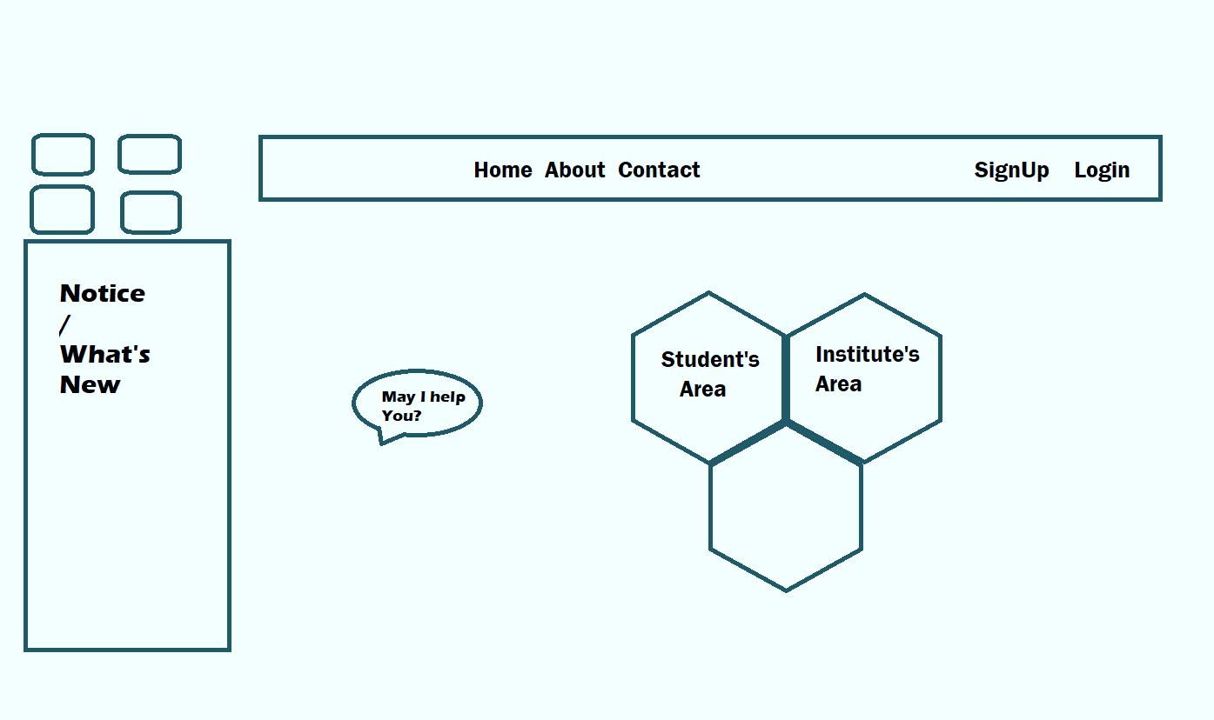


Home Page

Slide 5
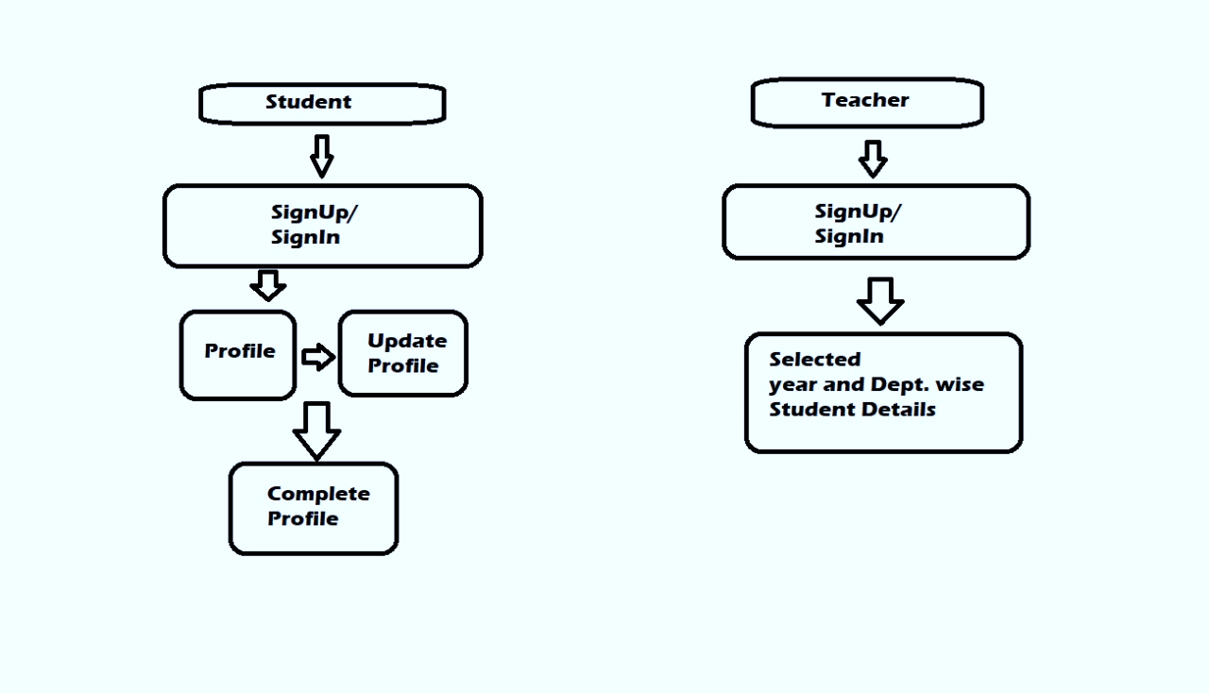
Block Diagram

Slide 6
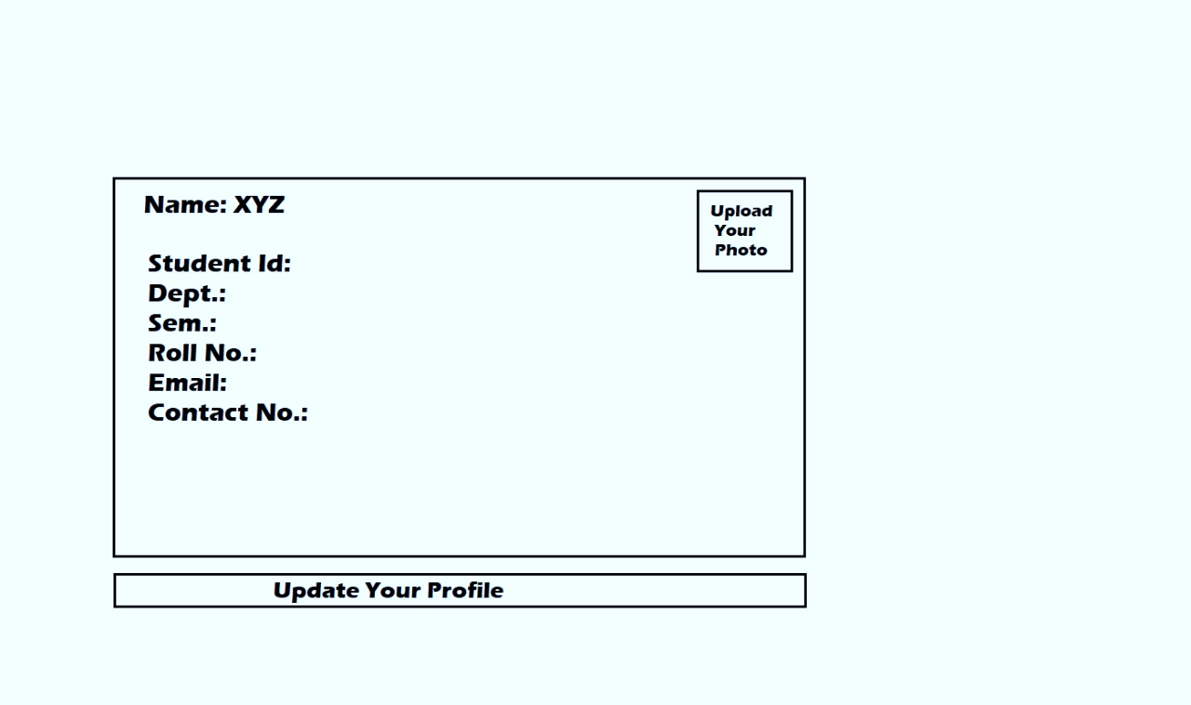
Profile Page

Slide 7
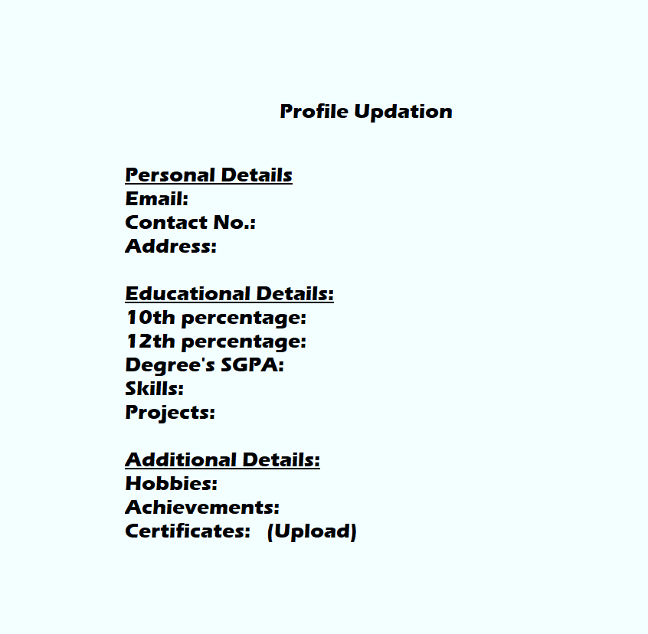
Profile Updation Page

Slide 8
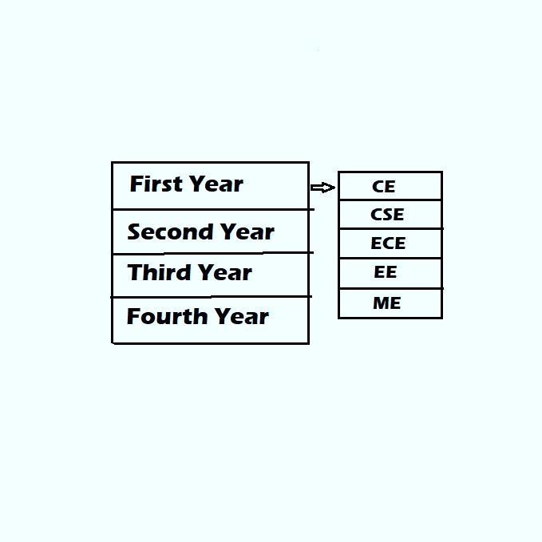
Institute Page

Slide 9
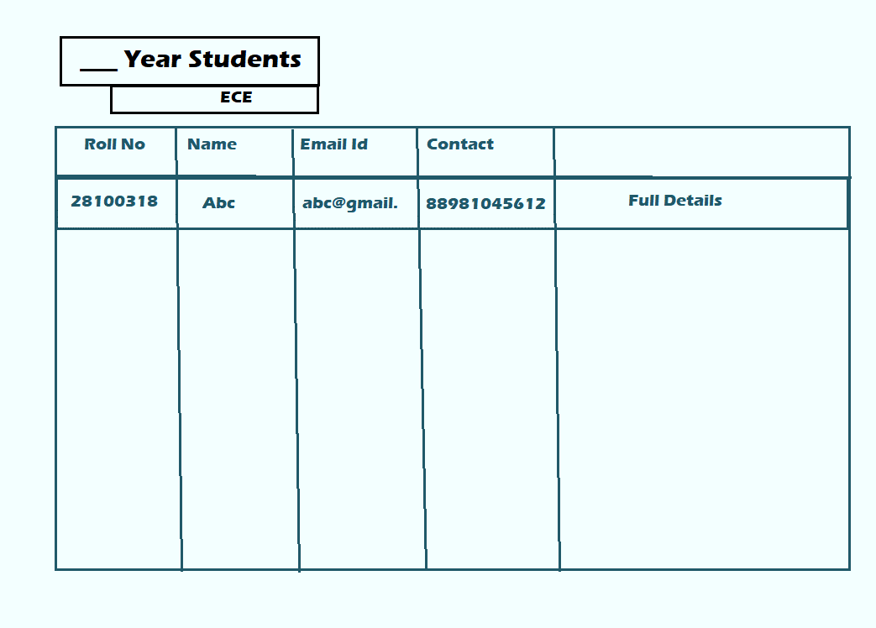
Database Page

Slide 10
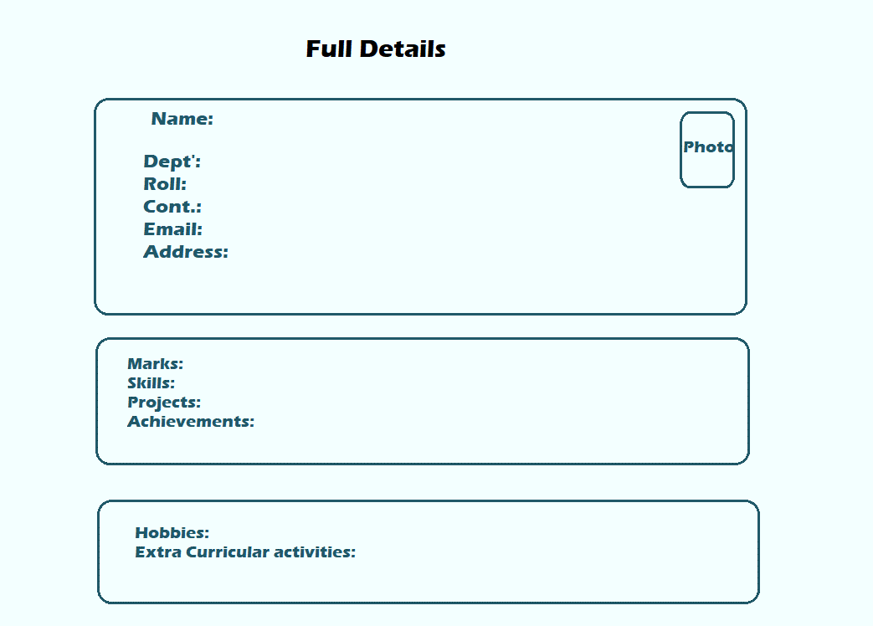
Complete Profile

Slide 11
Thank You

