Slide 1
Optimized Localization of Underwater Wireless Sensors Using Differential Evolution Algorithm
Presented By
Supervised By
May 9, 2019

Slide 2
OUTLINE
Research Problem
Efficiency
Differential Evolution
Applications
Working Mechanism
Limitations
Simulation and Data Analysis
Future Works

Slide 3
Localization
Determining one’s position precisely on the surface of the earth.
Underwater Wireless Sensor Networks (UWSNs)
Contains surface stations and Autonomous
Underwater Vehicles (AUVs) along with the underwater sensor nodes.
Localization is needed for meaningful interpretation of the measured data using underwater sensors.

Slide 4
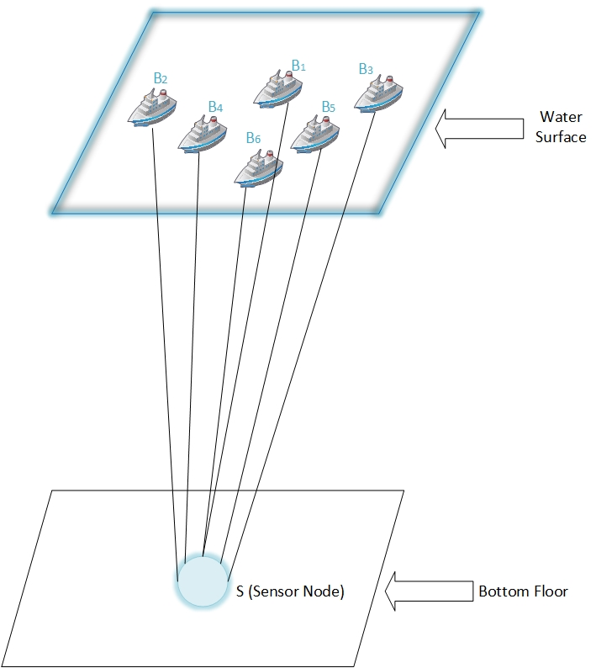
RESEARCH PROBLEM
Finding a new method to determine the co-ordinates of submerged sensors with a single beacon from different positions.
Using Differential Evolution algorithm in this regard instead of Multilateration or Cayley-Menger determinant.

Slide 5
DIFFERENTIAL EVOLUTION
A branch of evolutionary programming developed by Rainer Storn and Kenneth Price in 1997 for optimization problems.
Meta-heuristic algorithm with stochastic search technology.
Faster convergence, fewer parameters and more robustness.
Effect of crossover and mutation is the main difference between DE and Genetic Algorithm.
Four main parts: Initialization, Mutation, Crossover and Selection.

Slide 6



Control Parameters of DE Algorithm
Three main control parameters-
The mutation factor $F.$
The crossover constant $Cr$.
The population size $NP$.

Slide 7
Mutation Factor
Divergence operation.
Good initial choice of F is 0.5
Crossover Rate
Controls how many parameters are changed in a population member.
Population Size
Small population may lead to premature convergence.
Large population may lead to slower convergence.

Slide 8
WORKING MECHANISM
Initialization of Vectors
Difference-vector based mutation
Crossover or Recombination
Selection

Slide 9
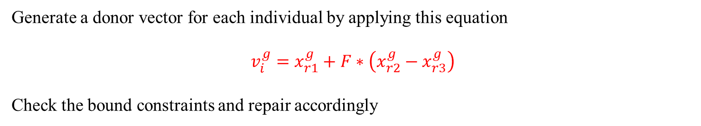
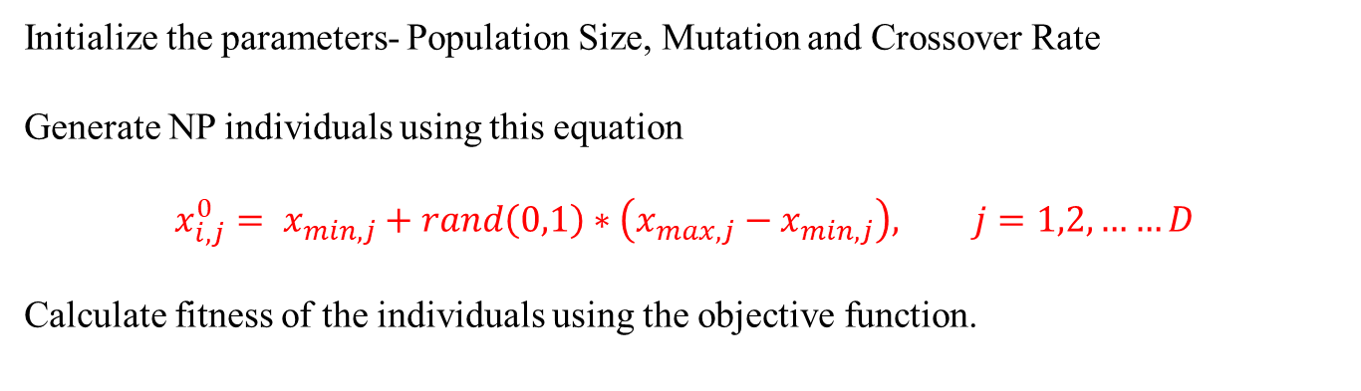

WORKING MECHANISM
Mutation
Selection
Initialization
Crossover
Calculate fitness of each trial vector using the objective function
Generate trial vector using this equation
$$u_{i,j}^{g}=\left\{\begin{aligned}v_{i,j}^{g} if rand\left(0,1\right)≤CR j=j_{rand} \\ x_{i,j}^{g}, \end{aligned}\right.$$
where $CR$ is called cross over rate, $CR∈[0,1]$, $j_{rand}$ is a random integer in the range 1 to $D$.
Greater crossover rate for higher convergence
Generate a donor vector for each individual by applying this equation
$$v_{i}^{g}=x_{r1}^{g}+F∗\left(x_{r2}^{g}−x_{r3}^{g}\right)$$
Check the bound constraints and repair accordingly
Initialize the parameters- Population Size, Mutation and Crossover Rate
Generate NP individuals using this equation
$$x_{i,j}^{0}= x_{min,j}+rand\left(0,1\right)∗\left(x_{max,j}−x_{min,j}\right), j=1,2,……D$$
Calculate fitness of the individuals using the objective function.
S
or
Select the better one between trial vector and target vector
otherwise
C
M
I

Slide 10
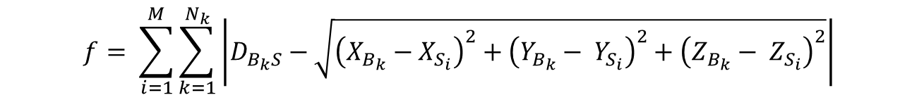
Objective Function
To check fitness of the population in Initialization stage.
To select the fittest result in Selection stage.
$$f= \sum_{i=1}^{M}{\sum_{k=1}^{N_{k}}{\left|D_{B_{k}S}−\sqrt{{\left(X_{B_{k}}−X_{S_{i}}\right)}^{2}+{\left(Y_{B_{k}}− Y_{S_{i}}\right)}^{2}+{\left(Z_{B_{k}}− Z_{S_{i}}\right)}^{2}}\right|}}$$

Slide 11

SIMULATION
Simulation done for 200, 250, 300 iterations.
Mutation factor considered 0.5, 0.6, 0.8
Crossover rate considered 0.6, 0.8, 0.9
Population size 50 in all cases
Best result achieved for $F=0.6$ and $C_{r}=0.9$

Slide 12
DATA ANALYSIS
Iteration | F = 0.6, C = 0.9
 | x | Y | Z | Error Rate | Average
 |  |  |  |  | X | Y | Z
200 | 81.98 | 41.20 | 47.52 | 0.04 | 82.45 | 41.85 | 48.24
 | 83.46 | 39.59 | 46.92 | 0.04
 | 81.62 | 41.72 | 49.83 | 0.06
 | 83.36 | 40.75 | 48.38 | 0.04
 | 80.31 | 42.01 | 48.57 | 0.08
250 | 82.13 | 41.88 | 47.99 | 0.10 | 82.03 | 41.15 | 48.90
 | 82.46 | 40.89 | 49.51 | 0.05
 | 82.94 | 41.53 | 48.53 | 0.06
 | 82.66 | 40.96 | 49.58 | 0.06
 | 82.04 | 40.50 | 48.87 | 0.05
300 | 81.20 | 40.09 | 49.89 | 0.03 | 81.52 | 40.24 | 49.70
 | 81.79 | 39.78 | 48.78 | 0.03
 | 80.93 | 40.15 | 49.45 | 0.02
 | 82.67 | 40.27 | 49.92 | 0.04
 | 81.09 | 41.04 | 49.69 | 0.03

Slide 13
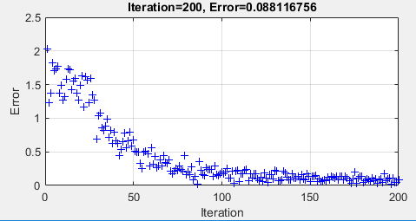
DATA ANALYSIS
m

Slide 14
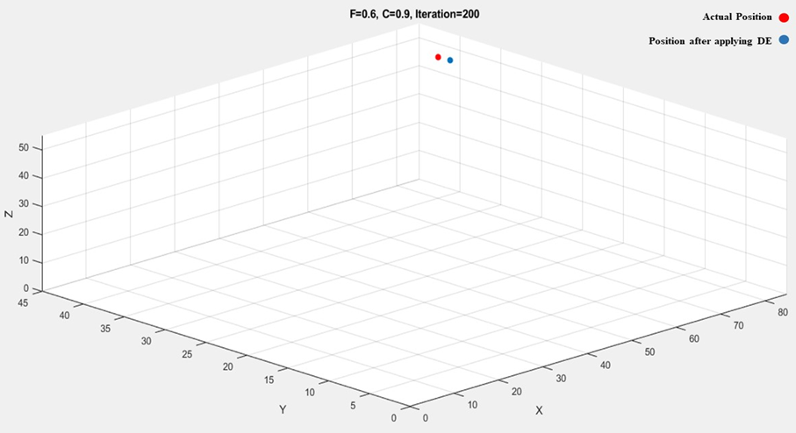
DATA ANALYSIS

Slide 15
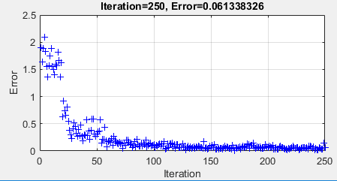
DATA ANALYSIS
m

Slide 16
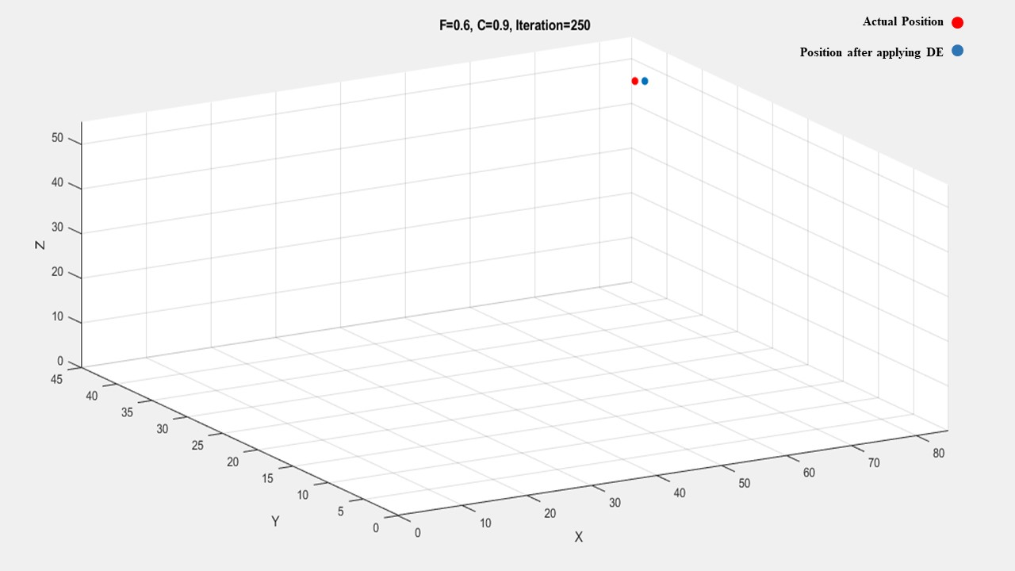
DATA ANALYSIS

Slide 17
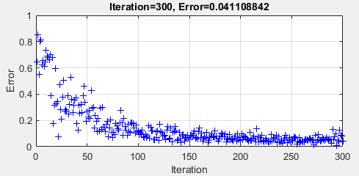
DATA ANALYSIS
m

Slide 18
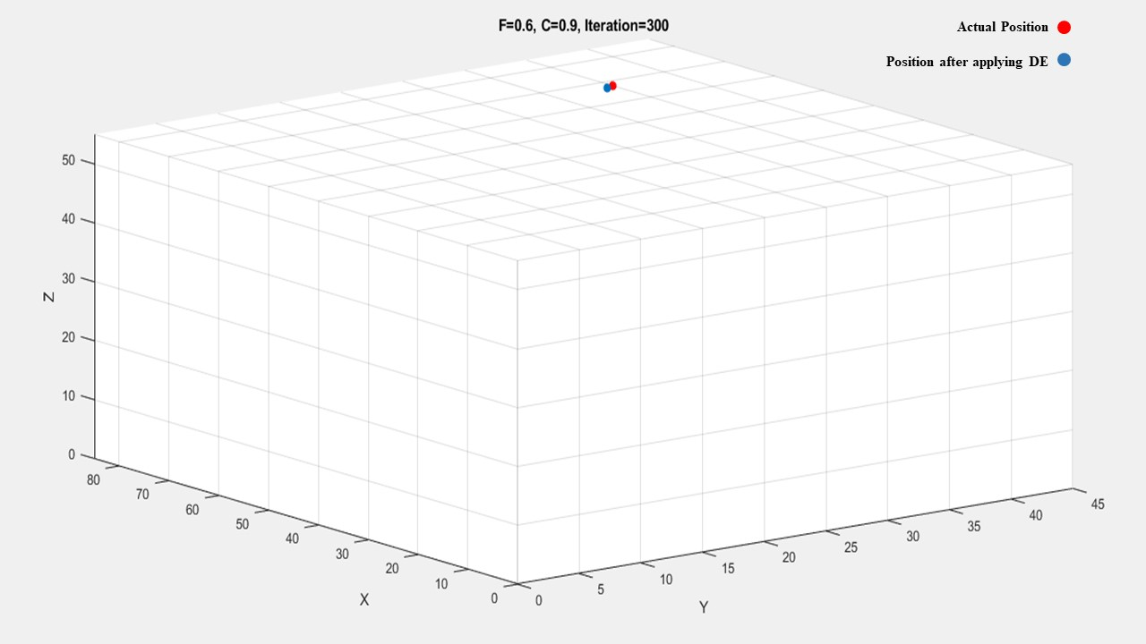
DATA ANALYSIS

Slide 19
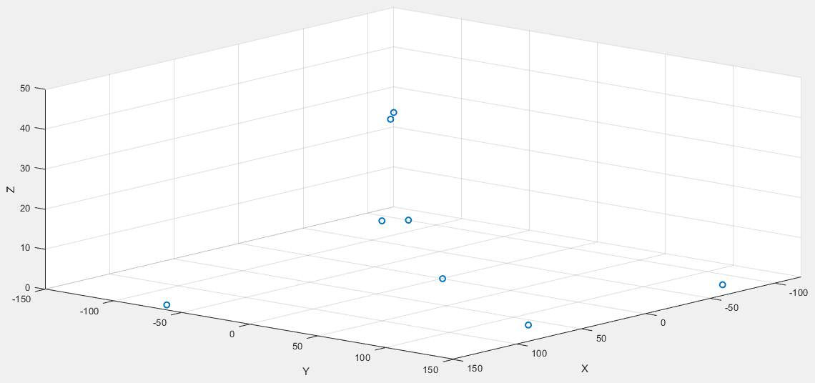
DATA ANALYSIS
Beacon Node
Position after applying DE
Actual Position

Slide 20
COMPARISON
Differential Evolution |  | Cayley Menger
X | Y | X | Y
80.83 | 40.58 | 78.42 | 39.21
81.25 | 41.44 | 77.52 | 38.76
82.32 | 42 | 80.99 | 40.49
81.18 | 41.26 | 79.48 | 39.74
80.35 | 42.41 | 80.15 | 40.07
83.19 | 40.96 | 81.25 | 40.62
79.29 | 39.42 | 81.91 | 40.95
83.28 | 40.72 | 80.5 | 40.25
79.15 | 42.38 | 79.47 | 39.73
81.54 | 42.5 | 80.3 | 40.15

Slide 21
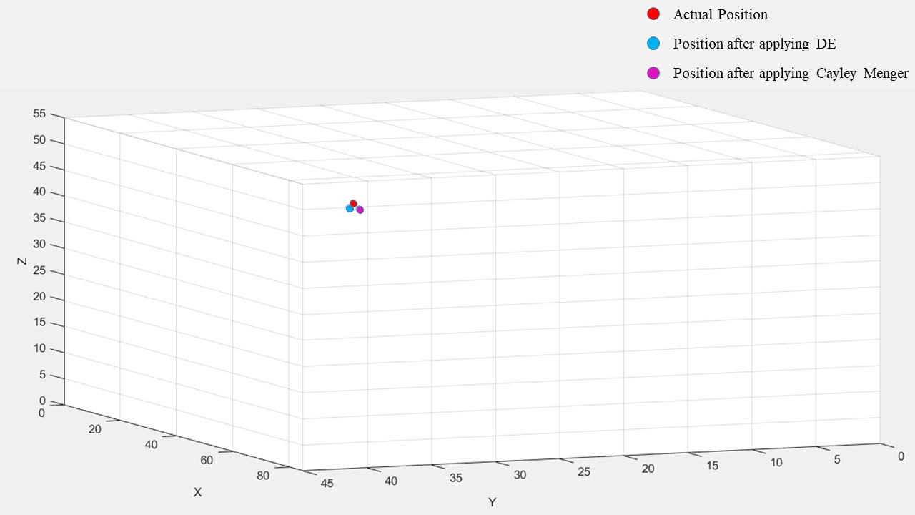
DATA ANALYSIS

Slide 22
EFFICIENCY
Analyzing the results, it can be said that more iterations give better result.
98%
96%
95%
Iteration = 300
Iteration = 250
Iteration = 200

Slide 23
APPLICATIONS
Submarine Track
Finding lost object
Black Box Track
Finding lost ship
Oceanographic Data Collection
Estuary Monitoring
Autonomous underwater vehicle control
Robot Navigation

Slide 24
LIMITATIONS
Works only for one sensor node at a time
Needs much higher iterations to get the most suited result
100% accuracy is hard to achieve

Slide 25
FUTURE WORKS
Implementing the method using only one position of the beacon node
Locating multiple sensor nodes at a time

Slide 26
REFERENCES
J. H. Cui, J. Kong, M. Gerla, and S. Zhou, "The challenges of building mobile underwater wireless networks for aquatic applications," Network, IEEE, vol. 20, pp. 12-18, 2006
H. P. Tan, R. Diamant, W. K. G. Seah, and M. Waldmeyer, "A survey of techniques and challenges in underwater localization," Ocean Engineering, vol. 38, pp. 1663-1676, 2011.
J. Kennedy R. Eberhart, Particle swarm optimization, Neural Networks, 1995. IEEE International Conference on Neural Networks, 4 (1995) 1942-1948.
S. Zhao, S. Chai and B. Zhang, "Dynamic differential evolution strategy localization for Wireless Sensor Networks in three-dimensional space," 2016 35th Chinese Control Conference (CCC), Chengdu,2016, pp. 8423-8427.
Q. Wei and X. Qiu, "Dynamic Differential Evolution algorithm with composite strategies and parameter values self-adaption," 2015 Seventh International Conference on Advanced Computational Intelligence (ICACI), Wuyi,2015, pp. 271-274.
Storn, R., Price, K.: Differential evolution – a simple and efficient adaptive scheme for global optimization over continuous spaces. Journal of Global Optimization 11, 341–359 (1997)

Slide 27
THANK YOU

