Slide 1

DATA ANALYSIS • ASSIGNMENT
Data Analysis Projects
Three tools • One dataset • End-to-end workflow
Excel
Power BI
Python
SQL Bonus
DATASET
Omair_Sales_Data.xlsx
≈ 1,998 transactions • 6 cities • 4 stores • 5 reps • 4 product categories • 2004–2006
Instructor: Dr. Abdullah Al-Omair
01 / 12

Slide 2
OVERVIEW
What you'll deliver
01
Excel Project
Clean, model, and analyze the data inside Excel — finish with a dashboard.
02
Power BI Report
Build a multi-page interactive BI report with DAX measures and slicers.
03
Python Notebook
Use pandas / numpy / matplotlib to clean, analyze, and visualize the data.
04
SQL Bonus
Three SQL questions: Easy, Intermediate, Hard — submit answers and output.
Goal: practice the full data analysis workflow — cleaning, transformation, analysis, visualization.
Takniat Al-Oloum • Data Analysis Projects
2 / 12

Slide 3
DATASET
Omair_Sales_Data — what's inside
Columns (Unclean sheet)
1,998
6
Date
transaction date (Excel serial in raw)
transactions
cities
City
Riyadh, Jeddah, Dammam, Jubail, Abha, Hail
Rep
5 sales reps (some misspellings)
4
2004–06
Store
Othaim, Panda, Lulu, Tamimi
store chains
year range
Prod
Toys, Home, Food, Tech
⚠ Data quality issues to fix
Cost
purchase cost
• Dates stored as Excel serial numbers
• Inconsistent rep names (e.g. 'Mjeeed' vs 'Mjeed')
• Store name variants (e.g. 'Lulu' vs 'Lulu Hyper')
• Missing values & potential outliers in Cost / Sale
Sale
sale price
Takniat Al-Oloum • Data Analysis Projects
3 / 12

Slide 4
PROJECT 1
Excel Analysis
OBJECTIVE
Transform the raw dataset into a clean analytical Excel report.
Tasks
DELIVERABLE
1
Clean the dataset — fix inconsistent values, missing values, formatting.
One Excel file
Prepare the data so it can be used for analysis.
containing:
2
✓ Clean dataset sheet
3
Add useful columns (Profit, Margin, time fields, categories…).
✓ Summary analysis sheet
4
Build summary tables by city, store, rep, and product.
Compute basic statistics — average, min, max, variability.
✓ Final dashboard sheet
5
6
Build a final Excel dashboard with charts and slicers.
.xlsx
Takniat Al-Oloum • Data Analysis Projects
4 / 12

Slide 5
PROJECT 2
Power BI Dashboard
OBJECTIVE
Build an interactive business intelligence report using Power BI.
Tasks
DELIVERABLE
1
Import the dataset into Power BI.
Power BI report
Clean and prepare the data using Power Query.
containing:
2
✓ Cleaned data model
3
Create DAX measures (Total Sales, Total Profit, Average Sale…).
✓ Calculated measures
4
Analyze the dataset by city, product, store, and rep.
Build a multi-page report with meaningful visuals.
✓ Interactive dashboard
5
6
Add filters, slicers, and visual interactions.
.pbix
Takniat Al-Oloum • Data Analysis Projects
5 / 12

Slide 6
PROJECT 3
Python Data Analysis
OBJECTIVE
Use Python to explore, analyze, and visualize the dataset.
Tasks
SUGGESTED LIBRARIES
1
Load the dataset using pandas.
pandas
numpy
2
Perform data cleaning and preprocessing.
matplotlib
plotly
3
Transform the data to prepare it for analysis.
4
Conduct exploratory data analysis (EDA).
DELIVERABLE
Notebook / script
5
Statistical analysis on key variables (Sales, Profit).
Cleaning • Analysis • Visuals • Insights
6
Create visualizations to communicate insights.
.ipynb / .py
Takniat Al-Oloum • Data Analysis Projects
6 / 12

Slide 7
BONUS • SQL
Three SQL questions
Practice writing SQL against the same Omair Sales dataset. Submit your queries and the resulting output.
EASY
Q1 — Foundations
Filtering, sorting, and a single aggregate. SELECT / WHERE / GROUP BY.
INTERMEDIATE
Q2 — Joins & Rank
Multi-dimension grouping and finding the top performer per category.
HARD
Q3 — Window + CTE
Window functions, CTEs, and month-over-month profit growth per city.
Submission: a .sql file with all three queries + a screenshot or CSV of the result.
Takniat Al-Oloum • Data Analysis Projects
7 / 12

Slide 8
SQL • EASY
EASY
Q1 — Total sales by city
QUESTION
For each city, return the total Sale and total Profit. Sort the results by total profit (highest first).
EXPECTED OUTPUT
City | TotalSales | TotalProfit
----------+--------------+------------
Riyadh | ... | ...
Jeddah | ... | ...
... | ... | ... (6 rows total)
Hints → GROUP BY • SUM() • ORDER BY ... DESC
Takniat Al-Oloum • Data Analysis Projects
8 / 12

Slide 9
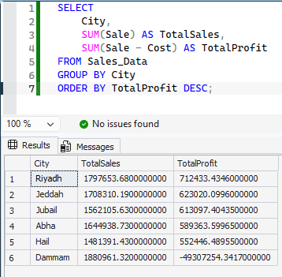
SQL • EASY
EASY
Q1 — Total sales by city
QUESTION
SELECT
City,
SUM(Sale) AS TotalSales,
SUM(Sale - Cost) AS TotalProfit
FROM Sales_Data
GROUP BY City
ORDER BY TotalProfit DESC;
Takniat Al-Oloum • Data Analysis Projects
8 / 12

Slide 10
SQL • INTERMEDIATE
INTERMEDIATE
Q2 — Top rep per product category
QUESTION
For each product category (Prod), find the sales rep with the highest total profit, along with that profit amount. Return one row per product category.
EXPECTED OUTPUT
Prod | Rep | TotalProfit
-------+-----------+--------------
Toys | ... | ...
Home | ... | ...
... | ... | ... (4 rows total)
Hints → GROUP BY Prod, Rep • RANK() / ROW_NUMBER() OVER (PARTITION BY Prod ORDER BY ... DESC)
Takniat Al-Oloum • Data Analysis Projects
9 / 12

Slide 11
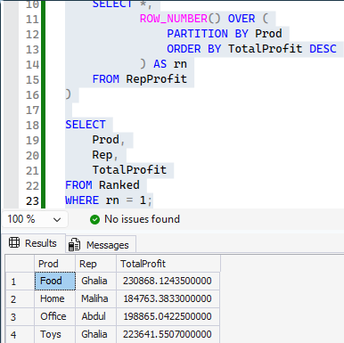
SQL • INTERMEDIATE
INTERMEDIATE
Q2 — Top rep per product category
QUESTION
WITH RepProfit AS (
SELECT
Prod,
Rep,
SUM(Sale - Cost) AS TotalProfit
FROM Sales_Data
GROUP BY Prod, Rep
),
Ranked AS (
SELECT *,
ROW_NUMBER() OVER (
PARTITION BY Prod
ORDER BY TotalProfit DESC
) AS rn
FROM RepProfit
)
SELECT
Prod,
Rep,
TotalProfit
FROM Ranked
WHERE rn = 1;
Takniat Al-Oloum • Data Analysis Projects
9 / 12

Slide 12
SQL • HARD
HARD
Q3 — Month-over-month profit growth per city
QUESTION
For each City and Month, return total profit and the % change vs. the previous month for that same city. Show only rows where the previous month exists.
EXPECTED OUTPUT
City | YearMonth | MonthlyProfit | PrevMonthProfit | MoMGrowthPct
---------+--------------+-----------------+-------------------+----------------
Riyadh | 2005-02-01 | ... | ... | ...
Riyadh | 2005-03-01 | ... | ... | ...
... | ... | ... | ... | ...
Hints → CTE • DATEFROMPARTS / EOMONTH • LAG() OVER (PARTITION BY City ORDER BY YearMonth) • NULLIF()
Takniat Al-Oloum • Data Analysis Projects
10 / 12

Slide 13
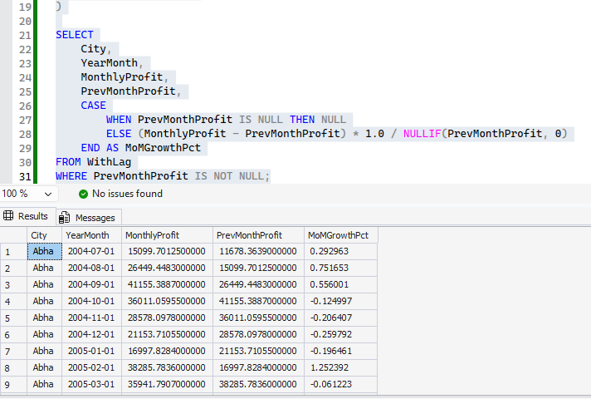
SQL • HARD
HARD
Q3 — Month-over-month profit growth per city
QUESTION
WITH MonthlyProfit AS (
SELECT
City,
DATEFROMPARTS(YEAR(Date), MONTH(Date), 1) AS YearMonth,
SUM(Sale - Cost) AS MonthlyProfit
FROM Sales_Data
GROUP BY
City,
DATEFROMPARTS(YEAR(Date), MONTH(Date), 1)
),
WithLag AS (
SELECT *,
LAG(MonthlyProfit) OVER (
PARTITION BY City
ORDER BY YearMonth
) AS PrevMonthProfit
FROM MonthlyProfit
)
SELECT
City,
YearMonth,
MonthlyProfit,
PrevMonthProfit,
CASE
WHEN PrevMonthProfit IS NULL THEN NULL
ELSE (MonthlyProfit - PrevMonthProfit) * 1.0 / NULLIF(PrevMonthProfit, 0)
END AS MoMGrowthPct
FROM WithLag
WHERE PrevMonthProfit IS NOT NULL;
Takniat Al-Oloum • Data Analysis Projects
10 / 12

Slide 14
GRADING
How your work will be evaluated
25%
Data Cleaning
Correctness of cleaning steps, handling of nulls and outliers, type fixes.
25%
Analysis Depth
Useful aggregations, statistics, and meaningful breakdowns.
25%
Visualization
Clarity, choice of chart types, dashboards that actually answer questions.
15%
Insights & Storytelling
Written conclusions tied to the numbers, not just charts.
10%
Code & File Quality
Readable code, organized sheets, clean .pbix model.
Takniat Al-Oloum • Data Analysis Projects
11 / 12

Slide 15
SUBMISSION
How to submit
FOLDER STRUCTURE
FINAL CHECKLIST
📁 YourName_DataAnalysis/
├── 📊 excel_project.xlsx
├── 📈 powerbi_report.pbix
├── 🐍 python_analysis.ipynb
└── 🗄️ sql_bonus.sql
☐ Excel — clean data + summary + dashboard
☐ Power BI — model + measures + dashboard
☐ Python — cleaning + EDA + visuals + insights
☐ SQL — three answered questions + outputs
☐ Brief written conclusions for each project
✓ One zipped folder per student
Each project should demonstrate your
✓ Filenames in English, no spaces
analytical thinking
✓ Each project standalone & runnable
and ability to work with data.
Good luck — and have fun with it!
Takniat Al-Oloum • Data Analysis Projects
12 / 12

