Slide 1





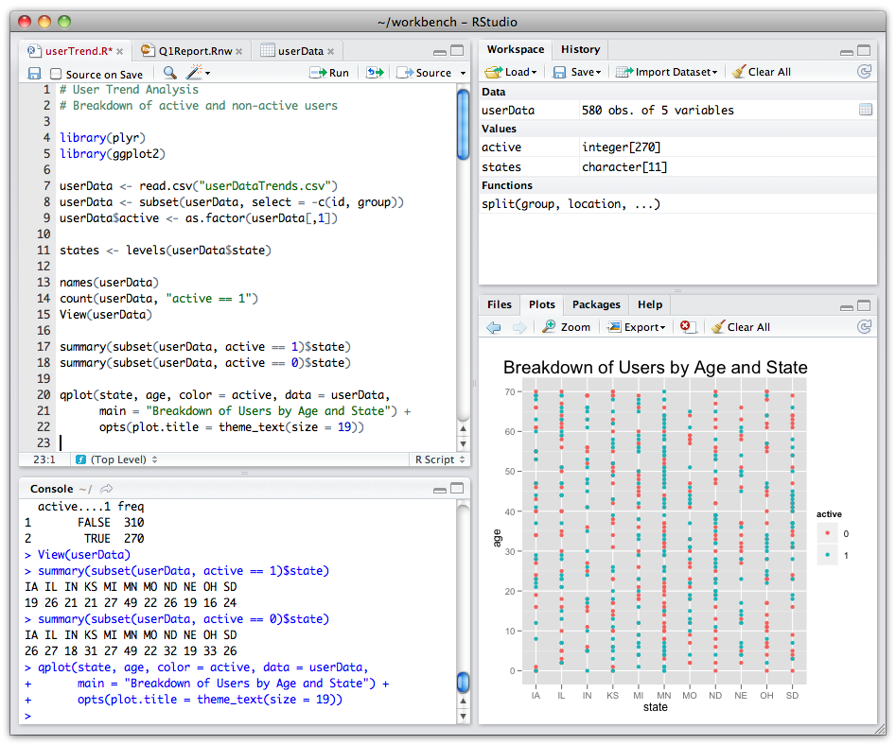




USETHIS
GIT
GITHUB
RSTUDIO
OTHER DEVELOPPER
CRAN
USER
YOU

Slide 2
USETHIS
GIT
GITHUB
RSTUDIO
OTHER DEVELOPPER
CRAN
USER
YOU

Slide 3
USETHIS
GIT
RSTUDIO
YOU

Slide 4
USETHIS
RSTUDIO
YOU

