Slide 1





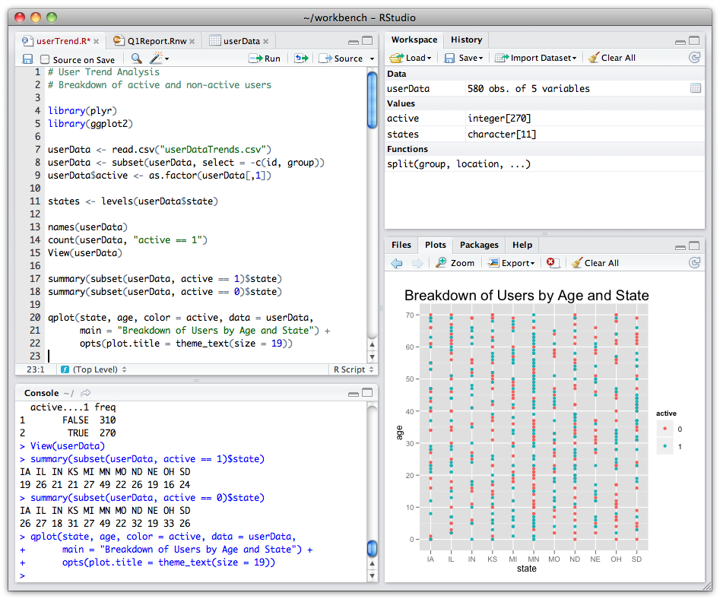




USETHIS
GIT
GITHUB
RSTUDIO
OTHER DEVELOPPER
CRAN
USER
YOU

