Slide 1
React.js
Krishna Aryal

Slide 2
Table of Contents
Introduction
Prerequisites
Installation & Configuration
First Project
Hello world
Java Script Basics
ECMAScript
Components
Routing
Advanced
API
Redux

Slide 3
Introduction
Open-source front end JavaScript library that is used for building UI components and user interfaces created by Facebook in 2013.
Commonly used as the code base for SPA’s (Single Page Applications).
Partial control update – fast
Large community for support

Slide 4
Introduction
Mobile app development with React-Native
Companies used React in their production Netflix, Facebook, Instagram, Airbnb, Reddit, Dropbox, and Postmates.

Slide 5
Prerequisites
HTML, CSS, JavaScript basics
ES6 Basics
Node & Node Modules
MongoDB

Slide 6
Installation & Configuration
Download and install Node.js
https://nodejs.dev/download
Chrome Extension
React Developer Tools
Postman – API Testing Tool
Visual Studio Code
VS Code ES7 React/Redux/React-Native/JS snippets
Thunder Client – API Testing Tool
Bracket Pair Color DLW
Auto Rename Tag
Prettier Formatter for Visual Studio Code
Live Server
Material Icon Theme

Slide 7
Create React App-1
react-0\index.html

Slide 8
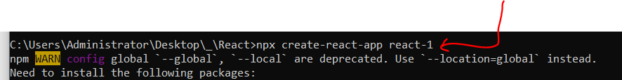
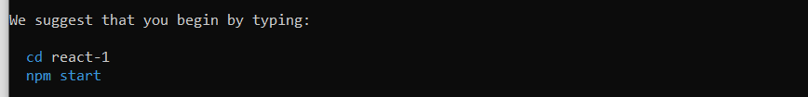
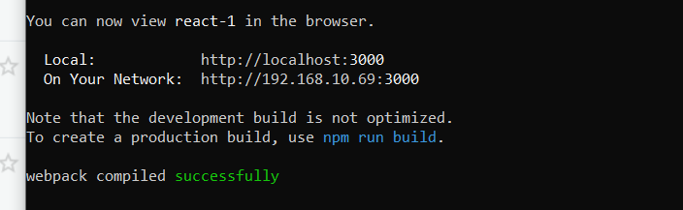
Create React App-2
npx create-react-app react-1

Slide 9
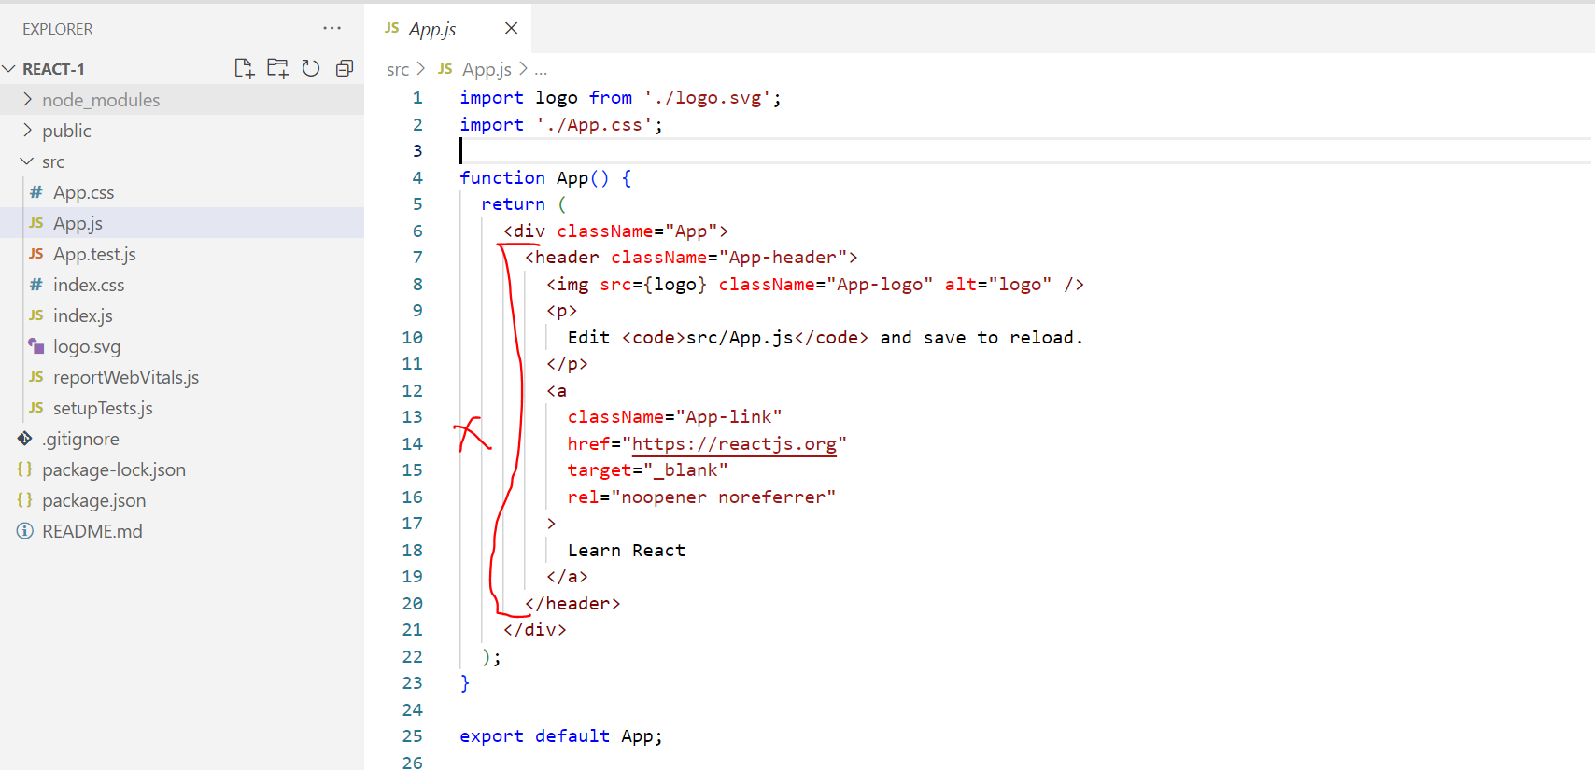
Create React First App

Slide 10
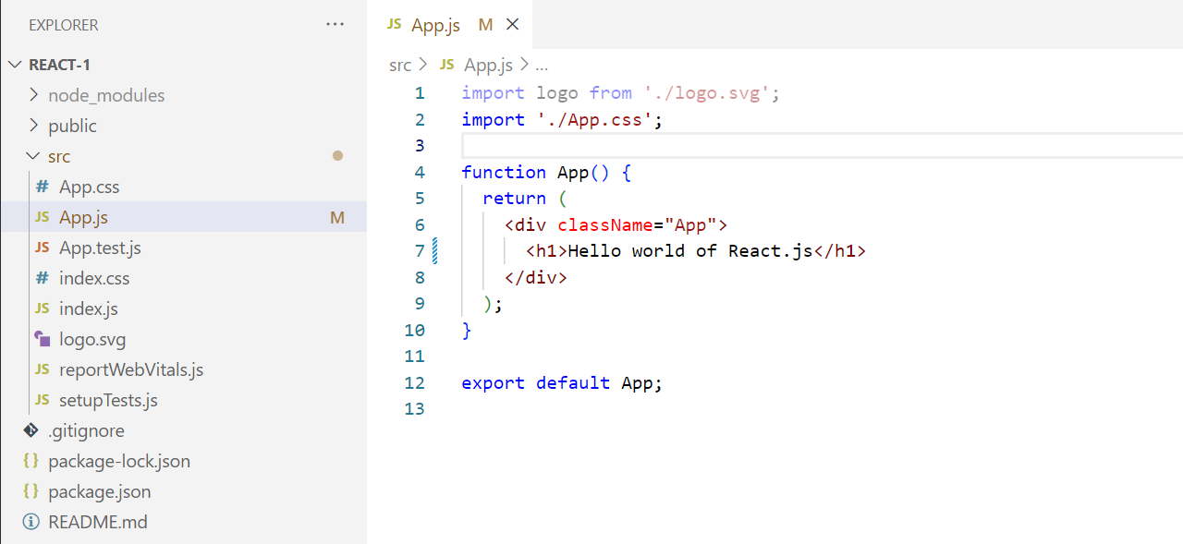
Create React First App

Slide 11
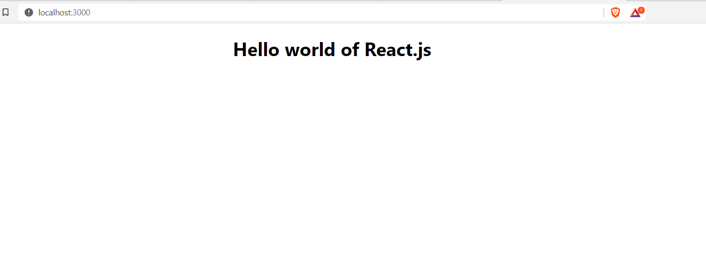
Create React First App

Slide 12
Java Script Basics

Slide 13

ECMAScript
Introduction
ES Versions
New in ES-6
let, const keyword
Default parameter
Rest parameter
Spread operator
for of
Template Literals `${variable}`
Array de-structuring
Object de-structuring

Slide 14
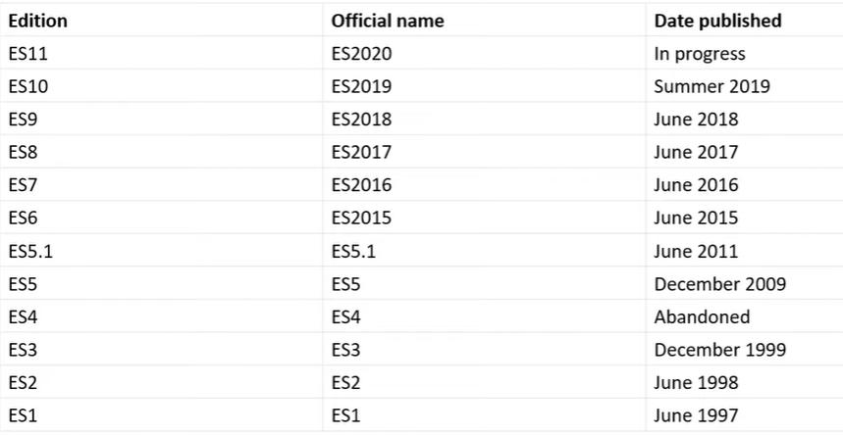
ES versions

Slide 15
Module
Case-1
<script src=“./file1.js”></script> : declare variable
<script src=“./file1.js”></script> : create a function
<script src=“./file1.js”></script> : call a function
Case-2
export
import
default
agregate

Slide 16
Introduction
Introduction
ES Versions
New in ES-6
let, const keyword
Default parameter
Rest parameter
Spread operator
for of
Template Literals `${variable}`
Array de-structuring
Object de-structuring

Slide 17
OOPs
Understand Object Oriented Concept in real life
Difference between procedural and object oriented
Four pillar of Object Oriented
Object Oriented programming in JavaScript till ES5
What’s new in ES6

Slide 18
Class, Object, and Inheritance
Object
Class
Inheritance

Slide 19
Class, Object, and Inheritance
Every object has
Features or Properties
Actions
Raj Rai
Name, address, phone
Walk, talk, and sleep
Hyundai i20
Color, price
Start, go, stop

Slide 20
Features of OOP
1. Encapsulation
Wrapping up data and member function (method) together into a single unit.
2. Abstraction
Visibility of features of an entity/object to the outside world (consumer) to hide the irrelevant info.
3. Inheritance
Allows a class (subclass) to acquire the properties and behavior of another class. Helps to reuse, customize, and enhance the existing code.

Slide 21
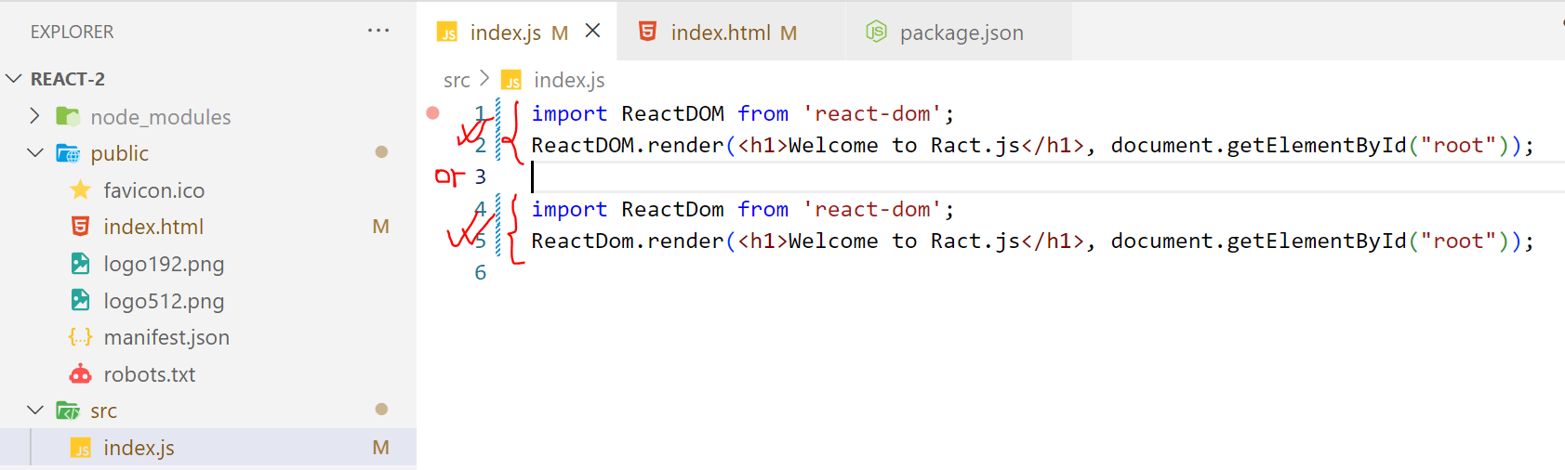
Creating new app - manually

Slide 22
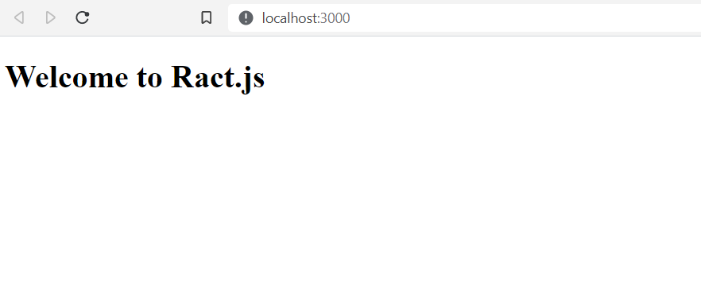
Creating new app - manually

Slide 23
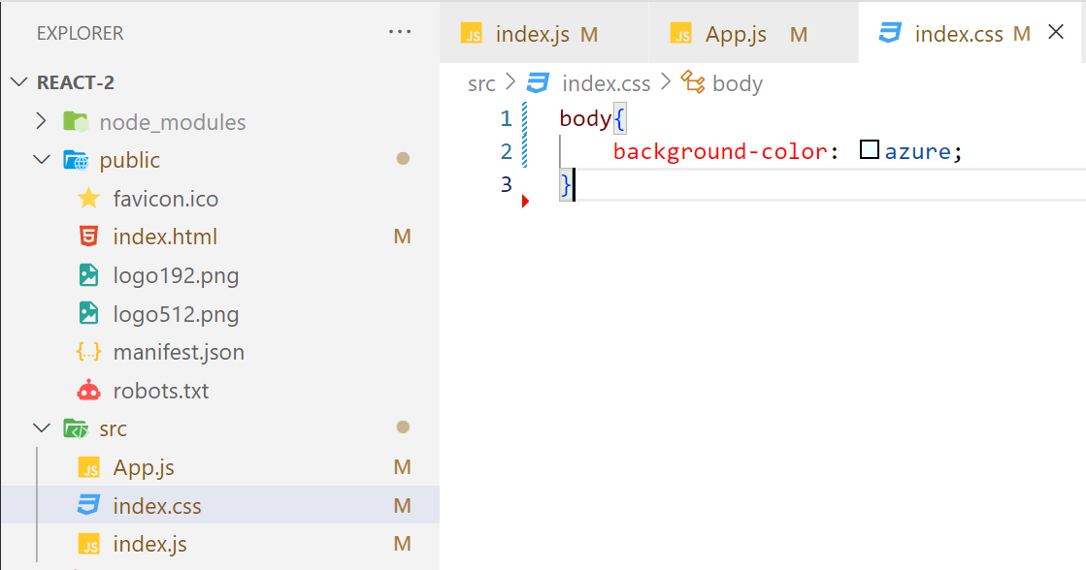
Creating new app - manually

Slide 24
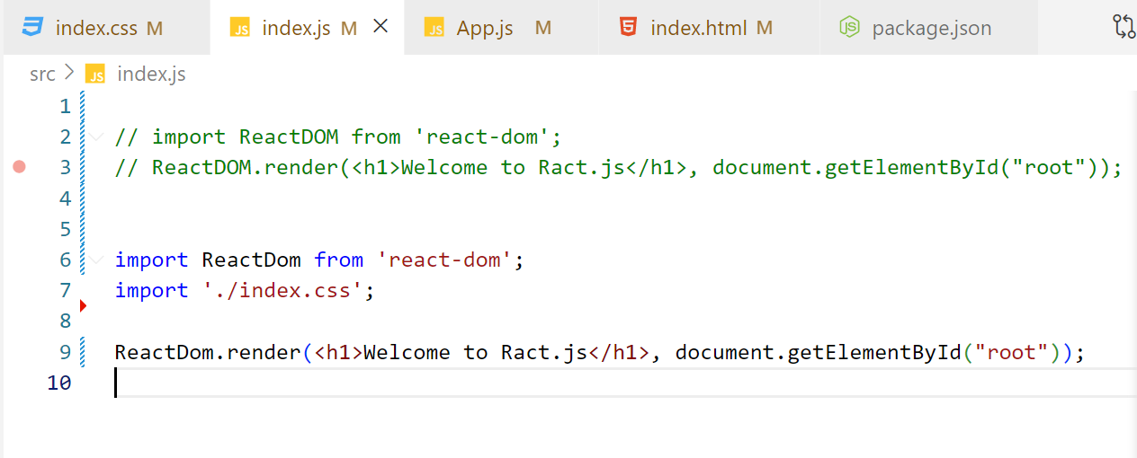
Creating new app - manually

Slide 25
Creating new app - manually

Slide 26
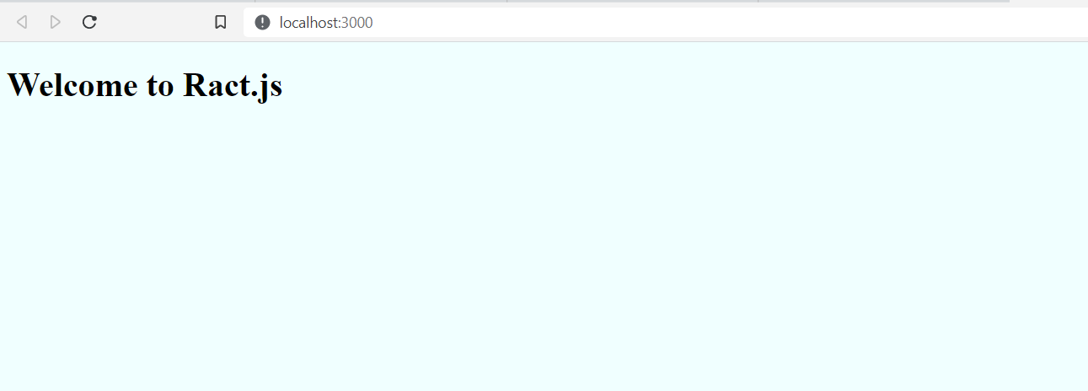
Creating new app - manually

Slide 27
React.js
https://www.youtube.com/watch?v=F18Rxw6ftcM&t=1156s
ES6
https://www.youtube.com/watch?v=UEHAC3VJG-g&list=PLjpp5kBQLNTSvHo6Rp4Ky0X8x_MabmKye&index=87

