Slide 1
React.js
Krishna Aryal

Slide 2
Table of Contents
Introduction
Prerequisites
Installation & Configuration
First Project
Hello world
Components
Routing
Advanced
API
Redux

Slide 3
Introduction
Open-source front end JavaScript library that is used for building UI components and user interfaces created by Facebook in 2013.
Commonly used as the code base for SPA’s (Single Page Applications).
Partial control update – fast
Large community for support

Slide 4
Introduction
Mobile app development with React-Native
Companies used React in their production Netflix, Facebook, Instagram, Airbnb, Reddit, Dropbox, and Postmates.

Slide 5
Prerequisites
HTML, CSS, JavaScript basics
ES6 Basics
Node & Node Modules
MongoDB

Slide 6
Installation & Configuration
Download and install Node.js
https://nodejs.dev/download
Chrome Extension
React Developer Tools
Postman – API Testing Tool
Visual Studio Code
VS Code ES7 React/Redux/React-Native/JS snippets
Thunder Client – API Testing Tool
Bracket Pair Color DLW
Auto Rename Tag
Prettier Formatter for Visual Studio Code
Live Server
Material Icon Theme

Slide 7
Create React App-1
react-0\index.html

Slide 8
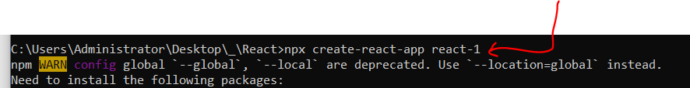
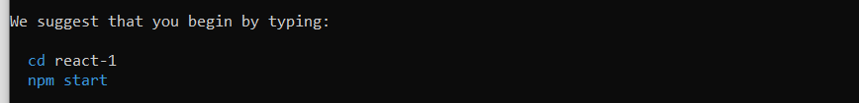
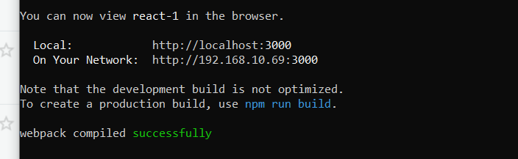
Create React App-2
npx create-react-app react-1

Slide 9
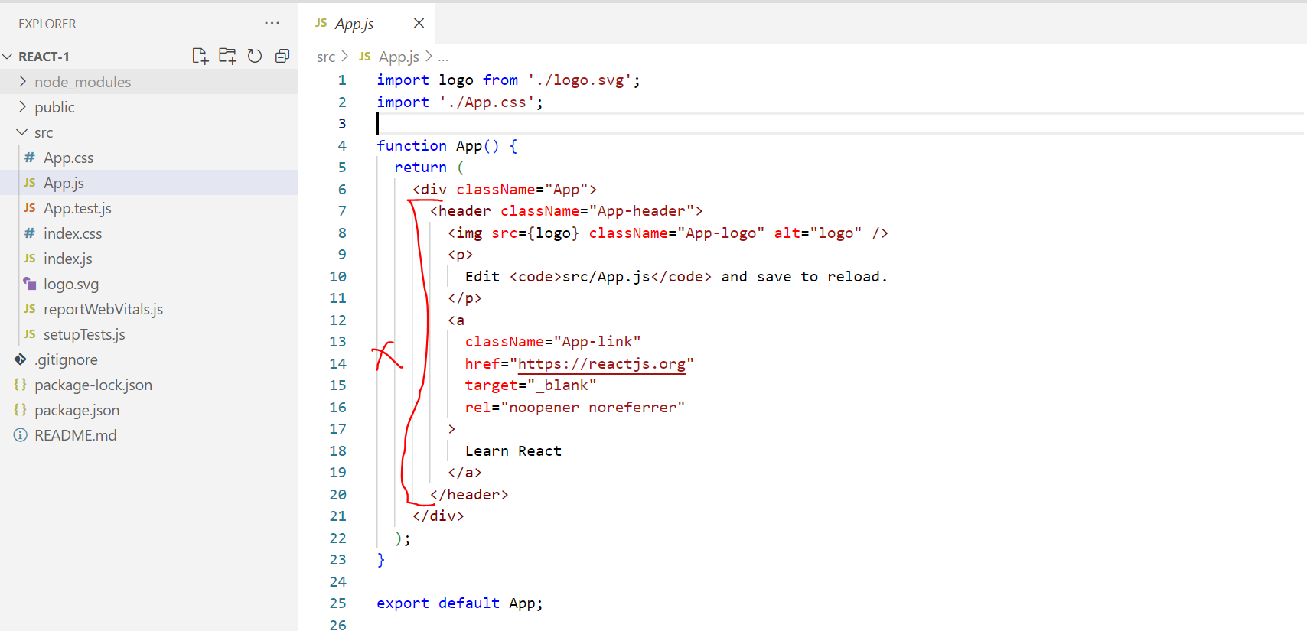
Create React First App

Slide 10
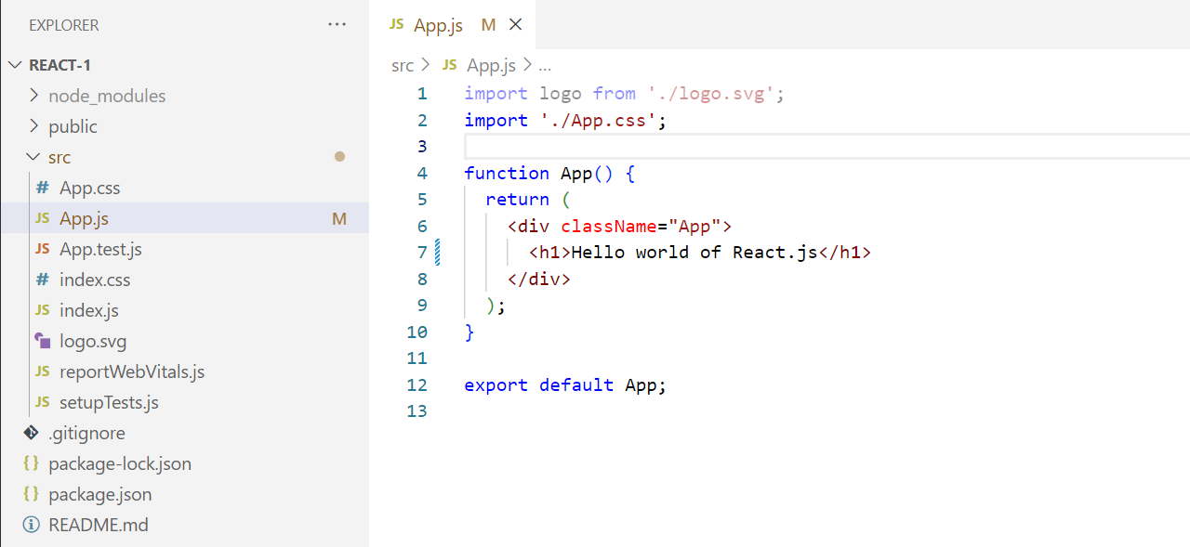
Create React First App

Slide 11
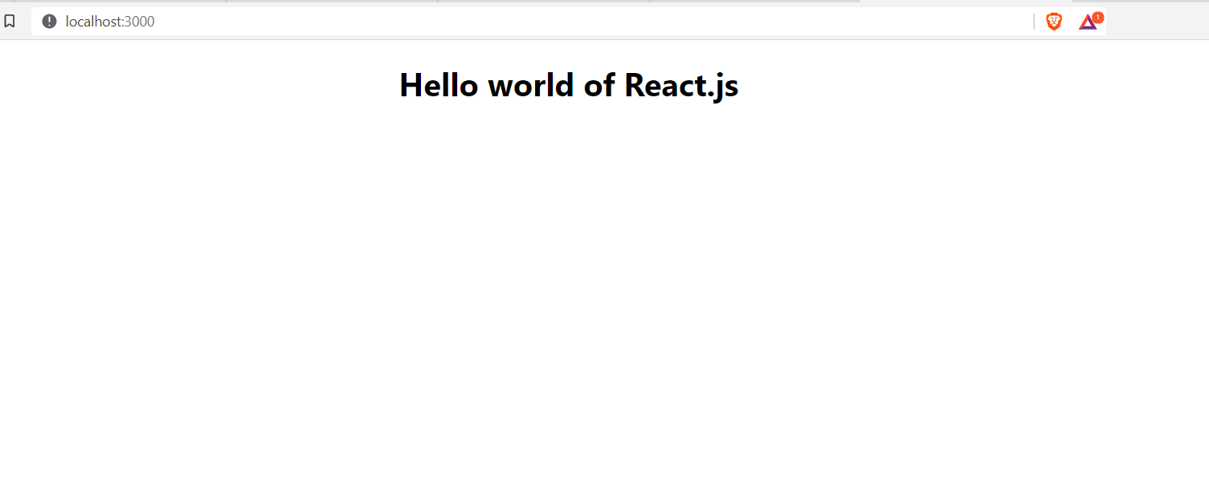
Create React First App

Slide 12
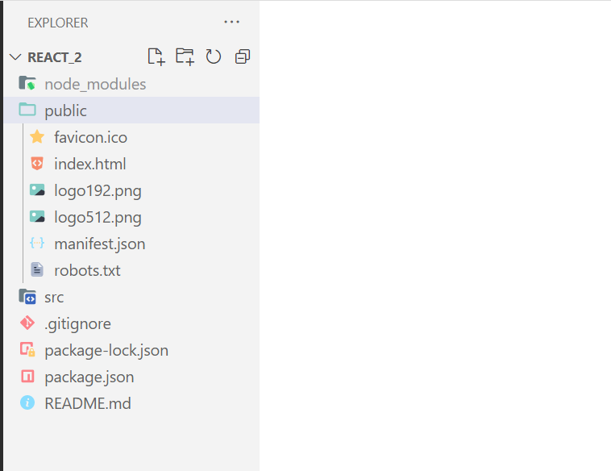
Project File Structure

Slide 13
Project File Structure
.gitignore : List of folder/files to ignore to push on github
README.md : Description of project
package.json : Project Details – Metadata of project
package-lock.json : Package details of project
node_module : NPM dependencies

Slide 14
Project File Structure
public
facicon.ico : Site icon file
robots.txt : SEO meta data
logo192.png : Logo-1
logo512.png : Logo-2
manifest.json : Meta-data of progressive web app
index.html : Single page web app

Slide 15
Project File Structure
src
App.css : CSS for Components
App.js : Components – jsx code
App.test.js : Testing - App
index.css : Universal CSS for app
Index.js : Render components
logo.svg : Image file format
reportWebVitals.js : Testing - App
setupTest.js : Testing - App

Slide 16
Components
Reusable building block in user interface (html, css, and js) is known as component. Combination of these components we can built a page.
Reusability - Don’t repeat your code
Maintainability - Easy to maintain code
Nested Component
Component inside of component

Slide 17


Slide 18
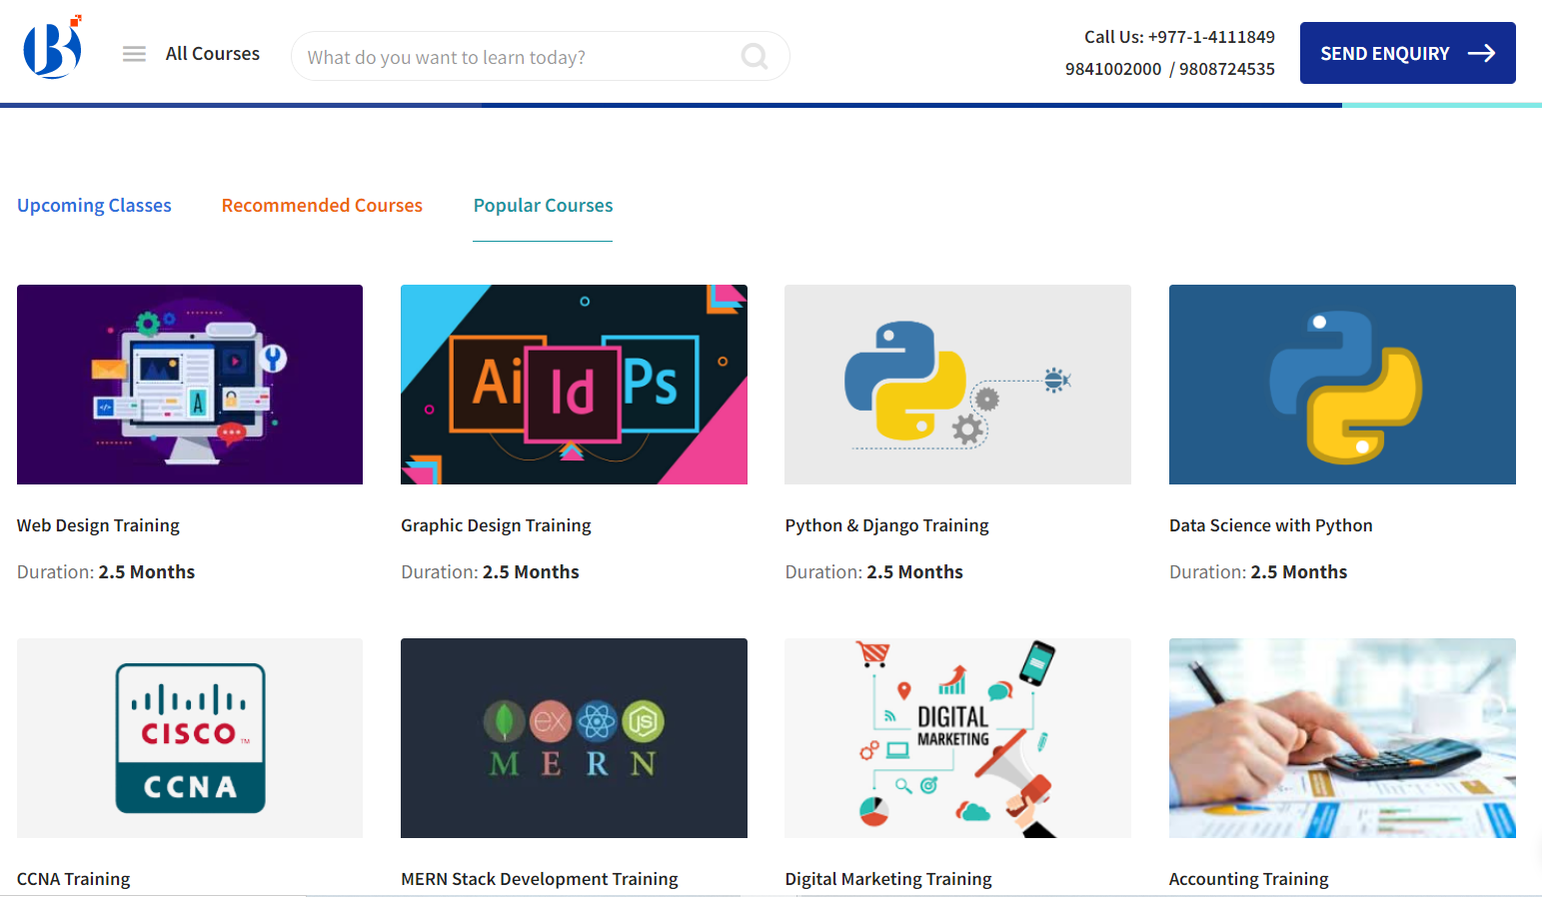

Slide 19
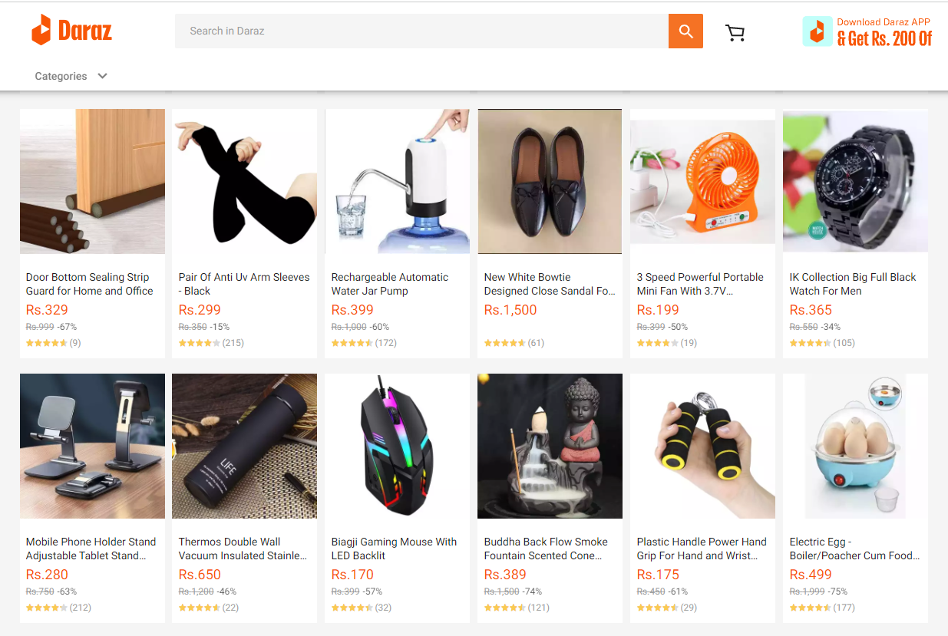

Slide 21
React.js
https://www.youtube.com/watch?v=F18Rxw6ftcM&t=1156s
ES6
https://www.youtube.com/watch?v=UEHAC3VJG-g&list=PLjpp5kBQLNTSvHo6Rp4Ky0X8x_MabmKye&index=87

