Slide 1
React.js
Krishna Aryal

Slide 2
Installation & Configuration
Download and install Node.js
https://nodejs.dev/download
Chrome Extension
React Developer Tools
Postman – API Testing Tool
Visual Studio Code
VS Code ES7 React/Redux/React-Native/JS snippets
Thunder Client – API Testing Tool
Bracket Pair Color DLW
Auto Rename Tag
Prettier Formatter for Visual Studio Code
Live Server
Material Icon Theme

Slide 3
Create React App-1
react-0\index.html

Slide 4
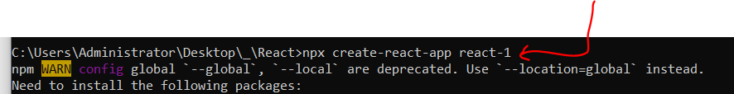
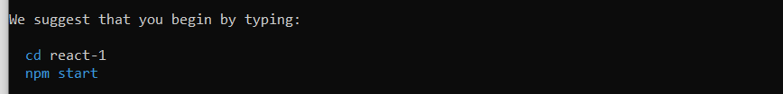
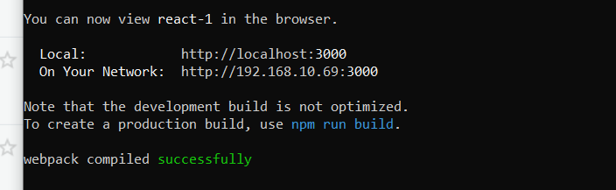
Create React App-2
npx create-react-app react-1

Slide 5
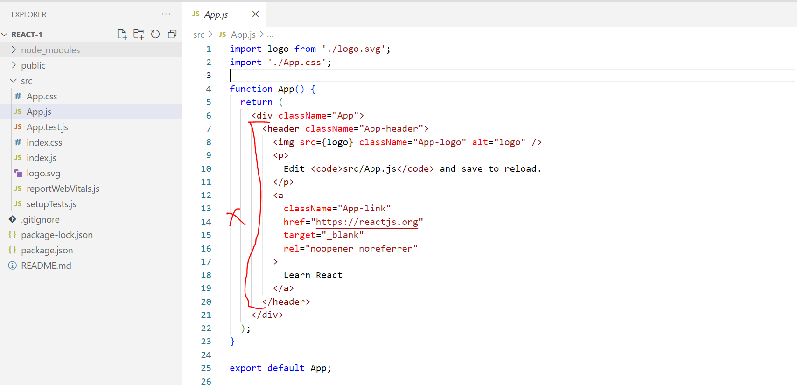
Create React First App

Slide 6
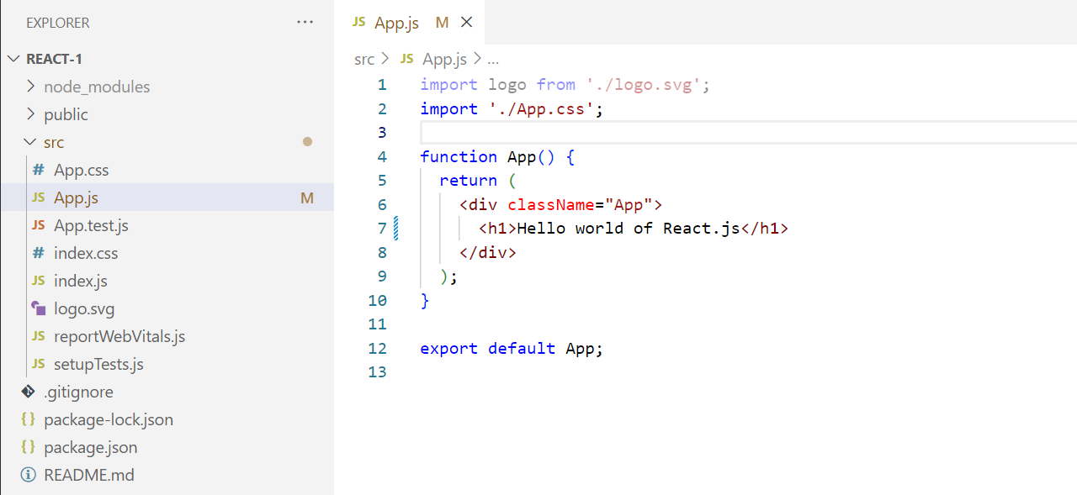
Create React First App

Slide 7
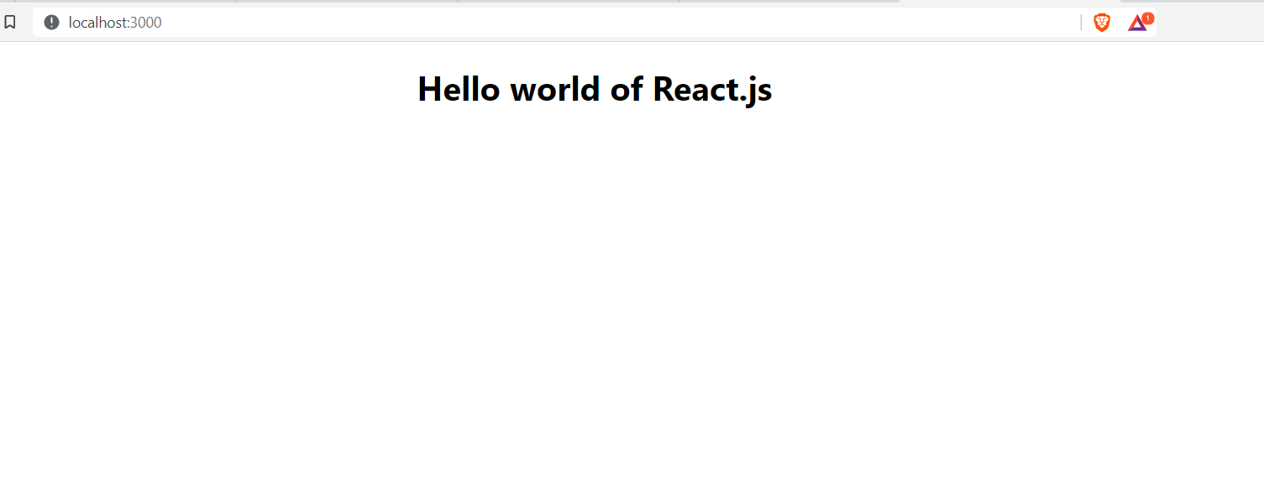
Create React First App

Slide 8
Java Script Basics

Slide 9

ECMAScript
Introduction
ES Versions
New in ES-6
let, const keyword
Default parameter
Rest parameter
Spread operator
for of
Template Literals `${variable}`
Array de-structuring
Object de-structuring

Slide 10
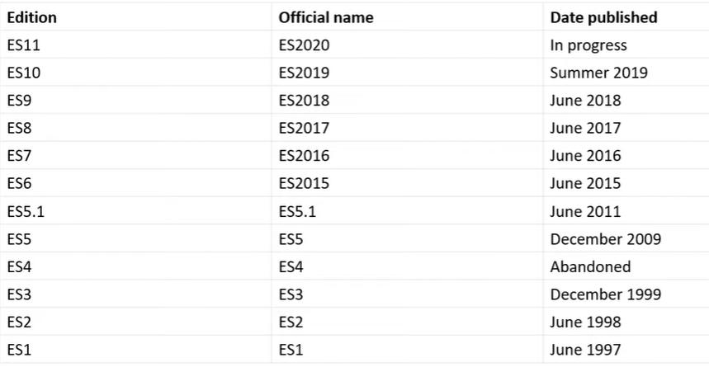
ES versions

Slide 11
Module
Case-1
<script src=“./file1.js”></script> : declare variable
<script src=“./file1.js”></script> : create a function
<script src=“./file1.js”></script> : call a function
Case-2
export
import
default
agregate

Slide 12
Introduction
Introduction
ES Versions
New in ES-6
let, const keyword
Default parameter
Rest parameter
Spread operator
for of
Template Literals `${variable}`
Array de-structuring
Object de-structuring

Slide 13
OOPs
Understand Object Oriented Concept in real life
Difference between procedural and object oriented
Four pillar of Object Oriented
Object Oriented programming in JavaScript till ES5
What’s new in ES6

Slide 14
Class, Object, and Inheritance
Object
Class
Inheritance

Slide 15
Class, Object, and Inheritance
Every object has
Features or Properties
Actions
Raj Rai
Name, address, phone
Walk, talk, and sleep
Hyundai i20
Color, price
Start, go, stop

Slide 16
Features of OOP
1. Encapsulation
Wrapping up data and member function (method) together into a single unit.
2. Abstraction
Visibility of features of an entity/object to the outside world (consumer) to hide the irrelevant info.
3. Inheritance
Allows a class (subclass) to acquire the properties and behavior of another class. Helps to reuse, customize, and enhance the existing code.

Slide 17
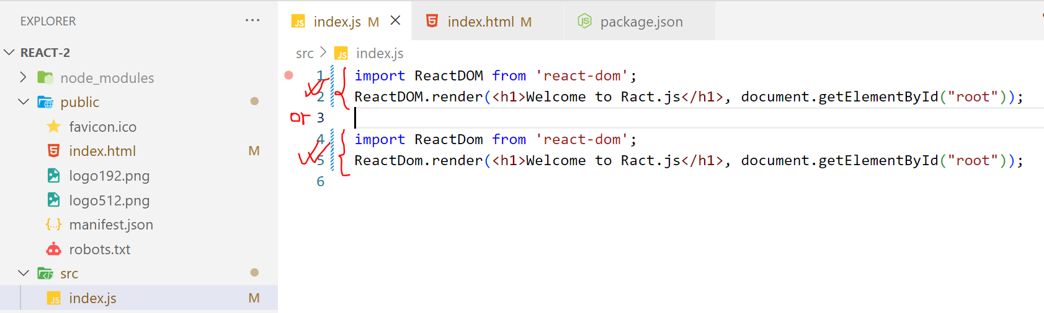
Creating new app – 1

Slide 18
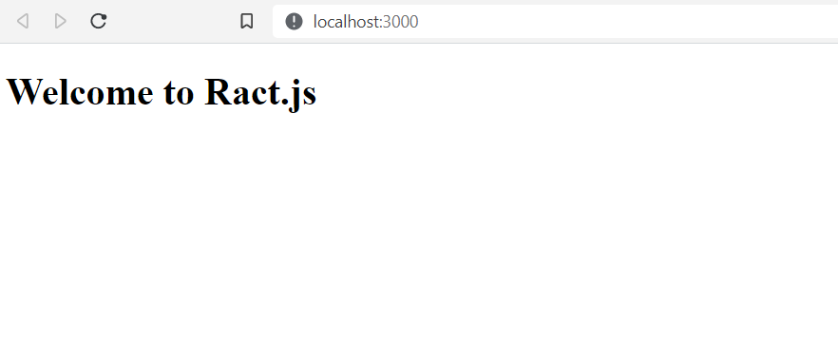
Creating new app – 1

Slide 19
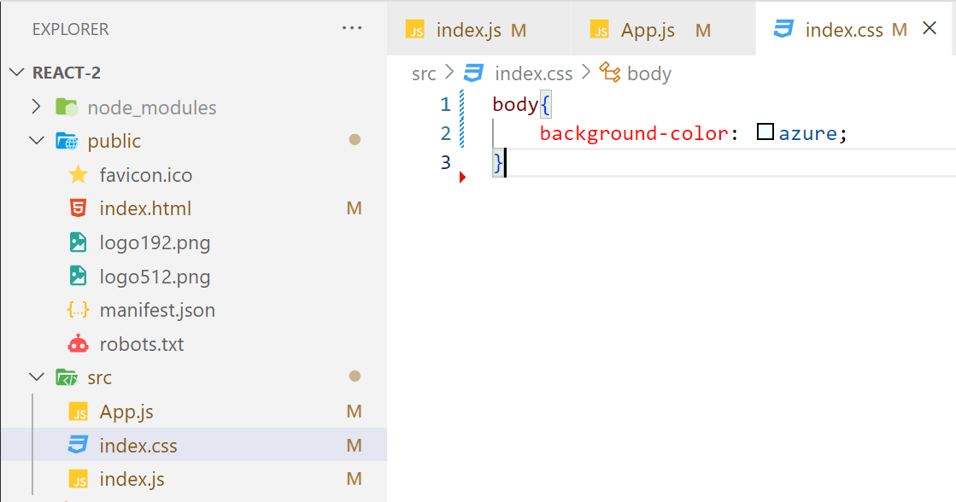
Creating new app – 2

Slide 20
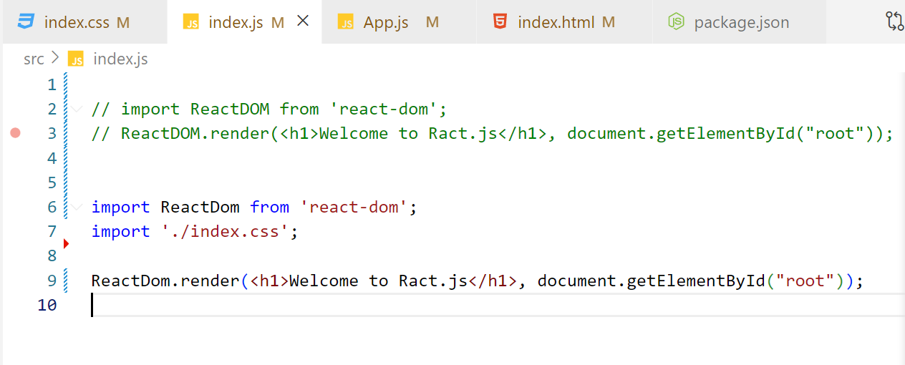
Creating new app – 2

Slide 21
Creating new app – 2

Slide 22
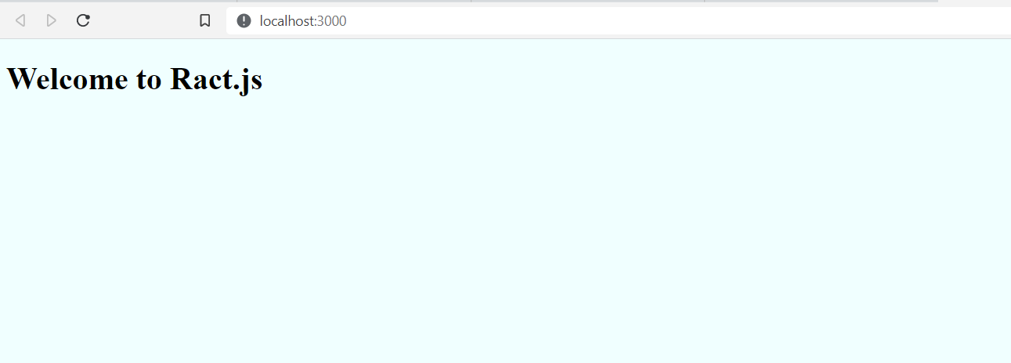
Creating new app – 2

Slide 23
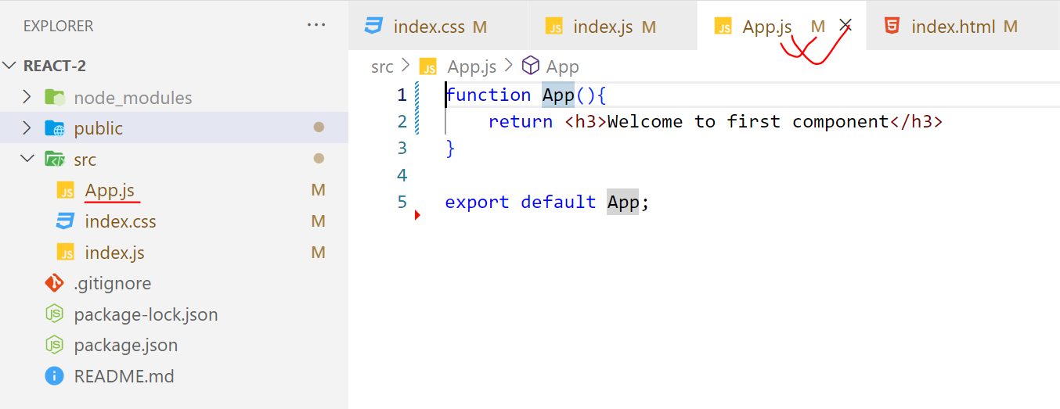
Creating new app – 2

Slide 24
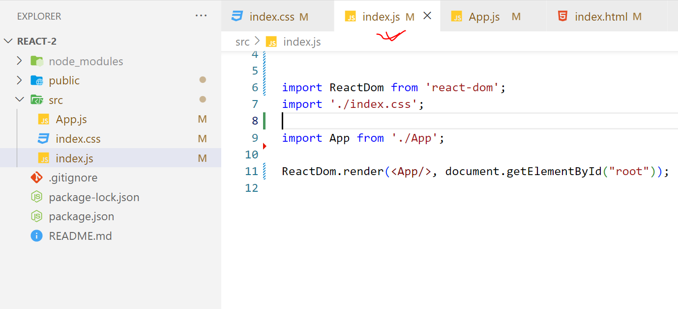
Creating new app – 2

Slide 25
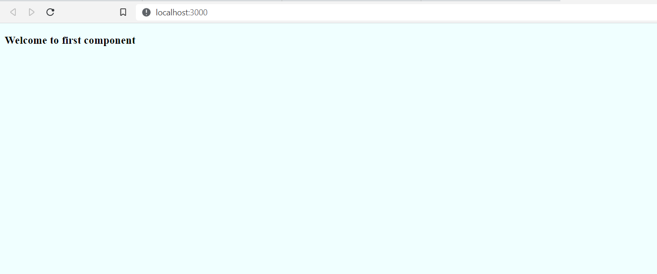
Creating new app – 2

Slide 26
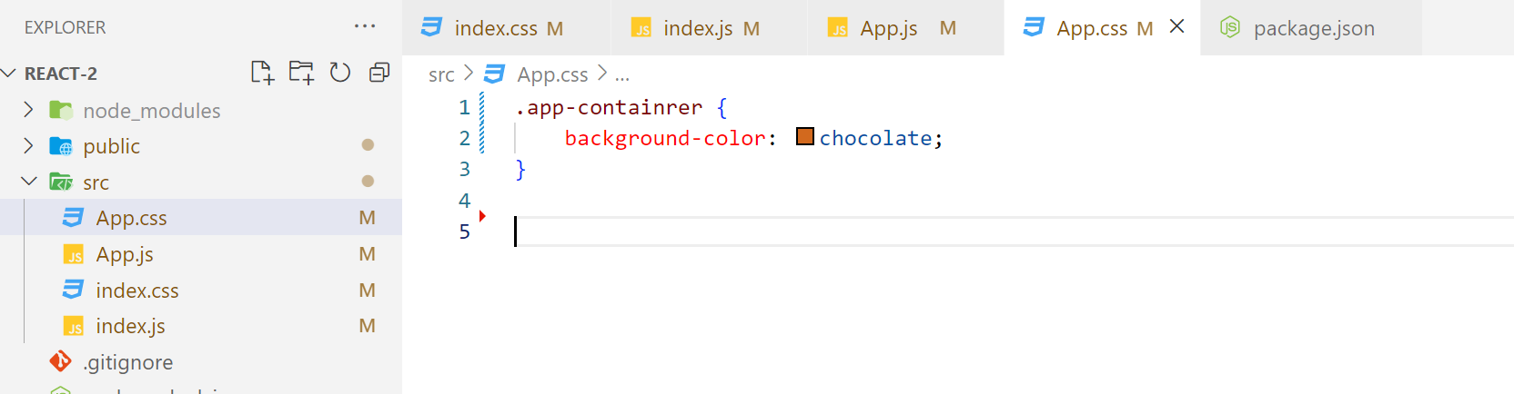
Creating new app – 2

Slide 27
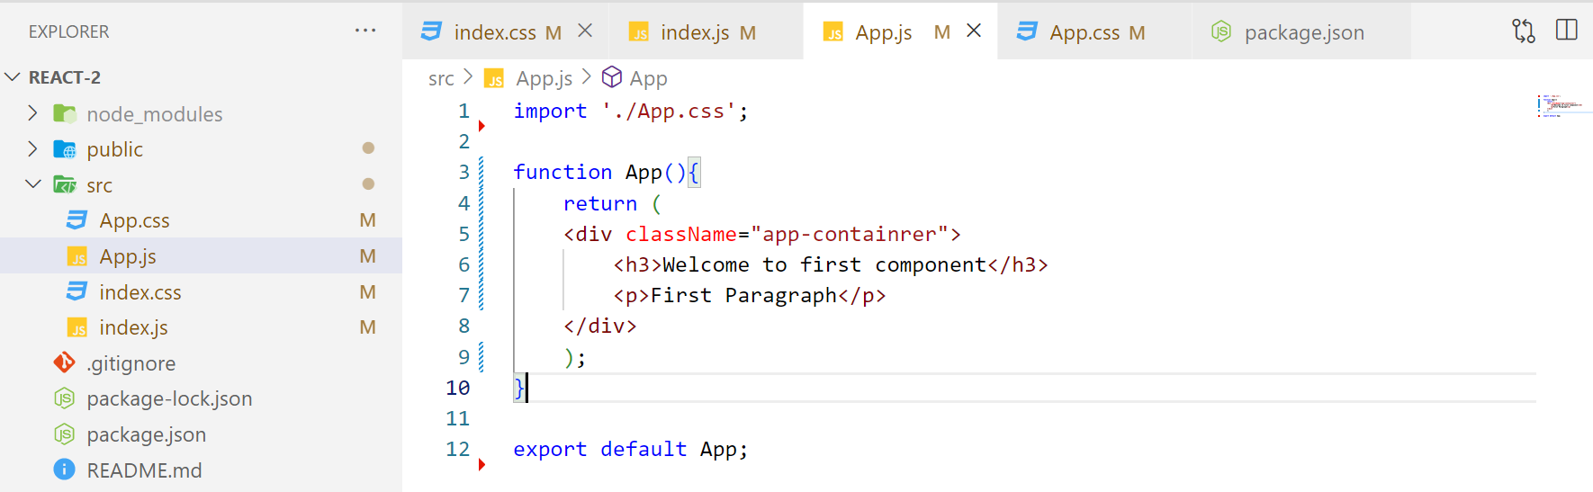
Creating new app – 2

Slide 28
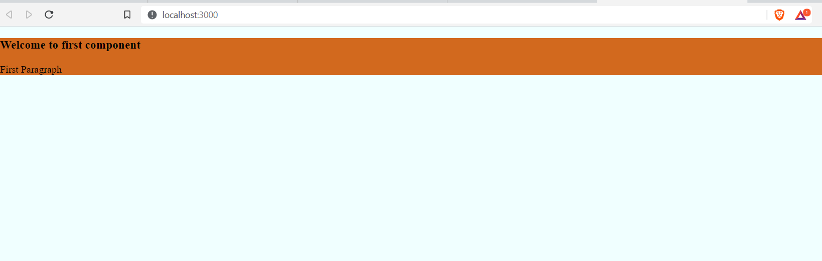
Creating new app – 2

Slide 29
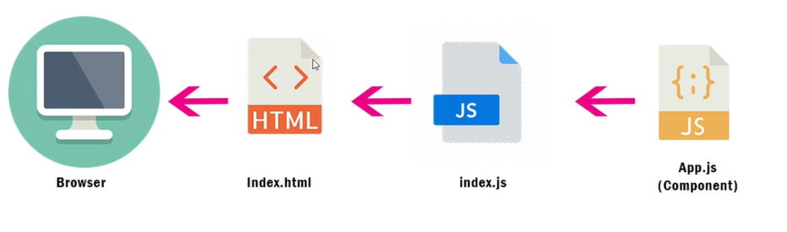
Creating new app – 2

Slide 30
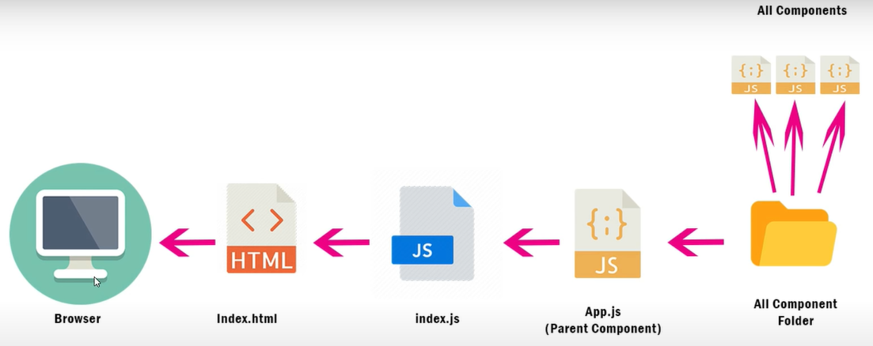
Creating new app – 3

Slide 31
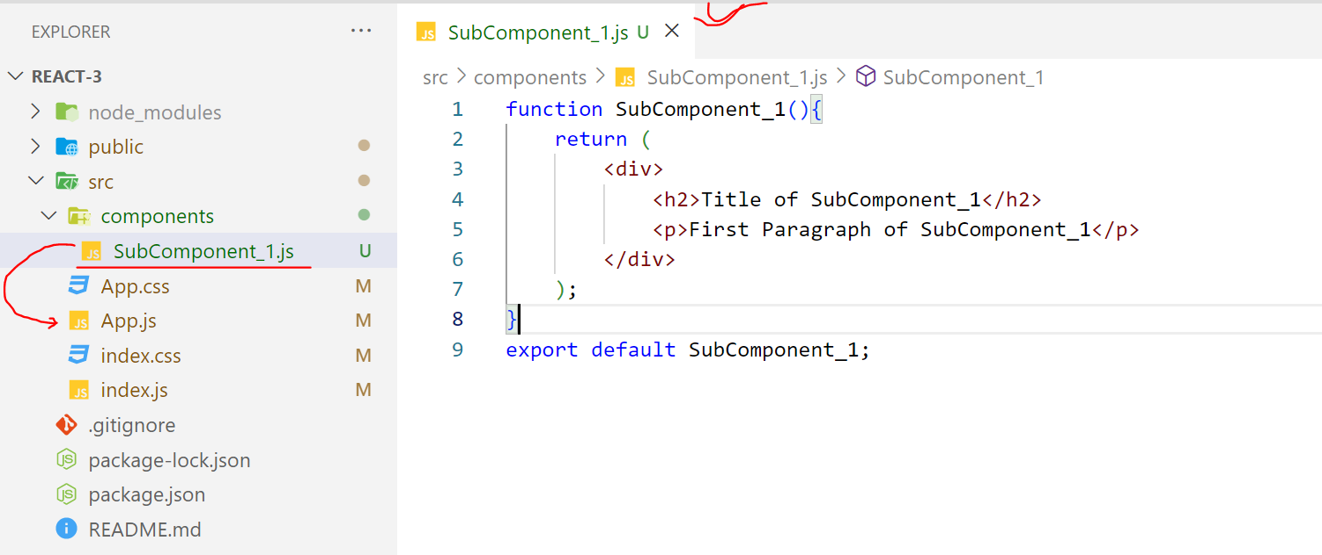
Creating new app – 3

Slide 32
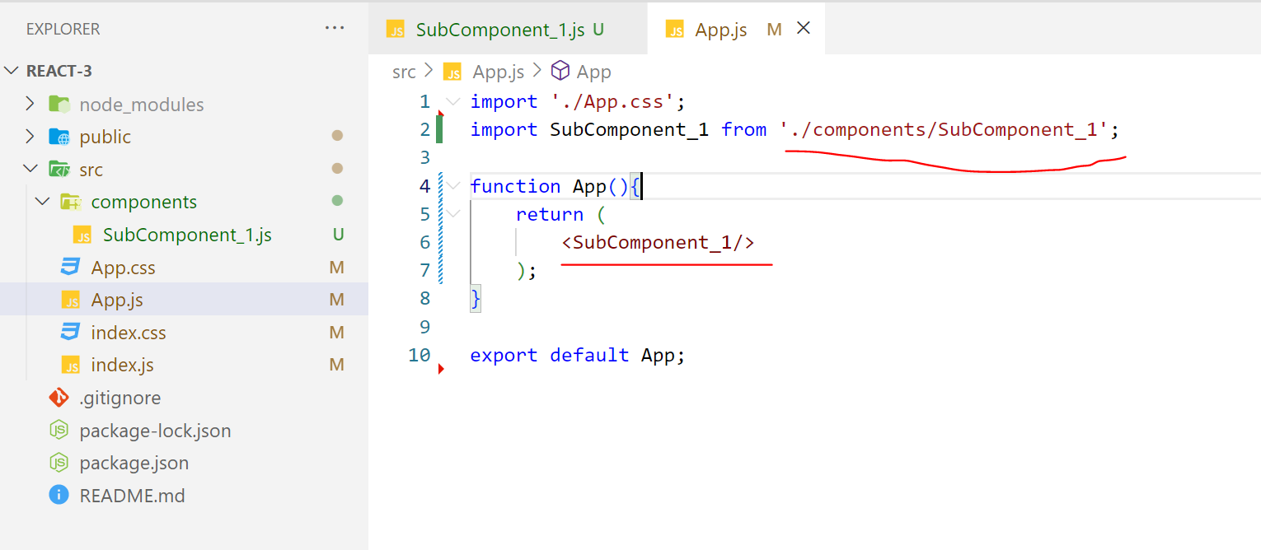
Creating new app – 3

Slide 33
React.js
https://www.youtube.com/watch?v=F18Rxw6ftcM&t=1156s
ES6
https://www.youtube.com/watch?v=UEHAC3VJG-g&list=PLjpp5kBQLNTSvHo6Rp4Ky0X8x_MabmKye&index=87

