Slide 1
数据挖掘导论
Pang-ning Tan, Michael Stieinbach, and Vipin Kumar著
Pearson Education LTD.
范明 等译
人民邮电出版社

Slide 2

数据挖掘导论

Slide 3
主要参考书
  Jiawei Han, Micheline Kamber and Jian Pei
  Data Mining: Concepts and Techniqus (third Edition),
  Monrgan Kaufmann Publishers Inc., 2012
  范明, 孟小峰译
  数据挖掘:概念与技术（第二版）
  机械工业出版社, 2007
数据挖掘导论

Slide 4
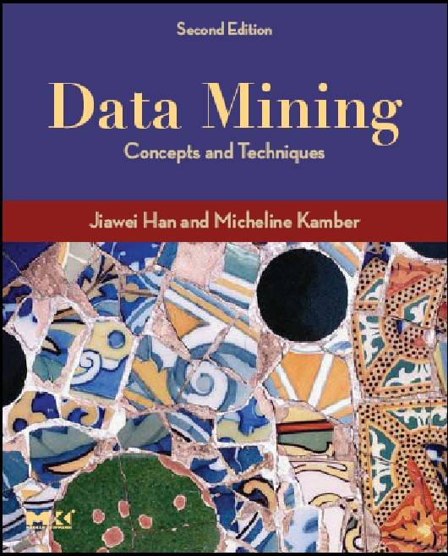
数据挖掘导论

Slide 5
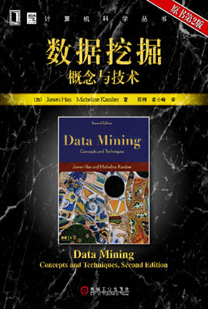
数据挖掘导论

Slide 6

Jiawei Han
在数据挖掘领域做出杰出贡献的郑州大学校友——韩家炜
数据挖掘导论

Slide 7
第1章 绪论
英文幻灯片制作： Tan, Steinbach, Kumar
中文幻灯片编译：范明

Slide 8



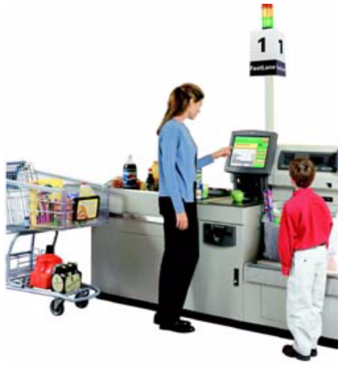
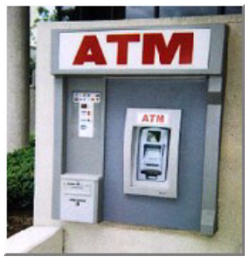
为什么挖掘数据？(商业)
大量数据被收集,存储在数据库\数据
仓库中
  Web data, e-commerce
  purchases at department/
  grocery stores
  Bank/Credit Card
  transactions
计算机越来越便宜，功能越来越
强大
竞争压力越来越大
  Provide better, customized services for an edge (e.g. in Customer Relationship Management)
数据挖掘导论

Slide 9
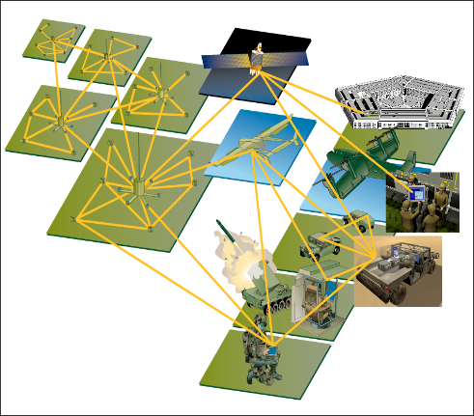
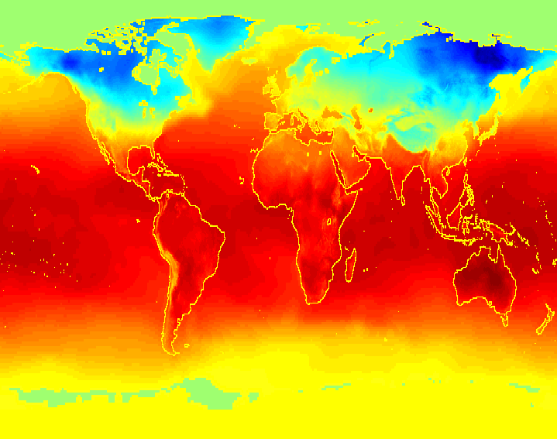
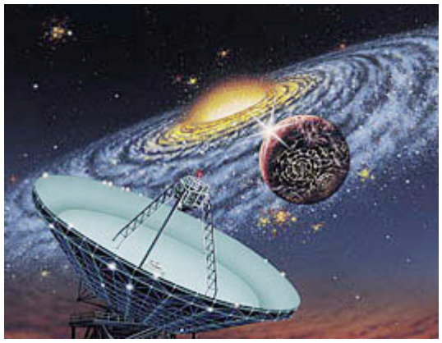
为什么挖掘数据？(科学)
数据以极快的速度收集和存储 (GB/hour)
  remote sensors on a satellite
  telescopes scanning the skies
  microarrays generating gene expression data
  scientific simulations generating terabytes (千兆字节) of data
传统的技术难以处理这些 raw data
数据挖掘可能帮助科学家
  in classifying and segmenting data
  in Hypothesis Formation
数据挖掘导论

Slide 10
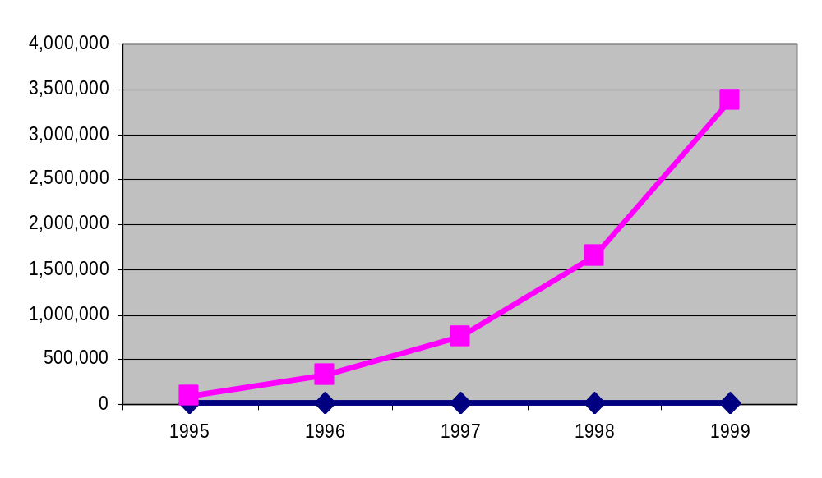
挖掘大型数据集：动机
常常有些信息“隐藏”在数据中, 并非显而易见的
人分析需要数周\数月, 才能发现有用的信息
许多数据根本未曾分析过
The Data Gap
数据挖掘导论

Slide 11
什么是数据挖掘
许多不同定义
  本书定义
    在大型数据存储库中，自动地发现有用信息的过程。
    Exploration & analysis, by automatic or semi-automatic means, of large quantities of data in order to discover meaningful patterns
  Jiawei Han的定义
    从大型数据集中提取有趣的 (非平凡的, 蕴涵的, 先前未知的并且是潜在有用的) 信息或模式
  一个类似于Jiawei Han的定义
    Non-trivial extraction of implicit, previously unknown and potentially useful information from data
数据挖掘导论

Slide 12
什么(不)是数据挖掘
What is not Data Mining?
  Look up phone number in phone directory
  Query a Web search engine for information about “Amazon”
What is Data Mining?
  Certain names are more prevalent in certain US locations (O’Brien, O’Rurke, O’Reilly… in Boston area)
  Group together similar documents returned by search engine according to their context (e.g. Amazon rainforest, Amazon.com,)
数据挖掘导论

Slide 13
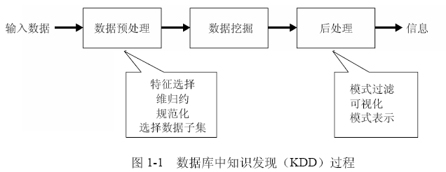
数据挖掘与KDD
数据挖掘与知识发现
  数据挖掘是数据库中知识发现（knowledge discovery in database, KDD）不可缺少的一部分
  KDD是将未加工的数据转换为有用信息的整个过程
数据挖掘导论

Slide 14
引发数据挖掘的挑战1
可伸缩
  海量数据集越来越普遍
    数千兆字节(terabytes)
  为处理海量数据，算法必须是可伸缩的（scalable）
  可伸缩可能还需要新的数据结构，以有效的方式访问个别记录
    例如，当要处理的数据不能放进内存时，可能需要非内存算法
  使用抽样技术或开发并行和分布算法也可以提高可伸缩程度
数据挖掘导论

Slide 15
挑战2
高维性
  具有数以百计或数以千计属性的数据集
    生物信息学：涉及数千特征的基因表达数据
    不同地区温度测量：维度（特征数）的增长正比于测量的次数
  为低维数据开发的数据分析技术不能很好地处理高维数据
  某些数据分析算法，随着维度（特征数）的增加，计算复杂性迅速增加
数据挖掘导论

Slide 16
挑战3
异种数据和复杂数据
  传统的数据分析方法只处理包含相同类型属性的数据集
  非传统的数据类型的出现需要能够处理异种属性的技术
    半结构化文本和超链接的Web页面集
    具有序列和三维结构的DNA数据
    地球表面不同位置上的时间序列测量值（温度、气压等）的气象数据
  数据中的联系
    如时间和空间的自相关性、图的连通性、半结构化文本和XML文档中元素之间的父子联系
数据挖掘导论

Slide 17
挑战4
数据的所有权与分布
  数据地理上分布在属于多个机构的资源中
    需要开发分布式数据挖掘技术
  分布式数据挖掘算法面临的主要挑战包括
    (1) 如何降低执行分布式计算所需的通信量？
    (2) 如何有效地统一从多个资源得到的数据挖掘结果？
    (3) 如何处理数据安全性问题？
数据挖掘导论

Slide 18
挑战5
非传统的分析
  传统的统计学方法：假设-检验模式
    提出一种假设，设计实验来收集数据，然后针对假设分析数据
  当前的数据分析任务常常需要产生和评估数以千计的假设
    希望自动地产生和评估假设导致了一些数据挖掘技术的开发
  数据挖掘所分析的数据集通常不是精心设计的实验的结果
    代表数据的时机性样本（opportunistic sample）而不是随机样本（random sample）
    数据集常常涉及非传统的数据类型和数据分布
数据挖掘导论

Slide 19
数据挖掘的起源
数据挖掘是多学科交叉领域
  利用了来自如下一些领域的思想：
    统计学的抽样、估计和假设检验
    人工智能、模式识别和机器学习的搜索算法、建模技术和学习理论
    数据库系统提供有效的存储、索引和查询处理支持
    分布式技术也能帮助处理海量数据
    最优化、进化计算、信息论、信号处理、可视化和信息检索
Statistics/
AI
Machine Learning/
Pattern
Recognition
Data Mining
Database systems
数据挖掘导论

Slide 20
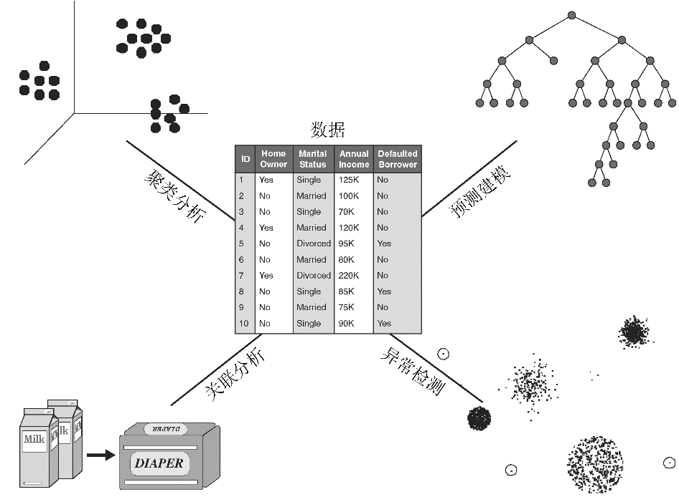
数据挖掘任务
预测vs.描述
预测(Prediction)
  根据其他属性的值，预测特定属性的值
描述(Description)
  导出概括数据中潜在联系的模式
数据挖掘导论

Slide 21
数据挖掘任务
分类（Classification） [Predictive]
回归（Regression） [Predictive]
关联规则发现（Association Rule Discovery） [Descriptive]
序列模式发现（Sequential Pattern Discovery） [Descriptive]
聚类（Clustering） [Descriptive]
异常/偏差检测（Anomaly/Deviation Detection） [Predictive]
数据挖掘导论

Slide 22
分类:定义
给定一批记录----训练集 (training set )
  Each record contains a set of attributes, one of the attributes is the class label (类标号) .
任务: 建立一个模型(model )
  类标号属性是其他属性值的函数
目标: previously unseen records should be assigned a class as accurately as possible.
  A test set (检验集) is used to determine the accuracy of the model.
  Usually, the given data set is divided into training and test sets, with training set used to build the model and test set used to validate it
数据挖掘导论

Slide 23


分类:例子
categorical
categorical
continuous
class
Test
Set
Learn
Classifier
Training
Set
Model
数据挖掘导论

Slide 24
分类:应用1
Direct Marketing
  Goal:
    Reduce cost of mailing by targeting a set of consumers likely to buy a new cell-phone product.
  Approach:
    Use the data for a similar product introduced before.
    We know which customers decided to buy and which decided otherwise. This {buy, don’t buy} decision forms the class attribute.
    Collect various demographic, lifestyle, and company-interaction related information about all such customers.
      Type of business, where they stay, how much they earn, etc.
    Use this information as input attributes to learn a classifier model.
数据挖掘导论

Slide 25
分类:应用2
Fraud Detection
  Goal:
    Predict fraudulent cases in credit card transactions.
  Approach:
    Use credit card transactions and the information on its account-holder as attributes.
      When does a customer buy, what does he buy, how often he pays on time, etc
    Label past transactions as fraud or fair transactions. This forms the class attribute.
    Learn a model for the class of the transactions.
    Use this model to detect fraud by observing credit card transactions on an account.
数据挖掘导论

Slide 26
分类:应用3
Sky Survey Cataloging
  Goal: To predict class (star or galaxy) of sky objects, especially visually faint ones, based on the telescopic survey images (from Palomar Observatory).
    3000 images with 23,040 x 23,040 pixels per image.
  Approach:
    Segment the image.
    Measure image attributes (features) - 40 of them per object.
    Model the class based on these features.
    Success Story: Could find 16 new high red-shift quasars, some of the farthest objects that are difficult to find!
数据挖掘导论

Slide 27



分类:应用3
Courtesy: http://aps.umn.edu
Early
Class:
Stages of Formation
Attributes:
Image features,
Characteristics of light waves received, etc.
Intermediate
Late
Data Size:
72 million stars, 20 million galaxies
Object Catalog: 9 GB
Image Database: 150 GB
数据挖掘导论

Slide 28
回归
回归(regression)
  Predict a value of a given continuous valued variable based on the values of other variables, assuming a linear or nonlinear model of dependency.
Greatly studied in statistics, neural network fields.
Examples:
  Predicting sales amounts of new product based on advertising expenditure.
  Predicting wind velocities as a function of temperature, humidity, air pressure, etc.
  Time series prediction of stock market indices
数据挖掘导论

Slide 29

关联规则:定义
关联规则(association rule)
  Given a set of records each of which contain some number of items from a given collection;
    Produce dependency rules which will predict occurrence of items based on occurrences of other items.
Rules Discovered:
{Milk} --> {Coke}
{Diaper, Milk} --> {Beer}
数据挖掘导论

Slide 30
关联规则:应用1
Marketing and Sales Promotion:
  Let the rule discovered be
  {Bagels, … } --> {Potato Chips}
  Potato Chips as consequent => Can be used to determine what should be done to boost its sales.
  Bagels in the antecedent => Can be used to see which products would be affected if the store discontinues selling bagels.
  Bagels in antecedent and Potato chips in consequent => Can be used to see what products should be sold with Bagels to promote sale of Potato chips!
数据挖掘导论

Slide 31
关联规则:应用2
Supermarket shelf management.
  Goal:
    To identify items that are bought together by sufficiently many customers.
  Approach:
    Process the point-of-sale data collected with barcode scanners to find dependencies among items.
  A classic rule --
    If a customer buys diaper and milk, then he is very likely to buy beer.
    So, don’t be surprised if you find six-packs stacked next to diapers!
数据挖掘导论

Slide 32
聚类: 定义
Given a set of data points, each having a set of attributes, and a similarity measure among them, find clusters such that
  Data points in one cluster are more similar to one another.
  Data points in separate clusters are less similar to one another.
Similarity Measures:
  Euclidean Distance if attributes are continuous.
  Other Problem-specific Measures
Intracluster distances
are minimized
Intercluster distances
are maximized
数据挖掘导论

Slide 33
聚类: 应用1
Market Segmentation:
  Goal:
    subdivide a market into distinct subsets of customers where any subset may conceivably be selected as a market target to be reached with a distinct marketing mix.
  Approach:
    Collect different attributes of customers based on their geographical and lifestyle related information.
    Find clusters of similar customers.
    Measure the clustering quality by observing buying patterns of customers in same cluster vs. those from different clusters.
数据挖掘导论

Slide 34
聚类: 应用2
Document Clustering:
  Goal:
    To find groups of documents that are similar to each other based on the important terms appearing in them.
  Approach:
    To identify frequently occurring terms in each document. Form a similarity measure based on the frequencies of different terms. Use it to cluster.
  Gain:
    Information Retrieval can utilize the clusters to relate a new document or search term to clustered documents
数据挖掘导论

Slide 35
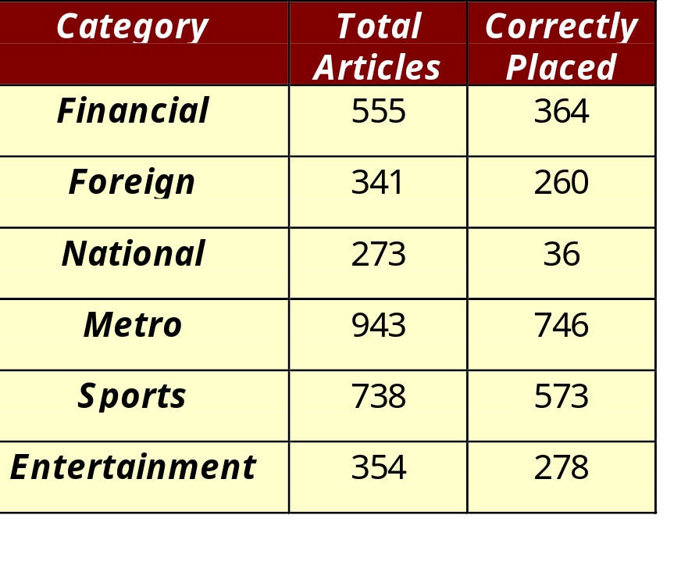
文档聚类: 例
Clustering Points: 3204 Articles of Los Angeles Times.
Similarity Measure:
  How many words are common in these documents (after some word filtering).
数据挖掘导论

Slide 36





异常检测
任务：识别其特征显著不同于其他数据的观测值
  这样的观测值称为异常点（anomaly）或离群点（outlier）
  发现真正的异常点，而避免错误地将正常的对象标注为异常点
应用
  信用卡欺诈检测
  网络入侵检测
数据挖掘导论

Slide 37
数据挖掘的应用

Slide 38
数据挖掘的应用
数据库分析和决策支持
  市场分析和管理
    针对销售(target marketing), 顾客关系管理, 购物篮分析, 交叉销售(cross selling), 市场分割(market segmentation)
  风险分析与管理
    预测, 顾客关系, 改进保险, 质量控制, 竞争能力分析
  欺骗检测与管理
其它应用
  文本挖掘 (新闻组, email, 文档资料)
  流数据挖掘(Stream data mining)
  Web挖掘.
  DNA 数据分析
数据挖掘导论

Slide 39
市场分析与管理(1)
用于分析的数据源在哪?
  信用卡交易, 会员卡, 打折优惠卷, 顾客投诉电话, (公共) 生活时尚研究
针对销售(Target marketing)
  找出顾客群, 他们具有相同特征 : 兴趣, 收入水平, 消费习惯, 等.
确定顾客随时间变化的购买模式
  个人帐号到联合帐号的转变: 结婚, 等.
交叉销售分析(Cross-market analysis)
  产品销售之间的关联/相关
  基于关联信息的预测
数据挖掘导论

Slide 40
市场分析与管理(2)
顾客分类(Customer profiling)
  数据挖掘能够告诉我们什么样的顾客买什么产品(聚类或分类)
识别顾客需求
  对不同的顾客识别最好的产品
  使用预测发现什么因素影响新顾客
提供汇总信息
  各种多维汇总报告
  统计的汇总信息 (数据的中心趋势和方差)
数据挖掘导论

Slide 41
法人分析和风险管理
财经规划和资产评估
  现金流分析和预测
  临时提出的资产评估
  交叉组合(cross-sectional) 和时间序列分析 (金融比率(financial-ratio), 趋势分析, 等.)
资源规划 :
  资源与开销的汇总与比较
竞争:
  管理竞争者和市场指导
  对顾客分类和基于类的定价
  在高度竞争的市场调整价格策略
数据挖掘导论

Slide 42
欺骗检测和管理(1)
应用
  广泛用于健康照料, 零售, 信用卡服务, 电讯 (电话卡欺骗), 等.
方法
  使用历史数据建立欺骗行为模型, 使用数据挖掘帮助识别类似的实例
例
  汽车保险: 检测这样的人, 他/她假造事故骗取保险赔偿
  洗钱: 检测可疑的金钱交易 (US Treasury's Financial Crimes Enforcement Network)
  医疗保险 : 检测职业病患者, 医生和介绍人圈
数据挖掘导论

Slide 43
欺骗检测和管理(2)
检测不适当的医疗处置
  澳大利亚健康保险会(Australian Health Insurance Commission) 发现许多全面的检查是请求做的, 而不是实际需要的 (每年节省100万澳元).
检测电话欺骗
  电话呼叫模式: 通话距离, 通话时间, 每天或每周通话次数. 分析偏离期望的模式.
  英国电讯(British Telecom)识别频繁内部通话的呼叫者的离散群, 特别是移动电话, 超过数百万美元的欺骗.
零售
  分析家估计, 38%的零售业萎缩是由于不忠诚的雇员造成的.
数据挖掘导论

Slide 44
其它应用
运动
  IBM Advanced Scout分析NBA的统计数据 ( 阻挡投篮, 助攻, 和犯规 ) 获得了对纽约小牛队(New York Knicks)和迈艾米热队( Miami Heat )的竞争优势
天文
  借助于数据挖掘的帮助,JPL 和 Palomar Observatory 发现了22 颗类星体(quasars)
Internet Web Surf-Aid
  IBM Surf-Aid 将数据挖掘算法用于有关交易的页面的Web访问日志, 以发现顾客喜爱的页面, 分析Web 销售的效果, 改进Web 站点的组织, 等.
数据挖掘导论

Slide 45
数据挖掘界简史
1989 IJCAI Workshop on Knowledge Discovery in Databases (Piatetsky-Shapiro)
  Knowledge Discovery in Databases (G. Piatetsky-Shapiro and W. Frawley, 1991)
1991-1994 Workshops on Knowledge Discovery in Databases
  Advances in Knowledge Discovery and Data Mining (U. Fayyad, G. Piatetsky-Shapiro, P. Smyth, and R. Uthurusamy, 1996)
1995-1998 International Conferences on Knowledge Discovery in Databases and Data Mining (KDD’95-98)
  Journal of Data Mining and Knowledge Discovery (1997)
1998 ACM SIGKDD, SIGKDD’1999-2001 conferences, and SIGKDD Explorations
More conferences on data mining
  PAKDD, PKDD, SIAM-Data Mining, (IEEE) ICDM, etc.
数据挖掘导论

Slide 46
参考文献源
Data mining and KDD (SIGKDD member CDROM):
  Conference proceedings: KDD, and others, such as PKDD, PAKDD, etc.
  Journal: Data Mining and Knowledge Discovery
Database field (SIGMOD member CD ROM):
  Conference proceedings: ACM-SIGMOD, ACM-PODS, VLDB, ICDE, EDBT, DASFAA
  Journals: ACM-TODS, J. ACM, IEEE-TKDE, JIIS, etc.
AI and Machine Learning:
  Conference proceedings: Machine learning, AAAI, IJCAI, etc.
  Journals: Machine Learning, Artificial Intelligence, etc.
Statistics:
  Conference proceedings: Joint Stat. Meeting, etc.
  Journals: Annals of statistics, etc.
Visualization:
  Conference proceedings: CHI, etc.
  Journals: IEEE Trans. visualization and computer graphics, etc.
数据挖掘导论

Slide 47
Important Web sites
DBLP: 计算机科学文献库
  http://www.informatik.uni-trier.de/~ley/db
Weka: Data Mining Software in Java
  http://www.cs.waikato.ac.nz/~ml/weka/
Data Resource: UCI Machine Learning Repository
  http://archive.ics.uci.edu/ml/
机器学习
  http://www.springerlink.com/content/100309/
数据挖掘导论

