Slide 1

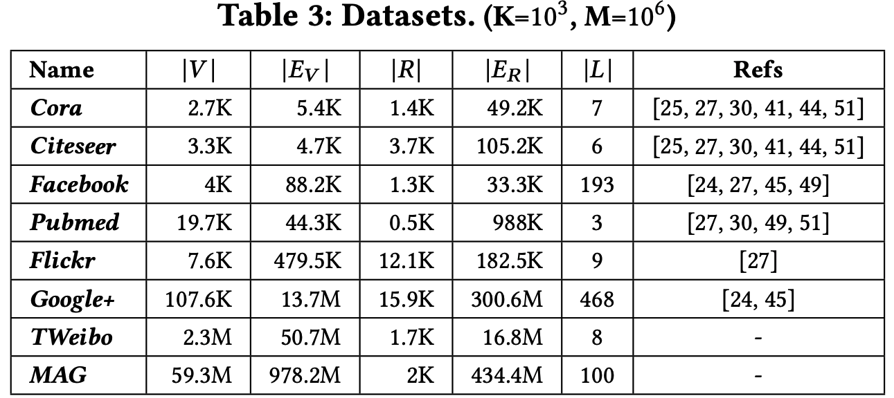
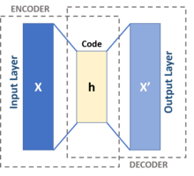
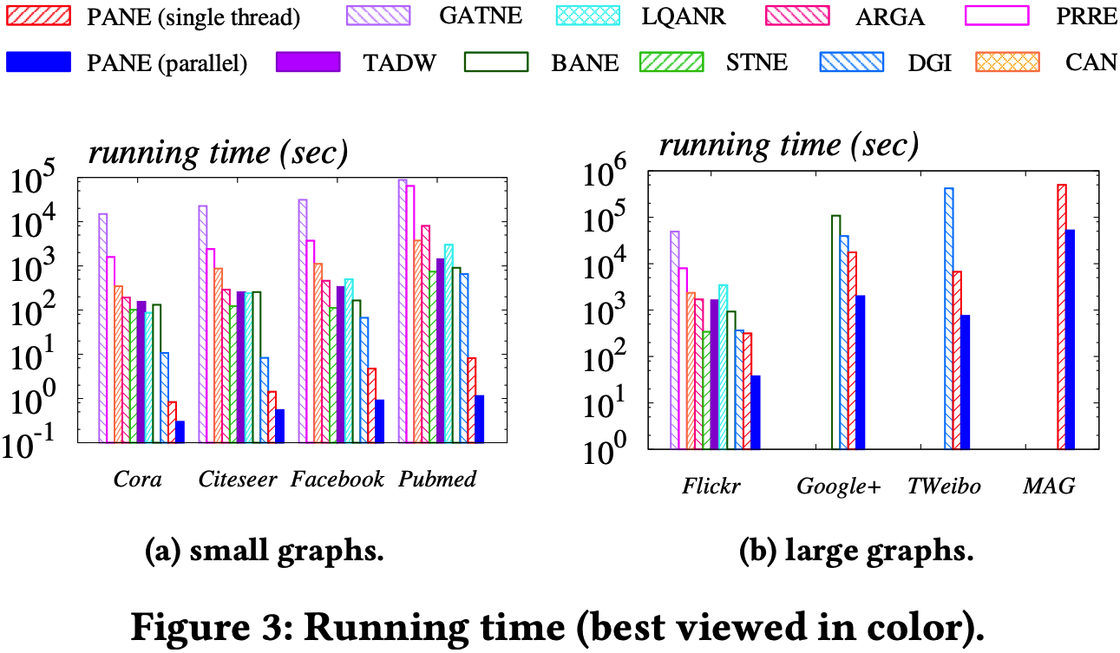
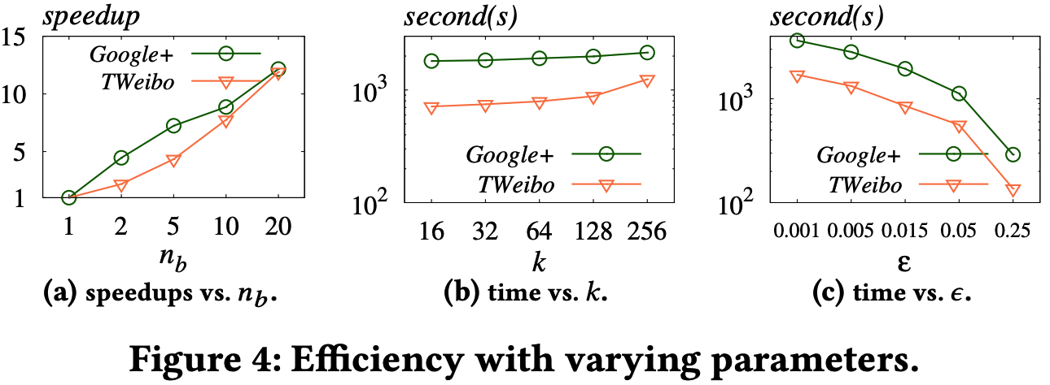
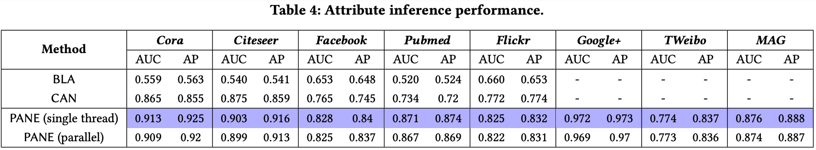
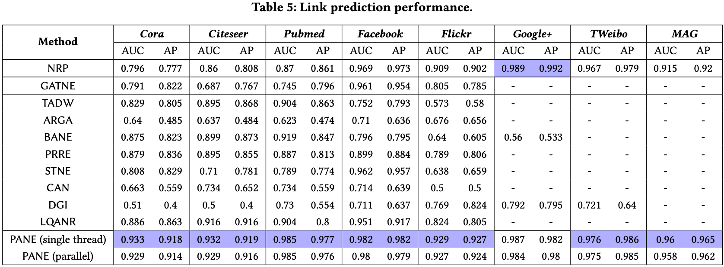


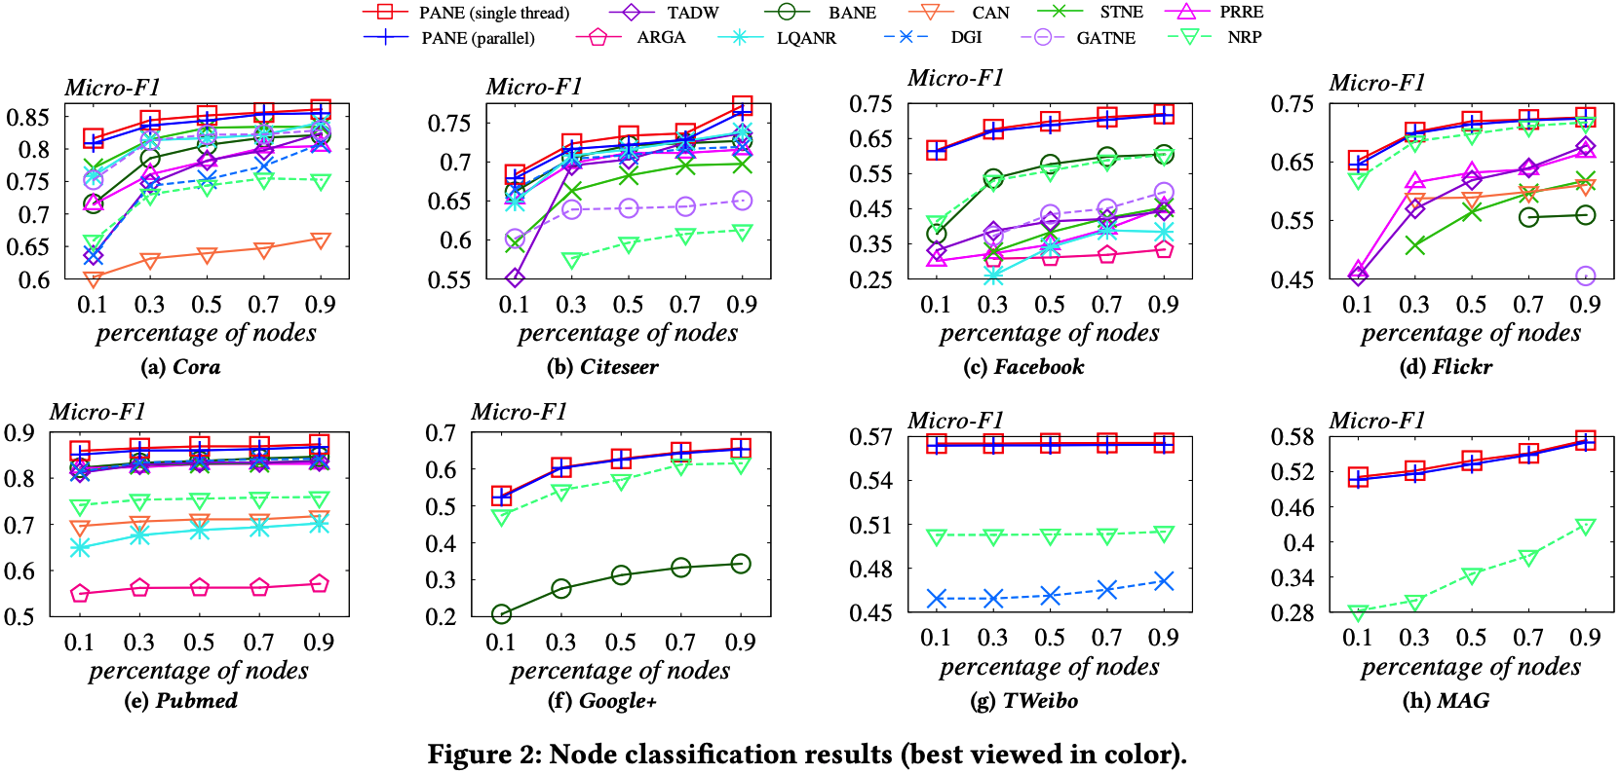









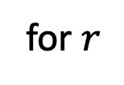


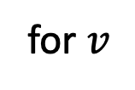



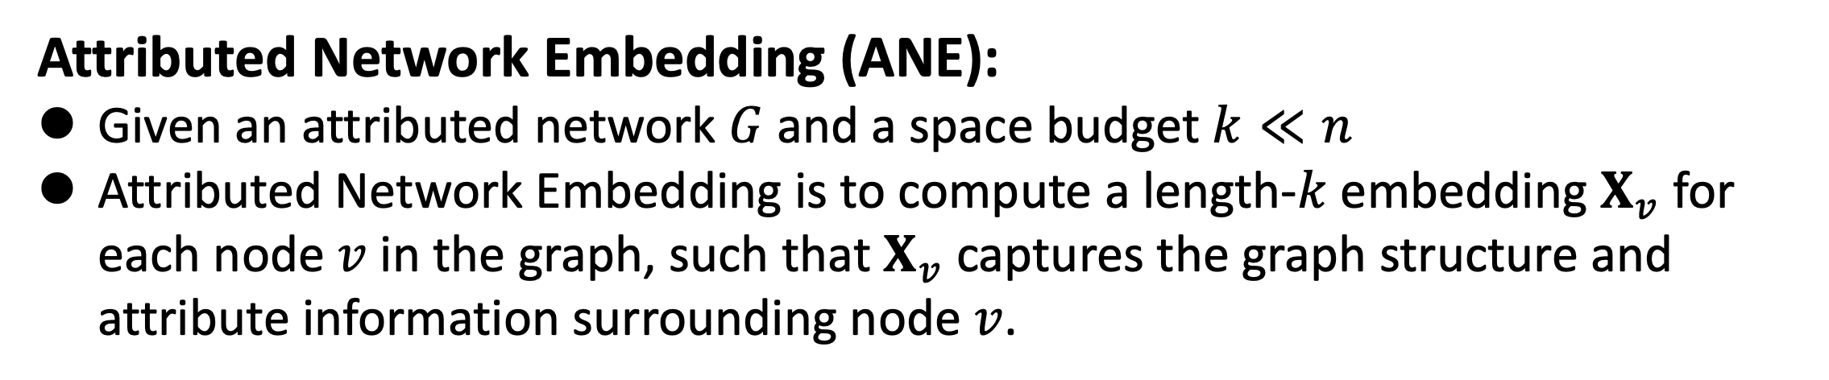


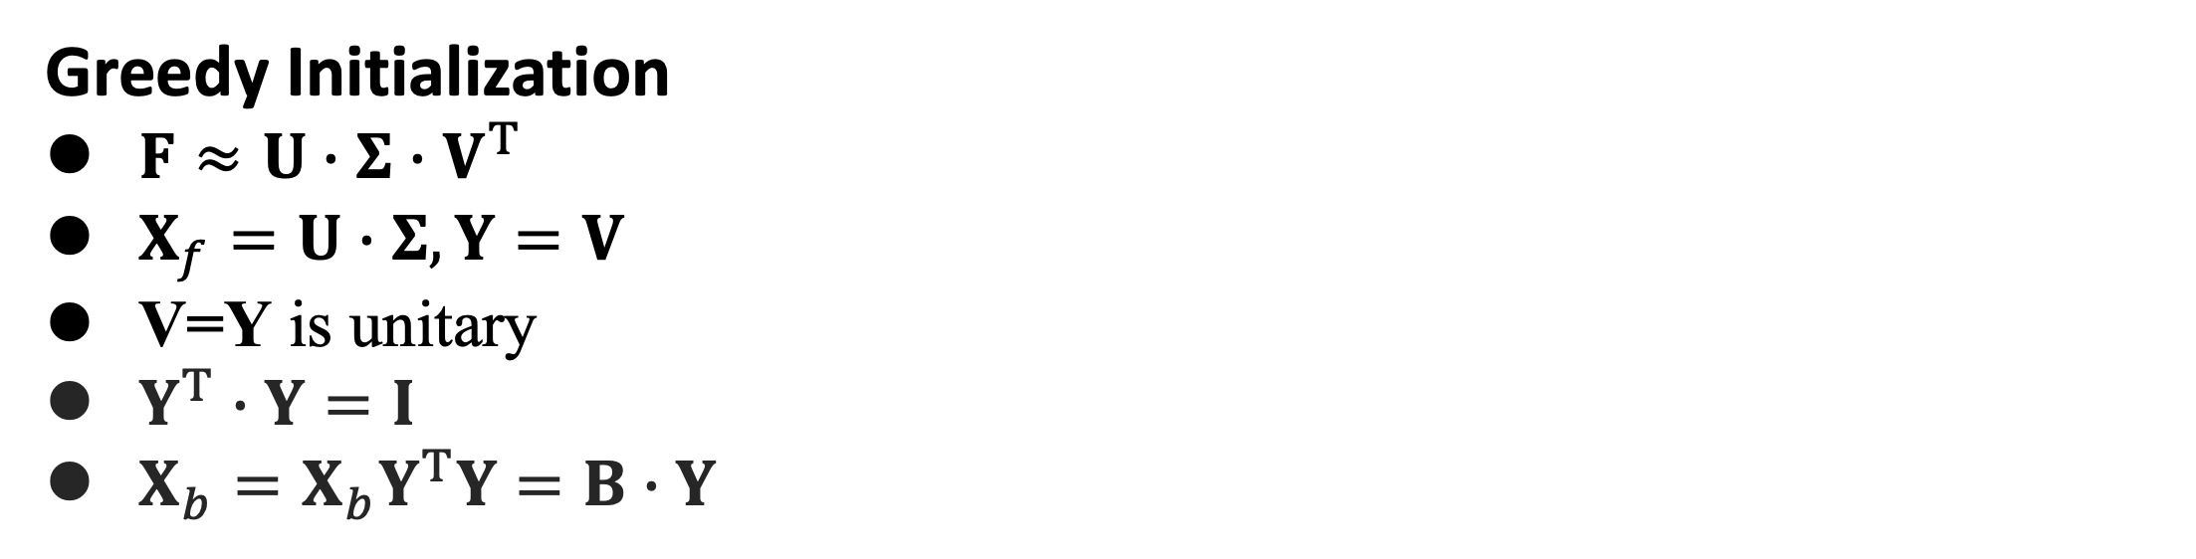












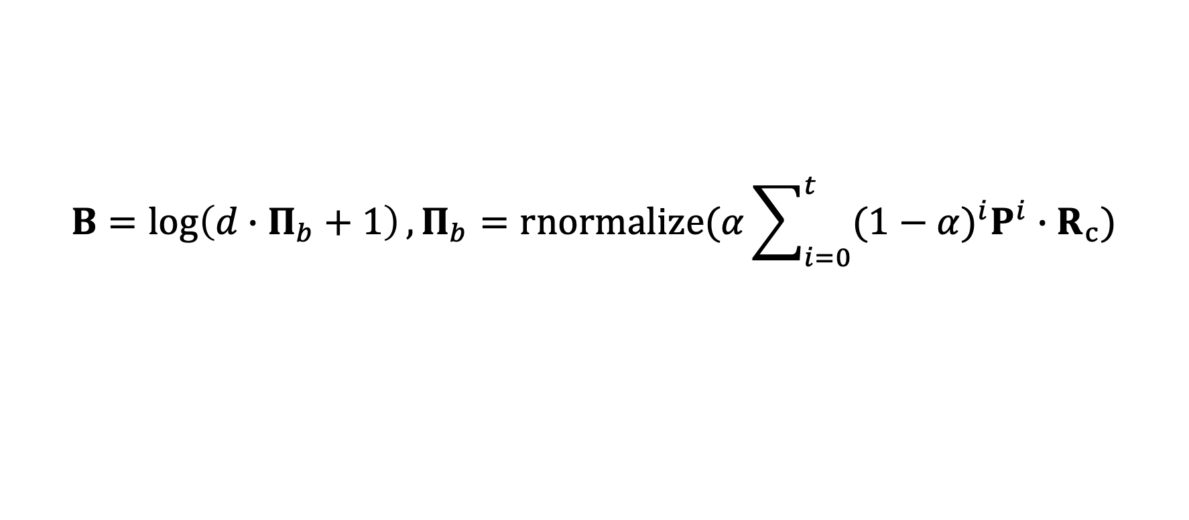

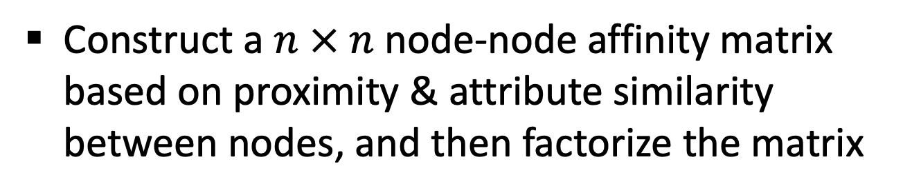

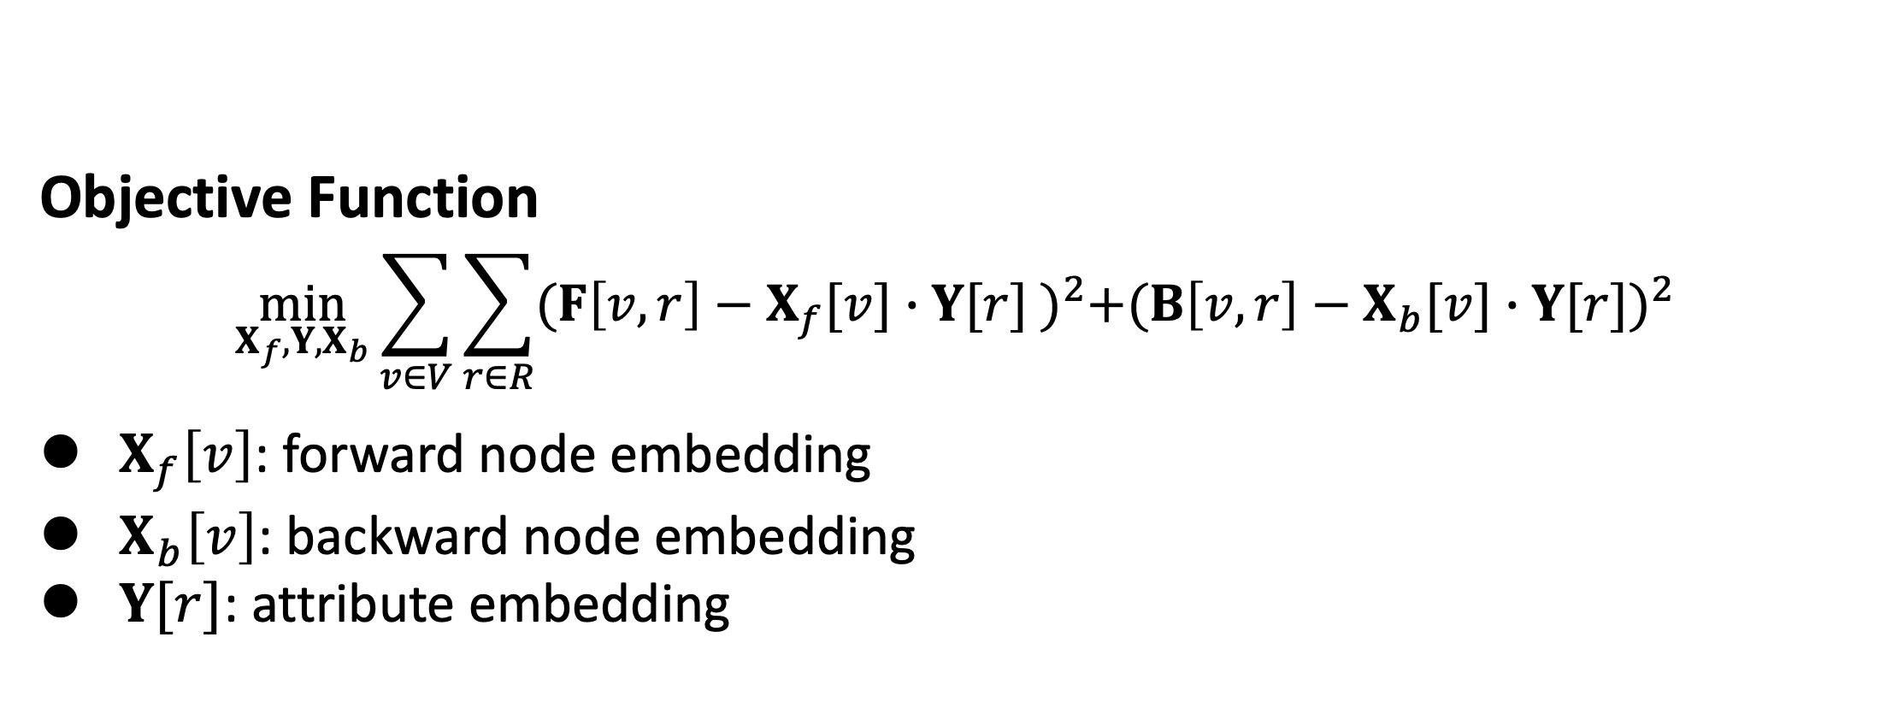

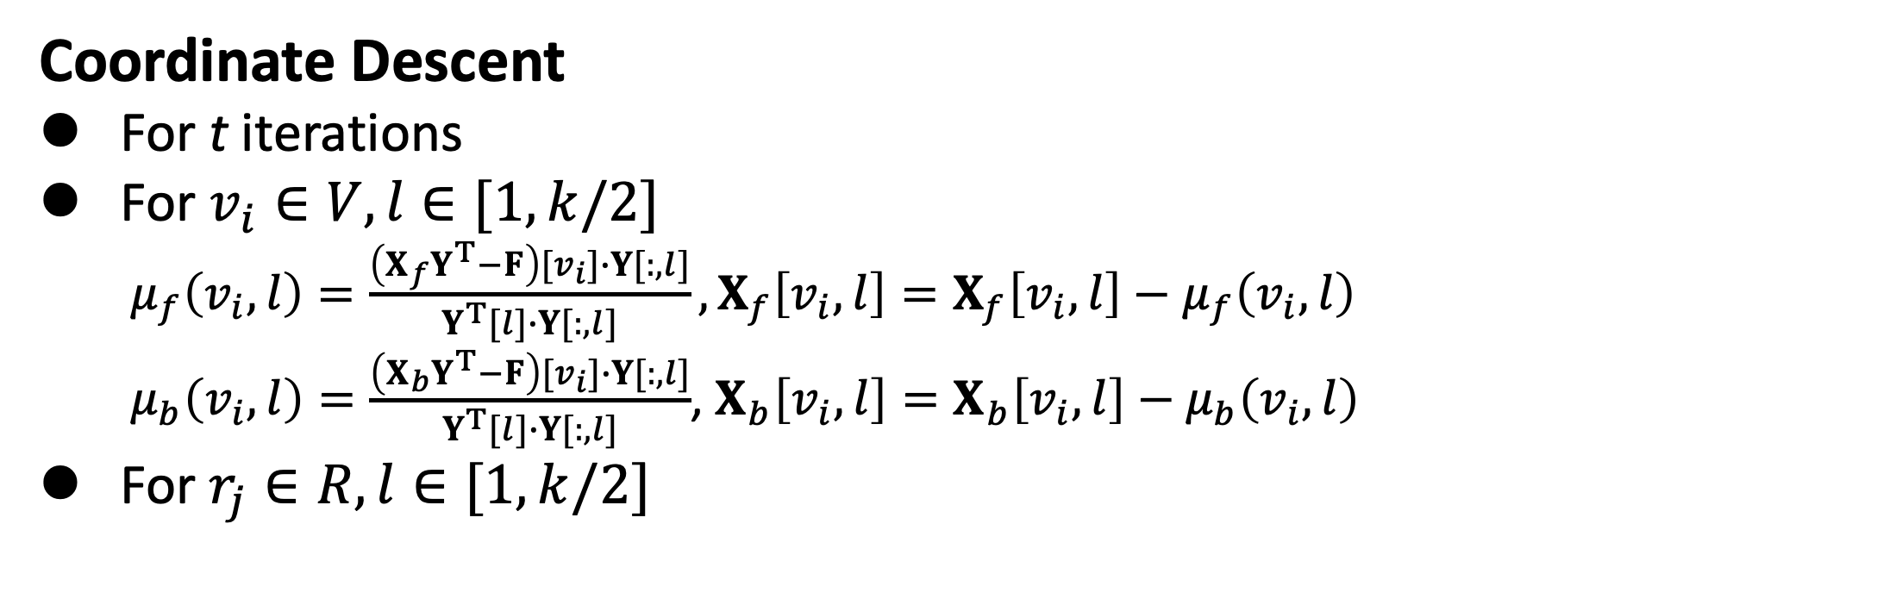
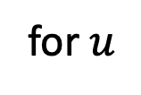






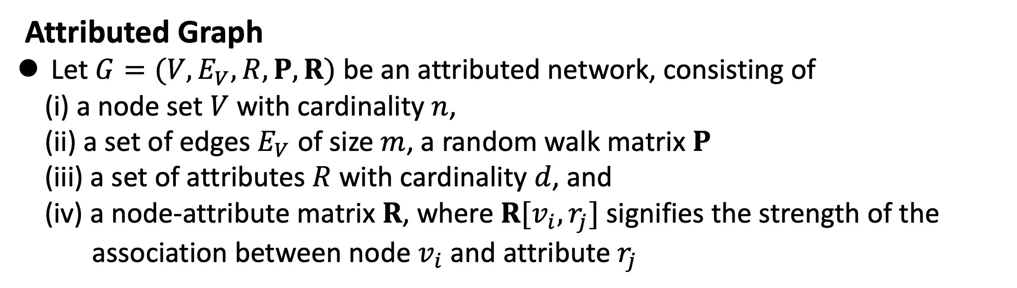
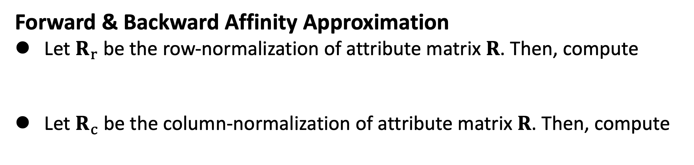
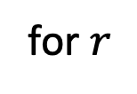
Scaling Attributed Network Embedding to Massive Graphs
Renchi Yang, Jieming Shi, Xiaokui Xiao, Yin Yang, Juncheng Liu and Sourav S. Bhowmick
Contact: renchi@nus.edu.sg
Problems and Motivations
Greedy Initialization
$F≈U∙Σ∙V^{T}$
$X_{f}=U∙Σ, Y=V$
$\text{V}\text{=}\text{Y} \text{is} \text{unitary}$
$Y^{T}∙Y=I$
$X_{b}=X_{b}Y^{T}Y=B∙Y$
Attributed Graph
Let $G=(V,E_{V},R,P,R)$ be an attributed network, consisting of
(i) a node set $V$ with cardinality $n$,
(ii) a set of edges $E_{V}$ of size $m$, a random walk matrix $P$
(iii) a set of attributes $R$ with cardinality $d$, and
(iv) a node-attribute matrix $R$, where $R[v_{i},r_{j}]$ signifies the strength of the
association between node $v_{i}$ and attribute $r_{j}$
$F$
$$≈$$
$U$
$$×$$
$Σ$
$$×$$
$V^{T}$
$$X_{b}$$
$$X_{f}$$
$B$
Coordinate Descent
For t iterations
For $v_{i}∈V, l∈[1,k/2]$
$μ_{f}\left(v_{i},l\right)=\frac{\left(X_{f}Y^{T}−F\right)[v_{i}]∙Y[:,l]}{Y^{T}[l]∙Y[:,l]},X_{f}\left[v_{i},l\right]=X_{f}\left[v_{i},l\right]−μ_{f}\left(v_{i},l\right)$
$μ_{b}\left(v_{i},l\right)=\frac{\left(X_{b}Y^{T}−F\right)[v_{i}]∙Y[:,l]}{Y^{T}[l]∙Y[:,l]}$, $X_{b}\left[v_{i},l\right]=X_{b}\left[v_{i},l\right]−μ_{b}\left(v_{i},l\right)$
For $r_{j}∈R, l∈[1,k/2]$
Attributed Network Embedding (ANE):
Given an attributed network $G$ and a space budget $k≪n$
Attributed Network Embedding is to compute a length-$k$ embedding $X_{v}$ for each node $v$ in the graph, such that $X_{v}$ captures the graph structure and attribute information surrounding node $v$.
Applications
Node Classification [Hamilton et al. NeurIPS’17, Velickovic et al. ICLR’19]
Link Prediction and Recommendations: Pinterest’s “PinSage” [Yang et al. KDD’18], Alibaba’s “AliGraph” [Zhu et al. VLDB’19, Chen et al. KDD’19]
Attribute Inference [Meng et al. WSDM’18]
$$μ_{y}\left(r_{j},l\right)=\frac{X_{f}^{T}\left[l\right]∙\left(X_{f}Y^{T}−F\right)\left[:,r_{j}\right]+X_{b}^{T}\left[l\right]∙\left(X_{b}Y^{T}−B\right)\left[:,r_{j}\right]}{X_{f}^{T}\left[l\right]∙X_{f}\left[:,l\right]+X_{b}^{T}\left[l\right]∙X_{b}\left[:,l\right]}, Y\left[r_{j},l\right]=Y\left[r_{j},l\right]−μ_{y}\left(r_{j},l\right)$$
Experiments
Existing Work
Matrix factorization-based methods
Neural network-based methods
Datasets:
Construct a $n × n$ node-node affinity matrix based on proximity & attribute similarity between nodes, and then factorize the matrix
$$n$$
$$d$$
$$×$$
$$n$$
$$≈$$
$$n$$
$$n$$
NN-based methods
STNE [KDD 2018]
ARGA [IJCAI 2018]
LQANR [IJCAI 2019]
CAN [WSDM 2019]
DGI [ICLR 2019]
GATNE [KDD 2019]
MF-based methods
TADW [IJCAI 2015]
BANE [ICDM 2018]
NRP [VLDB 2020]
Other method
PRRE [CIKM 2018]
$$X$$
$$X$$
$$M$$
Feed the graph matrix & attribute similarity matrix to a deep neural network to compress them
Reconstruct the graph matrix & attribute similarity matrix based on the compress data
Experiments for efficiency and scalability
Outperforms competitors often by orders of magnitude
Objective Function
Node-Attribute Affinity (Forward Affinity)
Start a random walk from $u$
At each step, stop with $α$ probability
After stopping at a node $v$, pick an attribute $r$ with probability $∝w(v,r)$
$F\left[v,r\right]=\log\left(\frac{n∙p_{f}\left(v,r\right)}{\sum_{u∈V}{p_{f}\left(u,r \right)}}+1\right)$
$p_{f}\left(u, r\right)$ is the probability that a node-to-attribute random walk from $u$ samples $r$ in the end
We normalize $p_{f}\left(u, r\right)$ by how "frequently" $r$ is sampled by others
attribute $r$
$u$
stop
Sampling-based algorithm
Experiments for attribute inference, link prediction & node classification
Consistently achieve the best attribute inference performance on all datasets and significantly outperforms existing solutions by a large margin.
Outperform all competitors over all datasets except NRP on Google+, by a substantial margin of up to 6.6% for AUC and up to 13% for AP.
Outperform competitors by 3.4%-17.2% on node classification.
$v$
stop?
stop?
Attribute-Node Affinity (Backward Affinity)
Randomly pick a node $s$ with probability $∝$ the weight of $(s,r)$
Start a random walk from $s$,
At each step, stop with $α$ probability,
Let $v$ be the stopping point of the walk
$B\left[v,r\right]=\log\left(\frac{d∙p_{b}\left(v,r\right)}{\sum_{r_{h}∈V}{p_{b}\left(v,r_{h}\right)}}+1\right)$
$p_{b}\left(r,v\right)$ is the probability that an attribute-to-node random walk from $r$ samples $v$ in the end
attribute $r$
stop?
$u$
$v$
stop?
stop
Objective Function
$$\min_{X_{f},Y{,X}_{b}}{\sum_{v∈V}{\sum_{r∈R}{{(F\left[v,r\right]−X_{f}[v]∙Y[r] )}^{2}+{(B\left[v,r\right]−X_{b}[v]∙Y[r])}^{2}}}}$$
$X_{f}\left[v\right]$: forward node embedding
$X_{b}\left[v\right]$: backward node embedding
$Y[r]$: attribute embedding
$$X_{f}$$
$$⋅$$
$$Y^{⊤}$$
$$≈$$
$$Y$$
$$⋅$$
$$X_{b}$$
$$≈$$
for $u$
for $r$
$F[u,r]$
for $r$
for $v$
$B[r,v]$
PANE Algorithm
Forward & Backward Affinity Approximation
Let $R_{r}$ be the row-normalization of attribute matrix $R$. Then, compute
Let $R_{c}$ be the column-normalization of attribute matrix $R$. Then, compute
$$F=\log\left(n∙Π_{f}+1\right),Π_{f}=cnormalize(α\sum_{i=0}^{t}{{(1−α)}^{i}P^{i}∙R_{r})}$$
$$B=\log\left(d∙Π_{b}+1\right),Π_{b}=rnormalize(α\sum_{i=0}^{t}{{(1−α)}^{i}P^{i}∙R_{c})}$$
Codes: https://github.com/AnryYang/PANE

