Slide 1

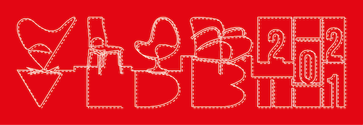




Scaling Attributed Network Embedding to Massive Graphs
by: R. Yang, J. Shi, X. Xiao, Y. Yang, J. Liu, and S. Bhowmick

Slide 2
Basic data analytics is easy.
Attributes
X₁
X₂
X₃
X₄
Y?
Stock | Profit | Revenue | Market share | Overvalued? | Buy?
TSLA | $721m | $31B | 3.6% | Yes | ???
Target attribute

Slide 3



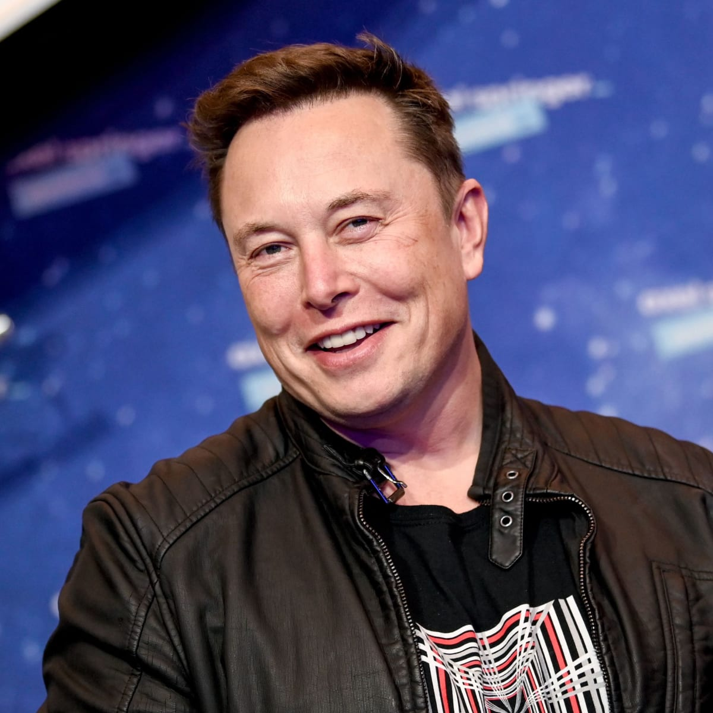



Graph data analytics is more powerful.
X1 | X2 | X3 | X4 | X5
$$$ | $$$ | $$$ | $$$ | $$$
X1 | X2 | X3 | X4 | X5
$$$ | $$$ | $$$ | $$$ | $$$
X1 | X2 | X3 | X4 | X5
$$$ | $$$ | $$$ | $$$ | $$$
X1 | X2 | X3 | X4 | X5
$$$ | $$$ | $$$ | $$$ | $$$
Stock | Profit | Revenue | Market share | Overvalued? | Buy?
TSLA | $721m | $31B | 3.6% | Yes | ???
X1 | X2 | X3 | X4 | X5
$$$ | $$$ | $$$ | $$$ | $$$
X1 | X2 | X3 | X4 | X5
$$$ | $$$ | $$$ | $$$ | $$$

Slide 4

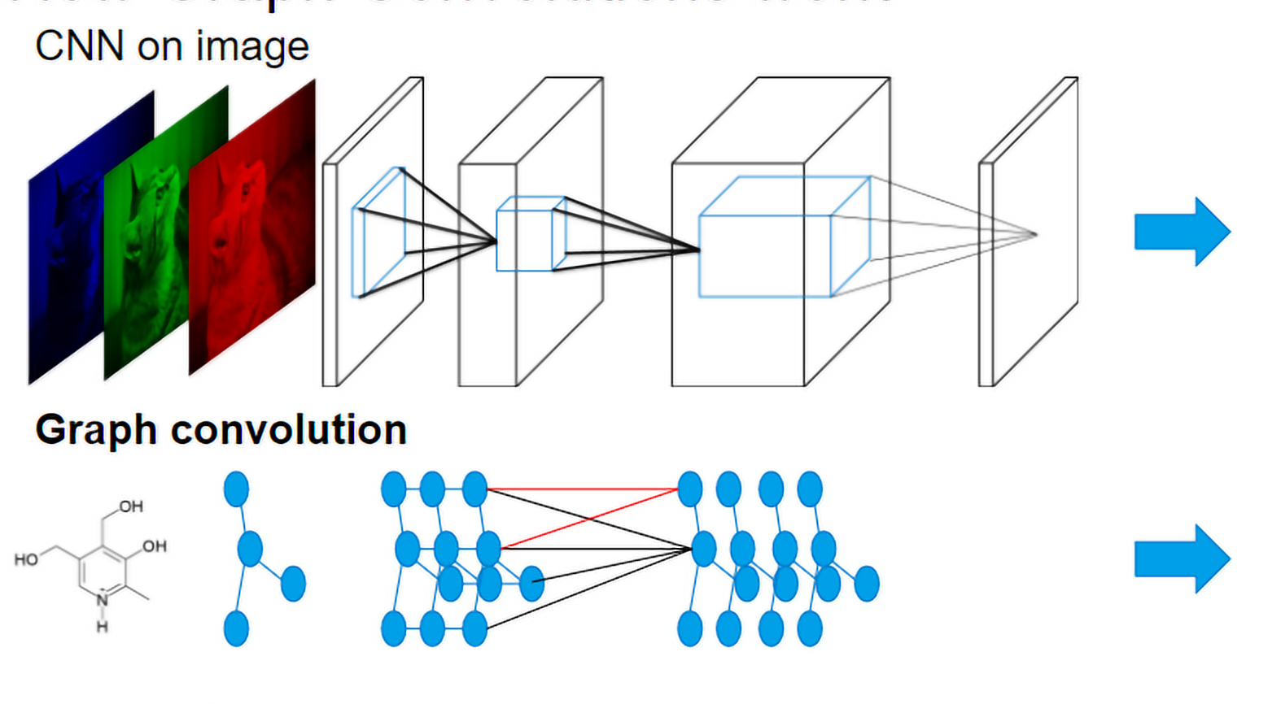



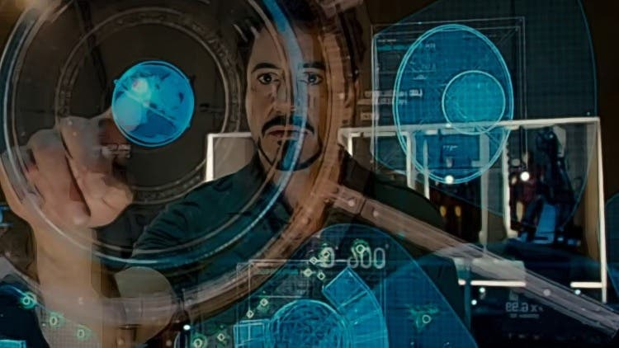
Graph data analytics is powerful but difficult.
Single table data analytics
Attributed graph data analytics
Deep graph
neural network
Tools
Difficulty
Req. Skill level

Slide 5
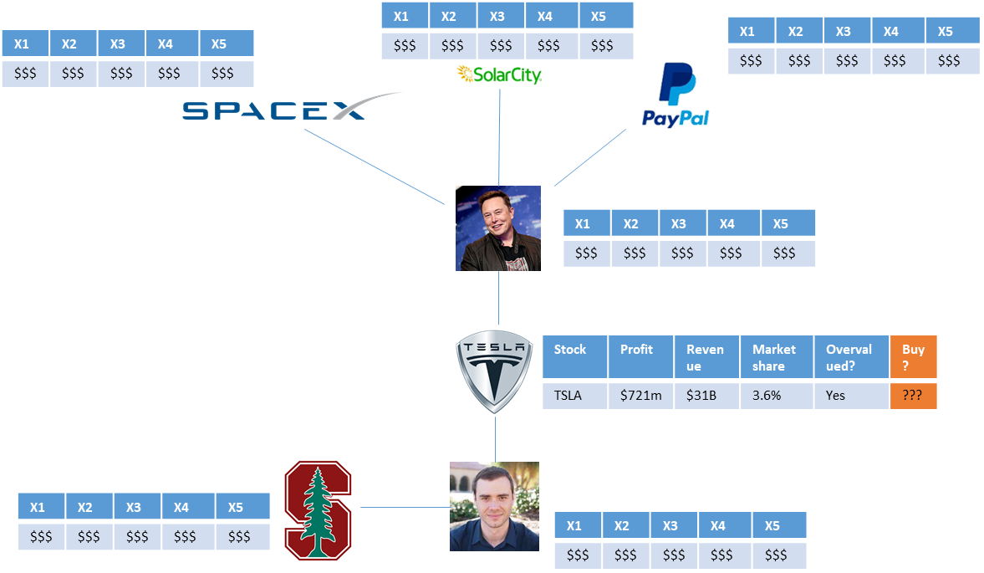
We present Practical Attributed Network Embedding (PANE).
Embedding vector
PANE
X1 | X2 | X3 | X4 | … | X30 | X31 | X32 | Buy?
0.12 | 0.34 | 0.56 | 0.78 | … | 0.101 | 0.223 | 0.334 | ???
Attributed graph data analytics
Embedding vector data analytics

Slide 6
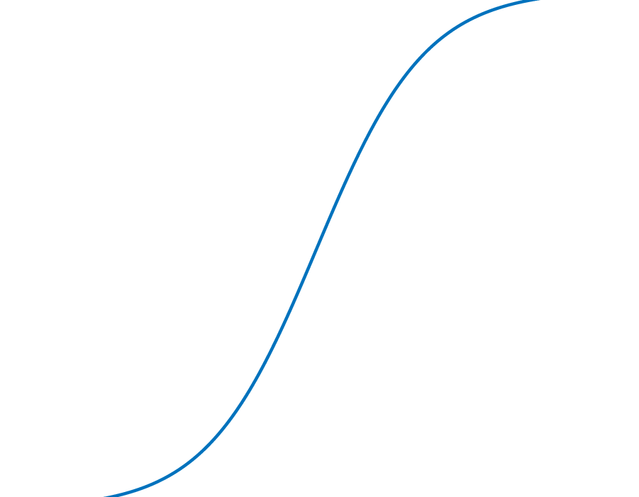

Performance of PANE
Computing all embeddings on a HUGE graph with 59m nodes,
0.98b edges, 2k attributes
Effective
Accuracy (F1):
_{up to} +17.2%
Single-server:
~ 12 hours
Compared to SOTA
Neural Network methods
Efficient

Slide 7
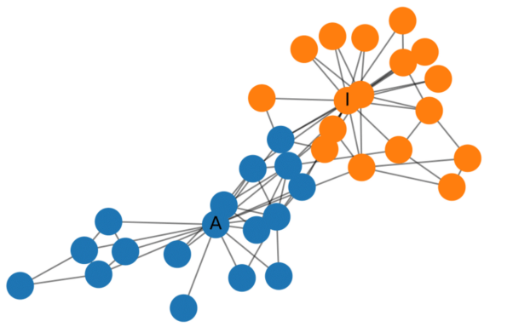
Applications of PANE
?
Link Prediction
Attribute Inference
Node Classification

Slide 8
PANE is based on mostly novel database technologies (with a bit of machine learning flavor).
1
PANE measures Node-Attribute affinity via random walks.
2
PANE computes embeddings with joint matrix factorization.
3
PANE makes full use of multi-core parallel computation.

Slide 9

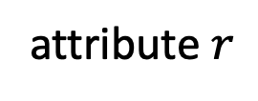
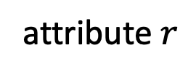


Types of Random Walks in PANE
1
$$u$$
attribute $r$
attribute $r$
$$v$$
Forward: node-to-attribute
Backward: attribute-to-node

Slide 10
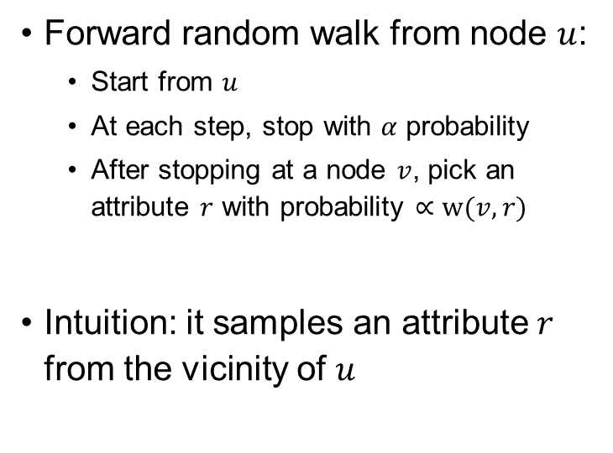



Forward Random Walks
1
Forward random walk from node $u$:
Start from $u$
At each step, stop with $α$ probability
After stopping at a node $v$, pick an attribute $r$ with probability $∝w(v,r)$
Intuition: it samples an attribute $r$ from the vicinity of $u$
attribute $r$
$v$
stop
$u$
stop?
stop?

Slide 11
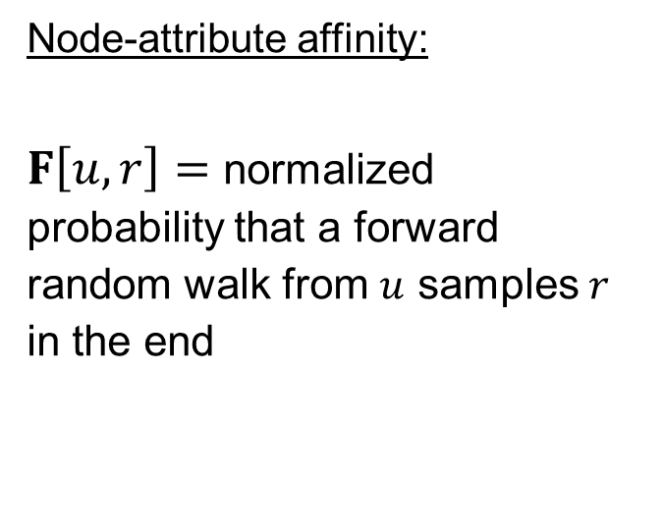
Node-Attribute Affinity
1
Node-attribute affinity:
$F\left[u,r\right]=$ normalized probability that a forward random walk from $u$ samples $r$ in the end
attribute $r$
$v$
stop
$u$
stop?
stop?

Slide 12
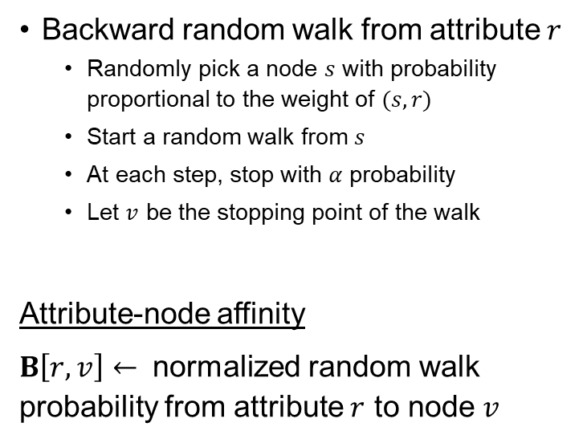



Backward RW & Attribute-Node Affinity
1
Backward random walk from attribute $r$
Randomly pick a node $s$ with probability proportional to the weight of $(s,r)$
Start a random walk from $s$
At each step, stop with $α$ probability
Let $v$ be the stopping point of the walk
Attribute-node affinity
$B\left[r,v\right]←$ normalized random walk probability from attribute $r$ to node $v$
attribute $r$
stop?
$s$
$v$
stop?
stop

Slide 13



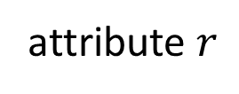
Node-to-Node affinity is derived.
1
$$p\left(u,v\right)=\sum_{r∈R}{F\left[u,r\right]⋅B\left[r,v\right]}$$
$$u$$
$$v$$
attribute $r$
This saves a LOT of space: $O\left(n^{2}\right)→O\left(nd\right), d≪n$

Slide 14


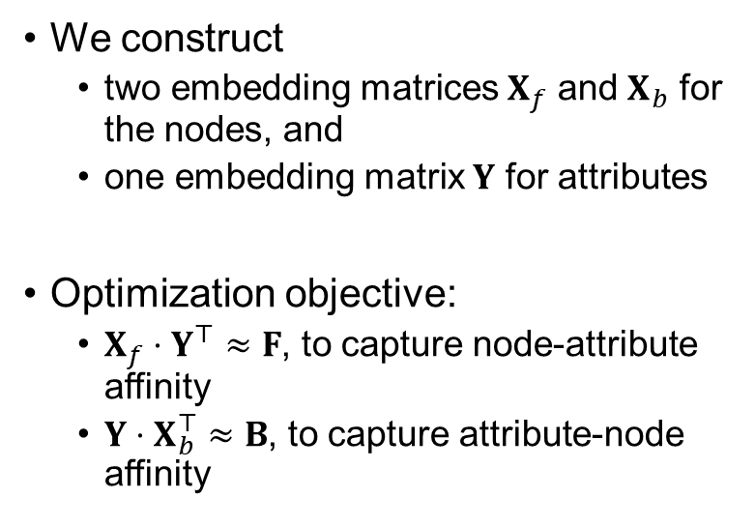












Embedding Matrices in PANE
2
We construct
two embedding matrices $X_{f}$ and $X_{b}$ for the nodes, and
one embedding matrix $Y$ for attributes
Optimization objective:
$X_{f}⋅Y^{⊤}≈F$, to capture node-attribute affinity
$Y⋅X_{b}^{⊤}≈B$, to capture attribute-node affinity
$$Y^{⊤}$$
$$⋅$$
$$X_{f}$$
$$≈$$
for $u$
for $r$
$F[u,r]$
$$X_{b}$$
$$⋅$$
$$Y$$
$$≈$$
for $r$
for $v$
$B[r,v]$

Slide 15
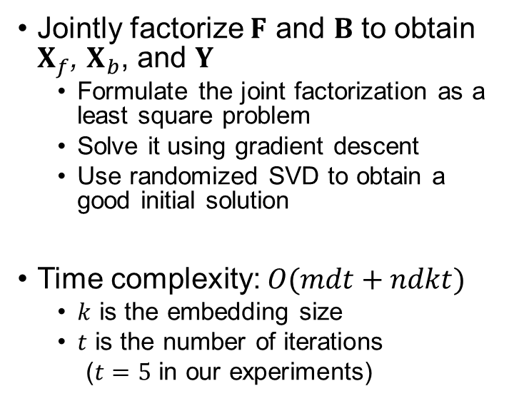
Solving the optimization program
2
Jointly factorize $F$ and $B$ to obtain $X_{f}$, $X_{b}$, and $Y$
Formulate the joint factorization as a least square problem
Solve it using gradient descent
Use randomized SVD to obtain a good initial solution
Time complexity: $O(mdt+ndkt)$
$k$ is the embedding size
$t$ is the number of iterations
($t=5$ in our experiments)
$$Y^{⊤}$$
$$⋅$$
$$X_{f}$$
$$≈$$
for $u$
for $r$
$F[u,r]$
$$X_{b}$$
$$⋅$$
$$Y$$
$$≈$$
for $r$
for $v$
$B[r,v]$

Slide 16

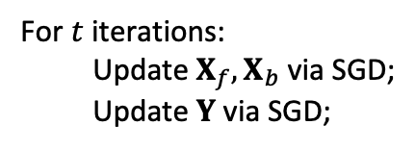








Greedy Initialization + SGD
2
$F≈U∙Σ∙V^{T}$
$X_{f}=U∙Σ, Y=V$
$\text{V}\text{=}\text{Y} \text{is} \text{unitary}$
$Y^{T}∙Y=I$
$X_{b}=X_{b}Y^{T}Y=B∙Y$
For $t$ iterations:
Update $X_{f}, X_{b}$ via SGD;
Update $Y$ via SGD;
$$F$$
$$≈$$
$$X_{f}$$
$$∙$$
$$Y$$
$$B$$
$$≈$$
$$X_{b}$$
$$∙$$
$$Y$$
Greedy initialization of embeddings via randomized SVD and the unitary property
Only a few iterations are needed!

Slide 17
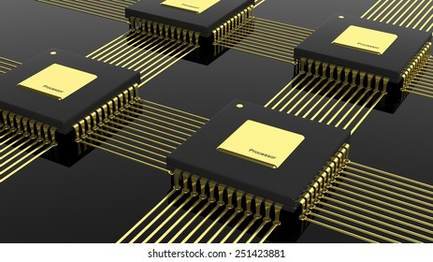
PANE is fully parallelized on multi-core computers.
3
Explained in Section 4 of our paper.

Slide 18
Experiments: 8 Datasets
Name | # of nodes | # of edges | # of distinct attributes | # of attributes per node | # of distinct labels
Cora | 2.7k | 5.4k | 1.4k | 18.2 | 7
Citeseer | 3.3k | 4.7k | 3.7k | 31.9 | 6
Facebook | 4k | 88.2k | 1.3k | 8.3 | 193
Pubmed | 19.7k | 44.3k | 0.5k | 50.2 | 3
Flickr | 7.6k | 479.5k | 12.1k | 24.0 | 9
Google+ | 107.6k | 13.7M | 15.9k | 2793.7 | 468
TWeibo | 2.3M | 50.7M | 1.7k | 7.3 | 8
MAG | 59.3M | 978.2M | 2.0k | 7.3 | 100

Slide 19
Experiments: 10 Competitors
Default embedding dimensionality: $k=128$
6 neural-network-based methods
STNE [KDD 2018]
ARGA [IJCAI 2018]
LQANR [IJCAI 2019]
CAN [WSDM 2019]
DGI [ICLR 2019]
GATNE [KDD 2019]
3 factorization-based methods
TADW [IJCAI 2015]
BANE [ICDM 2018]
NRP [VLDB 2020]
1 other method
PRRE [CIKM 2018]

Slide 20
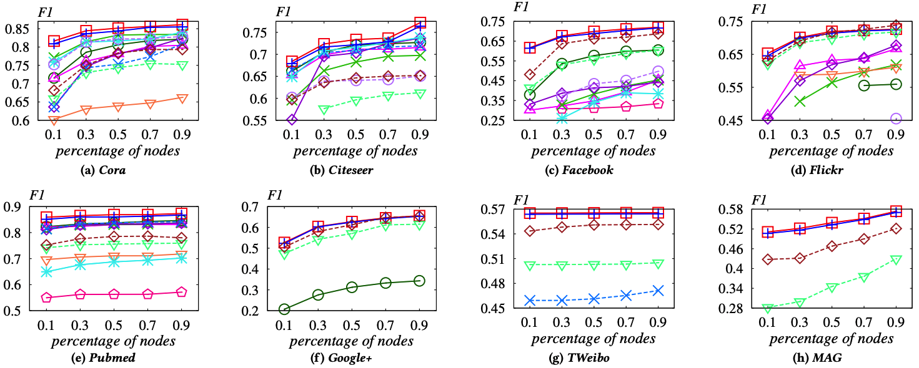
Results: Node Classification
Percentage of nodes used for training: 10% ~ 90%
PANE vs. SOTA: improvements of 3.4%-17.2% in terms of F1 measure

Slide 21
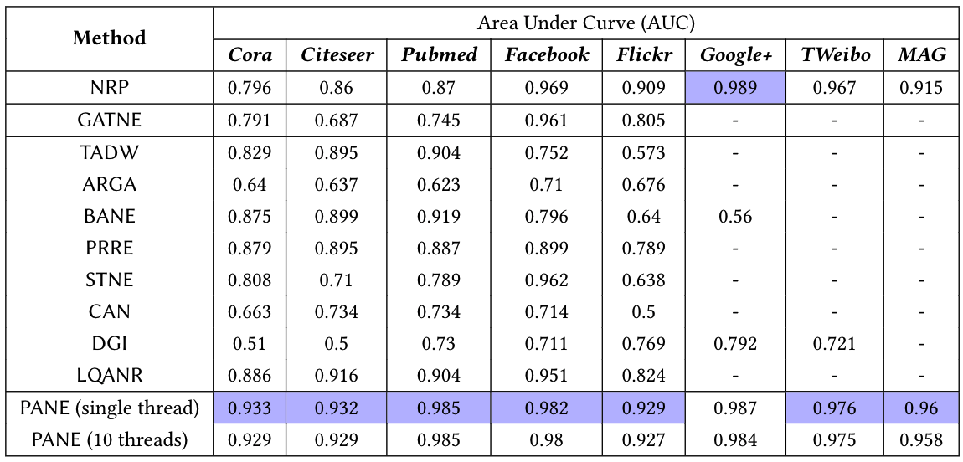
Results: Link Prediction

Slide 22
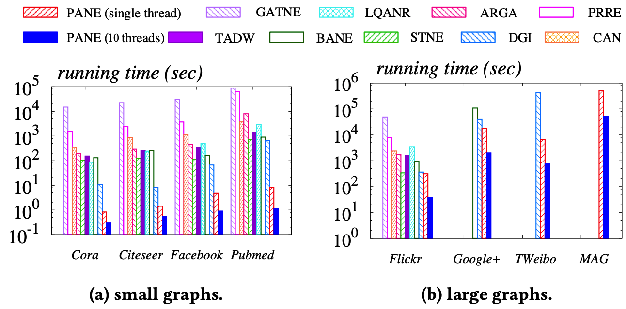
Results: Efficiency
Compared to the state of the art, PANE is orders of magnitude faster
On the MAG dataset with 0.98 billion edges, PANE can terminate within 12 hours using 10 CPU cores (Intel Xeon 2.2GHz)

Slide 23
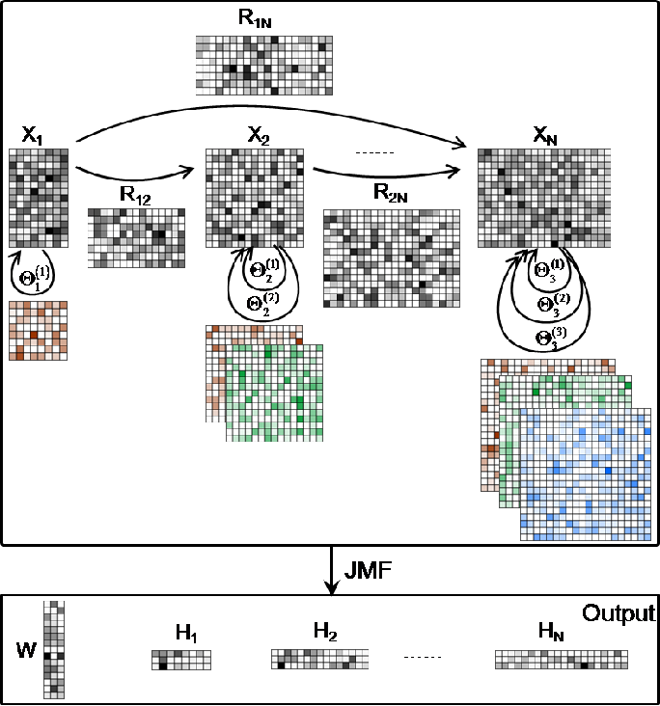
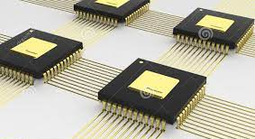
THANK YOU
PANE
1
2
3
Parallelization
Random walks
Joint matrix factorization
Notes:
Thanks.

